Slide 1
And many were gathered together, so that there was no more room, not even at the door. And he was preaching the word to them. And they came, bringing to him a paralytic carried by four men. And when they could not get near him because of the crowd, they removed the roof above him, and when they had made an opening, they let down the bed on which the paralytic lay. And when Jesus saw their faith, he said to the paralytic, “Son, your sins are forgiven.”
Mark 2:2-5, ESV

Slide 3
Forgiveness…
Justifies
The person; not the sin.
Jesus doesn’t say: “Your sins weren’t a big deal.”
The sins of the past were still wrong.
Jesus gives release from their current power.
“Cheap grace” offers an excuse (cf. Rom. 6:1)
God’s grace offers forgiveness.

Slide 4
Forgiveness…
Releases
In two ways.
Jesus released him from his sins and from sin’s captivity.
It is “The year of the Lord’s favor” (Lk. 4:19)
For us:
The offender is released from all guilt.
The offended is released from all grudges.

Slide 5
Forgiveness…
Reconciles
Rather than vindicates.
Jesus’ priority: Help someone who needs him.
Result: he shames the scribes (Mk. 2:6-7).
Purpose: he heals & forgives a needy man.
For us:
Forgiveness forfeits the moral high ground.
Don’t win against someone; win someone.

Slide 6
Forgiveness…
Acts
Speak words of forgiveness to others.
Christians forgive others just as Jesus does.
Christians forgive others
“I’m sorry.” —> “It’s okay.”
“I’m sorry.” —> “It’s okay.”

Slide 7
Forgiveness…
Acts
Christians forgive others just as Jesus does.
Speak words of forgiveness to others.
“I’m sorry.” —> “I forgive you.”
Express gratitude for God’s forgiveness.
Don’t work to win; work to mend.
Apologize quickly and sincerely.
Forgive readily and completely.

Slide 8
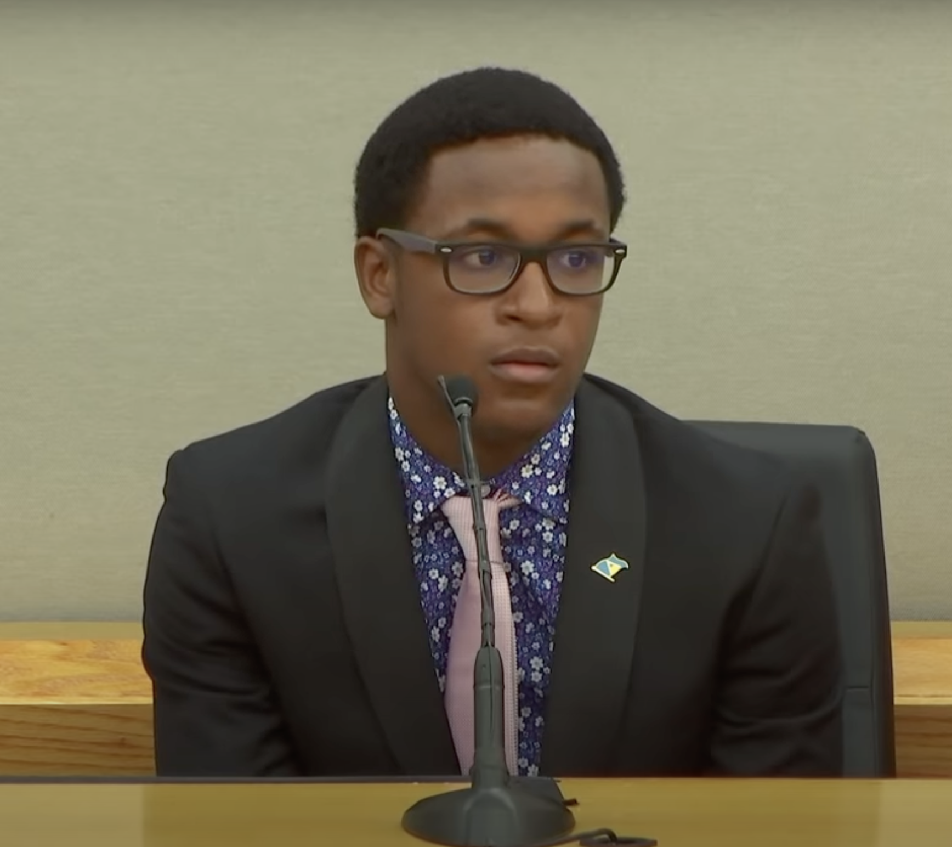
Forgiveness…
Acts
"If you truly are sorry, I know... I can speak for myself and say, 'I forgive you. And I love you just like anyone else.”
"And I want the best for you... and the best would be for you to give your life to Christ. I don't wish anything bad on you."

Slide 9
Forgiveness…
Welcomes
the forgiven into fellowship.
God has forgiven each of us a great deal
Can we welcome those who’ve committed “that sin”?
The world should hear us…
Call sin wrong.
Offer Jesus’ forgiveness of sin.
Welcome ALL forgiven people among us.

Slide 10
“And when he had come to Jerusalem, he attempted to join the disciples. And they were all afraid of him, for they did not believe that he was a disciple…”
“But Barnabas took him and brought him…”
“So he went in and out among them at Jerusalem…”
Acts 9:26-28

