Slide 1
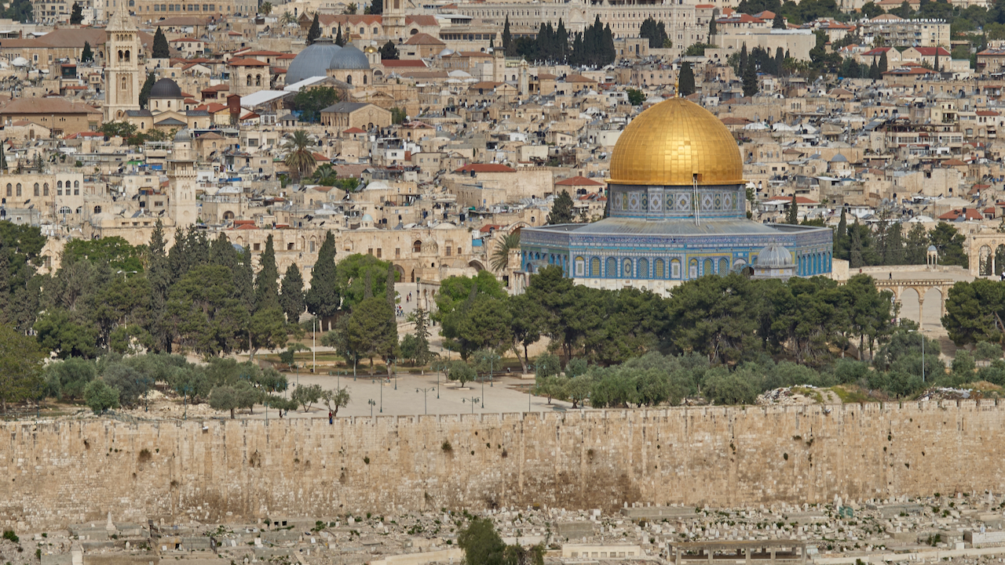
RETURN FROM CAPTIVITY #2

Slide 2
SUMMARY OF GROUP RETURNING
Almost 50,000 people
Almost all (if not all) of tribes of Judah, Levi, Benjamin
Zerubbabel and high priest, Jeshua, are leaders.
Had a large number of priests in the group.
Upon arrival in Judah, each family returned to own town/city.
There is no “return” to the area of the former northern kingdom.
up

Slide 6
REASONS NOT TO RETURN TO JERUSALEM/JUDAH
The trip was a long one—1,000 miles or more.
The trip would have been a logistical nightmare and would have meant a drastic upheaval of lifestyle.
Only the oldest had any memory of Jerusalem/Judah.
They could not have known what conditions awaited them in Judah, but there was little reason for optimism.
up

Slide 7
Lamentations 1:1
“How lonely sits the city that was full of people! How like a widow has she become, she who was great among the nations! She who was a princess among the provinces has become a slave.”

Slide 8
Cyrus/Cambyses
539 530/ 521
Darius I
521 486
Ahasuerus
(Xerxes)
486 464
Artaxerxes I
464 423
Darius the Mede
539 525
Fall of
Babylon
539
534--Temple
work stopped
516
Temple finished
483
Xerxes’
Feast
Queen Vashti
deposed
473
Feast of
Purim
458
Ezra
returns
445
Nehemiah returns
to Jerusalem
and rebuilds
walls in 52 days
538-Decree of Cyrus
536
Zerubbabel
returns,
begins temple
478
Esther
crowned
Queen
2
520
Temple work
resumed
3
Three Returns
from Exile
1
C. 12 Years
Book of
EZRA
516
Chapters 1-6
Book of
ESTHER
483 473
Book of
NEHEMIAH
445 415
Ezra
Chapters 7-10
(One year—457)
Zechariah
520 489
Haggai
520 505
C. 60 Years
Malachi
435? 415?
540 530 520 510 500 490 480 470 460 450 440 430 420

Slide 9
Ezra 3:10-11
10 And when the builders laid the foundation of the temple of the LORD, the priests in their vestments came forward with trumpets, and the Levites, the sons of Asaph, with cymbals, to praise the LORD, according to the directions of David king of Israel. 11 And they sang responsively, praising and giving thanks to the LORD, “for he is good, for his steadfast love endures forever toward Israel.” And all the people shouted with a great shout when they praised the LORD, because the foundation of the house of the LORD was laid.

Slide 10
Ezra 3:12-13
12 But many of the priests and Levites and heads of fathers’ houses, old men who had seen the first house, wept with a loud voice when they saw the foundation of this house being laid, though many shouted aloud for joy, 13 so that the people could not distinguish the sound of the joyful shout from the sound of the people’s weeping, for the people shouted with a great shout, and the sound was heard far away.

Slide 11
Ezra 4:1-2
1 Now when the adversaries of Judah and Benjamin heard that the returned exiles were building a temple to the LORD, the God of Israel, 2 they approached Zerubbabel and the heads of fathers’ houses and said to them, “Let us build with you, for we worship your God as you do, and we have been sacrificing to him ever since the days of Esarhaddon king of Assyria who brought us here.”

Slide 12
Ezra 4:3
3 But Zerubbabel, Jeshua, and the rest of the heads of fathers’ houses in Israel said to them, “You have nothing to do with us in building a house to our God; but we alone will build to the LORD, the God of Israel, as King Cyrus of Persia has commanded us.”

Slide 13
Ezra 4:4-5
4 Then the people of the land discouraged the people of Judah and made them afraid to build 5 and bribed counselors against them to frustrate their purpose, all the days of Cyrus king of Persia, even until the reign of Darius king of Persia.

Slide 14
Cyrus/Cambyses
539 530/ 521
Darius I
521 486
Ahasuerus
(Xerxes)
486 464
Artaxerxes I
464 423
Darius the Mede
539 525
Fall of
Babylon
539
534--Temple
work stopped
516
Temple finished
483
Xerxes’
Feast
Queen Vashti
deposed
473
Feast of
Purim
458
Ezra
returns
445
Nehemiah returns
to Jerusalem
and rebuilds
walls in 52 days
538-Decree of Cyrus
536
Zerubbabel
returns,
begins temple
478
Esther
crowned
Queen
2
520
Temple work
resumed
3
Three Returns
from Exile
1
C. 12 Years
Book of
EZRA
516
Chapters 1-6
Book of
ESTHER
483 473
Book of
NEHEMIAH
445 415
Ezra
Chapters 7-10
(One year—457)
Zechariah
520 489
Haggai
520 505
C. 60 Years
Malachi
435? 415?
540 530 520 510 500 490 480 470 460 450 440 430 420

Slide 15
The Complaint Letter: Ezra 4:11-16
11 …. To Artaxerxes the king: Your servants, the men of the province Beyond the River, send greeting. And now 12 be it known to the king that the Jews who came up from you to us have gone to Jerusalem. They are rebuilding that rebellious and wicked city. They are finishing the walls and repairing the foundations. 13 Now be it known to the king that if this city is rebuilt and the walls finished, they will not pay tribute, custom, or toll, and the royal revenue will be impaired. 14 Now because we eat the salt of the palace and it is not fitting for us to witness the king’s dishonor, therefore we send and inform the king, 15 in order that search may be made in the book of the records of your fathers. You will find in the book of the records and learn that this city is a rebellious city, hurtful to kings and provinces, and that sedition was stirred up in it from of old. That was why this city was laid waste. 16 We make known to the king that if this city is rebuilt and its walls finished, you will then have no possession in the province Beyond the River.”

Slide 16
Cyrus/Cambyses
539 530/ 521
Darius I
521 486
Ahasuerus
(Xerxes)
486 464
Artaxerxes I
464 423
Darius the Mede
539 525
Fall of
Babylon
539
534--Temple
work stopped
516
Temple finished
483
Xerxes’
Feast
Queen Vashti
deposed
473
Feast of
Purim
458
Ezra
returns
445
Nehemiah returns
to Jerusalem
and rebuilds
walls in 52 days
538-Decree of Cyrus
536
Zerubbabel
returns,
begins temple
478
Esther
crowned
Queen
2
520
Temple work
resumed
3
Three Returns
from Exile
1
C. 12 Years
Book of
EZRA
516
Chapters 1-6
Book of
ESTHER
483 473
Book of
NEHEMIAH
445 415
Ezra
Chapters 7-10
(One year—457)
Zechariah
520 489
Haggai
520 505
C. 60 Years
Malachi
435? 415?
540 530 520 510 500 490 480 470 460 450 440 430 420

