Slide 1
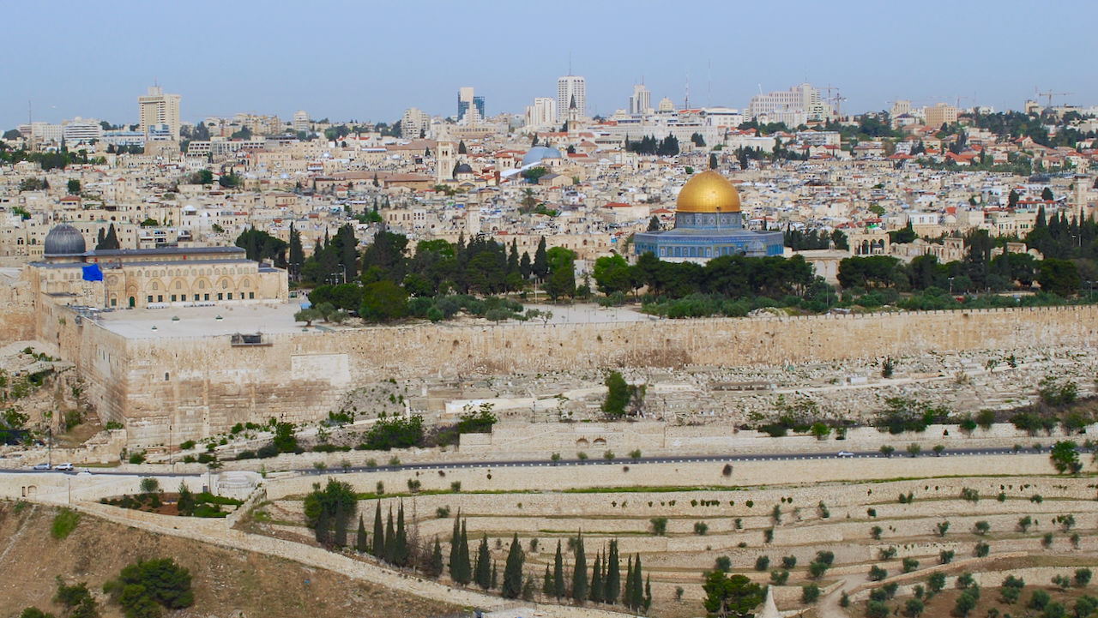
THE RETURN FROM CAPTIVITY

Slide 2
Cyrus/Cambyses
539 530/ 521
Darius I
521 486
Ahasuerus
(Xerxes)
486 464
Artaxerxes I
464 423
Darius the Mede
539 525
Fall of
Babylon
539
534--Temple
work stopped
516
Temple finished
483
Xerxes’
Feast
Queen Vashti
deposed
473
Feast of
Purim
458
Ezra
returns
445
Nehemiah returns
to Jerusalem
and rebuilds
walls in 52 days
538-Decree of Cyrus
536
Zerubbabel
returns,
begins temple
478
Esther
crowned
Queen
2
520
Temple work
resumed
3
Three Returns
from Exile
1
C. 12 Years
Book of
EZRA
516
Chapters 1-6
Book of
ESTHER
483 473
Book of
NEHEMIAH
445 415
Ezra
Chapters 7-10
(One year—457)
Zechariah
520 489
Haggai
520 505
C. 60 Years
Malachi
435? 415?
540 530 520 510 500 490 480 470 460 450 440 430 420

Slide 3
THE 1ST RETURN
606-605-1st Invasion
Daniel taken;
Jeremiah prophesies 70-year captivity (Jere. 25:11-12)
539
Babylon
falls to
Medo-Persia
538
Decree of Cyrus
536
1st Return
Zerubbabel
returns,
begins temple
C. 740-700
Isaiah Prophecy re Cyrus
(Isa. 44, 45)
597-2d Invasion
Ezekiel taken;
Jeremiah again
prophesies 70-
year captivity
(Jere. 29:10)
Three Babylonian
Invasions
722-721
Samaria falls to Assyria;
Northern Kingdom taken
into captivity
590-580
Birth of Cyrus (?)
586-3d Invasion
City destroyed
Temple burned
760 740 720 700 680 660 640 620 600 580 560 540 520

Slide 4
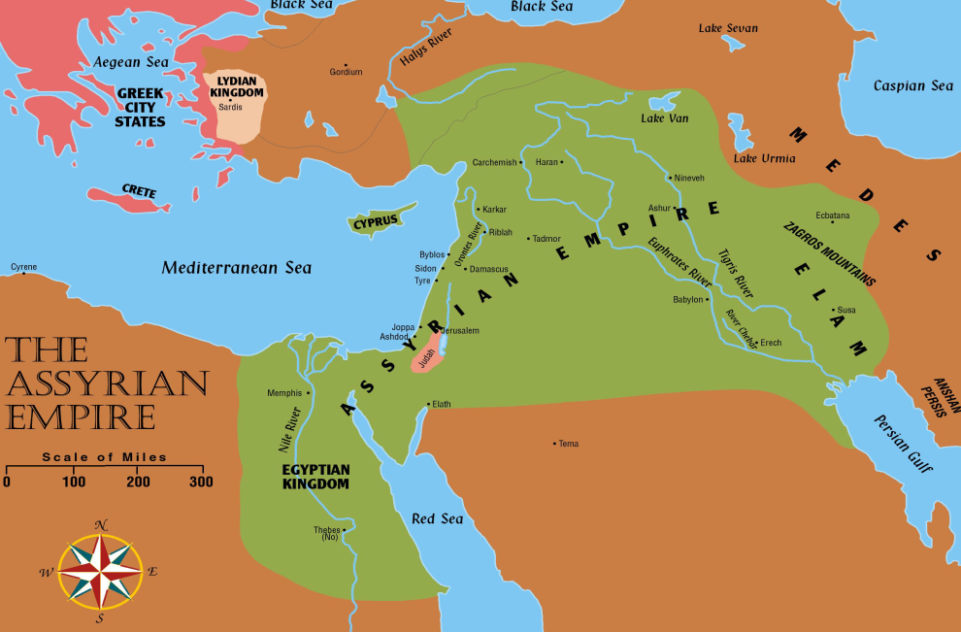
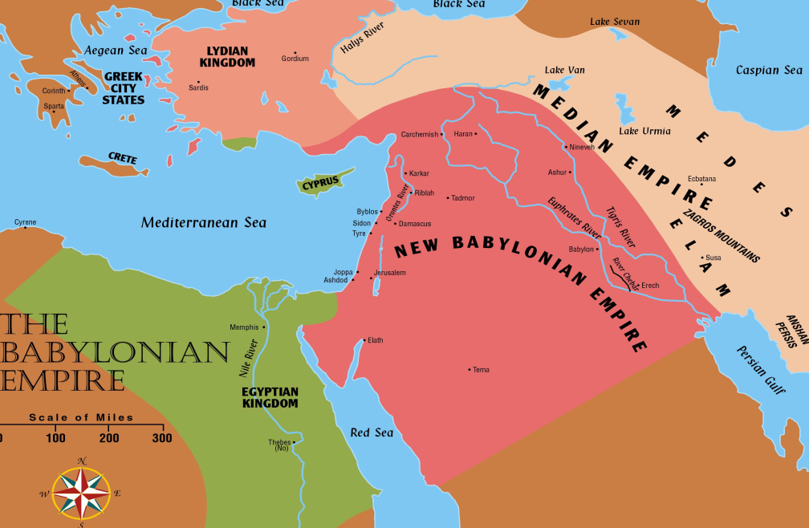
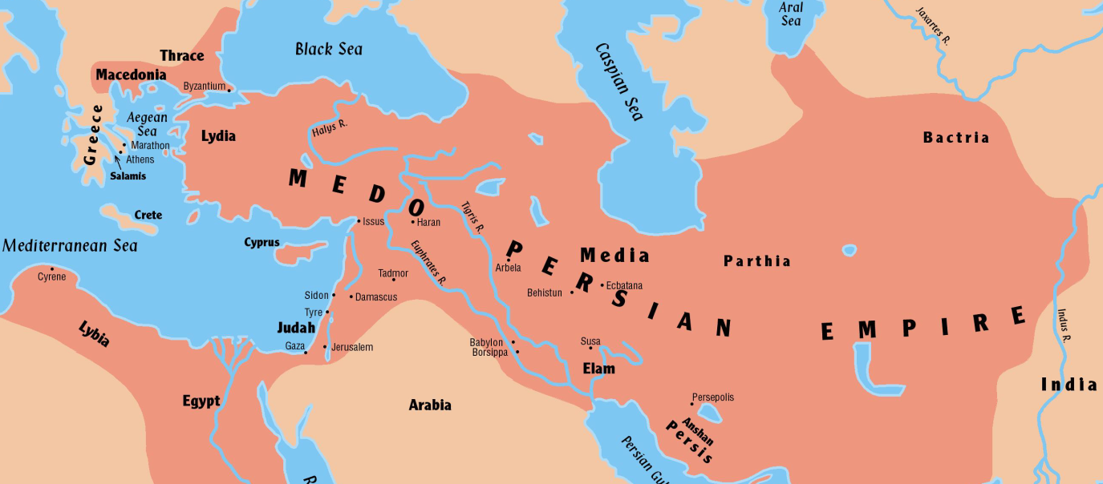
Comparing Kingdom Size
Assyrian
Babylonian
Persian

Slide 6
Isaiah 44:24-28
24 Thus says the Lord, your Redeemer, who formed you from the womb. “I am the Lord, who made all things, who alone stretched out the heavens, who spread out the earth by myself, 25 who frustrates the signs of liars and makes fools of diviners, who turns wise men back and makes their knowledge foolish, 26 who confirms the word of his servant and fulfills the counsel of his messengers, who says of Jerusalem, ‘She shall be inhabited,’ and of the cities of Judah, ‘They shall be built, and I will raise up their ruins’; 27 who says to the deep, ‘Be dry, I will dry up your rivers’; 28 who says of Cyrus, ‘He is my shepherd, and he shall fulfill all my purpose’, saying of Jerusalem, ‘She shall be built,’ and of the temple, ‘Your foundation shall be laid.’”

Slide 7
THE 1ST RETURN
606-605-1st Invasion
Daniel taken;
Jeremiah prophesies 70-year captivity (Jere. 25:11-12)
539
Babylon
falls to
Medo-Persia
538
Decree of Cyrus
536
1st Return
Zerubbabel
returns,
begins temple
C. 740-700
Isaiah Prophecy re Cyrus
(Isa. 44, 45)
597-2d Invasion
Ezekiel taken;
Jeremiah again
prophesies 70-
year captivity
(Jere. 29:10)
Three Babylonian
Invasions
722-721
Samaria falls to Assyria;
Northern Kingdom taken
into captivity
590-580
Birth of Cyrus (?)
586-3d Invasion
City destroyed
Temple burned
760 740 720 700 680 660 640 620 600 580 560 540 520

Slide 8
Isaiah 45:1-4, 13
1 Thus says the Lord to his anointed, to Cyrus, whose right hand I have grasped, to subdue nations before him and to loose the belts of kings, to open doors before him that gates may not be closed. 2 “I will go before you and level the exalted places, I will break in pieces the doors of bronze and cut through the bars of iron, 3 I will give you the treasures of darkness and the hoards in secret places, that you may know that it is I, the Lord, the God of Israel, who call you by your name. 4 For the sake of my servant Jacob, and Israel my chosen, I call you by your name, I name you, though you do not know me.....13 I have stirred him up in righteousness, and I will make all his ways level; he shall build my city and set my exiles free, not for price or reward,” says the LORD of hosts.

Slide 9
Daniel 9:16-17
16 “O Lord, according to all your righteous acts, let your anger and your wrath turn away from your city Jerusalem, your holy hill, because for our sins, and for the iniquities of our fathers, Jerusalem and your people have become a byword among all who are around us. 17 Now therefore, O our God, listen to the prayer of your servant and to his pleas for mercy, and for your own sake, O Lord, make your face to shine upon your sanctuary, which is desolate.”
up

Slide 10
Daniel 9:25
25 “So you are to know and discern that from the issuing of a decree to restore and rebuild Jerusalem until Messiah the Prince there will be seven weeks and sixty-two weeks; it will be built again, with plaza and moat, even in times of distress.” (NASB)
up

Slide 11
Ezra 1:1-6
In the first year of Cyrus king of Persia, that the word of the LORD by the mouth of Jeremiah might be fulfilled, the LORD stirred up the spirit of Cyrus king of Persia, so that he made a proclamation throughout all his kingdom and also put it in writing: 2 “Thus says Cyrus king of Persia: The LORD, the God of heaven, has given me all the kingdoms of the earth, and he has charged me to build him a house in Jerusalem, which is in Judah. 3 Whoever is among you of all his people, may his God be with him, and let him go up to Jerusalem, which is in Judah, and rebuild the house of the LORD, the God of Israel—he is the God who is in Jerusalem. 4 And let each survivor, in whatever place he sojourns, be assisted by the men of his place with silver and gold, with goods and with beasts, besides freewill offerings for the house of God that is in Jerusalem.” 5 Then rose up the heads of the fathers’ houses of Judah and Benjamin, and the priests and the Levites, everyone whose spirit God had stirred to go up to rebuild the house of the LORD that is in Jerusalem. 6 And all who were about them aided them with vessels of silver, with gold, with goods, with beasts, and with costly wares, besides all that was freely offered.

Slide 12
An Interesting Theory…Did Daniel Show Isaiah’s Prophecy to Cyrus?
Daniel remained prominent after Cyrus defeated Babylon.
Daniel had been reading Jeremiah and knew that the 70 years was up.
Daniel doubtless knew of Isaiah’s prophecy re Cyrus….and thus knew that Cyrus was “the one.”
Given these facts, maybe Daniel did show Isaiah to Cyrus.
up

Slide 13
Ezra 1:1-6
In the first year of Cyrus king of Persia, that the word of the LORD by the mouth of Jeremiah might be fulfilled, the LORD stirred up the spirit of Cyrus king of Persia, so that he made a proclamation throughout all his kingdom and also put it in writing: 2 “Thus says Cyrus king of Persia: The LORD, the God of heaven, has given me all the kingdoms of the earth, and he has charged me to build him a house in Jerusalem, which is in Judah. 3 Whoever is among you of all his people, may his God be with him, and let him go up to Jerusalem, which is in Judah, and rebuild the house of the LORD, the God of Israel—he is the God who is in Jerusalem. 4 And let each survivor, in whatever place he sojourns, be assisted by the men of his place with silver and gold, with goods and with beasts, besides freewill offerings for the house of God that is in Jerusalem.” 5 Then rose up the heads of the fathers’ houses of Judah and Benjamin, and the priests and the Levites, everyone whose spirit God had stirred to go up to rebuild the house of the LORD that is in Jerusalem. 6 And all who were about them aided them with vessels of silver, with gold, with goods, with beasts, and with costly wares, besides all that was freely offered.

Slide 14
Ezra 1:3-4
3 Whoever is among you of all his people, may his God be with him, and let him go up to Jerusalem, which is in Judah, and rebuild the house of the LORD, the God of Israel—he is the God who is in Jerusalem. 4 And let each survivor, in whatever place he sojourns, be assisted by the men of his place with silver and gold, with goods and with beasts, besides freewill offerings for the house of God that is in Jerusalem.
up

Slide 15
Ezra 1:6
6 And all who were about them aided them with vessels of silver, with gold, with goods, with beasts, and with costly wares, besides all that was freely offered.
up

Slide 16
FACTORS IN CYRUS RELEASING TEMPLE TREASURE
Policy of Cyrus and Persians to allow conquered peoples to stay at home/go home
Daniel’s prominence and possible influence
Daniel’s knowledge of scripture (might have helped identify items taken from Jerusalem temple)
(Maybe….possibly….) Daniel showing pertinent parts of Isaiah’s prophecy to Cyrus
up

Slide 17
SUMMARY OF GROUP RETURNING
Almost 50,000 people
Almost all (if not all) of tribes of Judah, Levi, Benjamin
Zerubbabel and high priest, Jeshua, are leaders.
Had a large number of priests in the group.
Upon arrival in Judah, each family returned to own town/city.
There is no “return” to the area of the former northern kingdom.
up

Slide 19
REASONS NOT TO RETURN TO JERUSALEM/JUDAH
The trip was a long one—1,000 miles or more.
The trip would have been a logistical nightmare, as well as a drastic upheaval of lifestyle.
Only the oldest had any memory of Jerusalem/Judah.
They could not have known what conditions awaited them in Judah, but there was little reason for optimism.
up

Slide 20
Lamentations 1:1
“1 How lonely sits the city that was full of people! How like a widow has she become, she who was great among the nations! She who was a princess among the provinces has become a slave.”

