Slide 2
JUDAH (South)
ISRAEL (North)
Rehoboam (17 years)
Abijam (3 years)
Asa (41 years)
Jehoshaphat (25 years)
Jeroboam (22 years)
Nadab (2 years)
Baasha (24 years)
Elah (2 years)
Zimri (7 days)
Omri (12 years)
Ahab (22 years)
DOOMS DAY CLOCK
158 years*

Slide 3
JUDAH (South)
ISRAEL (North)
Jehoshaphat (25 years)
Ahab (22 years)
Ahaziah (2 years)
Jehoram (12 years)

Slide 4
EVENTS TO COME
Hazael to become king of Aram
Jehu to become king of Israel
Elisha to become new prophet

Slide 5
OUTLINE OF JEHOSHAPHAT
Jehoshaphat as king (II Chron. 17:1-19) – the good he did. Blessed by God
Jehoshaphat and Ahab fight against Aram (II Chron. 18; I Kings 22:1-40)
Jehoshaphat is rebuked (II Chron. 19:1-3)
Jehoshaphat brings the people to God / good judges (II Chron. 19:4-11)
Jehoshaphat faces fear and three kings (II Chron. 20:1-30)
Jehoshaphat stats / summary (II Chron. 20:31-34; I Kings 22:41-44)
Jehoshaphat allies with Ahaziah (II Chron. 20:35-37; I Kings 22:47-50))
Jehoshaphat dies (II Chron. 21:1)
Jehoshaphat shows up again in II Kings 3, allying with Jehoram. Remember, I and II Kings are not perfectly chronological.

Slide 6
JUDAH (South)
ISRAEL (North)
Jehoshaphat
AHAB
1. Ahab was a horribly wicked king in Israel (North). During most of his reign, the South would enjoy having Jehoshaphat (South) as their king. He was a good king (II Chron. 17:3-4). In contrast to Ahab, he was outstanding. But right after telling us that Jehoshaphat was a good king, what two problems are mentioned (I Kings 22:41-44)?

Slide 7
JUDAH (South)
ISRAEL (North)
Jehoshaphat
AHAB
2. How did Jehoshaphat feel about God’s ways (II Chron. 17:6-9)? Because of this, how did God treat Jehoshaphat (II Chron. 17:5,10-12)?

Slide 8
JUDAH (South)
ISRAEL (North)
Jehoshaphat
AHAB
3. After three years of peace, why did Ahab want to go to war against Aram (I Kings 22:3-4)? How did Jehoshaphat respond to Ahab’s invitation? Who did Jehoshaphat want to consult (I Kings 22:5-7)? Why did Jehoshaphat want to inquire of this man but Ahab did not want to?

Slide 9
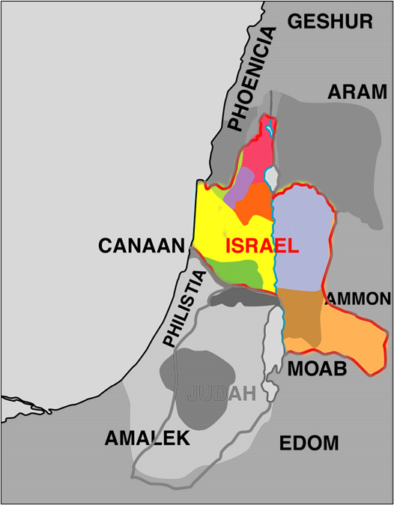
Dan
Ramoth-Gilead
Samaria
Bethel

Slide 10
JUDAH (South)
ISRAEL (North)
Jehoshaphat
AHAB
3. After three years of peace, why did Ahab want to go to war against Aram (I Kings 22:3-4)? How did Jehoshaphat respond to Ahab’s invitation? Who did Jehoshaphat want to consult (I Kings 22:5-7)? Why did Jehoshaphat want to inquire of this man but Ahab did not want to?

Slide 11
JUDAH (South)
ISRAEL (North)
Jehoshaphat
AHAB
4. The account of the prophet Micaiah is troubling. What is Micaiah’s first message to the kings (I Kings 22:14)? What was his second message (I Kings 22:17)? Finally, what was Micaiah’s explanation for the first message (I Kings 22:19-23)?

Slide 12
JUDAH (South)
ISRAEL (North)
Jehoshaphat
AHAB
5. After the unfavorable prophecy, what foolishness did Jehoshaphat agree to (I Kings 22:29-33)? How did Jehoshaphat escape (II Chron. 18:31)?

Slide 13
JUDAH (South)
ISRAEL (North)
Jehoshaphat
AHAB
6. What message did Jehu the prophet have for Jehoshaphat (II Chron. 19:1-3)?

Slide 14
JUDAH (South)
ISRAEL (North)
Jehoshaphat
AHAB
7. What instructions did Jehoshaphat have for the judges he appointed and for the priests (II Chron. 19:5-11)?

Slide 15
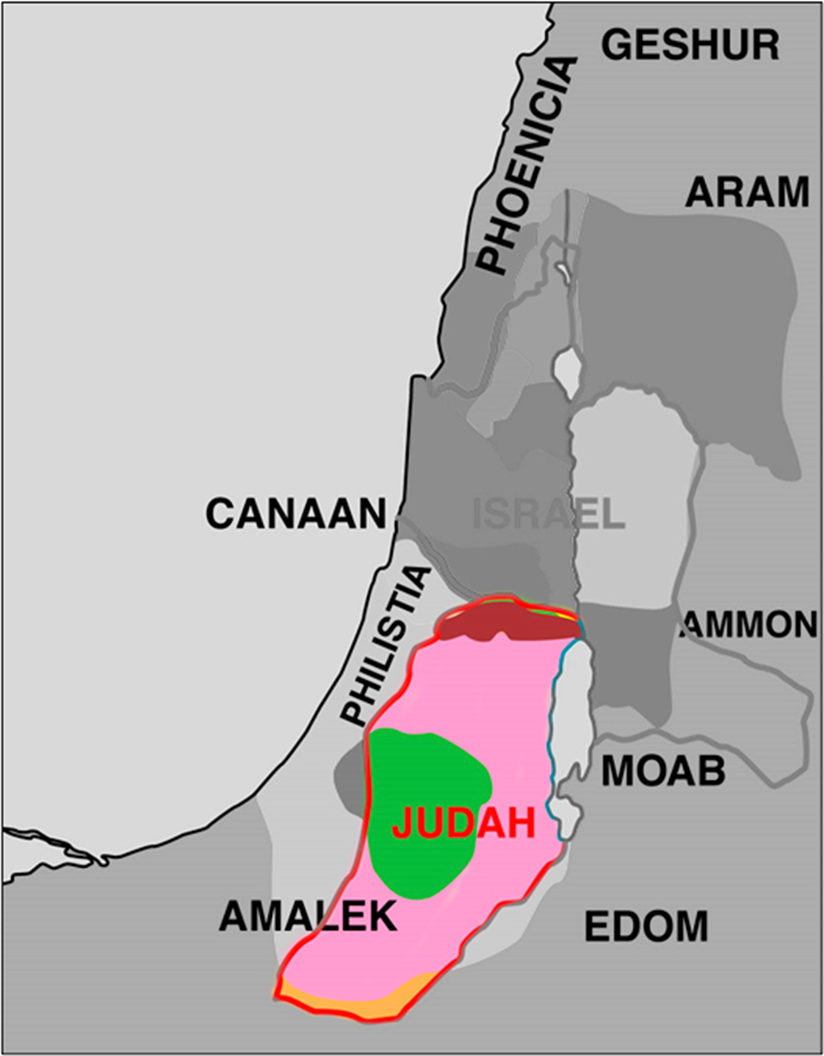

Slide 16
JUDAH (South)
ISRAEL (North)
Jehoshaphat
AHAB
8. How did Jehoshaphat respond when he became afraid (II Chron. 20:1-13)? What did the people of Judah do as they marched to face a fearfully large army (II Chron. 20:14-23)?

Slide 17
JUDAH (South)
ISRAEL (North)
Jehoshaphat
AHAZIAH
9. What is the final thing we see Jehoshaphat doing (I Kings 22:47-50; II Chron. 20:35-37)?

Slide 18
JUDAH (South)
ISRAEL (North)
Jehoshaphat
Jehoram
10. Just kidding, that wasn’t the final thing. After Ahaziah the son of Ahab dies, Jehoram another son of Ahab becomes king. Guess who he invites to go to war with him (II Kings 3:1-10). Who does Jehoshaphat want to talk to first (II Kings 3:11)? Why did Elisha agree to see the kings (II Kings 3:14)?

Slide 19
JUDAH (South)
ISRAEL (North)
Jehoshaphat
AHAB
11. Jehoshaphat was a good king, but he had a weakness. What was his weakness (refer back to earlier questions)? Why would Jehoshaphat want to do something like this?

