Slide 2
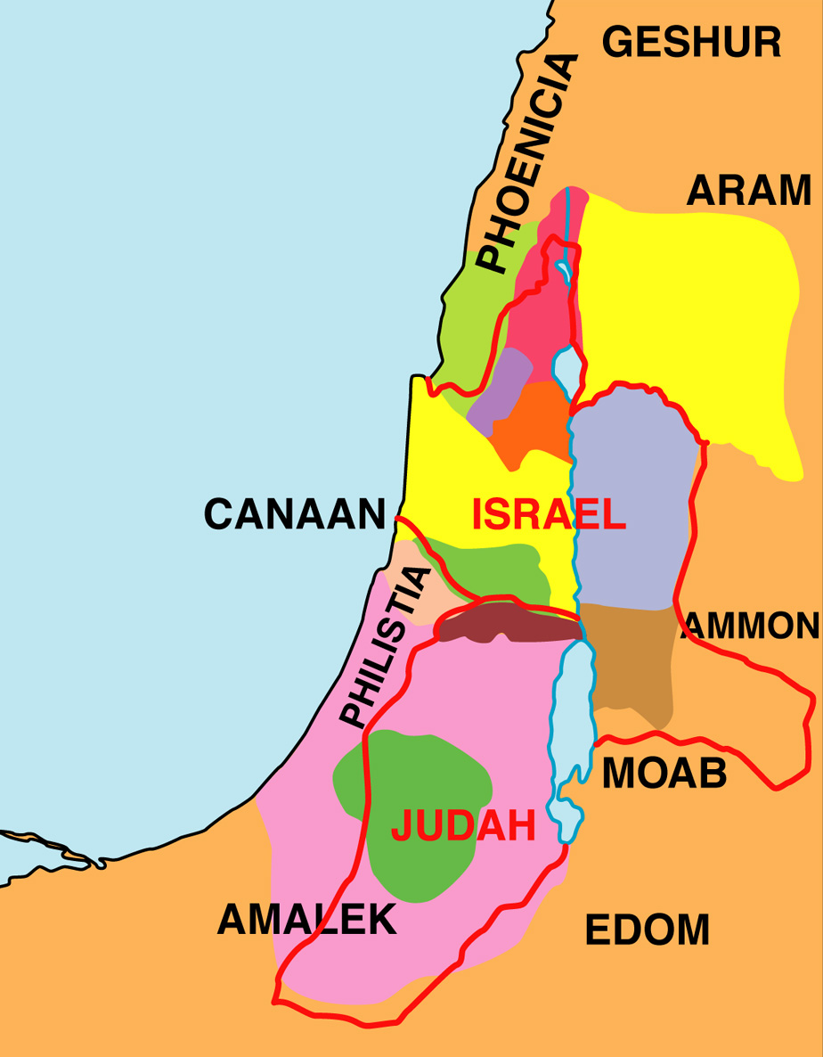

Slide 3
JUDAH (South)
ISRAEL (North)
Rehoboam (17 years)
Abijam (3 years)
Asa (41 years)
Jeroboam (22 years)
Nadab (2 years)
Baasha (24 years)
Elah (2 years)
Zimri (7 days)
Omri (12 years)
Ahab (22 years)

Slide 4
JUDAH (South)
ISRAEL (North)
Rehoboam (17 years)
Abijam (3 years)
Asa (41 years)
Jehoshaphat (25 years)
Jeroboam (22 years)
Nadab (2 years)
Baasha (24 years)
Elah (2 years)
Zimri (7 days)
Omri (12 years)
Ahab (22 years)
DOOMS DAY CLOCK
158 years*

Slide 5
JUDAH (South)
ISRAEL (North)
ELIJAH
Jehoshaphat
AHAB
1. Elijah declares to Ahab that there would be a drought (I Kings 17:1). What is the point of that drought? What does it prove?

Slide 6
JUDAH (South)
ISRAEL (North)
ELIJAH
Jehoshaphat
AHAB
2. How does Elijah initially survive the drought (I Kings 17:2-7)?

Slide 7
Samaria (Start here)*
Brook Cherith
Zarephath / Sidon

Slide 8
JUDAH (South)
ISRAEL (North)
ELIJAH
Jehoshaphat
AHAB
3. In what way does the widow of Zarephath show faith (I Kings 17:8-16)? How was she rewarded?

Slide 9
JUDAH (South)
ISRAEL (North)
ELIJAH
Jehoshaphat
AHAB
4. What amazing miracle does Elijah perform (I Kings 17:17-24)? To our knowledge, how many times has this miracle been performed before?

Slide 10
JUDAH (South)
ISRAEL (North)
ELIJAH
Jehoshaphat
AHAB
5. What point is Jesus making when he references the widow of Zarephath (Lk. 4:25-26)?

Slide 11
Samaria (Start here)*
Brook Cherith
Zarephath / Sidon
Mt. Carmel

Slide 12
JUDAH (South)
ISRAEL (North)
ELIJAH
Jehoshaphat
AHAB
6. Obadiah is an unsung hero of the Bible. What had he done and why (I Kings 18:1-16)? What was he concerned about (I Kings 18:7-16)?

Slide 13
JUDAH (South)
ISRAEL (North)
ELIJAH
Jehoshaphat
AHAB
7. Who was to blame for the drought (I Kings 18:17-18)?

Slide 14
JUDAH (South)
ISRAEL (North)
ELIJAH
Jehoshaphat
AHAB
8. What decision did Elijah ask the people to make (I Kings 18:20-21)? How did the people respond?

Slide 15
JUDAH (South)
ISRAEL (North)
ELIJAH
Jehoshaphat
AHAB
9. How long did the prophets of Baal try to get their god to light their sacrifice (I Kings 18:25-29)? What did they do to appeal to their god? What were the two results of their efforts (I Kings 18:29)? If you met one of these prophets of Baal, do you think they would come across as sincere believers of their religion or as two-faced hypocrites?

Slide 16
JUDAH (South)
ISRAEL (North)
ELIJAH
Jehoshaphat
AHAB
10. What does Elijah do to show how different God is from Baal (I Kings 18:30-38)? What was the result of the contest between Elijah and the prophets (I Kings 18:36-40)?

Slide 17
JUDAH (South)
ISRAEL (North)
ELIJAH
Jehoshaphat
AHAB
11. What lessons can we learn from the end of the contest when the drought comes to an end (I Kings 18:41-46)? What lesson does James take from Elijah and the drought (Jam. 5:17-18)?

Slide 18
Samaria (Start here)*
Brook Cherith
Zarephath / Sidon
Mt. Carmel
Jezreel
Beersheba (and wilderness)
Mt. Sinai

Slide 19
JUDAH (South)
ISRAEL (North)
ELIJAH
Jehoshaphat
AHAB
12. The contest against the prophets of Baal went very well. Why does Elijah want to die (I Kings 19:1-14)? In what ways does God respond to Elijah? What do we learn about God in this chapter?

Slide 20
JUDAH (South)
ISRAEL (North)
ELIJAH
Jehoshaphat
AHAB
13. We end this section with a divine preview of what is to come (I Kings 19:15-21). What three tasks does God give Elijah to accomplish? What encouragement does God give Elijah?

Slide 21
JUDAH (South)
ISRAEL (North)
ELIJAH
Jehoshaphat
AHAB
14. The final revelation from God before the Years Of Silence involves a prophecy that Elijah would be coming again (Mal. 4:5-6). What would Elijah do? How does this compare to the work Elijah did during Ahab’s life?

Slide 22
JUDAH (South)
ISRAEL (North)
ELIJAH
Jehoshaphat
AHAB
15. How is Elijah described (II Kings 1:8)? How is John the Baptist described (Mt. 3:4; Mk. 1:6)?

Slide 23
JUDAH (South)
ISRAEL (North)
ELIJAH
Jehoshaphat
AHAB
16. Has Elijah already come again (Mt. 17:10-13; Lk. 1:17)?

Slide 24
JUDAH (South)
ISRAEL (North)
ELIJAH
Jehoshaphat
AHAB
17. Who appeared with Jesus on the Mount of Transfiguration (Lk. 9:30-31)?

