Slide 1
Introduction in Studying the Psalms

Slide 2
Come, let us worship and bow down,
Let us kneel before the Lord our Maker.
For He is our God, and we are the people of His pasture and the sheep of His hand.
Psalms 95:6-7

Slide 3
What do you know
about the book of Psalms?

Slide 4
Purpose of our study in the Psalter
It’s in God’s word
II Tim 2:15
II Pet 3:18
To know Him, to please Him
How the Psalter relates to the O.T. and N.T.
Enhance and deepen our prayers and singing

Slide 5
Class Goals/Outcomes
What is a Psalm
Types of Psalms
Characteristics of Psalter
Authors, Dates
Arrangement – Division
Insights to David (a man after Gods own heart)
Share favorite Psalms/Verses – (tell why)
Study – Apply – Teach (Ezra 7:10)

Slide 6
What is a Psalm?

Slide 7
Types of Psalms
Praise
Guidance
Messianic
Instructional
Nature
Repentance
Kingship
Imprecatory

Slide 8
I will give thanks to You, for I am fearfully and wonderfully made; Wonderful are Your works, and my soul knows it very well
Psalms 139:14

Slide 9
“to appreciate the Psalms, one must enter into and share the spirit of the Psalmist”
--Homer Hailey

Slide 10
Let me ask, how do we do that? How does one enter and share the spirit of the Psalmist?
Read/Meditate on Gods word
Ask for the Holy Spirit to guide us
We pray for wisdom
We spend lots of time in Psalms everyday
We pray like the Psalmist
We look to the Psalms for guidance, encouragement
We praise joyfully
We open ourselves up fully, we confess everything
We study the language, poetry structure
We learn more about David's life
We learn more about Israel's history
We learn more about context regarding Psalms
We bring the Psalms into our daily living and conversations
We memorize Psalms

Slide 11
Lifestyle of Worship
from David
A lifestyle of worship requires total confidence in God
A lifestyle of worship emanates from a submissive spirit
A lifestyle of worship emanates from courageous faith
A lifestyle of worship emanates from a raw passion of God
A lifestyle of worship emanates a contrite heart
“True worship manifests itself in action and
emanates from a heart for God”
-Wiersbe

Slide 12
Psalm100
Lord We Come Before Thee Now

Slide 13
Enter His gates with thanksgiving, and His courts with praise. Give thanks to Him; bless His name. For the Lord is good; His lovingkindness is everlasting And His faithfulness to all generations.
Psalm 100:4-5

Slide 14
O Lord, my heart is not proud, nor my eyes haughty; nor do I involve myself in great matters, or in things too difficult for me. Surely I have composed and quieted my soul; Like a weaned child rests against his mother, My soul is like a weaned child within me. Oh Israel, hope in the Lord from this time forth and forever.
Psalm 131

Slide 15
Effective Study in Psalms
Principal 1: Determine Who Is Speaking
Principal 2: Determine if the Psalm is Personal or Corporate
Principal 3: Determine for What Purpose the Psalm was Written
Principal 4: Determine the Emotional Orientation of the Psalm
Principal 5: Determine the Genre of the Psalm if Possible
Principal 6: Determine if There is a Refrain or Recurring Words and Phrases

Slide 16
5 Books of the Psalms
Book I Ps 1-41
Book II Ps 42-72
Book III Ps 73-89
Book IV Ps 90-106
Book V Ps 107-150
Genesis
Exodus
Leviticus
Numbers
Deuteronomy

Slide 17
Authors / Dates

Slide 18
Authors of Psalms
David 73 + 2
Asaph 12 (50,73-83)
Sons of Korah 10 (42,44-49,84-85,87-88)
Solomon 2 (72,127)
Ethan 1 (89)
Moses 1 (90)
Heman 1 (88)
Anonymous 50 (approximately)

Slide 19
Dating the Psalms
Ps 90 Moses
Ps 126 Captivity/Release
Ps 137 Solomon
Earliest – 3,500 years ago
Latest – 2,500 years ago
Time Span of 1,000 years

Slide 20
Make me know Your ways, O Lord; Teach me Your paths. Lead me in Your truth and teach me, For You are the God of my salvation; For you I wait all the day.
Psalm 25:4-5

Slide 21
The Lord is my shepherd,
I shall not want.
Psalm 23:1

Slide 22
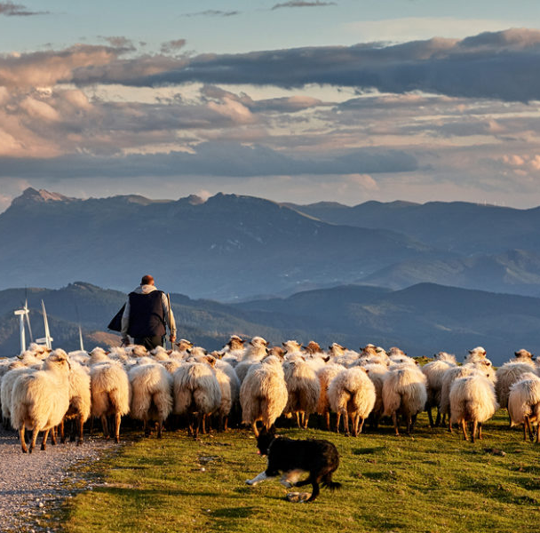

Slide 23
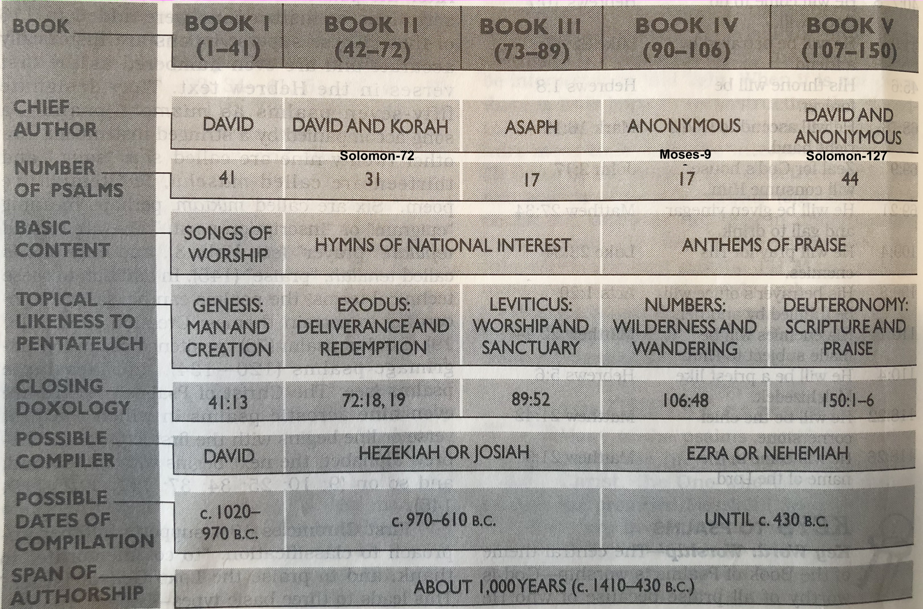

Slide 24
Resources
Bible – God
Psalms By the Day – Alec Motyer
How to Read the Psalms – Tramper Longman III
Studying the Psalms – Gene Taylor
Psalms – Derek Kidner
Studies in the Psalms – Essays from Florida
All the Prayers of the Bible – Herbert Lockyer
Give Us a King – Bob and Sandra Waldron
Be Worshipful – Warren E Wiersbe
Encountering Psalms – C. Hassell Bullock

Slide 25
Unless * the LORD builds the house, they labor in vain
who build it;
Unless * the LORD guards the city, the watchman keeps awake in vain
Psalm 127:1

Slide 26
Titles / Superscriptions
Author
Historical Occasion
Melody
Type/Genre
Instruments

Slide 27
“Some psalms you see,
Some psalms you feel,
Some psalms you hear”
Wiersbe

Slide 28
Psalm 2
4 Voices
Conspiracy – the Voice of the Nations (vv.1-3)
Mockery – the Voice of God the Father (vv.4-6)
Victory – the Voice of God the Son (vv.7-9)
Opportunity – the Voice of the Holy Spirit (vv.10-12)

Slide 29
Messianic Psalms
5 Types
Typical Messianic (34:20; 69:4,9)
Typical Prophetic (22)
Indirectly Messianic (2; 45; 72)
Purely Prophetic (110)
Enthronement (96-99)

Slide 30
Lament Psalms
Invocation (vs 1)
Plea for help (vs 1,16-19)
Complaints (vs 1-4,20,21)
Confession (vs 5-12)
Imprecation (vs 20-28)
Expression of confidence (vs 13-15)
Hymn (vs 30-36)
Psalm 69
Messianic / Imprecatory

Slide 31
Lament Psalms
3 Types of Complaints
Psalmist is troubled by his own thoughts and actions
He complains about the actions of others against him (enemies)
He may be frustrated at God
Psalms 22, 42, 43

Slide 32
10 Different Words
for the Scriptures
Law
Testimonies
His ways
Precepts
Statues
Commandments
Judgements
Ordinances
Your word
Promise
Each name indicates what the Word is
and how we should respond to it.

Slide 33
Psalm 37
Security in the Lord
Trust in the Lord vs 3
Dwell in the Land vs 3
Delight in the Lord vs 4
Commit your way vs 5
Rest in the Lord vs 7
Cease from anger vs 8
Do not fret vs 8

Slide 34
Revive
To return to life; to recover life.
To recover new life or vigor; to be reanimated after depression.
To recover from a state of neglect, oblivion, obscurity or depression.
To recomfort; to quicken; to refresh with joy or hope.

Slide 35
Psalm 119
Longest chapter in God’s word
Combines worship, prayer, praise, admonitions
22 sections each containing 8 verses
Acrostic psalm – each section begins with letter of Hebrew alphabet
It has 8-10 synonyms to describe scripture
Yahweh/Jehovah appears 24 times
Author is unknown
Scripture is mentioned 171 out of 176 verses

Slide 36
Psalm 119
Key Words/Phrases
Heart 15 times
Delight 9 times
Walk 4 times
Revive me 9 times
I love you 9 times

Slide 37
Psalm 119:11
“Your word I have treasured in my heart, that I may not sin against You”

Slide 38
Let the words of my mouth and the meditation of my heart be acceptable in Your sight, O Lord, my rock and my Redeemer
Psalm 19:14

Slide 39
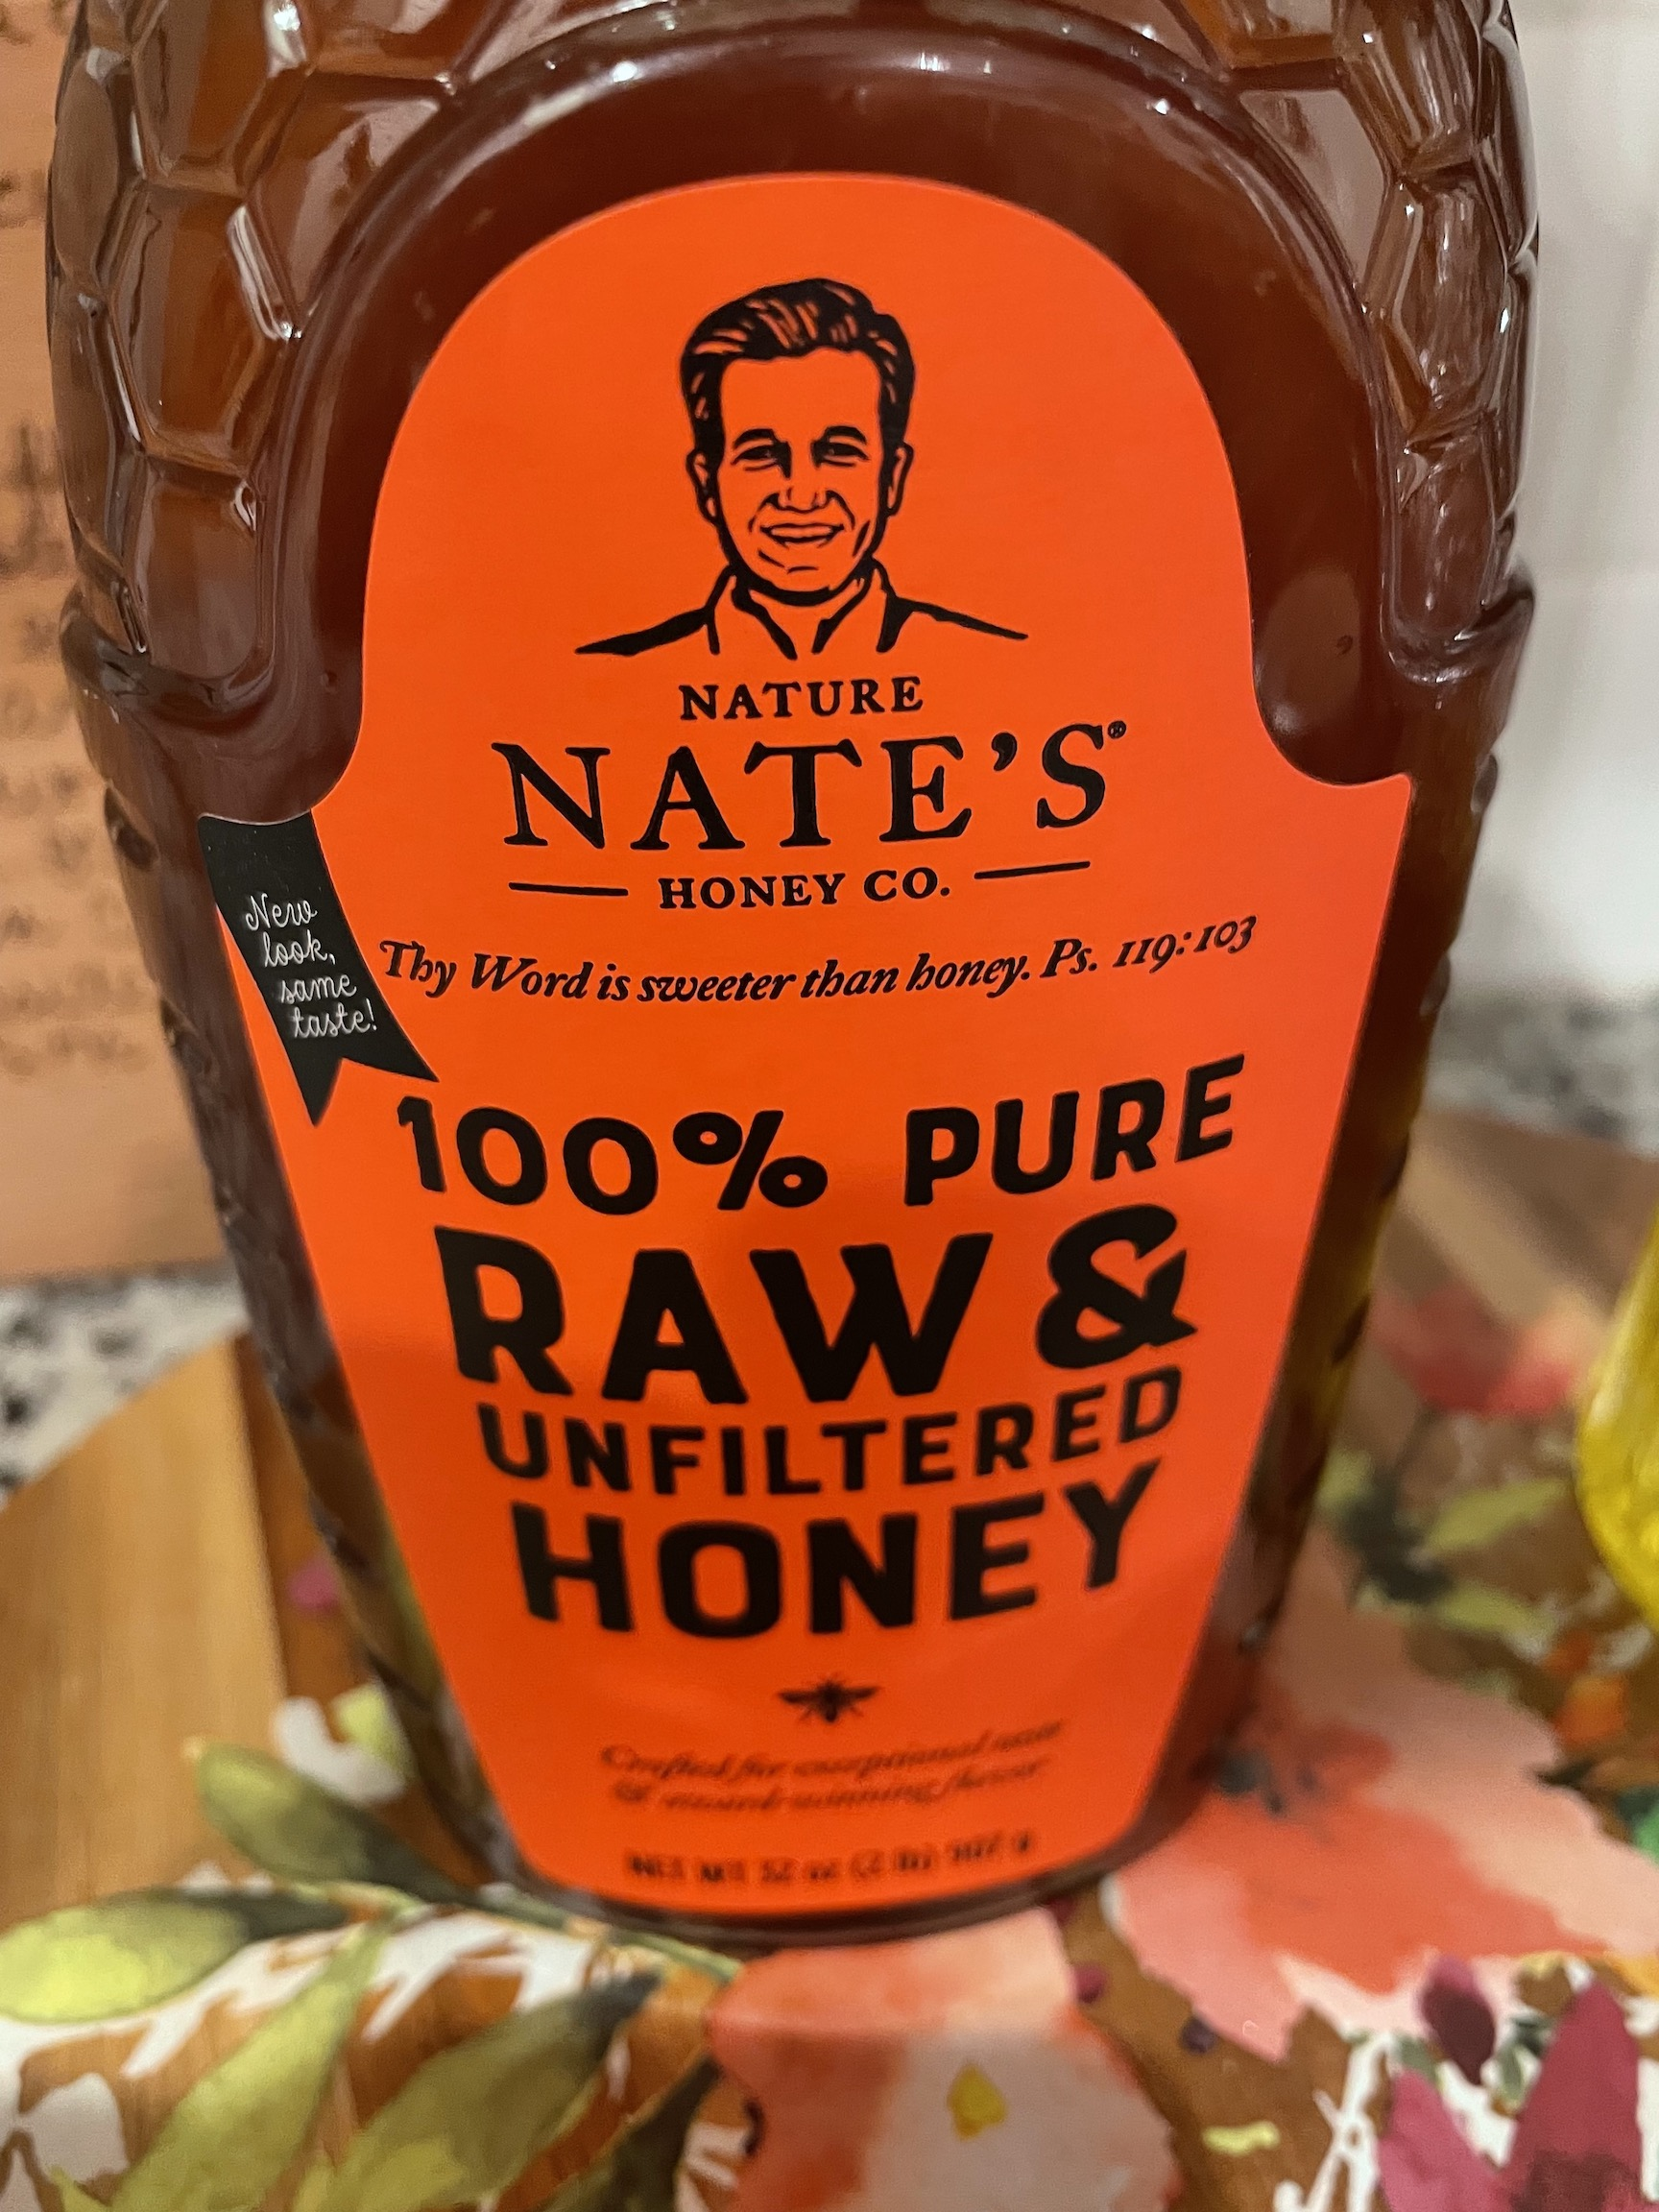

Slide 40
How God reveals Himself
Psalm 19
In Creation vs 1-6
In Scripture vs 7-11
In our Hearts vs 12-14

Slide 41
Characteristics/Values/Uses
Psalm 19
Law Perfect Restores
Testimony Sure Making
Precepts Right Rejoicing
Commandment Pure Enlightening
Reverence Clean Enduring
Judgements True Righteous

Slide 42
God’s Word…
Psalm 33
in Worship (vs 1-5)
in Creation (vs 6-9)
in History (vs 10-17)
in Life (vs 18-22)
-Wiersbe

Slide 43
Ways the Lord is our help
and our shield
Psalm 33
Our soul waits for the Lord
Our heart rejoices in Him
We trust in His holy name
We have hope in Him

Slide 44
Create in me a clean heart O God and renew a steadfast spirit within me.
Ps 51:10

Slide 45
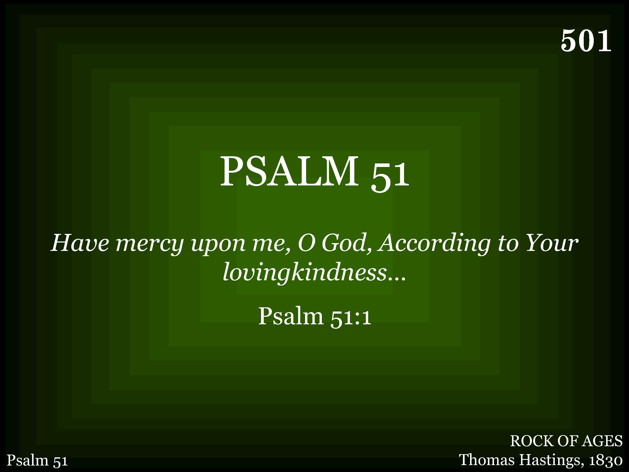
501 - Psalm 51 - Title

Slide 46
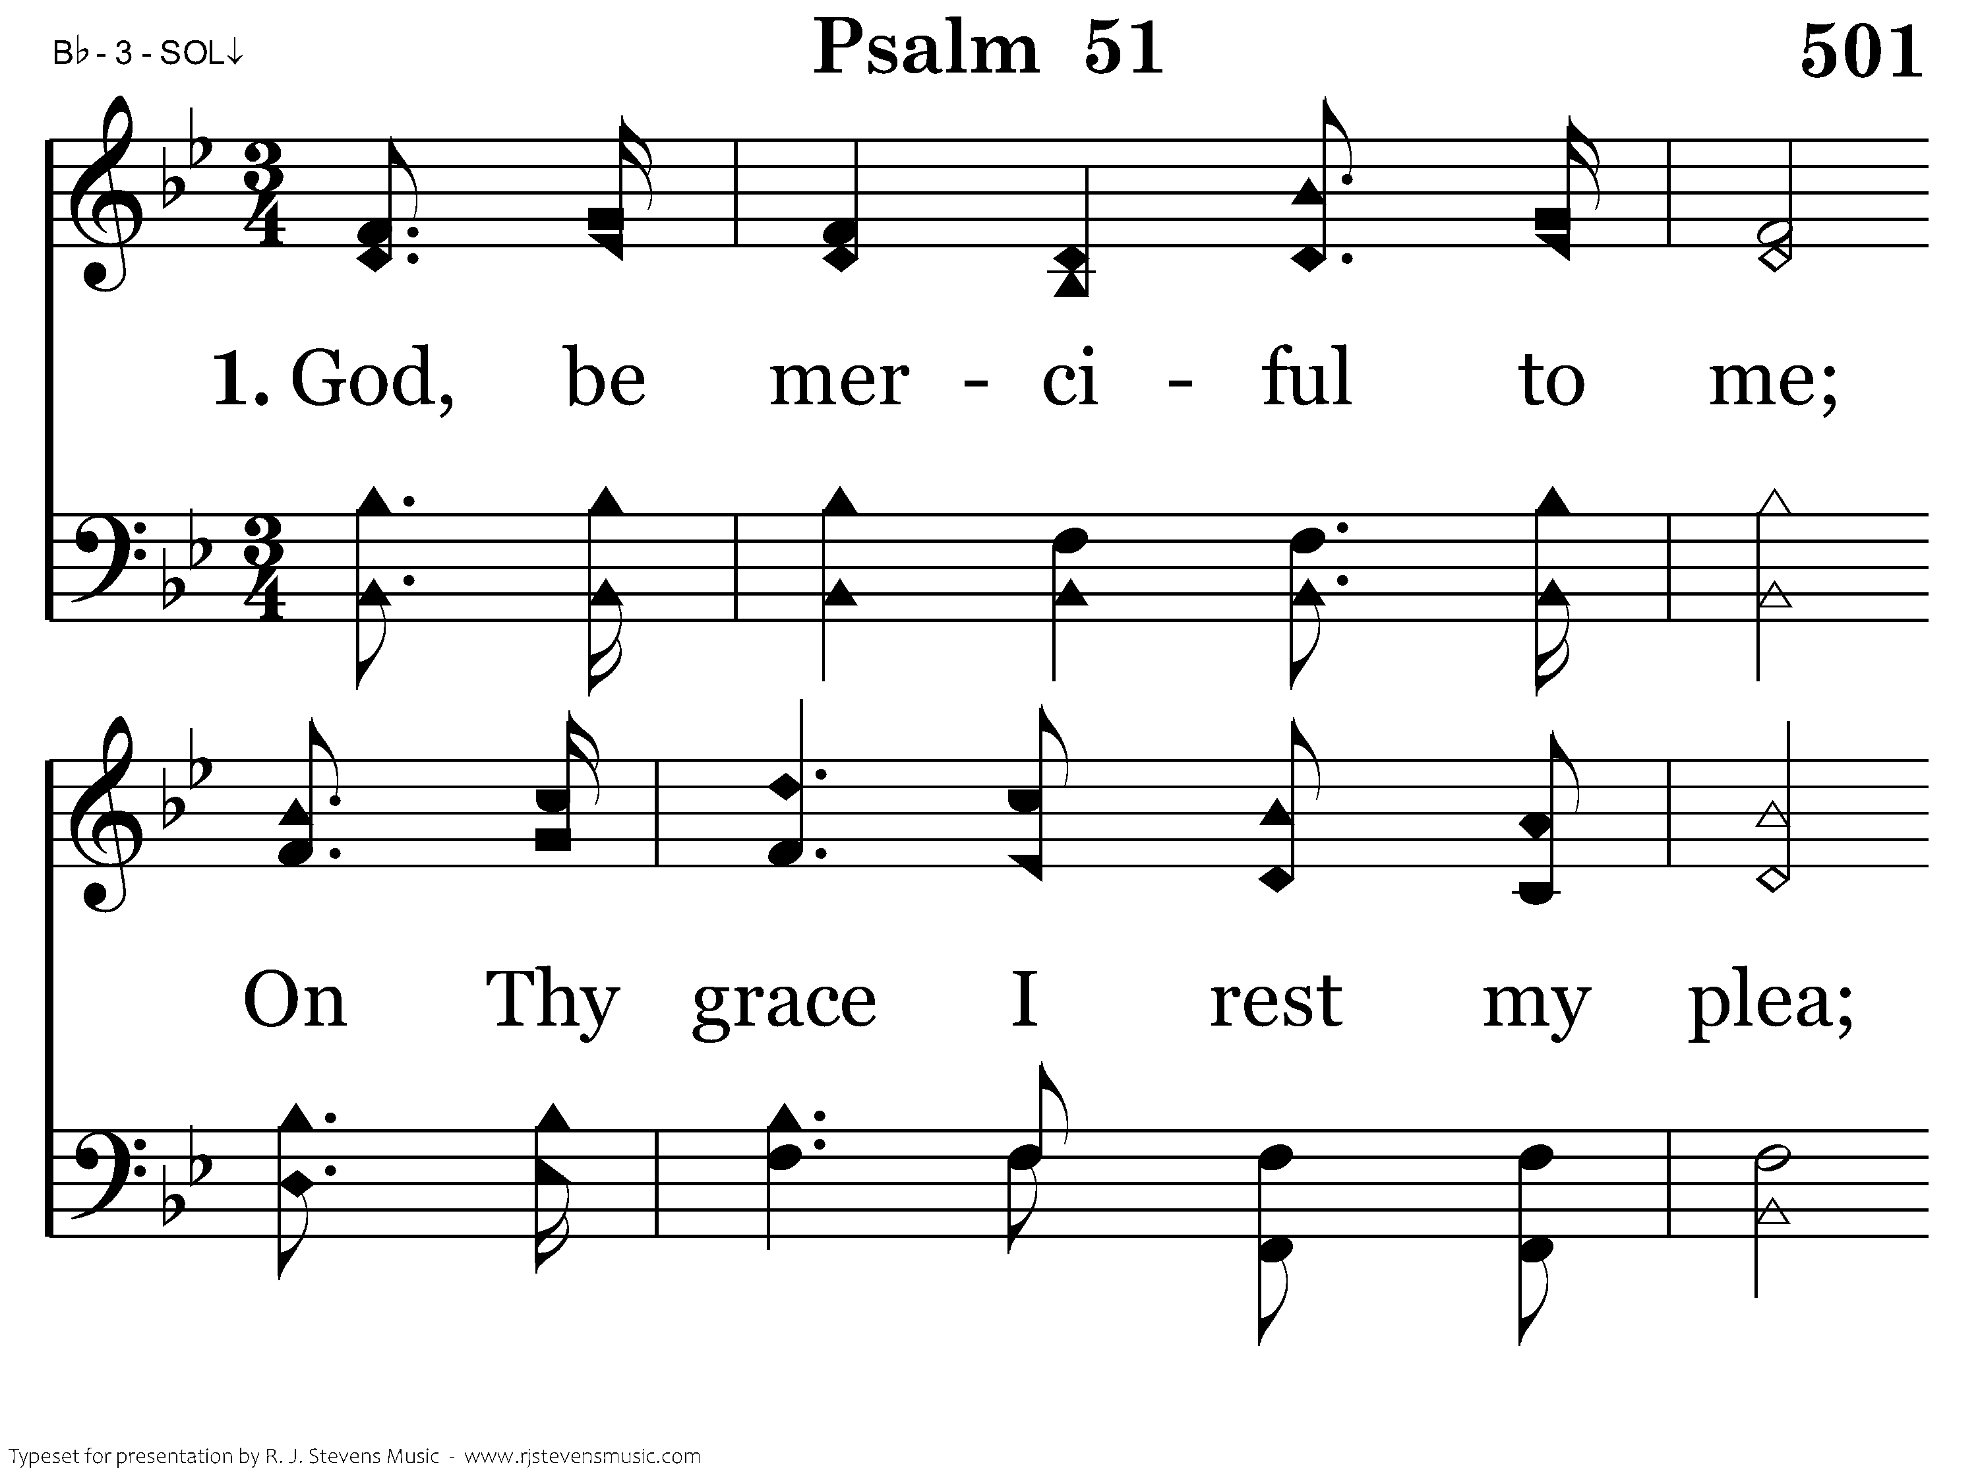
501 - Psalm 51 - 1.1

Slide 47
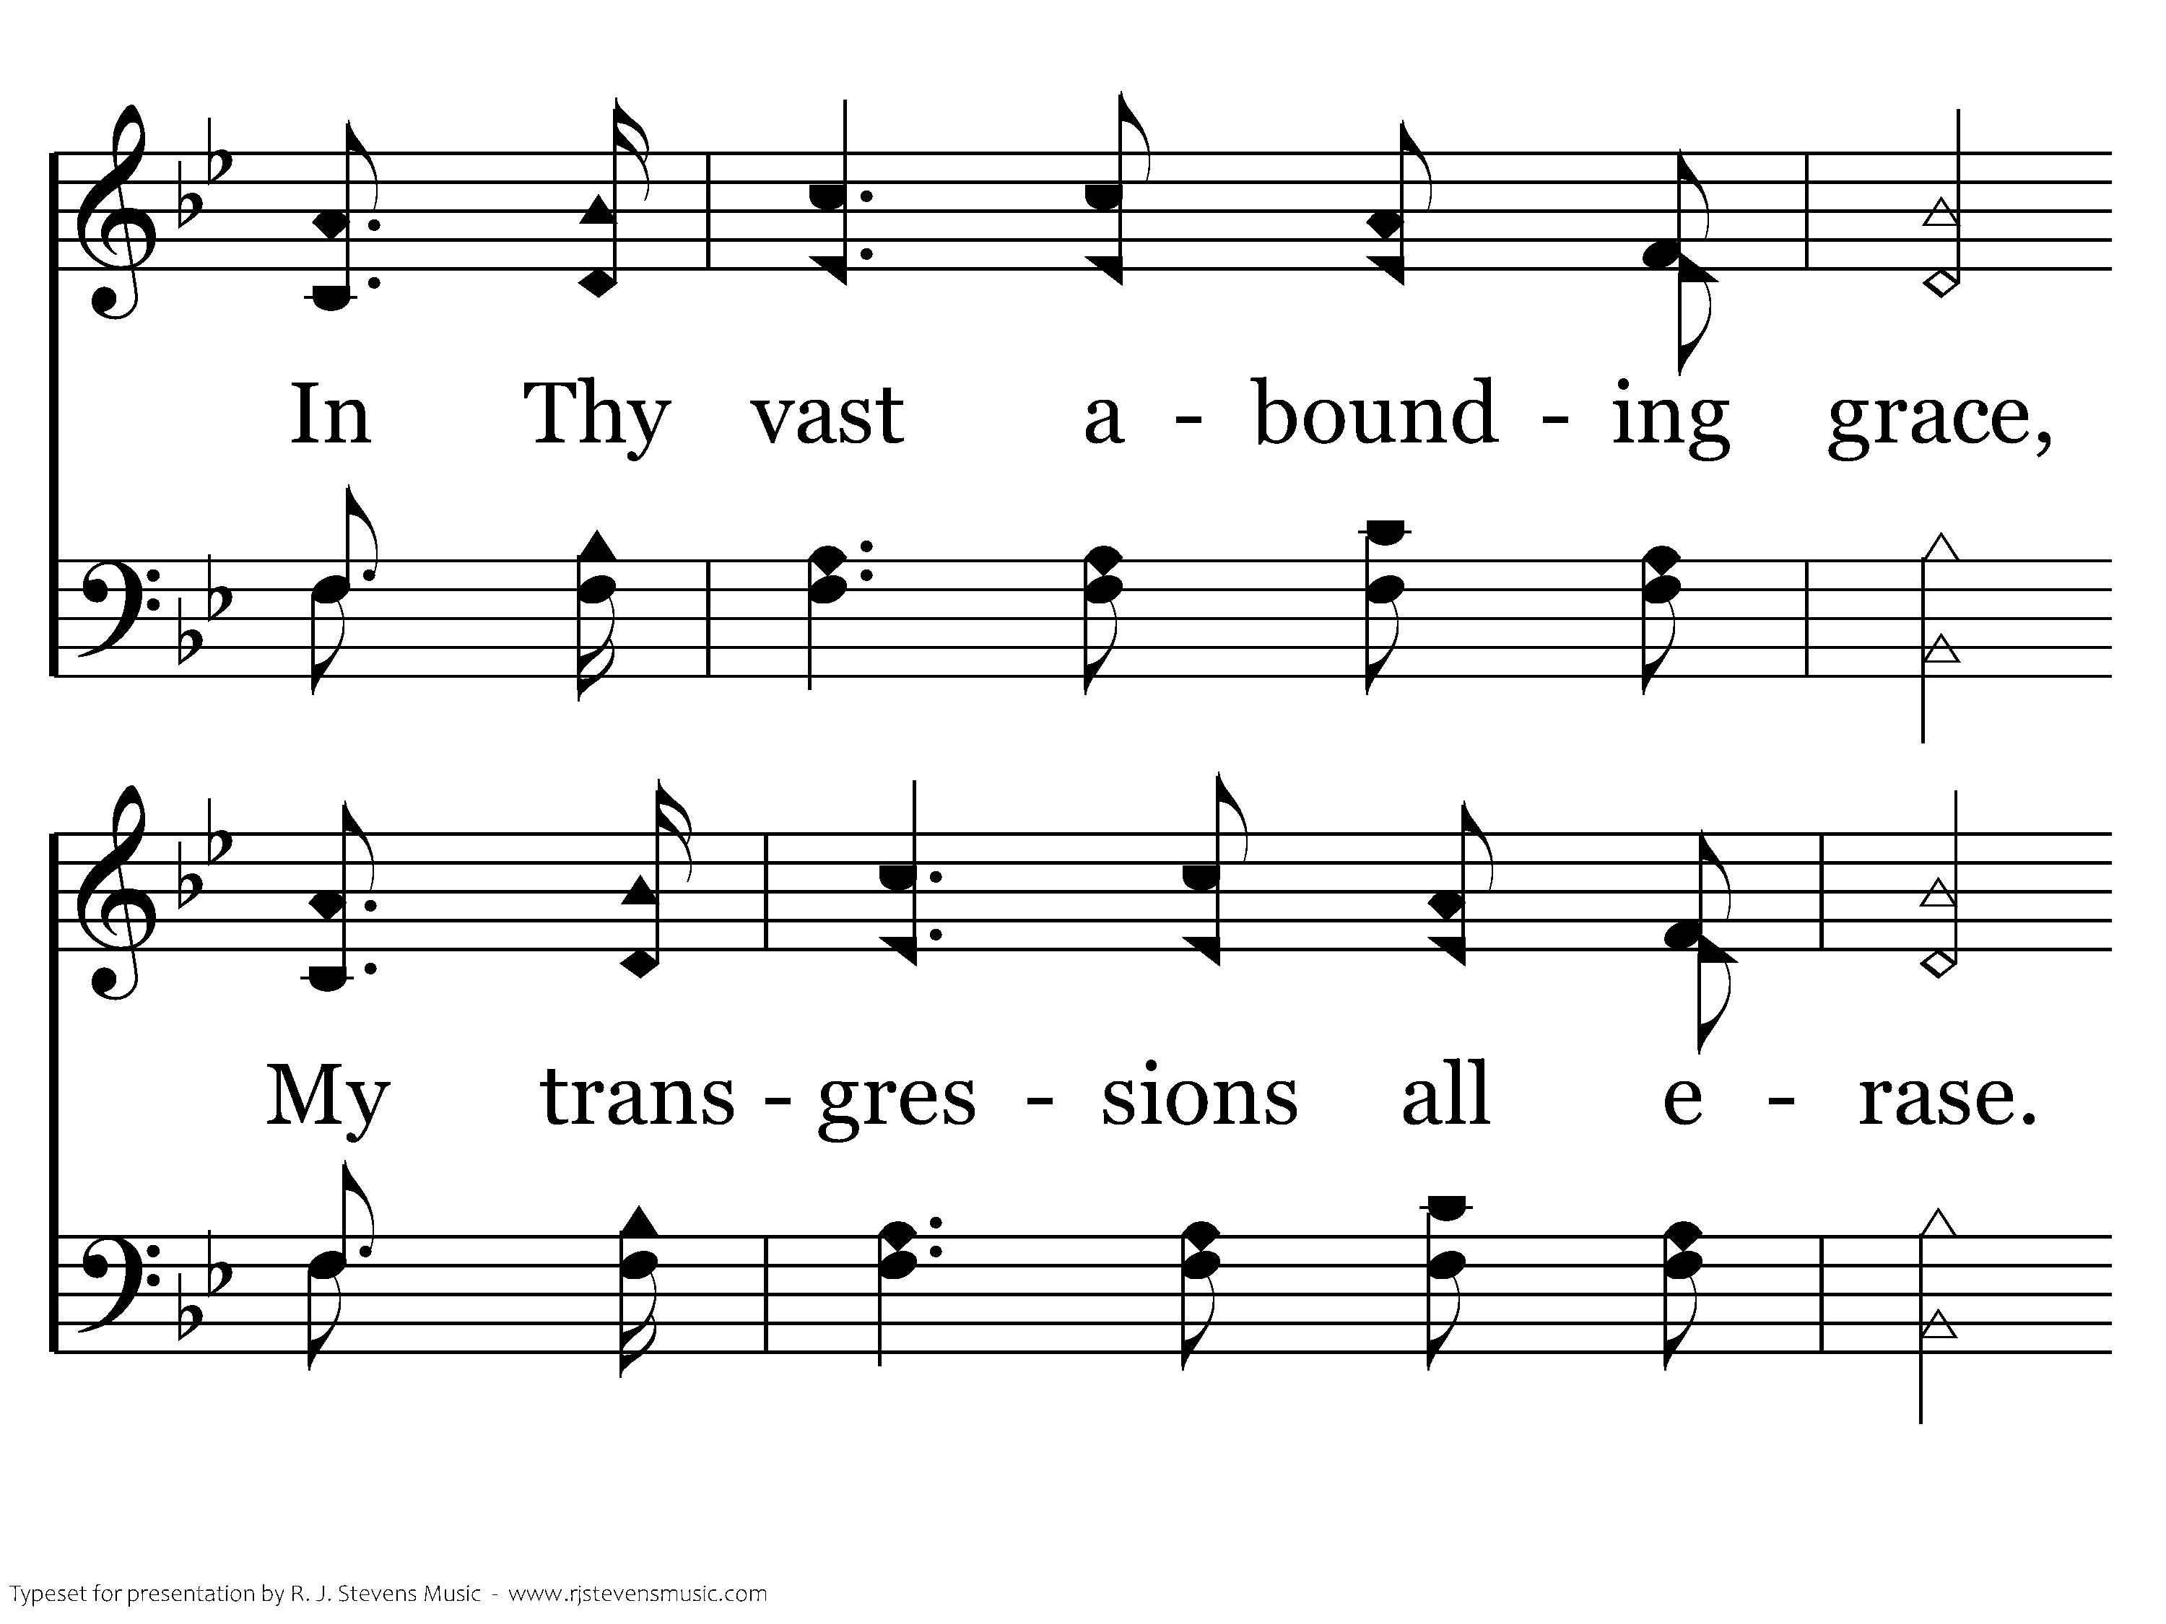
501 - Psalm 51 - 1.2

Slide 48
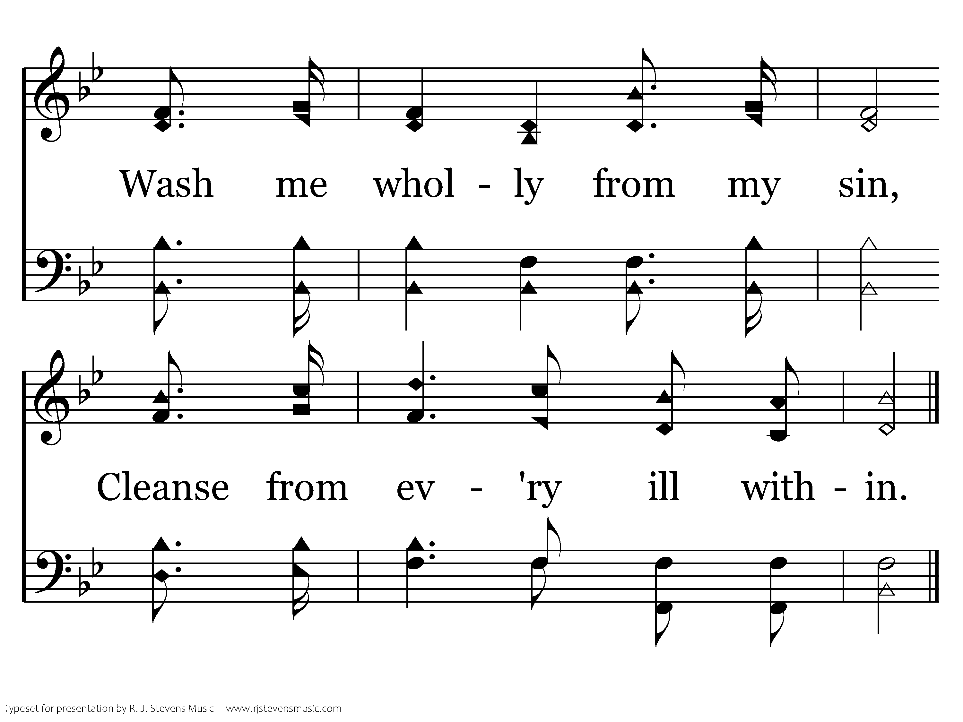
501 - Psalm 51 - 1.3
End of Verse 1

Slide 49
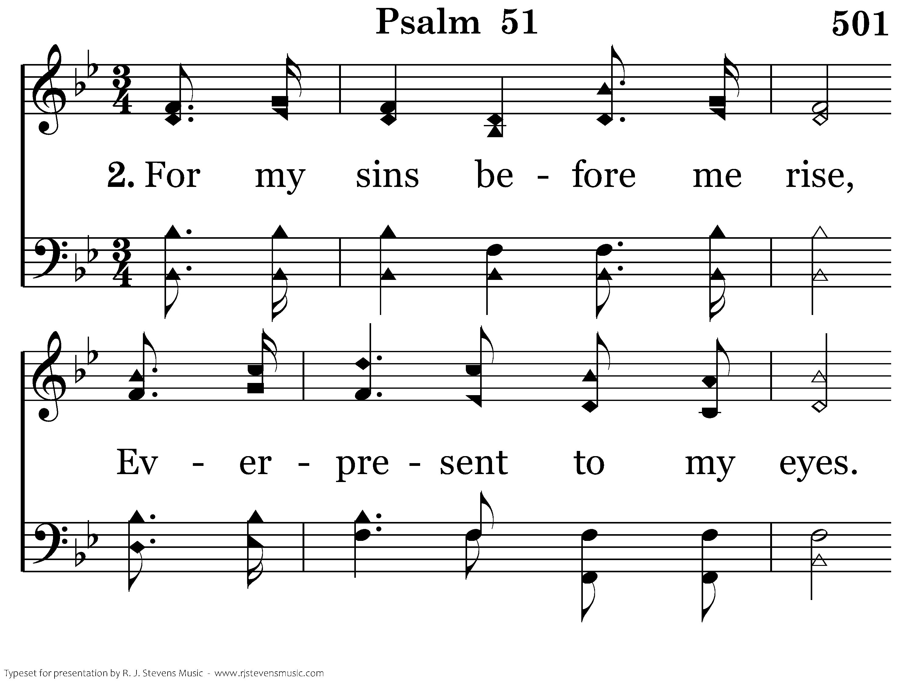
501 - Psalm 51 - 2.1

Slide 50
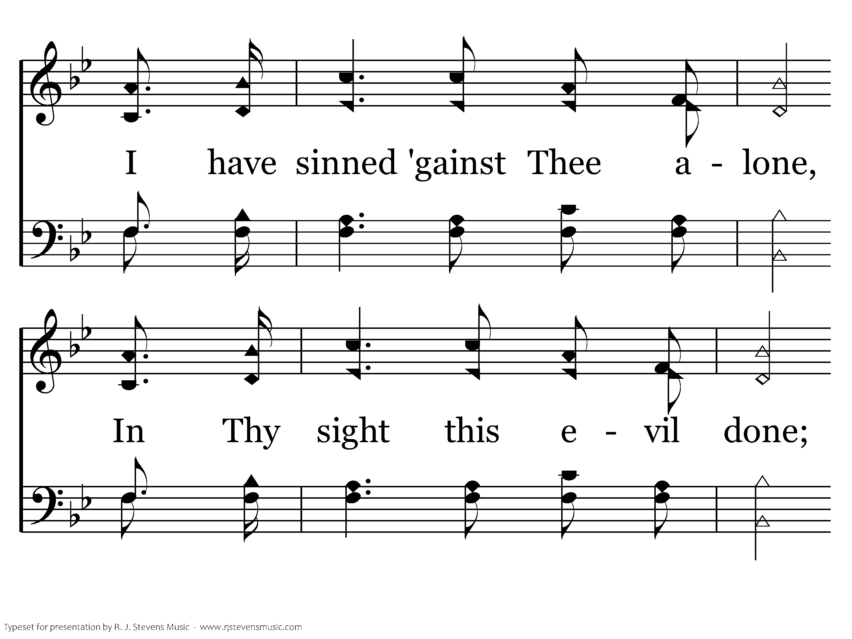
501 - Psalm 51 - 2.2

Slide 51
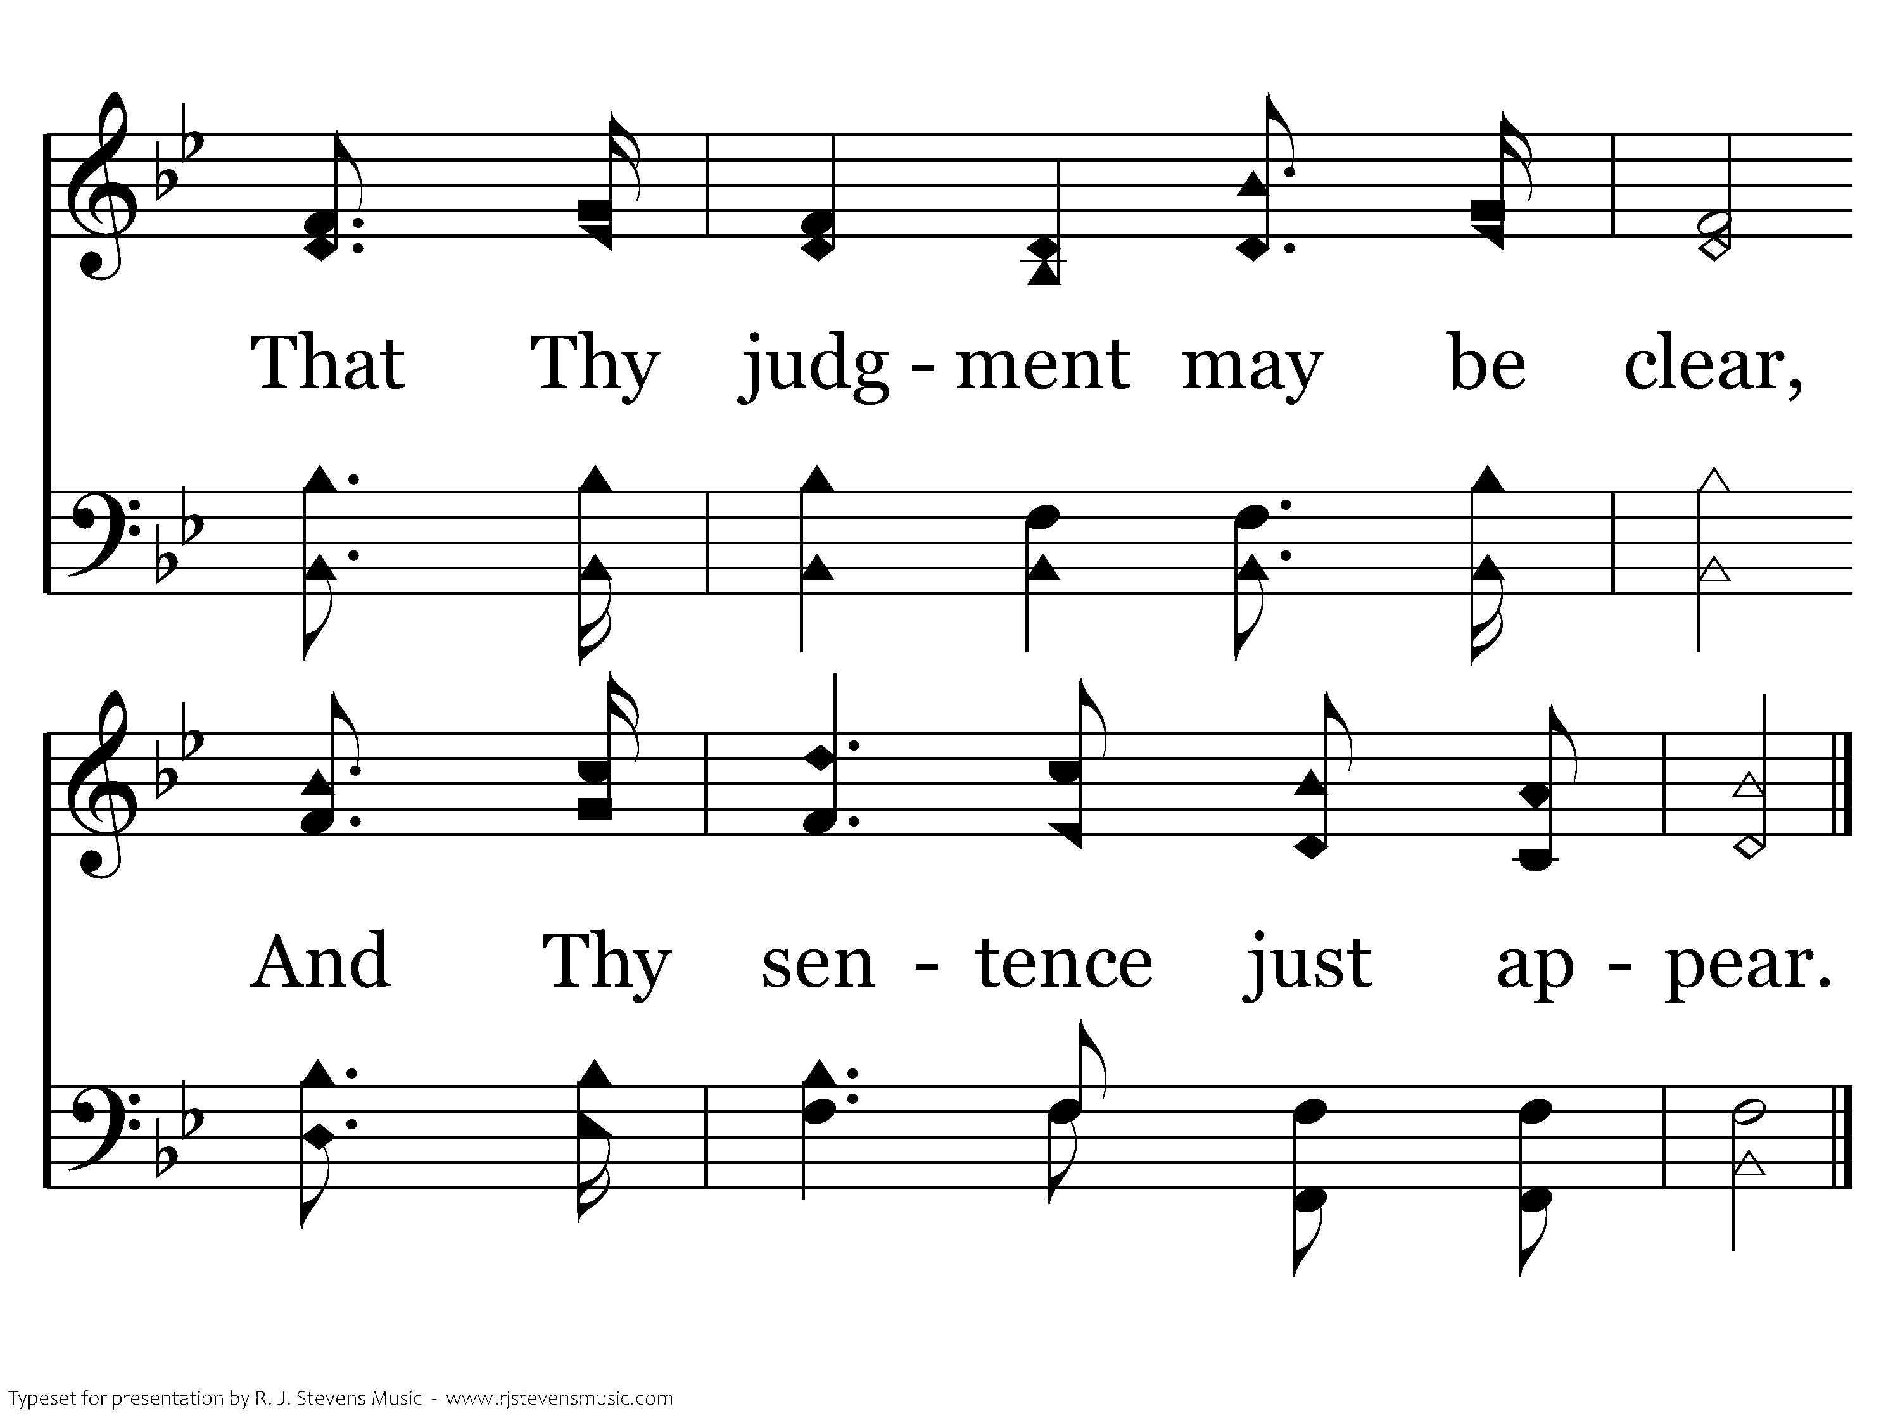
501 - Psalm 51 - 2.3
End of Verse 2

Slide 52
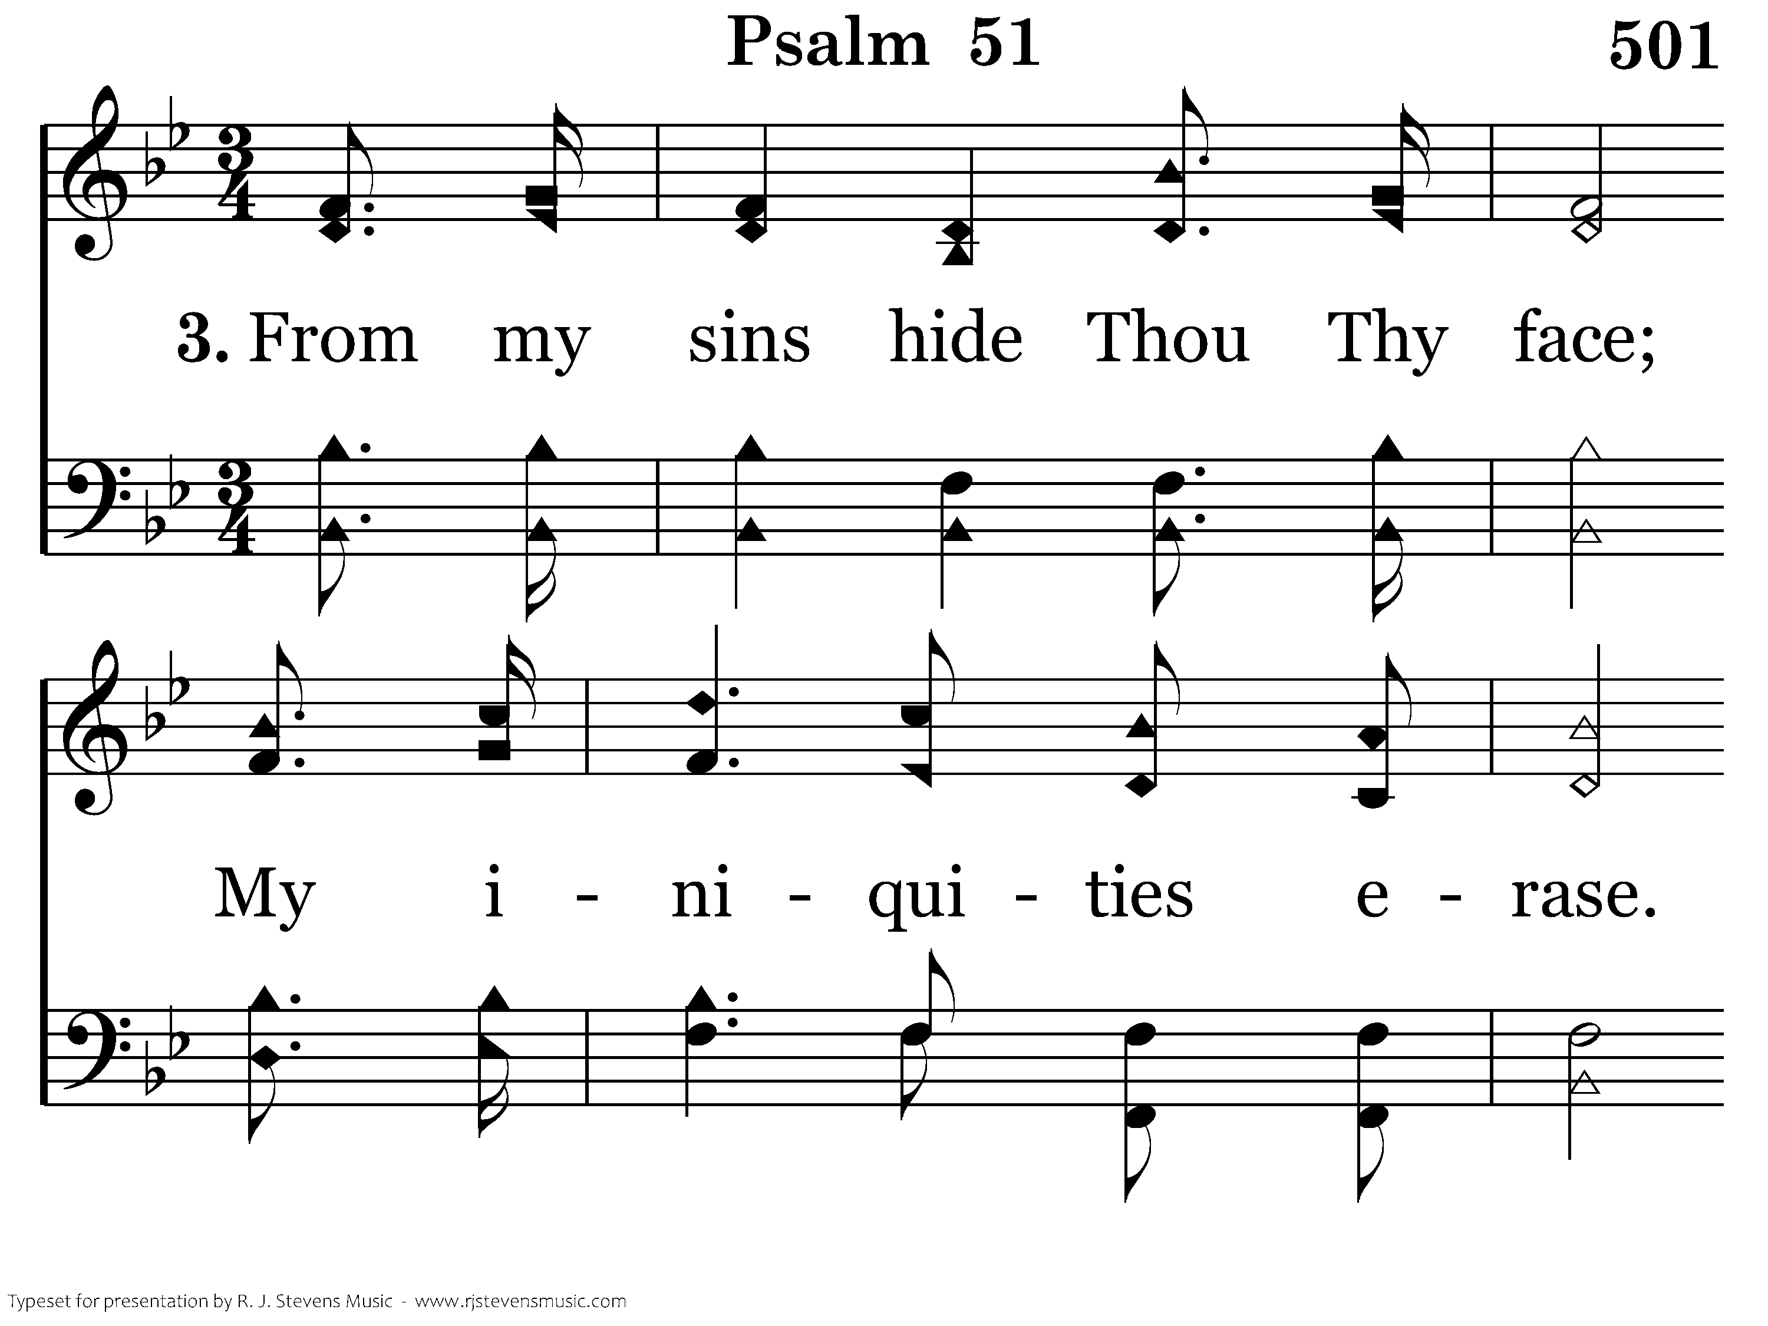
501 - Psalm 51 - 3.1

Slide 53
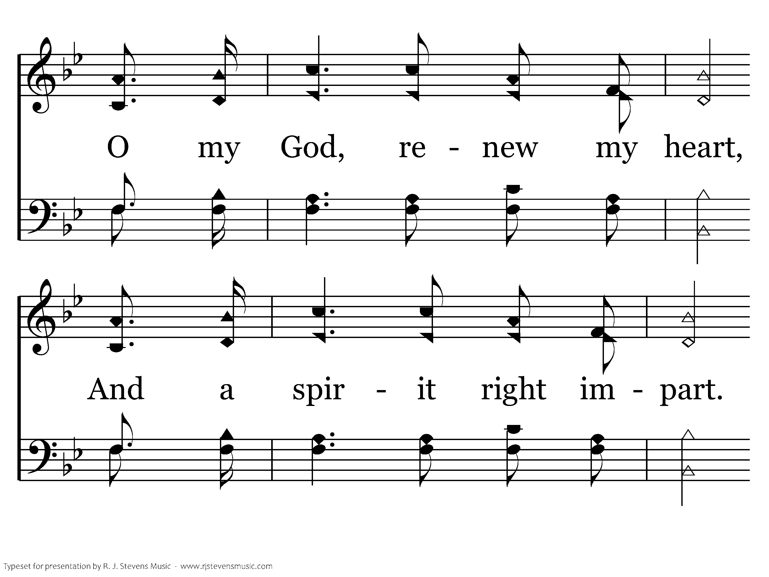
501 - Psalm 51 - 3.2

Slide 54
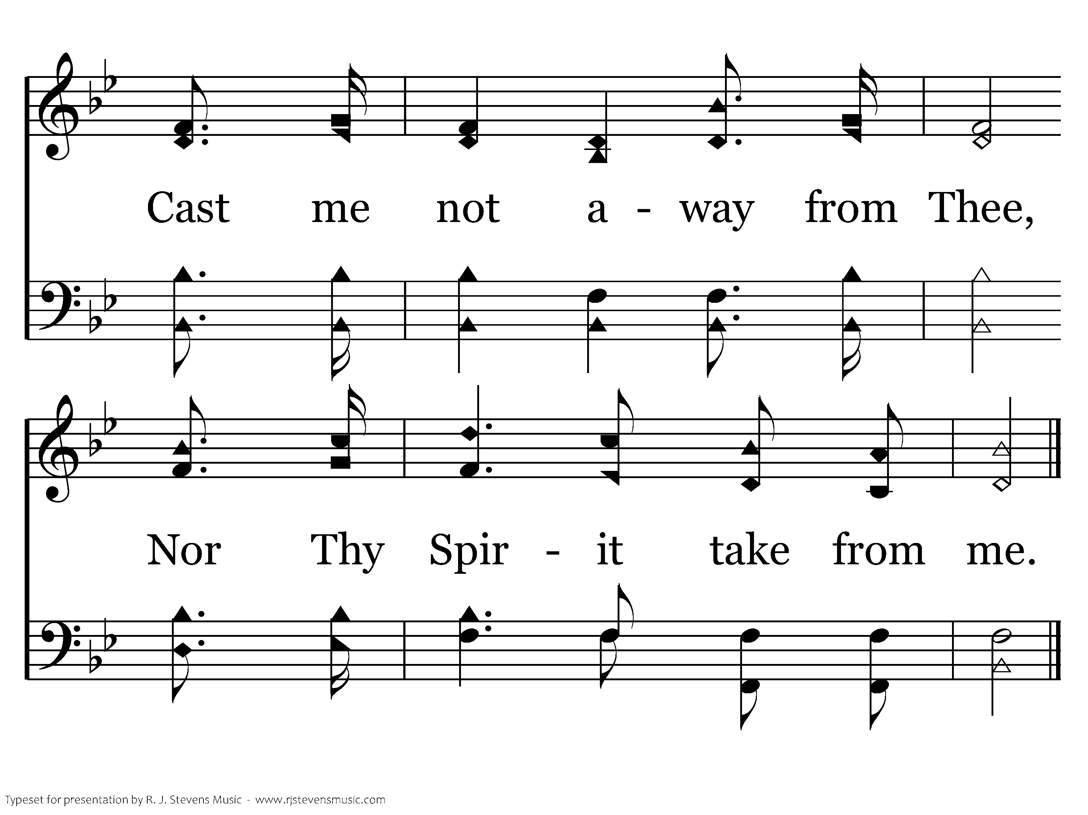
501 - Psalm 51 - 3.3
End of Verse 3

Slide 55
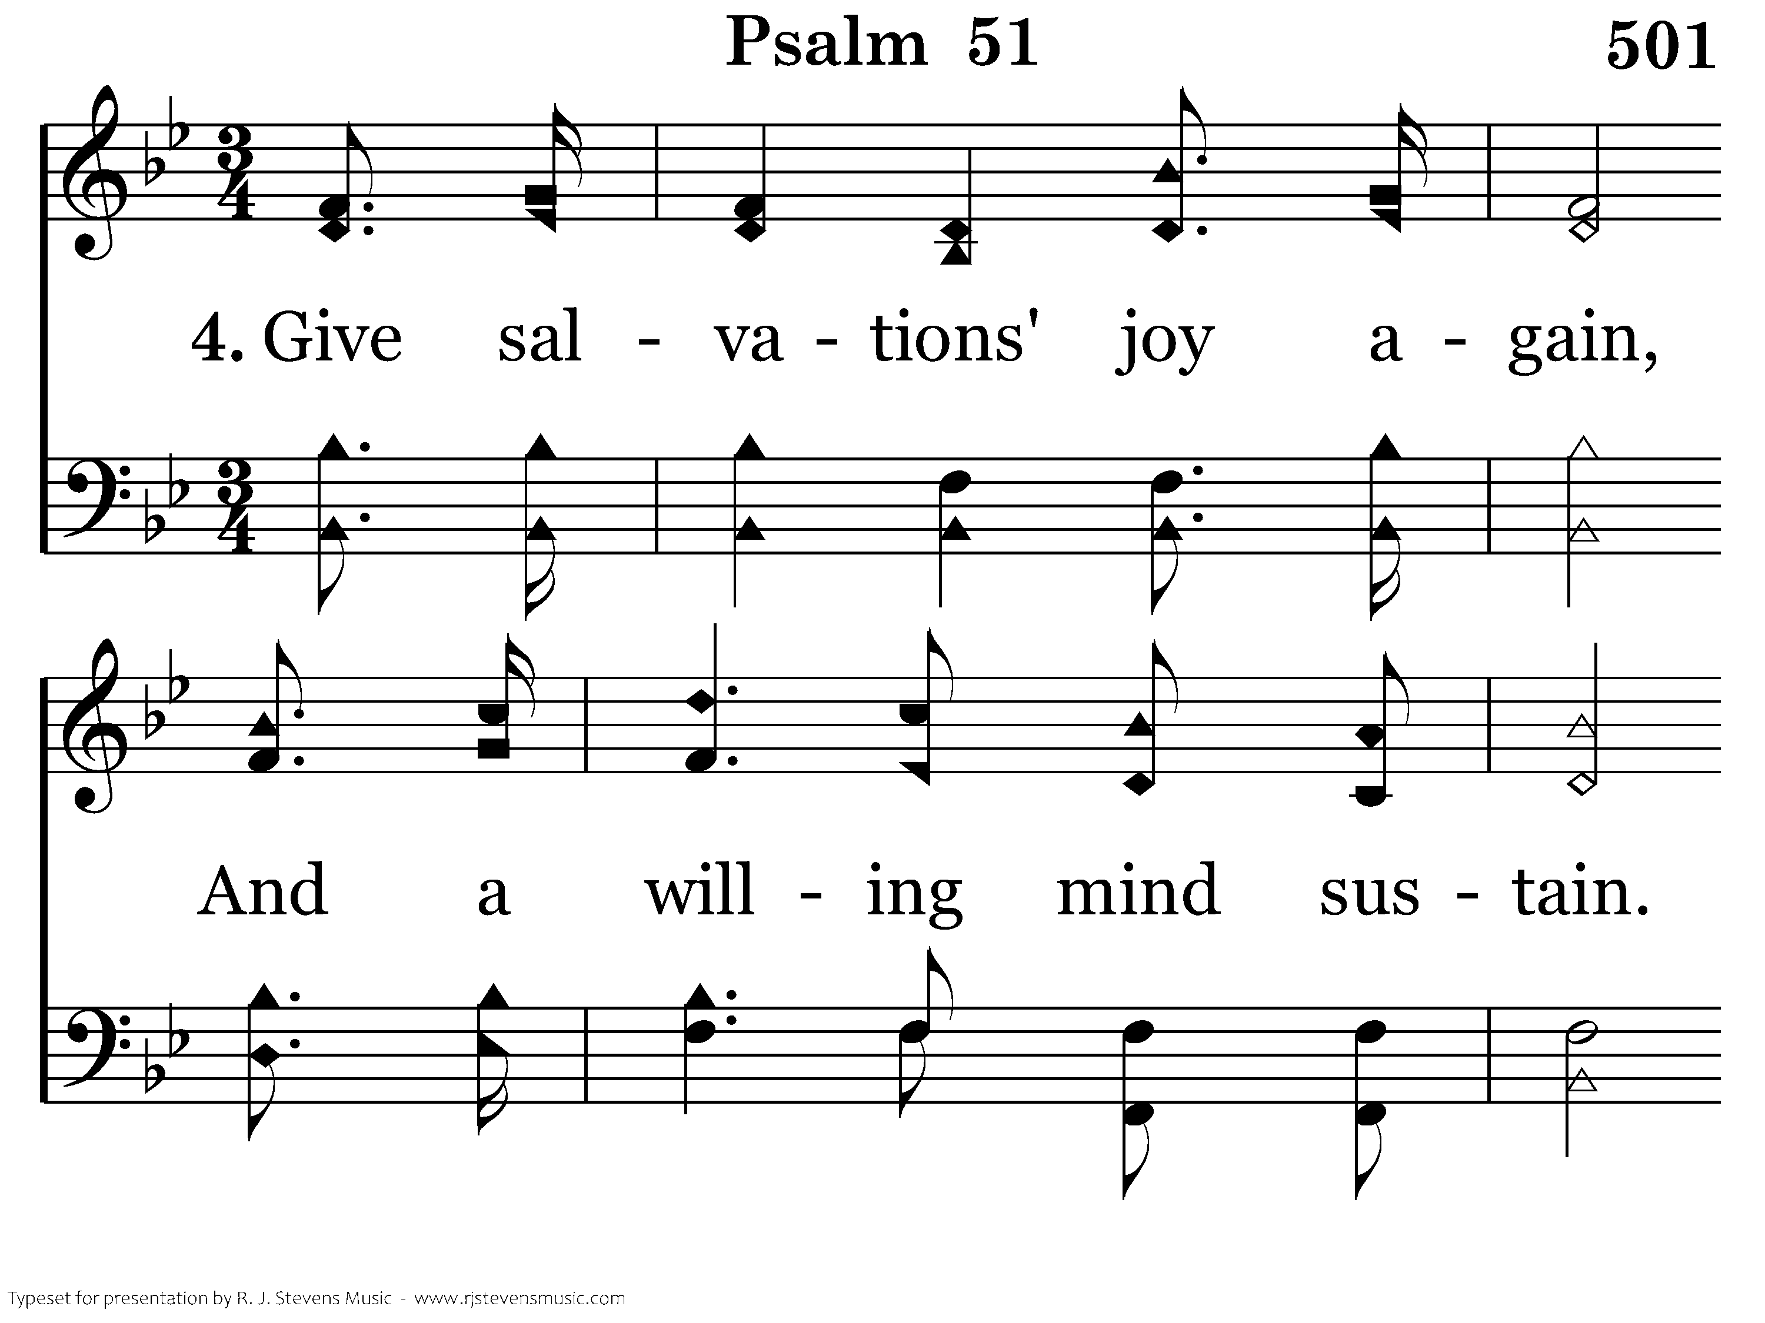
501 - Psalm 51 - 4.1

Slide 56
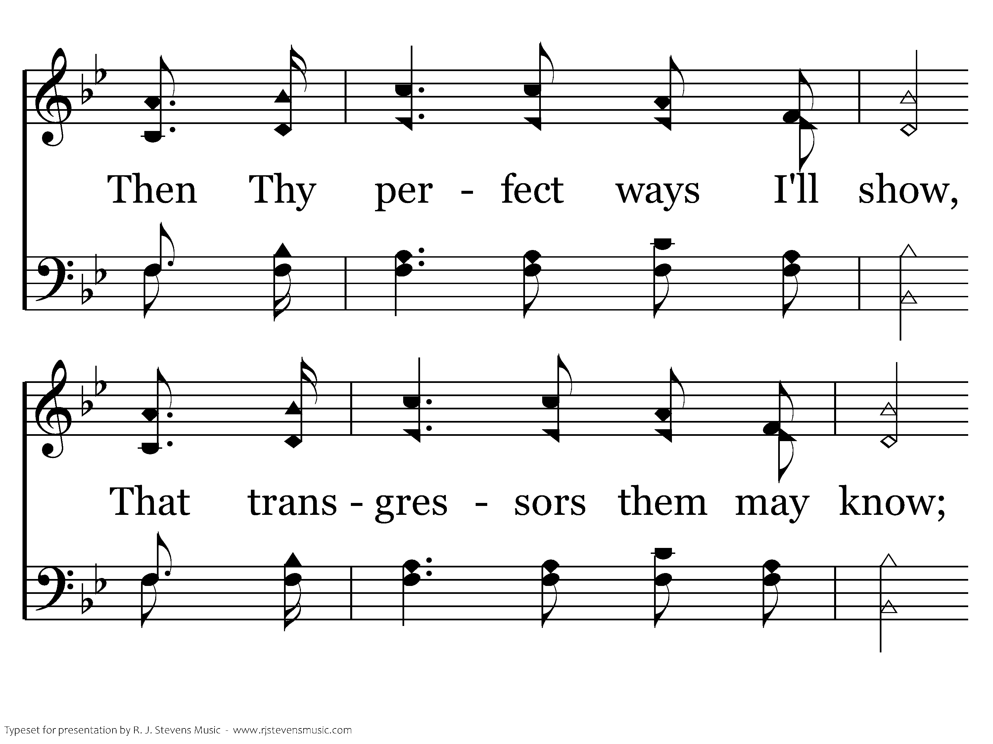
501 - Psalm 51 - 4.2

Slide 57
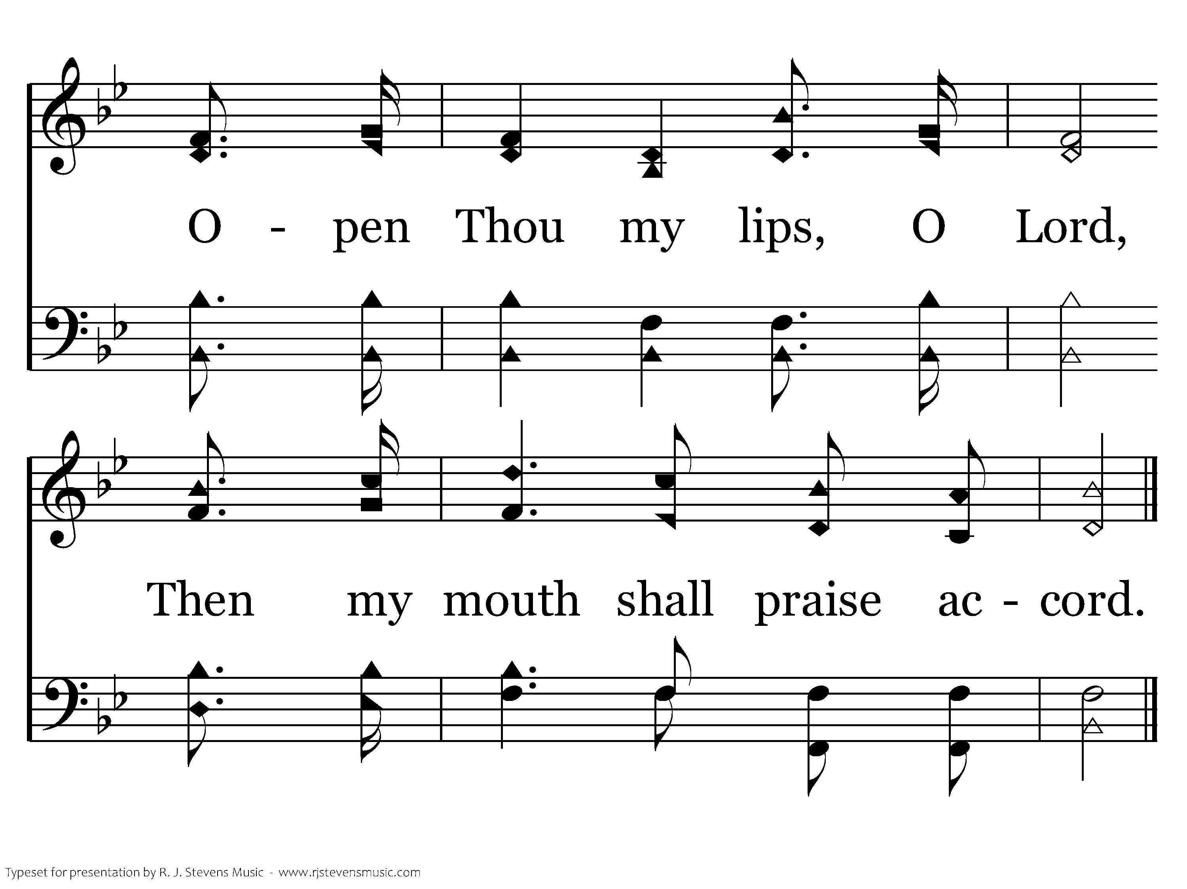
501 - Psalm 51 - 4.3
End of Song

Slide 58
Repentance/Penitent
Psalms
6, 32, 38, 51, 102, 130, 143

Slide 59
Pining?
Suffering with or longing for someone or something; failing gradually in health from grief, regret or longing

Slide 60
Psalm 6
How is David suffering?
pining away v2
bones dismayed v2
soul is greatly dismayed v3
weary with sighing v6
every night crying v6
eye wasted away with grief v7

Slide 61
Question:
How does sin/sinning negatively affect a believer?

Slide 62
Psalm 32
Sin and Silence 1-3
Contrition and Confession 4-6
Pardon and Peace 7-11

Slide 63
Psalm 51
Prayer of a Broken Heart
Prayer of Forgiveness 1-9
Prayer for Renewal 10-12
Prayer and Offering for Service 13-17

