Slide 2
Previously, on “A House For My Name”
Solomon became king & built the temple
Uninterrupted, untainted rise to power & honor
Uninterrupted, untainted connection between God & Solomon
God’s glorious presence dwells among his people like never before
Adding layers to the story:
Complications in Solomon’s early days
Amassing wealth and honor from other nations
Deepening connections around the world & with it

Slide 3
Reading Kings & Chronicles
Two books; two different purposes:
1-2 Kings recounts from Solomon to captivity. Royal failures abound. Desire for a Messiah who will heal the nation.
1-2 Chron. recounts the story of David’s Kingdom from Abrahamic genealogy to return from captivity. Royal failures exist, but are overcome by God’s unstoppable grace shown toward his people over the centuries.
Solomon’s story is wonderful and tragic, so that even he leaves us wishing for a Messiah.

Slide 4
Solomon Becomes King (1 Kings version)
1 Kings 1 – David’s strength is gone.
Another household rebellion requires someone else’s attention.
Bathsheba & Nathan bring about Solomon’s anointing.
Literary bookends:
“his kingdom was firmly established” (2:12)
-and-
“the kingdom was established in the hand of Solomon.” (2:46)
Starts off as an emergency political move.
Solomon’s first gracious act: let the insurrectionist live.
Passing the baton (1 Kings 2:1-12)
David’s main instruction: Walk faithfully with God (vv. 2-4)
Second instruction: Tie up loose ends from Absalom story
Why?
They are acts of divine blessing or divine vengeance to establish the “house for [David’s] name.”
Notes:
Emergency political move = very clever maneuvering. Adonijah is feasting within earshot of where David commands the coronation to take place.
Re: “…to establish ‘the house for David’s name’” —> you can tell from the rest of the long chapter that’s what this about.

Slide 5
Solomon Becomes King (1 Kings version)
“his kingdom was firmly established” (2:12)
Solidifying Solomon’s reign:
Solomon’s rebellious brother… killed.
The previous unfaithful high priest… deposed, then exiled.
David’s rebellious general… killed.
David’s enemy who cursed him when he was down… given a chance to live, but he squanders it and is killed.
“the kingdom was established in the hand of Solomon.” (2:46)

Slide 6
Solomon Becomes A Great King
Solomon’s ascent to greatness:
Wisdom that surpasses all others
A gift of divine origin and therefore superhuman ability
Solidified by the ruling between two prostitutes
Wisdom that is awe-inspiring.
Wisdom that is popular.
Wisdom that gives justice.
…to the mother, to the infant, and to the liar.
Notes:
The wisdom re: the decision between the two prostitutes is profound —> shows deep understanding of human nature, shows the value of human life, shows an almost-divine ability to predict human behavior without entirely predestining it.
justice — a concept that every people aspires to, but which YHWH God is particularly attached to (because it is an extension of his own nature). Solomon's ruling here is not just a lesser-of-two-evils kind of thing — it's a matter of life-preserving-good-and-evil.

Slide 7
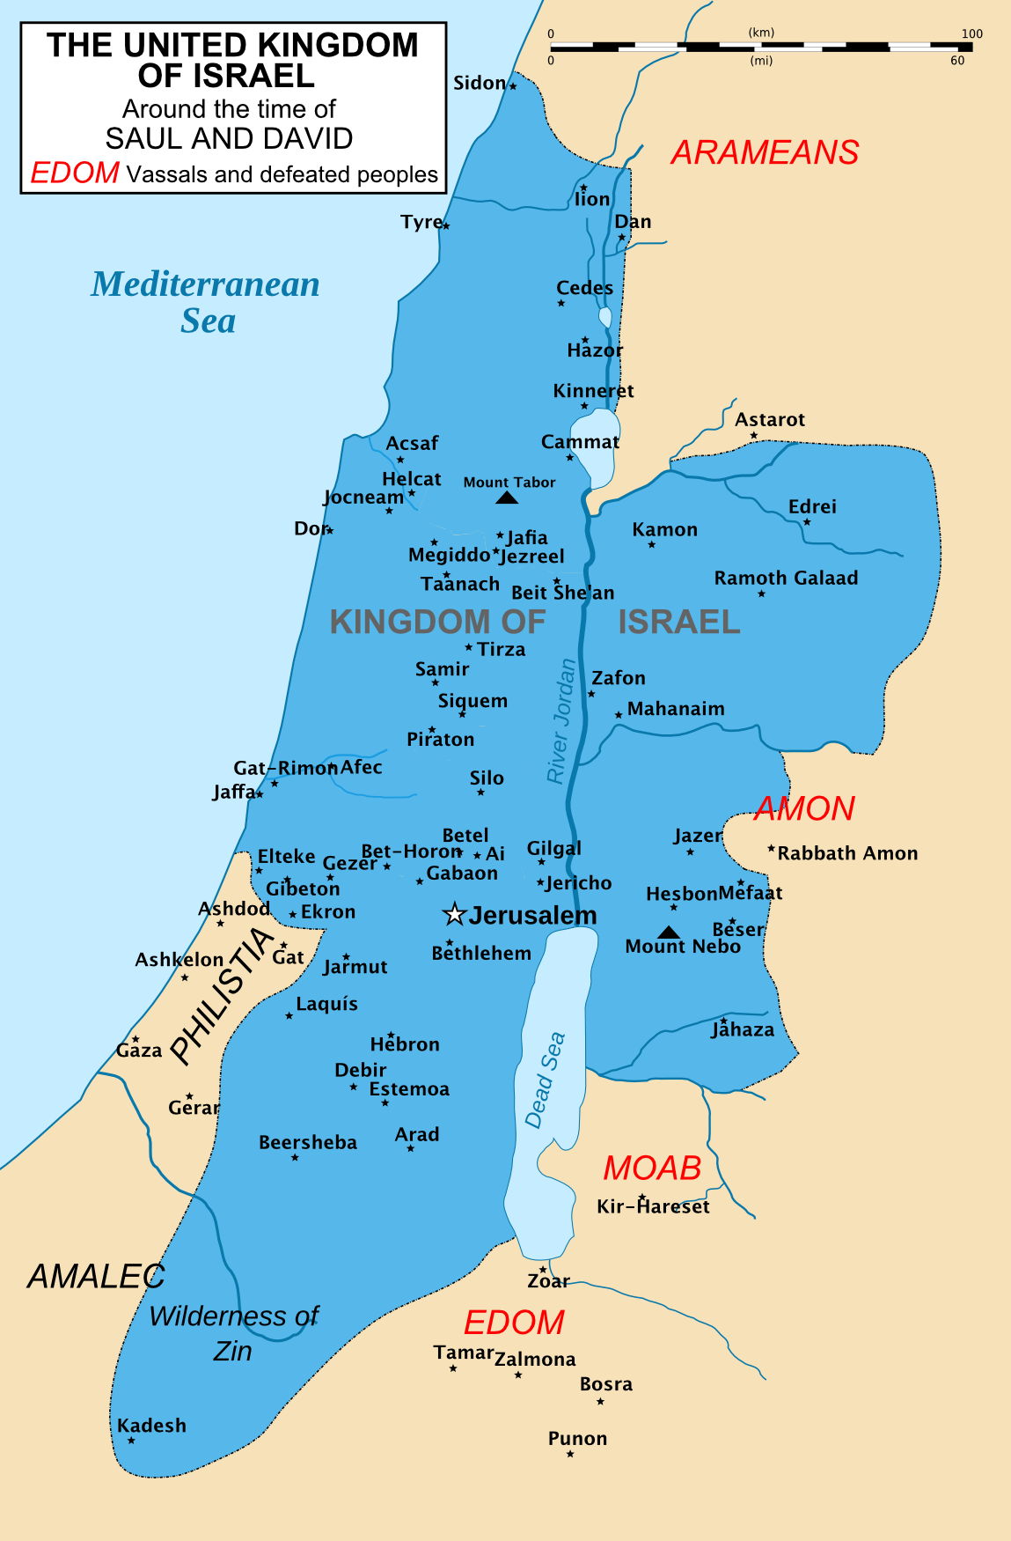
Solomon Becomes A Great King
Solomon’s ascent to greatness:
Israel’s borders expand in Solomon’s reign
The happiness of Solomon’s people repeated (4:20, 10:8, 2Chr 9:7)
Language of fulfilled promises:
“as many as the sand by the sea” (4:20), etc…
Solomon’s intellect spans vastly varied disciplines:
People & psychology
Horticulture & biology
Proverbs & poetry
Politics

Slide 8
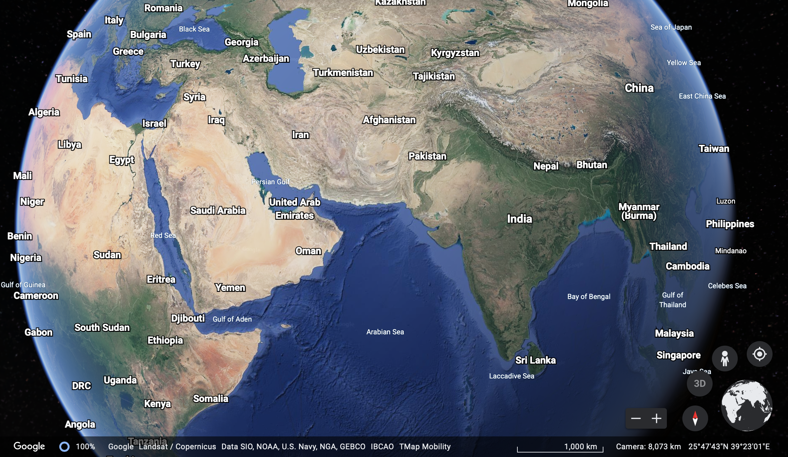
Solomon Becomes A Great King
Solomon’s ascent to greatness:
Israel’s prominence increases during his reign.
Gentiles learn from him, bring him abundant gifts.
The land is filled with wealth:
Silver so common it is devalued.
Mind-boggling amounts of gold
Precious stones used in the palace foundations
Spices, gold, and exotice animals all the way from India and Indonesia

Slide 9
Solomon Becomes A Great King
Solomon’s ascent to greatness:
The visit from Queen of the South:
Sought his wisdom – found it all as she’d been told.
Even with her own wealthy, powerful status… amazed by King Solomon’s status.
“I did not believe the reports, but what they described was less than half the truth of all this greatness!”

Slide 10
Solomon Becomes A Great King
Solomon’s wealth and prominence, in theological terms:
Descriptors of his greatness:
Precious stones & abundant gold
EDEN
Wood, fruit, and spices from many kinds of trees & plants
Solomon & his people eat from lavish abundance
Solomon exercises dominion over land, beast, and man
Solomon cares about (tends) the plants around him
Animals of all types brought into Solomon’s presence
They dwell in the presence of YHWH
Solomon knows good & evil better than any other creature

Slide 11
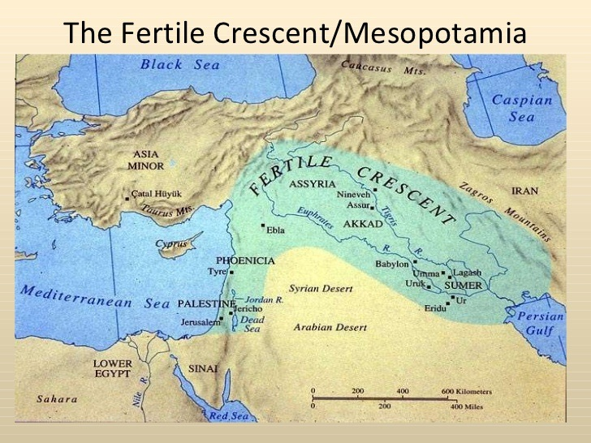
Solomon Becomes A Great King
Solomon’s wealth and prominence, in theological terms:
The presence of so many Gentiles in the story – Good or bad?
Good! Beginning to reverse the disaster at the Tower of Babylon (Babel)
When God’s people are the influence on the Gentiles, it’s good for them to be in proximity.
It all falls apart when the influence is allowed to flow in the other direction.
Notes:
This = the same thing that will happen on the Day of Pentecost, albeit even more powerful an event then!

Slide 12
Solomon Becomes A Great King
Solomon’s wealth and prominence, in theological terms:
The presence of so many Gentiles in the story – Good or bad?
Good! Beginning to reverse the disaster at the Tower of Babylon (Babel)
Is God blessing Solomon because he’s morally perfect?
No. Marriage to Pharaoh’s daughter is forbidden, and so are the multitude of chariots and horses (cf. Dt. 17:14-20).
But he is devoted to YHWH alone.
Doesn’t serve God perfectly, but serves Him exclusively.
Notes:
It’s easy to confuse Solomon’s wisdom with good moral behavior and faithfulness of heart… They’re not the same thing.

