Slide 1
Introduction in Studying the Psalms

Slide 2
Come, let us worship and bow down,
Let us kneel before the Lord our Maker.
For He is our God, and we are the people of His pasture and the sheep of His hand.
Psalms 95:6-7

Slide 3
What do you know
about the book of Psalms?

Slide 4
Purpose of our study in the Psalter
It’s in God’s word
II Tim 2:15
II Pet 3:18
To know Him, to please Him
How the Psalter relates to the O.T. and N.T.
Enhance and deepen our prayers and singing

Slide 5
Class Goals/Outcomes
What is a Psalm
Types of Psalms
Characteristics of Psalter
Authors, Dates
Arrangement – Division
Insights to David (a man after Gods own heart)
Share favorite Psalms/Verses – (tell why)
Study – Apply – Teach (Ezra 7:10)

Slide 6
What is a Psalm?

Slide 7
Types of Psalms
Praise
Guidance
Messianic
Instructional
Nature
Repentance
Kingship
Imprecatory

Slide 8
I will give thanks to You, for I am fearfully and wonderfully made; Wonderful are Your works, and my soul knows it very well
Psalms 139:14

Slide 9
“to appreciate the Psalms, one must enter into and share the spirit of the Psalmist”
--Homer Hailey

Slide 10
Let me ask, how do we do that? How does one enter and share the spirit of the Psalmist?
Read/Meditate on Gods word
Ask for the Holy Spirit to guide us
We pray for wisdom
We spend lots of time in Psalms everyday
We pray like the Psalmist
We look to the Psalms for guidance, encouragement
We praise joyfully
We open ourselves up fully, we confess everything
We study the language, poetry structure
We learn more about David's life
We learn more about Israel's history
We learn more about context regarding Psalms
We bring the Psalms into our daily living and conversations
We memorize Psalms

Slide 11
Lifestyle of Worship
from David
A lifestyle of worship requires total confidence in God
A lifestyle of worship emanates from a submissive spirit
A lifestyle of worship emanates from courageous faith
A lifestyle of worship emanates from a raw passion of God
A lifestyle of worship emanates a contrite heart
“True worship manifests itself in action and
emanates from a heart for God”
-Wiersbe

Slide 12
Psalm100
Lord We Come Before Thee Now

Slide 13
Enter His gates with thanksgiving, and His courts with praise. Give thanks to Him; bless His name. For the Lord is good; His lovingkindness is everlasting And His faithfulness to all generations.
Psalm 100:4-5

Slide 14
O Lord, my heart is not proud, nor my eyes haughty; nor do I involve myself in great matters, or in things too difficult for me. Surely I have composed and quieted my soul; Like a weaned child rests against his mother, My soul is like a weaned child within me. Oh Israel, hope in the Lord from this time forth and forever.
Psalm 131

Slide 15
Effective Study in Psalms
Principal 1: Determine Who Is Speaking
Principal 2: Determine if the Psalm is Personal or Corporate
Principal 3: Determine for What Purpose the Psalm was Written
Principal 4: Determine the Emotional Orientation of the Psalm
Principal 5: Determine the Genre of the Psalm if Possible
Principal 6: Determine if There is a Refrain or Recurring Words and Phrases

Slide 16
5 Books of the Psalms
Book I Ps 1-41
Book II Ps 42-72
Book III Ps 73-89
Book IV Ps 90-106
Book V Ps 107-150
Genesis
Exodus
Leviticus
Numbers
Deuteronomy

Slide 17
Authors / Dates

Slide 18
Authors of Psalms
David 73 + 2
Asaph 12 (50,73-83)
Sons of Korah 10 (42,44-49,84-85,87-88)
Solomon 2 (72,127)
Ethan 1 (89)
Moses 1 (90)
Heman 1 (88)
Anonymous 50 (approximately)

Slide 19
Dating the Psalms
Ps 90 Moses
Ps 126 Captivity/Release
Ps 137 Solomon
Earliest – 3,500 years ago
Latest – 2,500 years ago
Time Span of 1,000 years

Slide 20
Make me know Your ways, O Lord; Teach me Your paths. Lead me in Your truth and teach me, For You are the God of my salvation; For you I wait all the day.
Psalm 25:4-5

Slide 21
The Lord is my shepherd,
I shall not want.
Psalm 23:1

Slide 22
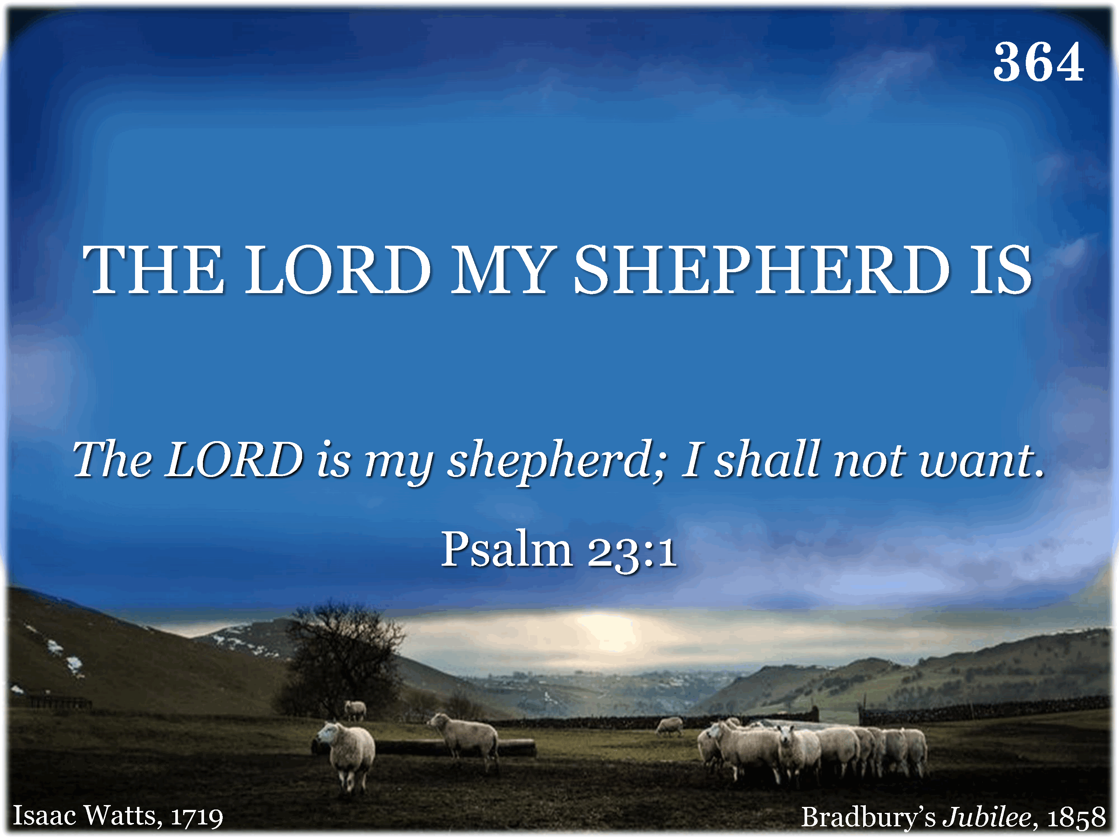
364 - The Lord My Shepherd Is - Title

Slide 23
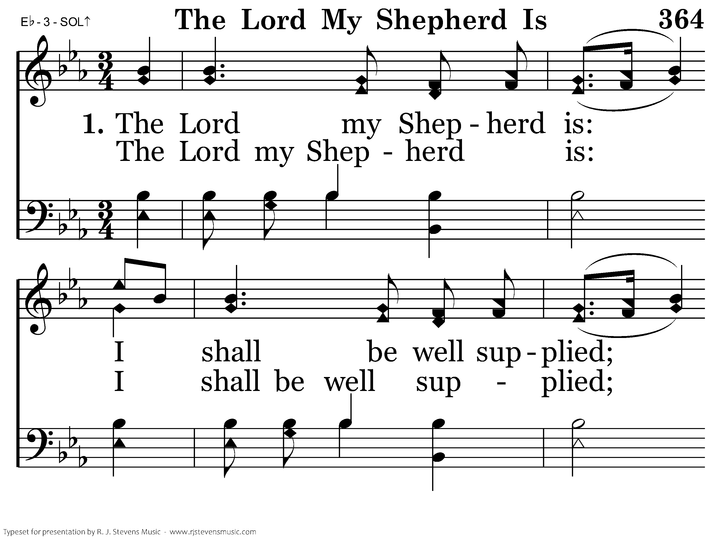
364 - The Lord My Shepherd Is - 1.1

Slide 24
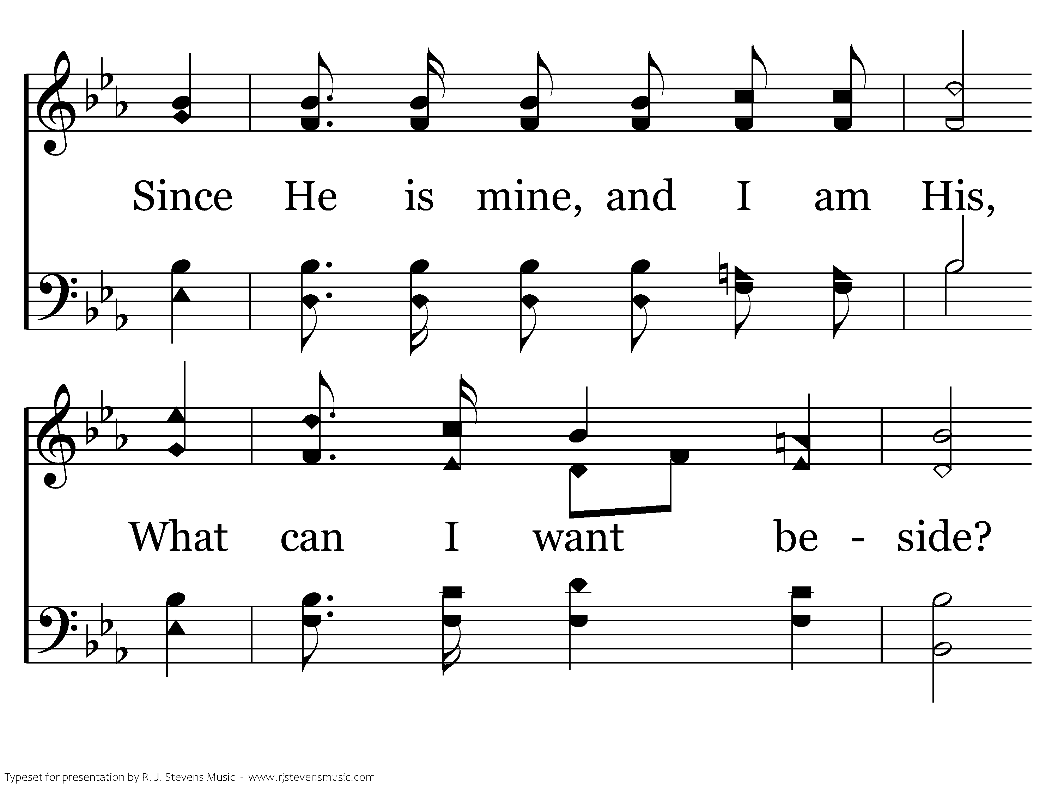
364 - The Lord My Shepherd Is - 1.2

Slide 25
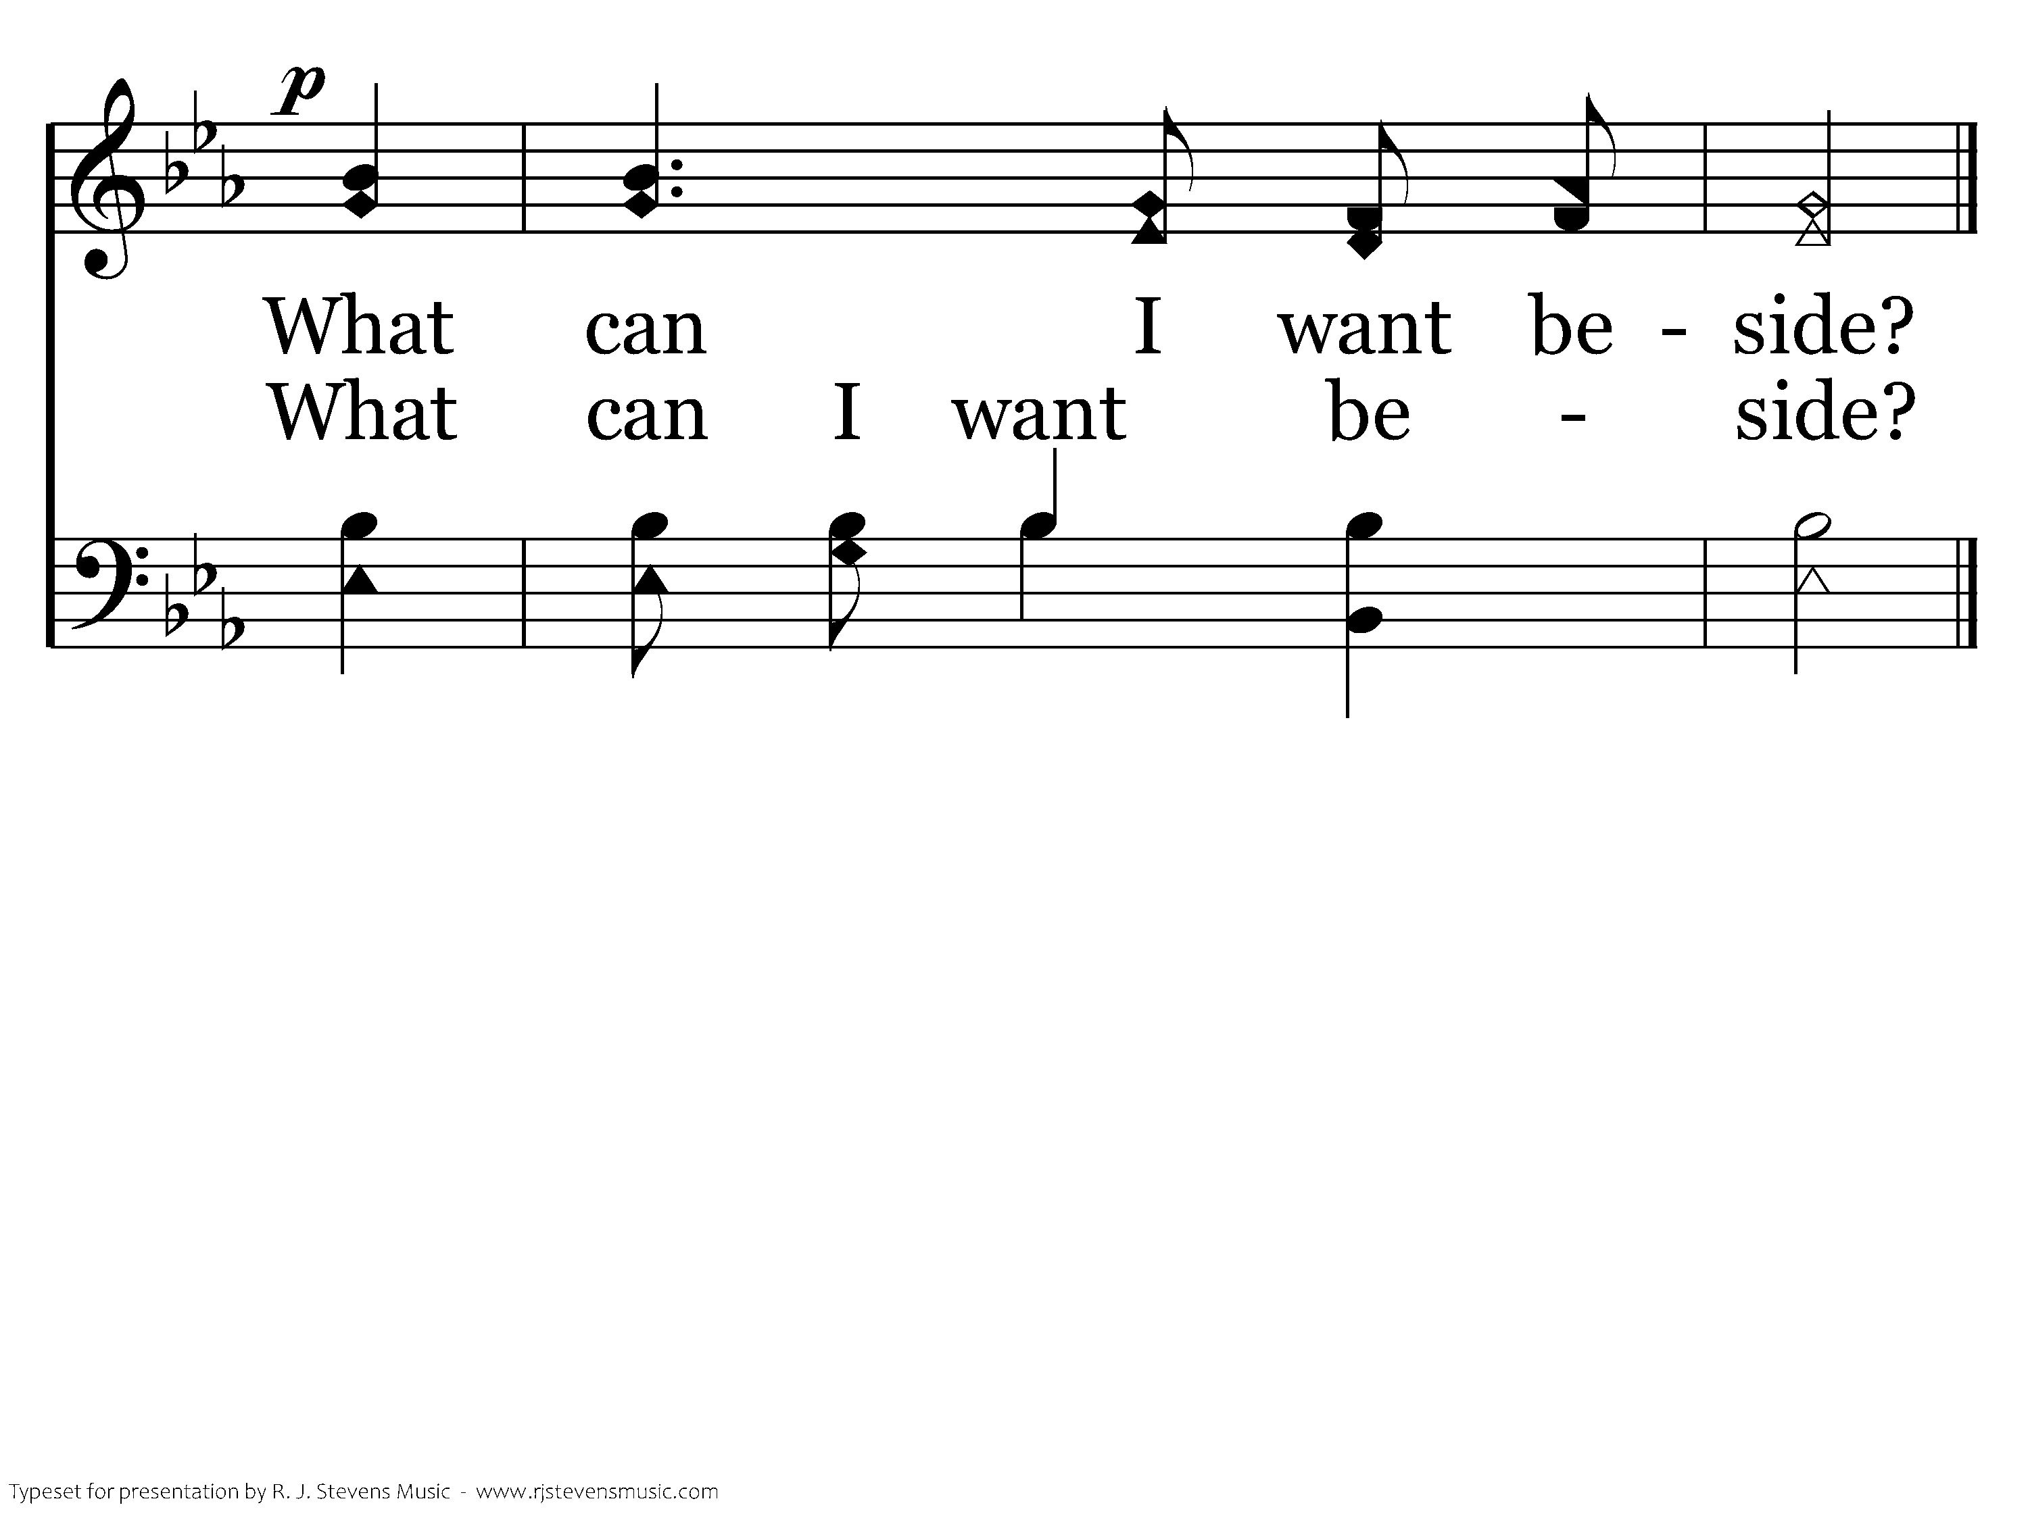
364 - The Lord My Shepherd Is - 1.3
End of Verse 1

Slide 26
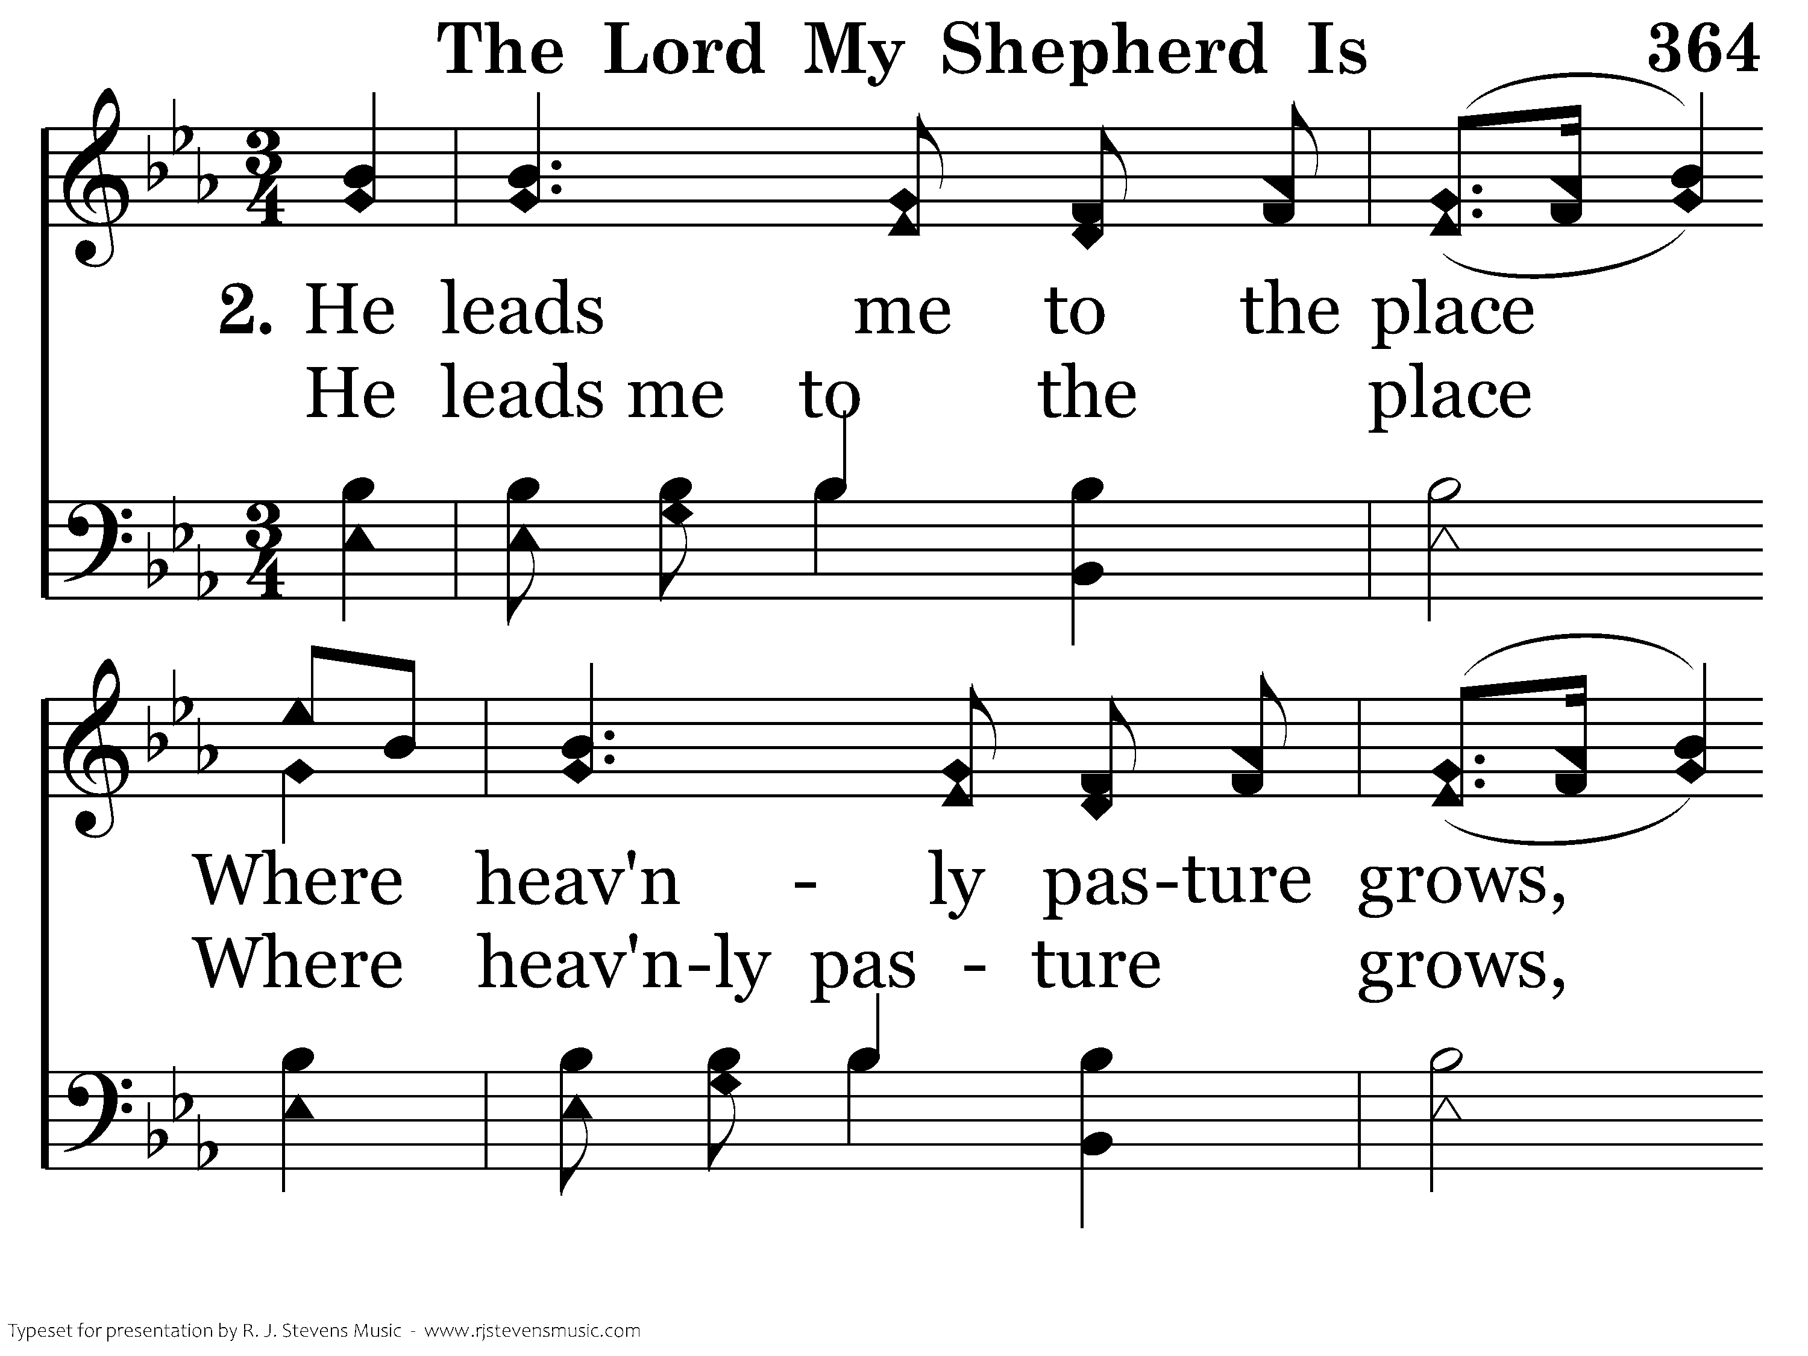
364 - The Lord My Shepherd Is - 2.1

Slide 27
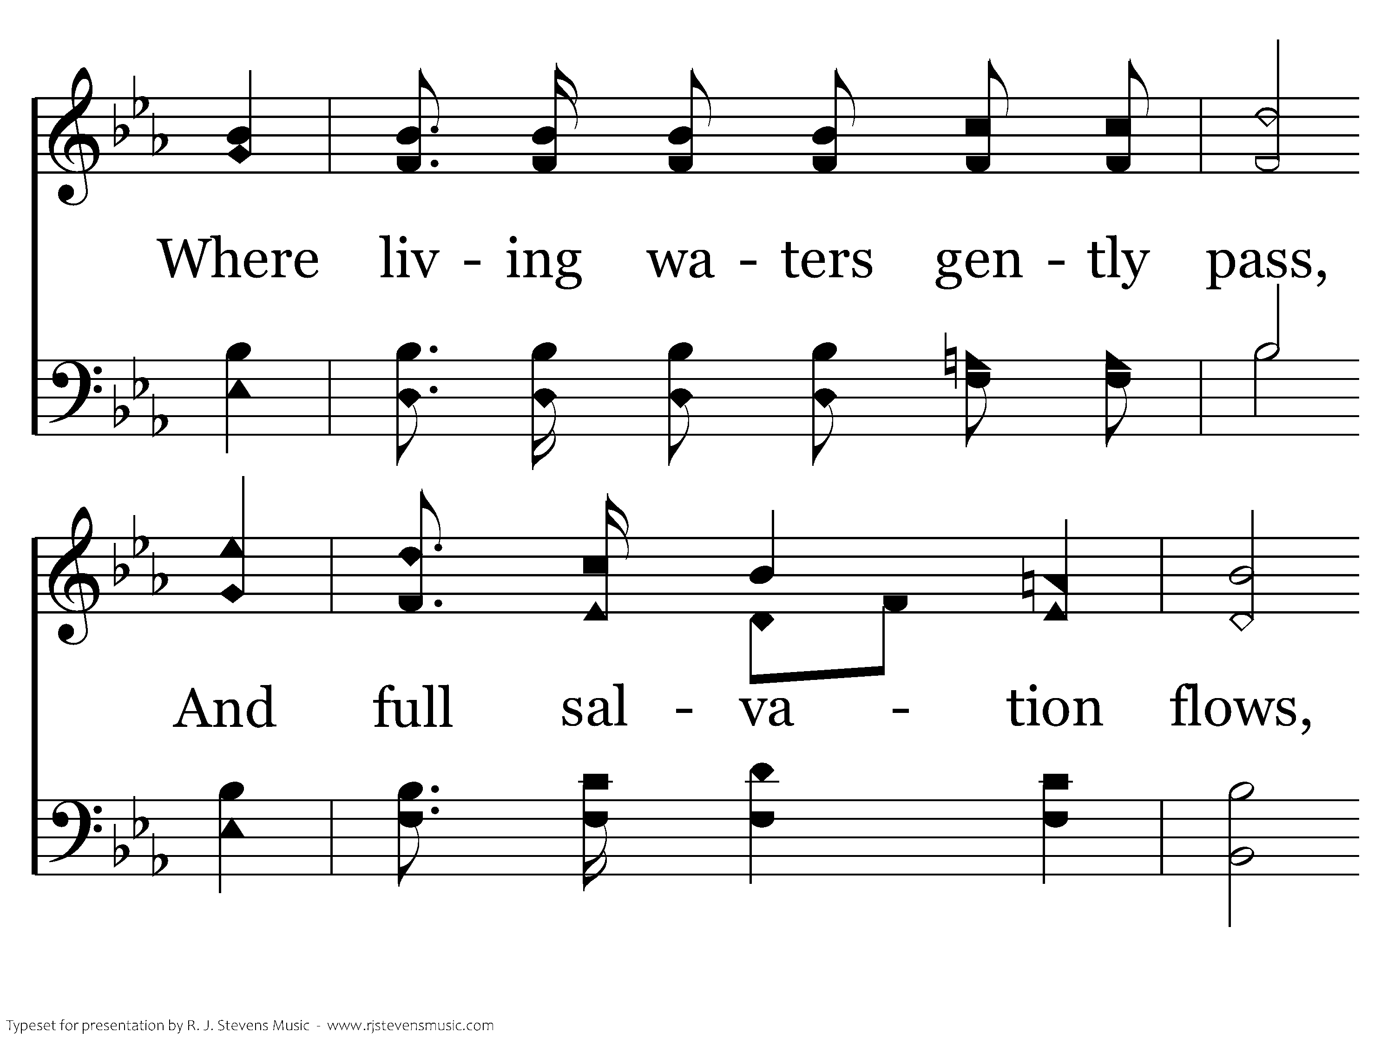
364 - The Lord My Shepherd Is - 2.2

Slide 28
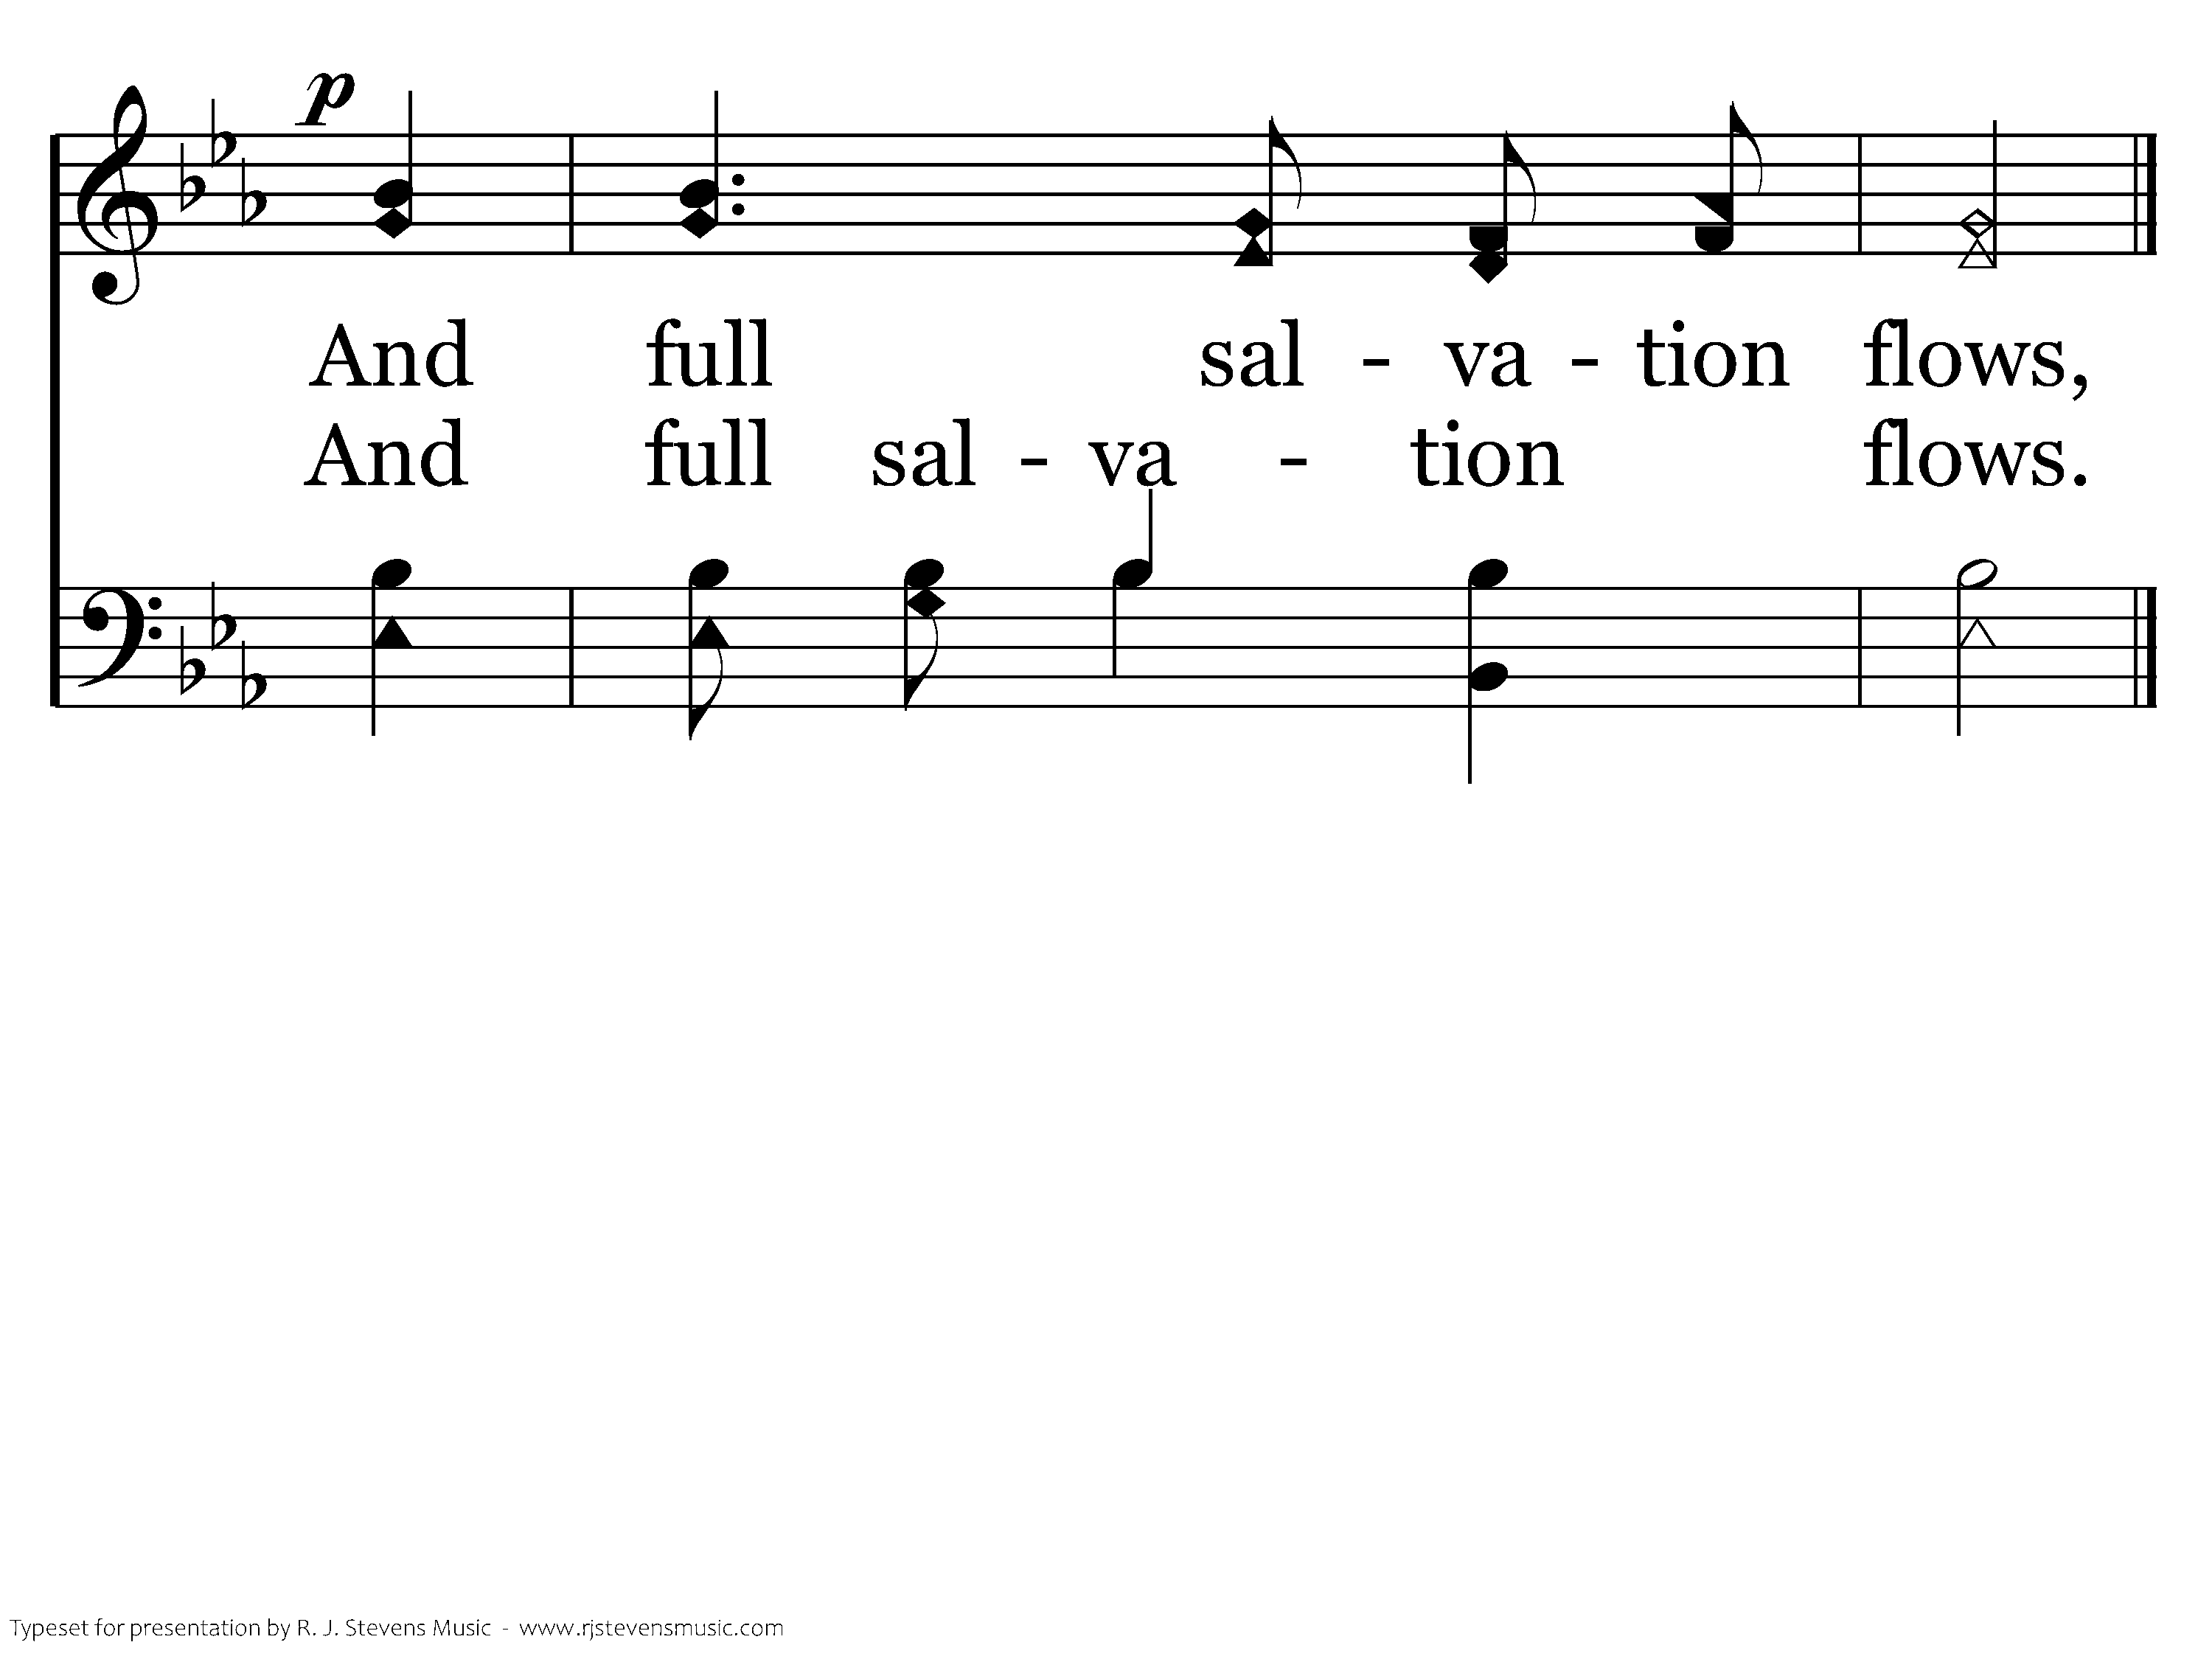
364 - The Lord My Shepherd Is - 2.3
End of Verse 2

Slide 29
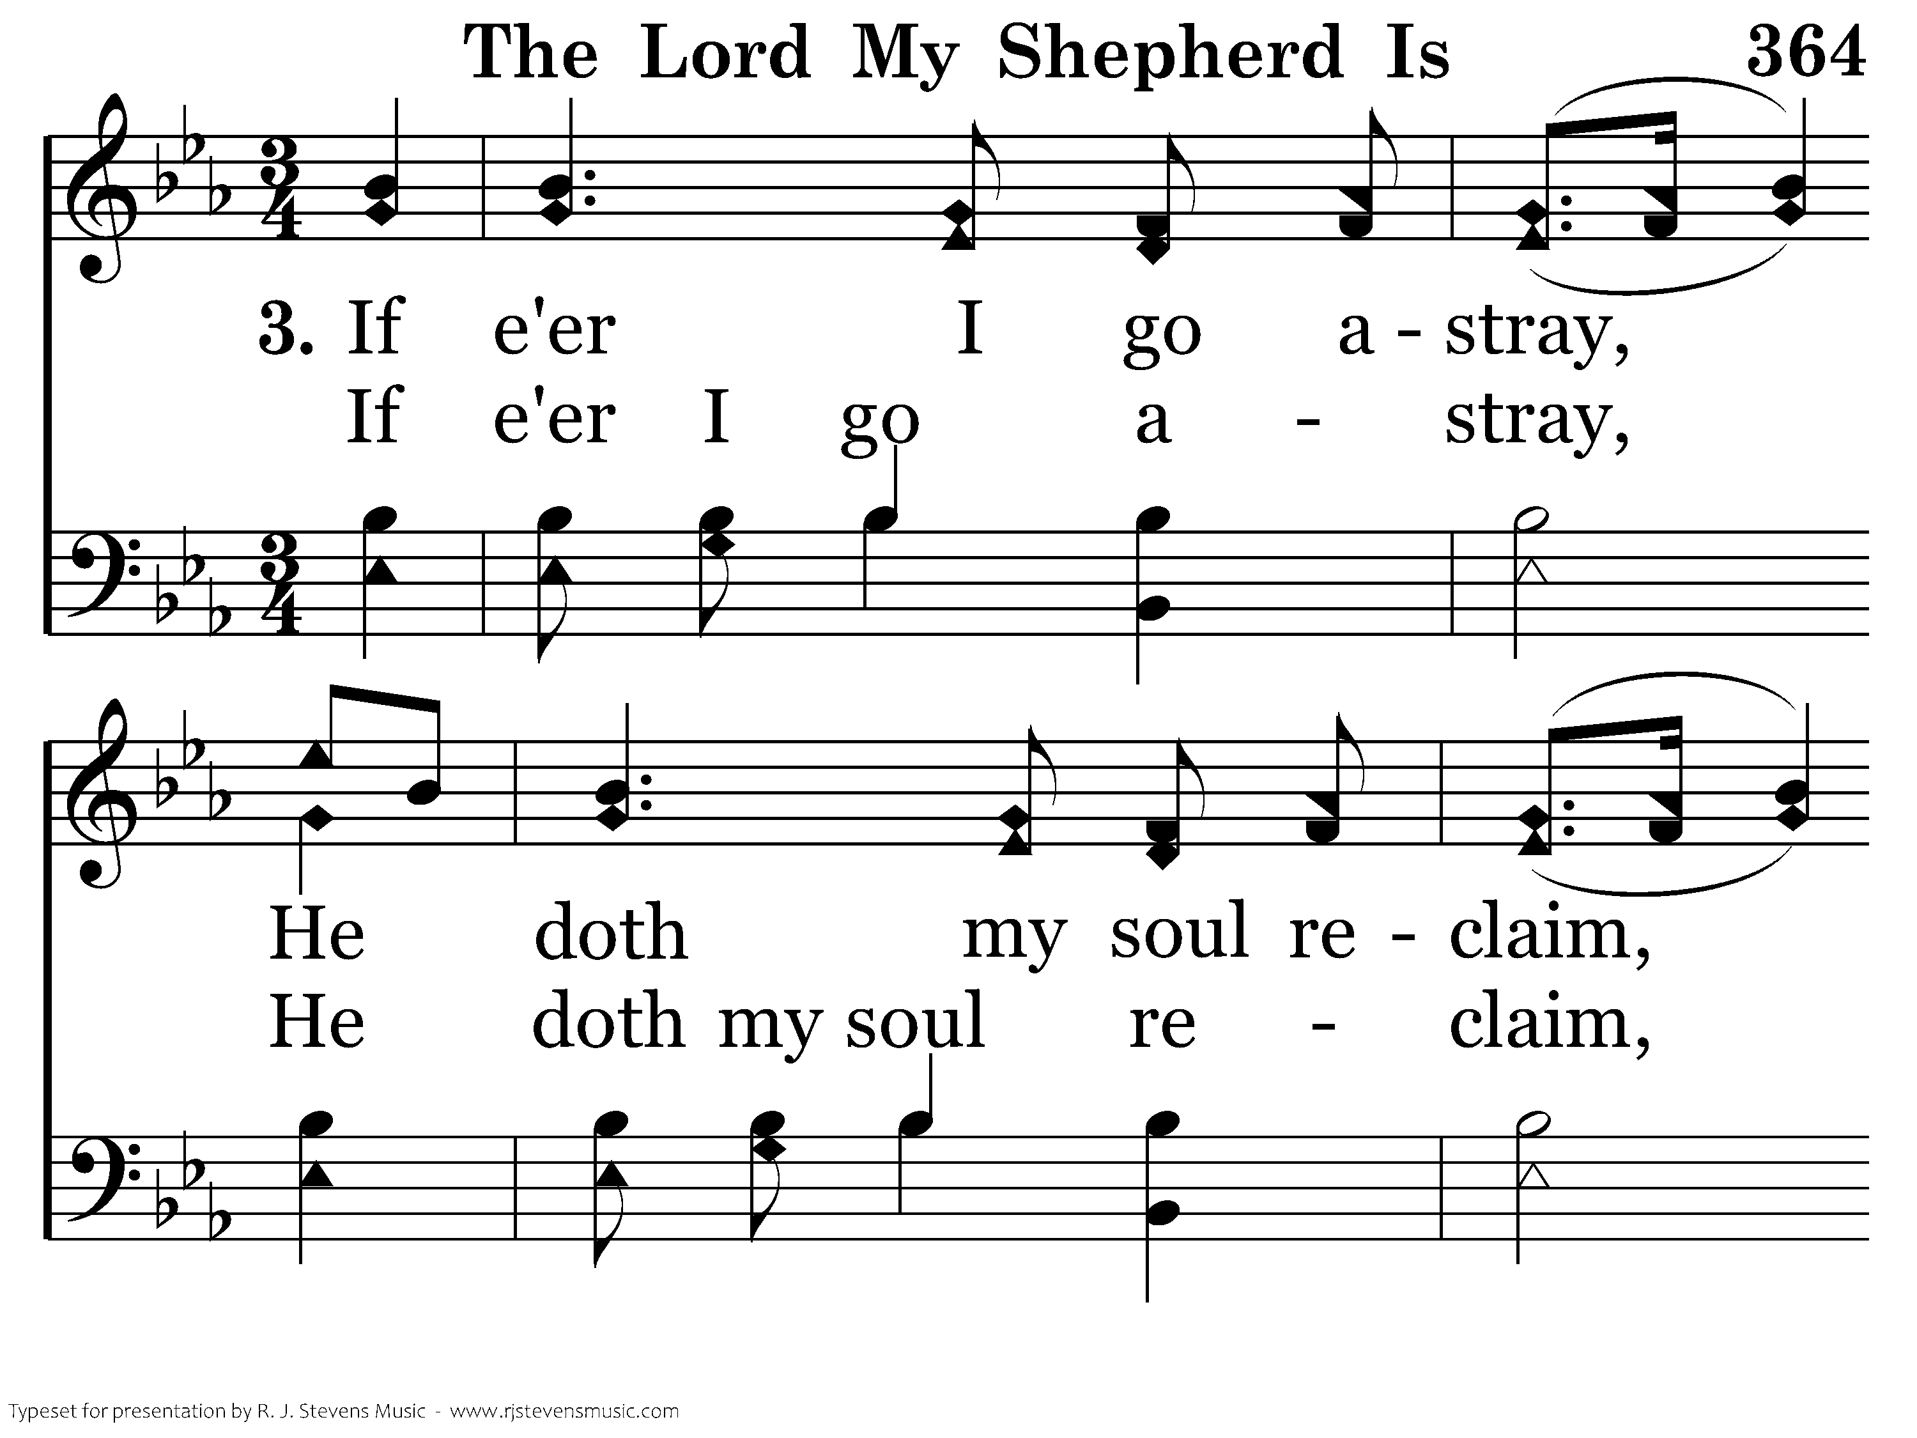
364 - The Lord My Shepherd Is - 3.1

Slide 30
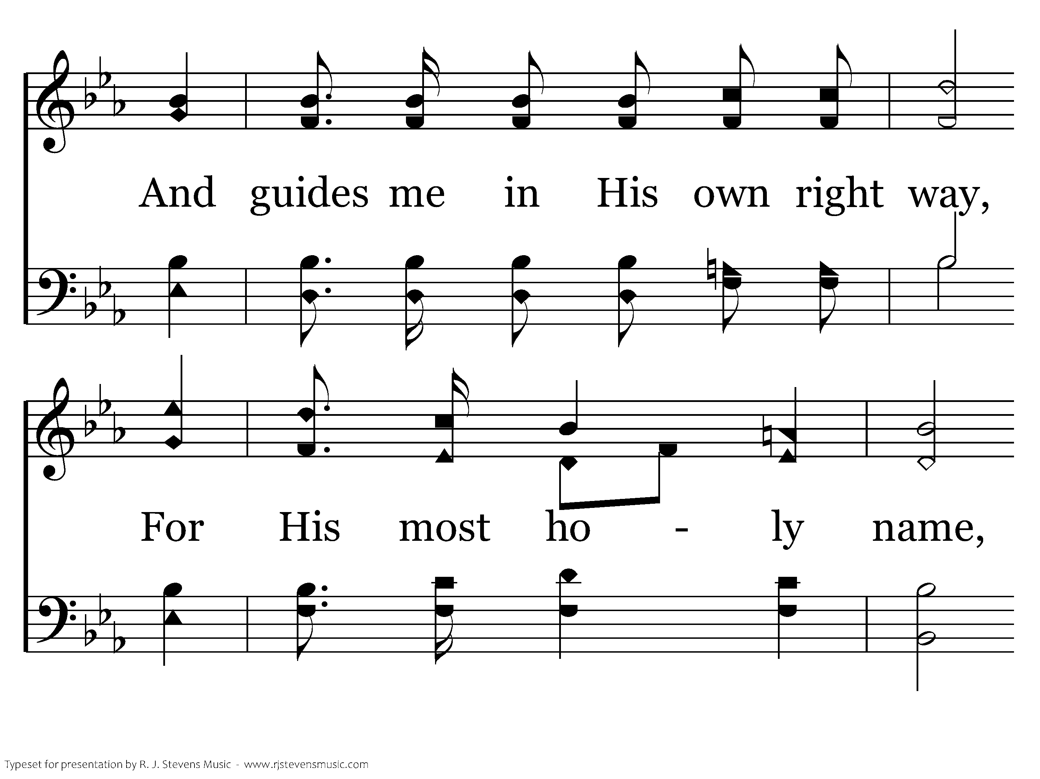
364 - The Lord My Shepherd Is - 3.2

Slide 31
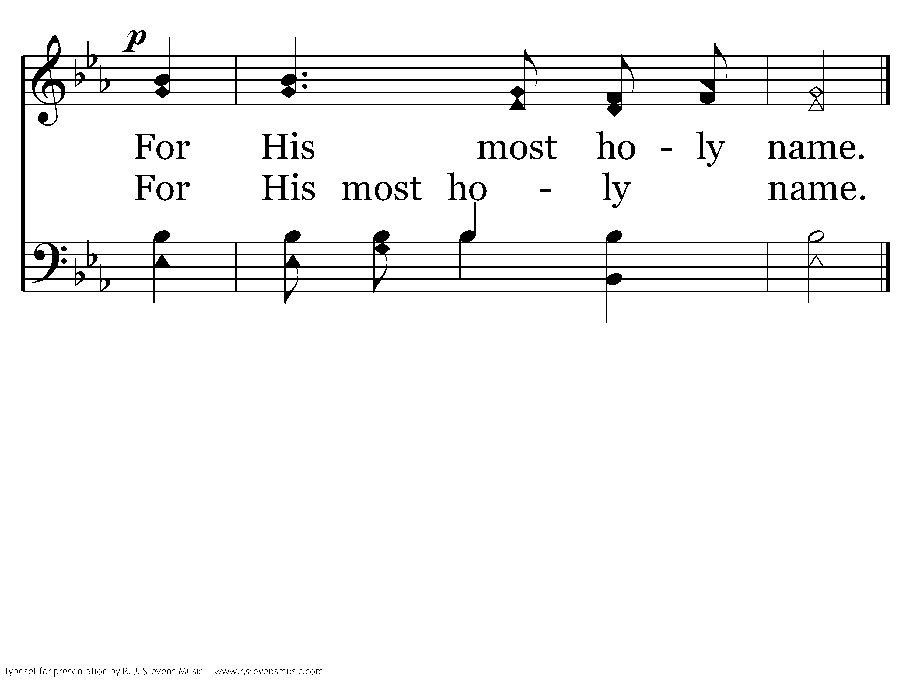
364 - The Lord My Shepherd Is - 3.3
End of Song

Slide 32
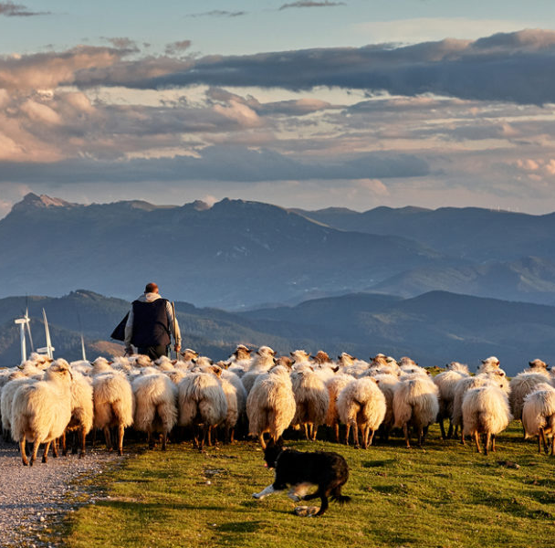

Slide 33
Lament Psalms
Invocation (vs 1)
Plea for help (vs 1,16-19)
Complaints (vs 1-4,20,21)
Confession (vs 5-12)
Imprecation (vs 20-28)
Expression of confidence (vs 13-15)
Hymn (vs 30-36)
Psalm 69
Messianic / Imprecatory

Slide 34
Lament Psalms
3 Types of Complaints
Psalmist is troubled by his own thoughts and actions
He complains about the actions of others against him (enemies)
He may be frustrated at God
Psalms 42,43

Slide 35
Titles / Superscriptions
Author
Historical Occasion
Melody
Type/Genre
Instruments

Slide 36
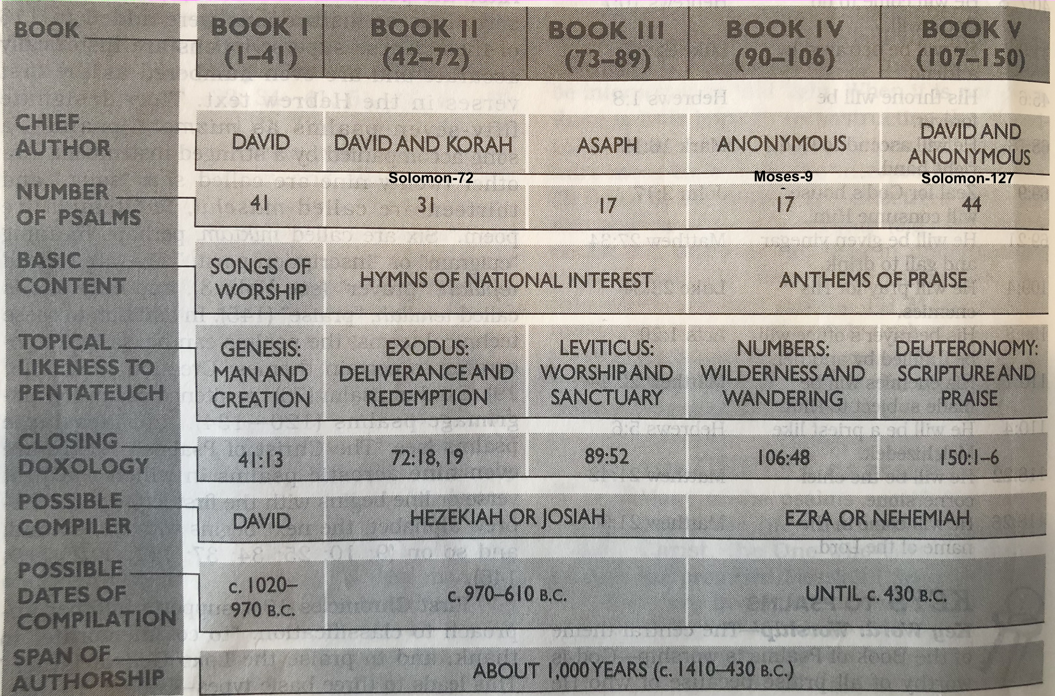

Slide 37
Resources
Bible – God
Psalms By the Day – Alec Motyer
How to Read the Psalms – Tramper Longman III
Studying the Psalms – Gene Taylor
Psalms – Derek Kidner
Studies in the Psalms – Essays from Florida
All the Prayers of the Bible – Herbert Lockyer
Give Us a King – Bob and Sandra Waldron
Be Worshipful – Warren E Wiersbe
Encountering Psalms – C. Hassell Bullock

