Slide 2
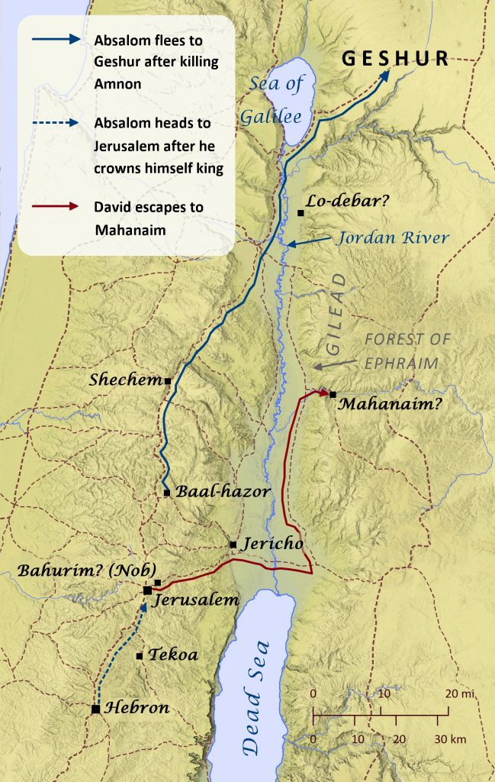
The King’s Friends & Frenemies
2 Sam. 19:16-43 – interactions as David returns home
A repentant enemy. (Shimei – cf. 16:5-14)
A friend who was slandered. (Mephibosheth – cf. 16:1-4)
A friend who offered aid. (Barzillai – cf. 17:27-29)
A pre-divided, argumentative kingdom. (Israel v. Judah)
David’s responses: Gracious, but wearied.

Slide 3
Blood On His Hands
2 Sam. 20 – Joab fights for David
A rebellion against David begins, attempting to capitalize on his perceived weakness.
One of David’s servants fails to do as commanded.
Joab steps in:
Punishes David’s disobedient servant.
Sieges the hideout of David’s rebellious enemy, until the citizens hand over his severed head.

Slide 4
Saul’s Still David’s Problem
2 Sam. 21:1-14 – Innocent blood cries out; David answers
Divine punishment in effect for Saul’s past violence
David rectifies the innocent bloodshed, fulfills Torah requirements (cf. Num. 35:30-34)
After justice for the murdered innocents, David further honors Saul’s & Jonathan’s deaths (cf. 2 Sam. 1:17-27).
Notes:
“innocent blood” – a reference to Abel’s blood “crying to me from the ground.” (Gen. 4:10)

Slide 5
The Lord Defeats His Enemies
Two connected chapters:
Israelites defeating Canaan’s giants (21:15-22)
“These were descended from the giants in Gath, and they fell by the hand of David and by the hand of his servants.”
- 2 Samuel 21:22 -
David’s kingdom fulfills Israel’s old command to conquer the land from “giants” (cf. Num. 13:33)

Slide 6
The Lord Defeats His Enemies
Two connected chapters:
Israelites defeating Canaan’s giants (21:15-22)
A song to praise God for deliverance (22:1-51)
Deliverance takes many forms: David’s safety, Israel’s history, military battles, and politics.
A summary of the whole book of Samuel [the story of God exalting the house of David].
A concluding accompaniment to Hannah’s poem at the beginning of the story (1 Sam. 2:1-10)

Slide 7
David’s Greatest Soldiers
2 Samuel 23:8-39
Three champions: Josheb-Basshebeth, Eleazer, and Shammah
Great warriors in Israel’s battles.
Faithful servants to David himself (vv. 15-17).
The rest: Battle heroes who fought for God’s glory & God’s people..
Noteworthy among the group: Uriah The Hittite

Slide 8
David’s Sin & Repentance
2 Sam. 24, 1 Chron. 21
The big question: What’s wrong with a census?
Answer: David trusts in armies more than in God.
verse 3 – Joab’s response, essentially: “The numbers are irrelevant [implied: because God is on our side].”
David’s response:
1) Repent (v. 8)
2) Put his trust in God (v. 13)

Slide 9
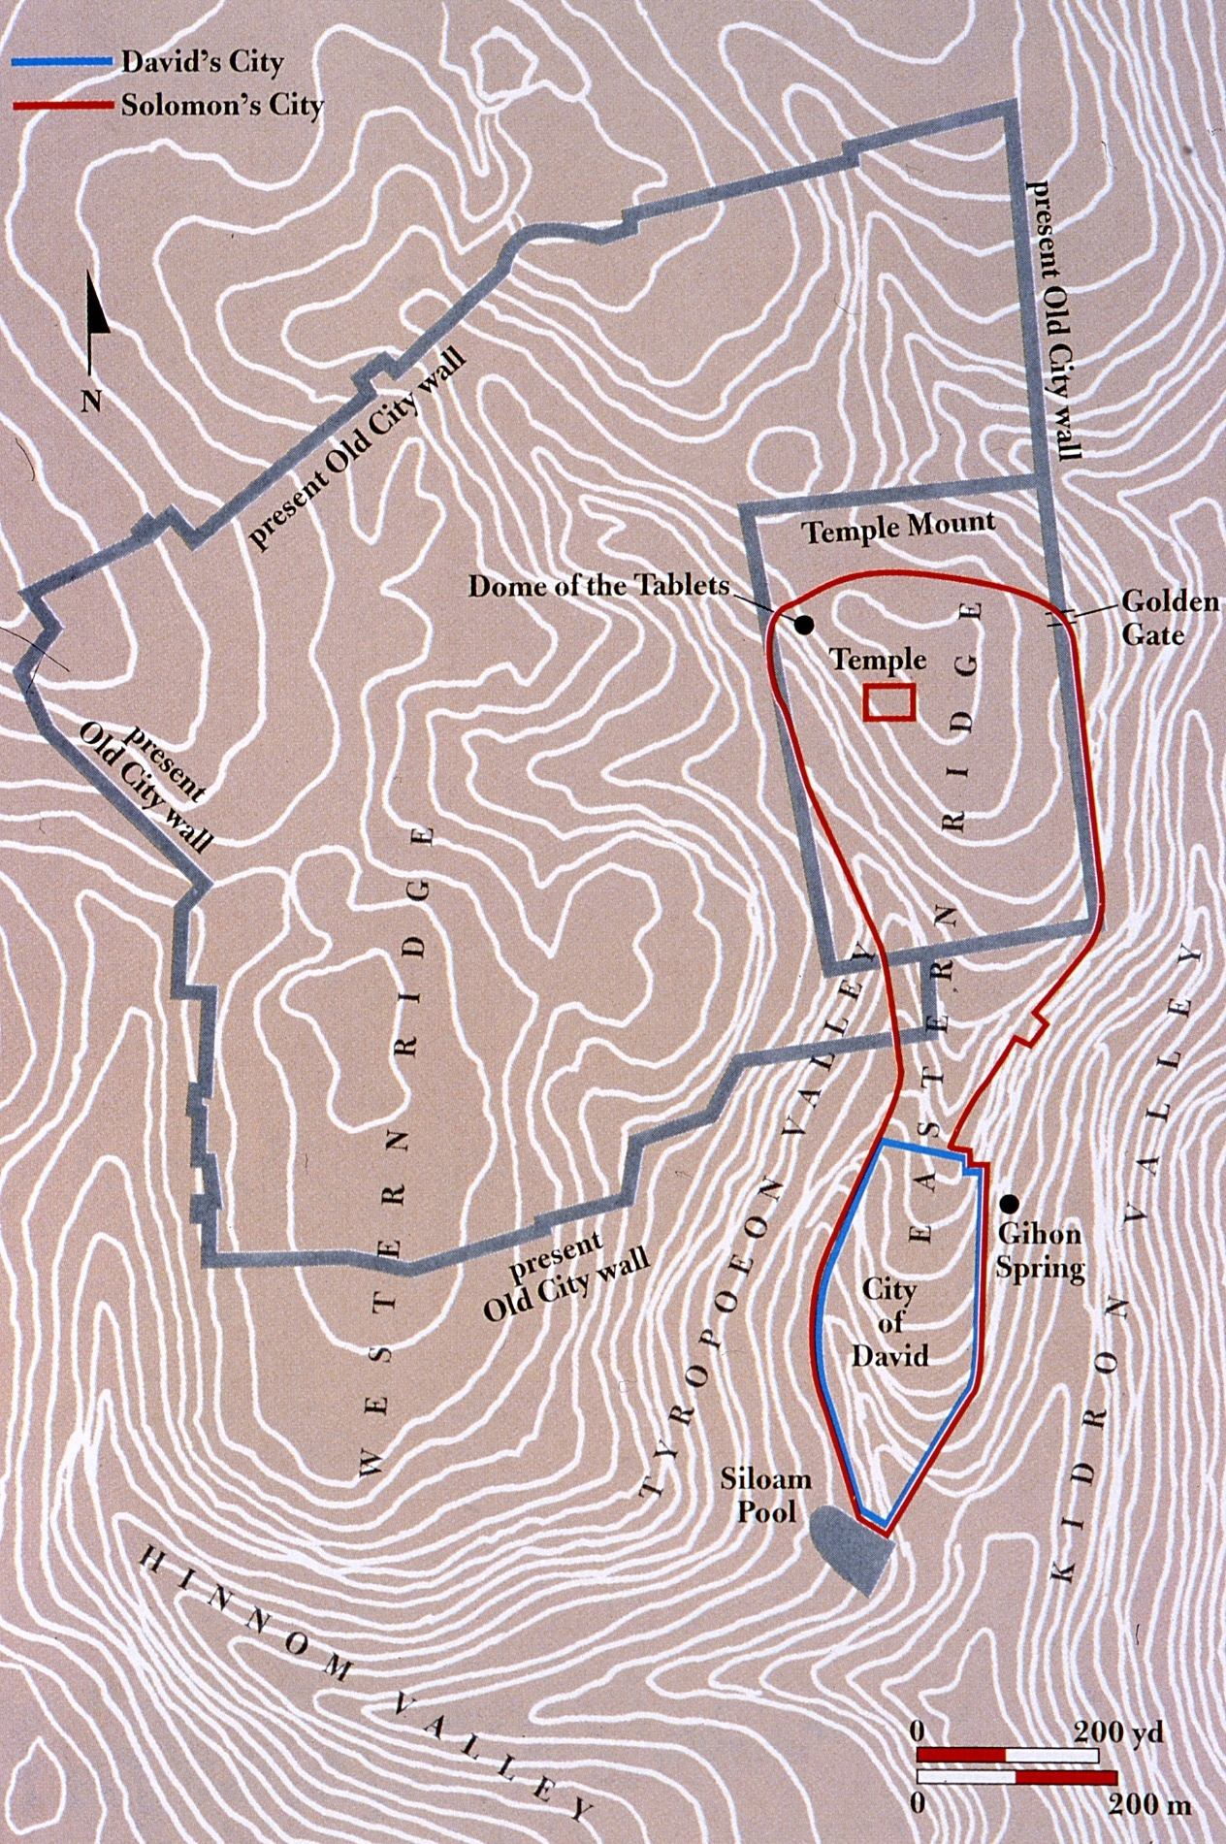
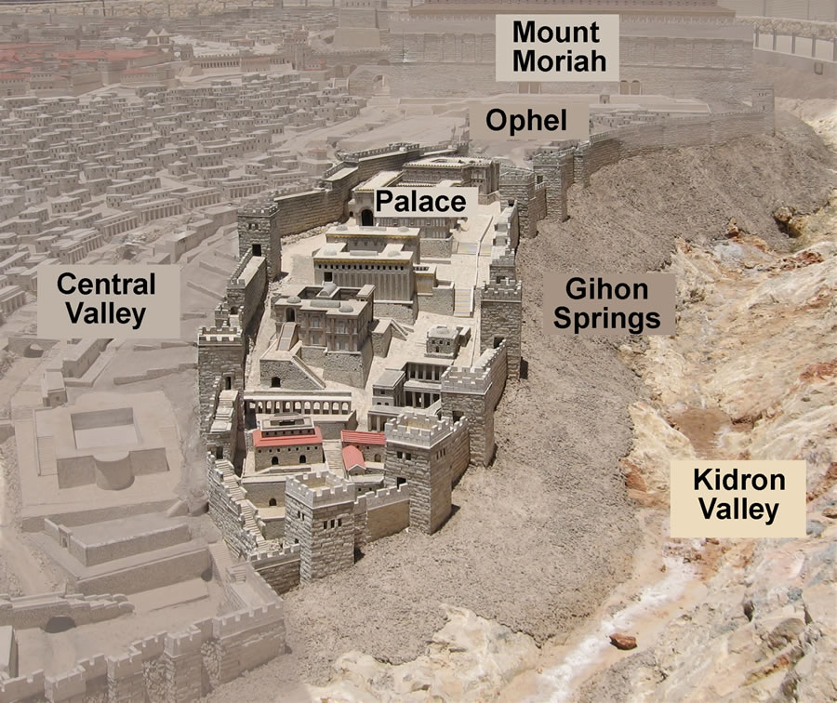
David’s Sin & Repentance
The Temple
David’s response, cont:
Intercedes for his people, takes on the divine punishment instead of them (1 Chr. 21:17)
Buys a place to offer redemption and peace offerings to YHWH (1 Chr. 21:18-26)
Foreshadowing later stories: the place where David’s altar was built
(see 1 Chr. 22:1)

Slide 10
Long Live King Solomon!
1 Kings 1 – Solomon is chosen & anointed
David’s old age necessitates a successor
A political necessity, and a blessing from God.
Solomon shows wisdom right from the start.
To be continued…

Slide 11
Things Have Gotten Messy
David’s story in summary:
Marked by virtue. Great faithfulness & trust in God.
Dotted by spiritual failures w/ deep consequences.
Is he the Messianic figure? Or do we wait for another?
Perhaps Solomon will fit the bill…

