Slide 1
Theology
The most foundational element of the faith…
Is the truth about God himself.

Slide 2
The Idea Is
Rich In The Bible
The Lord, The Lord, a God merciful and gracious, slow to anger, and abounding in steadfast love and faithfulness, keeping steadfast love for thousands, forgiving iniquity and transgression and sin, but who will by no means clear the guilty, visiting the iniquity of the fathers on the children and the children's children, to the third and the fourth generation.
Exodus 34:6-7

Slide 3
The Idea Is
Rich In The Bible
Hear, O Israel: The LORD our God, the LORD is one. You shall love the LORD your God with all your heart and with all your soul and with all your might.
Deuteronomy 6:4-5

Slide 4
The Idea Is
Rich In The Bible
...my people have forsaken me, the fountain of living waters...
Jeremiah 2:13

Slide 5
The Idea Is
Rich In The Bible
Thus says the LORD of hosts: Consider your ways. Go up to the hills and bring wood and build the house, that I may take pleasure in it and that I may be glorified, says the LORD. You looked for much, and behold, it came to little. And when you brought it home, I blew it away. Why? declares the LORD of hosts. Because of my house that lies in ruins, while each of you busies himself with his own house.
Haggai 1:7-9

Slide 6
The Idea Is
Rich In The Bible
Therefore choose life, that you and your offspring may live, loving the LORD your God, obeying his voice and holding fast to him, for he is your life and length of days.
Deuteronomy 30:19-20

Slide 7
The Idea Is
Rich In The Bible
God Himself must be the most important thing to us.

Slide 8
The Idea Is
Seen In History
In the teaching of God’s people:
Acts 2 — the identity of Jesus
Acts 3 — the response to Jesus
Acts 4 — the supremacy of Jesus
Acts 7 — the righteousness of Jesus
Acts 17 — the identity of Jesus
Revelation 4-5 — the glory of God in Jesus

Slide 9
The Idea Is
Crucial In Religion
In worship assemblies.
Religion and Christ cannot be separated.
If we worship the God of all excellencies, then we should do so with excellence.
“Worship shouldn’t be a performance.”
The solution to both:
Let worship be all about God Himself.
“Worship shouldn’t be bored and boring.”

Slide 10
The Idea Is
Vital In Us
Theology undergirds everything:
Parenting
Marriage
Evangelism
Authority & doctrinal purity
Cultural issues
Church growth
Young Christians’ keeping the faith
Salvation
Confess your faith in JESUS.
Be baptized in the name of JESUS.
Repent from sin and toward JESUS.
Believe in JESUS.
Hear about JESUS.

Slide 11
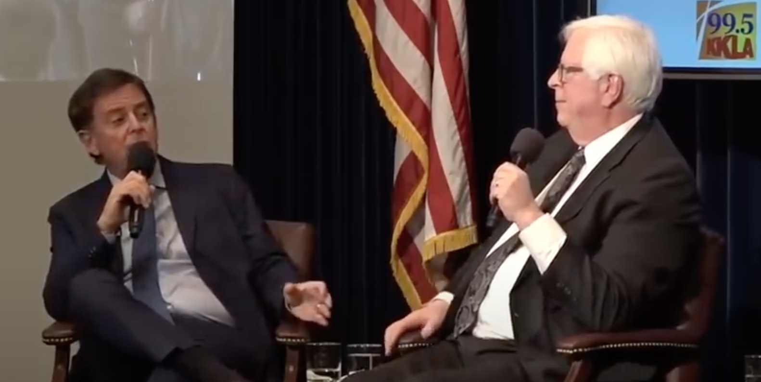
The Idea Is
Vital In Us
Prager: “I believe the Christianity and Judaism are allies in the world today because both are brining people to Mt. Sinai and to obey the Ten Commandments, and I believe that’s what God wants.”

Slide 12
The Idea Is
Vital In Us
Begg: “I would challenge what he has just said, because the purpose of the Bible as it unfolds is clearly not for the world to be brought to Sinai. It is for the world to be brought to Christ.”

Slide 16
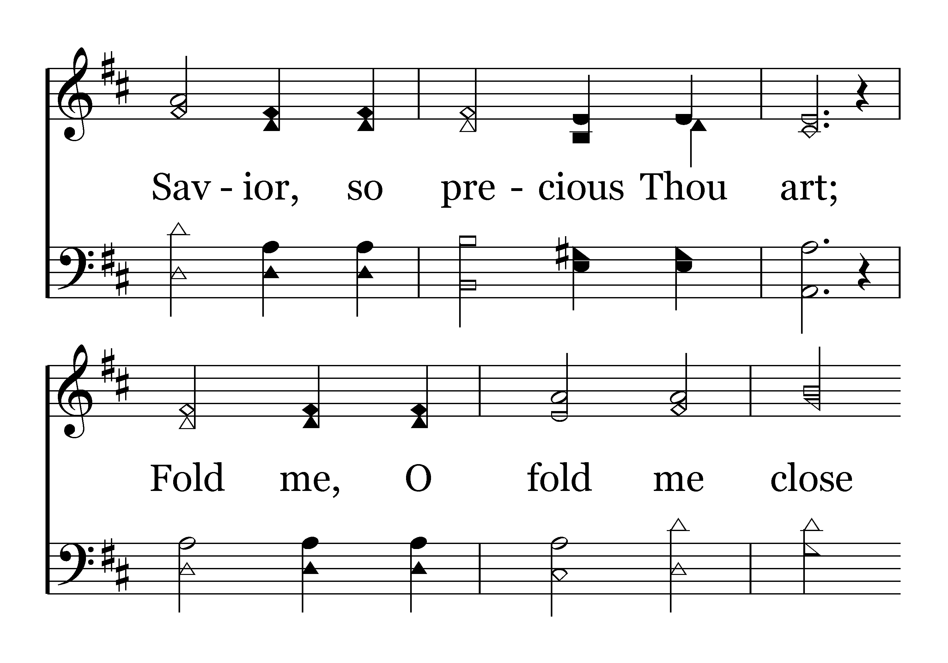

Slide 17
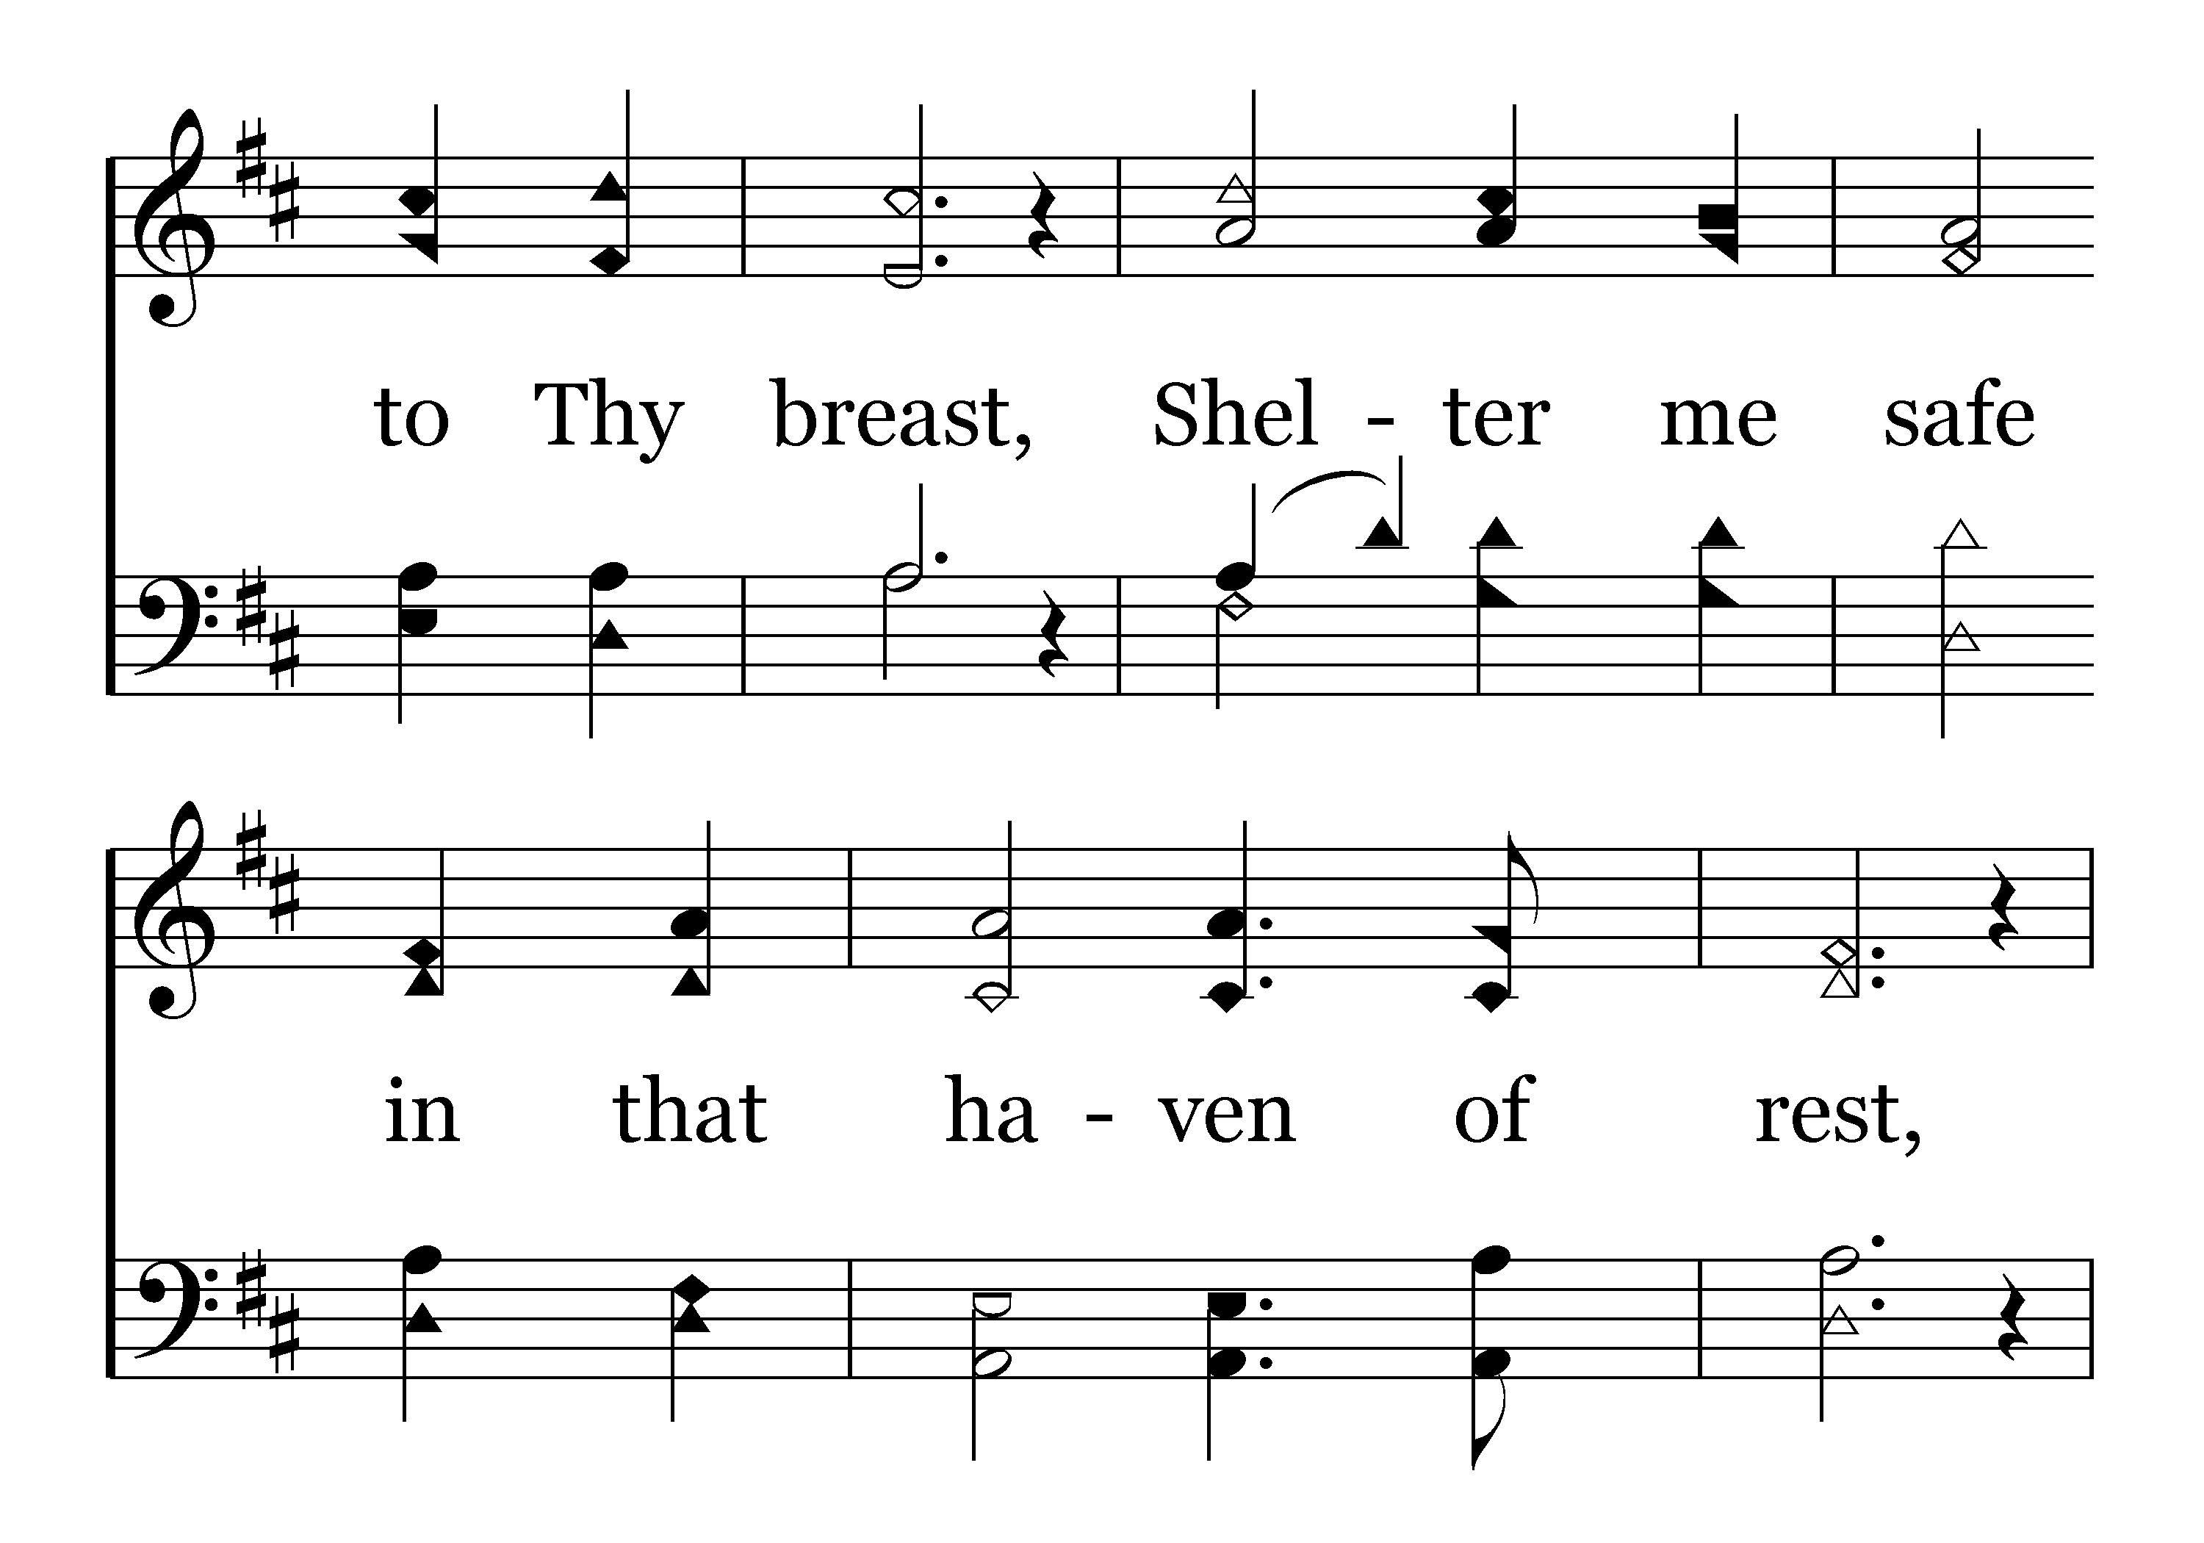

Slide 18
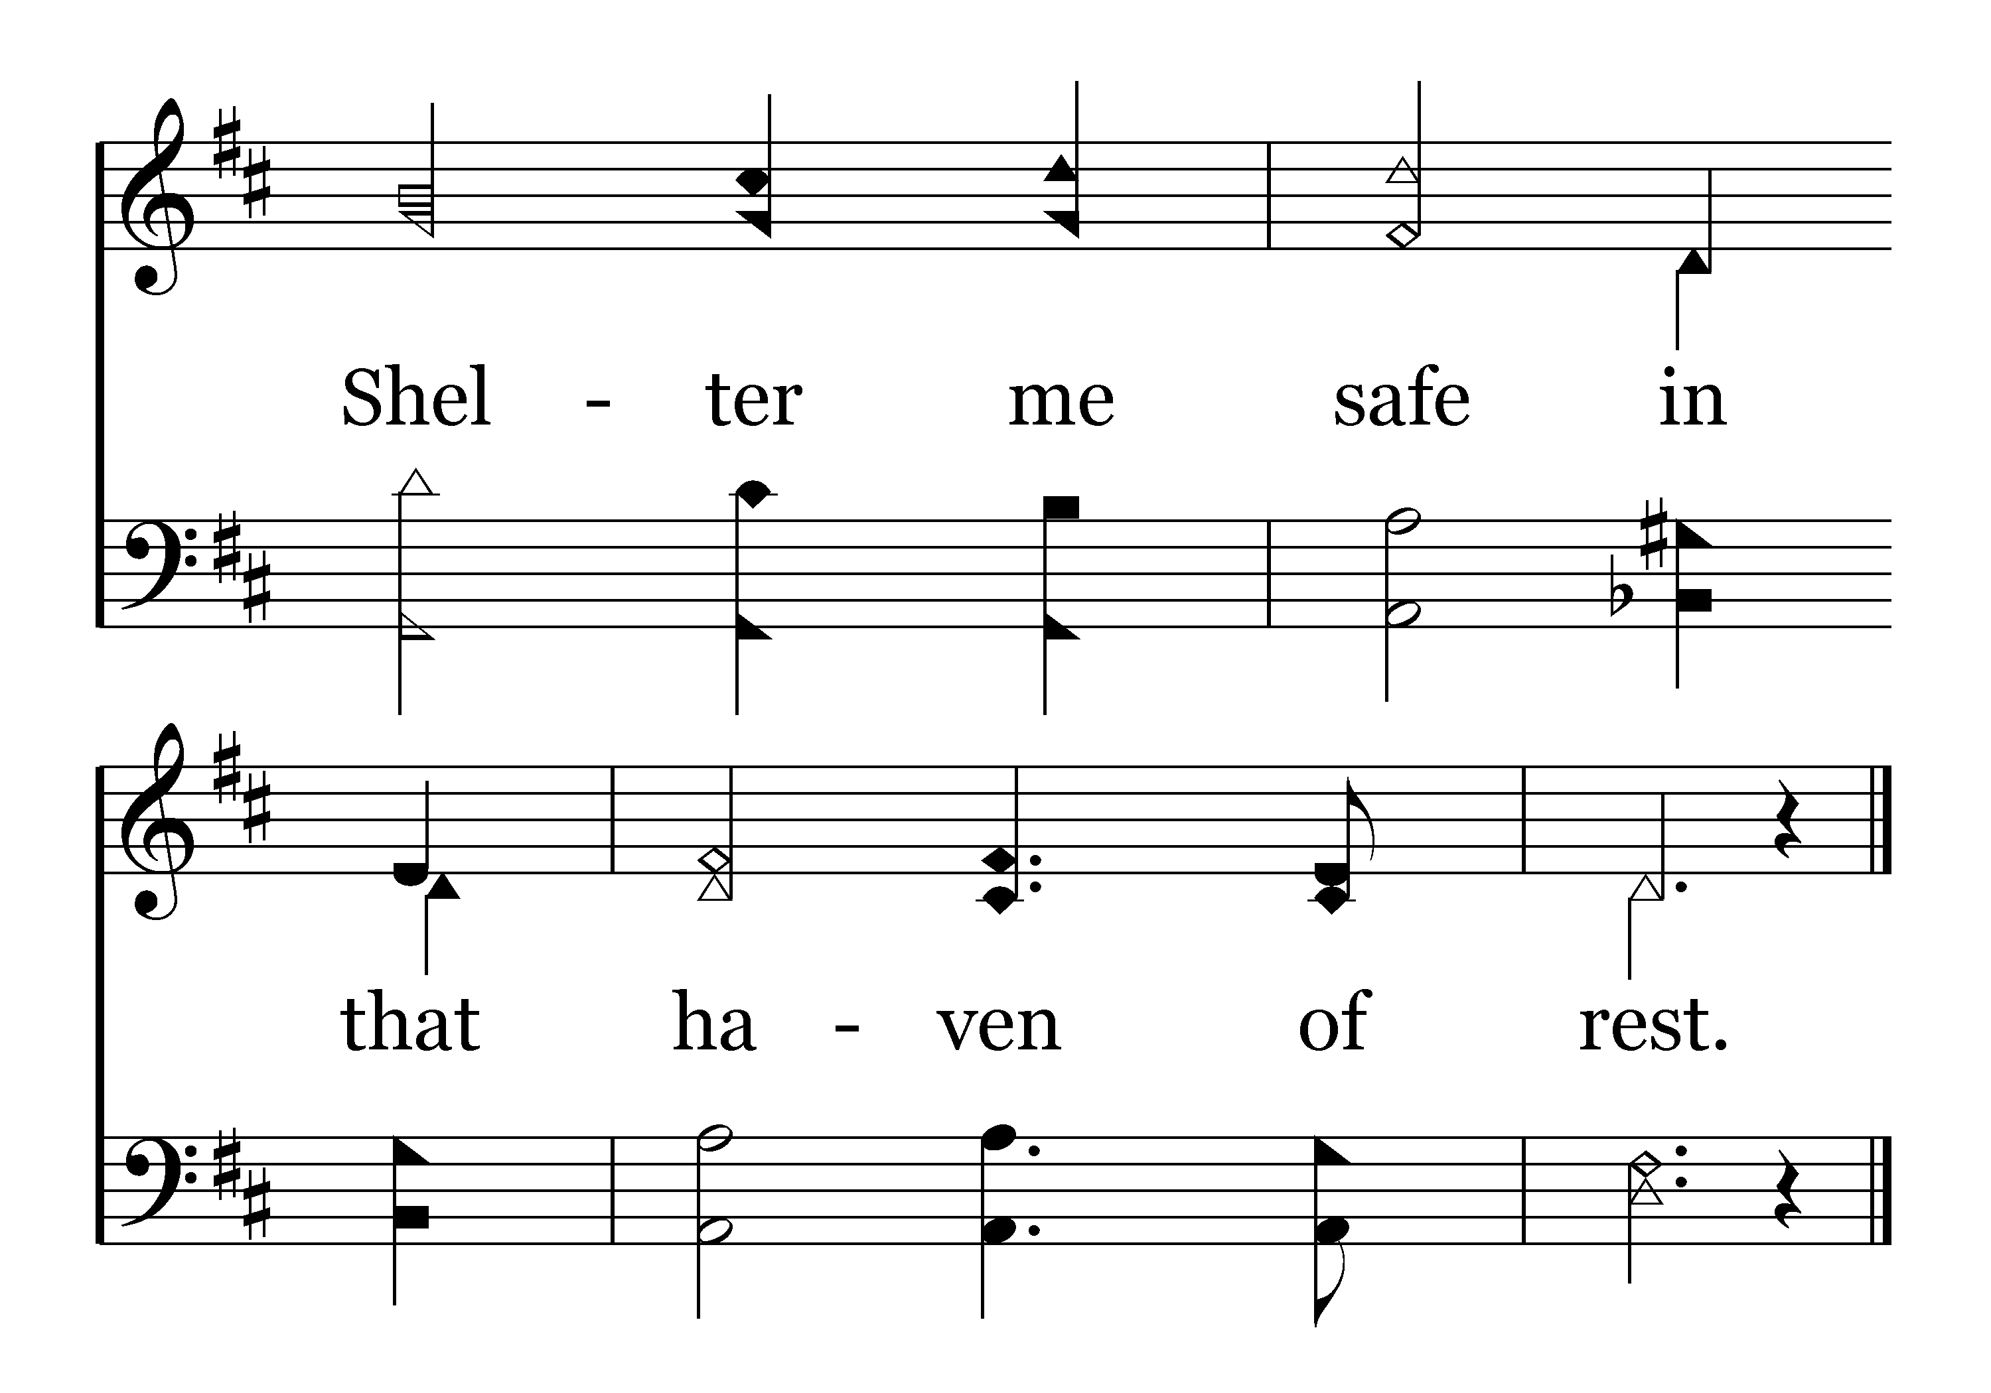
End of Verse 1

Slide 20
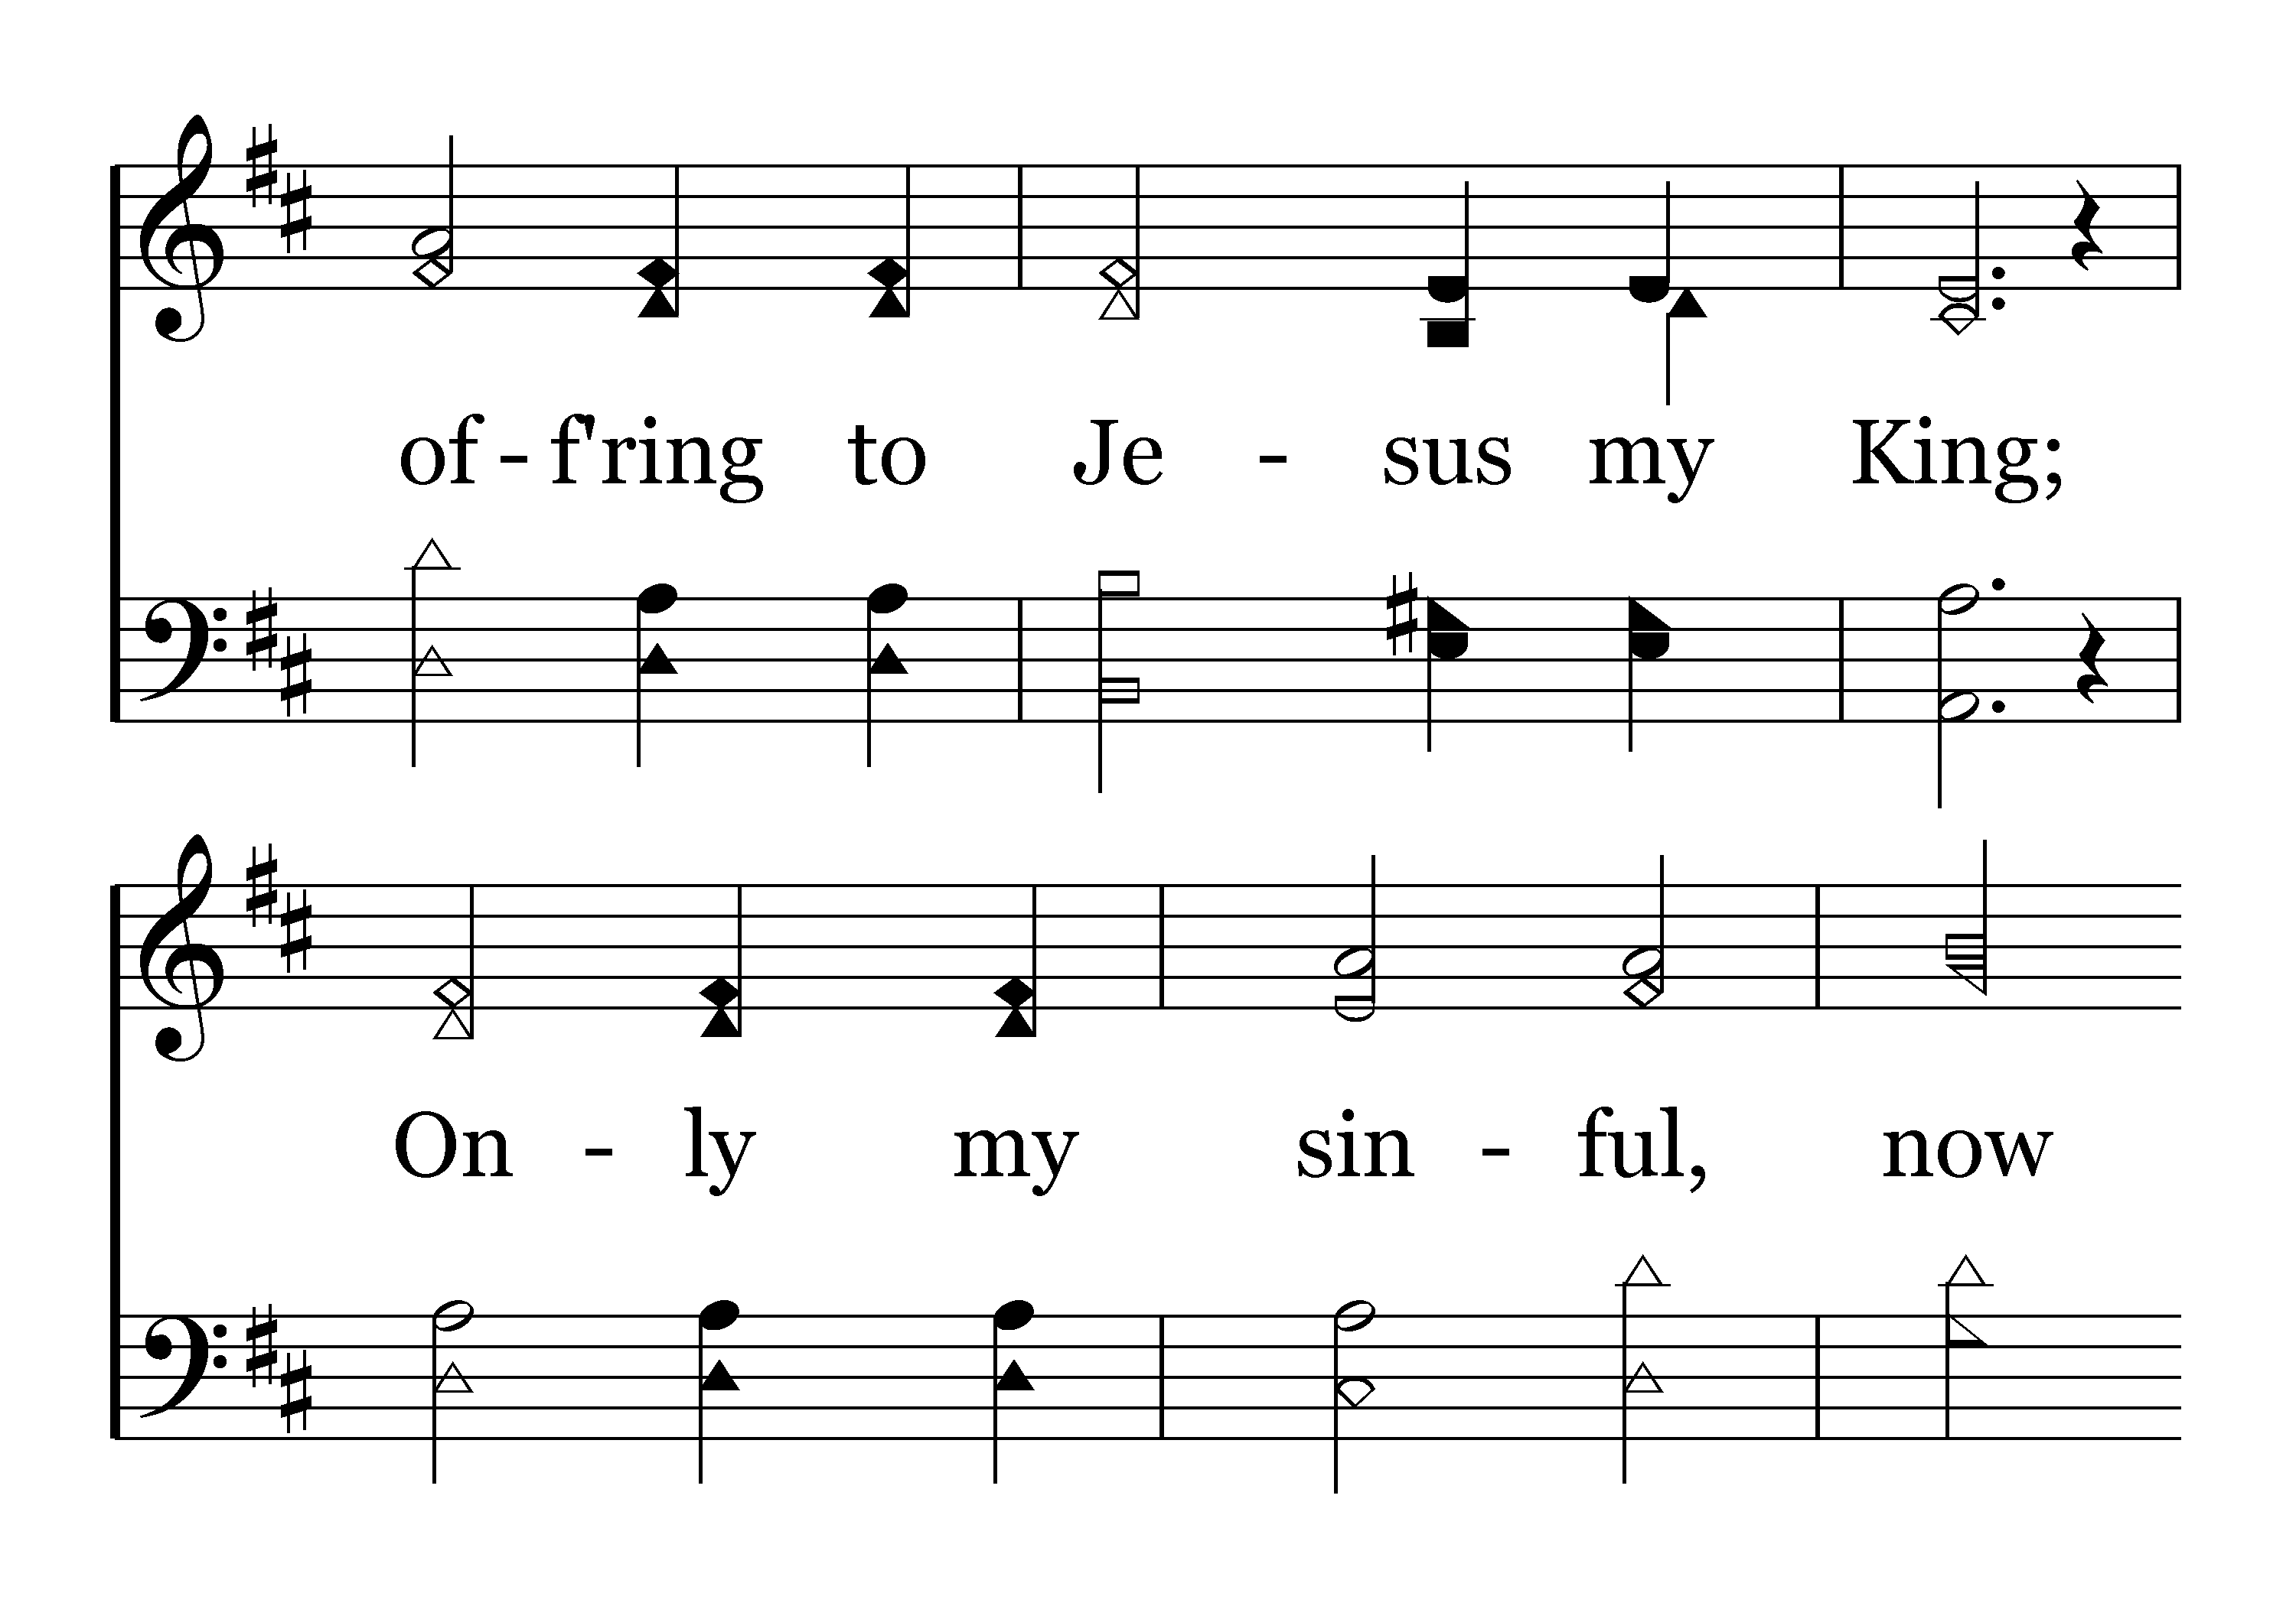

Slide 21
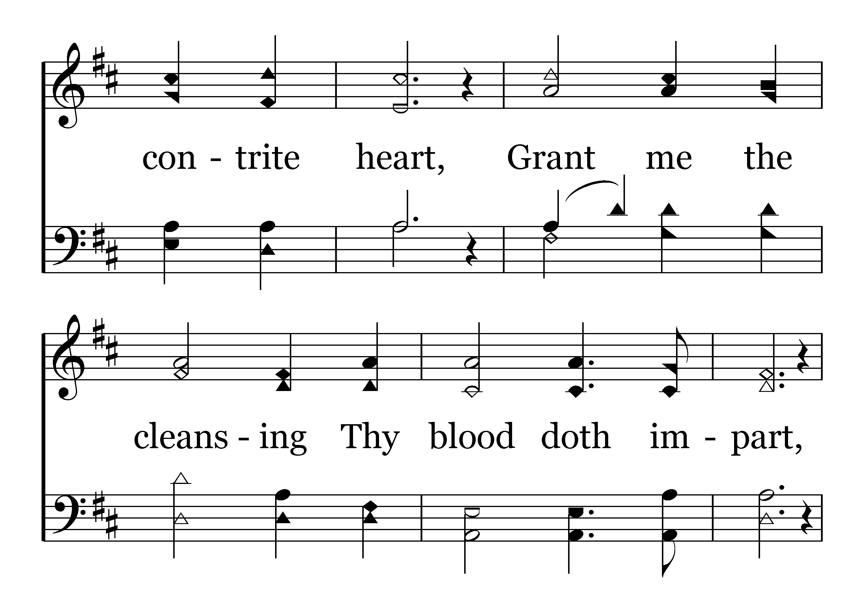

Slide 22
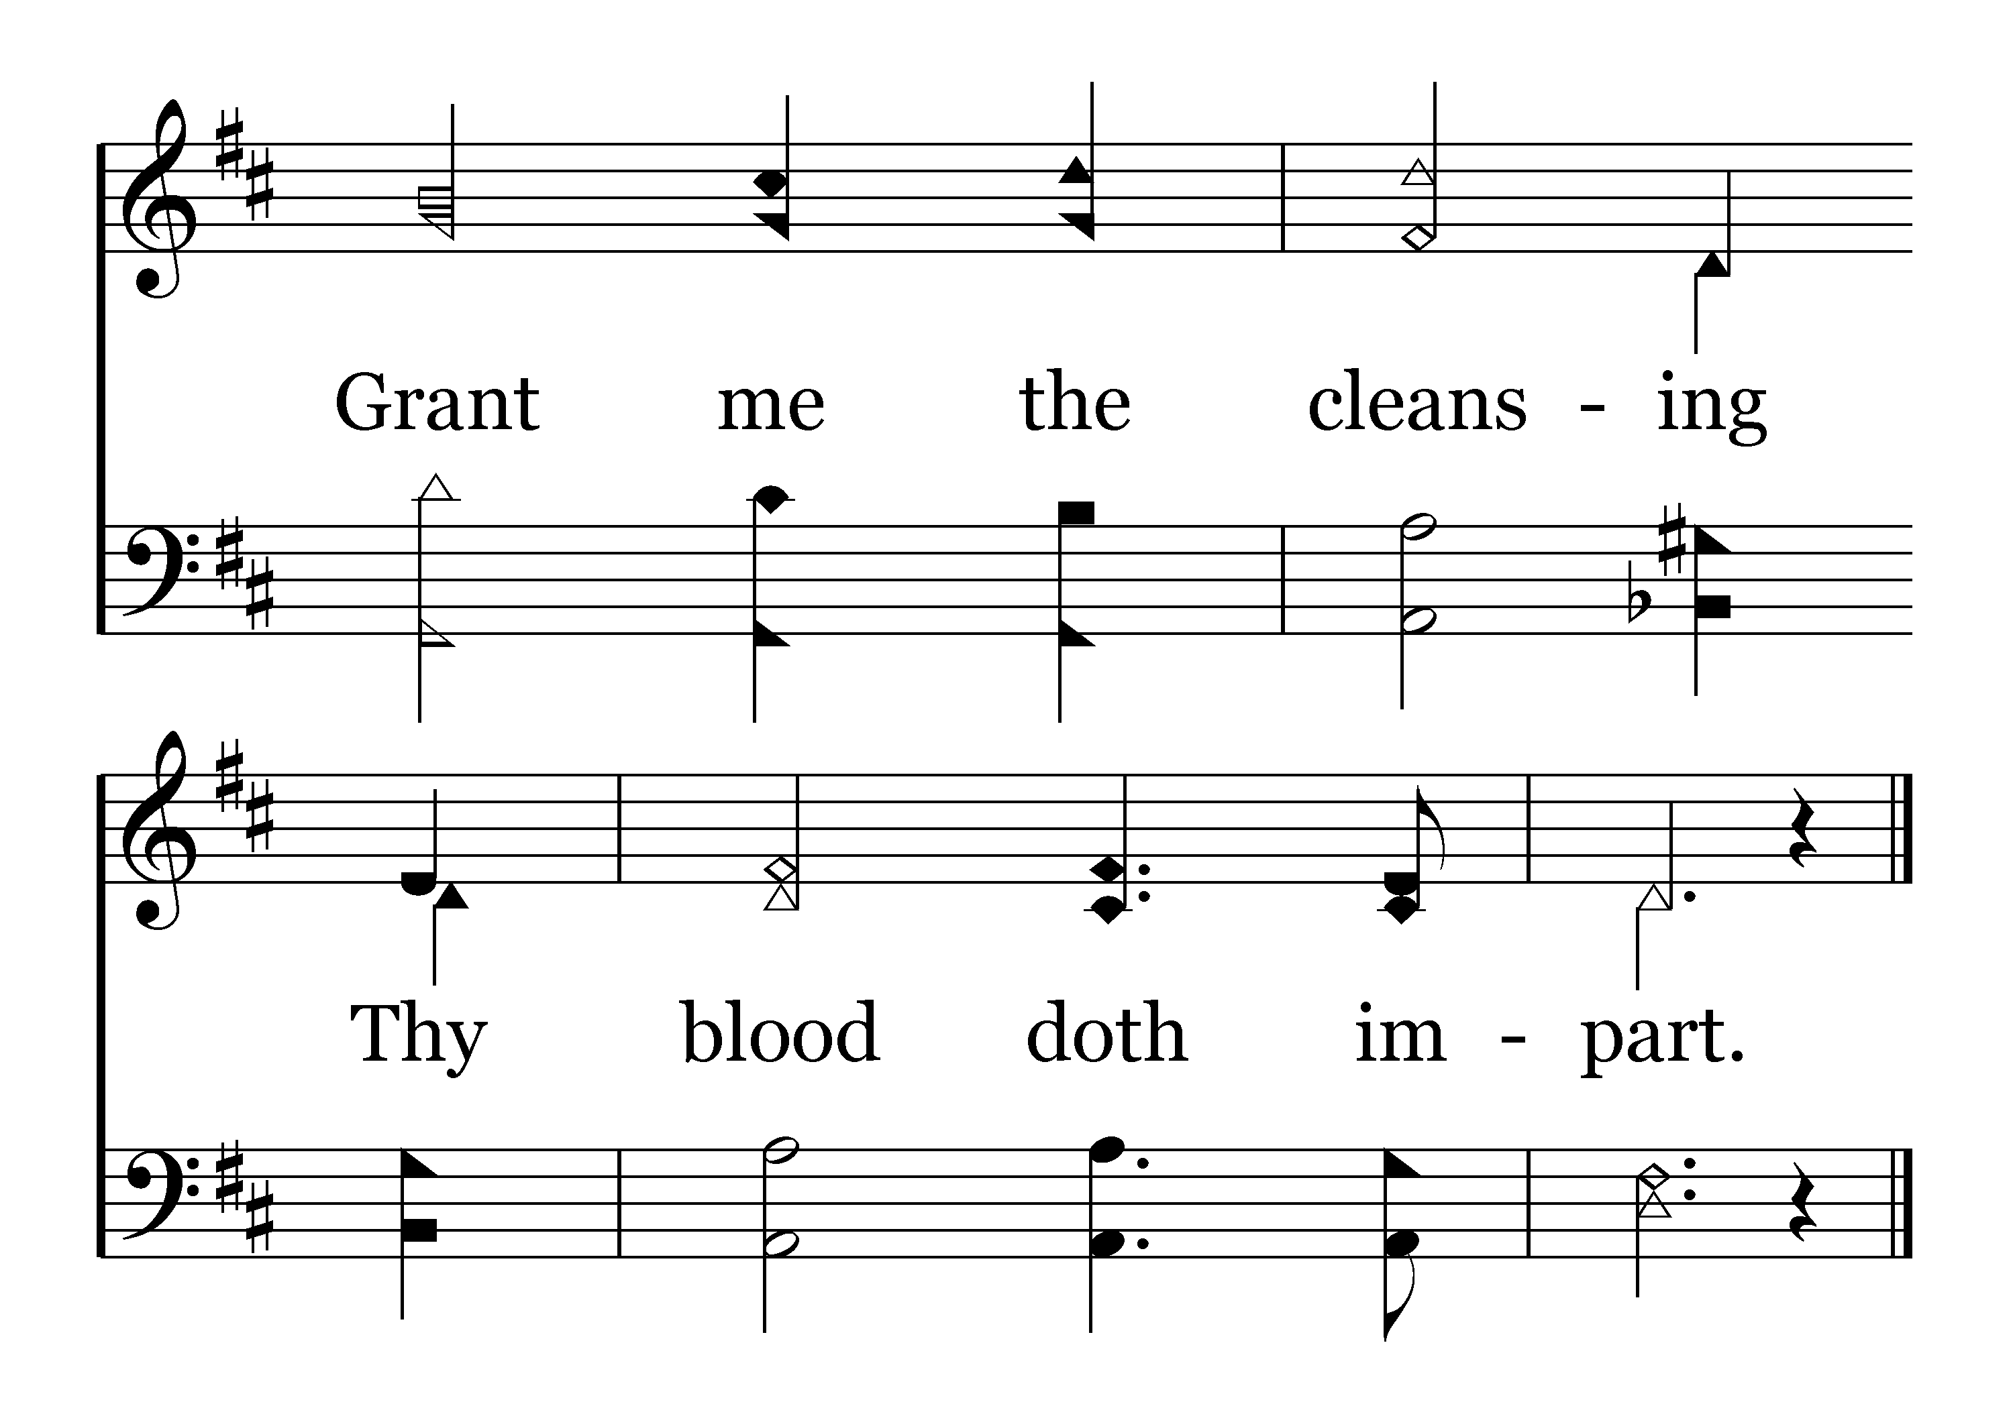
End of Verse 2

Slide 24
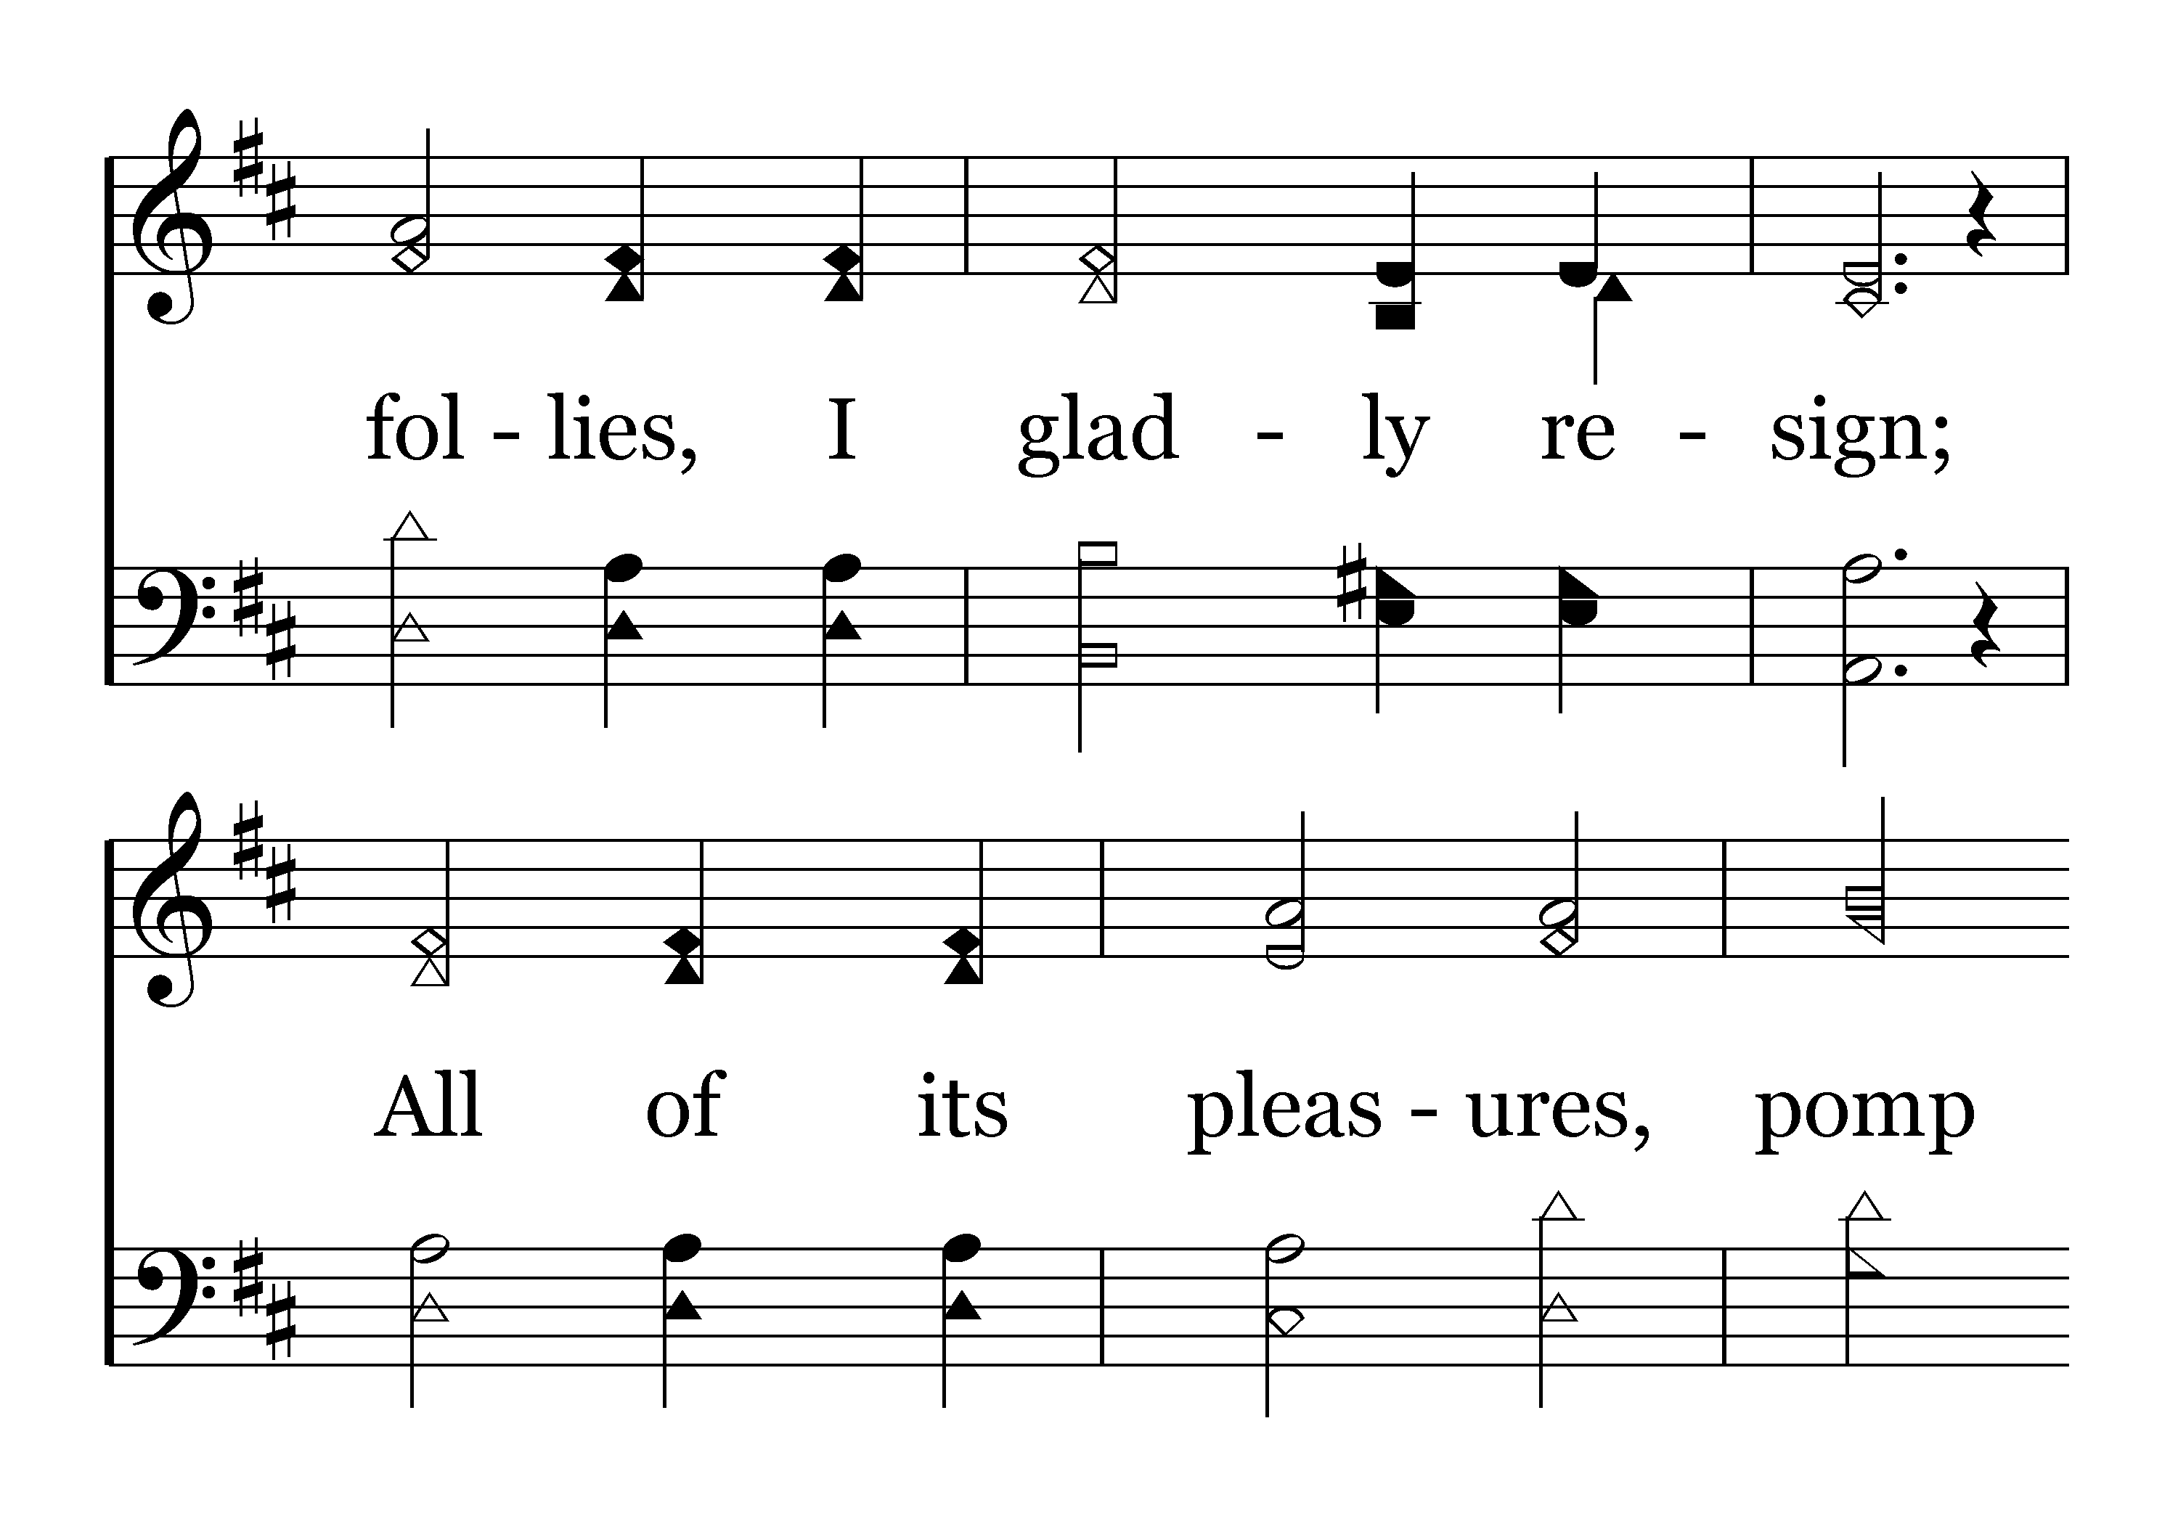

Slide 25
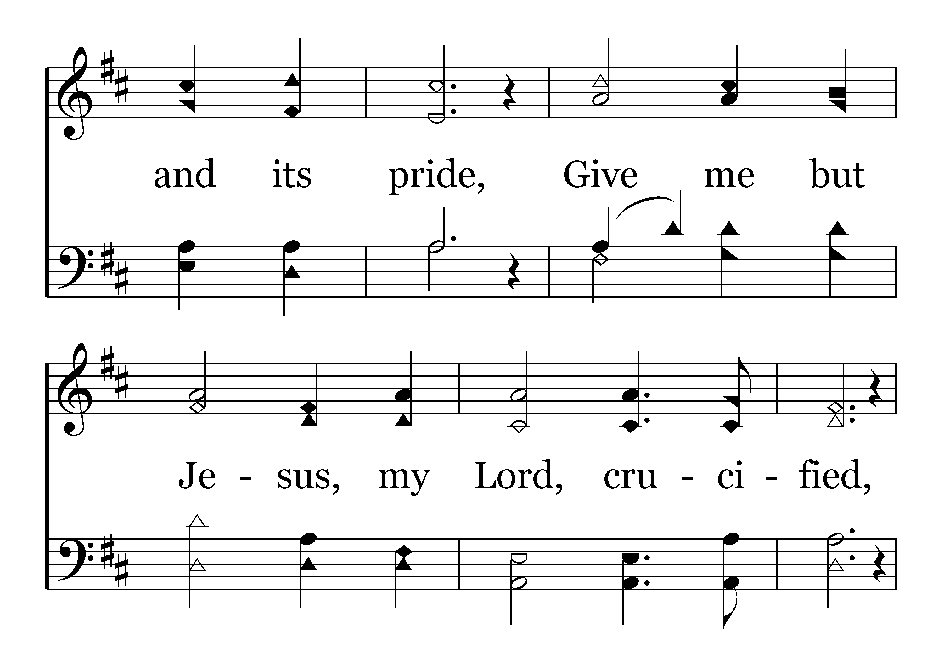

Slide 26
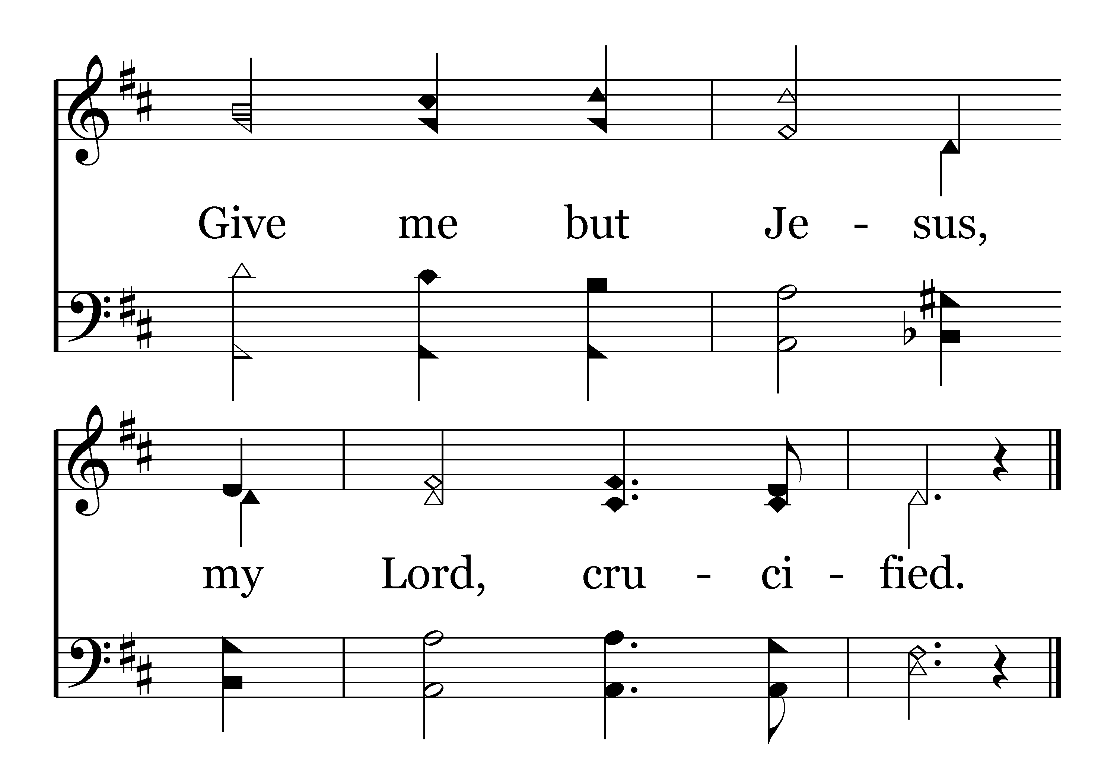
End of Verse 3

Slide 28
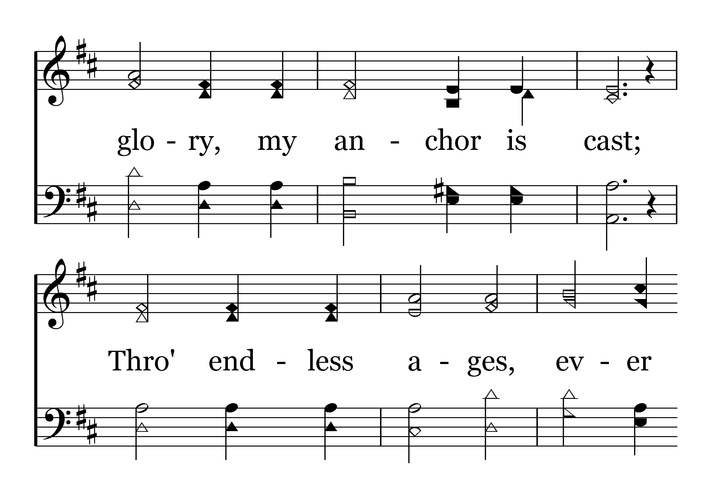

Slide 29
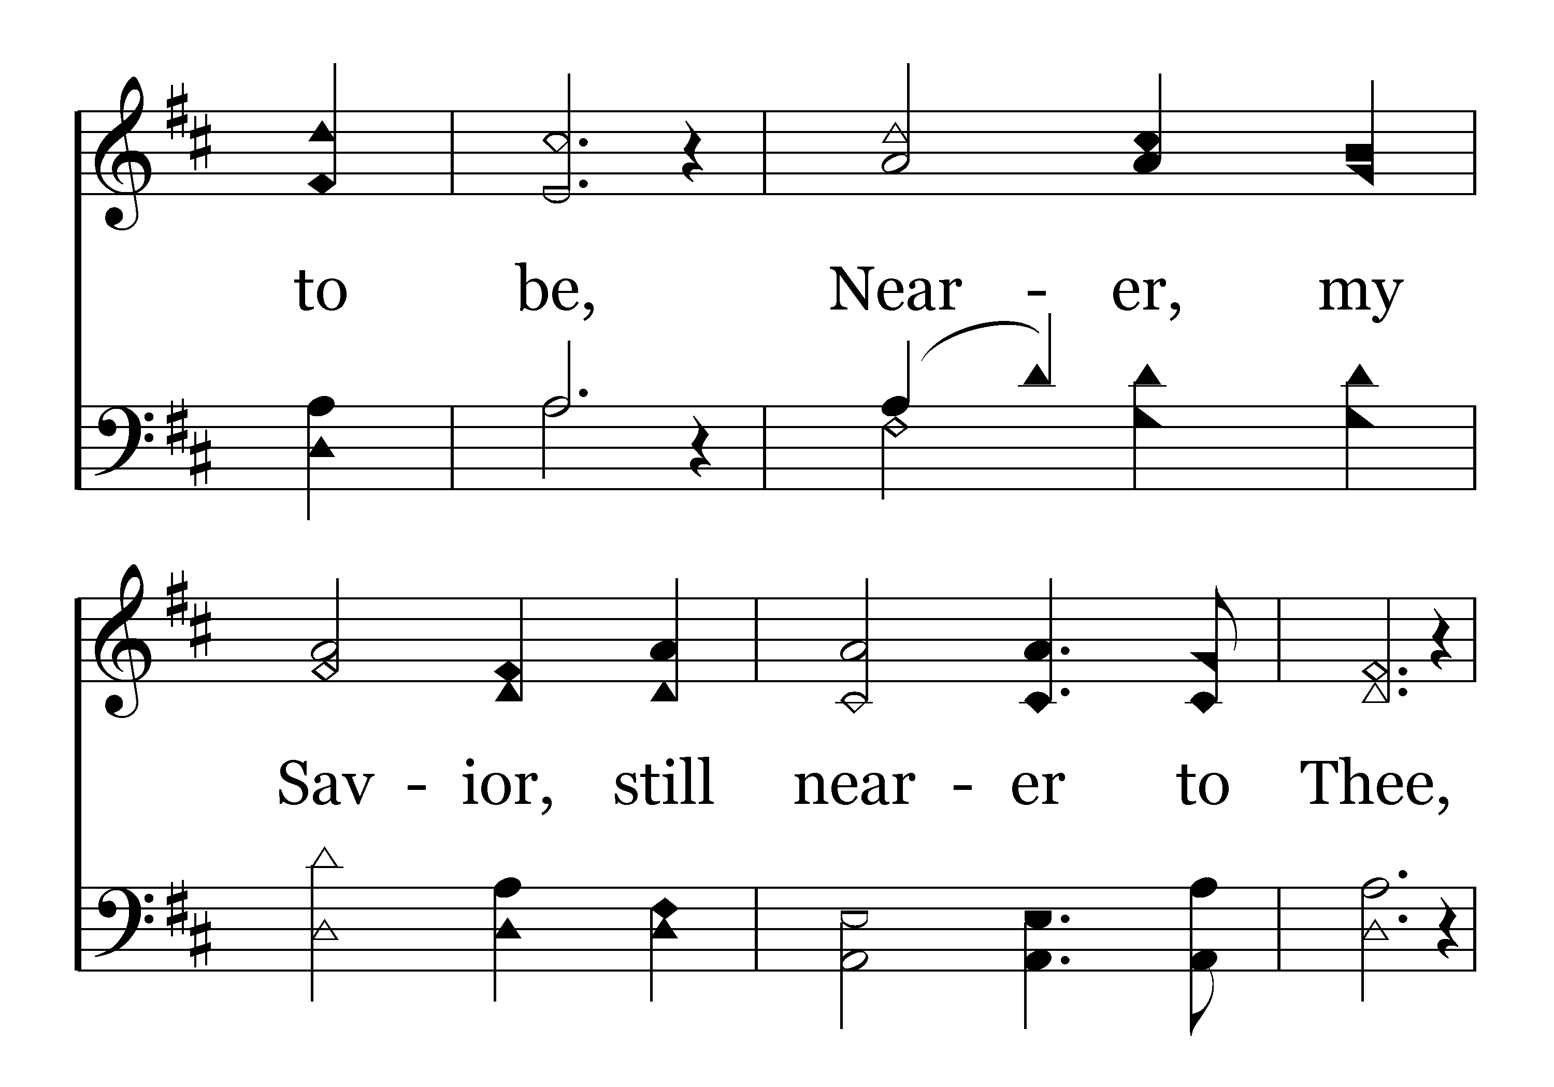

Slide 30
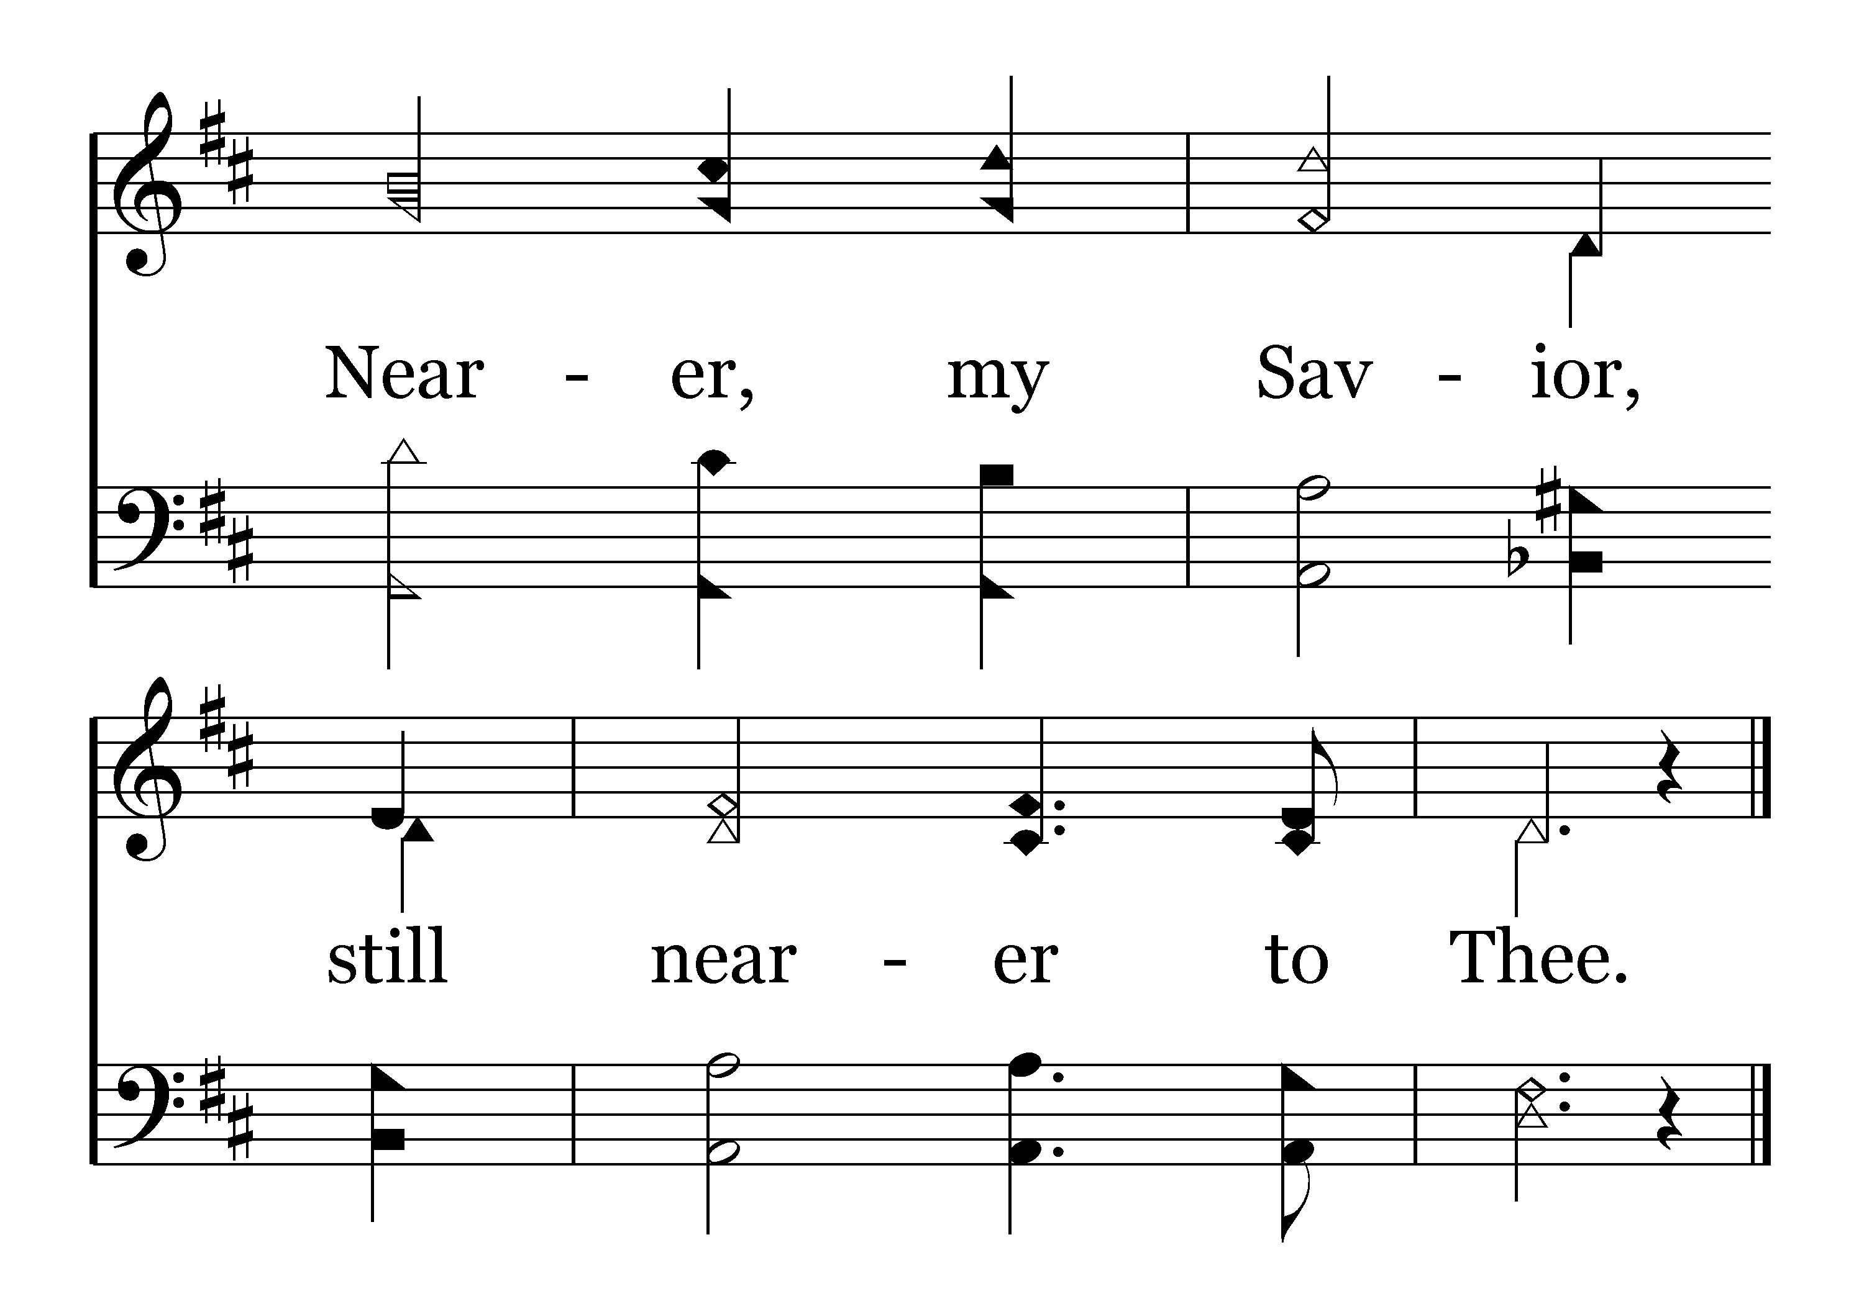
End of Song

