Slide 1
Before the Flood
Flood
Scattering
Patriarchs
Exodus
Wandering
Invasion and Conquest
JUDGES
JUDGES WEEK 6: SAMSON (Part 1) (Judges 13-16)

Slide 2
QUESTION 4 (last week): In contrast with Abimelech, the story of Jephthah recorded in Judges 11 portrays Jephthah as being a man of faith (Heb. 11:32). How did Jephthah show his faith in God?
In discussing the Gilead elders’ offer to make him “head,” Jephthah stated that any future victory over the Ammonites would be due to God. (Judges 11:9)
He restated the terms of his agreement with the Gilead elders “before the LORD.” (Judges 11:11)
In making his argument to the Ammonite king about the disputed land, he attributed the Israelites’ victory over Sihon and the Amorites to God, crediting God for the Israelites’ possession of the land. (Judges 11:21, 23-24)
His vow to the LORD….and the fulfillment of the vow (Judges 11:30-39)
From all of these, we can reasonably infer that his actions in leading the men of Gilead against the Ammonites were grounded in his faith in God.

Slide 3
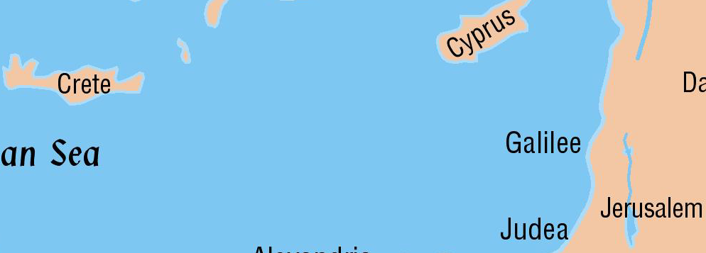
The Philistines Come to Palestine
The Philistines came to Palestine from the island of Crete.
They brought with them the knowledge of iron smelting which neither the Canaanites nor the Israelites had.
This gave them an advantage in their weaponry.
Shamgar is the first Israelite named who fought the Philistines.
He is briefly mentioned in Judges 3:31 as killing 600 of them with an ox goad.

Slide 4
The Philistines: A Little History
Information earlier in the Bible
Some were in the land as early as Abraham’s day.
Genesis 21:34
They were no major threat at that time.
Moses does not list them as one of the tribes to be conquered in his day.
It appears from historical notes as well as scriptural facts that a new wave of Philistines moved into the southern coastal plain about the time of the early judges.

Slide 5
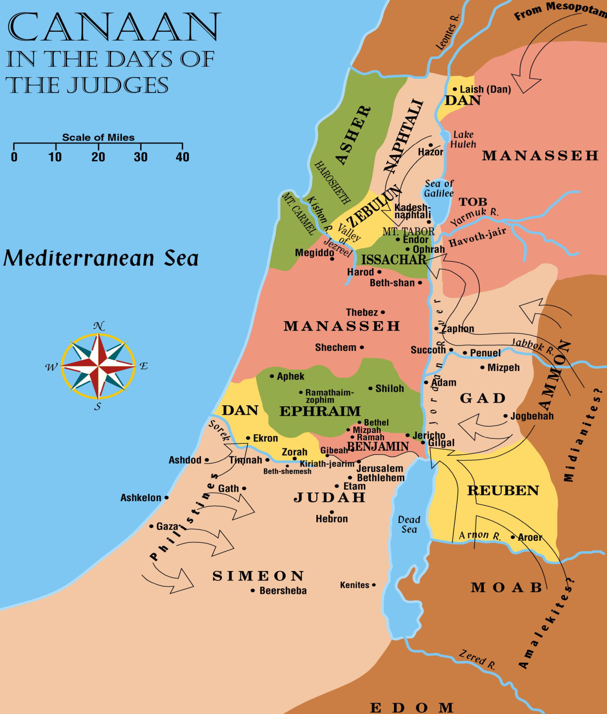
Othniel
Deborah
Jephthah
Samson
Ehud
Gideon

Slide 6
QUESTION 1: In some ways, Samson turns out to be a different type of “judge” than some of the others we’ve studied. What are some of the ways in which he was different (in character and in actions) than his predecessors?
Never leads an army; always acts alone.
No battles between Israelites and Philistines recorded during his time.
Uses superhuman strength to gain successes.
Seemed to be very unlikely person for God to use to help deliver Israel.
(While others, i.e., Gideon, might have seemed unlikely choices, Samson appeared to be in a category of his own.)
Big problem with women—Philistine women
Extremely hot-tempered
Preferred associating with pagan Philistines to associating with his own people.
Hardly a righteous leader
Will not end Philistine oppression.

Slide 7
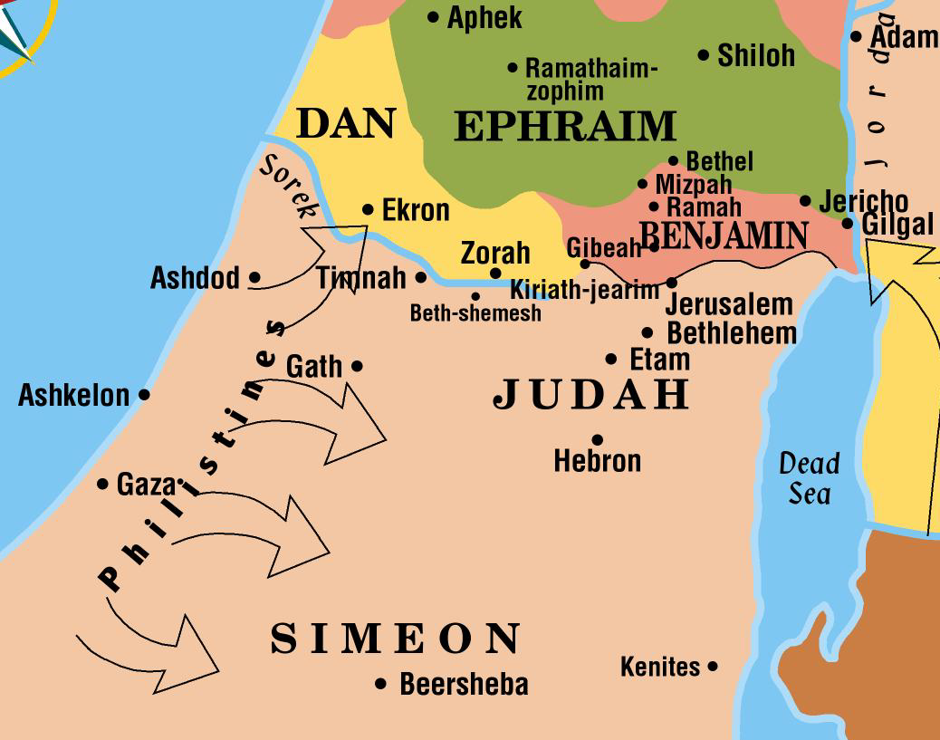
Samson’s Birth
Samson was of the tribe of Dan from the village of Zorah.
His birth was something that his parents had not been expecting, as his mother was barren.

Slide 8
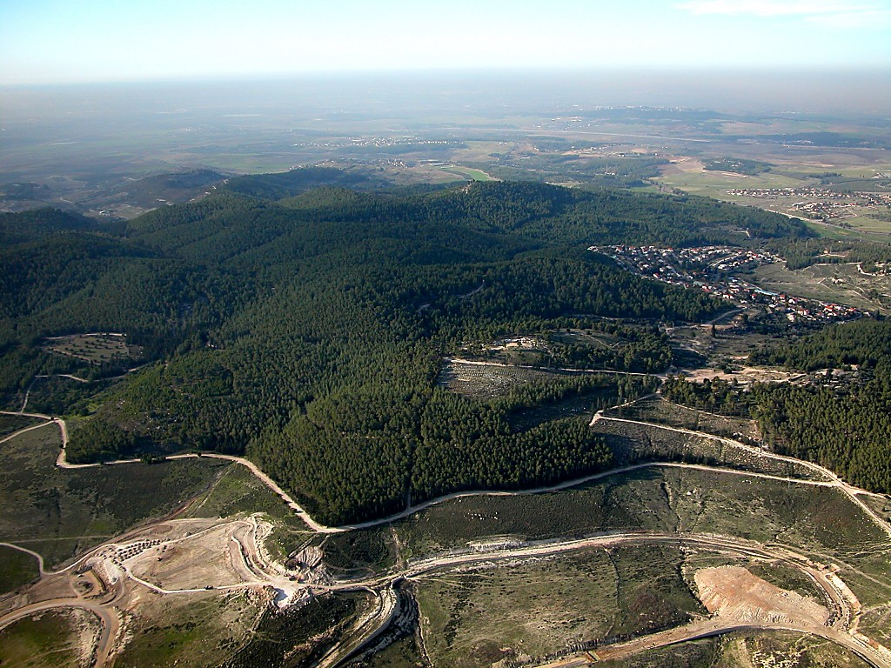
Zorah
Zorah aerial from southeast
Notes:
tb010703385

Slide 9
QUESTION 2: What were the requirements that the law stated for Nazirites which would have ostensibly applied to Samson (See Num. 6)?
No wine or strong drink
Eat or drink nothing produced from grape vine (no raisins, grapes, vinegar from grapes…)
Could not cut hair
“All the days of his separation to the LORD, he shall not go near a dead person.” (Num. 6:6)
(Apparently did not apply to Nazirites for life.)
(Requirements pertaining to end of vow period would not apply.)

Slide 10
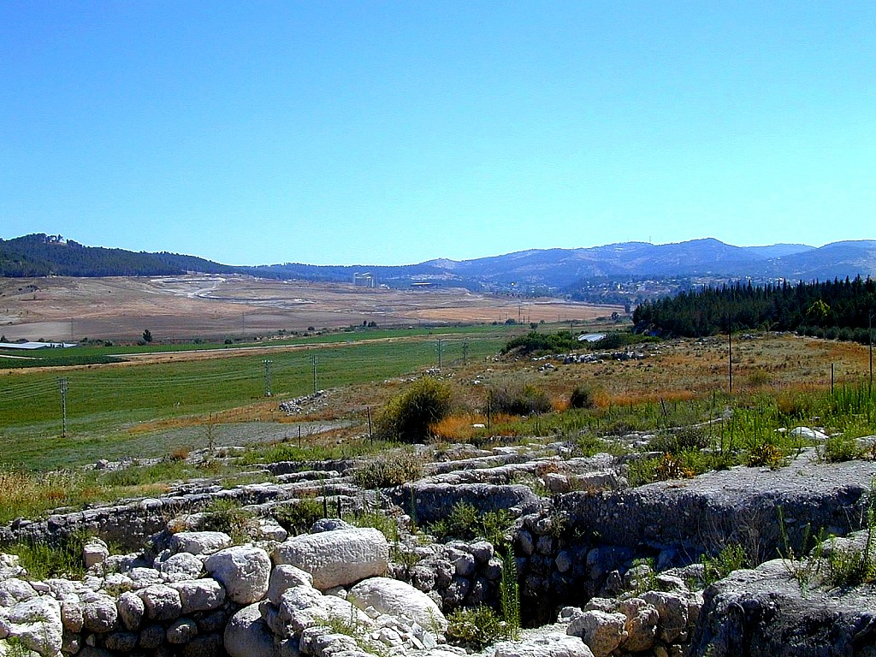
Zorah
Eshtaol
Zorah and Eshtaol from Beth Shemesh
Notes:
tb062300343

Slide 11
Woman No. 1: In Timnah
The first woman we encounter in Samson’s endless quest for Philistine women lived in Timnah, in the Philistine-populated area, but not far from Zorah, his birthplace.
She was a “one of the daughters of the Philistines.” (Judges 14:1)
Samson demanded that his parents arrange a marriage. (Judges14:2)

Slide 12
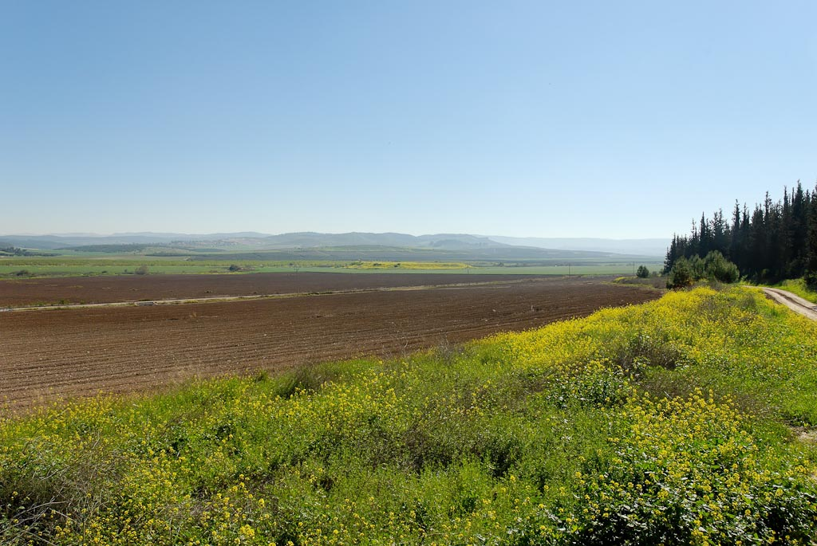
Timnah from southwest
Notes:
tb030407632

Slide 13
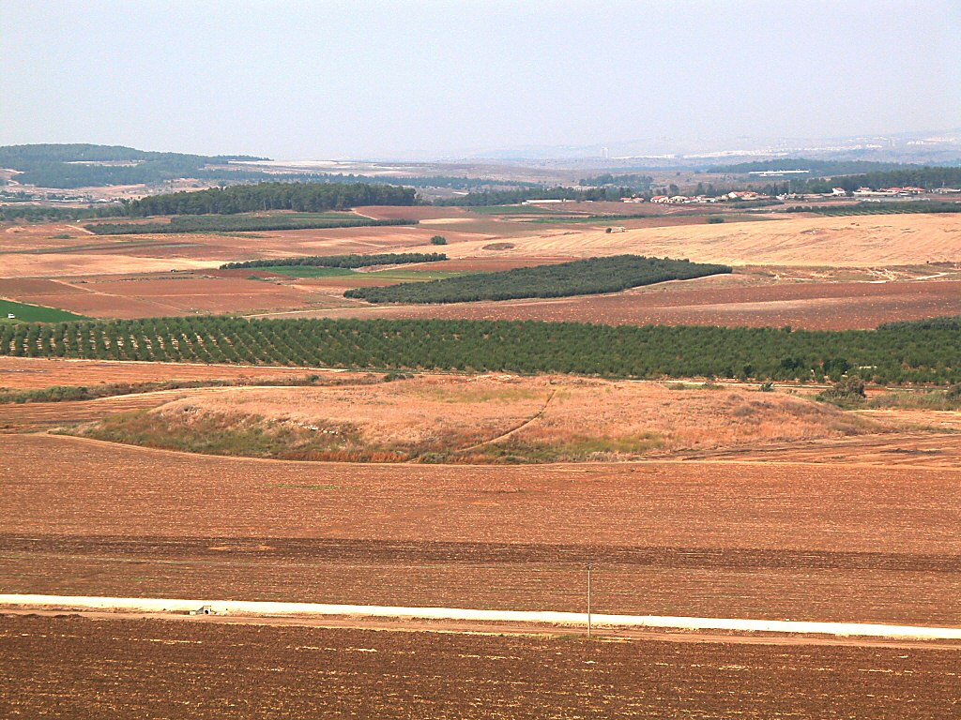
Timnah from south
Notes:
tb100702275

Slide 14
QUESTION 3: Judges 14:4 says (concerning Samson’s marriage to the Philistine woman) that “…it was of the LORD, for He was seeking an occasion against the Philistines.” That being true, was Samson’s marriage sinful?
That the marriage was “of the LORD” did not release Samson from responsibility for sin—God used him as he was.
God has, on a number of occasions, used mens’ sins to bring about good.
Pharaoh when Israel was delivered
Men who crucified Jesus
God used Samson’s weakness (women) to work toward His purpose of delivering Israel from Philistine oppression.
Doesn’t mean that God approved of Samson’s behavior.
The marriage was sinful. (Exod. 34:16; Deut. 7:3-4—prohibition against marrying Canaanites; marrying a Philistine no different)

Slide 15
QUESTION 4: Three times in Samson’s story (Judges 14:6; 14:19; 15:14) we read that “the Spirit of the LORD came upon him mightily.” (NASB) What did the coming of the Spirit of the LORD upon Samson cause or enable in each of those instances?
We often think of the Spirit “coming upon” someone in the positive sense of revealing God’s truth in some manner.
Here, it was different, though it will nevertheless work for good.
In each instance in Judges 14 and 15, the coming of the Spirit upon Samson empowered Samson to do something.
In each case, that “something” involved using superhuman strength.
Recall Samson’s purpose as the angel had stated it to Samson’s mother: to begin to deliver Israel from Philistine oppression.
While the incident with the lion seems but tenuously connected to that purpose, the other two incidents show a stronger connection.

Slide 16
ANGER BUILDS BETWEEN SAMSON AND THE PHILISTINES…
The “solving” of the riddle—dishonor and betrayal

Slide 17
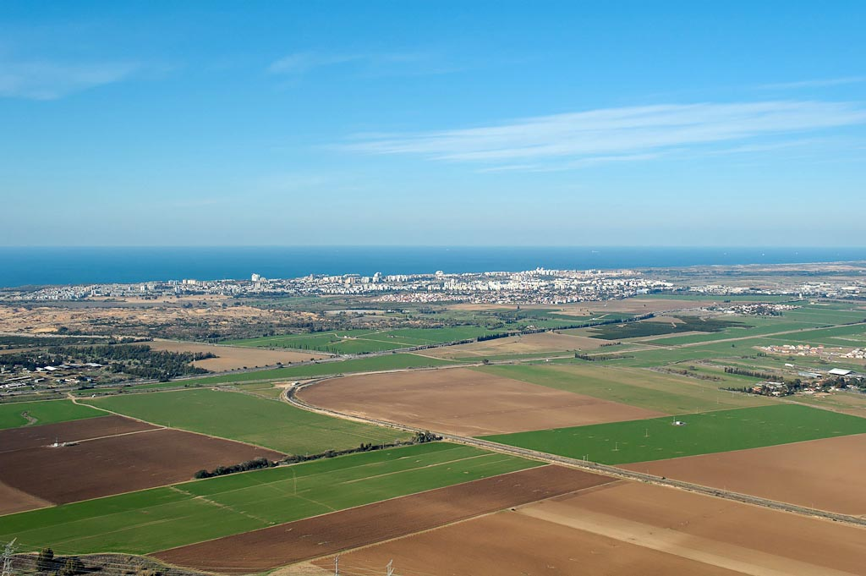
Ashkelon area aerial from southeast
Notes:
Ashkelon: Early History
Ashkelon is mentioned in both sets of Execration Texts (c. 1900 BC), indicating the city’s strategic importance in the border zone between Egypt and Canaan.
Seven letters were sent by the ruler of Ashkelon to the pharaoh in Egypt.
Joshua took Ashkelon in the conquest (Josh 13:1-3; Judg 1:18), but the city was not held for long.
The Merneptah Stele claims that Egypt defeated Ashkelon: “Carried off is Ashkelon, seized upon is Gezer…Israel is laid waste.”
Samson killed 30 men of Ashkelon and took their clothes to pay for a wager he lost over a riddle (Judg 14:19).
“Tell it not in Gath, proclaim it not in the streets of Ashkelon,” said David as he mourned the death of Saul (2 Sam 1:20, NIV).
Ashkelon was frequently mentioned by the prophets: Jeremiah 25:20; 47:5-7; Amos 1:8; Zephaniah 2:4, 7; Zechariah 9:5.
Tiglath-pileser III made Asqaluna a subject of Assyria in 733 BC. Sennacherib captured it in 701, following the revolt of Sidqa, and placed Sharruludar on the throne in Sidqa’s place.
Egypt took control of the city about 630.
In 604, Babylon attacked the city for resisting Nebuchadnezzar, according to the Babylonian Chronicle. King Aga’ was killed and prisoners were taken to Babylon in 598, thus fulfilling the prophecies of Jeremiah 47:5-7 and Zephaniah 2:4-7.
tb121704822

Slide 18
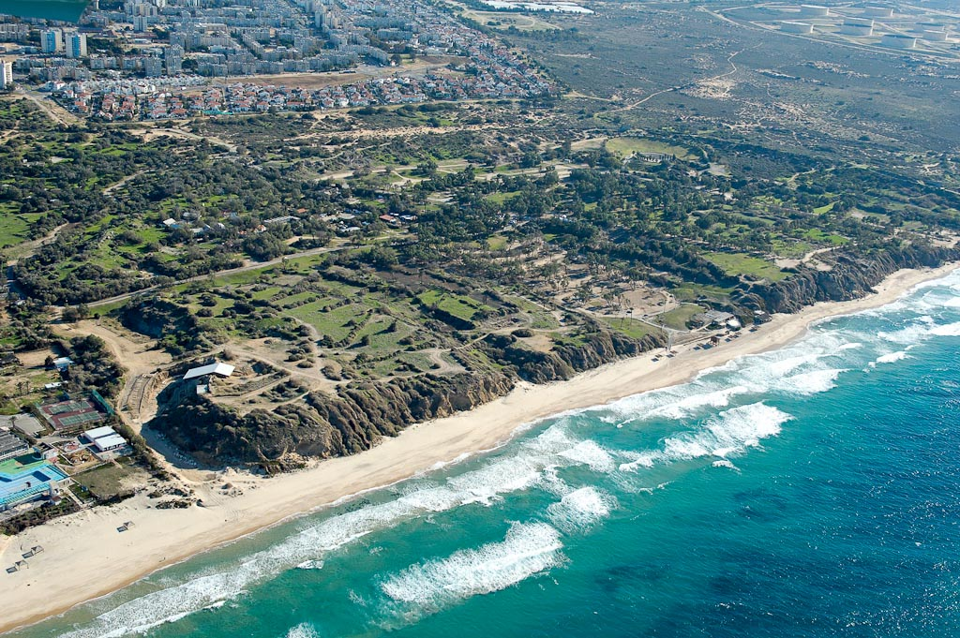
Ashkelon tell aerial from northwest
Notes:
Philistine Settlement
The Philistines migrated to the coastal plain of Israel in about 1200 BC, and they settled in five major cities.
Three of these cities were located along the coastal branch of the International Highway leading from Egypt. Because of the presence of sand dunes along the coast, the other cities were built inland and Ashkelon was the only one of the three built on the shore.
Encompassing 150 acres, the tell of Ashkelon is the largest of the Philistine cities and one of the largest tells in all of ancient Israel.
The Philistines of Ashkelon were assimilated by other people groups following the Babylonian conquest at the end of the 7th century BC.
tb121704841

Slide 19
ANGER BUILDS BETWEEN SAMSON AND THE PHILISTINES…
The “solving” of the riddle—dishonor and betrayal
Samson slaughters 30 men in Ashkelon and (presumably) leaves them lying naked.
(Imagine the Philistine view of Samson.)

Slide 20
ANGER BUILDS BETWEEN SAMSON AND THE PHILISTINES…
The “solving” of the riddle—dishonor and betrayal
Samson slaughters 30 men in Ashkelon and (presumably) leaves them lying naked (imagine the Philistine view of Samson now).
In the aftermath of the Ashkelon slaughter, angry at his wife, Samson goes home.

Slide 21
ANGER BUILDS BETWEEN SAMSON AND THE PHILISTINES…
The “solving” of the riddle—dishonor and betrayal
Samson slaughters 30 men in Ashkelon and (presumably) leaves them lying naked (imagine the Philistine view of Samson now).
In the aftermath of the Ashkelon slaughter, angry at his wife, Samson goes home.
Upon returning to Timnah to resume relationship with wife, Samson learns she has been given to one of the “companions.”

Slide 22
ANGER BUILDS BETWEEN SAMSON AND THE PHILISTINES…
The “solving” of the riddle—dishonor and betrayal
Samson slaughters 30 men in Ashkelon and (presumably) leaves them lying naked (imagine the Philistine view of Samson now).
In the aftermath of the Ashkelon slaughter, angry at his wife, Samson goes home.
Upon returning to Timnah to resume relationship with wife, Samson learns she has been given to one of the “companions.”
(Reacting to news that wife had been given away) Samson burns large area of Philistine crops, vineyards, olive groves.

