Slide 1
Before the Flood
Flood
Scattering
Patriarchs
Exodus
Wandering
Invasion and Conquest
JUDGES
JUDGES WEEK 4: ABIMELECH, JEPHTHAH (Judges 9-11:28)

Slide 2
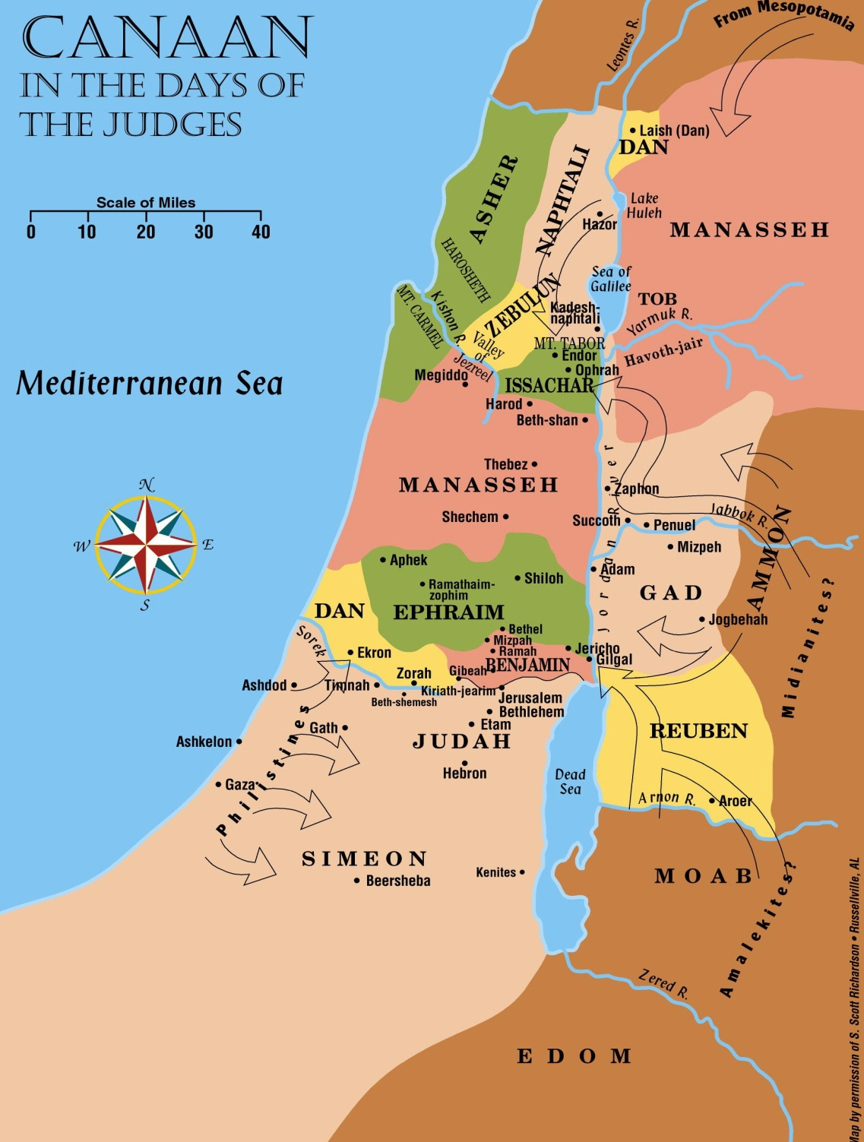
Early Judges
MAIN LOCATIONS OF EVENTS IN ABIMELECH STORY:
Shechem (red)
Thebez (red)
Ophrah (blue)

Slide 3
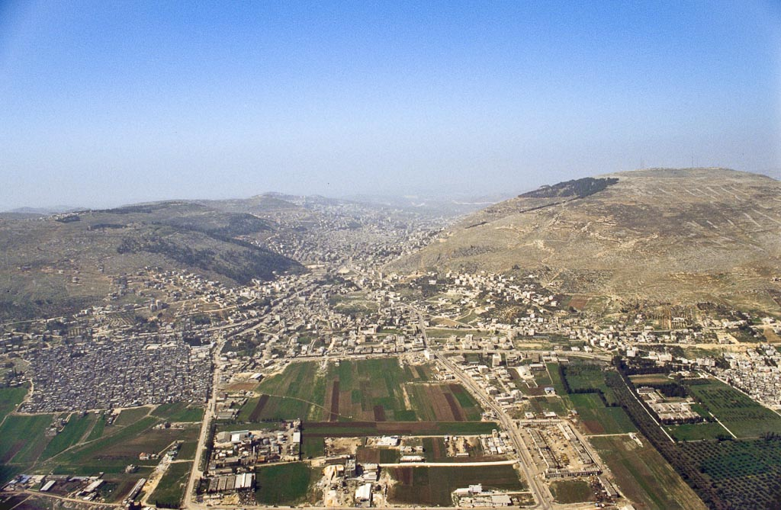
Mt. Ebal
Mt. Gerizim
Shechem
(Tell Balata)
Jotham shouted his message to Shechem from Mt. Gerizim.
Notes:
bb00120041

Slide 4
Early Judges
MAIN LOCATIONS OF EVENTS IN ABIMELECH STORY:
Shechem (red)
Thebez (red)
Ophrah (blue)

Slide 5
JUDGES 9:56-57—”56 Thus God repaid the wickedness of Abimelech, which he had done to his father in killing his seventy brothers. 57 Also God returned all the wickedness of the men of Shechem on their heads, and the curse of Jotham the son of Jerubbaal came upon them.” (NASB)

Slide 6
QUESTION 1: Although Abimelech’s story does appear in the account of the judges, and though his name appears on many lists of the judges, why is it arguably incorrect to view him as one of the judges?
He is never referred to as a “judge” in the text.
God did NOT select or “raise up” Abimelech (Judges 2:16)—he pushed himself upon the people of Shechem.
Got the people to ratify his self-selection.
He did NOT deliver Israel (or any part of it) from oppression—he was an oppressor.
God was NOT on his side, and God did NOT help him. (Judges 2:18)
God caused his death as punishment. (Judges 9:56)
Account reveals no good traits.
Ambitious and power-crazed murderer
Cared about nothing but being king.

Slide 7
QUESTION 2: Does the story of Abimelech fit the pattern of the 5-part cycle we’ve seen in Judges? If not, how does the story differ from that pattern?
It doesn’t.
Had people of Shechem fallen into apostasy? Maybe…
Broad statement of Judges 8:33 suggests so.
Abimelech was said in text to have “ruled over Israel” for 3 years. (Judges 9:22)
To the extent Abimelech’s “subjects” were Canaanites, they had never believed in God.
We see some oppression, but it comes from Abimelech.
We don’t see other phases of the cycle.
No repentance/crying out to God
No God-appointed deliverer—bad people on both sides
God caused the demise of people of Shechem and Abimelech.
No mention of peace stemming from (non-existent) deliverance.

Slide 8
QUESTION 3: Why do you think the story of Abimelech was included in the narrative? What, if anything, does it add? (There aren’t necessarily “right” answers to these questions.)
Perhaps extension or continuation of story of Gideon
Effect of his lessening faithfulness in later life
Effect of his evident failure as father to Abimelech
It presents a vivid picture of life in the land in areas where people served false gods.
It shows that the Israelites were increasingly inclined toward having a king.
At the same time, it perhaps explains why a serious demand for a king would not happen for another hundred years.

Slide 9
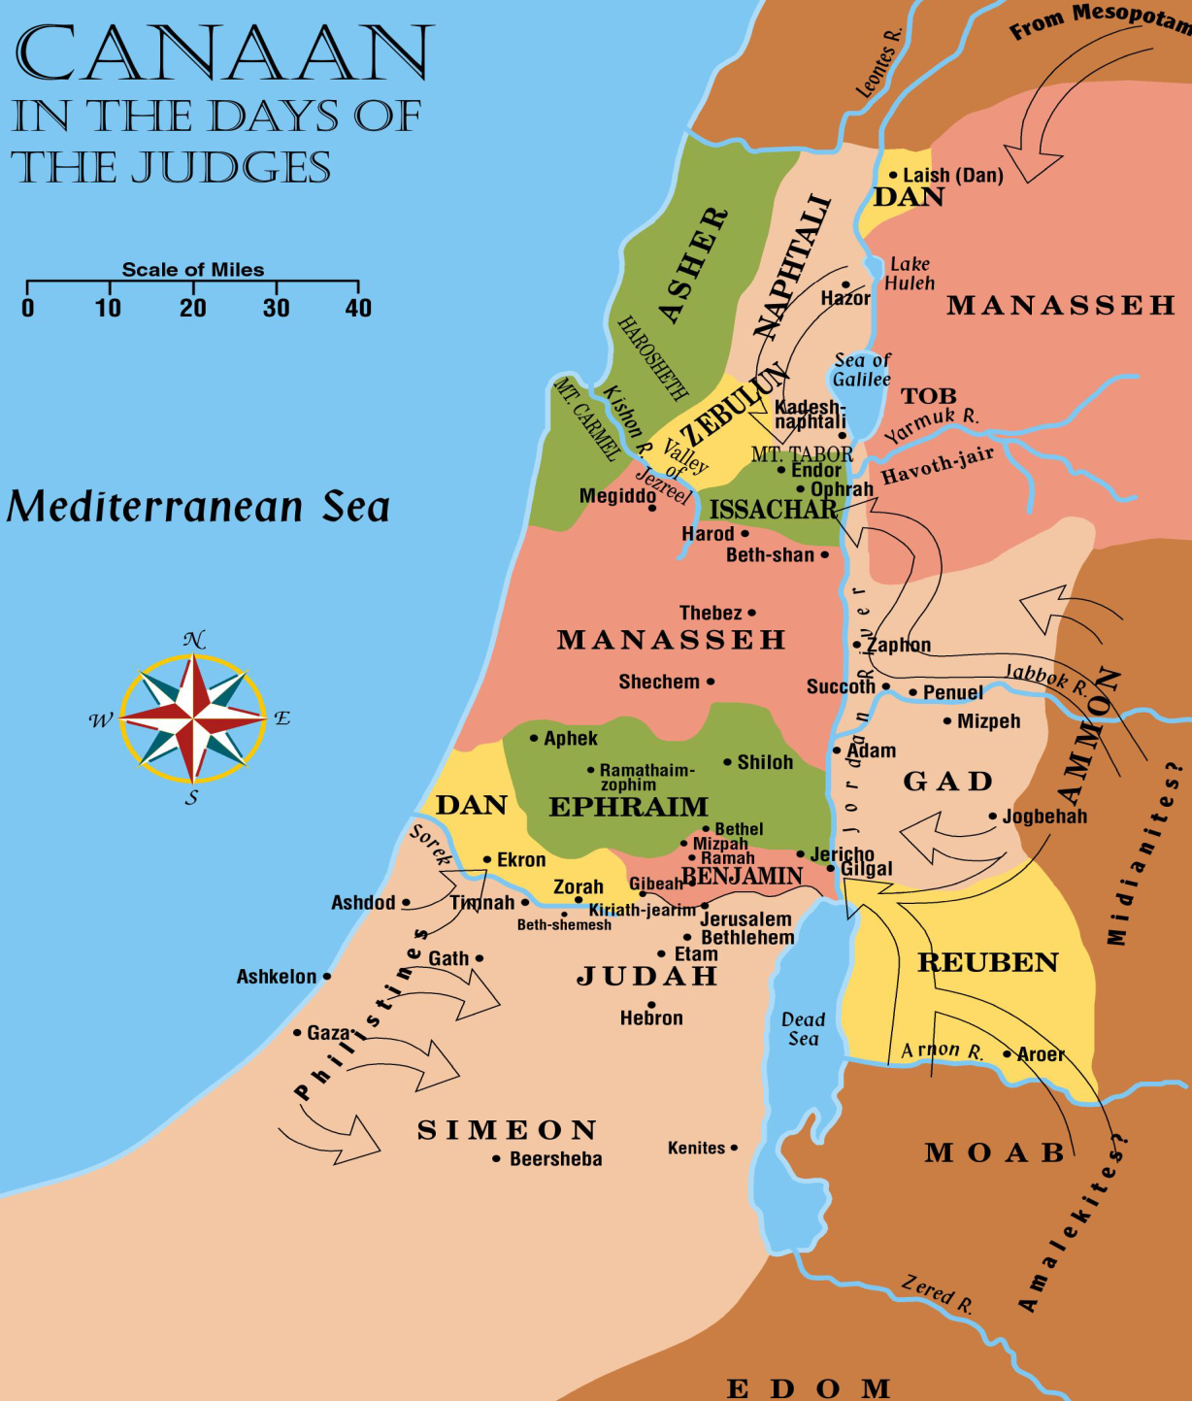
Othniel
Deborah
Ehud
Gideon

Slide 10
Jephthah

Slide 11
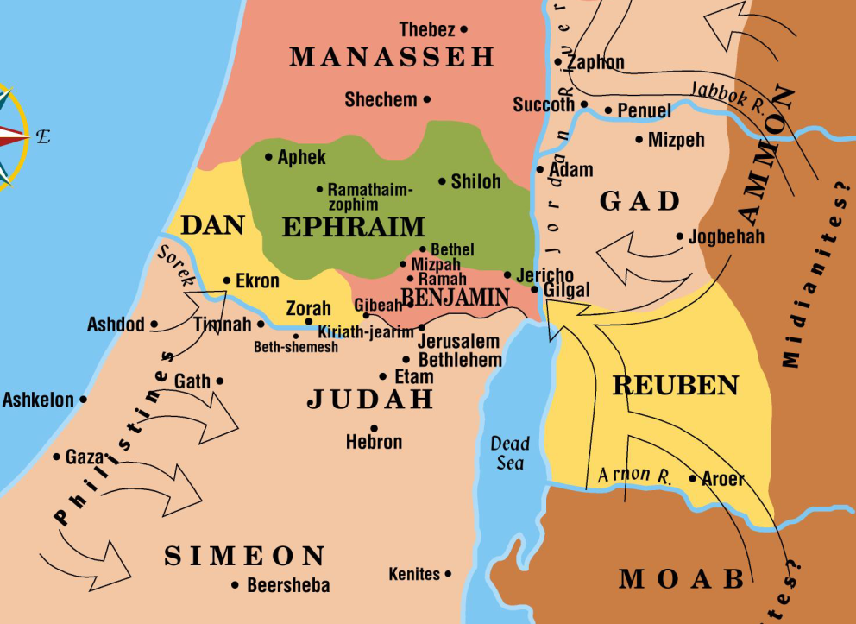
Areas of Ammonite Oppression
Ammonites operated primarily in Gilead.
Reuben, Gad, and the half tribe of Manasseh were involved in this oppression.
Ammonites crossed the Jordan to fight against Judah, Benjamin and Ephraim.
Ammonites

Slide 12
The Two Sides Face Off
Ammonites encamped in Gilead.
Israelites gathered at Mizpah ( below red triangle)
Ammonites

Slide 13
The Ammonite King’s Accusation
When Jephthah asked the Ammonite king why he seemed intent upon fighting “against my land,” the Ammonite king gave this reply: “Because Israel took away my land when they came up from Egypt, from the Arnon as far as the Jabbok and the Jordan…” (Judges 11:12-13)
(The green area to the west of Ammon is the disputed land.)

Slide 14
QUESTION 4: What was the true history (as Jephthah related it) of Israel’s acquisition of the land that the Ammonite king claimed as his? (Judges 11:16-23)
While the Israelites were at Kadesh Barnea, Edom and Moab refused to permit the Israelites to pass through their territories. (v. 17)
The Israelites were careful to go around Edom and Moab and crossed the Arnon River. (v. 18)
Upon crossing the Arnon, they were in the land of the Amorite king, Sihon, who also refused to permit the Israelites to cross through his land and fought them instead. (vv. 19-20)
(The land now in dispute had been part of Sihon’s Amorite kingdom.)
The LORD helped the Israelites defeat Sihon, and the Israelite victory gave the Israelites “all the territory of the Amorites, from the Arnon as far as the Jabbok, and from the wilderness as far as the Jordan.” (vv. 21-22)

Slide 15
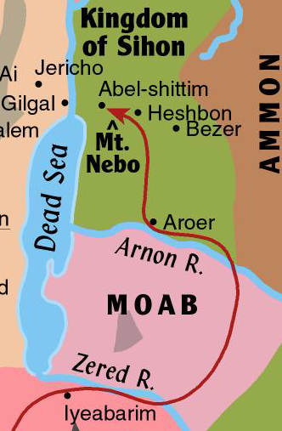
Israelites’ Avoidance of Moab
At the valley of the Zered they had turned eastward.
After crossing the Zered River they were on the edge of the land belonging to the Moabites.
After skirting Moab on the east, they crossed the Arnon into the territory of the Amorite king, Sihon (the land that the Ammonite king claimed in Judges 11).
The defeat of Sihon gave that land to the Israelites.

Slide 16
A Brief Review: Israel’s Conquests East of the Jordan
After defeating Sihon, the Israelites conquered King Og of Bashan.
With Og’s defeat, the Israelites controlled all the land from the Arnon River northward to Mt. Hermon.
(Again) The area that the Ammonite king claimed in Judges 11 is the green section at the bottom of the map.

