Slide 1
Before the Flood
Flood
Scattering
Patriarchs
Exodus
Wandering
Invasion and Conquest
JUDGES
JUDGES WEEK 2: EARLY JUDGES (Judges 3:7-5:31)

Slide 2
THE FIVE PART CYCLE OR SPIRAL
Apostasy
Oppression
Repentance
Deliverance
Peace

Slide 3
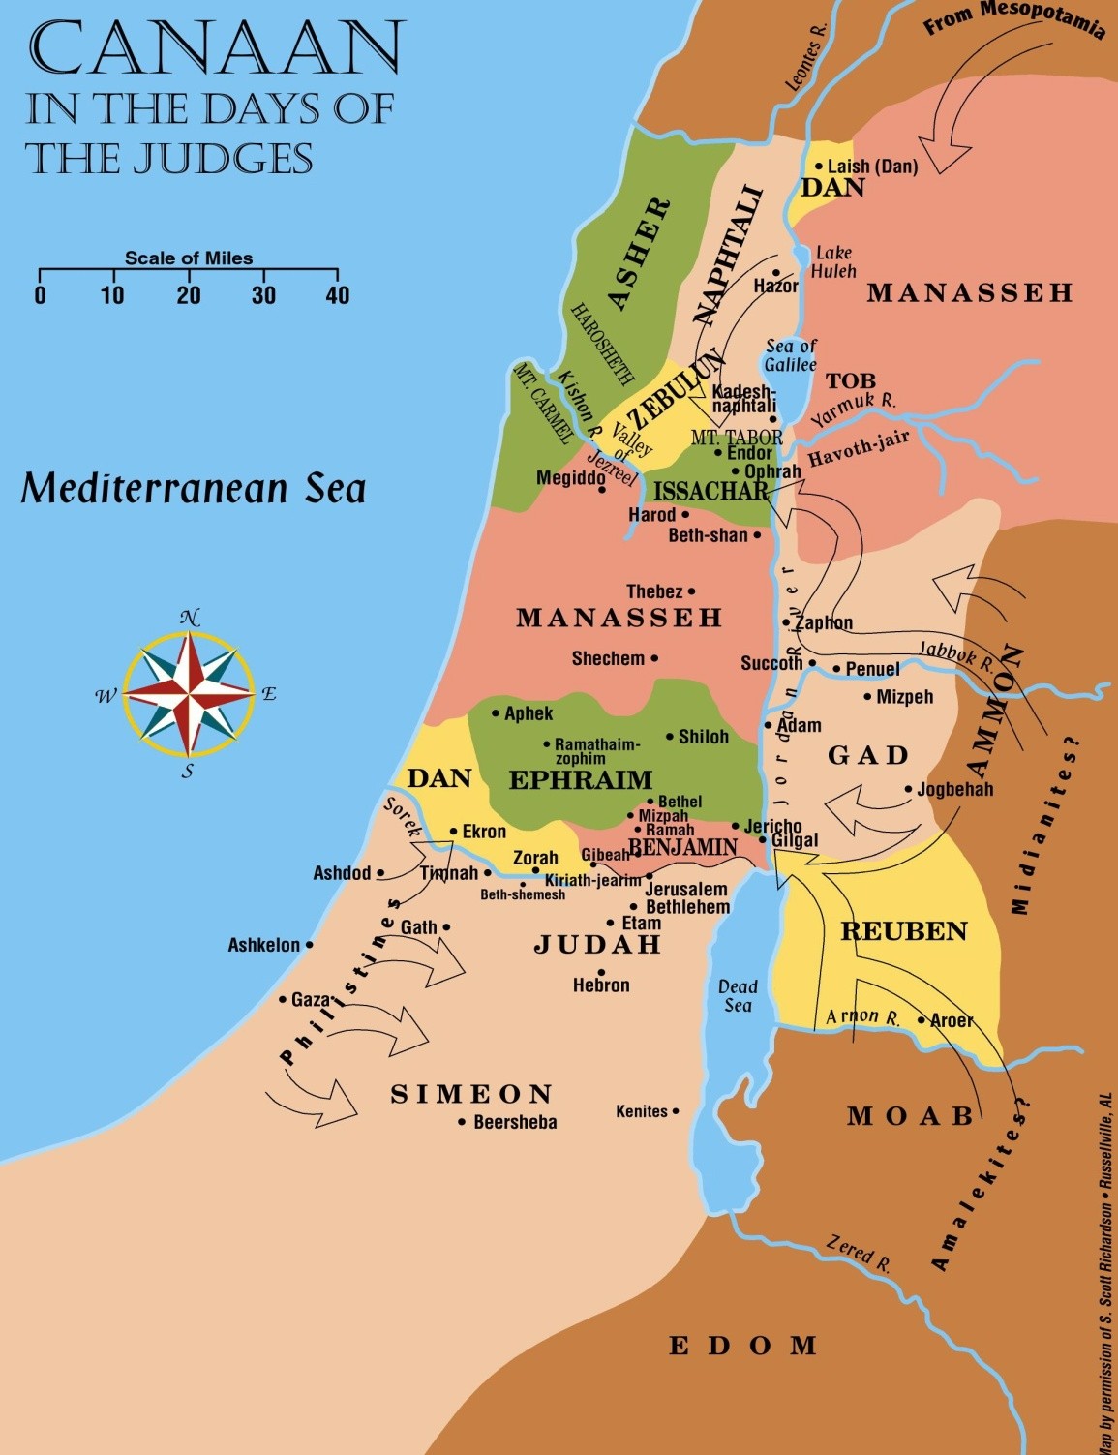
Early Judges
Oppression in first cycle came from Mesopotamia.
God helped the first judge, Othniel, throw off the oppression.
We’re told no details of the battle.
Othniel was a long way from home.
Othniel

Slide 4
JUDGES 3:7-11—”7 The sons of Israel did what was evil in the sight of the Lord, and forgot the Lord their God and served the Baals and the Ashteroth. 8 Then the anger of the Lord was kindled against Israel, so that He sold them into the hands of Cushim-rishathaim king of Mesopotamia; and the sons of Israel served Cushim-rishathaim eight years. 9 When the sons of Israel cried to the Lord, the Lord raised up a deliverer for the sons of Israel to deliver them, Othniel, the son of Kenaz, Caleb’s younger brother. 10 The spirit of the Lord came upon him, and he judged Israel. When he went out to war, the Lord gave Cushan-rishathaim king of Mesopotamia into his hand, so that he prevailed over Cushan-rishathaim. 11 Then the land had rest forty years. And Othniel the son of Kenaz died.” (NASB)

Slide 5
Early Judges
Oppression from outside the land that the Israelites occupied would come from different directions.
Othniel

Slide 6
QUESTION 1: During the first “cycle” or “spiral,” how much of the land that the Israelites occupied was subjected to the Moabite oppression?
We don’t know.
Here, the Mesopotamians would have come into the land from the north, but we can’t say how far south they went.
It seems highly doubtful that in each (or, indeed, in any) of these instances of oppression, that the oppressor subjected the entire land of Canaan to oppression.

Slide 7
Early Judges
In the second cycle, the Moabites, Ammonites and Amalekites joined forces to oppress Israel.

Slide 8
QUESTION 2: Who were the Moabites and the Ammonites?
Moabites descended from Lot’s elder daughter. (from her son, Moab; Gen. 19:37)
Ammonites descended from the younger of Lot’s daughters. (from her son, Ben-ammi; Gen. 19:38)

Slide 9
Early Judges
They took the city of Jericho (“the city of the palm trees”).
Again, we don’t know full geographical extent of the oppression. (Likely that invasion brought numerous occupiers.)
Oppression lasted 18 years.
Again, the Israelites “cried to the Lord.” (Judges 3:15)
Ehud

Slide 10
Early Judges
Ehud killed Eglon, king of Moab, and rallied the Israelites.
He led the Israelites to victory, and the land had rest for 80 years.
Ehud

Slide 11
QUESTION 3: What was the significance of the fact that Ehud was left-handed?
Warriors usually wore their sword on the left side and drew it with the right hand.
Ehud, being left-handed, concealed his sword under his clothing on his right side, causing Eglon’s guards to overlook it.

Slide 12
QUESTION 4: When you read the accounts of Othniel and Shamgar, can you say that there was anything “spiritual” about what they did? What seems to have been the main function of a judge?
The accounts describe military successes.
God raised up judges to save the nation from actual, physical oppression.

Slide 13
Early Judges
Gradually, the Canaanites remaining in the land gained enough strength to fight the Israelites again.
When the Israelites again did evil, God “sold them into the hand of Jabin king of Canaan, who reigned in Hazor.” (Judges 4:2-3)
Sisera was commander of army (from Harosheth-hagoyim (see oval on map))

Slide 14
QUESTION 5: In Joshua 11:10-11, late in the conquest phase, we read that Joshua captured Hazor, killed the king (Jabin), burned the city, and that the Israelites killed every person found in Hazor. But now, in Judges 4, we find “Jabin king of Canaan who ruled in Hazor” (Judges 4:2) stirring up serious trouble for the “sons of Israel” and “severely” oppressing them for 20 years (Judges 4:3). What gives?
Many years had passed, and Israelites apparently decided not to rebuild Hazor and settle there.
In the meantime, Canaanites did rebuild and resettle it.
It’s a different “Jabin” now.
Perhaps an example of “little by little” (Deut. 7:22), the Israelites lacking enough people to quickly settle all of the available land.

Slide 15
Early Judges
They gained control of the rich valley of Jezreel and oppressed Israel for 20 years.
The oppression was “severe,” and Jabin had 900 iron chariots.
Conditions were terrible...
…so bad that people didn’t travel; the highways were deserted. (Judges 5:6)
It seems that the Israelites didn’t even have conventional weapons. (Judges 5:8)
Deborah

Slide 16
Early Judges
Deborah was judging Israel at the time and lived between Ramah and Bethel in hill country of Ephraim (south of where oppression in north was taking place).
Sat as judge beneath “palm tree of Deborah.”
Needed a general—called Barak.
Deborah

Slide 17
GOD’S CHARGE TO BARAK
JUDGES 4:6-7—”6 Now she sent and summoned Barak the son of Abinoam from Kadesh-Naphtali, and said to him, ‘Behold, the Lord, the God of Israel, has commanded, ‘Go and march to Mt. Tabor, and take with you ten thousand men from the sons of Naphtali and from the sons of Zebulun. 7 I will draw out to you Sisera, the commander of Jabin’s army, with his chariots and his many troops to the River Kishon, and I will give him into your hand.’” (NASB)

Slide 18
Early Judges
Places to note:
The Kenites’ home territory was in Judah. (They turn up later in the story—Jael.)
Hazor
Valley of Jezreel
Kadesh-Napthali (home of Barak; Jael and husband nearby)
Mt. Tabor
Kishon River
Napthali and Zebulun (where most of army would be drawn from)

Slide 19
Barak
Ehud
Deborah
Othniel

Slide 20
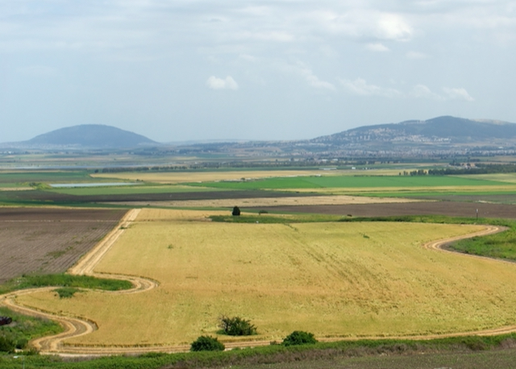
Mt. Tabor
Hill of Moreh
Kishon River
Jezreel Valley from West

Slide 21
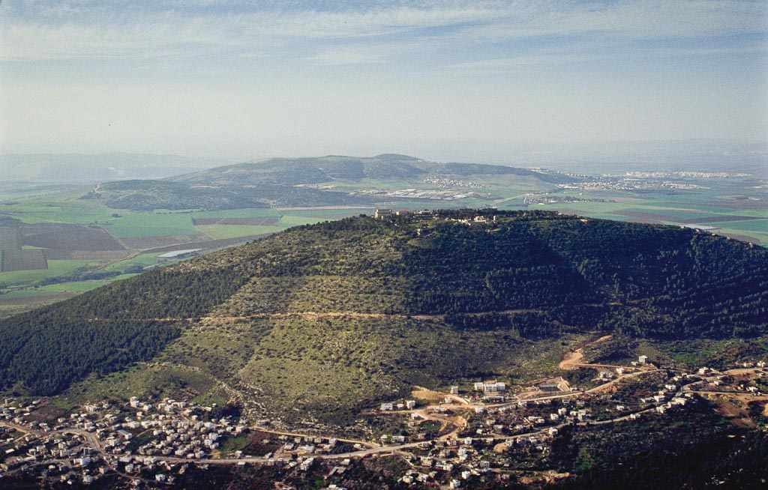
Hill of Moreh
Mt. Tabor
Mount Tabor aerial from north
Notes:
bb00170054

Slide 22
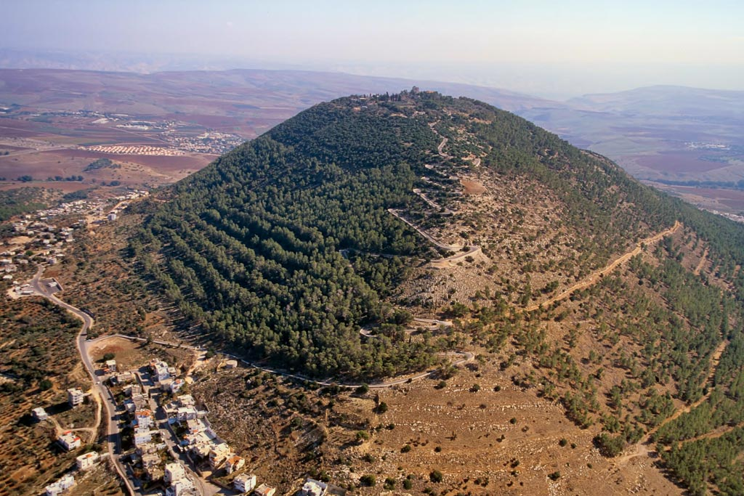
Mount Tabor aerial from northwest
Notes:
Jeremiah 46:18 (NASB) “‘As I live,’ declares the King Whose name is the Lord of hosts, ‘Surely one shall come who looms up like Tabor among the mountains, Or like Carmel by the sea.’”
tbs121210011

Slide 23
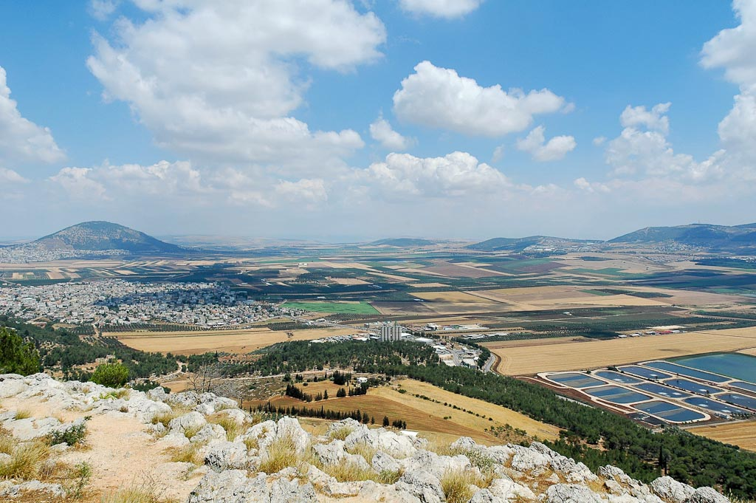
Mt. Tabor
Endor
Jezreel Valley and Mount Tabor from Nazareth ridge
Notes:
tb053005458

Slide 24
Mt. Tabor
Hill of Moreh
Mt. Gilboa
Kishon River
Jezreel Valley from Mount Carmel panorama
Notes:
tb032407526

Slide 25
Barak
Ehud
Deborah
Othniel

Slide 26
JUDGES 4:15-16—”15 The Lord routed Sisera and all his chariots and all his army with the edge of the sword before Barak; and Sisera alighted from his chariot and fled away on foot. 16 But Barak pursued the chariots and the army as far as Harosheth-hagoyim, and all the army of Sisera fell by the edge of the sword, not even one was left.” (NASB)

Slide 27
Barak
Ehud
Deborah
Othniel

Slide 28
QUESTION 6: In the “cycles” we’ve seen so far, the periods of oppression were far shorter than the periods of peace (8 yrs. vs. 40 yrs.; 18 yrs. vs. 80 yrs.; 20 yrs. vs. 40 yrs.). Can you think of any reason(s) why the periods of peace lasted so much longer than the periods of oppression?

