Slide 1
Before the Flood
Flood
Scattering
Patriarchs
Exodus
Wandering
INVASION AND CONQUEST
Judges
WEEK 7: INVASION AND CONQUEST REVIEW

Slide 2
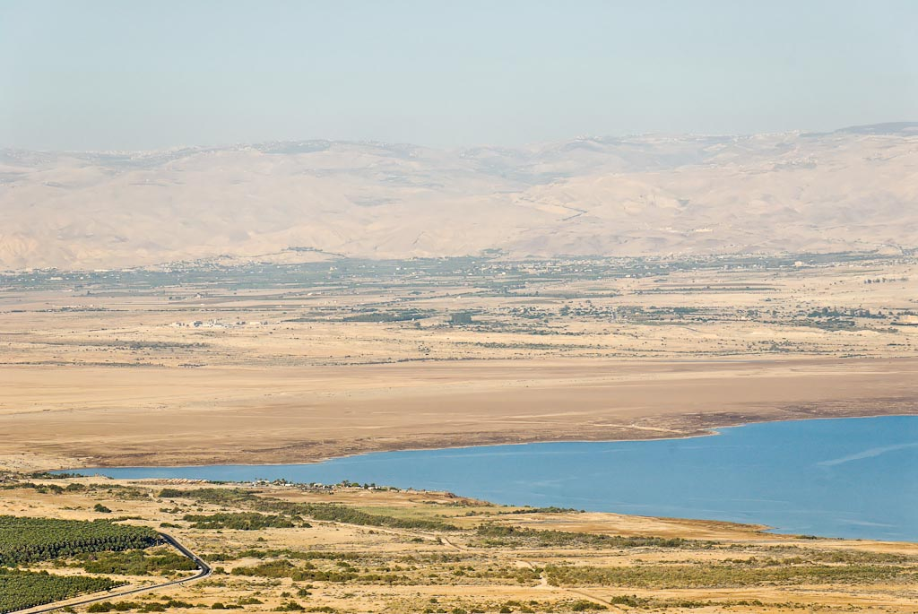
Late in the WITW period, the Israelites were on the Plains of Moab, viewed here from the southwest.
Notes:
The Israelites were encamped on the Plains of Moab below Mount Nebo at the time of Moses’ death and just prior to crossing the Jordan River and entering the Promised Land.
tb092706271

Slide 3
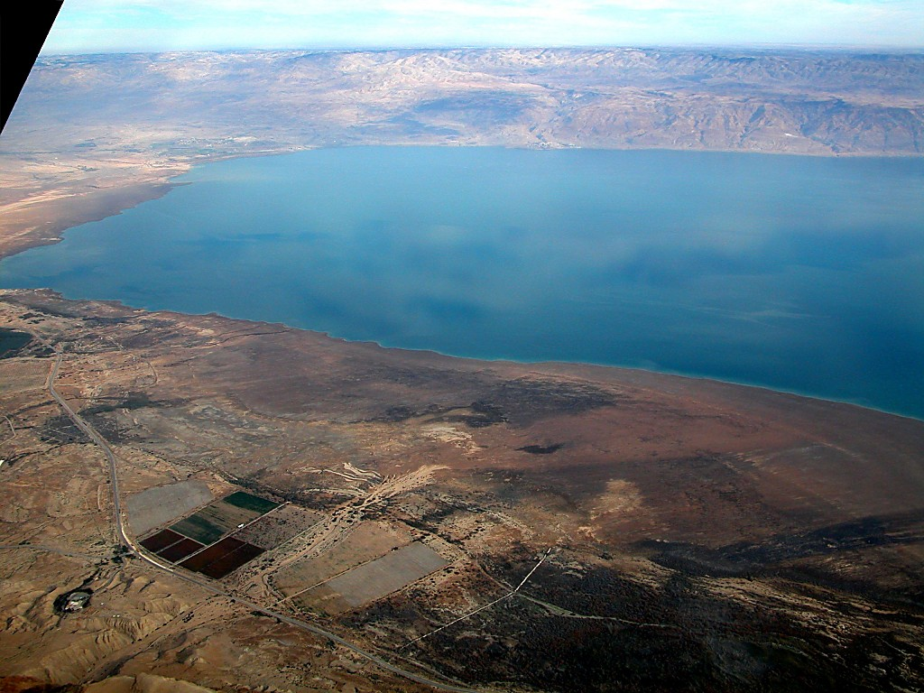
Mt. Nebo
Plains of Moab
Dead Sea
Moses had just died on Mt. Nebo
Notes:
tb010703243

Slide 4
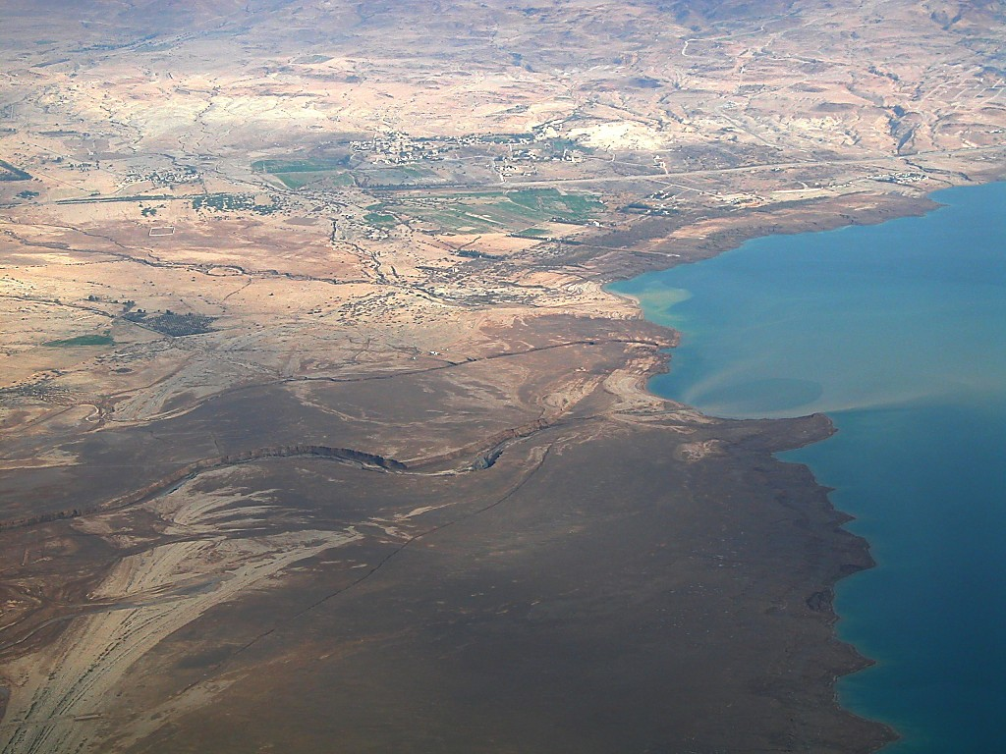
Plains of Moab
Mouth of the Jordan
Jordan River entering Dead Sea--aerial from west
Notes:
tb010703283

Slide 5
WITH THE INVASION LOOMING, JOSHUA RECEIVED NUMEROUS ASSURANCES FROM GOD. (Josh. 1:2-9; 3:7)
God is giving the land to Israel; Joshua would be the one to “cause” them to “inherit” the land. (Josh. 1:2-4, 6)
God would always be with Joshua, as He had been with Moses. (Josh 1:5, 9)
Joshua (and the people) would always have prosperity and success if they followed the law. (Josh. 1:7-8)
God would “exalt” Joshua in the eyes of the people. (Josh. 3:7)
They would know that God would be with Joshua in the same way that He had been with Moses.

Slide 6
THE LORD ALSO GAVE JOSHUA INSTRUCTIONS AND A WARNING.
Instructions—Josh. 1:6-9
Be strong and courageous. (vv. 6, 7, 9)
Focus on the law: think about it; talk about it; obey it! (vv. 7-9)
The warning was implied in the instructions in vv. 7-8.
Don’t “turn from” the law so that you “may have good success.” (v. 7)
Don’t let the law “depart from your mouth” and meditate on it constantly so that you will have prosperity and success. (v. 8)

Slide 7
KEY EVENTS IN PREPARATION FOR INVASION
God’s assurances, instructions, warning to Joshua
Spies sent into Jericho—they receive a “friendly welcome” from Rahab.
Joshua gives predictions to people about what was about to happen:
Evidence that God was with them and that He would “without fail” drive enemies from land
What would happen when they reached river
Crossing of river and setting up the 12 “memorial” stones at Gilgal
Circumcising of the “sons of Israel”
Observation of Passover and (on following day) eating of the “produce of the land”

Slide 8
KEY EVENTS cont.
Joshua’s encounter with the “commander of the army of the LORD”
(Instructions for marching around Jericho (Josh. 6:3-5))
The Israelites’ demonstration of obedience and faith in doing all the marching around the Jericho walls

Slide 9
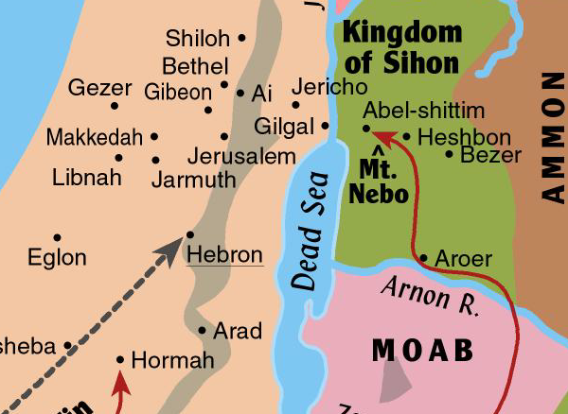
The Conquest of Canaan
Joshua sent spies across the Jordan to the city of Jericho. (Josh. 2:1)
The spies learned that the people of Jericho were terrified.
The Israelites then crossed the Jordan River, confident of success!

Slide 10
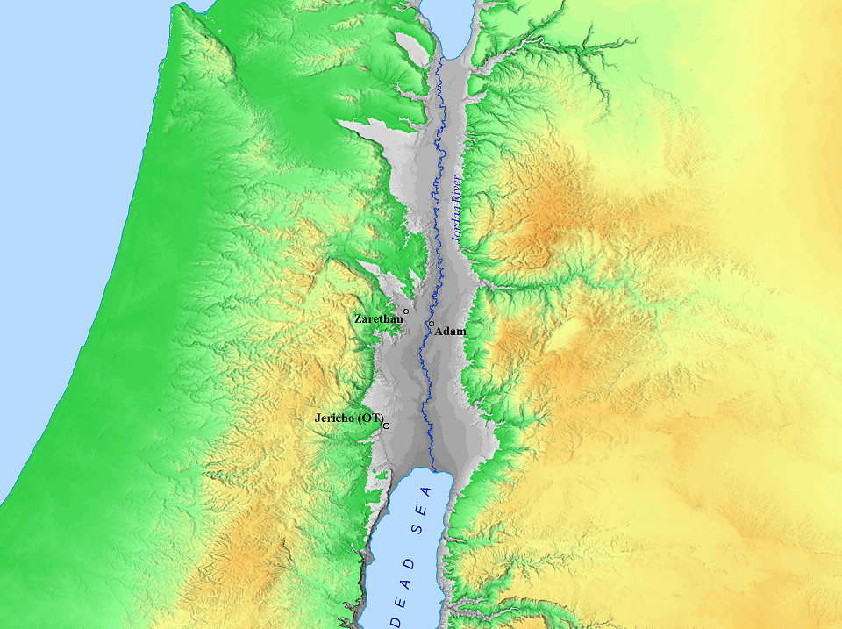
THE SITE(S) OF THE JORDAN RIVER CROSSING MIRACLE

Slide 11
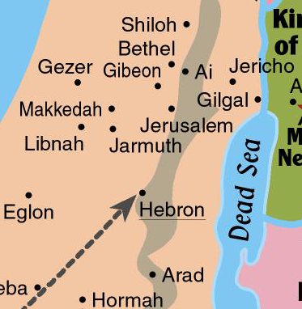
The Conquest of Canaan
After crossing the Jordan, the Israelites set up camp at Gilgal.
Jericho was the logical city to attack first.
Jericho lay directly in the path between Israel’s camp at Gilgal and the central portion of the land they were to take.

Slide 12
GOD’S GENERAL INSTRUCTIONS FOR INTERACTING WITH THE LOCAL PEOPLE
(See Exod. 23:31-33; 34:12-16; Deut. 20:16-18)
CONCERNING THE INHABITANTS OF THE LAND:
Exod. 23:31-33—”31 …I will give the inhabitants of the land into your hand, and YOU SHALL DRIVE THEM OUT BEFORE YOU. 32 YOU SHALL MAKE NO COVENANT WITH THEM AND THEIR GODS. 33 THEY SHALL NOT DWELL IN YOUR LAND, lest they make you sin against me; for if you serve their gods, it will surely be a snare to you.” (ESV)

Slide 13
GOD’S GENERAL INSTRUCTIONS cont.
CONCERNING CITIES:
Deut. 20:16-18—”16 But in the cities of these peoples that the LORD your God is giving you for an inheritance, YOU SHALL SAVE ALIVE NOTHING THAT BREATHES, 17 but you shall devote them to complete destruction….that they may not teach you to do according to all their abominable practices that they have done for their gods, and so you sin against the LORD your God.” (ESV)
(This general instruction would not require the killing of livestock.)

Slide 14
GOD’S INSTRUCTIONS SPECIFICALLY CONCERNING JERICHO
Josh. 6:17-19—”And the city and all that is within it shall be devoted to the LORD for destruction. Only Rahab the prostitute and all who are with her in her house shall live, because she hid the messengers whom we sent. 18 But you keep yourselves from the things devoted to destruction, lest when you have devoted them you take any of the devoted things and make the camp of Israel a thing for destruction and bring trouble upon it. 19 But all silver and gold, and every vessel of bronze and iron, are holy to the LORD; they shall go into the treasury of the LORD.” (ESV)
“…all that is within it” included the livestock—the Israelites killed all livestock found in Jericho.
Spoils, including livestock, would be taken in future city conquests. Jericho was a special case.
While largely followed, there will be an important violation.
Achan will steal “devoted” items.

Slide 15
The Conquest of Canaan
God used a miracle to give Jericho into the Israelites’ hands.
They marched around the city 7 days, and the walls fell flat.
The city enclosed within the city walls covered only 7-10 acres.
Rahab and the Israelites demonstrated working faith (Heb. 11:30-31).
Jericho was the first city in Canaan proper to fall to the Israelites.

Slide 16
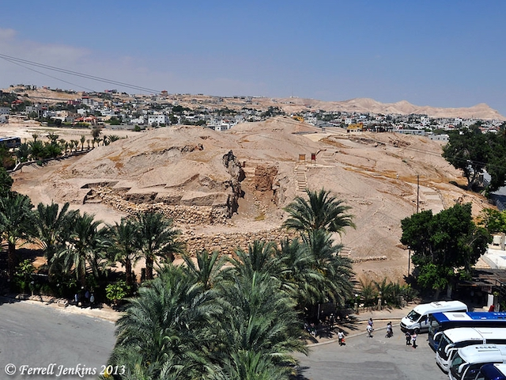

Slide 17
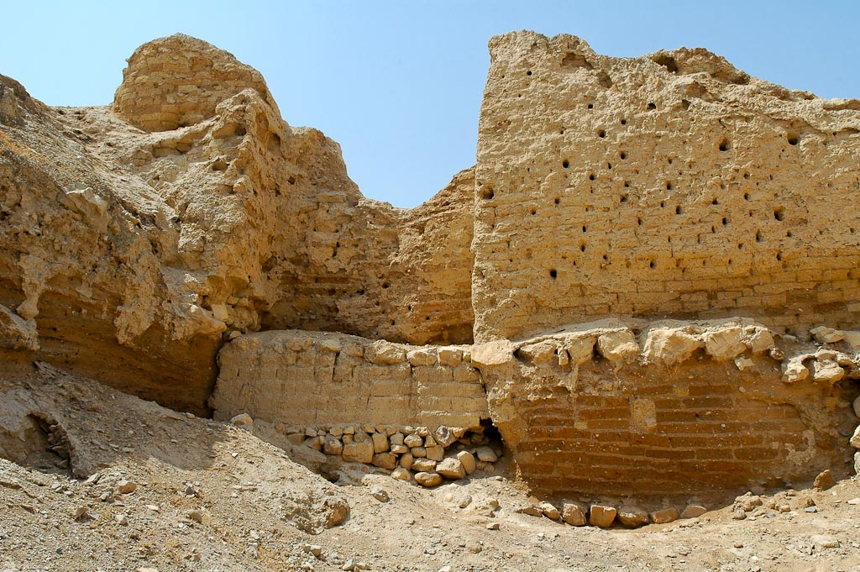
Jericho—section of mud brick wall that did not fall (perhaps where Rahab lived?)
Notes:
tb052205948

Slide 18
KEY EVENTS IN THE CENTRAL CAMPAIGN
(Destruction of Jericho as prelude)
The devastating defeat at Ai (resulting from Achan’s sin)
The punishment of Achan and family, removing the sin from the Israelites’ camp
The second—and successful—attack on Ai
The reading of the law—and staking the Israelites’ claim to the land—at Shechem (Mts. Gerizim and Ebal)

Slide 19
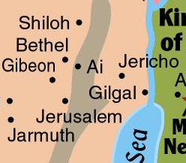
The Conquest of Canaan
Joshua sent spies toward Bethel. They returned reporting they could take Ai.
A small company of soldiers (about 3,000) attacked Ai. To their utter shock, they were defeated, and the survivors even ran away. 36 of their men died.
The unexpected loss completely demoralized the people and Joshua.
“I will be with you if you will obey My commandments.”

Slide 20
The Conquest of Canaan
God shook Joshua out of his demoralized state, telling him to “get up.”
Achan’s sin was discovered. He was stoned, his body burned, and stones heaped atop the burnt remains.
With God’s anger assuaged, the people prepared for battle again.
The Israelites would now have no trouble defeating Ai and the neighboring city of Bethel.

Slide 21
The Conquest of Canaan
Joshua sent an ambush force west of Ai.
The main Israelite force attacked from the north and lured the men of Ai (and Bethel) out of the city.
The defeat of Ai was total; it was burned, with nothing but a pile of rubble remaining.

Slide 22
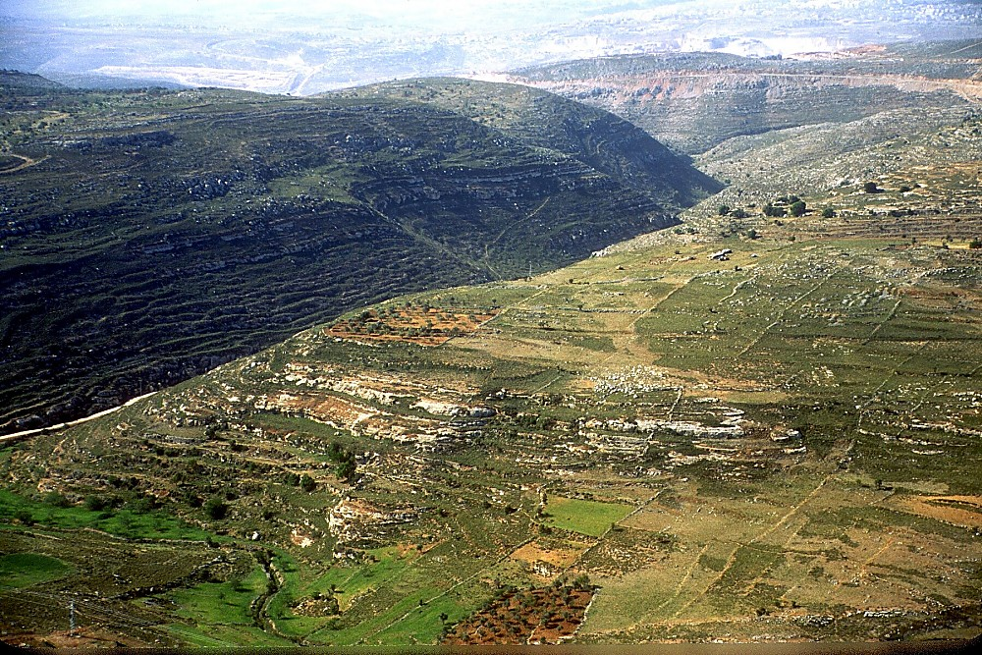
Wadi Sheban aerial from northwest (plausible hiding place of Joshua’s ambush force—deep valley would hide force between Ai and Bethel)
Notes:
A logical place for the ambush force, whether one locates Ai at Khirbet el-Maqatir or at et-Tell, is the Wadi Sheban. The ambush force would have concealed between Bethel and Ai in this deep valley.
Joshua 8:3-7 (NRSV) “So Joshua and all the fighting men set out to go up against Ai. Joshua chose thirty thousand warriors and sent them out by night with the command, “You shall lie in ambush against the city, behind it; do not go very far from the city, but all of you stay alert. I and all the people who are with me will approach the city. When they come out against us, as before, we shall flee from them. They will come out after us until we have drawn them away from the city; for they will say, ‘They are fleeing from us, as before.’ While we flee from them, you shall rise up from the ambush and seize the city; for the Lord your God will give it into your hand.”
tbs104349905

Slide 23
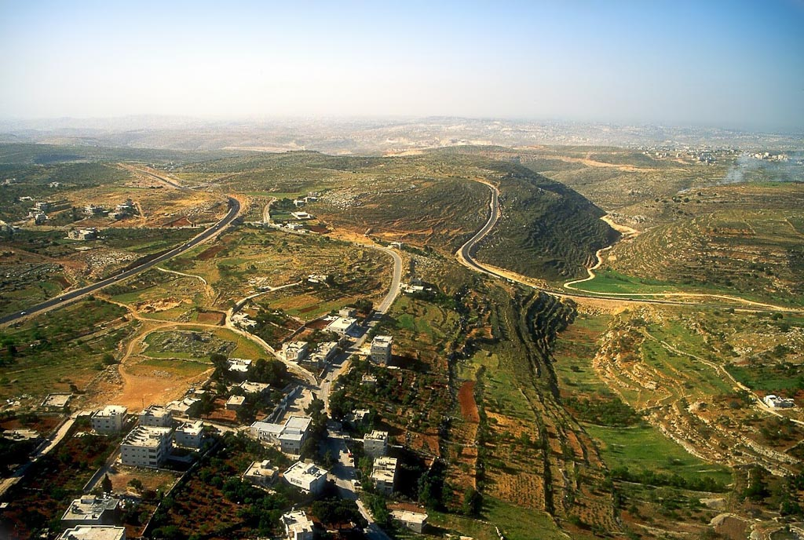
Et-Tell
Khirbet el-Maqatir
(Ai?)
Jerusalem
Wadi Sheban
(Ambush Force)
Khirbet el-Maqatir and Wadi Sheban aerial (Bethel would be out of this picture, to the right.)
Notes:
tbs104369905

Slide 24
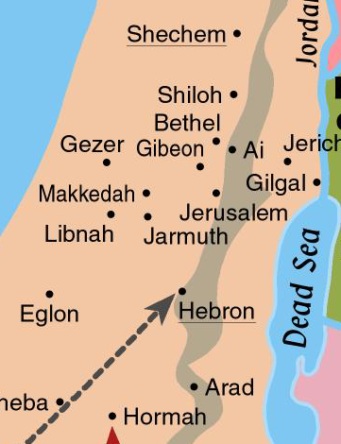
The Conquest of Canaan
With Jericho, Ai, and Bethel destroyed, the Israelites were able to move freely into the central hill country.
They went to the twin peaks of Gerizim and Ebal.
There, they read the law, including the blessings for obedience and curses for disobedience, and staked their claim to the territory.

Slide 25
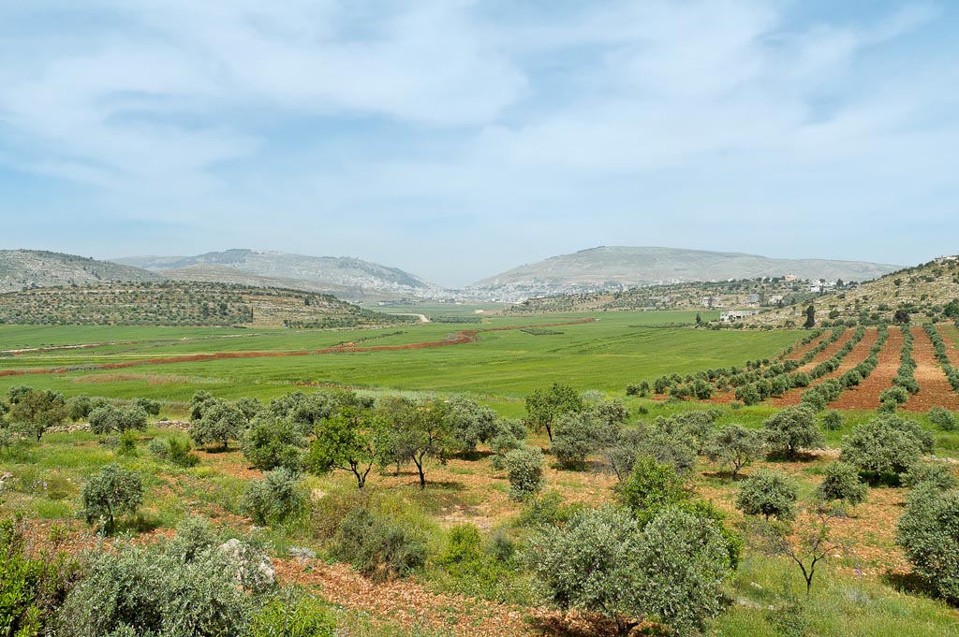
Mount Gerizim, Shechem, and Mount Ebal from east
Notes:
tb050106458

Slide 26
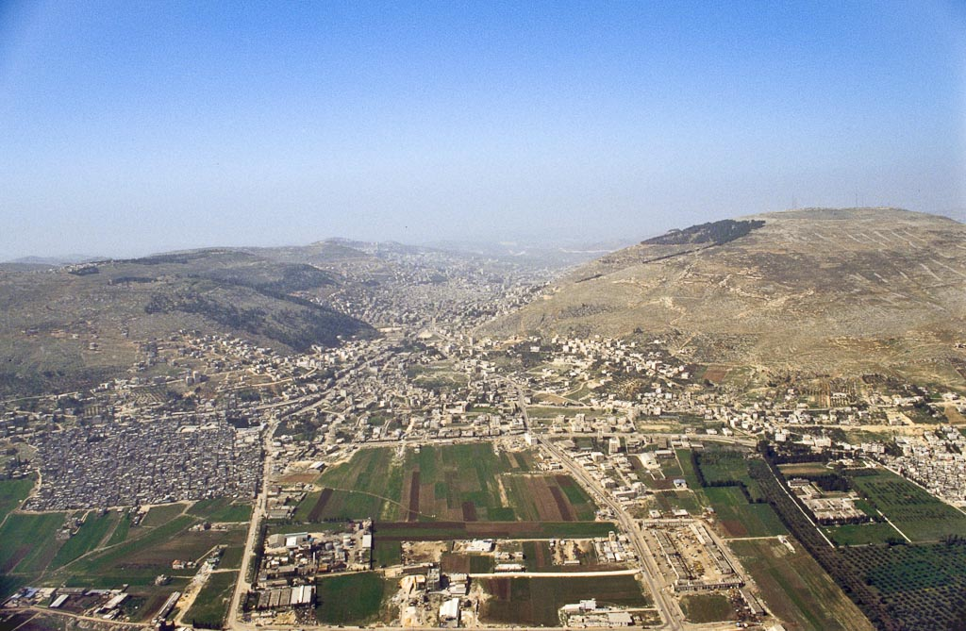
Mt. Ebal
Mt. Gerizim
Shechem
(Tell Balata)
Shechem and Mounts Gerizim and Ebal aerial from east
Notes:
bb00120041

Slide 27
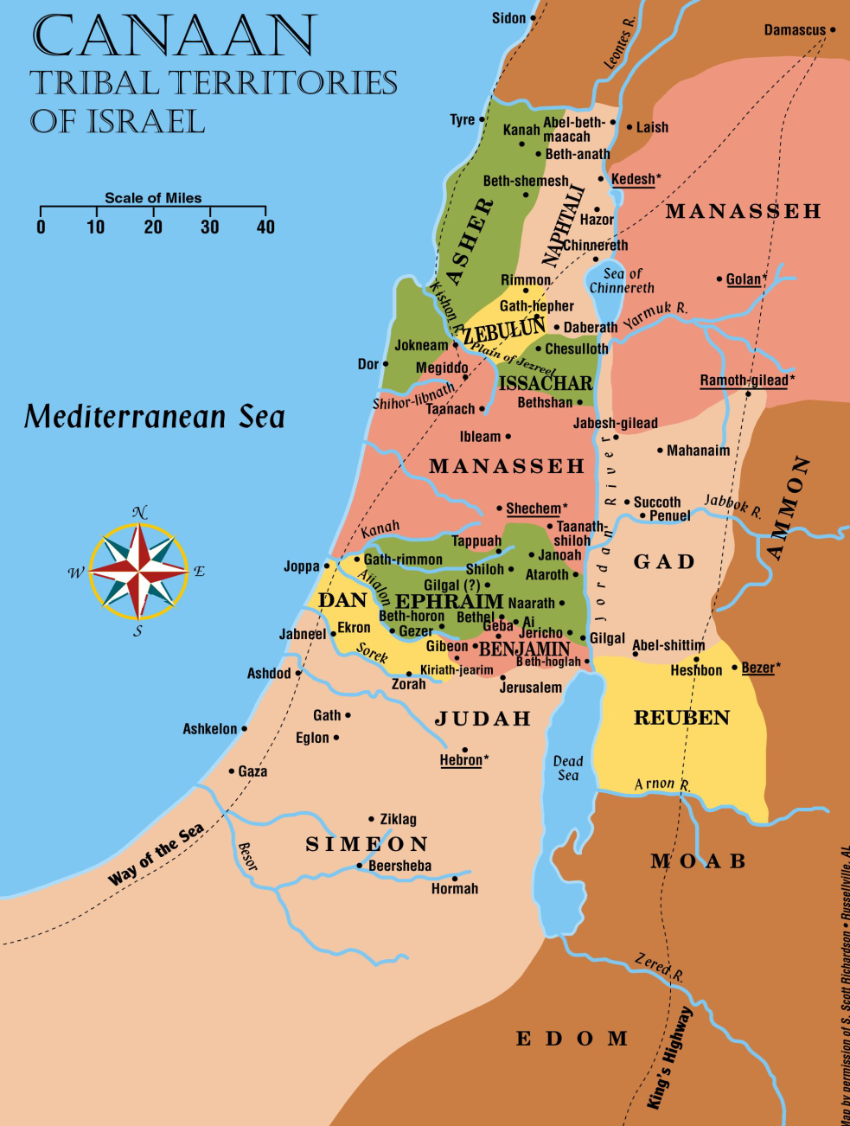
Central Campaign:
(Jericho)
Ai/Bethel
Shechem (no battle; reading of the law)

Slide 28
KEY EVENTS IN THE SOUTHERN CAMPAIGN
The Gibeonites’ deception
The forming of an alliance of 5 Amorite kings (of Jerusalem and 4 other cities)….and their utter defeat at the hands of the Israelites at Gibeon
The headlong flight south from Gibeon of the armies of the 5 kings …and the additional destruction wreaked upon them as they fled
The “great stones” from the sky
The miraculous stopping of the sun for a day
The conquest of 7 cities in the south and the killing of every person found in those cities (as God had commanded)
The killing of each of the 5 allied southern kings

Slide 29
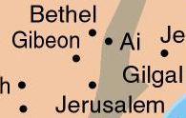
The Conquest of Canaan
Men from Gibeon came and deceived the Israelite leaders into making a treaty of peace with them.
In a failure of leadership, Joshua and the other leaders neglected to seek God’s advice in the matter—a major oversight with profound consequences.

Slide 30
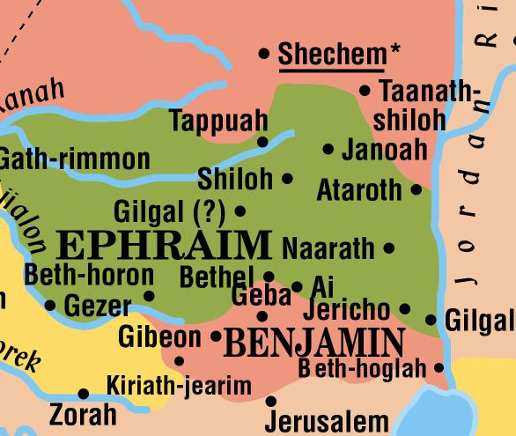
GIBEON-NOT FAR FROM THE ISRAELITES

Slide 31
WHY THE GIBEONITES DUPED THE ISRAELITES:
They knew of the Israelite successes—how the LORD had helped Israel. (Josh. 9:3, 9-10)
They didn’t want to be next.
They were aware of God’s instructions about how Israelites were to treat inhabitants of the land—that they were to be “destroyed.” (Josh. 9:24)
They understood that peoples/cities not within the promised land of Canaan would receive less harsh treatment.
THE ISRAELITES HONORED THE OATH THEY HAD SWORN AND DID NOT ATTACK THE GIBEONITES.

Slide 32
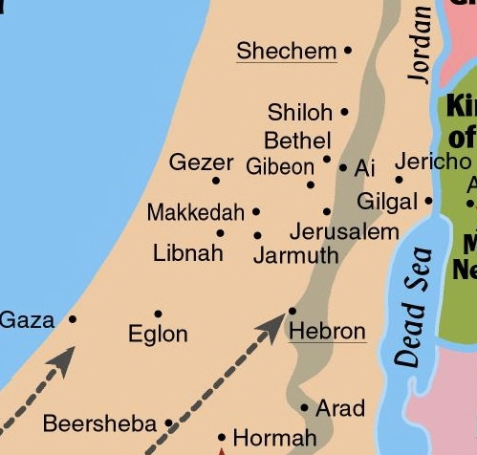
The Conquest of Canaan
Adoni-Zedek, king of Jerusalem, was upset over Israel’s victories.
Especially alarmed when he learned Gibeon had made peace with them.
Asked help from the kings of Hebron, Jarmuth, Lachish and Eglon.
Lachish

Slide 33
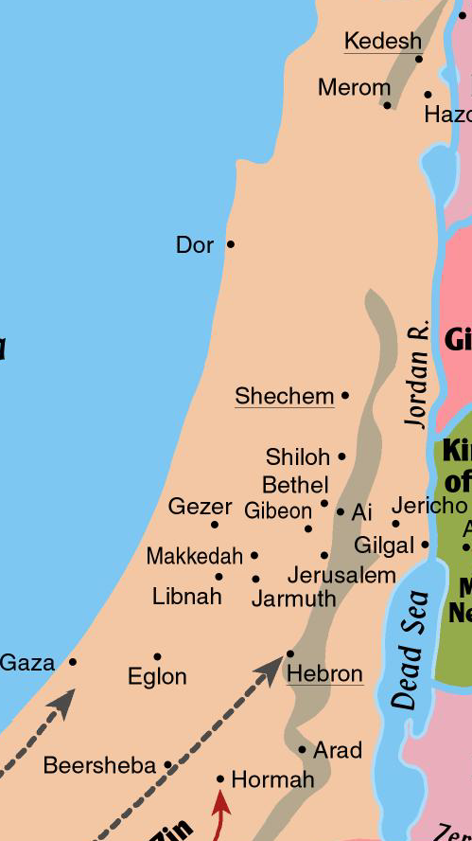
The Conquest of Canaan
5 kings attacked Gibeon.
Gibeon sent for help from Joshua.
Israelites made a surprise attack on the armies of the 5 kings.
Soon the Amorites were fleeing south, toward cities in southern foothills of hill country.
God sent a hailstorm that killed more than the battle.
Sun stopped for one day.
Sun and Moon
Joshua 10:12-14

Slide 34
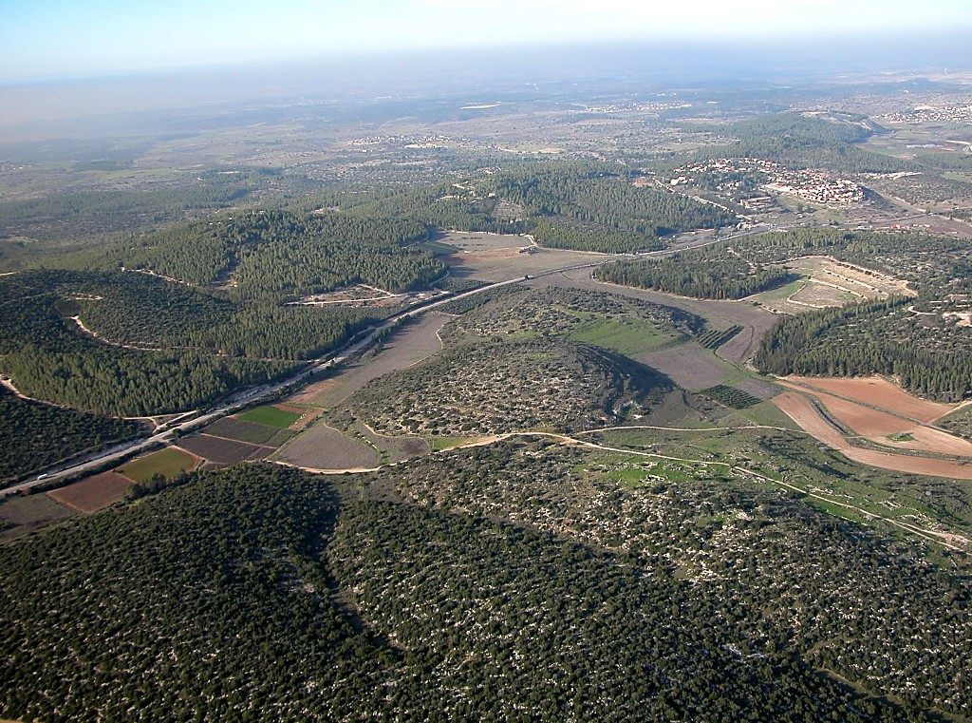
Azekah
Diagonal Route
to Lachish
Diagonal Route aerial from south—”And the LORD threw them into a panic before Israel, who struck them with a great blow at Gibeon and chased them by the way of the ascent of Beth-horon and struck them as far as Azekah and Makkedah.” (Josh. 10:10)
Notes:
tb010703250

Slide 35
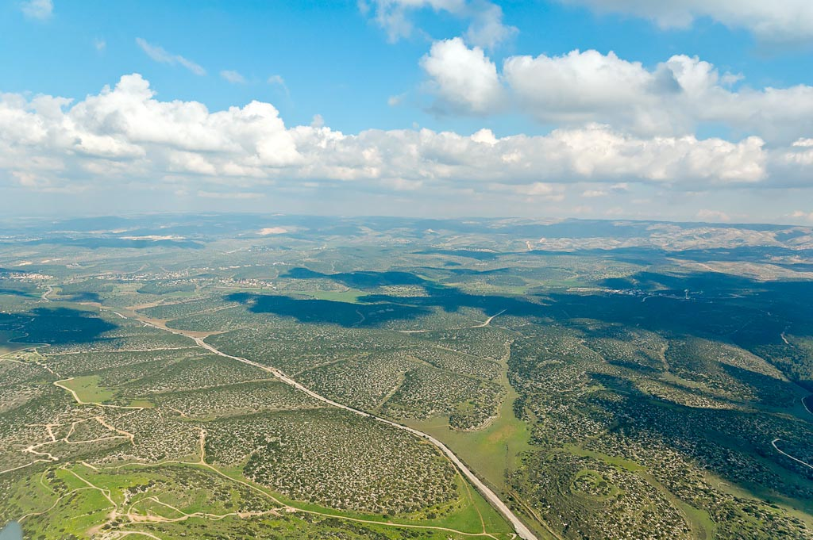
Judean Hills
Diagonal Route
to Lachish
Shephelah Diagonal Route from south aerial—probably the route the armies of the 5 kings took as they fled south
Notes:
tb011606761

Slide 36
The Conquest of Canaan
While Joshua had the advantage, he pushed through all the major cities of the south. (Josh. 10:28-39)
Makkedah - killed 5 allied kings
Libnah
Lachish
Gezer
Eglon
Hebron
Debir
Every person in these cities was “devoted to destruction.”
Lachish
Debir

Slide 37
By the end of the central and southern campaigns, the Israelites had taken many cities scattered over most of the central and southern hill country and the western foothills (the Shephelah).

Slide 38
The Conquest of Canaan
SUMMARY OF THE SOUTHERN CAMPAIGN:
Josh. 10:40—”So Joshua struck the whole land, the hill country and the Negeb and the lowland and the slopes, and all their kings. He left none remaining, but devoted to destruction all that breathed, just as the LORD God of Israel commanded.” (ESV)
(So far, the Israelites are following God’s instruction to kill all city-dwellers.)
Lachish
Debir

Slide 39
KEY EVENTS IN THE NORTHERN CAMPAIGN
Jabin, king of Hazor, assembles an alliance of northern kings.
The idea was to defeat the Israelites.
Israel defeats the large, powerful army of the northern kings at the waters of Merom.
Israelites inflicted additional defeats throughout the territory of the north.
The defeat and burning of Hazor…and the killing of all people in the city

Slide 40
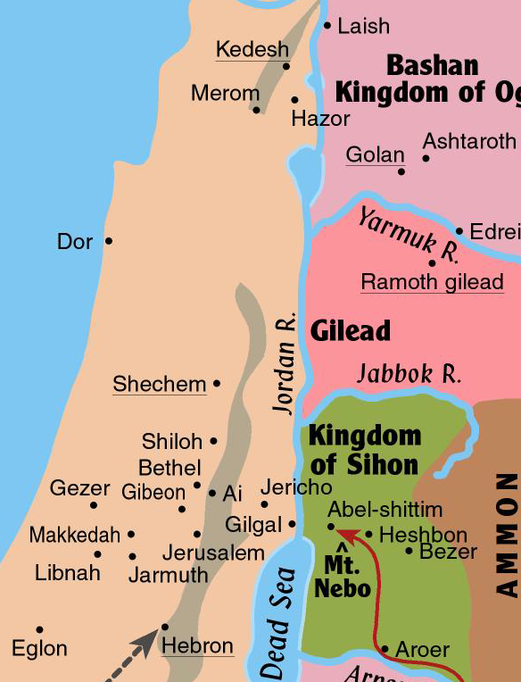
The Conquest of Canaan
Kings of the north formed a coalition.
Jabin, king of Hazor, was the leader.
They gathered a huge, powerful army, including many horses and chariots, from the northern third of the land.
Assembled at the waters of Merom.
God assured Israel of victory.

Slide 41
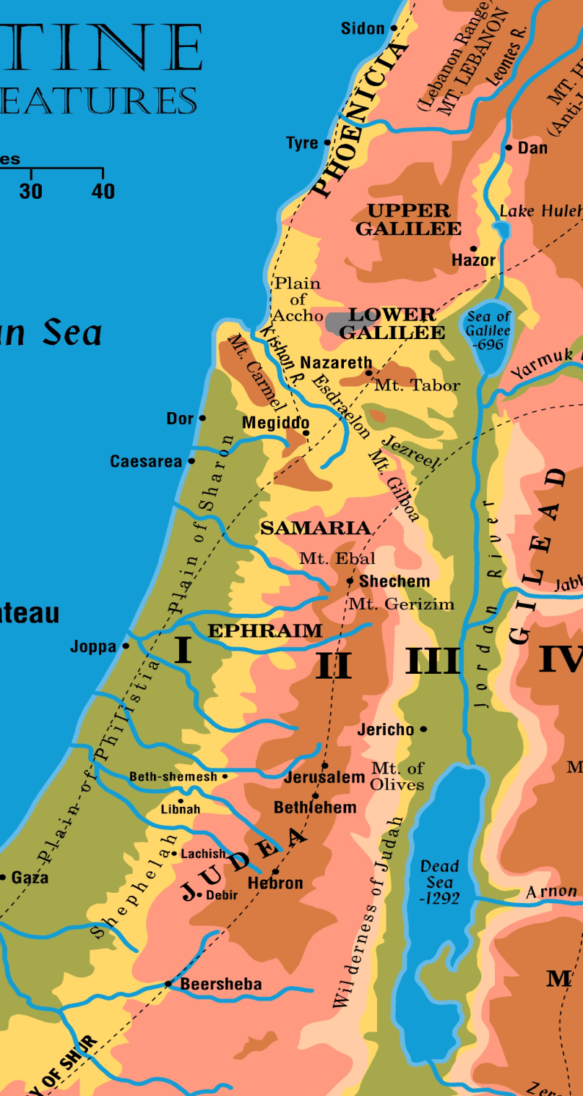
Joshua defeated the northern armies, and they fled northward. (Josh. 11:8-9)
Leontes River Valley
Valley between the Lebanon Mountains and the Anti-Lebanons
“8 …And they struck them until he left none remaining. 9 And Joshua did to them just as the LORD said to him: he hamstrung their horses and burned their chariots with fire.” (ESV)
Merom

Slide 42
The Conquest of Canaan
Next, Joshua backtracked and took Hazor.
Killed inhabitants; burned city.
A major conquest—probably largest city in the land, with 200 acres within massive walls.
After these victories in the north, there was no king or coalition of kings left to fight Israel.

Slide 43
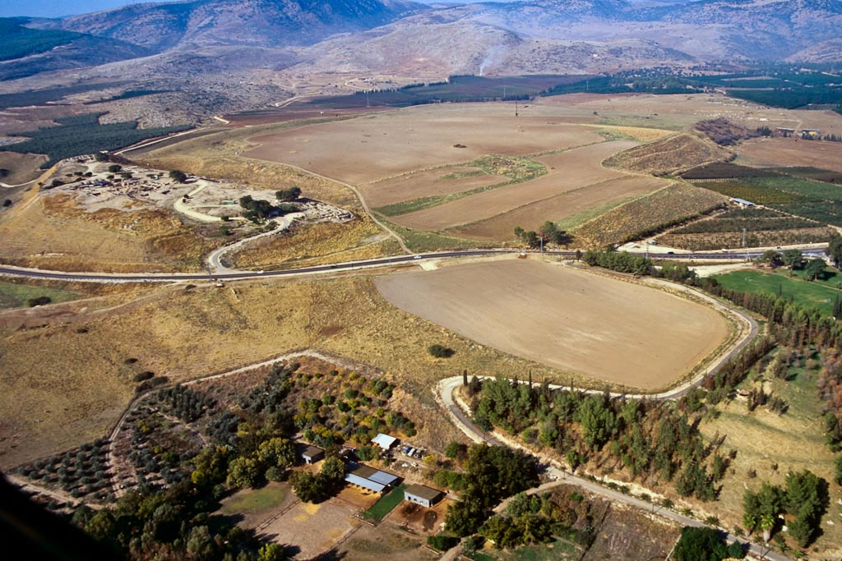
upper tell
lower city
lower city
Hazor aerial from southeast—upper and lower cities were within walls, the walls enclosing about 200 acres
Notes:
tbs112120011

Slide 44
While Hazor is named, Joshua also took a number of other cities in the north. (Josh. 11:12-13)

Slide 45
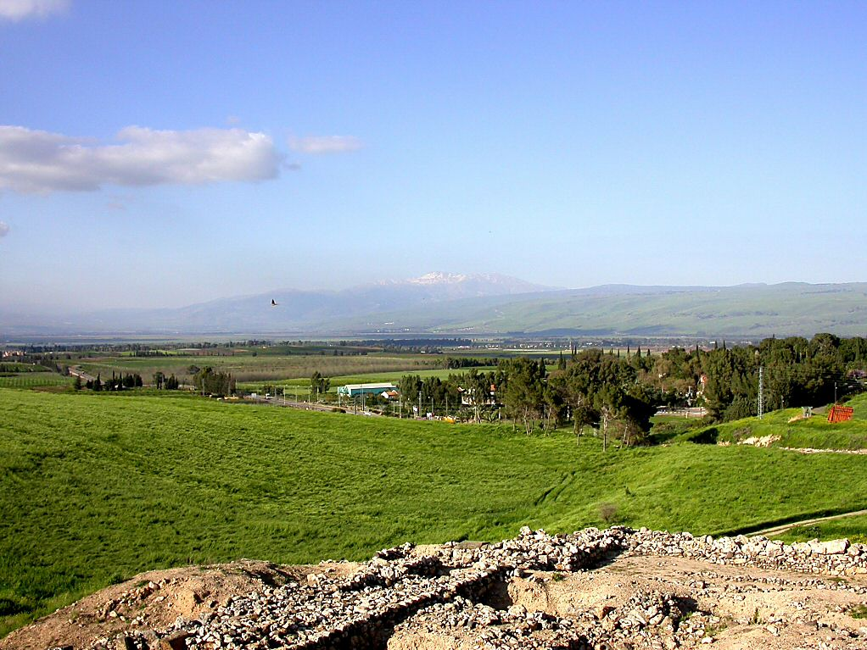
Mount Hermon from Hazor
Notes:
tb040903220

Slide 46
JOSH. 11:19-20—”19 There was not a city that made peace with the people of Israel except the Hivites, the inhabitants of Gibeon. They took them all in battle. 20 For it was the LORD’s doing to harden their hearts that they should come against Israel in battle, in order that they should be devoted to destruction and should receive no mercy but be destroyed, just as the LORD commanded Moses.” (ESV)

Slide 47
AN OVERALL SUMMARY:
JOSH. 11:23—”23 So Joshua took the whole land, according to all that the LORD had spoken to Moses. And Joshua gave it for an inheritance to Israel according to their tribal allotments. And the land had rest from war.” (ESV)

Slide 48
The Land Promise Fulfilled
Joshua was told to divide the land between the tribes.
The LORD would help each tribe finish the task of clearing its possession.

Slide 49
The Land Promise Fulfilled
Joshua 13-19 describes the border lines of the tribal territories in detail.
One can easily determine the general location of each tribe.
It is difficult to determine the exact boundary lines.

Slide 50
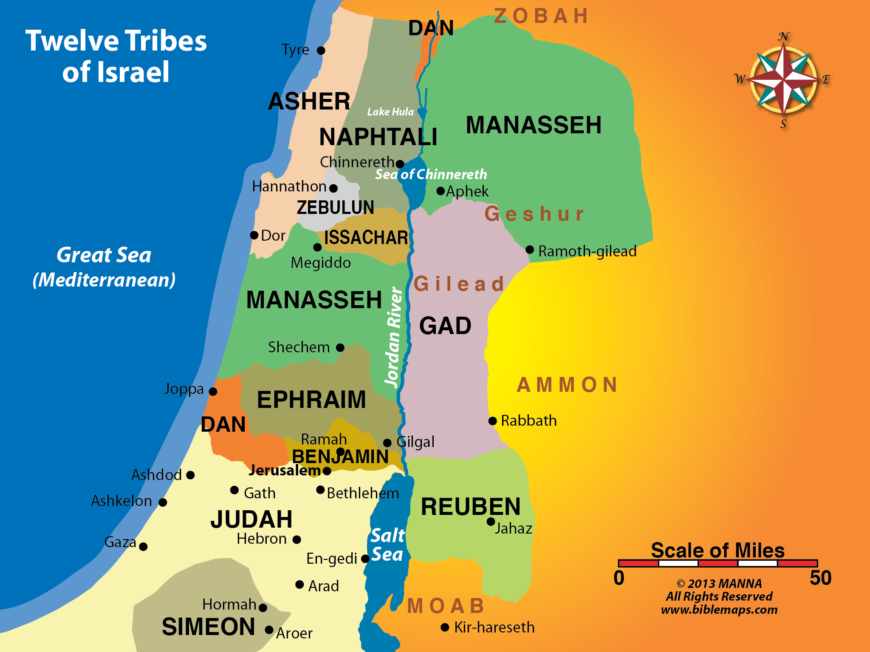

Slide 51
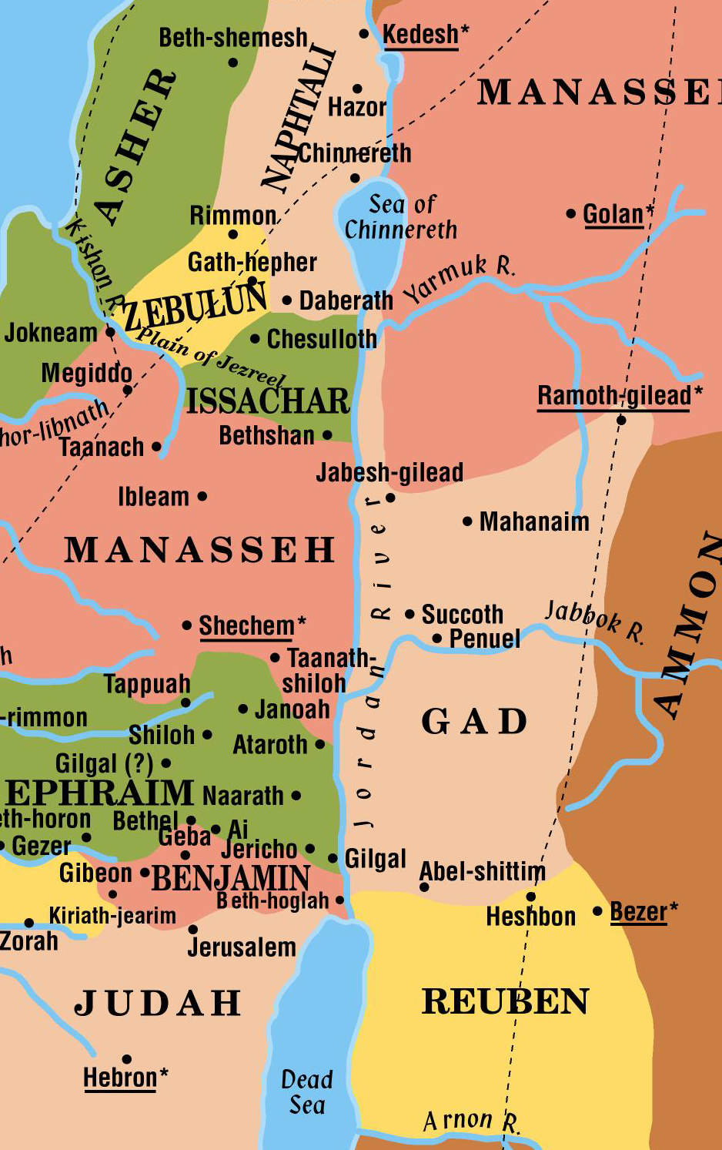
Tribe of Levi
God selected Levi to be His special ministers in the tabernacle worship.
They were given 48 cities scattered throughout the land.
The 48 cities included the 6 cities of refuge.
Surrounding pastureland was included with each city.

Slide 52
EVENTS CLOSING THE INVASION AND CONQUEST PERIOD
The men of Reuben, Gad and the half tribe of Manasseh headed home to lands east of the Jordan.
Joshua gave an admonition to observe the law, love God and “serve him with all your heart and with all your soul.” (Josh. 22:5)
The construction of the altar by the Jordan River
Joshua’s address to Israelite leaders (Josh. 23)
Joshua’s address to the nation (Josh. 24)
Joshua’s death

Slide 53
Joshua Calls for Faithfulness!
Joshua called the people together before he died and urged them to be faithful. He told them that God had given them ALL the land that he had promised. (Joshua 21:43-45; 23:14)
Two of the promises to Abraham are fulfilled by the end of the book of Joshua (and by the end of the Invasion and Conquest period).
His descendants are a distinct, separate nation.
They are living in a land of their own – Canaan.

Slide 54
Joshua Calls for Faithfulness!
The Jews do not need to inherit the land today to fulfill the land promise to Abraham – that promise was made and fulfilled over 1,000 years before Christ was born!

Slide 55
The Land Promise Fulfilled
At the close of Joshua’s life, the land that the Israelites had settled extended barely north of Tyre and stopped short of Damascus.

Slide 56
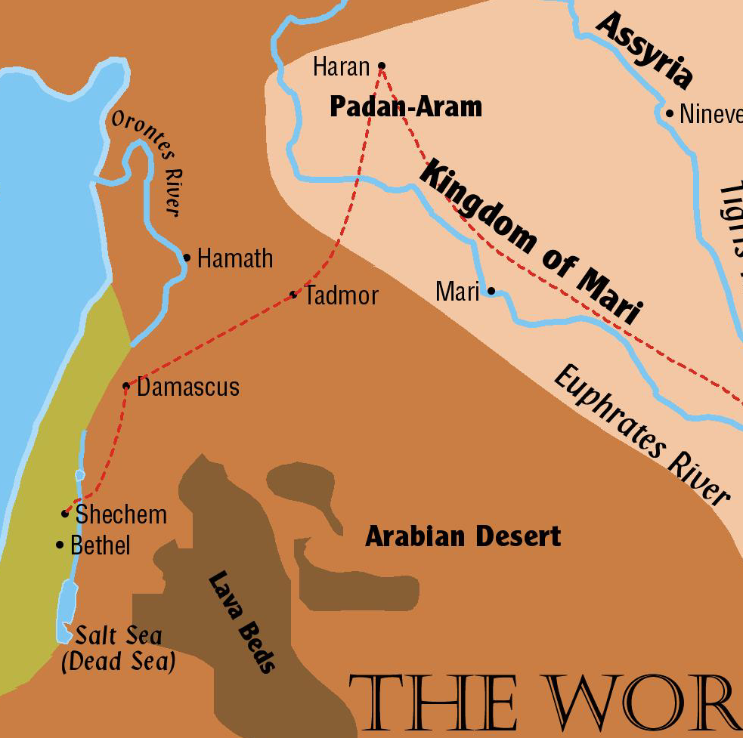
Abraham
God made His promises to Abraham in the form of a covenant (Genesis 15).
His descendants – all the land from River of Egypt to the Euphrates River

Slide 57
LOOKING AHEAD: As Joshua neared the end of his life, how do you think he would have assessed the Israelites’ prospects for living successfully in the land and keeping the land long term? What would he have viewed as reasons for optimism? What might have concerned him?
REASONS FOR OPTIMISM:
Israelites have taken large part of promised land.
All major battles have been successfully fought.
Are no remaining military threats anywhere in land.
The land is at peace—Israelites have “rest on every side.” (Josh. 23:24)
Land has been divided, each tribe receiving its designated portion.
Within the tribes, plots have been given to families, and land is being farmed.

Slide 58
REASONS FOR OPTIMISM cont.
The land is good, as the spies sent from Kadesh Barnea had said.
Much of the land is excellent farmland.
Plenty of good pastureland for livestock
Israelites had moved into a developed land.
Orchards, vineyards, fields were well-established.
Almost all cities had been “move-in ready.”
GOD IS THEIR KING; His law is their law.
Law provides a fully organized, fully functioning framework for life as a nation and as individuals.
Levites are dispersed throughout the land to teach and interpret the law.

Slide 59
REASONS FOR CONCERN:
Joshua knows that some Israelites are, in fact, serving “other gods.” (Josh. 24:14)
BIG PROBLEM
No longer one man leading the entire nation, as Moses and Joshua had done.
Have been signs that tribal leadership is lacking.
Leaders of last 7 tribes to get land allotments had seemed reluctant to take land—lacked initiative and leadership qualities.
Many Canaanites remain in land, and driving them out will take time and effort.
Ominously, there have been examples of laxity in driving the Canaanites out of the land.

Slide 60
REASONS FOR CONCERN cont.
(laxity in driving Canaanites out)
The problem is not that many Canaanites are still present—Moses had said that driving them out would be gradual (”little by little”). (See Deut. 7:22-24)
The problem was that in a number of places, Israelites were living side by side with Canaanites—which God had repeatedly and emphatically forbidden.
ANOTHER BIG PROBLEM
In a few areas, powerful adversaries still have total control over large areas of the land.
Main example: Philistine coastal plain

