Slide 1
Before the Flood
Flood
Scattering
Patriarchs
Exodus
Wandering
INVASION AND CONQUEST
Judges
WEEK 6: LAND PROMISE FULFILLED (Josh. 23-24)

Slide 2
QUESTION 5: Why—for what purpose—had the men of Reuben, Gad and the half tribe of Manasseh built the altar by the Jordan?
Said their intent was to prevent a future claim of those west of the Jordan that the LORD intended the river to be a boundary between them and those east of the river.
A MAJOR CONCERN: Those west of the Jordan would take the view that those east of the river had “no portion in the LORD.”
And…that as a result, the children of those east of the river would “cease to worship the LORD.” (Josh. 22:25)
MAIN CONCERN WAS FOR GENERATIONS TO FOLLOW.
This altar was to serve as a reminder—”…a witness between us and you, and between our generations after us, that we do perform the service of the LORD in his presence with our burnt offerings and sacrifices and peace offerings, so your children will not say to our children in time to come, ‘You have no portion in the LORD.’” (Josh. 22:27) (ESV)

Slide 3
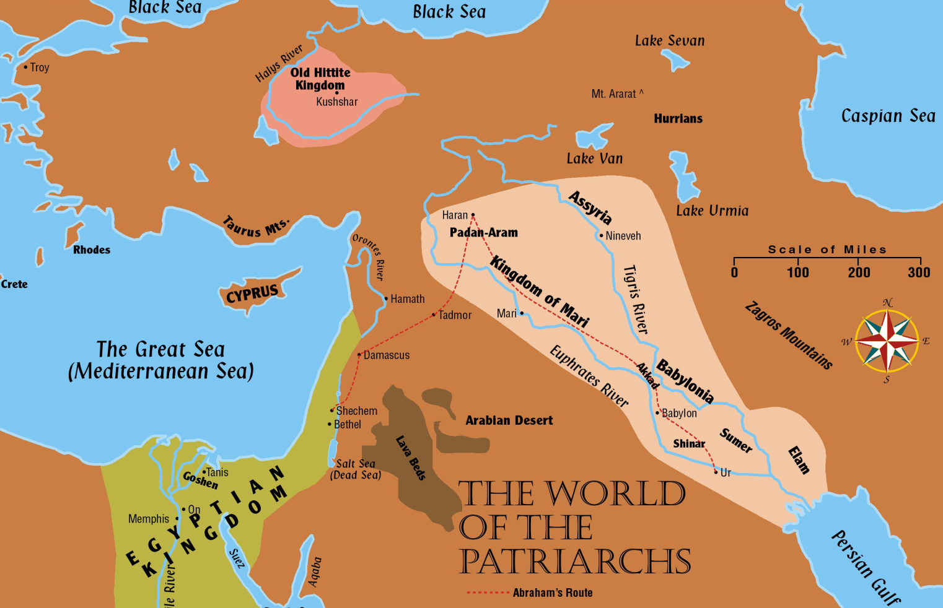
Abraham – Called to Serve
1900-2000 years before Christ, Abraham had left Ur and gone to Haran.
From
Haran, he
would go to a land God would show him.
Genesis
12:4-5
400 Miles
600 Miles
Hebrews 11:8-10

Slide 4
JOSH. 21:43-45—”43 Thus the Lord gave to Israel all the land that he swore to give to their fathers. And they took possession of it, and they settled there. 44 And the Lord gave them rest on every side just as he had sworn to their fathers. Not one of their enemies had withstood them, for the Lord had given all their enemies into their hands. 45 Not one word of all the good promises that the Lord had made to the house of Israel had failed; all came to pass.” (ESV)

Slide 5
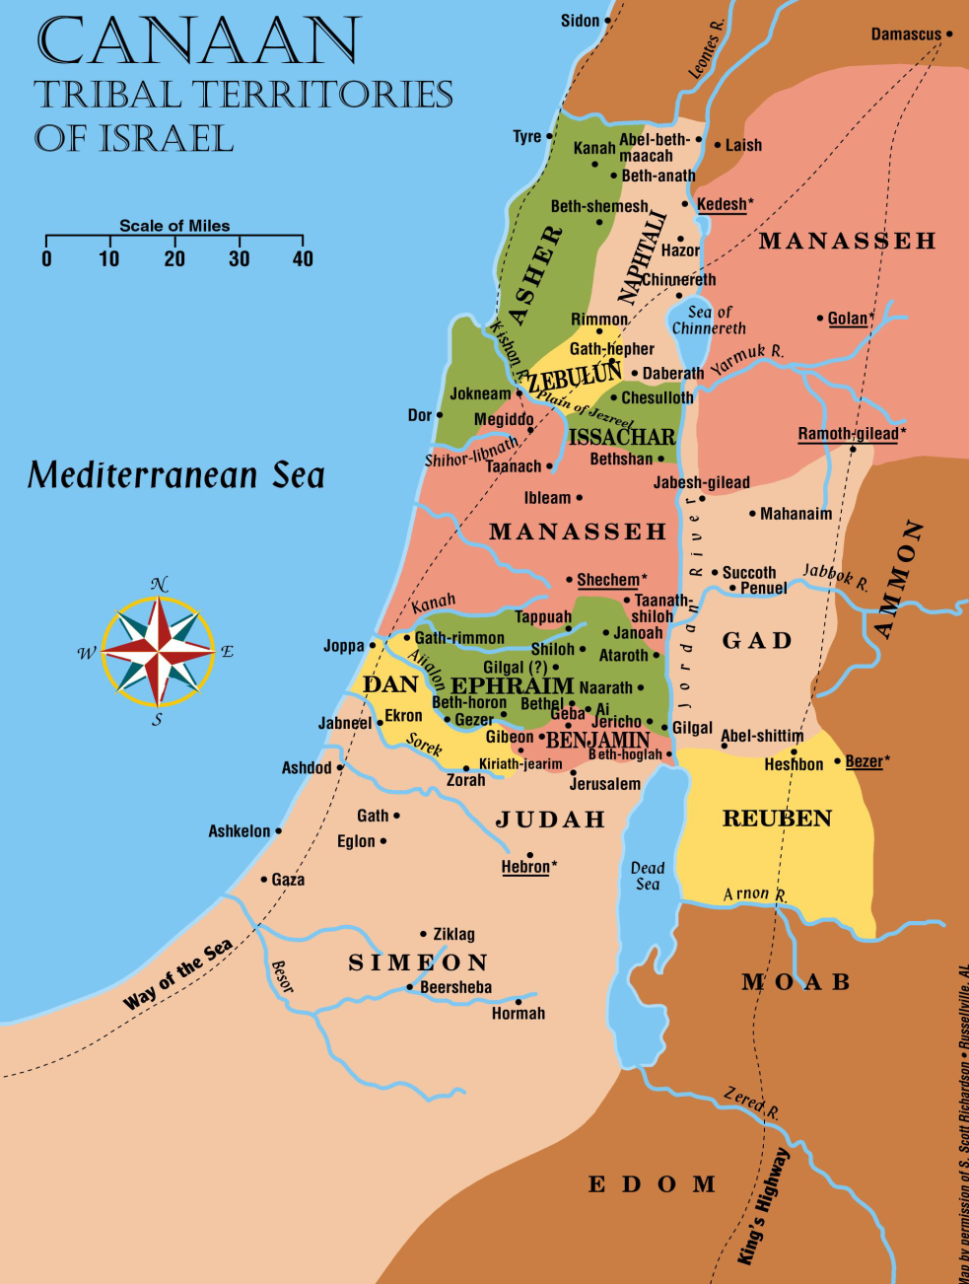
The Land Promise Fulfilled
At the close of Joshua’s life, the land that the Israelites had settled extended barely north of Tyre and stopped short of Damascus.

Slide 6
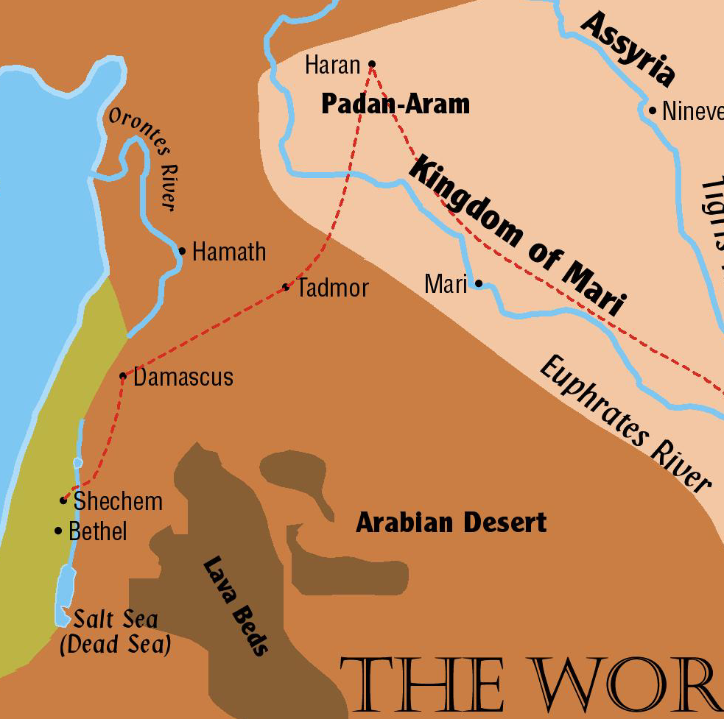
Abraham
God made His promises to Abraham in the form of a covenant (Genesis 15).
His descendants – all the land from River of Egypt to the Euphrates River

Slide 7
QUESTION 1: What is the relevance of Josh. 21:43-45 to the current, ongoing territorial dispute over Palestine?
The short answer: It’s not relevant (though many Jews, many “Evangelicals” and many in denominations disagree).
Statements in the passage that the land promise has been fulfilled are plain.
God “gave” to Israel “ALL the land that he swore to give their fathers.” (v. 43)
The Israelites “took possession” of the land. (v. 43)
They did settle in the land. (v. 43)
“NOT ONE WORD” of the promise had failed. (v. 45)
(See also Ps. 105:8-11, 42-45; Jere. 32:21-23; Neh. 9:7-8)

Slide 8
QUESTION 2: What advice did Joshua give to the Israelite leaders in Josh. 23:6-16?
DO THIS:
Be “very strong” in keeping to the law; don’t deviate from it. (v. 6)
Drive out the “remnant” of “these nations remaining among you.” (Implied, vv. 7, 12)
Cling to the LORD your God. (v. 8)
Be very careful to love the LORD your God. (v. 11)
DON’T DO THIS:
Don’t mix with “these nations remaining among you.” (vv. 7, 12)
Do not even mention the names of their gods, much less serve them. (v. 7)

Slide 9
QUESTION 2 cont.
Do not “turn back and cling to” the remnant of “the nations remaining among you.” (v. 12)
Do not marry individuals of those nations; do not associate with them in any way! (v. 12)
WARNINGS—REPEATED, ALL STRESSING THE DANGER OF LOSING THE LAND. (vv. 13-17)
Association with remaining Canaanites would result in God no longer driving them out of the land. (v. 13)
Violating God’s covenant by serving other gods would result in their losing the land (the same warning Moses had given in Deut). (vv. 15-17)

Slide 10
QUESTION 3: What was the main argument that Joshua conveyed to the people of Israel (the entire nation) in Josh. 24:1-13 as to why they should obey the LORD?
The short answer: “You should obey me because of all that I, the LORD, have done for you.”
God recounts the Israelites’ history, from His perspective, with Joshua conveying His words:
Reminds Israelites of history from Abraham’s father, Terah, giving a list of “highlights”—great things He had done for them.
Summing up, the LORD noted that “I gave you a land on which you had not labored and cities that you had not built, and you dwell in them. You eat the fruit of vineyards and olive orchards that you did not plant.” (Josh. 24:13)

Slide 11
Josh. 24:14—”Now therefore fear the LORD and serve him in sincerity and faithfulness. Put away the gods that your fathers served beyond the River and in Egypt, and serve the LORD.” (ESV)

Slide 12
(ROD’S QUESTION 1 from Wed., July 28) “What was the first commandment Israel was given in Deuteronomy 6:4-5 (cf. Matthew 22:34-38)? Were there reasons why the people of Israel should love God? Why would it seem significant that this was mentioned before he discusses the place that God’s law should occupy in their daily lives (Deut. 6:6-9)?”

Slide 13
Josh. 24:14-15—”14 Now therefore fear the LORD and serve him in sincerity and faithfulness. Put away the gods that your fathers served beyond the River and in Egypt, and serve the LORD. 15 And if it is evil in your eyes to serve the LORD, choose this day who you will serve, whether the gods your fathers served in the region beyond the River, or the gods of the Amorites in whose land you dwell. But as for me and my house, we will serve the LORD.” (ESV)

Slide 14
Josh. 24:19-20—”19 But Joshua said to the people, ‘You are not able to serve the LORD, for he is a holy God. He is a jealous God; he will not forgive your transgressions or your sins. 20 If you forsake the LORD and serve foreign gods, then he will turn and do you harm and consume you, after having done you good.’” (ESV)

Slide 15
QUESTION 4: As Joshua neared the end of his life, how do you think he would have assessed the Israelites’ prospects for living successfully in the land and keeping the land long term? What would he have viewed as reasons for optimism? What might have concerned him?
REASONS FOR OPTIMISM:
Israelites have taken large part of promised land.
All major battles have been successfully fought.
Are no remaining military threats anywhere in land.
The land is at peace—Israelites have “rest on every side.” (Josh. 21:44)
Land has been divided, each tribe receiving its designated portion.
(Presumably) Within the tribes, plots have been given to families, and land is being farmed.

Slide 16
QUESTION 4 cont.:
REASONS FOR OPTIMISM:
The land is good, as the spies sent from Kadesh Barnea had said.
Much of the land is excellent farmland.
Plenty of good pastureland for livestock
Israelites had moved into a developed land.
Orchards, vineyards, fields were well-established.
Almost all cities had been “move-in ready.”
GOD IS THEIR KING; His law is their law.
Law provides a fully organized, fully functioning framework for life as a nation and as individuals.
Levites are dispersed throughout the land to teach and interpret the law.

Slide 17
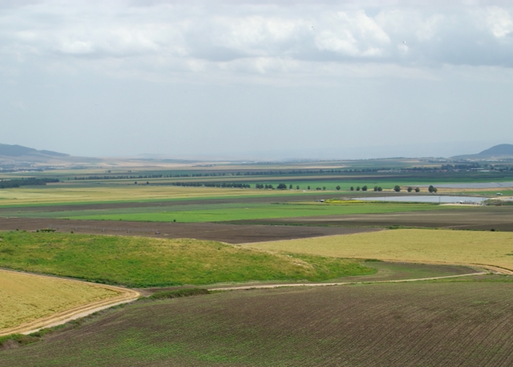
GALILEE—JEZREEL VALLEY

Slide 18
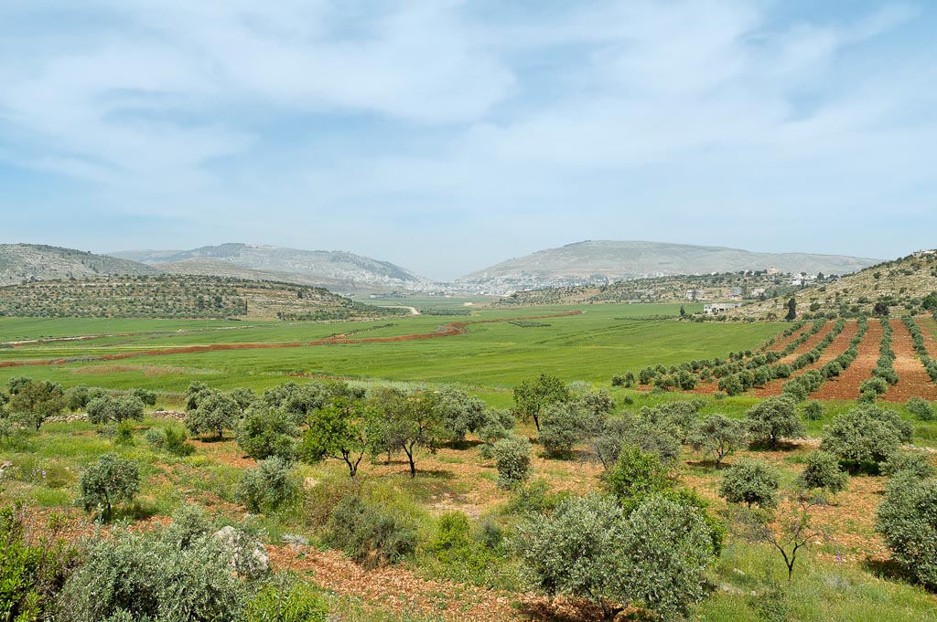
Central Hill Country—Mt. Gerizim, Shechem, and Mt. Ebal from east
Notes:
tb050106458

Slide 19
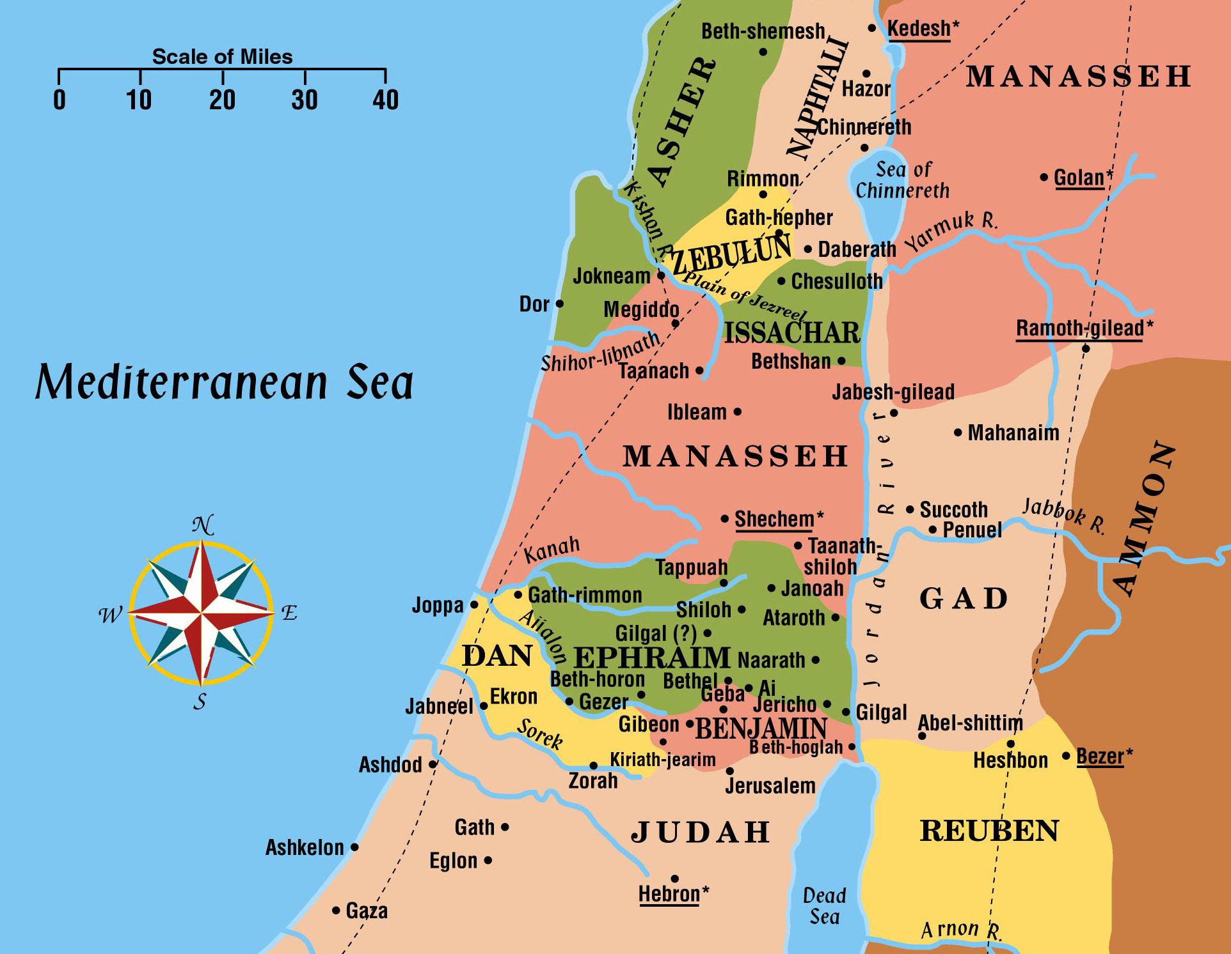
Cities of Refuge
Late in Joshua’s life, Israelites were living in many cities.

Slide 20
QUESTION 4 cont.:
REASONS FOR CONCERN:
Joshua knows that some Israelites are, in fact, serving “other gods.” (Josh. 24:14)
BIG PROBLEM
No longer one man leading the entire nation, as Moses and Joshua had done.
Have been signs that tribal leadership is lacking.
Leaders of last 7 tribes to get land allotments had seemed reluctant to take land—lacked initiative and leadership qualities.
Many Canaanites remain in land, and driving them out will take time and effort.
Ominously, there have been examples of laxity in driving the Canaanites out of the land.

Slide 21
QUESTION 4 cont.:
REASONS FOR CONCERN:
(laxity in driving Canaanites out)
The problem is not that many Canaanites are still present—Moses had said that driving them out would be gradual (”little by little”). (See Deut. 7:22-24)
The problem was that in a number of places, Israelites were living side by side with Canaanites—which God had repeatedly and emphatically forbidden.
In a few areas, adversaries still have total control over large areas of the land.
Main example: Philistine coastal plain

