Slide 1
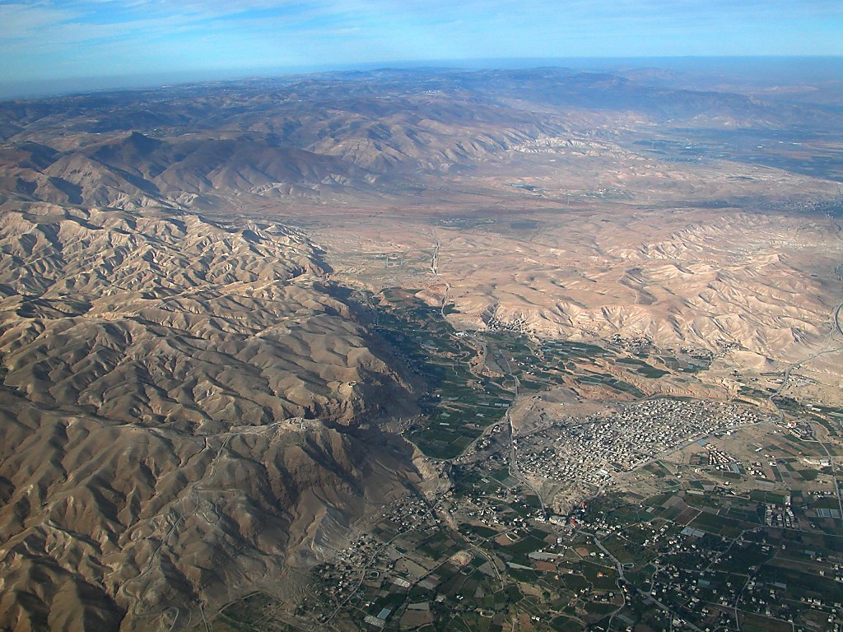
Tell es-Sultan
WEEK 3: JERICHO AND CENTRAL CAMPAIGN (Josh. 6:6—8:35)
Notes:
tb010703113

Slide 2
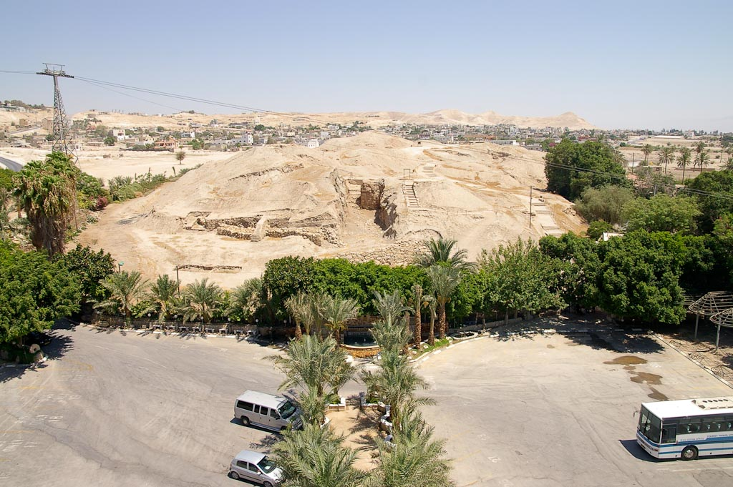
Jericho, Tell es-Sultan
Notes:
adr080711688

Slide 3
QUESTION 1: What instructions had God given the Israelites concerning how they should interact with the people they would encounter in the promised land—both as to the “inhabitants of the land” and the cities? (See Exod. 23:31-33; 34:12-16; Deut. 20:16-18)
Exod. 23:31-33—”31 And I will set your border from the Red Sea to the Sea of the Philistines, and from the wilderness to the Euphrates, for I will give the inhabitants of the land into your hand, and YOU SHALL DRIVE THEM OUT BEFORE YOU. 32 YOU SHALL MAKE NO COVENANT WITH THEM AND THEIR GODS. 33 THEY SHALL NOT DWELL IN YOUR LAND, lest they make you sin against me; for if you serve their gods, it will surely be a snare to you.” (ESV)

Slide 4
Exod. 34:12-16—(similar)
SUMMARY OF THESE TWO EXODUS PASSAGES:
Drive them out of your land.
Make no covenant with them.
Avoid their bad influence.
Deut. 20:16-18 (specifically addressing cities)—”16 But in the cities of these peoples that the LORD your God is giving you for an inheritance, YOU SHALL SAVE ALIVE NOTHING THAT BREATHES, 17 but you shall devote them to complete destruction….that they may not teach you to do according to all their abominable practices that they have done for their gods, and so you sin against the LORD your God.” (ESV)

Slide 5
QUESTION 2: What was the point of all the marching around Jericho?
It was what God had told them to do.
That being true, it demonstrated obedience.
It also demonstrated faith that God would give them victory.

Slide 6
Josh. 6:17-19—”And the city and all that is within it shall be devoted to the LORD for destruction. Only Rahab the prostitute and all who are with her in her house shall live, because she hid the messengers whom we sent. 18 But you keep yourselves from the things devoted to destruction, lest when you have devoted them you take any of the devoted things and make the camp of Israel a thing for destruction and bring trouble upon it. 19 But all silver and gold, and every vessel of bronze and iron, are holy to the LORD; they shall go into the treasury of the LORD.” (ESV)

Slide 7
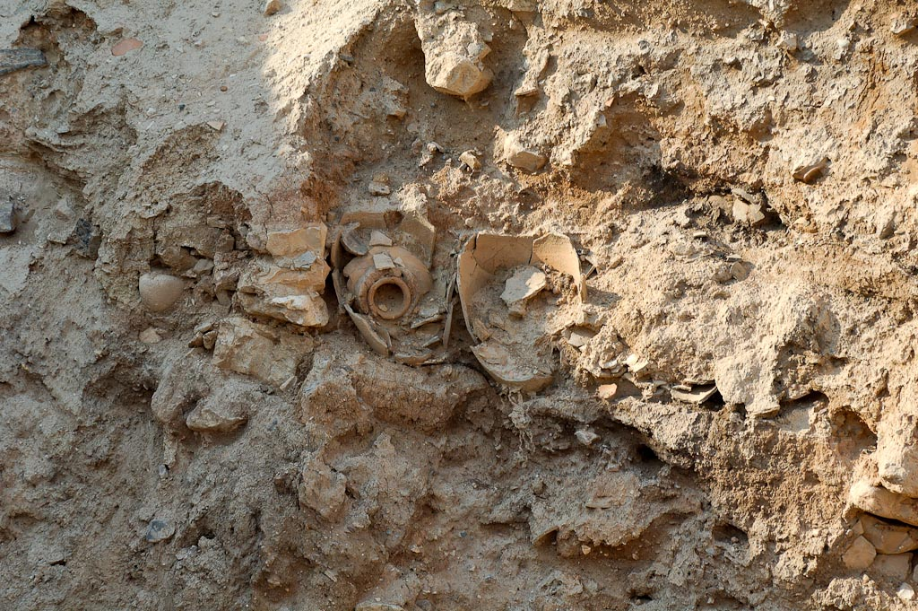
Jericho, Tell es-Sultan, grain storage jars
Notes:
Storage Jars of Grain
Both Garstang and Kenyon found dozens of storejars full of burnt grain from the last Canaanite city of Jericho. Bryant Wood has suggested that this fits the biblical account of the destruction of the city by Joshua:
Joshua’s destruction occurred in the spring just after harvest time.
The city was not looted by God’s command. Any other conquering army would have taken the grain for food supplies.
The city was burned.
The storage jars pictured here still remain in one of Kenyon's balks at Jericho.
tb052006445

Slide 8
MATT. 1:5-6—”5 Salmon was the father of Boaz by RAHAB, Boaz was the father of Obed by Ruth, and Obed the father of Jesse. 6 Jesse was the father of David the king. David was the father of Solomon by Bathsheba who had been the wife of Uriah.” (NASB)
Rahab was a Gentile and a prostitute.
Married Salmon, a prince of Judah.
Rahab was the mother of Boaz, who married Ruth (also a Gentile).
Was great-great-grandmother of King David
….and thus an ancestor of Jesus

Slide 9
STATEMENTS ON FAITH TO NT CHRISTIANS:
Eph. 2:8-9—Paul wrote that ”…by grace you have been saved through faith. And this is not your own doing; it is the gift of God, 9 not a result of works, so that no one may boast.” (ESV)
Heb. 11:30-31 (seizing upon Jericho narrative)—”30 By faith the walls of Jericho fell down after they had been encircled for seven days. 31 By faith Rahab the prostitute did not perish with those who were disobedient, because she had given a friendly welcome to the spies.” (ESV)

Slide 10
QUESTION 3: What was Achan’s sin?
He had violated God’s explicit instructions that everything in Jericho was to be “devoted” to God.
In his own words later: (Josh. 7:20-21) “20…Truly I have sinned against the LORD God of Israel, and this is what I did; 21 When I saw among the spoil a beautiful cloak from Shinar, and 200 shekels of silver, and a bar of gold weighing 50 shekels, then I covered them and took them. And see, they are hidden in the earth inside my tent, with the silver underneath.”
Cloak should have been destroyed.
Silver and gold should have been added to the LORD’s treasury.
Instead, Achan stole and hid the items.

Slide 11
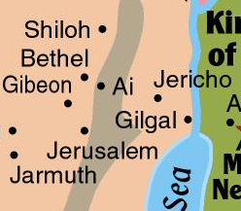
The Conquest of Canaan
Joshua sent spies toward Bethel. Upon return, reported they could take Ai.
A small company of soldiers went in and to their horror, they were driven back – 36 were killed.
“I will be with you if you will obey My commandments.”

Slide 12
Josh. 7:7-9—”7 And Joshua said, ‘Alas, O Lord GOD, why have you brought this people over the Jordan at all, to give us into the hands of the Amorites, to destroy us? Would that we had been content to dwell beyond the Jordan! 8 O Lord, what can I say, when Israel has turned their backs before their enemies! 9 For the Canaanites and the inhabitants of the land will hear of it and will surround us and cut off our name from the earth. And what will you do for your great name?” (ESV)

Slide 13
QUESTION 4: Why do you think that the defeat at Ai was so devastating to Joshua?
The utter shock, coming right after the miraculous river crossing and the collapsing of Jericho walls
So soon after God’s numerous assurances to Joshua
The cowardice shown—had run away from relatively weak opponent
Joshua sensed three things:
People were demoralized. (Josh. 7:5)
Disaster might put his leadership in jeopardy.
It might mark the beginning of total defeat at the hands of the Canaanites.

Slide 14
The Conquest of Canaan
Joshua sent an ambush force west of Ai.
Main Israelite force attacked from the north and lured men of Ai (and Bethel) out of the city.

Slide 15
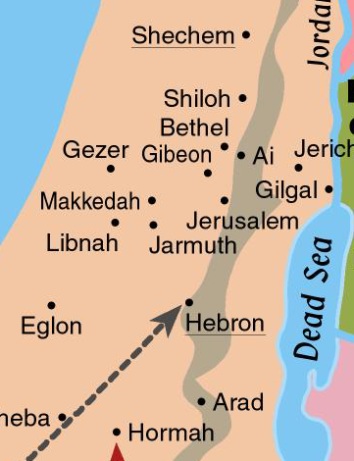
The Conquest of Canaan
Since Jericho, Ai, and Bethel were destroyed, the Israelites were able to move freely into the central hill country.
Went to Shechem and the twin peaks of Gerizim and Ebal.

Slide 16
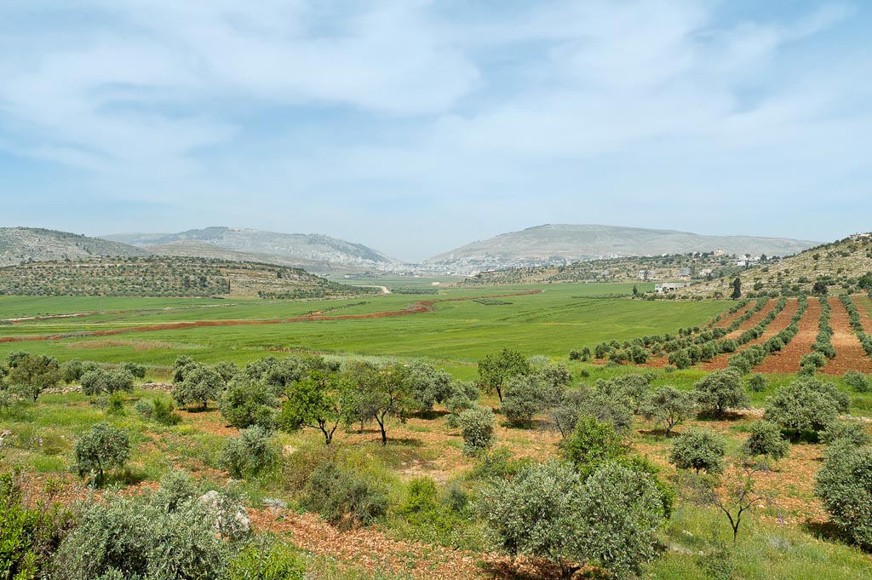
Mount Gerizim, Shechem, and Mount Ebal from east
Notes:
tb050106458

Slide 17
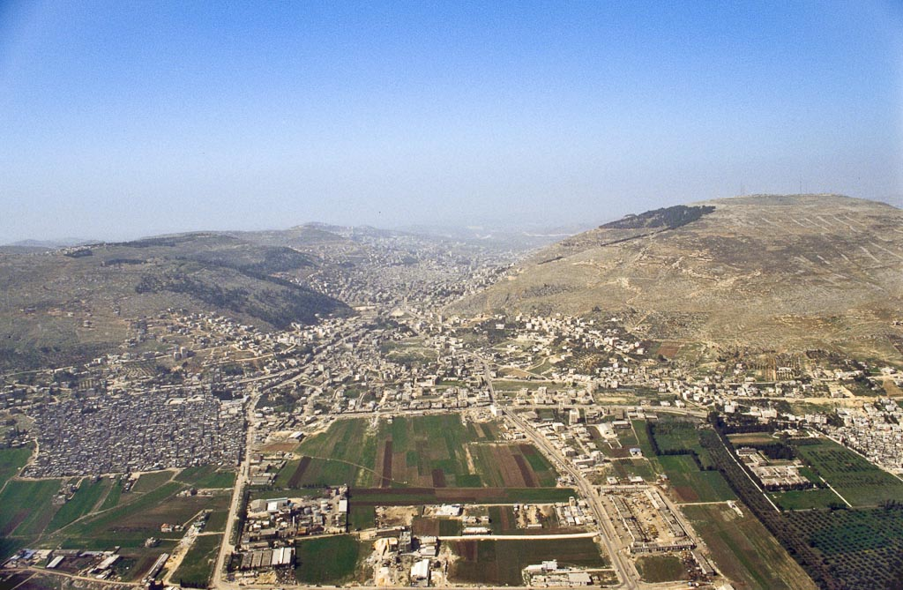
Mt. Ebal
Mt. Gerizim
Nablus
Shechem
(Tell Balata)
Shechem and Mounts Gerizim and Ebal aerial from east
Notes:
bb00120041

Slide 18
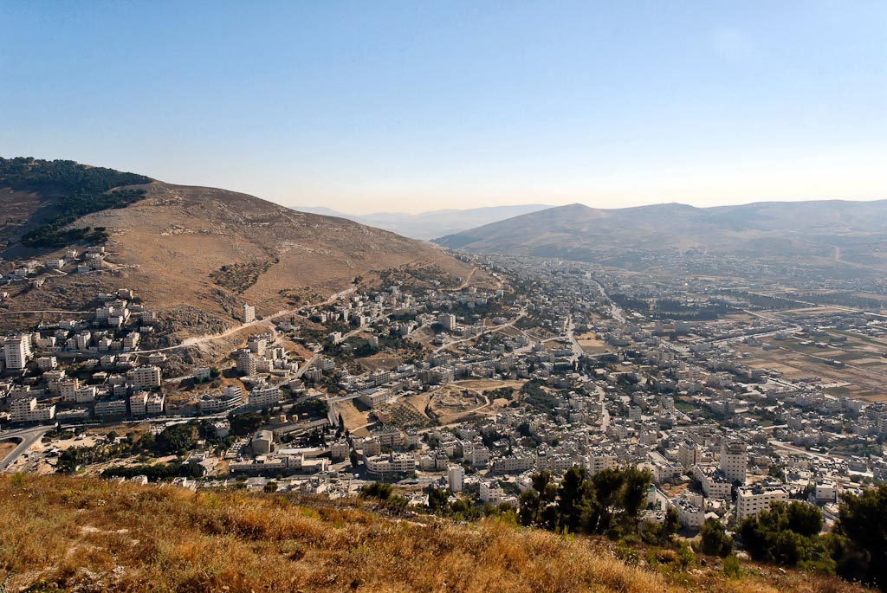
Mt. Ebal
Shechem
(Tell Balata)
Mt. Gerizim
Shechem, Mount Ebal, Sychar from Mount Gerizim
Notes:
tb070507675

Slide 19
QUESTION 5: Why was the ceremony at which Joshua read the entire law, including the blessings and the curses, so important?
Reaffirmed that they were in the land that God had promised.
Solemn reminder of responsibilities
They had better obey God—blessings would depend upon obedience; curses would result from disobedience.
Bob Waldron characterization: “By this ceremony, Israel was staking her claim to the land. There were many, many cities to be conquered, but the people were declaring that with God’s help, it would all be theirs.”

Slide 20
MATT. 1:3-6—”3 Judah was the father of Perez and Zerah by Tamar, Perez was the father of Hezron, and Hezron the father of Ram. 4 Ram was the father of Amminadab, Amminadab the father Nahshon, and Nahshon the father of Salmon. 5 Salmon was the father of Boaz by RAHAB, Boaz was the father of Obed by Ruth, and Obed the father of Jesse. 6 Jesse was the father of David the king. David was the father of Solomon by Bathsheba who had been the wife of Uriah.” (NASB)

