Slide 2
The exodus

Slide 3
REVIEW
God’s people have become a multitude / nation
God uses Moses and the plague to free the people from Egypt. (Passover – the people owe their firstborn)
The crossing of the Red Sea leads to the salvation of God’s people and destruction of the Egyptians
God provides for the people
At Mount Sinai, God gives the people the Law. They break it.
The tabernacle is built
The journey to the Promised Land resumes

Slide 4
TIMING OF THE EXODUS
1st year, 2nd month, 15th day – Complain about not having food and start receiving manna (Ex. 16:1)
1st year, 3rd month – Arrive at Mount Sinai (Ex. 19:1)
2nd year, 1st month, 1st day – Erect tabernacle (Ex. 40:17)
2nd year, 2nd month, 1st day – Israel is counted (Num. 1:1-2,18)
2nd year, 2nd month, 20th day – Leave Mount Sinai (Num. 10:11-12)
The people were at Mount Sinai for 11 months and 20 days.

Slide 5
2. Who was counted among the 11 tribes of Israel? How many were there? Who was counted among the Levites (Num. 3:15; 4:3)? How many were there (Num. 3:39; 4:48)?
From the 11 tribes, men, 20 years and up – 603,550
Among the Levites
All males, one month and older – 22,000 (Num. 3:39)
All males 30 years to 50 years – 8,580 (Num. 4:46-49)

Slide 6
3. Which tribe had the most men counted?
Judah with 74,600 men (Num. 2:4)

Slide 7
4. When the people made camp, the tabernacle was supposed to be at the center of everyone. Who was it that camped closest to the tabernacle? Why? (Num. 1:53; 2:2)

Slide 8
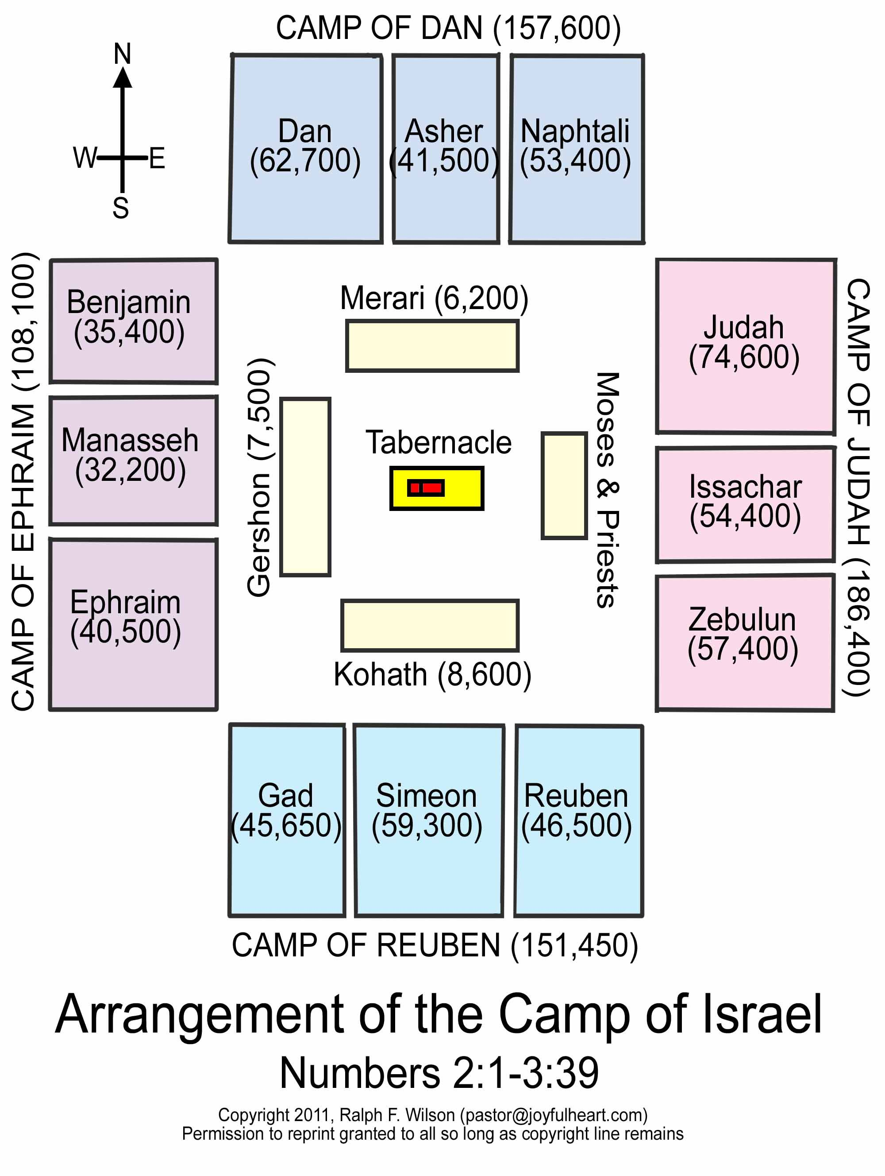

Slide 9
5. What role did the Gershonites have (Num. 3:25-26)? What role did the Kohathites have (Num. 3:31)? What role did the Merari have (Num. 3:36-37)?
GERSHONITES – The tent, its covering and screen as well as the hangings of the court and doorway along with those chords
KOHATHITES – Ark, table, lampstand, altars, utensils and the screen
MERARI – Frames, bars, pillars, sockets, and accompanying cords

Slide 10
6. What special rule did the Kohathites have regarding their duty (Num. 4:18-20)? How was this resolved (Num. 4:5-15)?
The Kohathites were not to touch the items they moved or they would die (Num. 4:15)
They Kohathites were not to see the items they moved or they would die (Num. 4:19-20). In fact, what was covering these items were themselves also covered by another layer.

Slide 11
7. If a man accused his wife of adultery, was the man to be believed (Num. 5:11-31)?

Slide 12
8. What was the vow of a Nazirite? What did it involve? (Num. 6:1-21)
Abstain from strong drink or wine or anything produced by the fruit of the vine (Num. 6:3-4)
No razor shall touch his head (Num. 6:5)
He is not to go near a dead person, not even a relative (Num. 6:9-12)

Slide 13
9. What did Aaron and his sons say to bring God’s blessings on the people (Num. 6:22-27)?
“The Lord bless you, and keep you;
The Lord make His face shine on you,
And be gracious to you;
The Lord lift up His countenance on you,
And give you peace”
Num. 6:24-26

Slide 14
10. Why were the Kohathites not given any oxen or carts for their work (Num. 7:9)?

Slide 15
11. What had God declared to be His as a result of the Passover (Num. 8:17)? What did God take instead from this first generation of Israelites (Num. 8:18-19)

Slide 16
12. What should happen if an Israelite was unclean when it was time to observe the Passover? Should he offer up the sacrifice anyway? What was God’s answer (Num. 9:1-14)? What, if anything, does this reveal about God?

Slide 17
13. What did the people complain about (Num. 11:4-6)? When God tells Moses what He is going to do about this, what objection does Moses have (Num. 11:21-23)? Consider how Moses’ comments in Num. 11:13,21-23 compares to the apostles’ comments in Mt. 15:33; John 6:5-9.

Slide 18
14. What did the 70 elders do (Num. 11:25)? Why do you think this happened? Why do you think this only happened once?

Slide 19
15. Joshua begs Moses to restrain Medad and Eldad. How does Moses respond? What does this reveal about Moses? (One might find it interesting to compare this to Mk. 9:38-40)

Slide 20
16. What does Kibrothhattaavah mean (might be revealed in a footnote on Num. 11:34)?

Slide 21
17. What problem did Miriam and Aaron have with Moses (Num. 12:1)? But what did they say (Num. 12:2)? What does Moses do for them after God punishes them (Num. 12:10-13)?

Slide 23
17 time periods
Before The Flood
Flood
Scattering Of The People
Patriarchs
Exodus
Wandering In The Wilderness
Invasion And Conquest
Judges
United Kingdom
Divided Kingdom
Judah Alone
Captivity
Return From Captivity
Years Of Silence
Life Of Jesus
Early Church
Letters To Christians

