Slide 1
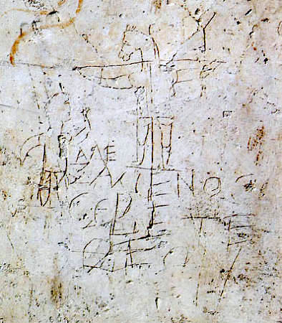

Slide 2
“Alexamenos worships his god”

Slide 3
“But we preach Christ crucified, to Jews a stumbling block and to Gentiles foolishness, but to those who are the called, both Jews and Greeks, Christ the power of God and the wisdom of God.”
I Corinthians 1:23-24

Slide 4
ARE YOU ASHAMED OR READY TO PROCLAIM?
“For as often as you eat this bread and drink the cup, you proclaim the Lord’s death until He comes”
I Corinthians 11:26

