Slide 1
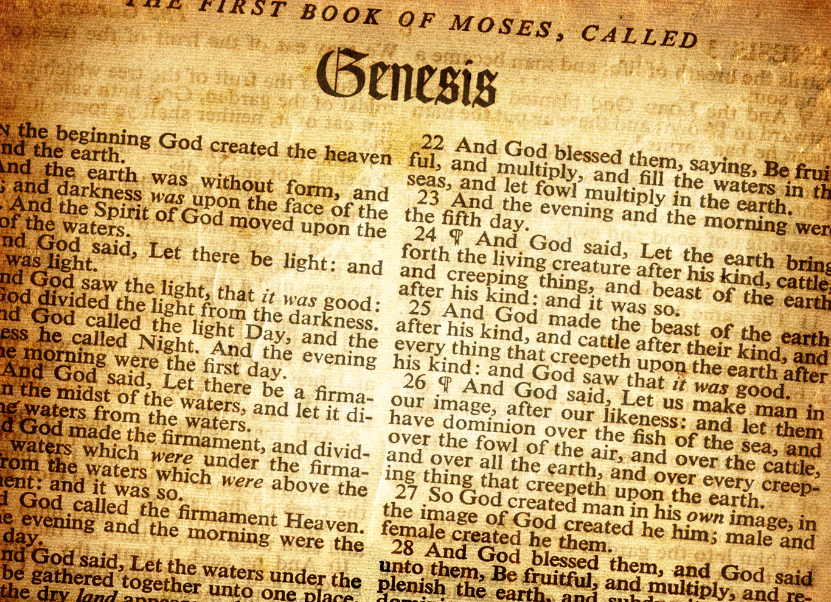
Lesson 13 Review Genesis

Slide 2
Review
Before the Flood
Flood
Scattering
Patriarchs
Genesis
Abraham’s Birth
2008
Joseph’s Birth
~2259
Creation
0
Flood
1650
Isaac’s Birth
2108
Joseph’s Death
~2369
Jacob’s Birth
2168
6 – 9, 10
1 – 5
11
12 – 5 0

Slide 3
Review
Abram in Egypt
Abram rescues Lot
Abram meets Melchizedek
Ishmael born
86
Isaac born
100
Abraham dies
175
Sodom & Gomorrah destroyed
Abraham lies to Abimelech
Life of Abraham
3-fold promise, Abram departs Haran
75
Renamed Abraham,
Circumcision
99
Sarah dies
127
Finds wife for Isaac
Abraham Marries Keturah
Abraham’s faith tested with Isaac

Slide 4
Timeline of Abraham, Isaac, Jacob together
Isaac born
Abraham 100
Gen 21:5
Jacob born
Isaac 60
Gen 25:26
Life of Abraham
Life of Isaac
Life of Jacob
Isaac marries Rebekah
Isaac 40
Gen 25:20

Slide 5
Timeline of Abraham, Isaac, Jacob, Joseph
Isaac born
Abraham 100
Gen 21:5
Jacob born
Isaac 60
Gen 25:26
Joseph born
Jacob ~91
Jacob goes to Egypt when 130 Gen 47:28
Abraham dies 175
Gen 25:7
Life of Abraham
Isaac dies 180
Gen 35:28
Life of Isaac
Jacob dies 147
Gen 47:28
Life of Jacob
Life of Joseph
Isaac marries Rebekah
Isaac 40
Gen 25:20
Joseph dies 110
Gen 50:26
Joseph interprets Pharaoh's dreams when ~30
Joseph about 17 sold when by bothers Gen 37:2

Slide 6
What is the book of Genesis about? What are some of the major events?
The account of creation through the start of a physical nation of people that God selected
Creation
Fall of man (first sin) and the first indication of a plan for salvation
Global catastrophic flood because of man’s wickedness
Eight people saved along with land animals
Scattering of the people through the creation of multiple languages
Three promises to Abram (land, nation, all mankind blessed)
Life of Abraham, Isaac, Jacob, and Joseph
The beginning of a physical nation of God’s people

Slide 7
What is the book of Genesis about? What are some of the major events?
Life of Abraham, Isaac, Jacob, and Joseph
Birth of Isaac
God tells Abraham to sacrifice Isaac
Jacob deceives Isaac and flees from Esau to Haran
Jacob is deceived by Laban and gets two wives (comes back with a large household)
Joseph is sold into slavery
Joseph prepares Egypt after God reveals what will happen in Pharaoh’s dreams
Joseph’s family comes to Egypt

Slide 8
How long does the Bible say it took to create everything?
Genesis 1:31 – 2:2 → six days
Exodus 20:11 → for in six days the Lord made the heavens and the earth, the sea, and all that is in them, and rested the seventh day.
Exodus 31:17 → for in six days the Lord made the heavens and the earth
Luke 13:14 → the ruler of the synagogue said to Jesus “There are six days on which men ought to work…” This is clearly a reference to the fourth commandment which refers to the days of creation. It seems that the new testament Israelites believed in a literal six days for creation

Slide 9
Why do some Christians doubt that the Genesis account of Christianity is a literal 6 days?
Because they believe that science has proven the world to be billions (4.5 billion) of years old
The argument doesn’t come from the Scriptures, but rather from an outside influence that dictates how we look at God’s word. Instead, God’s word should be the foundation of how we view everything else. When people allow the outside influence to shape their view of God’s word, they need to twist the Scriptures to fit that view.
Major long-age compromises
Gap theory: There is a gap of indeterminate time between the first two verses of Genesis
Theistic evolution: God directed the evolutionary process of millions of years or possibly set it up and let it run
Progressive creation: God intervened in the process of death and struggle to create millions of species at various times over millions of years
Framework hypothesis: The events of Genesis 1 are interpreted as poetical rather than historical narrative
Notes:
Frame work theory – Creation account is poetic

Slide 10
2 Peter 3:8 says “But beloved, do not forget this one thing, that with the Lord one day is as a thousand years and a thousand years is as one day.” Does this mean that the days of creation were possibly longer than one literal day?
CONTEXT: God will keep His promise (second coming of Jesus) even though it seems like it has been so long to us (vs. 1 – 7)
The rest of the verse says “a thousand years is as one day.” This verse tells us that with God, waiting a day is like waiting a thousand years and waiting a thousand years is like one day.
This may sound complicated, but it just means that God is outside of time and not limited by it like we are. It has nothing to do with the days of creation
Contextual conclusion: Don’t lose hope because you think it has been too long. God is patiently giving all a chance to repent (vs. 9)

Slide 11
How would you answer the statement that God used the process of the Big Bang and evolution to create everything?
For each day, the phrase “So the evening and the morning were the ____ day.” is used – Genesis 1:5, 1:8, 1:13, 1:19, 1:23, 1: 31
Outside of Genesis 1, yom is used with a number 359 times and each time it means an ordinary day.
Outside of Genesis 1, yom is used with the words “evening and morning” 23 times. “Evening and morning” appear in association, but without yom, 38 times. All 61 times, it refers to an ordinary day.
Outside of Genesis 1, yom is used with the word “night” 53 times and each time it means an ordinary night.

Slide 12
How would you answer the statement that God used the process of the Big Bang and evolution to create everything?
From the book of Romans
As a result of sin
Sin entered the world (5:12)
Death entered the world through sin (5:12)
Creation subjected to futility (8:20)
Creation subjected to the bondage of corruption (8:21)
Also as a result of sin
Ground cursed with thorns and thistles (Gen 3:17 – 18)
However, under long-age theories
Fossil records are interpreted to be millions of years old
Fossil records consist of the death of billions of creatures
Thorns exist in the fossil records
This would all be well before the first sin

Slide 13
How would you answer the statement that God used the process of the Big Bang and evolution to create everything?
Scripture says man and animal were originally vegetarian
Gen 1:29 – 30
However, under long-age theories
Creatures are not all vegetarian
How do you deal with man under long-age theories?
Evolution?
Separate from the rest of creation?

Slide 14
After Adam and Eve sinned, God proclaims curses upon the snake, Eve, and Adam. What else of great significance is found in the curses?
Genesis 3:15 → First promise of the Savior
Prophecy of Jesus and His victory over Satan
This curse is on Satan, not on the actual snake

Slide 15
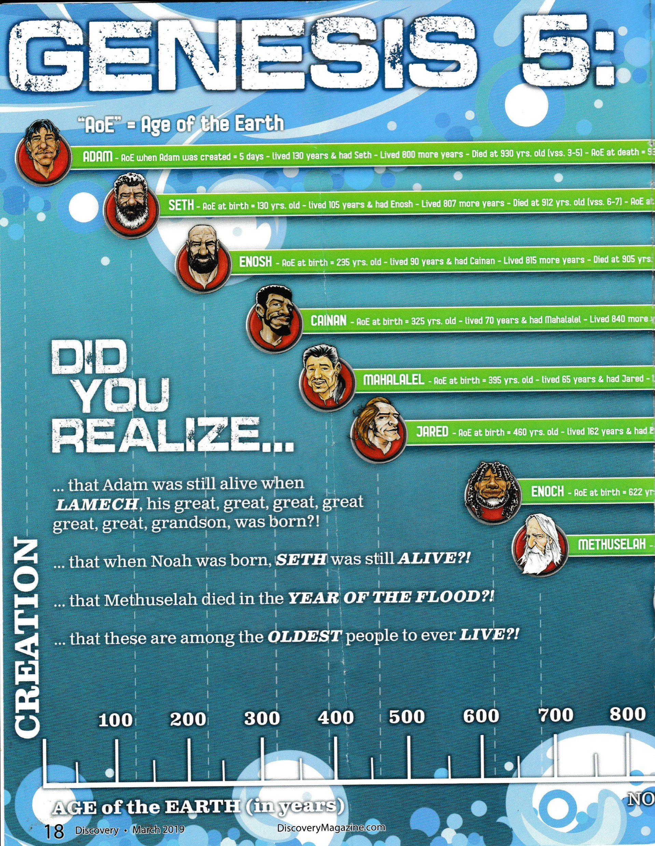
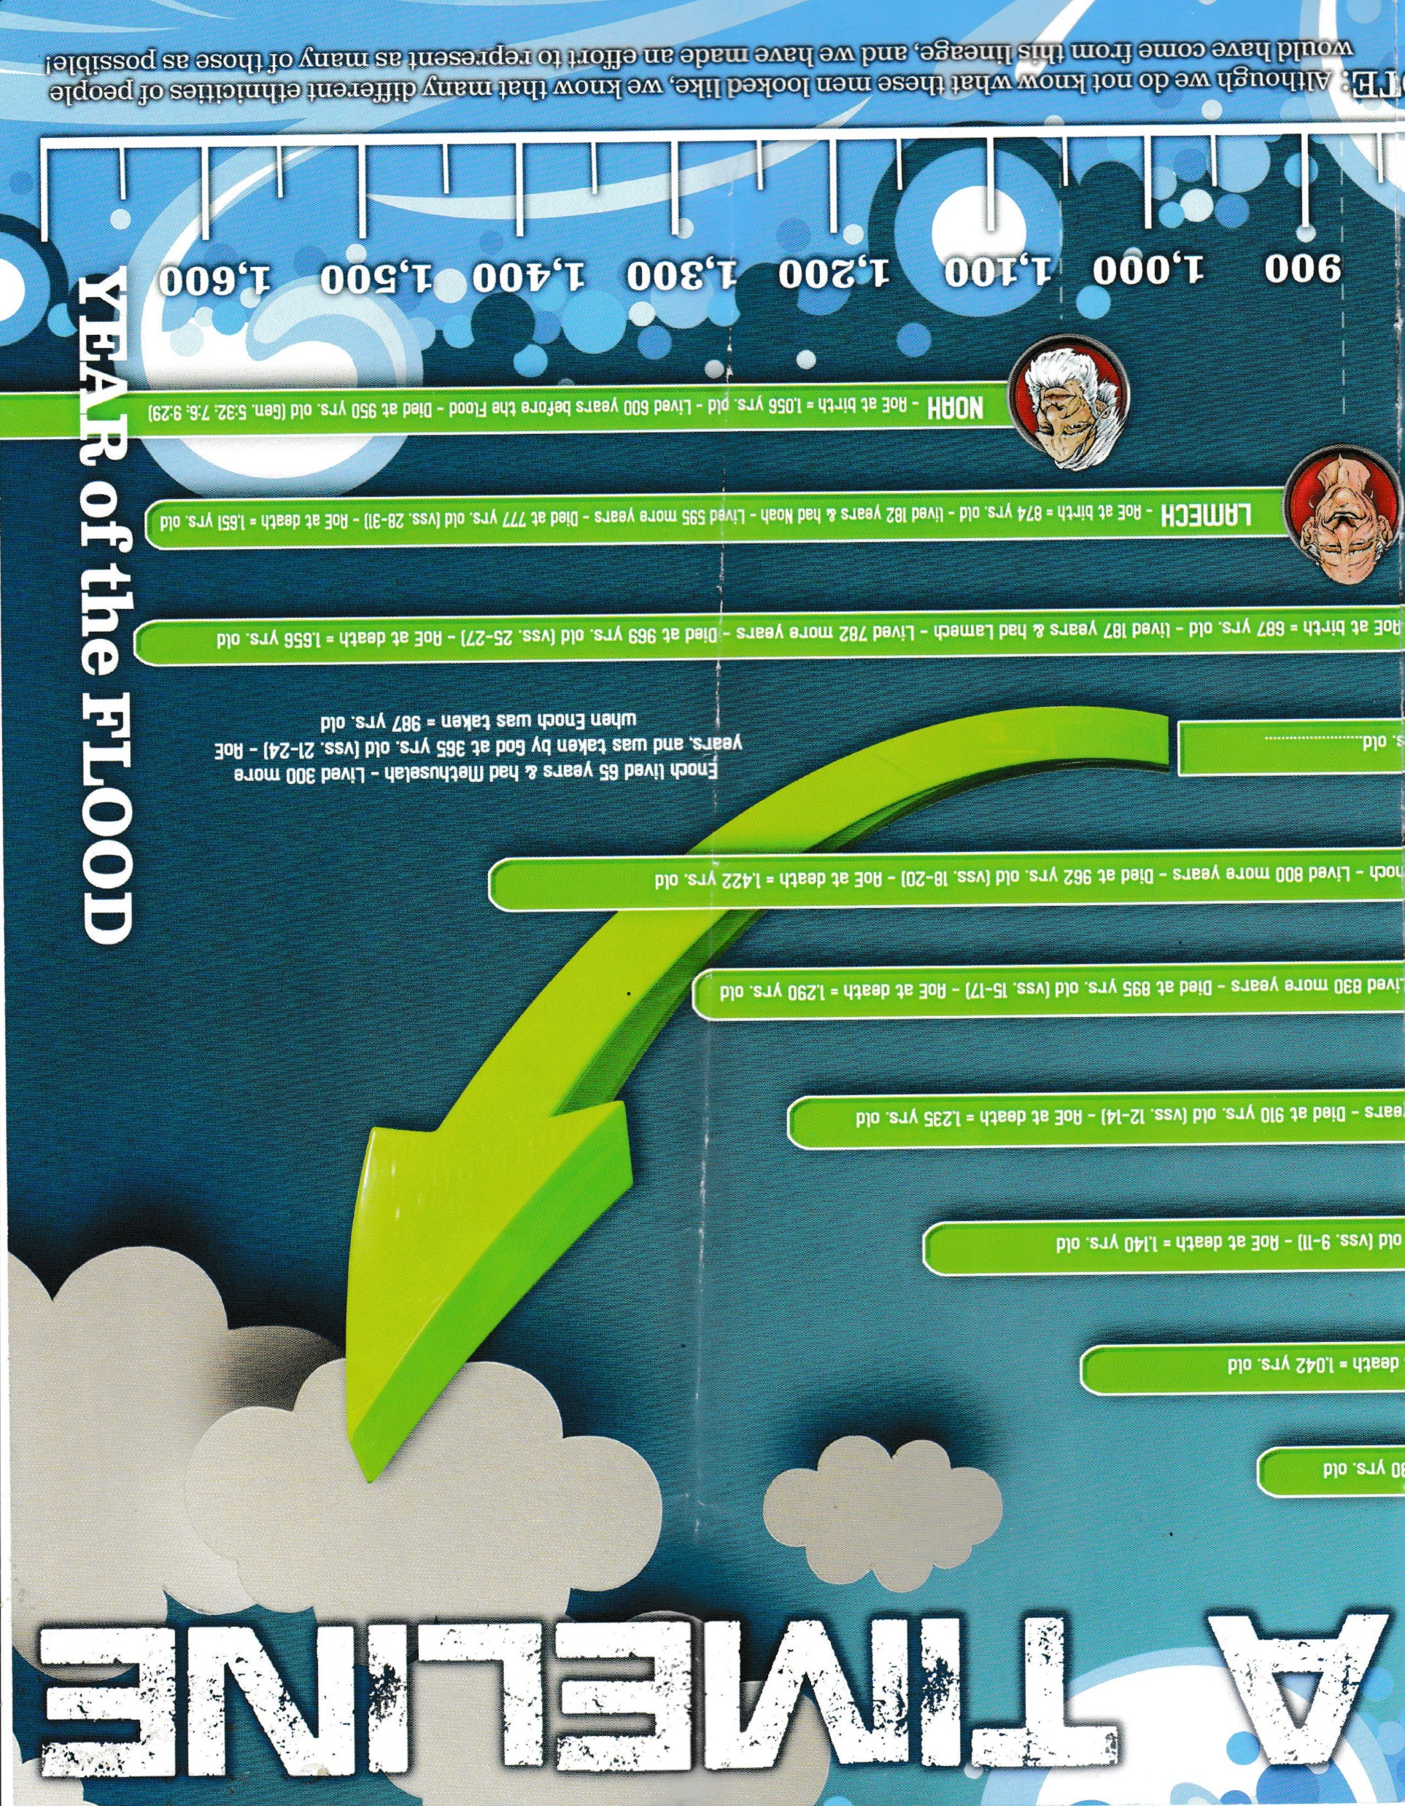
Genesis 5 is the genealogy from Adam to Noah.
Gen 5:24 →Enoch was taken by God
Discovery, Apologetics Press, Inc. Vol 30:3, March 2019, p. 18-19.

Slide 16
Why did God decide to destroy man? What else did God destroy with the flood? Who found grace in the eyes of the LORD?
Genesis 6:5 → Wickedness of man was great
Genesis 6:5 → every intent of the thoughts of man’s heart was only evil continually
Genesis 6:11 → The earth was corrupt and the earth was filled with violence
Genesis 7:21 → All flesh that moved on the earth; birds, cattle, beasts, every creeping thing, every man
Genesis 6:8 → “But Noah found grace in the eyes of the LORD.”

Slide 17
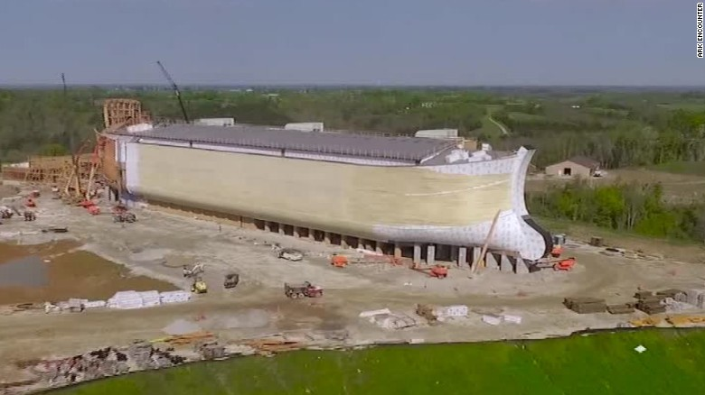
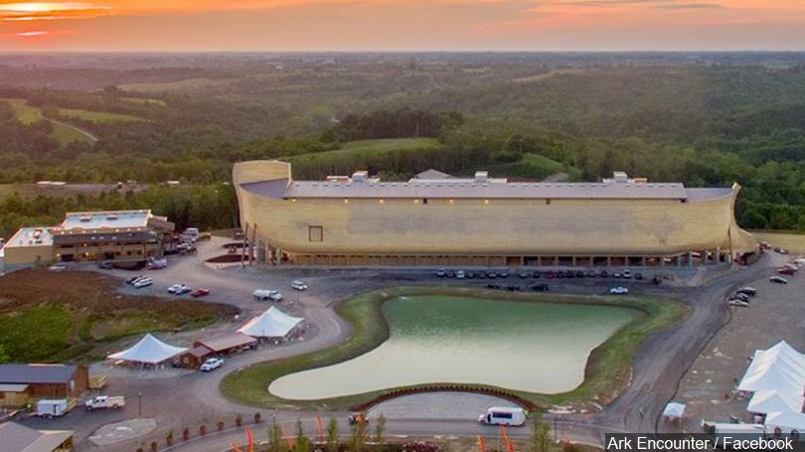
The ark
Size
Genesis 6:15 → 300 cubits long, 50 cubits wide, 30 cubits tall
Ark Encounter uses a cubit of 20.4 inches
510 feet long, 85 feet wide, 51 feet high
Photos building the Ark Encounter in northern Kentucky
https://arkencounter.com

Slide 18
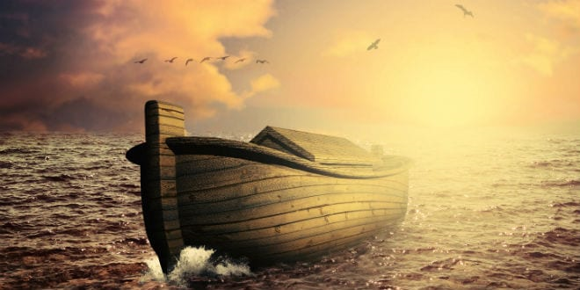
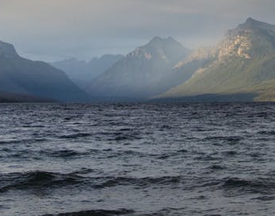
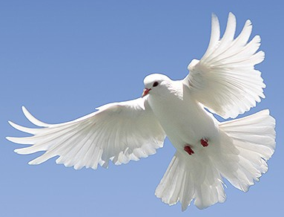
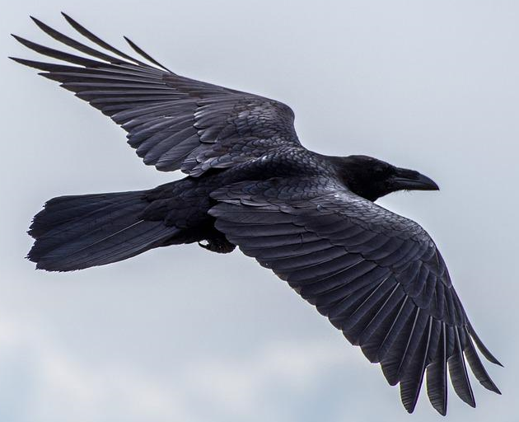
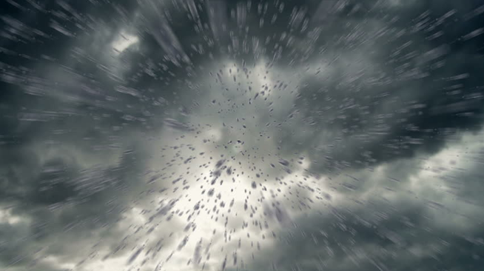
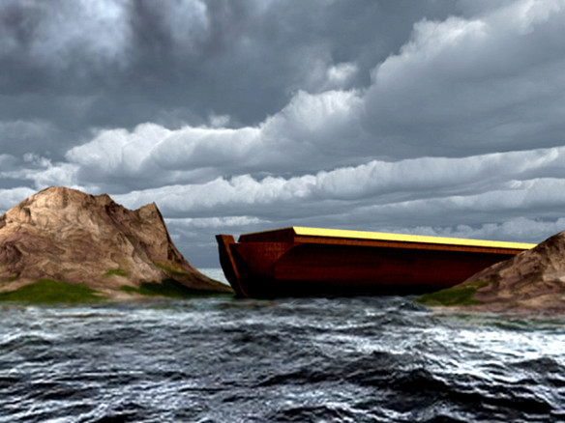
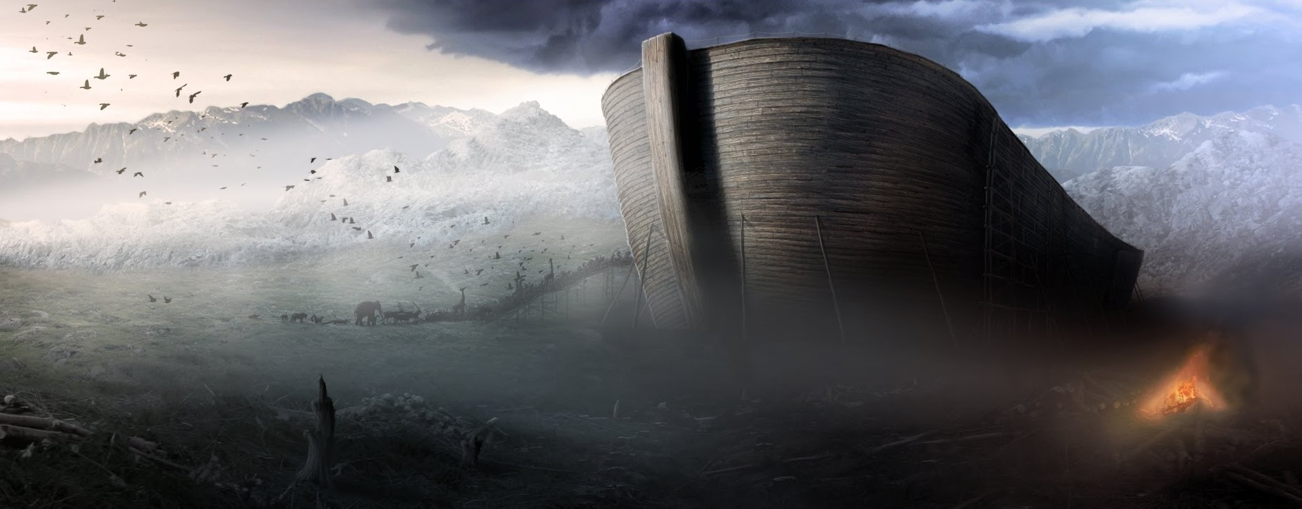
Describe the flood (how it occurred, how long it was on the earth, how long the waters prevailed on the earth, how long until the ark rested, etc.).
Rain stops – 40 days
Mountain tops seen ~300 days
Flood starts
Waters start to recede, Ark rests on mountains – 150 days
Man and animals leave ark ~ 1 year
Notes:
Frame work theory – Creation account is poetic

Slide 19
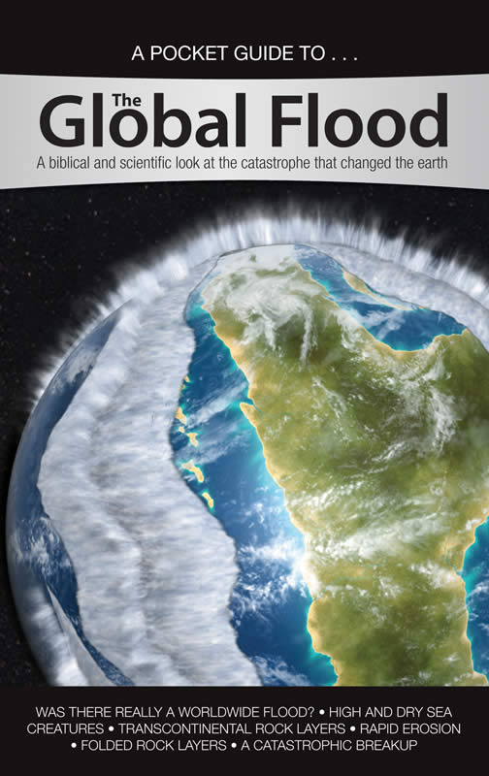
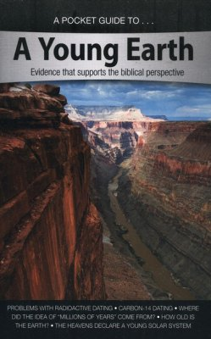
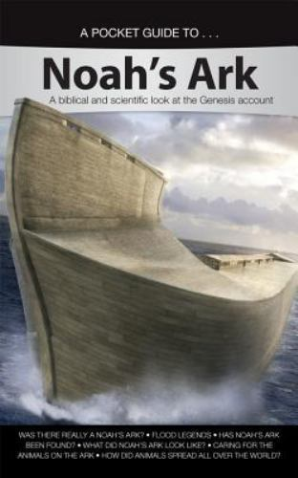
Review
Others of possible interest: Science, Apemen, Darwin, Dinosaurs, Astronomy, and more

Slide 20
Describe the events of the third time period: scattering of the people
Gen 11:4 → People wanted to build a city and a tower whose top is in the heavens.
This way they could make a name for themselves
So that they wouldn’t be scattered abroad over the face of the earth
Gen 11:7 → God confused their language, so that they didn’t understand each other’s speech
Gen 11:8-9 → This resulted in the people scattering abroad over the face of the earth, which is what God told Noah and his sons to do (Genesis 9:1)
Remember the prevalence of the flood story in so many cultures
Languages established when all together and knew of the flood history

Slide 21
In Genesis 12:1 – 3 God makes promises to Abram. These promises are a continual theme. What are the promises and when were the promises fulfilled?
Should know the location of these verses
Genesis 12:1 → “… a land”
Genesis 12:2 → “…make you a great nation”
Genesis 12:3 → “…in you all the families of the earth shall be blessed.”
This promise is a reference to Jesus
First promise of the Savior → Genesis 3:15 (in the curses)
Land and descendant promise to Abram → 13:14 – 17; 15:5, 18 – 21; 17
3-fold promise to Isaac → Genesis 26:4
3-fold promise to Jacob → Genesis 28:12 – 14

Slide 22
In Genesis 12:1 – 3 God makes promises to Abram. These promises are a continual theme. What are the promises and when were the promises fulfilled?
Fulfillment of the land promise
Joshua 21:43-45
Fulfillment of the nation promise
Exodus 1:7 → Children of Israel were fruitful and grew exceedingly mighty while in Egypt
Fulfillment of all nations of earth being blessed
Jesus resurrected from the dead (completed the salvation plan for all mankind)
Matthew 28:7, 18 – 20

Slide 23
In Genesis 12:1 – 3 God makes promises to Abram. These promises are a continual theme. What are the promises and when were the promises fulfilled?
Why does it take so long for Abram’s descendants to inherit the land
Genesis 15:16 → the iniquity of the Amorites was not yet complete
How did Abraham dwell in the promise land (what was his attitude)?
Hebrews 11:8 – 10 → sojourned as a foreigner, dwelling in tents because he waited for the city built by God
Hebrews 11:13 – 16 → desired a heavenly country

Slide 24
Abraham twice tells a lie about his wife Sarah. What was this lie, and to whom was the lie told?
Abraham said Sarah was his sister instead of his wife because he thought the people of the land would kill him and take Sarah.
First to the Egyptians (Genesis 12:10-20)
Also to Abimelech (Genesis 20)

Slide 25
One of the promises God made to Abraham was to make him a great nation. What did Sarah suggest, and Abraham do, to “help” this promise?
Genesis 16:1 – 6
Sarah gave Abraham her maidservant, Hagar, to have a child
This doesn’t turn out well and Sarah deals harshly with Hagar after she conceives
Hagar runs away but returns after the Angel of the Lord talks with her (Gen 16:6 – 16)
Sarah has Abraham send Hagar and Ishmael away after Isaac is born (Gen 21:8 – 21)
God promises Abraham that Ishmael will also become a nation

Slide 26
After Isaac is born, God tests Abraham’s faith. Describe this.
Genesis 22
God tells Abraham to sacrifice Isaac, his only son in whom the promise God made to Abraham would be fulfilled
Abraham is in the process of obeying when the Angel of the Lord stops him and tells Abraham that he knows Abraham fears God

Slide 27
Where is Isaac’s wife Rebekah from?
Genesis 24
The land of Abraham’s kindred

Slide 28
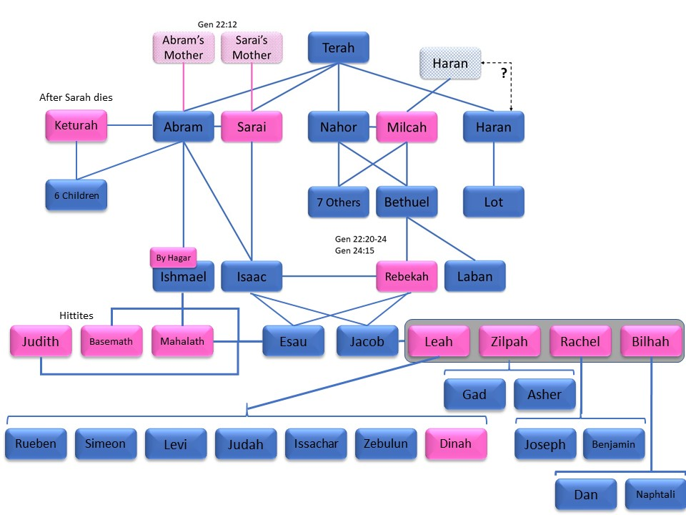
Describe how Rachel died.
Genesis 35:16 – 20
Jacob and his household left Bethel
A little distance from Ephrath (Bethlehem), Rachel had hard labor
Rachel died in childbirth, but named the boy Ben-Oni (Son of My Sorrow)
Jacob called him Benjamin (Son of My Right Hand)
Rachel was buried on the way to Ephrath and Jacob set up a pillar on her grave

Slide 29
Why does Jacob leave and go to his uncle’s (why does Rebekah want him to leave, and what is the reason she gives)?
Genesis 27:41 – 46
Esau hated Jacob because of the stolen blessing and said he would kill Jacob after the days of mourning for his father (Isaac hadn’t died yet, but it was close at hand)
Rebekah finds out and tells Jacob to go to Haran to her brother Laban until Esau’s fury turns away
Rebekah tells Isaac she is weary of her life because of the daughters of Heth
Isaac tells Jacob to go take a wife from the land of Rebekah (Gen 28:1 – 2)

Slide 30
How does Jacob get his two wives? Who are the mothers of Jacob’s children?
Genesis 29
Jacob agrees to work for Laban for seven years to get Rachel
Laban gives Jacob Leah instead claiming the oldest must be married first
Jacob agrees to work another seven years for Rachel (he marries Rachel a week after marrying Leah, and then works for another seven years)
Gen 29, 30
Leah has 6 sons and a daughter
Zilpah (Leah’s maid) has 2 sons
Rachel has 2 sons
Bilhah (Rachel’s maid) has 2 sons

Slide 31
Jacob returns to Canaan with his household. What happens to his favorite son, Joseph?
Genesis 37
Joseph’s brothers sell him to Midianite traders who take him to Egypt and sell him to Potiphar, the captain of the guard
Potiphar’s wife lies about Joseph and he ends up in prison

Slide 32
How does God save Egypt and the surrounding areas through Joseph?
Genesis 40 – 41
Pharaoh has a dream and no one can interpret it
Pharaoh’s butler (who had his dreams interpreted by Joseph while in prison with Joseph) remembers Joseph
Joseph interprets Pharaoh’s dreams
Seven years of plenty followed seven years of famine
Pharaoh sets Joseph as second in command of Egypt to prepare for the famine

Slide 33
How Israel (Jacob) and his household end up in Egypt?
Genesis 42 – 50
Joseph’s brothers go to Egypt to buy grain
Joseph recognizes them, but they don’t recognize him
Joseph keeps Simeon in prison and tells the brothers to return with Benjamin
They finally return because the famine is so great (Jacob did not want Benjamin to go)
Joseph tests the brothers and Judah gives himself for Benjamin
Joseph reveals himself and tells them to bring his father to Egypt
Jacob and hi household go to Egypt

