Slide 1
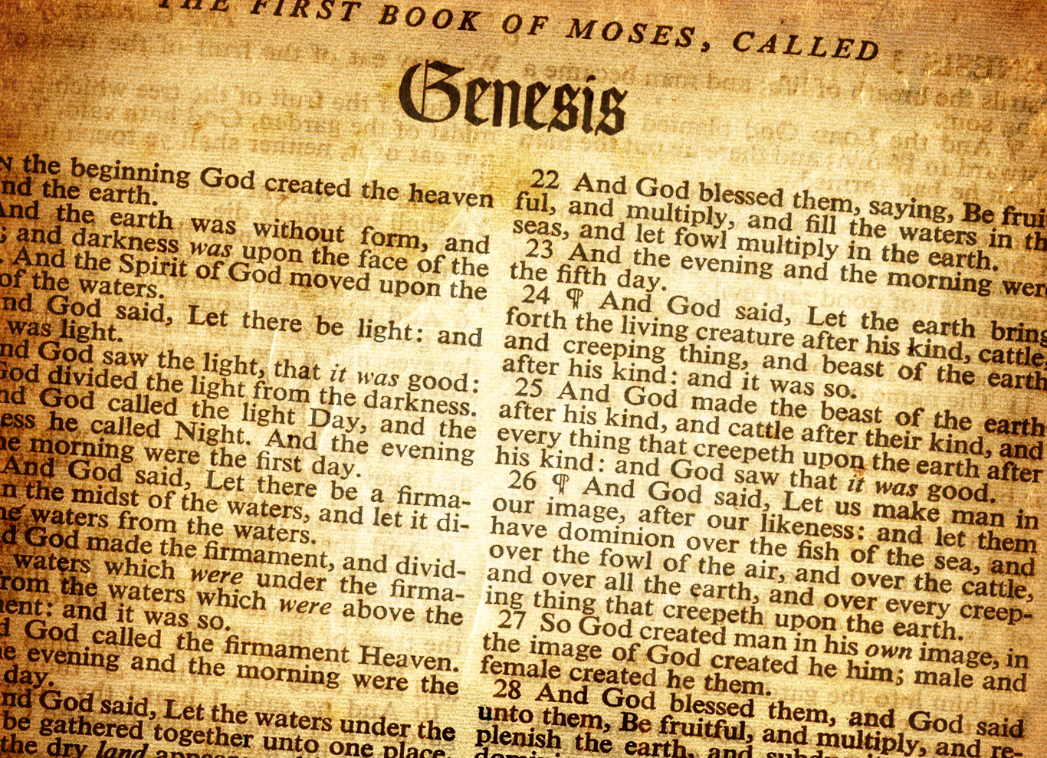
Lesson 11 Joseph’s Rise to Power Genesis 40 – 45

Slide 2
Review
Before the Flood
Flood
Scattering
Patriarchs
Genesis
Creation
0
Flood
1650
Abraham’s Birth
2008
Joseph’s Birth
~2259
Isaac’s Birth
2108
Joseph’s Death
~2369
Jacob’s Birth
2168

Slide 3
Review
Abram in Egypt
Abram rescues Lot
Abram meets Melchizedek
Ishmael born
86
Isaac born
100
Abraham dies
175
Sodom & Gomorrah destroyed
Abraham lies to Abimelech
Life of Abraham
3-fold promise, Abram departs Haran
75
Renamed Abraham,
Circumcision
99
Sarah dies
127
Finds wife for Isaac
Abraham Marries Keturah
Abraham’s faith tested with Isaac

Slide 4
Timeline of Abraham, Isaac, Jacob together
Isaac born
Abraham 100
Gen 21:5
Jacob born
Isaac 60
Gen 25:26
Life of Abraham
Life of Isaac
Life of Jacob
Isaac marries Rebekah
Isaac 40
Gen 25:20

Slide 5
Timeline of Abraham, Isaac, Jacob, Joseph
Isaac born
Abraham 100
Gen 21:5
Jacob born
Isaac 60
Gen 25:26
Joseph born
Jacob ~91
Jacob goes to Egypt when 130 Gen 47:28
Abraham dies 175
Gen 25:7
Life of Abraham
Isaac dies 180
Gen 35:28
Life of Isaac
Jacob dies 147
Gen 47:28
Life of Jacob
Life of Joseph
Isaac marries Rebekah
Isaac 40
Gen 25:20
Joseph dies 110
Gen 50:26
Joseph interprets Pharaoh's dreams when ~30
Joseph about 17 sold when by bothers Gen 37:2

Slide 6
Preview
Patriarchs – Genesis chapters 13 – 50:
40 | 41 | 42 | 43 | 44 | 45
Joseph and the prisoners’ dreams | Joseph and Pharaoh’s dreams Joseph’s rise to power | Joseph’s brothers go to Egypt Joseph’s brothers return to Canaan | Joseph’s brothers return with Benjamin | Joseph’s cup Judah intercedes for Benjamin | Joseph reveals himself to his brothers

Slide 7
Describe Joseph’s experience with the chief butler and chief baker while Joseph was in prison.
Pharaoh became angry with his chief butler and chief baker and put them in prison while Joseph was in prison; they were put in Joseph’s charge – Gen 40:4
Each of them had a dream – Gen 40:9-17
Chief butler: a vine had 3 branches that brought forth ripe grapes; the butler pressed them into Pharaoh’s cup and placed the cup in Pharaoh’s hand
Chief baker: had 3 white baskets on his head and the top basket had all kinds of baked goods for Pharaoh; birds came and ate the baked goods
The two were sad because there was no interpreter, but Joseph said interpretations belong to God, pleas tell them to me – Gen 40:8
Dream interpretations Gen 40:12-18
Chief Butler: in 3 days time Pharaoh would lift up his head and restore him to his place (Joseph asks the butler to remember him to get him out of prison)
Chief Baker: after he saw that the butler’s interpretation was good, he asked Joseph for his interpretation → within 3 days Pharaoh will lift off your head and hang you on a tree and the birds will eat your flesh
The interpretations come true, but the chief butler did not remember Joseph

Slide 8
How did Joseph come to be released from prison?
Genesis 41
After two full years, Pharaoh had two dreams and none of the magicians or wise men could interpret them for Pharaoh
The chief butler then remembered Joseph and told Pharaoh about Joseph
Joseph is brought before Pharaoh and Pharaoh says it is said that Joseph can interpret dreams → Joseph tells him that God will give him an answer
Joseph interprets Pharaoh’s dreams

Slide 9
Describe Pharaoh’s dreams and what they meant.
First dream – Genesis 40:3-4
7 fine looking fat cows came up out of the river and fed in the meadow. Then 7 ugly and gaunt cows came up out of the river and stood by the other cows, and then the ugly and gaunt cows ate up the 7 fine looking cows and were just as ugly as at the beginning
Second dream – Genesis 40:5-7
7 plump and good heads of grain came up on one stalk. Then 7 thin heads blighted by the east winds sprang up after them. The 7 thin heads devoured the 7 plump heads.
Interpretation – Genesis 40:25-32
The dreams were one. The 7 good cows and 7 good heads of grain represent 7 years of great plenty. The 7 bad cows and 7 thin heads represent 7 years of very severe famine that will follow the 7 years of plenty. The famine will deplete the land and no one will remember the years of plenty.
It was repeated twice because it is established by God and will shortly come to pass.

Slide 10
How did Joseph come to be second in all of Egypt? How old was Joseph at this time? Who did Joseph marry and what were his sons’ names?
Joseph was 30 years old when he stood in front of Pharaoh – Gen 41:46
Genesis 41:33-36
Joseph told Pharaoh to select a discerning and wise man that will appoint officers to collect one-fifth of the produce during the seven years of plenty, and store up grain under the authority of Pharaoh. This would be a reserve for the land during the famine.
Genesis 41:37-44
Pharaoh like Joseph’s advice and set him over all the land of Egypt. Only in regard to the throne would Pharaoh be greater than Joseph
Pharaoh put his signet ring on Joseph’s hand, clothed him in garments of fine linen, put a gold chain around his neck, and had him ride in the second chariot → they cried out “Bow the knee!”

Slide 11
How did Joseph come to be second in all of Egypt? How old was Joseph at this time? Who did Joseph marry and what were his sons’ names?
Genesis 41:45
Pharaoh gave Joseph Asenath, the daughter of Poti-Pherah priest of On as a wife.
Genesis 45:50-52
Joseph’s firstborn: Manasseh (Making forgetful)
For God has made me forget all my toil and my father’s house
Joseph’s second born: Ephraim (Fruitful)
For God has made me to be fruitful in the land of my affliction

Slide 12
Why did Joseph’s brothers go to Egypt? Which brother didn’t go and why? Describe this first interaction between Joseph and his brothers.
Genesis 41:53 – 57
The seven years of plenty ended and the seven years of famine began
The famine was in all the lands
The Egyptians went to Joseph to buy food
All countries came to Joseph to buy food
Genesis 42:1 – 5
Jacob saw that there was grain in Egypt and told his sons to go to Egypt and buy grain
Jacob did not send Benjamin “Lest some calamity befall him”

Slide 13
Why did Joseph’s brothers go to Egypt? Which brother didn’t go and why? Describe this first interaction between Joseph and his brothers.
Genesis 42:6 – 28
The brothers came to Joseph and bowed down before him
Joseph recognized them, but he acted as a stranger and spoke roughly to them asking “where do you come from?”
The brothers told him from Canaan to buy food
Joseph then remembered the dreams he had about them and said the brothers were spies
The brothers tell Joseph that they are only there to buy food and that they are all one man’s sons → twelve brothers, the youngest is with their father and one is no more
Joseph still says they are spies and says that they shall not leave unless their youngest brother comes → he tells them to send one to get their youngest brother while he keeps the rest in prison
Joseph then puts them all in prison for three days
On the third day, Joseph says he fears God → if you are honest men, let one of you be confined while the rest carry grain for the house and then bring the youngest son back

Slide 14
Why did Joseph’s brothers go to Egypt? Which brother didn’t go and why? Describe this first interaction between Joseph and his brothers.
Genesis 42:6 – 28
The brothers say they are truly guilty because of what they did to Joseph
Reuben says he told them not to sin against the boy and that now his blood is required of them
They didn’t know Joseph understood them because he had been speaking to them through an interpreter
Joseph left and wept, then returned and took Simeon and bound him before their eyes
Joseph commanded his men to fill his brothers sacks with grain, restore their money to their sacks, and give them provisions for their journey
On their journey back, one of the brothers finds his money had been returned and their hearts failed them saying “What is this that God has done to us?”
Remember, they think they are now paying the penalty for what they did to Joseph

Slide 15
Describe the interaction with their father, Jacob, when the brothers returned from Egypt.
Genesis 42:29 – 38
When they returned, they told Jacob all that had happened
They then emptied their sacks and found that all of their bundles of money had been restored – the brothers and Jacob became afraid
Jacob said to them that they had bereaved him of his children → “Joseph is no more, Simeon is no more, and you want to take Benjamin away”
Rueben says to kill his two sons if he doesn’t bring Benjamin back
Jacob says his son shall not go down to Egypt for his brother is dead and he is left alone

Slide 16
Why does Jacob finally agree to let Benjamin go to Egypt?
Genesis 43:1 – 15
The famine was severe and they ate all the grain they brought from Egypt
Jacob tells them to go back to Egypt and buy more food
Judah says they will not go unless Benjamin goes, since the man said they would not see his face without their youngest brother
Jacob asks why they even told him about Benjamin
Judah says the man asked pointedly and how were they to know that he would say to bring your brother down
Judah says that he will be the surety for Benjamin and if something happens to Benjamin, he will bear the blame
Judah also said they could have been back by now if they had gone right away
Jacob agrees and tells them to take double the money plus the money that was returned and gifts of balm, honey, spices, myrrh, pistachio nuts, and almonds

Slide 17
Describe the brothers’ second interaction with Joseph.
Genesis 43:16 – 34
When Joseph saw Benjamin, he told his steward to take the men to his home and slaughter an animal because the men would dine with him at noon
The brothers were afraid because they thought they were being brought to Joseph’s house because of the money that was returned in their sacks and he was seeking an occasion to take them as slaves
At Joseph’s house, they talked with the steward and told about how their money was returned and that they brought it back plus more
The steward tells them not to be afraid, God returned their money. He then brought out Simeon
When Joseph got their, they gave him the presents
Joseph asked them about their well-being and about their father
When Joseph saw Benjamin, he went out and wept, washed his face, and came back
They all ate, but at different places because it was an abomination to the Egyptians to eat with the Hebrews
Joseph took food to the brothers, but Benjamin’s serving was 5 times as much
The brothers drank and were merry with Joseph

Slide 18
What does Joseph command his steward to do when the brothers were preparing to leave? What does Judah propose to Joseph and why?
Genesis 40
Joseph tells his steward to fill all the men’s sacks, restore their money in their sacks, and to put his silver cup in the youngest’s sack
In the morning when the brothers left, Joseph told his steward to overtake them and ask them why they repaid evil for good
Is this not the one from which my lord drinks and practices divination
The steward overtakes the brothers and tells them these things, but the brothers deny doing any wrong and say to let the one die for whom it is found and that they would be the man’s slaves
The cup is found in Benjamins sack, and the brother’s tear their clothes and return to the city
Joseph asks them what they have done and did they not know that he practiced divination
The brother’s say that God has found their iniquities and that they would all be his slaves
Joseph says only the one who had the cup will be his slave

Slide 19
What does Joseph command his steward to do when the brothers were preparing to leave? What does Judah propose to Joseph and why?
Genesis 40
Judah tells Joseph about their family and how special Benjamin (and Joseph) is to their father
Judah also tell Joseph that if they don’t return with Benjamin, it will kill their father
Judah asks that he can take the place of Benjamin as a slave, and to let Benjamin return to his father
We see a big differences in Judah compared to when it was his idea to sell Joseph

Slide 20
Describe what happens when Joseph reveals himself to his brothers.
Genesis 45
After Judah asks to take Benjamin’s place, Joseph could not restrain himself
Joseph made everyone but his brothers leave. He wept aloud and the Egyptians heard it
Joseph told his brothers that he is Joseph
Joseph’s brothers couldn’t answer because they were dismayed
Remember what they did to him
Joseph tells them not to be grieved or angry since it was God that sent him to Egypt, not them
Joseph tells them God sent him to Egypt to save their lives by a great deliverance, and that God had blessed him greatly
Joseph tells them that there are still 5 years of famine left, and to go bring their father to him

Slide 21
Describe what happens when Joseph reveals himself to his brothers.
Genesis 45
Pharaoh heard the report about Joseph’s brothers and he told Joseph to have his brothers bring his family to Egypt
Pharaoh tells them to take carts to bring the little ones and their wives back to Egypt
Pharaoh tells them not to be concerned about their goods, because they would live off the fat of the land
Pharaoh would give them the choicest land in Egypt
Joseph gave the brothers changes of garments, but he gave Benjamin 300 pieces of silver and 5 changes of garments
Joseph sent 10 donkeys loaded with good things of Egypt and 10 female donkeys loaded with grain, bread, and food for his father for the journey
When the brothers return to Canaan, they tell Jacob about Joseph but he doesn’t believe them
After they tell him all that Joseph said, and Jacob sees the carts, Jacob says he will go down and see his son before he dies

