Slide 1
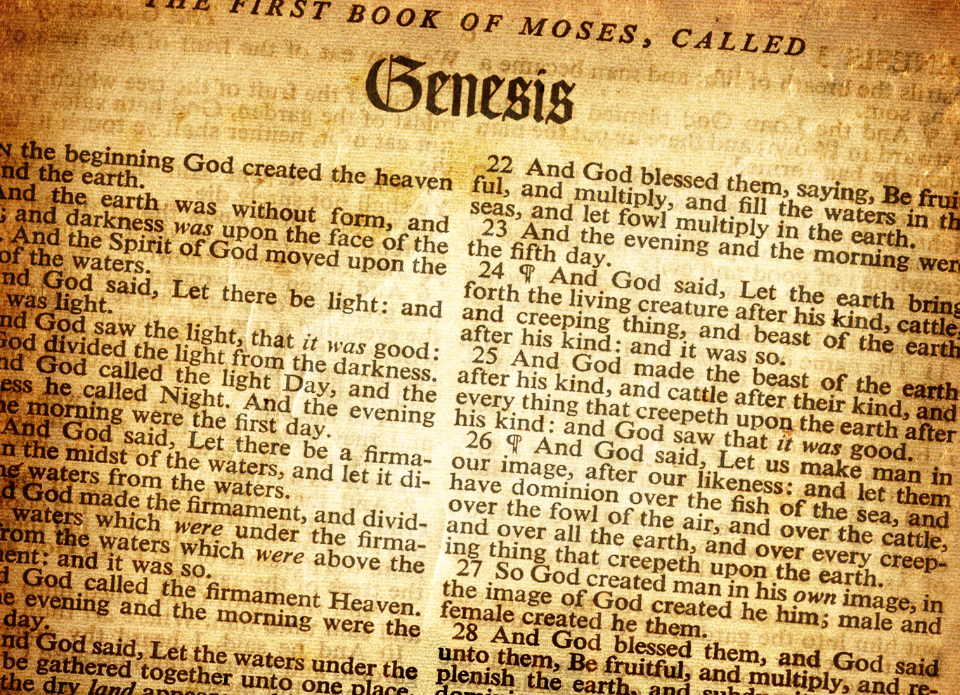
Lesson 5 Abram to Abraham Genesis 13 – 17

Slide 2
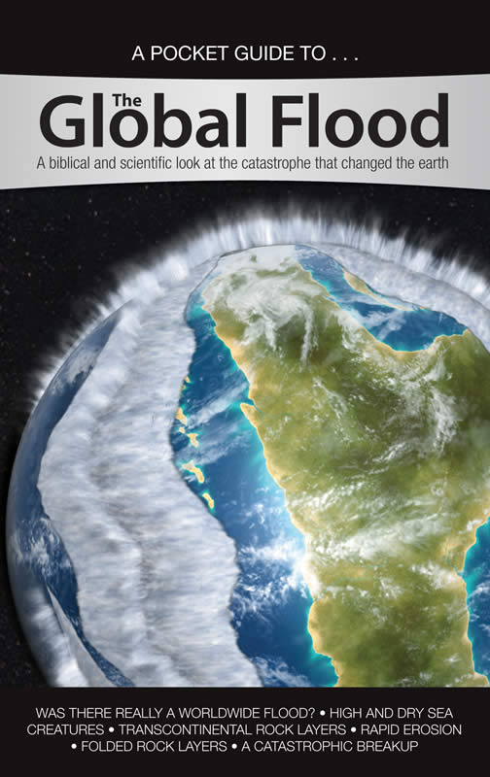
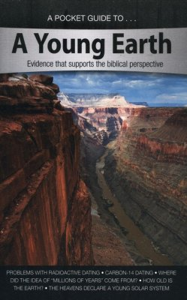
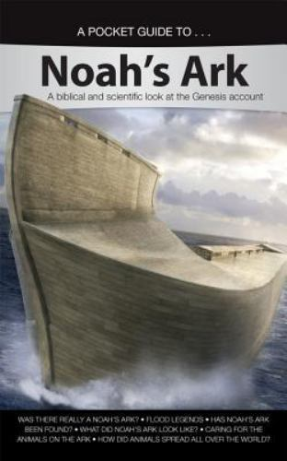
Review
Others of possible interest: Science, Apemen, Darwin, Dinosaurs, Astronomy, and more

Slide 3
Review
Before the Flood
Flood
Scattering
Patriarchs
Genesis
Creation
0
Flood
1650
Abraham’s Birth
2008
Joseph’s Birth
~2259
Isaac’s Birth
2108
Joseph’s Death
~2369
Jacob’s Birth
2168

Slide 4
Review
Before the Flood – Genesis chapters:
1 | 2 | 3 | 4 | 5
Creation | Sabbath Garden of Eden Creation of Eve | Temptation and fall of man Curses (serpent, woman, ground) First mention of Savior | Cain murders Abel Family of Cain | Genealogy from Adam to Noah
The Flood – Genesis chapters:
6 | 7 | 8 | 9 | 10
Wickedness of man Instructions for the ark | Entering the ark Flood waters on the earth | Waters receding Leaving the ark | Fear on animals; meat for food Capital punishment Rainbow covenant Noah’s drunkenness | Genealogy of Noah

Slide 5
Review
Scattering of the People – Genesis chapter:
11
Tower of Babel Shem’s Descendants to Abram
Patriarchs – Genesis chapters:
12 | 13 → 50
Promises to Abram Abram’s departure Aram in Egypt | Rest of the Patriarchs Later in study of Genesis

Slide 6
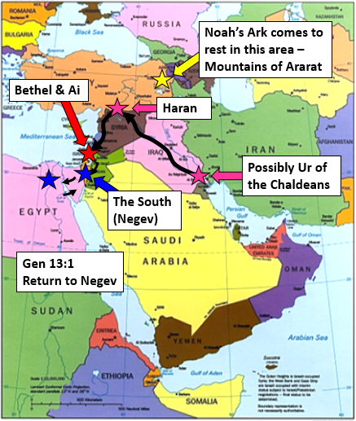
Review

Slide 7
Preview
Patriarchs – Genesis chapters 13 – 50:
13 | 14 | 15 | 16 | 17
Abram travels back to Canaan Abram and Lot split up | Lot gets captured Abraham rescues Lot Abraham meets Melchizzedek | God reiterates land and nation promises to Abraham | Hagar given to Abraham Hagar flees and returns; Ishmael born | God establishes land and nation covenant with Abraham Circumcision

Slide 8
At the end of Genesis 12, Abram is commanded to leave Egypt. Where does he go? Describe how do Abram and Lot come to live in different places.
Genesis 13:1 → Abram, Sarai, and Lot go back to the South (Negev)
Genesis 13:3 → From there, traveled back to where his tent had been between Bethel and Ai (where he made an altar to God)
Abram was very rich in livestock and Lot had flocks and herds (Gen 13:2, 5)
The land couldn’t support both of them (Gen 13:6)
There was strife between Abram’s and Lot’s herdsmen (Gen 13:7)
Abram doesn’t want strife with Lot and asks Lot to choose which land Lot wants (Gen 13:8-9)
Lot choose the plain of Jordan (east) and pitched his tent as far as Sodom (the men of Sodom were exceedingly wicked) (Gen 13:10-14)
After Lot departs, the LORD tells Abram that his descendants will be given all the land that he can see, north, east, south, west, and they will be as the dust of the earth (part of original promise in Gen 12) (Gen 13:14-16)

Slide 9
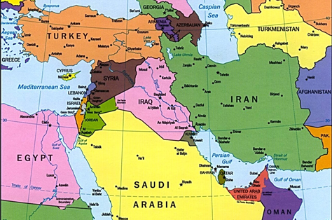
At the end of Genesis 12, Abram is commanded to leave Egypt. Where does he go? Describe how do Abram and Lot come to live in different places.

Slide 10
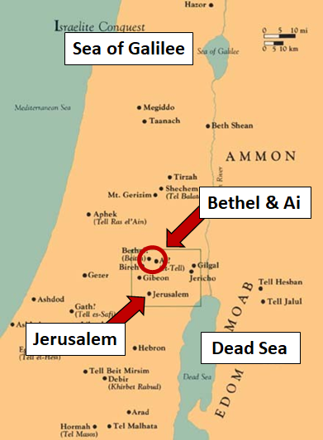
At the end of Genesis 12, Abram is commanded to leave Egypt. Where does he go? Describe how do Abram and Lot come to live in different places.
Possibly Sodom and Gomorrah

Slide 11
What is the significance of Genesis 13:14 – 17?
First time recorded that we see God telling Abram what the land is that his descendants will inherit
Reiteration of 2 of the promises made in Gen 12:1-3 (land and people)

Slide 12
Describe the events of Genesis 14:1 – 17.
War of allied kings in the Valley of Siddim (Salt Sea)
Kings of Sodom, Gomorrah, Admah, Zeboiim, and Bela served Chedorlaomer king Elam for 12 years and rebelled in the 13th year
Genesis 14:2, 4
5 kings
In the 14th year Chedorlaomer and the kings that stayed loyal (Shinar, Ellasar, nations) attacked nearby lands
Genesis 14:5-7
4 kings
The 5 kings joined in battle against the 4 kings in the Valley of Siddim
Genesis 14:8-9
The kings of Sodom and Gomorrah fled as well as those that were still alive
Genesis 14:10
The 5 kings took all the goods of Sodom and Gomorrah, as well as Lot and his goods
Genesis 14:12

Slide 13
Describe the events of Genesis 14:1 – 17.
Someone escapes and tells Abram
Genesis 14:13
Abram takes his 318 trained servants who were born in his house and pursues as far as Dan
Abram’s allies Aner, Eshcol, and Mamre go with him (Gen 14:13, 24)
Genesis 14:14
Abram divides his forces and attacks at night, pursuing as far as Hobah
Genesis 14:15
Abram defeats Chedorlaomer and brings back the goods as well as Lot and his goods and all the women and people; the king of Sodom went out to meet him
Genesis 14:16-17

Slide 14
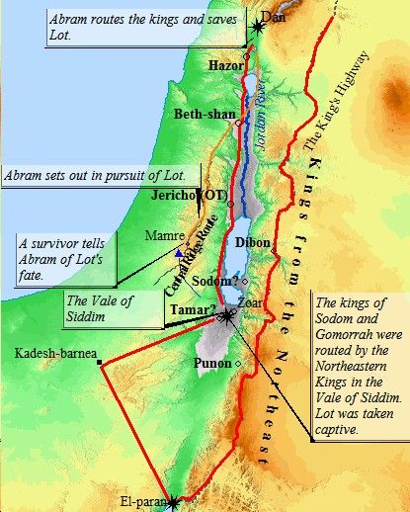
Describe the events of Genesis 14:1 – 17.
Possible locations of battles, pursuit, and rescue

Slide 15
Describe Abraham’s interaction with Melchizzedek. Where else do we read of Melchizzedek? Who is likened to Melchizzedek and how is Melchizzedek’s interaction with Abram used to clarify Jesus’ priesthood to the Levitical priesthood?
Melchizzedek was the king of Salem and a priest of God
Genesis 14:18
Melchizzedek brings out bread and wine to Abram and blesses Abram
Genesis 14:18-20
Abram gives Melchizzedek a tithe of all
Genesis 14:21
Melchizzedek is mentioned again in Psalm 110:4, Hebrews 5:6 – 10; 6:20; 7:1 – 21
Jesus is likened to Melchizzedek
Hebrews 7:3
Jesus being our High Priest is according to the order of Melchizzedek
Hebrews 6:20

Slide 16
Describe Abraham’s interaction with Melchizzedek. Where else do we read of Melchizzedek? Who is likened to Melchizzedek and how is Melchizzedek’s interaction with Abram used to clarify Jesus’ priesthood to the Levitical priesthood?
Importance of the Jesus-Melchizzedek comparison
Main theme of Hebrews → Jesus is superior
Hebrews 4:14 starts a discussion of Jesus as our High Priest
Interlude from Heb 5:11 – 6:12 to chastise them for not progressing in spiritual knowledge
Hebrew author is building the case to show that Jesus’ priesthood is superior to the Levitical priesthood
Hebrews 7:15 – 16
Melchizzedek’s priesthood didn’t come from the Mosaical law, but for the power of an endless life
Jesus came from the tribe of Judah (Heb 7:14) and therefore could not be a priest according to the law of Moses
Jesus’ priesthood comes from the power of an endless life (like Melchizzedek’s priesthood) not according to the law of a fleshly commandment
So, why is Abraham’s interaction with Melchizzedek so important
Notes:
Melchizzedek doesn’t have a genealogy derived from the nation of Israel (Heb 7:6) which may help explain Heb 7:3 → without father, mother, or genealogy

Slide 17
Describe Abraham’s interaction with Melchizzedek. Where else do we read of Melchizzedek? Who is likened to Melchizzedek and how is Melchizzedek’s interaction with Abram used to clarify Jesus’ priesthood to the Levitical priesthood?
Importance of Abraham’s interaction with Melchizzedek
Sons of Levi have a command to receive tithes from the people (Heb 7:5)
Known without a doubt that the lesser individual is blessed by the greater (Heb 7:7)
Melchizzedek blessed Abraham (Heb 7:6, Gen 16:19 – 20)
Abram gave a tithe of all to Melchizzedek (Heb 7:6, Gen 6:20)
Therefore, Levi paid tithes to Melchizzedek since he was still in the loins of Abraham (Heb 7:9 – 10)
Therefore, since Melchizzedek was greater than Abraham (and therefore Levi), Melchizzedek’s priesthood is greater than the Levitical priesthood
Jesus’ priesthood is of the order of Melchizzedek, and therefore superior to the Levitical priesthood
Hebrews continues to discuss other reasons Jesus’ priesthood is greater
Notes:
Melchizzadek doesn’t have a genealogy derived from the nation of Israel (Heb 7:6) which may help explain Heb 7:3 → without father, mother, or genealogy

Slide 18
What did the king of Sodom tell Abram when Abram returned from defeating Chedorlaomer? What was Abram’s response?
The king of Sodom told Abram to give him the people Abram rescued and keep the goods for himself
Genesis 14:21
Abram tells the king of Sodom that he will take nothing so the king of Sodom can’t say that he made Abram rich
Genesis 14:22 – 24
The only exceptions were what his young men had already eaten and the portion that should go to his allies Aner, Eshcol, and Mamre
Bonus Question!

Slide 19
What does God promise Abram in Genesis 15? Describe what will happen to Abram’s descendants before they inherit the land God gave to Abram. Why is it going to take this long before Abram’s descendants inherit the land?
Genesis 15:1 – 5
Abram tells God that he goes childless
God tells Abram that he will have a child who will be his heir
God also tells Abram that his descendants will be like the stars
Abram believes God and it is accounted to him as righteousness
Genesis 15:7 – 8
God tells Abram that He will give Abram the land
Abram asks God how he will know that he will inherit the land
Genesis 15:9 – 21
Abram falls into deep sleep and horror and great darkness falls on him
God then tells Abram that his descendants will be strangers in a land that is not theirs, and they will serve the masters of the land and they will be afflicted for 400 years
God will judge that nation and Abram’s descendants will come out with great possessions
This is a reference to bondage in Egypt and the deliverance

Slide 20
What does God promise Abram in Genesis 15? Describe what will happen to Abram’s descendants before they inherit the land God gave to Abram. Why is it going to take this long before Abram’s descendants inherit the land?
Genesis 15:16
The iniquity of the Amorites was not yet complete
God wouldn’t destroy them until that time

Slide 21
Describe what Sarai and Abram’s lack of faith cause them to do in Genesis 16? How did this turn out? What was the result?
After dwelling in Canaan for 10 years, Sarai was still without a child (Gen 16:3)
Sarai gives Abram her Egyptian maid, Hagar to be his wife (Gen 16:2 – 3)
Hagar conceives (Gen 16:4)
After Hagar conceives, Sarai becomes despised in Hagar’s eyes (Gen 16:4)
Sarai tells Abram “My wrong be upon you!” and Abram tells Sarai to do what she wants with Hagar (Gen 16:6)
Sarai deals harshly with Hagar, and Hagar flees (Gen 16:6)
The Angel of the LORD tells Hagar to return, and that her son’s descendants would be multiplied exceedingly (Gen 16:7 – 12)
The Angel of the LORD also tells Hagar that her son, Ishmael, would be a wild man and that his hand would be against every man, and every man’s hand against his (Gen 16:7 – 12)
Abraham was 86 when Ishmael was born (Gen 16:16)

Slide 22
Describe the covenant God makes with Abram in Genesis 17. What does God require of Abram? What else is established with this covenant? What is changed with this covenant?
Abram was 99 years old when the LORD appeared to him (Gen 17:1)
Reiteration of the people and land promise from Gen 12:1-3
Abram was required to walk before God and be blameless (Gen 17:1)
God would make nations and kings from Abraham (Gen 17:7)
God would establish his covenant with Abraham to be God to Abraham and to his descendants (Gen 17:7)
Beginning of Israelites being God’s special people
All the world would be blessed through Abraham from Gen 12:3 → this is fulfilled in Jesus and then all those serving Jesus are God’s people
God would give Abraham and his descendants the land that he was in, all the land of Canaan (Gen 17:8)

Slide 23
Describe the covenant God makes with Abram in Genesis 17. What does God require of Abram? What else is established with this covenant? What is changed with this covenant?
As part of this covenant, Abram’s name was changed to Abraham (Gen 17:5)
Abram → Exalted Father
Abraham → Father of a Multitude
Sarai’s name was changed to Sarah (Gen 17:15)
Sarah → Princess
Circumcision is established as a sign of the covenant (Gen 17:10 – 14)
He who is 8 days old shall be circumcised
He who is born into your house and bought with money
He who is not circumcised shall be cut off from his people

Slide 24
God establishes circumcision with Abraham well before the Mosaical Law. Does this mean that God’s people (Christians) should be circumcised? Why or why not?
We know circumcision is not part Christ’s law
Gal 5:2-3 → “if you become circumcised, Christ will profit you nothing.”
Gal 5:6 → in Christ Jesus neither circumcision nor uncircumcision avails anything
Circumcision was given to Abraham and his descendants as a sign of the land and nation covenant
Mosaical law was given to Abraham’s descendants (God’s special people that the land and nation promises applied to)
Today God’s people are Christians
We are blessed through the promise given to Abraham that all nations would be blessed through Abraham (promise fulfilled through Jesus), but we are not under the land and nation covenant
Notes:
this could be similar to people claiming the Sabbath still must be observed (even though we don’t have any indication that man observed the Sabbath until the gathering of the manna)

Slide 25
What is Abraham’s immediate response to the promise God makes in the covenant? What does God say He will do with Ishmael? After his initial response, what does Abraham do?
Abraham fell on his face and laughed, and said in his heart “Shall a child be born to a man 100 years old? And shall Sarah, who is 90 years old, bear a child?”
Gen 17:17
Abraham asks God that Ishmael might live before God
Gen 17:18
God responds that Sarah shall bear a son for Abraham, and his name shall be Isaac. God said He would establish the covenant with Isaac
Gen 17:19
God says that Ishmael would bear 12 princes and God would make Ishmael a great nation
Gen 17:20
Abraham takes Ishmael and all males in Abraham’s house and circumcises them. Abraham was 99 and Ishmael was 13 (Gen 17:23 – 27)

