Slide 1
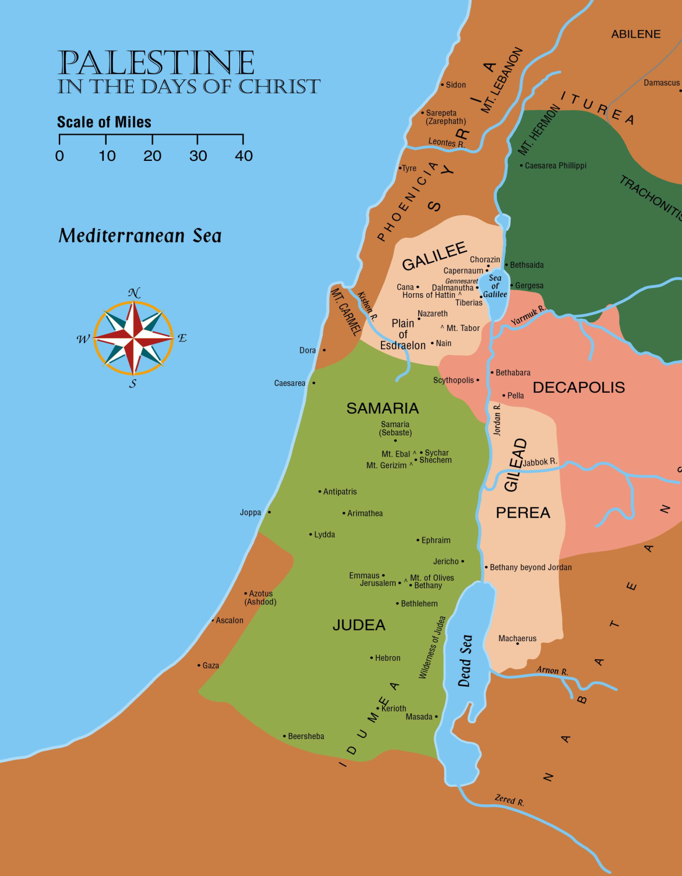
As the New Testament opens…

Slide 2
The Time Draws Near
Nebuchadnezzar had a dream some 600 years before Christ
Daniel Interpreted the Dream
Head of Gold (Babylon)
Another Kingdom (Persia)
Another Kingdom (Greece)
Fourth Kingdom (Roman)
“And in the days of these kings the God of heaven will set up a kingdom which shall never be destroyed; and the kingdom shall not be left to other people; it shall break in pieces and consume all these kingdoms, and it shall stand forever.” (Daniel 2:44)

Slide 3
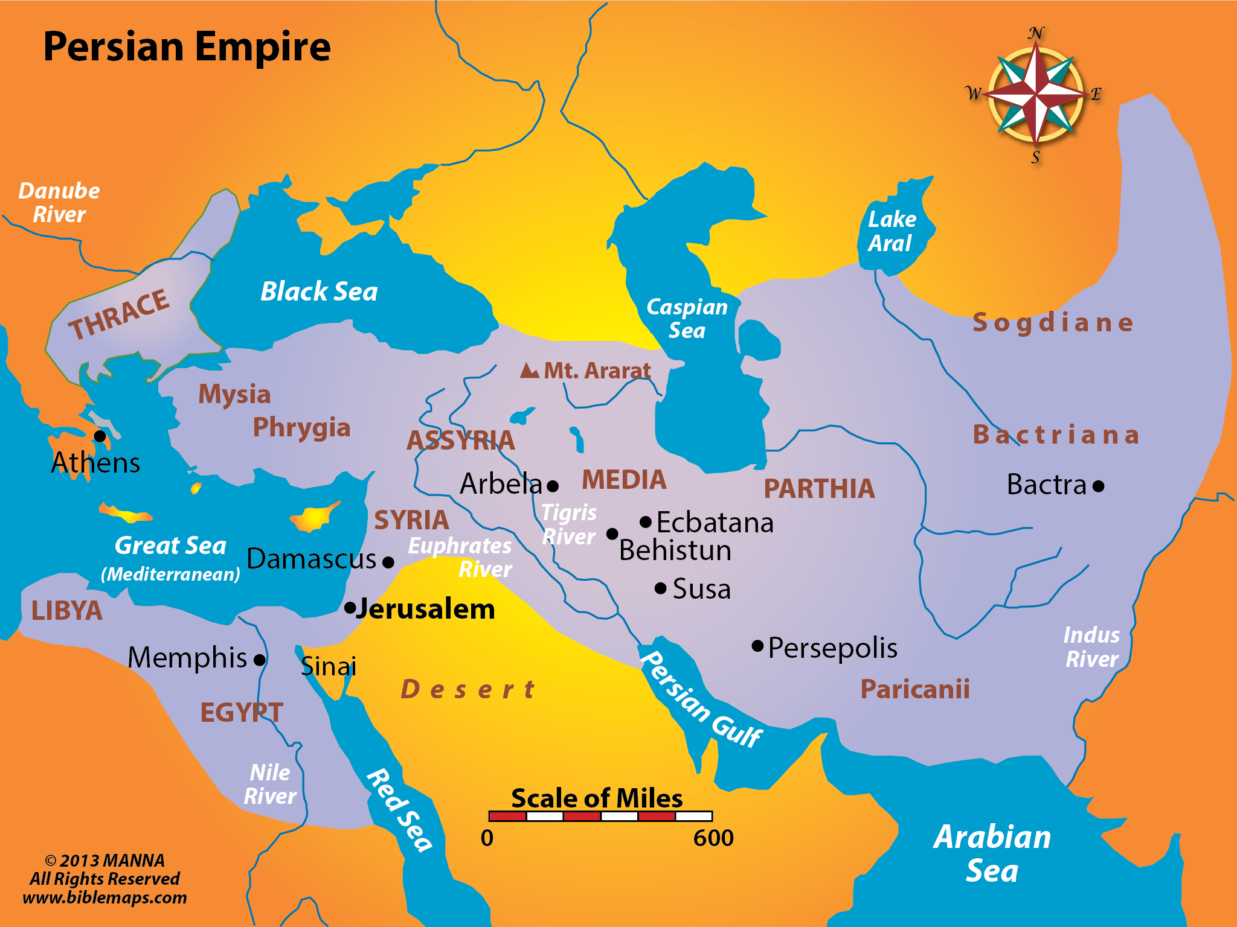
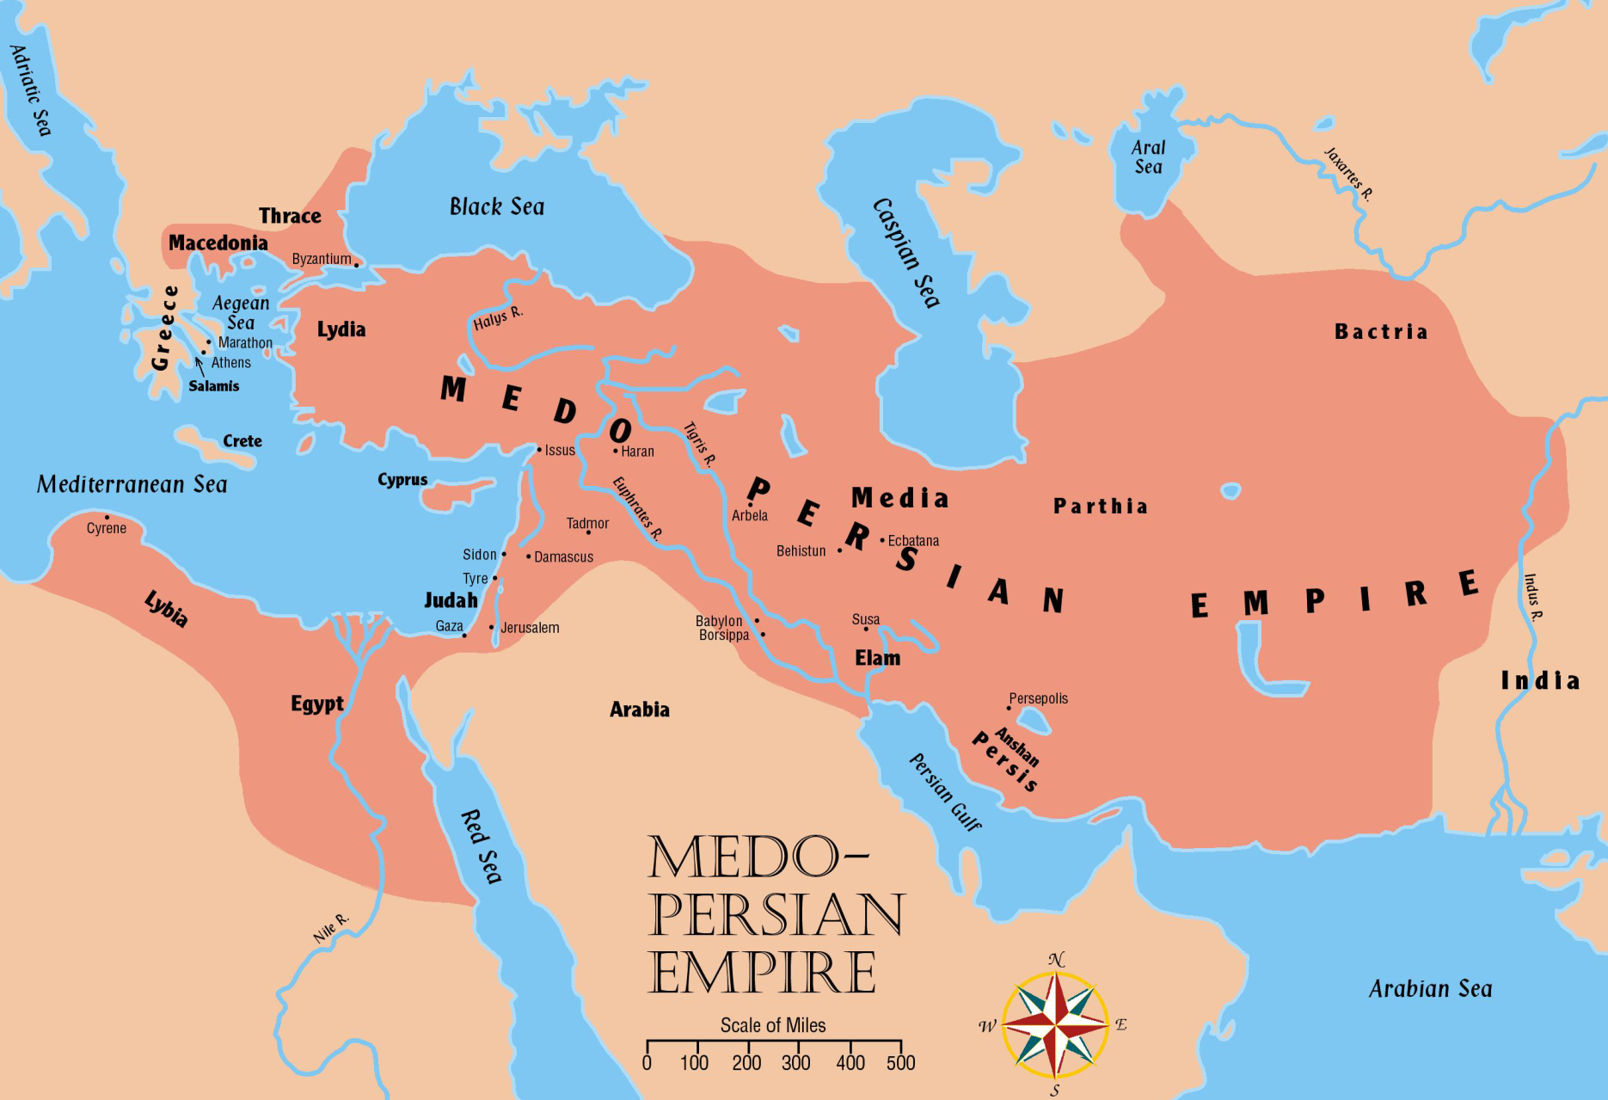
The Rise of the Persians

Slide 4
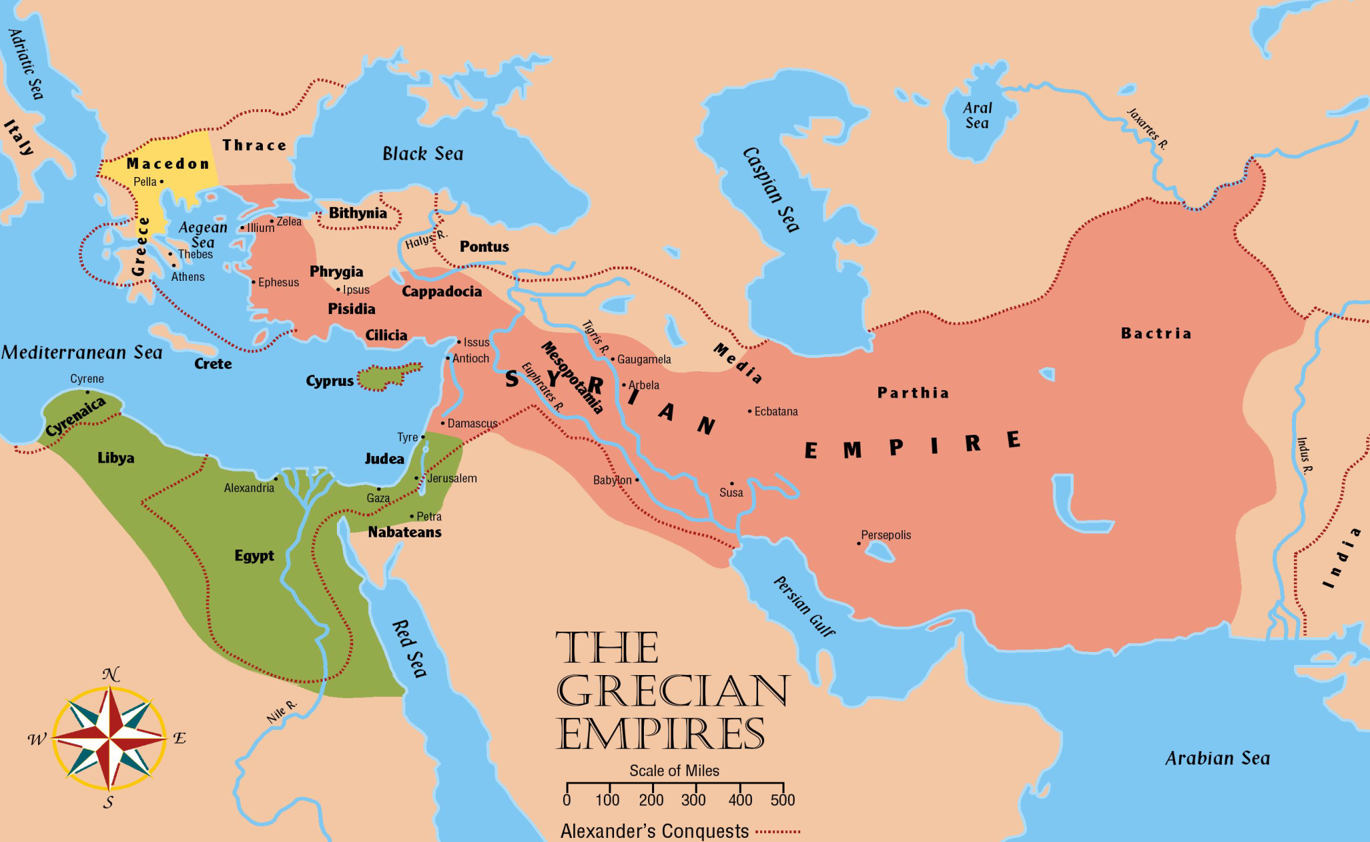

Slide 5
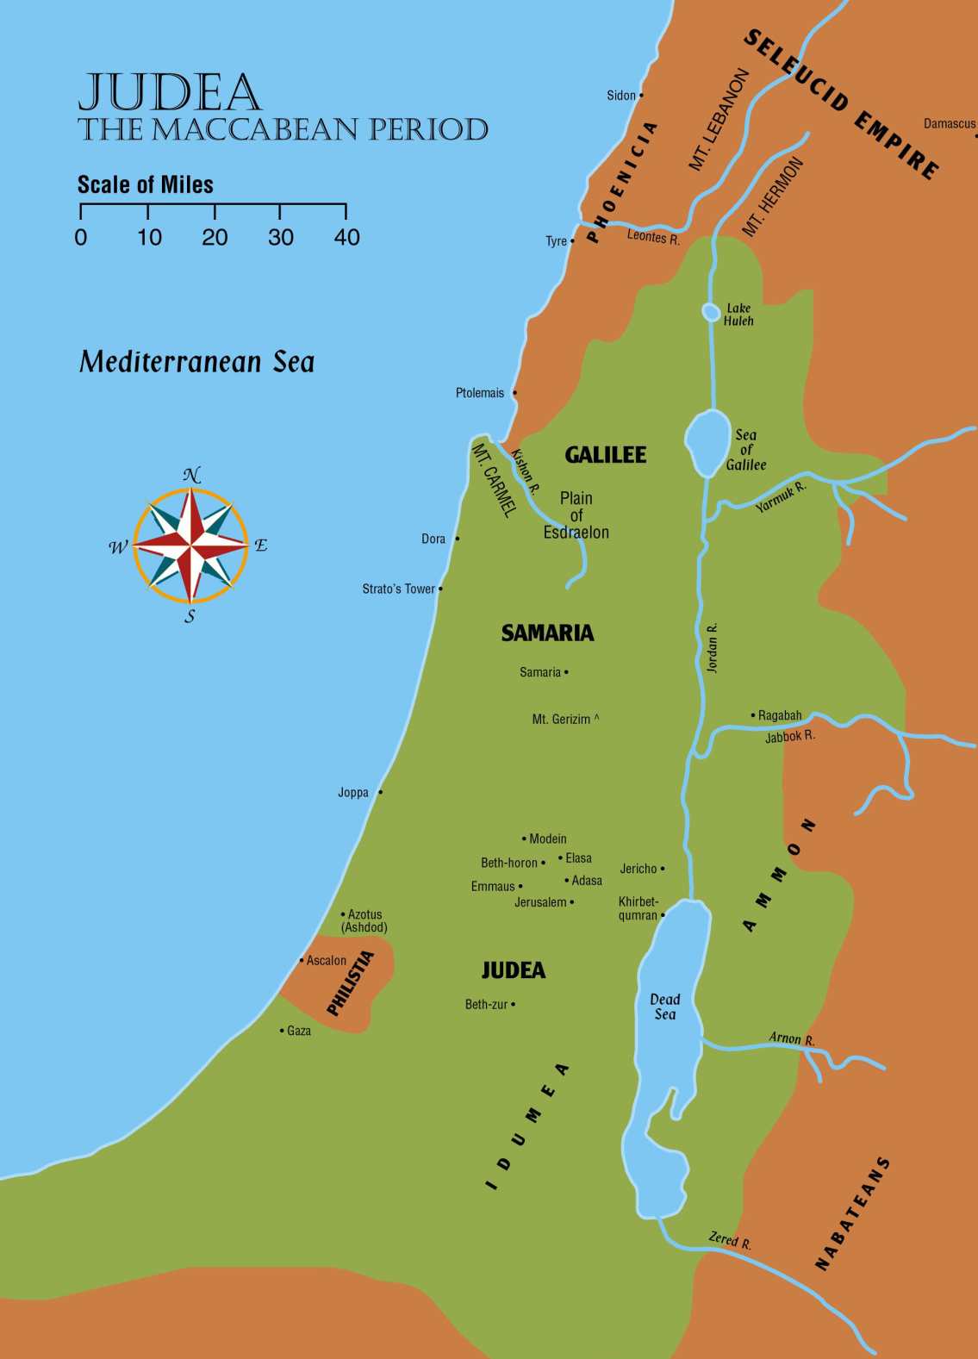

Slide 6
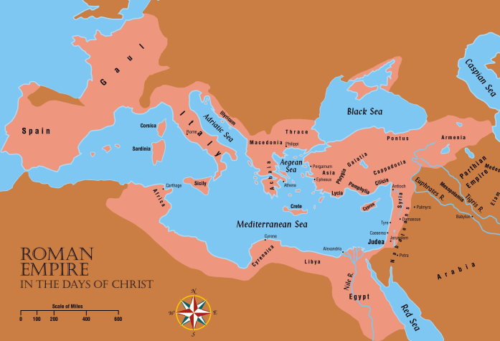
Roman Empire

