Slide 2
God’s Love: The Precious Blood of Jesus
God hates sin
Proverbs 6:16-19
16. These six things the Lord hates, yes seven are an abomination to Him.
17. A proud look, A lying tongue, Hands that shed innocent blood,
18. A heart that devises wicked plans, Feet that are swift in running to evil,
19. A false witness who speaks lies, And one who sows discord among the brethren.

Slide 3
God’s Love: The Precious Blood of Jesus
God hates sin
Proverbs 6:16-19
Psalm 5:4-6
4. For You are not a God who takes pleasure in wickedness, Nor shall evil dwell with You.
5. The boastful shall not stand in Your sight; You hate all workers of iniquity.
6. You shall destroy those who speak falsehood; the LORD abhors the bloodthirsty and deceitful man.

Slide 4
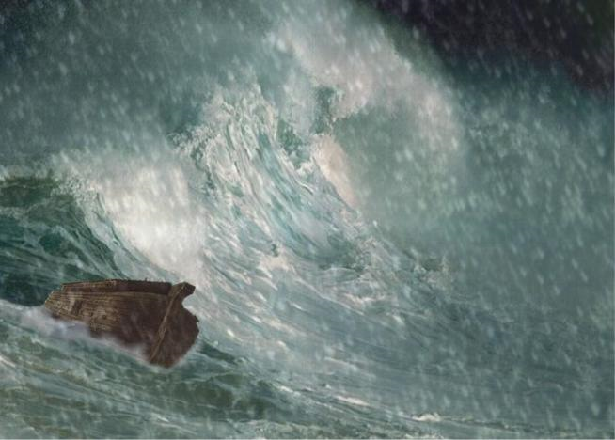
God’s Love: The Precious Blood of Jesus
God hates sin
Proverbs 6:16-19
Psalm 5:4-6
God opposes sin
At the flood
Gen 6:5-7, 13

Slide 5
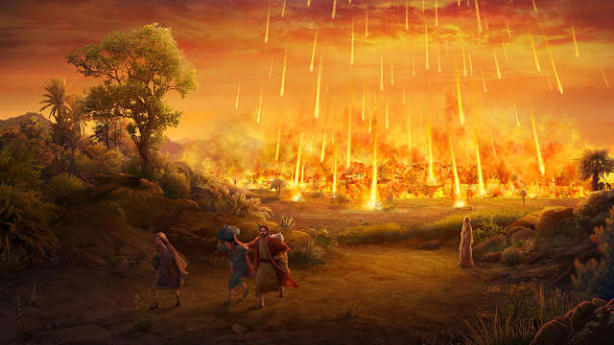
God’s Love: The Precious Blood of Jesus
God hates sin
Proverbs 6:16-19
Psalm 5:4-6
God opposes sin
At the flood
Gen 6:5-7, 13
At Sodom & Gomorrah
Gen 13;13; 19:13, 28

Slide 6
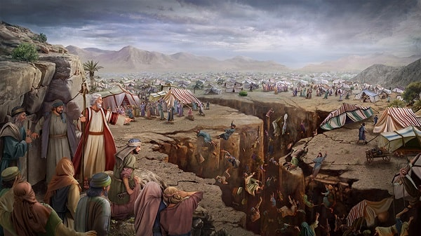
God’s Love: The Precious Blood of Jesus
God hates sin
Proverbs 6:16-19
Psalm 5:4-6
God opposes sin
At the flood
Gen 6:5-7, 13
At Sodom & Gomorrah
Gen 13;13; 19:13, 28
At Korah’s rebellion
Num 16: 32, 35, 49

Slide 7
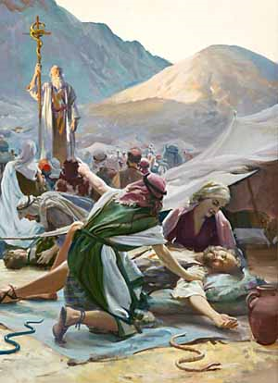
God’s Love: The Precious Blood of Jesus
God hates sin
Proverbs 6:16-19
Psalm 5:4-6
God opposes sin
At the flood
Gen 6:5-7, 13
At Sodom & Gomorrah
Gen 13;13; 19:13, 28
At Korah’s rebellion
Num 16: 32, 35, 49
With fiery serpents
Num 21:5-6

Slide 8
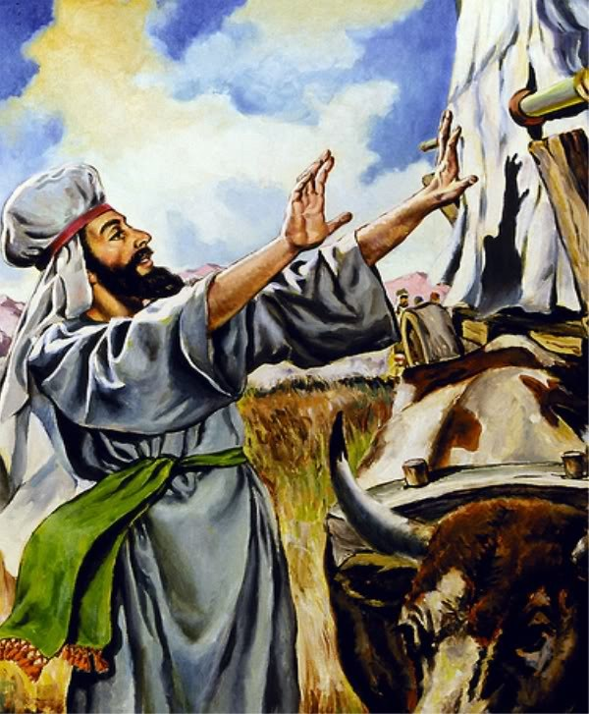
God’s Love: The Precious Blood of Jesus
God hates sin
Proverbs 6:16-19
Psalm 5:4-6
God opposes sin
At the flood
Gen 6:5-7, 13
At Sodom & Gomorrah
Gen 13;13; 19:13, 28
At Korah’s rebellion
Num 16: 32, 35, 49
With fiery serpents
Num 21:5-6
With Uzzah
II Sam 6:6-7

Slide 9
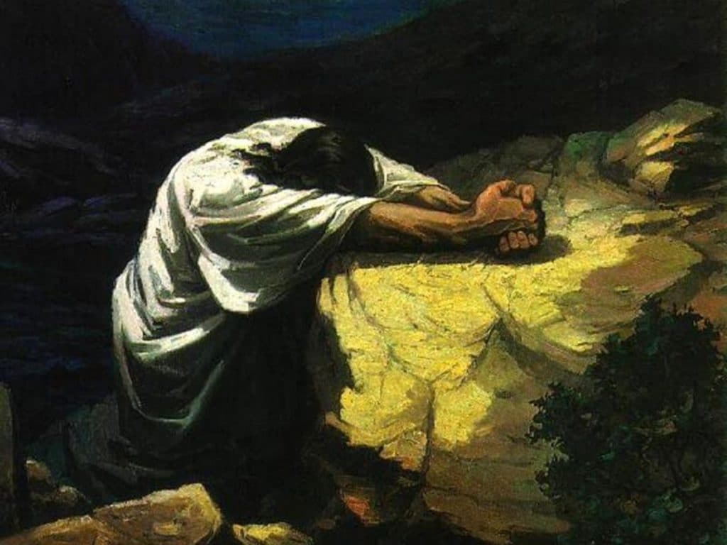
God’s Love: The Precious Blood of Jesus
God’s silence
Gethsemane
Matt 26:36-44

Slide 10
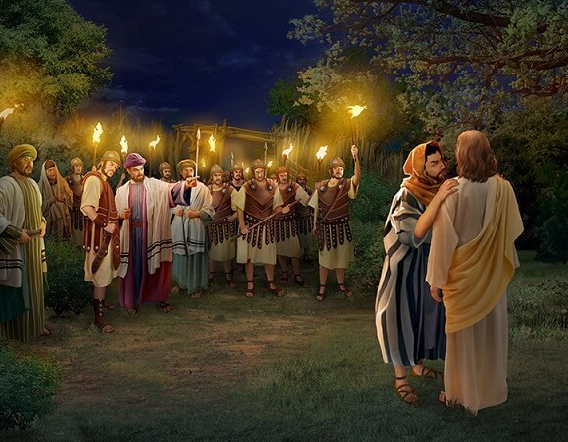
God’s Love: The Precious Blood of Jesus
God’s silence
Gethsemane
Matt 26:36-44
Betrayal
Matt 26:47-49

Slide 11
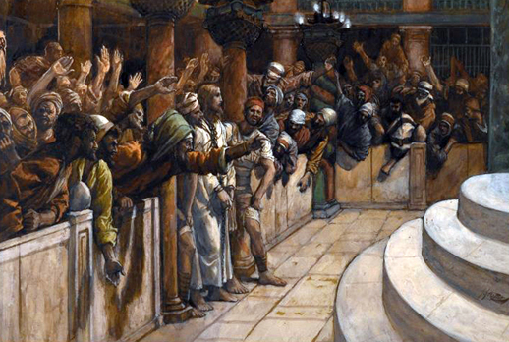
God’s Love: The Precious Blood of Jesus
God’s silence
Gethsemane
Matt 26:36-44
Betrayal
Matt 26:47-49
Before the council
Matt 26:64-68

Slide 12
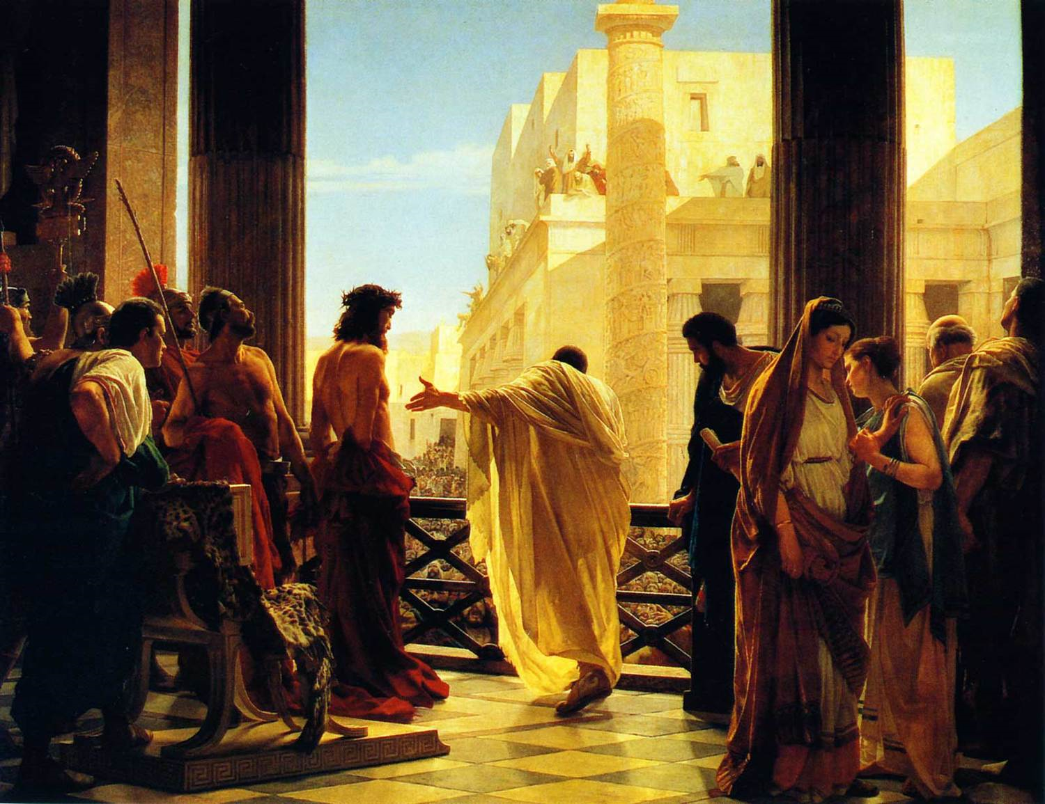
God’s Love: The Precious Blood of Jesus
God’s silence
Gethsemane
Matt 26:36-44
Betrayal
Matt 26:47-49
Before the council
Matt 26:64-68
Beside Barabbas
Matt 27:21-22

Slide 13
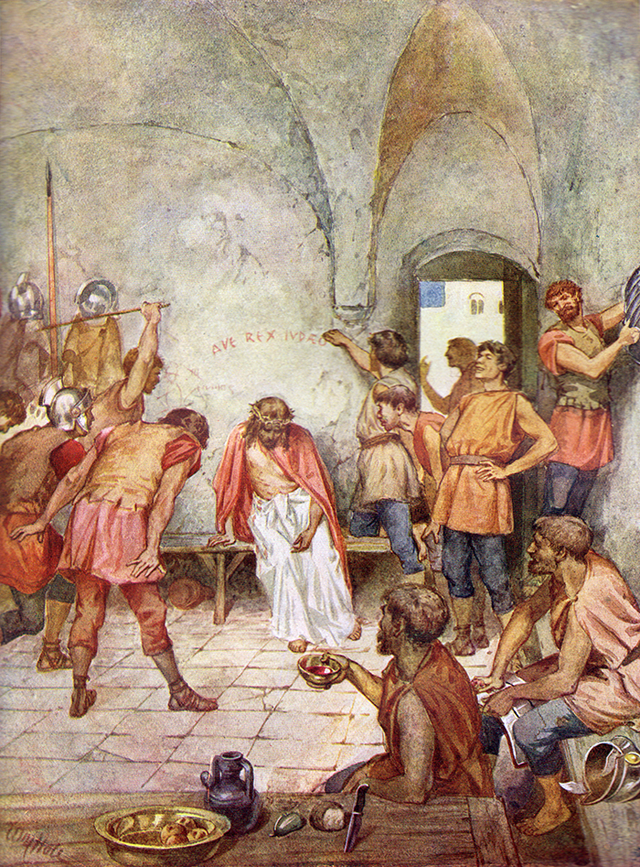
God’s Love: The Precious Blood of Jesus
God’s silence
Gethsemane
Matt 26:36-44
Betrayal
Matt 26:47-49
Before the council
Matt 26:64-68
Beside Barabbas
Matt 27:21-22
With soldiers
Matt 27:27-31

Slide 14
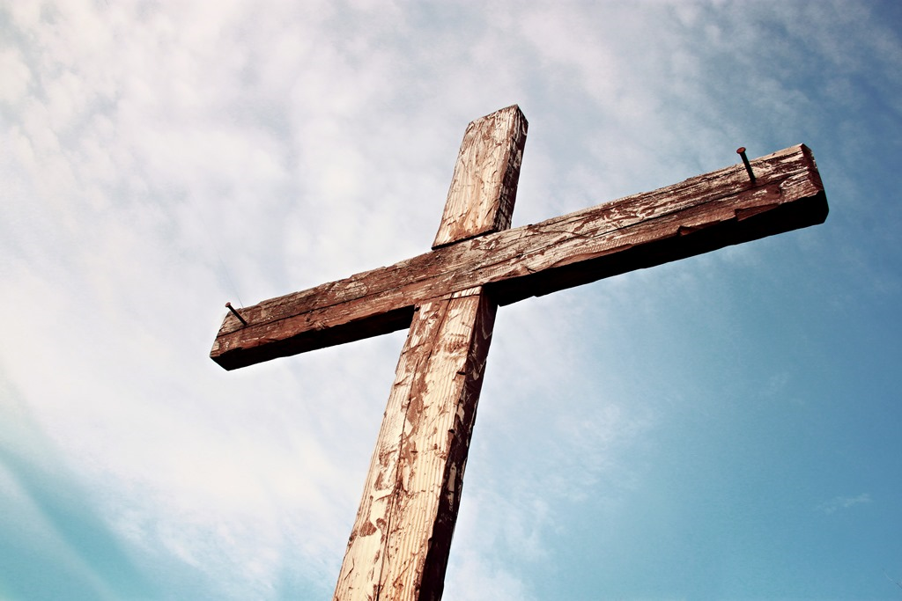
God’s Love: The Precious Blood of Jesus
God’s silence
Gethsemane
Matt 26:36-44
Betrayal
Matt 26:47-49
Before the council
Matt 26:64-68
Beside Barabbas
Matt 27:21-22
With soldiers
Matt 27:27-31
Cross
Matt 27:35, 39-44, 46, 50

