Slide 1
FRUITFUL SPEECH

Slide 2
OUR SPEECH MATTERS
Our religion depends on it (Jam. 1:26)
One of our greatest challenges (Jam. 3:2)
Our speech is an opportunity (Mt. 12:37)

Slide 3
FRUITFUL SPEECH FOR GOD
Speech which pleases Him (II Cor. 5:9)
Speech that gives thanks and brings glory to His name (Eph. 5:4; Heb. 13:15)
  What if we, through our speech, could counter the way the rest of the world takes His name in vain?

Slide 4
FRUITFUL SPEECH FOR OTHERS
Speech that is a good example for others to follow (I Tim. 4:12)
Speech that is needed, timely, truthful and loving (Eph. 4:15,25,29)
  Brings them closer to God
  Makes them better
  Gives them strength

Slide 5
FRUITFUL SPEECH FOR ME
Speech that reveals who I am / want to be (Mt. 12:33-37)
  Self-control
  Wisdom
  Focused on God and my family (spiritual and physical)

Slide 6
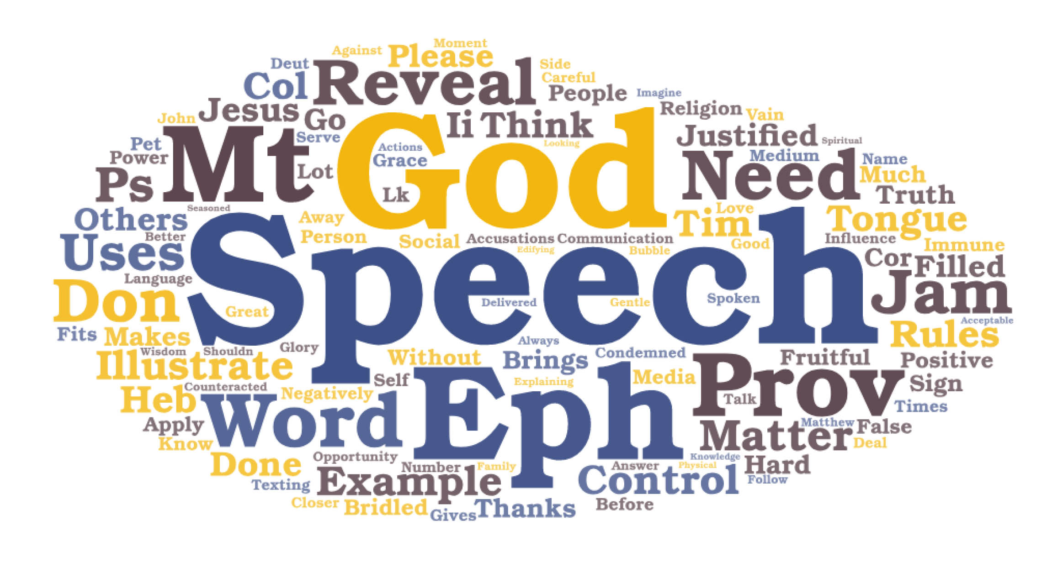

Slide 7
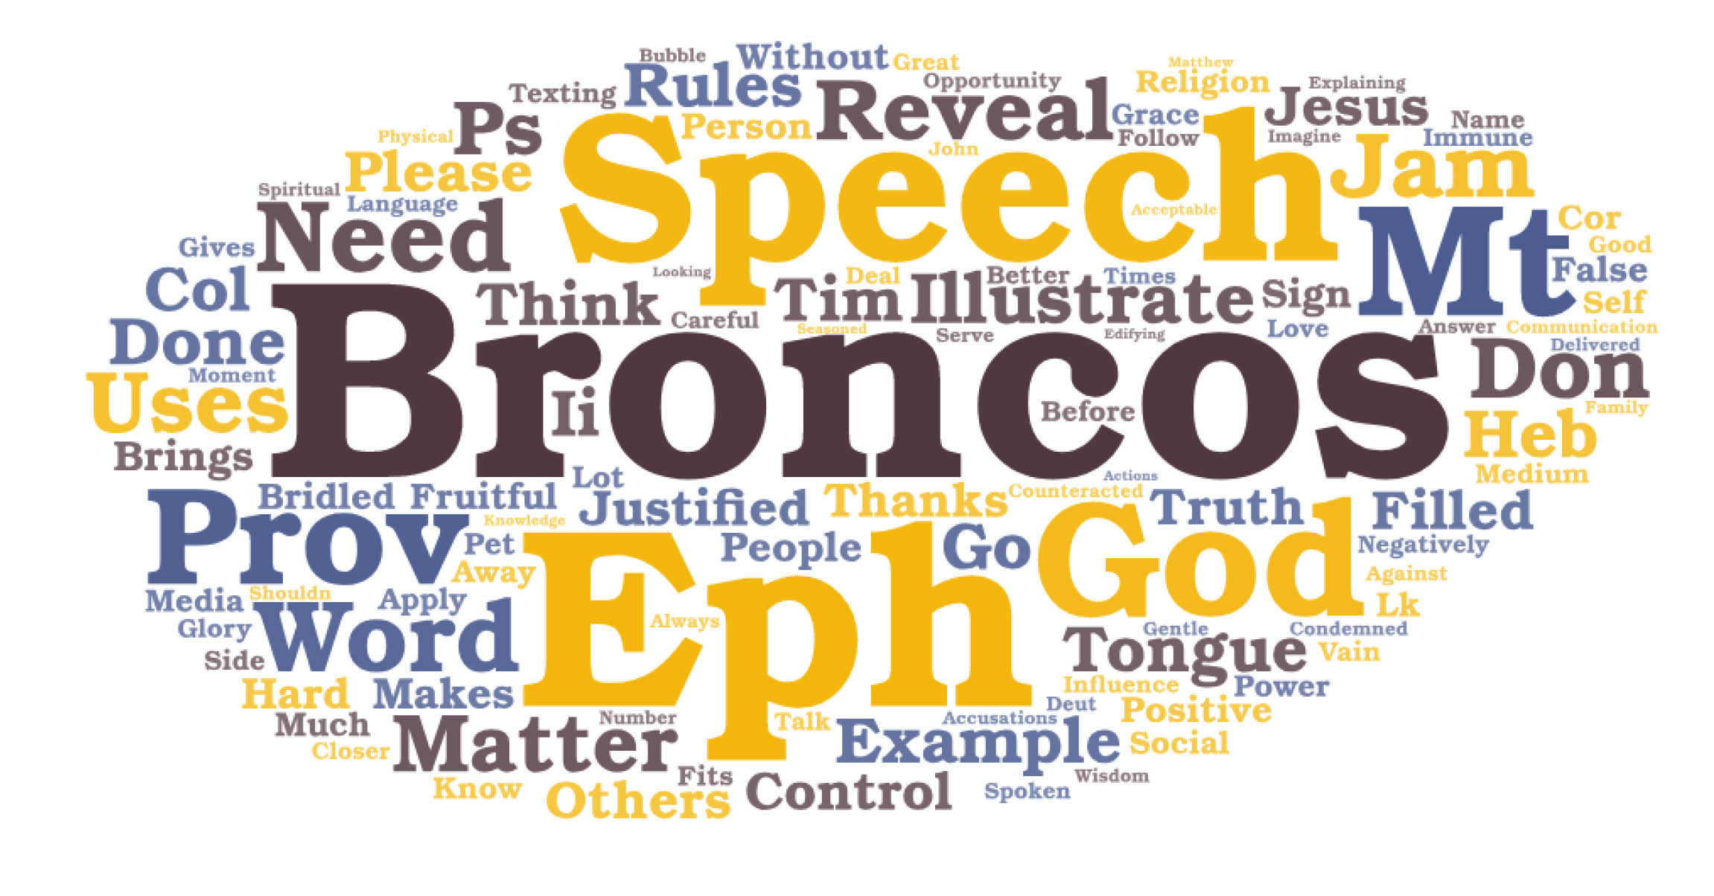

Slide 8
FRUITFUL SPEECH FOR
God
Others
Me

