Slide 1
17 Periods of Bible History
Invasion and Conquest

Slide 2
“Vector Check”
Need to become familiar with the Bible
The Bible consists of many “stories,” “accounts” that reveal God’s Plan through the ages
Many people and places are part of that
Our approach is to build Bible knowledge, to get the flow of the developing plan revealed in it
Three cycles, then a deep dive.
Take notes -- Lots of white space on some of the pages you have
As stated first Sunday of the year – expect recitation, and expect to build on it

Slide 3
QUIZ
Less than ten minutes
OK for family members to work together
Will be more of these, as we add periods and events

Slide 4
QUIZ TIME

Slide 5
17 Time Periods
Before the Flood
Flood
Scattering of the People
The Patriarchs
The Exodus
Wandering in the Wilderness
Invasion and Conquest
Judges
United Kingdom
Divided Kingdom
Judah Alone
Captivity
Return
Years of Silence
Life of Christ
Early Church
Letters to Christians
Notes:
5
5
5

Slide 6
Which Period?
Spies into Canaan _E___
Creation _BF__
Second Census WITW
Promise to Abraham P____
Burning Bush __E__
Rainbow a sign _F___
Edom refuses passage WITW
Pharaoh “Who is Jehovah? E_
Cain kills Abel _BF___
Fiery Serpents WITW
Crossing Red Sea E___
Israel refuses to enter land _E___
Fornication with Midianites WITW
Ten Commandments given _E___
Languages divided SOTP

Slide 7
Invasion and Conquest
Central Campaign
Jericho, Bethel, Ai (1406 BC)
Claim Shechem
Southern Campaign (1404-1402 BC)
Treaty with Gibeonites
Fight Kings of South
Northern Campaign (1401-1400 BC)
Fight Kings of North (led by Jabin – of Hazor)

Slide 8
INVASION AND CONQUEST
Lands Distributed
Trans-Jordanic tribes return
Joshua challenges Israel to choose
Israel renews covenant with Jehovah

Slide 9
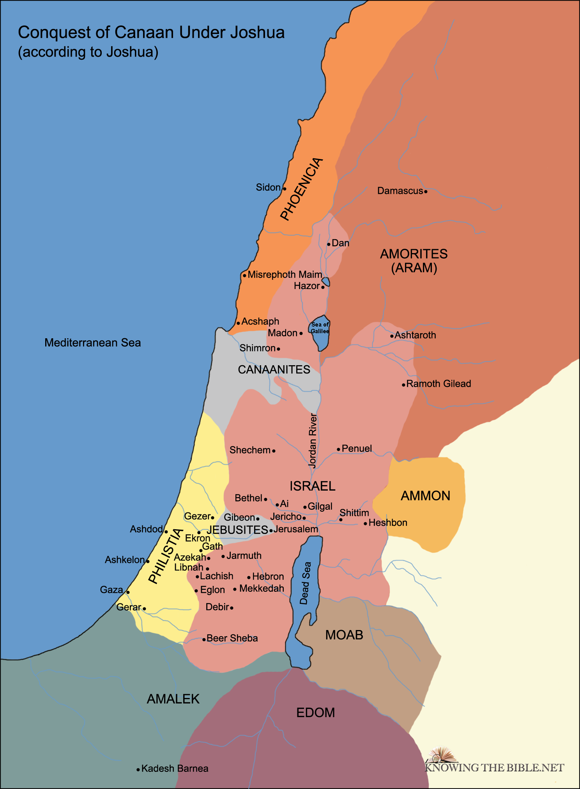

Slide 10
DIVISION OF THE LAND AMONG THE TRIBES

Slide 11
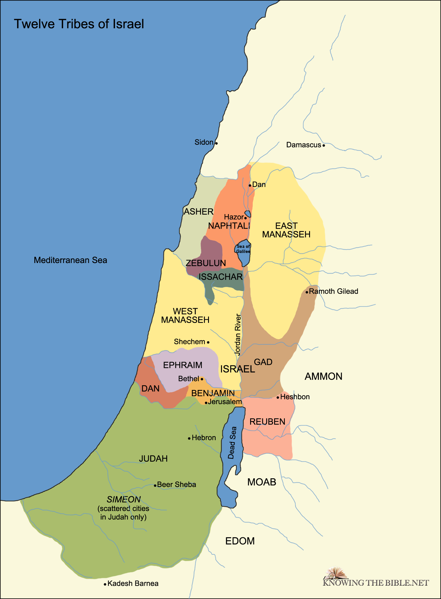

Slide 12
jUDGES

Slide 13
judGES
OTHNIEL
EHUD
SHAMGAR
DEBORAH
GIDEON
ABIMELECH (Hmmm)
TOLA
JAIR
JEPHTHAH
IBZAN
ELON
ABDON
SAMSON
ELI
SAMUEL

