Slide 1
THE TEMPLE
AND
MODERN PRAYER

Slide 2
THE TEMPLE – SOLOMON’S PRAYER
God’s blessings are dependent on man’s obedience (I Kings 8:25)
A place to reach an unearthly God (I Kings 8:27-30)
A place to be heard and forgiven (I Kings 8:30)
Anytime access to God (I Kings 8:29)
A place where cries for justice are heard and answered (I Kings 8:31-32)
A place for deliverance when the people sin and are taken away (I Kings 8:33-34,46-53)
A place for sinners to learn and repent and confess and be delivered (I Kings 8:35-36)
A place for whatever problems… pray towards the house (I Kings 8:37-40)
Hear the plea before battle and maintain their cause (I Kings 8:44-45)

Slide 3
THE TEMPLE
God agrees to Solomon’s requests (I Kings 9:1-3)
An example (Dan. 6:10)
The temple was their hope and their confidence. As long as it stood, any problem could be resolved.
Wouldn’t it be great to have something like that today? If we only knew the right direction to pray!

Slide 4
THE TEMPLE
Unfortunately…
They neglected the temple (II Chron. 29:5-9)
They stole from the temple (II Kings 12:18; II Chron. 16:2; etc.)
They defiled the temple by putting idols in it (II Chron. 33:4-5,7-8)
So God removed the temple and the people. It was rebuilt, but they killed God’s Son so God again removed the temple.

Slide 5
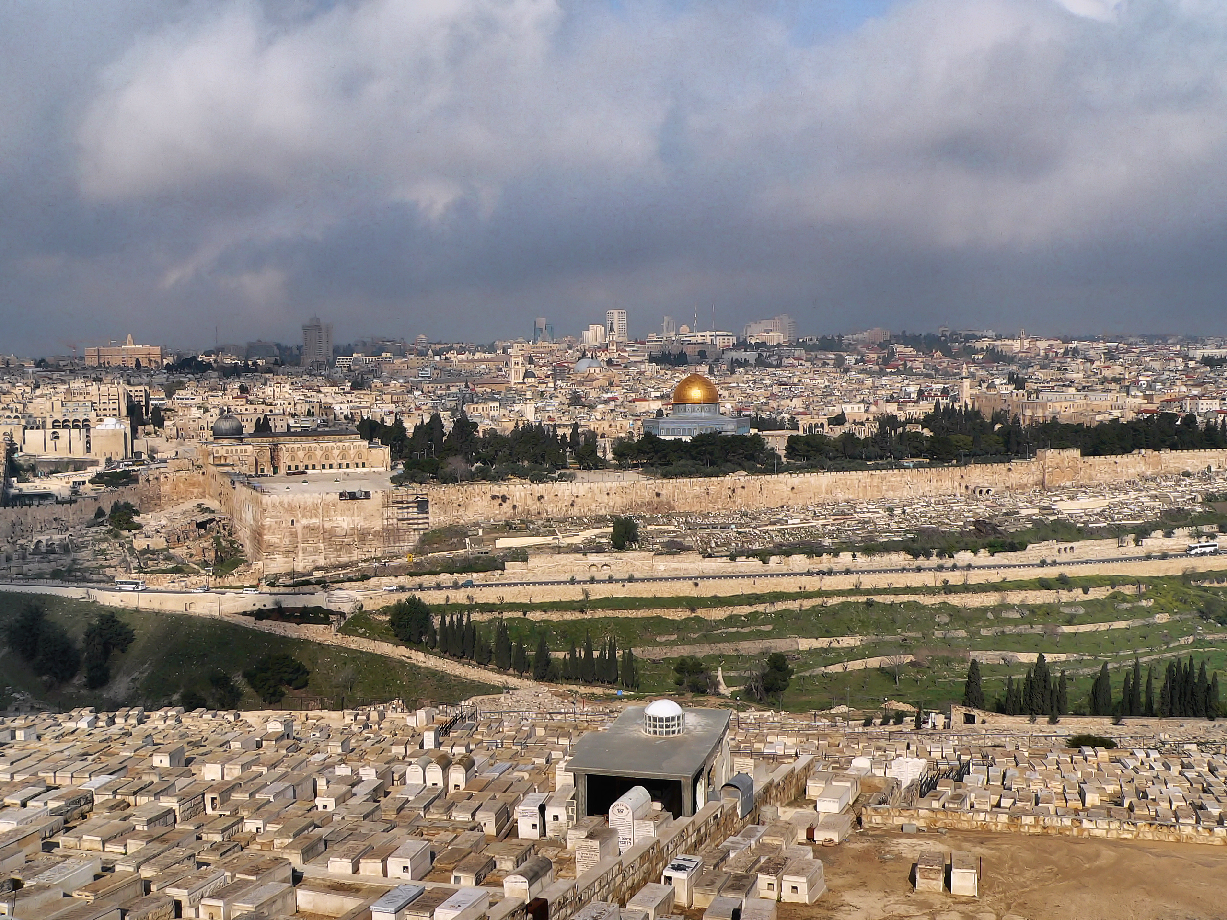

Slide 6
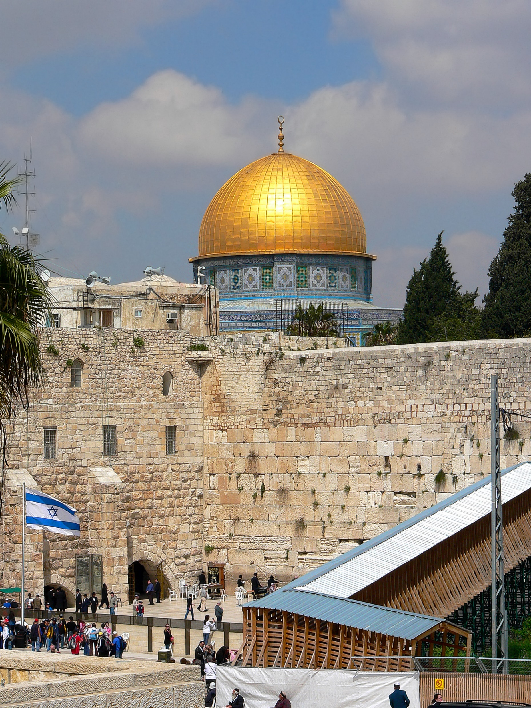

Slide 7
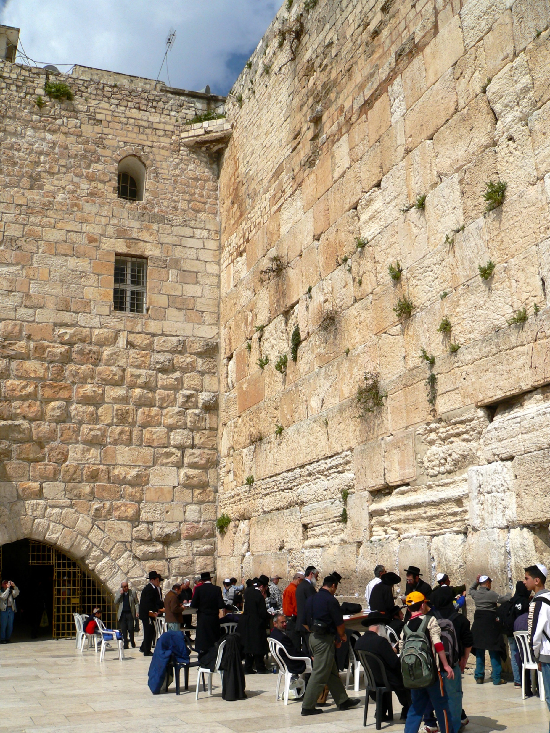

Slide 8
But what a blessing when the temple existed.
Wouldn’t it be great to have such a promise? If only we knew which direction to pray!

Slide 9
THE DIRECTION TO PRAY…
TOWARDS JESUS
Through Jesus, we have access to the Father (John 14:6)
Understanding “In Jesus’ name” (John 14:13-14; 16:23-24,26-27)
The Jews pray at a wall of rubble. Muslims pray towards Mecca. We pray up, where Jesus is.
  Fix your eyes (Heb. 12:2)
  Looking where Christ is (Col. 3:1)
  Confidence! (Eph. 3:11-12)

Slide 10
BEING IN JESUS SHOULD MEAN EVERYTHING TO US

Slide 11
GETTING “IN JESUS”
Baptism (Acts 2:38; 19:3,5; Rom. 6:3; Gal. 3:27)
Confession (I John 4:15)

Slide 12
STAYING “IN JESUS”
Obey Him (Mt. 7:21-23; I John 3:24)
Walk like Him (Col. 2:6; I John 2:6)
Rely on Him (Gal. 5:4,2)
Sacrifice for Him (Phil. 3:8-11)
Hold to proper teaching (II John 1:9)

Slide 13
USING “IN JESUS”
Pray “in Jesus’ name”
  Even if that isn’t the phrase you use
  Even if you aren’t literally looking upwards
  Come to God through the relationship you have in Jesus and be confident

