Slide 1
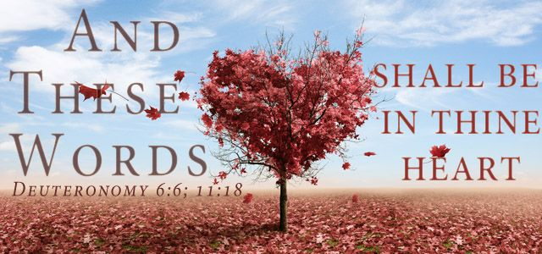
The Power Of Memorizing Scriptures

Slide 2
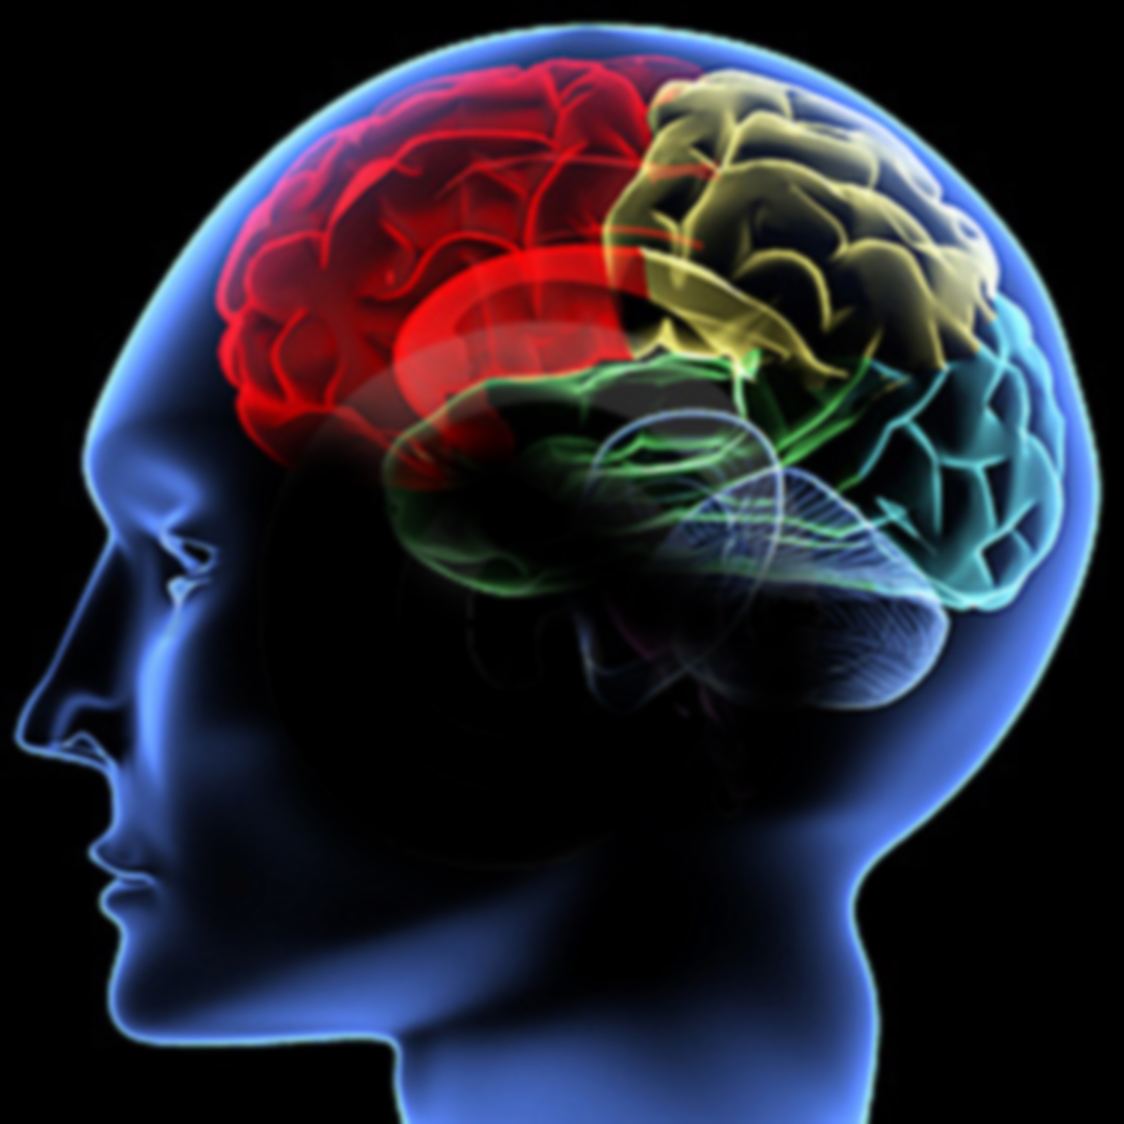
How The Brain Works
Use it (or) Lose it
Fearfully and Wonderfully Made (Psa. 139)

Slide 3
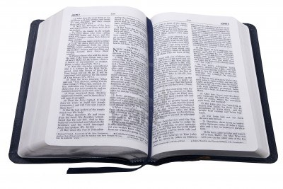
Why Memorize Scriptures?
2 Timothy 3:16-17
16 All Scripture is given by inspiration of God, and is profitable for doctrine, for reproof, for correction, for instruction in righteousness

Slide 4
Why Memorize Scriptures?
2 Timothy 3:16-17
17 that the man of God may be complete, thoroughly equipped for every good work.

Slide 5
PROVERBS 2
1 My son, if you receive my words, And treasure my commands within you,
2 So that you incline your ear to wisdom, And apply your heart to understanding;
3 Yes, if you cry out for discernment, And lift up your voice for understanding,
4 If you seek her as silver, And search for her as for hidden treasures;
5 THEN you will understand the fear of the LORD, AND find the knowledge of God.
“But this I say: He who sows sparingly will also reap sparingly, and he who sows bountifully will also reap bountifully.” - 2 Cor 9:6

Slide 6
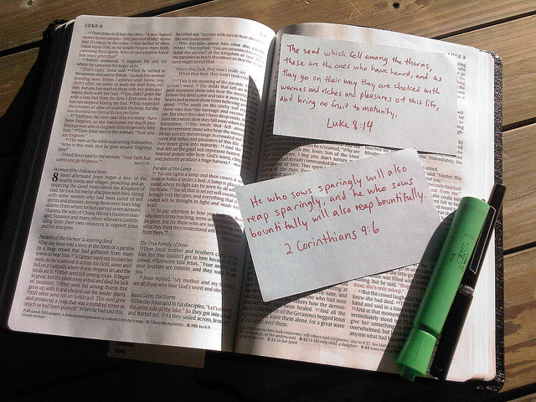
“Blessed are those who hunger and thirst for righteousness, for they shall be filled” – Matthew 5:6
“Oh, how I love Your law! It is my meditation all the day.” – Psalm 119:97

Slide 8
Overcome Laziness
Reason # 1
Luke 16:8 “So the master commended the unjust steward because he had dealt shrewdly. ‘The sons of this world are more shrewd in their generation than the sons of light.’”

Slide 9
The Lazy Man
…and so does Memory Work

Slide 10
Become Skilled Craftsman
Reason # 2
2 Timothy 2:15
“Be diligent to present yourself approved to God, a worker who does not need to be ashamed, rightly dividing the word of truth”

Slide 11
Become Skilled Craftsman
Reason # 2
2 Timothy 2:15
“…rightly dividing the word”
“accurately handling the word” – NASB “cutting in a straight line the word” - Darby
Orthotomeo: “to cut straight and smooth; to dissect correctly”

Slide 12
Quickly Defend Faith
Reason # 3
I Peter 3:15
“But sanctify the Lord God in your hearts, and always be ready to give a defense to everyone who asks you a reason for the hope that is in you, with meekness and fear”

Slide 13
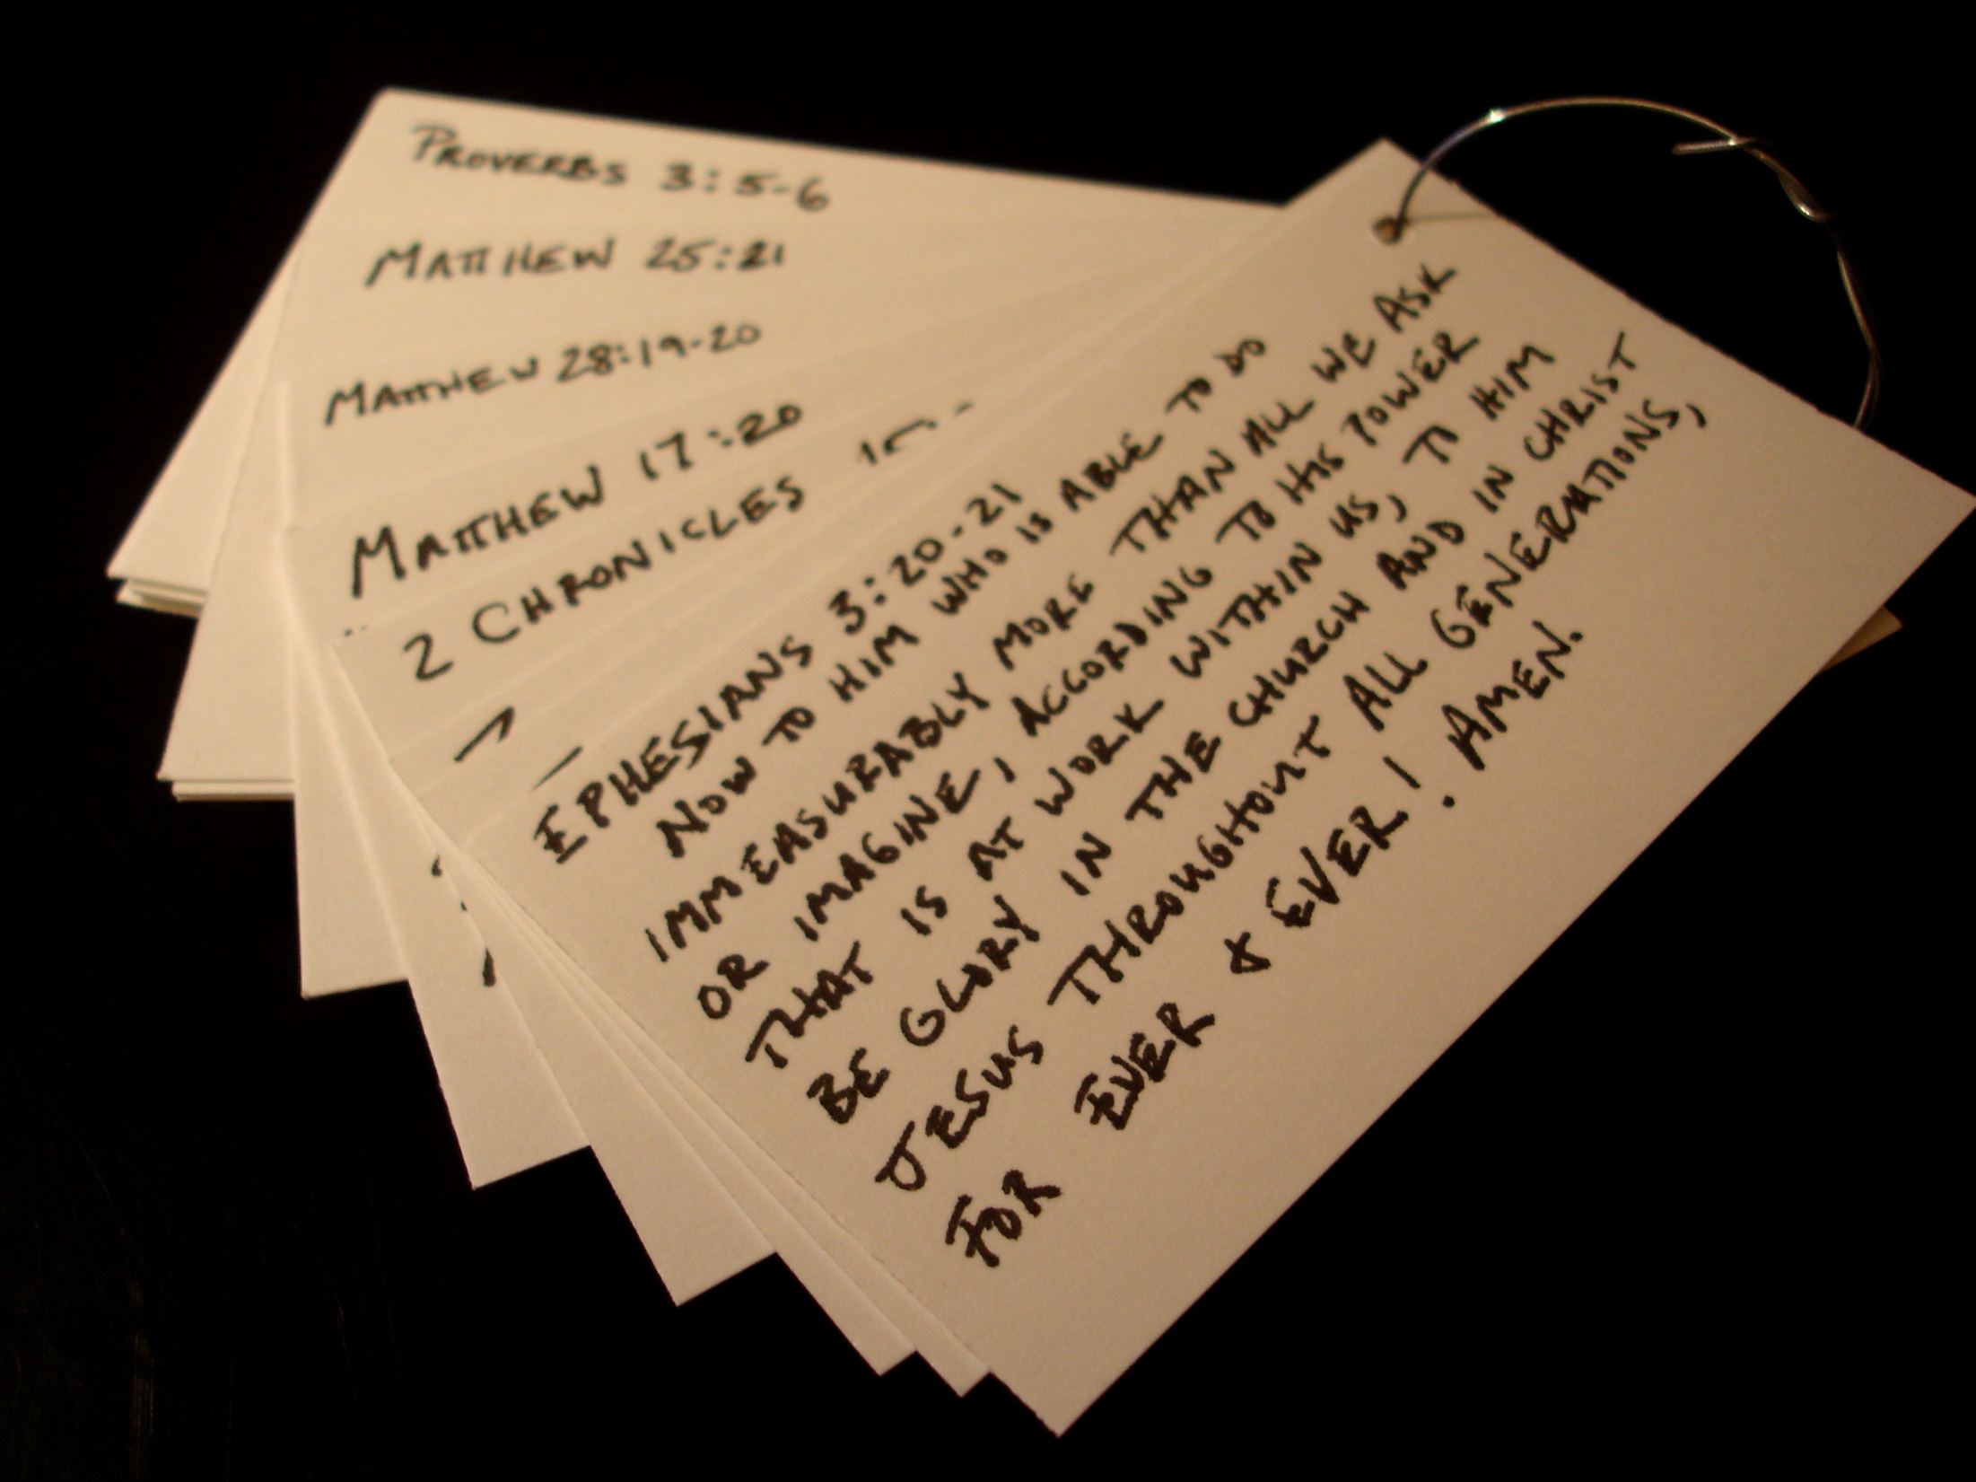
Plan of Salvation Faith (Rom 10:17)
Repentance (Acts 17:30) Confession (Matt 10:32) Baptism (Gal 3:27) Faithfulness (Rev 2:10)
Christ’s One Church Organization (Phil 1:1)
Work (I Tim 3:15) Worship (Acts 2:42)
Uniqueness (Eph 3:10-11)
Unity of the Spirit One God (Deut 6:4)
One Lord (I Cor 8:6)
One Spirit (I Cor 12:13) One Faith (Phil 1:27)
One Baptism (Acts 19:4-5) One Body (Eph 1:22-23)
One Hope (I Pet 1:3-4)
False Doctrines
Calvinism (2 Pet 3:9)
Millennialism (Matt 16:18-19)
Denominationalism (I Cor 1:10)
Institutionalism (Jam 1:27)
Atheism (Rom. 1:20)
Secular Humanism (Jer 10:23)
Moral Relativism (Prov 14:12)

Slide 14
Save My Soul
Reason # 4
Psalm 19:7
“The law of the LORD is perfect, converting the soul; The testimony of the LORD is sure, making wise the simple”

Slide 15
Save Your Family
Reason # 5
Deuteronomy 6:6-9
6 "And these words which I command you today shall be in your heart.
7 "You shall teach them diligently to your children, and shall talk of them when you sit in your house, when you walk by the way, when you lie down, and when you rise up.
8 "You shall bind them as a sign on your hand, and they shall be as frontlets between your eyes.
9 "You shall write them on the doorposts of your house and on your gates.

Slide 16
Save Your Family
Reason # 5
Proverbs 4:3-4
3 When I was my father's son, Tender and the only one in the sight of my mother,
4 He also taught me, and said to me: "Let your heart retain my words; Keep my commands, and live.

Slide 17
Save Our Youth
Reason # 6
Psalm 119:9-11
9 How can a young man cleanse his way? By taking heed according to Your word.
10 With my whole heart I have sought You; Oh, let me not wander from Your commandments!
11 Your word I have hidden in my heart, That I might not sin against You!

Slide 18
Save Our Youth
Reason # 6
2 Timothy 3:15
and that from childhood you have known the Holy Scriptures, which are able to make you wise for salvation through faith which is in Christ Jesus.

Slide 19
Save My Brethren
Reason # 7
James 5:19-20
“Brethren, if anyone among you wanders from the truth, and someone turns him back, let him know that he who turns a sinner from the error of his way will save a soul from death and cover a multitude of sins”

Slide 20
Save My Brethren
Reason # 7
Jude 20-23
But you, beloved, building yourselves up on your most holy faith, …
And on some have compassion, making a distinction; but others save with fear, pulling them out of the fire …

Slide 21
Save The Lost
Reason # 8
Proverbs 11:30
“The fruit of the righteous is a tree of life, and he who wins souls is wise” (cf John 15:1-8)

Slide 22
Save The Lost
Reason # 8
Romans 10:13-17
16 But they have not all obeyed the gospel. For Isaiah says, "Lord, who has believed our report?"
17 So then faith comes by hearing, and hearing by the word of God.

Slide 23
Save The Lost
Reason # 8
Acts 8 Conversion
35 Then Philip opened his mouth, and beginning at this Scripture, preached Jesus to him.
36 Now as they went down the road, they came to some water. And the eunuch said, "See, here is water. What hinders me from being baptized?"

Slide 24
Resist The Devil
Reason # 9
I Corinthians 10:13
No temptation has overtaken you except such as is common to man; but God is faithful, who will not allow you to be tempted beyond what you are able, but with the temptation will also make the way of escape, that you may be able to bear it.

Slide 25
Resist The Devil
Reason # 9
The Way Of Escape
Matthew 4:1-11
“It is written… man shall not live by bread alone” (Dt. 8:3)
“It is written… you shall not tempt the Lord your God” (Dt 6:16)
“It is written… you shall worship the Lord your God” (Dt. 6:13)

Slide 26
What Disciples Do!
Reason # 10
John 8:31-32
"If you abide in My word, you are My disciples indeed. And you shall know the truth, and the truth shall make you free.”

Slide 27
What Disciples Do!
Reason # 10
Matthew 10:25
“it is enough for a disciple that he be like his teacher”
Fact: Jesus quoted 24 books of the O.T. about 180x in the N.T.

Slide 28
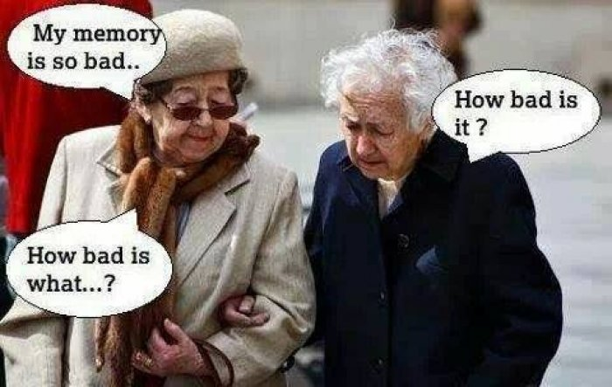
Excuses Excuses Excuses

Slide 29
Think
Think
Think
Oh bother
Memorizing
Takes Discipline

Slide 30
7 Step Method of Memorization
Hear it (audio learning)
Read it (verbal learning)
Write it (scribal learning)
Study it (investigative learning)
Meditate it (personal, emotional learning)
Apply it (kinesthetic learning: share it)
Review it (rote learning)
Memorized

Slide 31
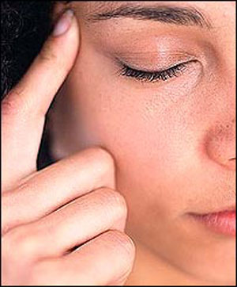
Meditation
Israel’s Oral Tradition
Psalm 119:15-16
I will meditate on Your precepts,
and contemplate Your ways.
I will delight myself in Your statutes;
I will not forget Your word.

Slide 32
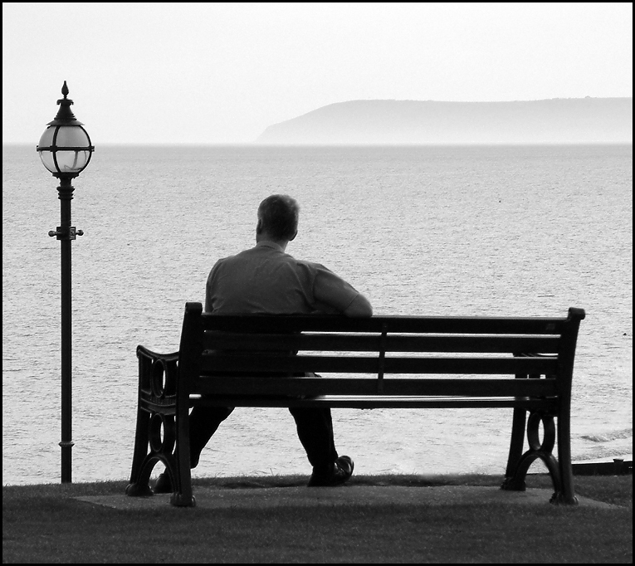
Meditation & Memorization The Quiet Study Of God’s Mind
1 Corinthians 2:10 “… For the Spirit searches all things, yes, the deep things of God.

Slide 33
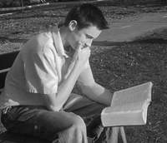
Joshua 1:8
"This Book of the Law shall not depart from your mouth, but you shall meditate in it day and night, that you may observe to do according to all that is written in it. For THEN you will make your way prosperous, and THEN you will have good success.
First: The Hard Work
Second: The Reward

Slide 34
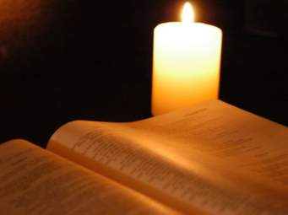
Psalm 119:147-148
I rise before the dawning of the morning, And cry for help; I hope in Your word. My eyes are awake through the night watches, That I may meditate on Your word.

Slide 35
One Christian’s
System

Slide 36
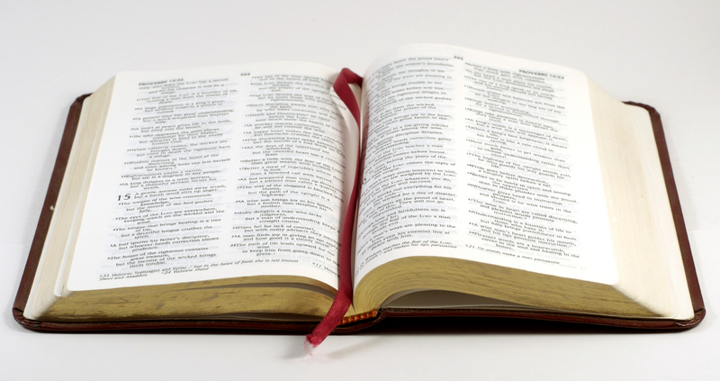
MemVerse.com
1 verse per week
52 verses per year
5 years = 262 verses

Slide 37
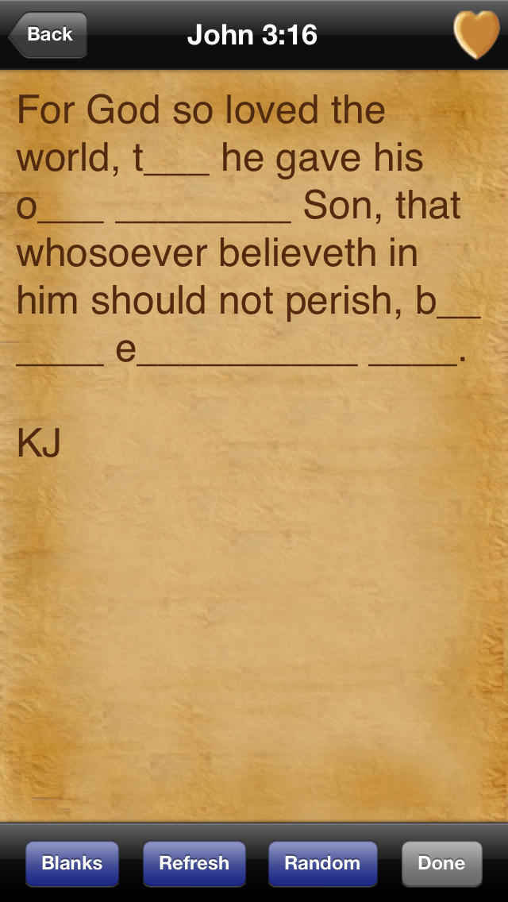

Slide 38
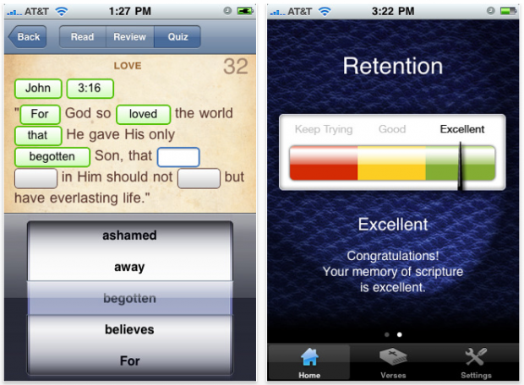

Slide 39
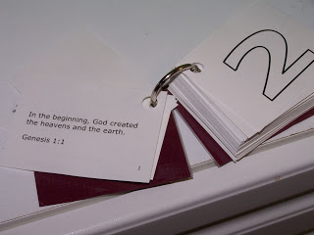
The Key To Memorizing the Bible
My Lord
My Prayers
Prov 3:5-6 “Trust in the LORD with all your heart, And lean not on your own understanding; In all your ways acknowledge Him, And He shall direct your paths.
Jam 1:5 “If any of you lacks wisdom, let him ask of God, who gives to all liberally and without reproach, and it will be given to him.

Slide 40
The Key To Memorizing the Bible
My Want-To
Overcome laziness
Skilled craftsman
Defend the faith
Save my soul
Save my family
Save our youth
Save my brethren
Save the lost
Resist the devil
Be a disciplined disciple

Slide 41
The Challenge
52 Verses in a year
1 Verse per week (bulletin)
Family devo
Categories: Godhead (13) Salvation (13) Christ’s Church (13) Promises of God (13)

