Slide 1
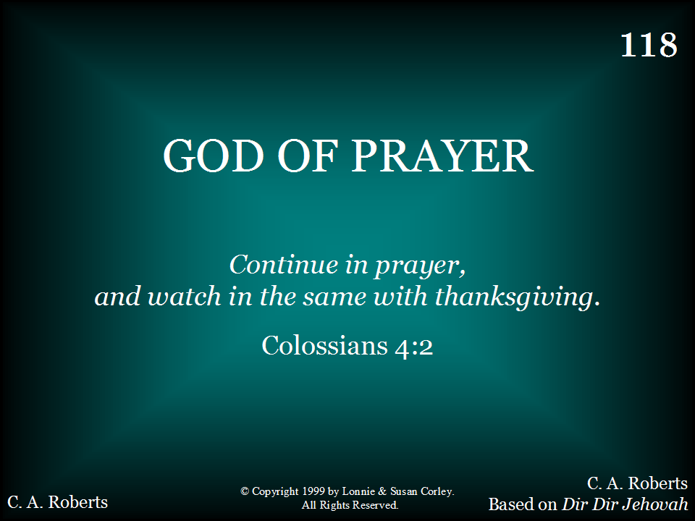
118 - God Of Prayer - Title

Slide 2
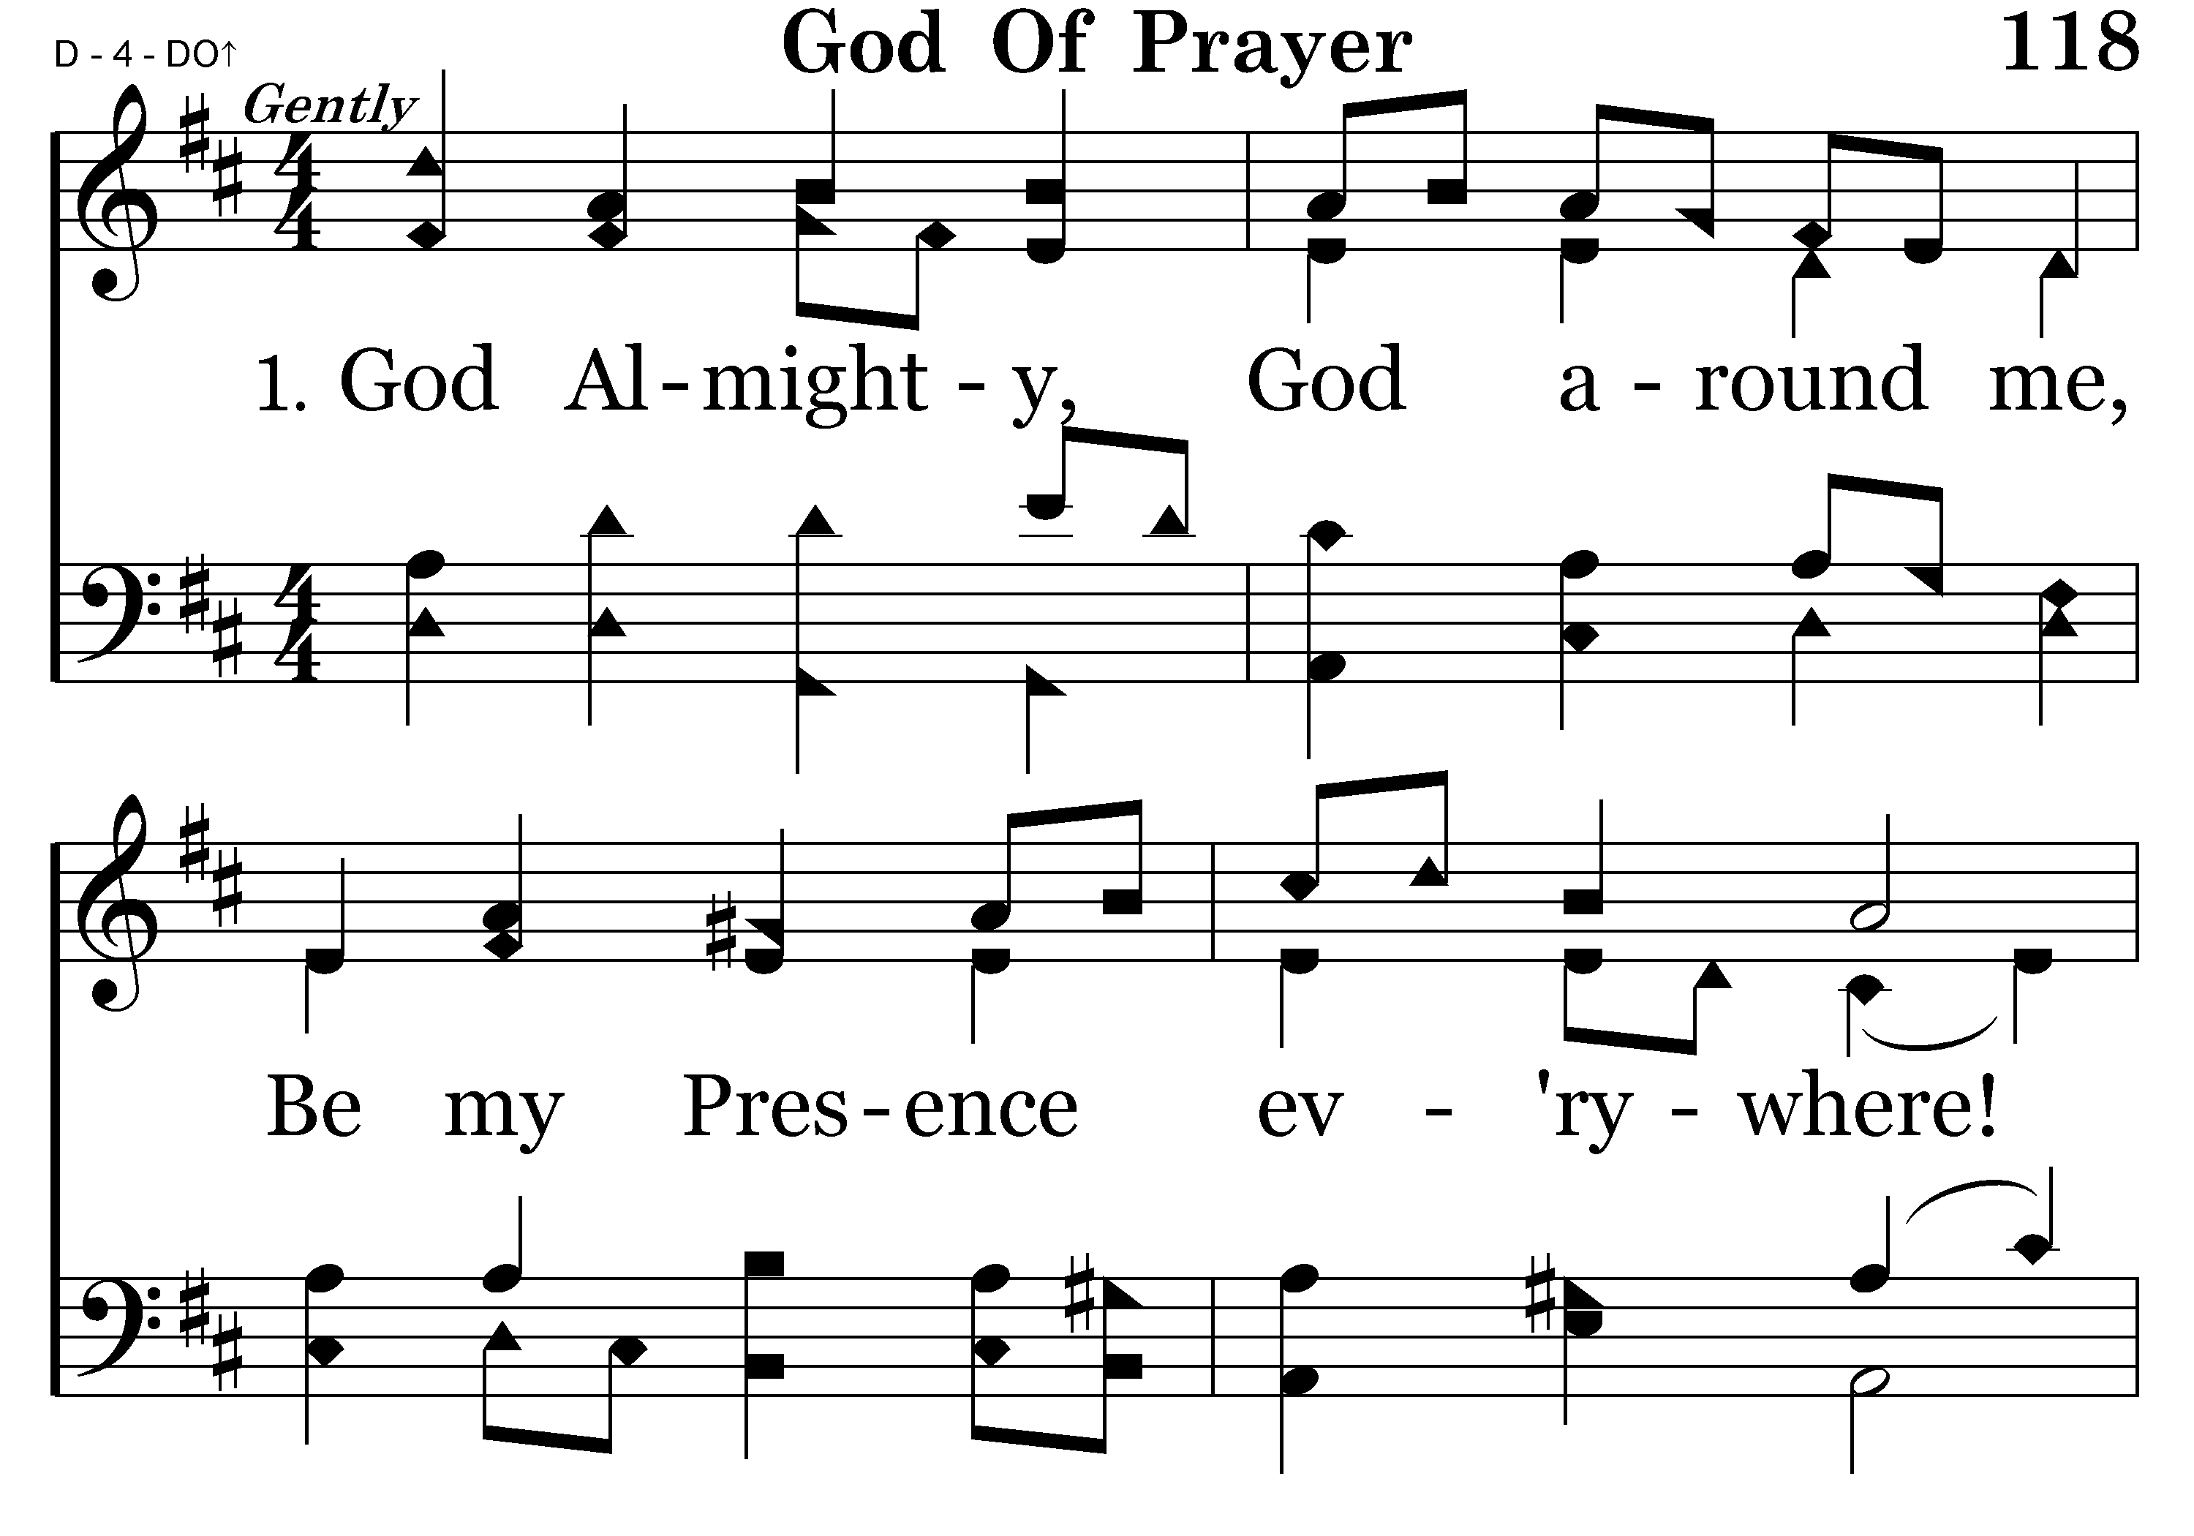
118 - God Of Prayer - 1.1

Slide 3
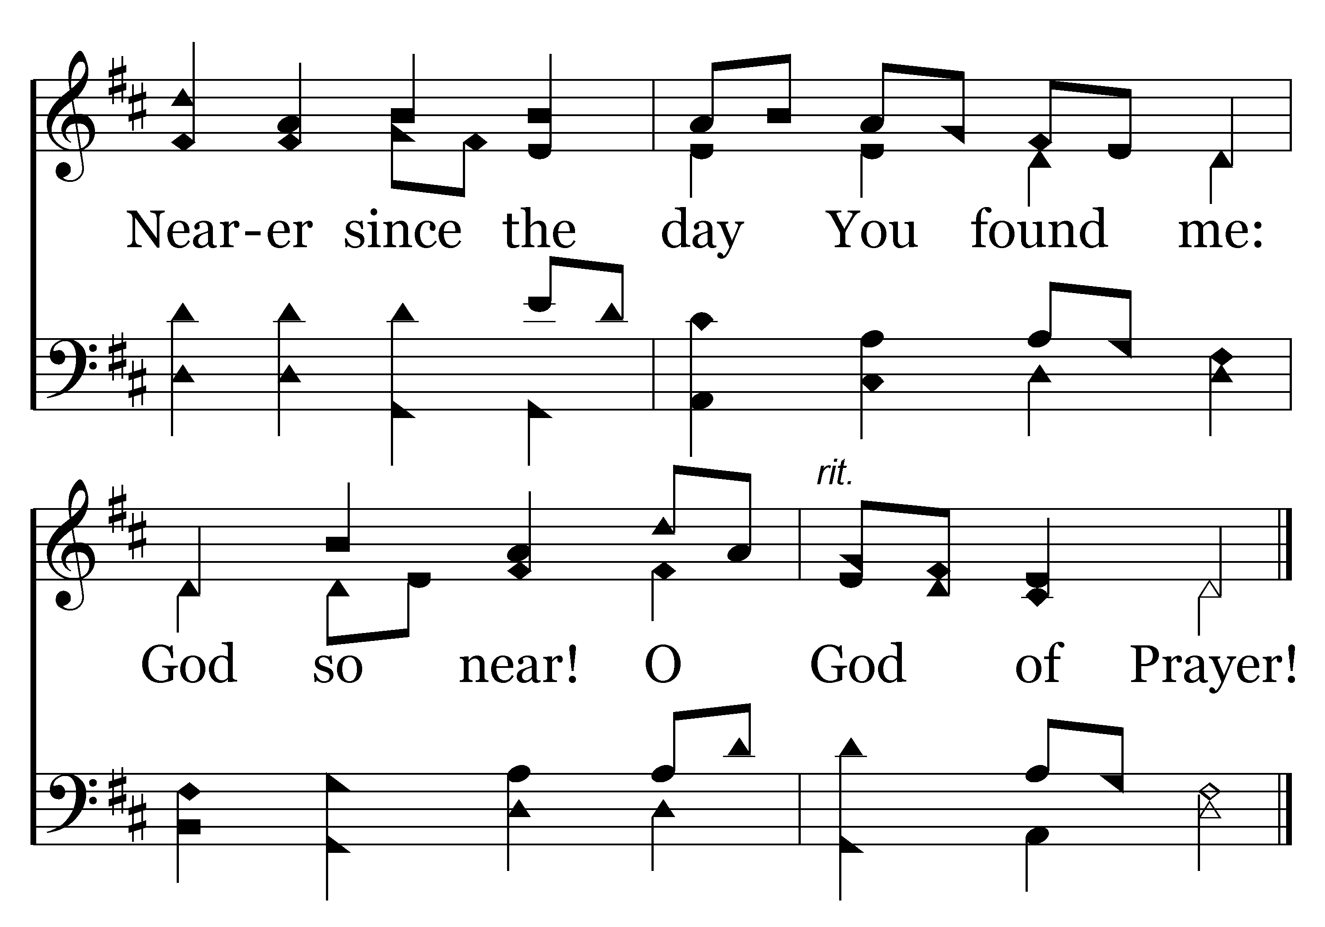
118 - God Of Prayer - 1.2
End of Verse 1

Slide 4
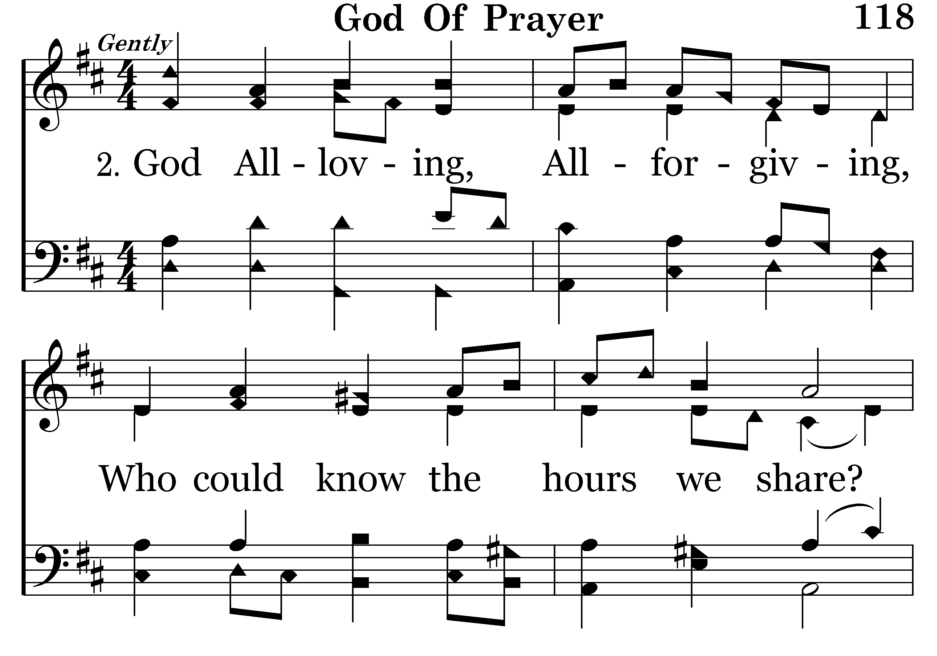
118 - God Of Prayer - 2.1

Slide 5
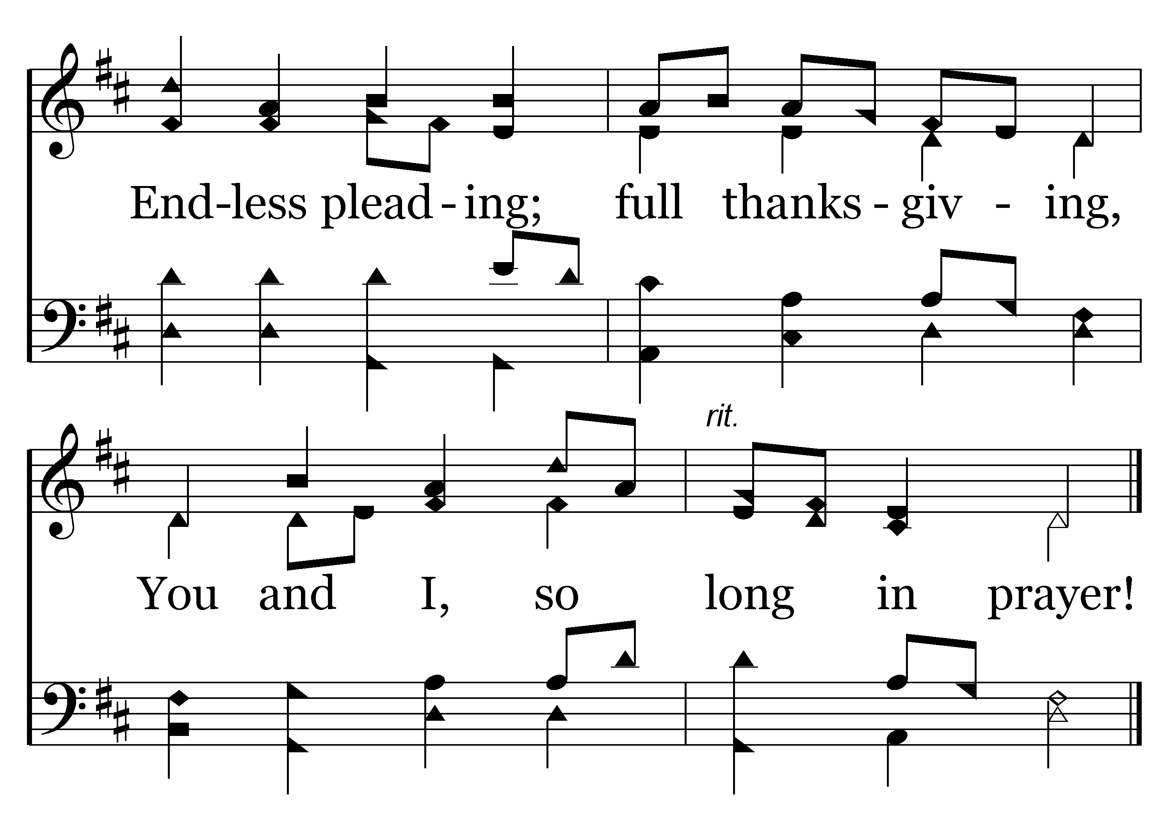
118 - God Of Prayer - 2.2
End of Verse 2

Slide 6
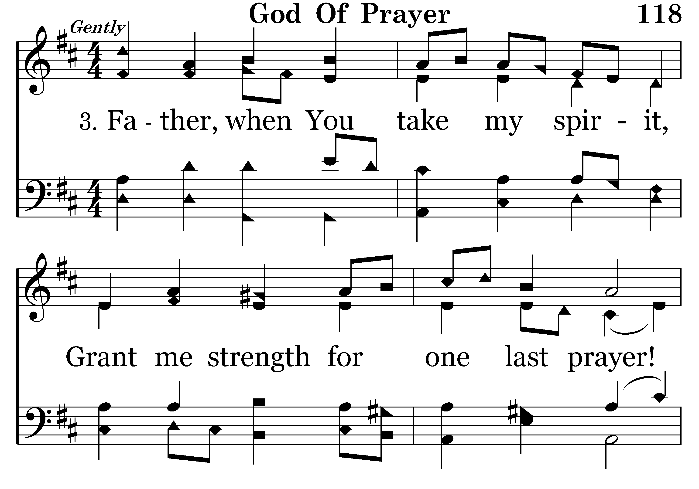
118 - God Of Prayer - 3.1

Slide 7
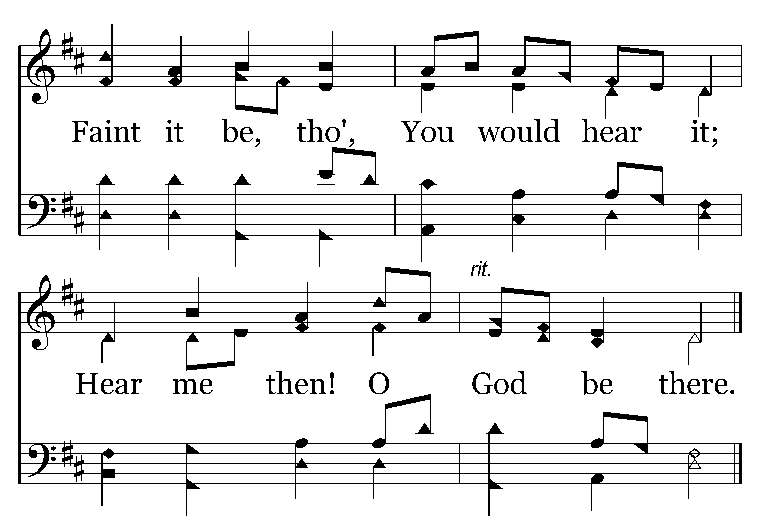
118 - God Of Prayer - 3.2
End of Song

Slide 9
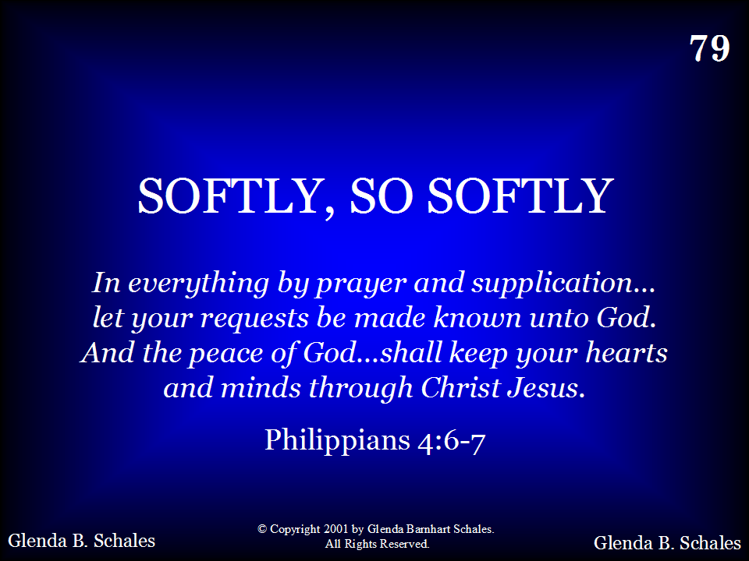
079 - Softly, So Softly - Title

Slide 10
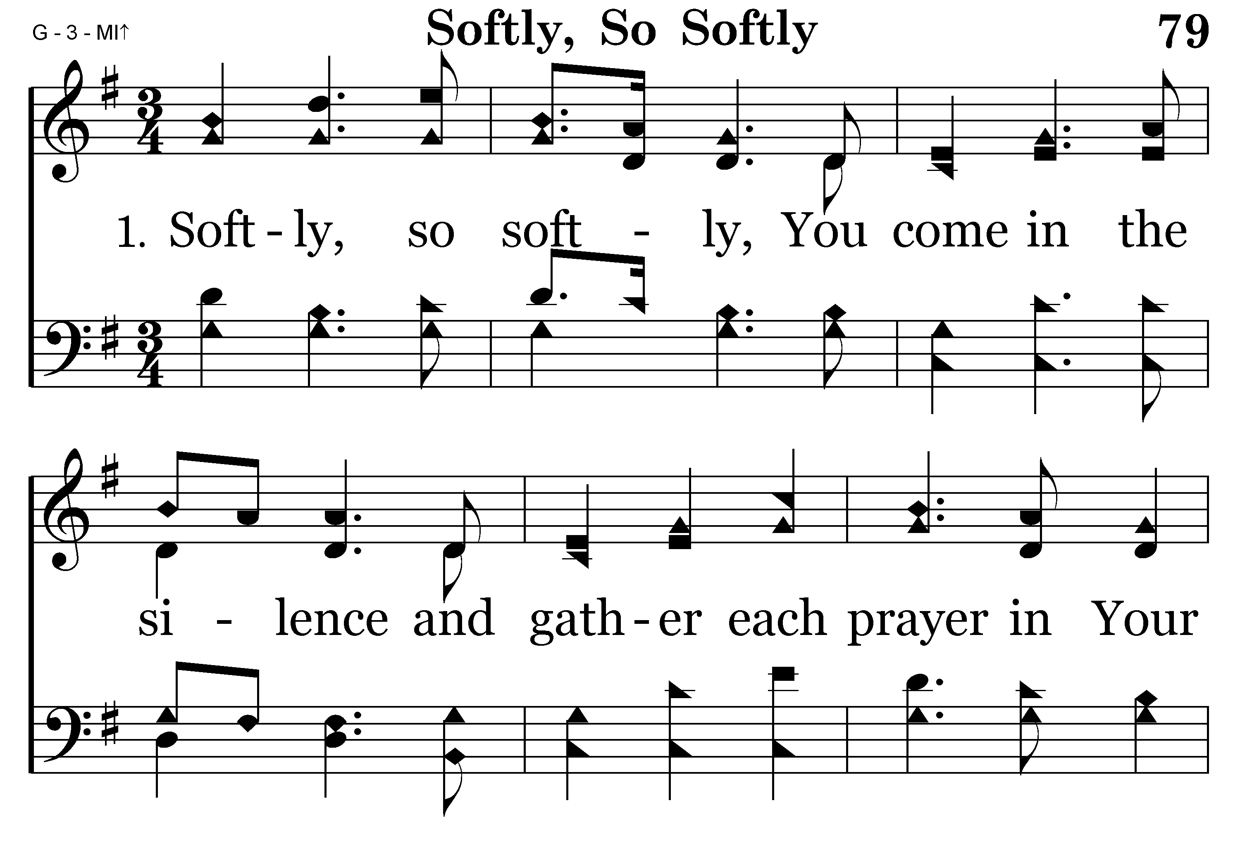
079 - Softly, So Softly - 1.1

Slide 11
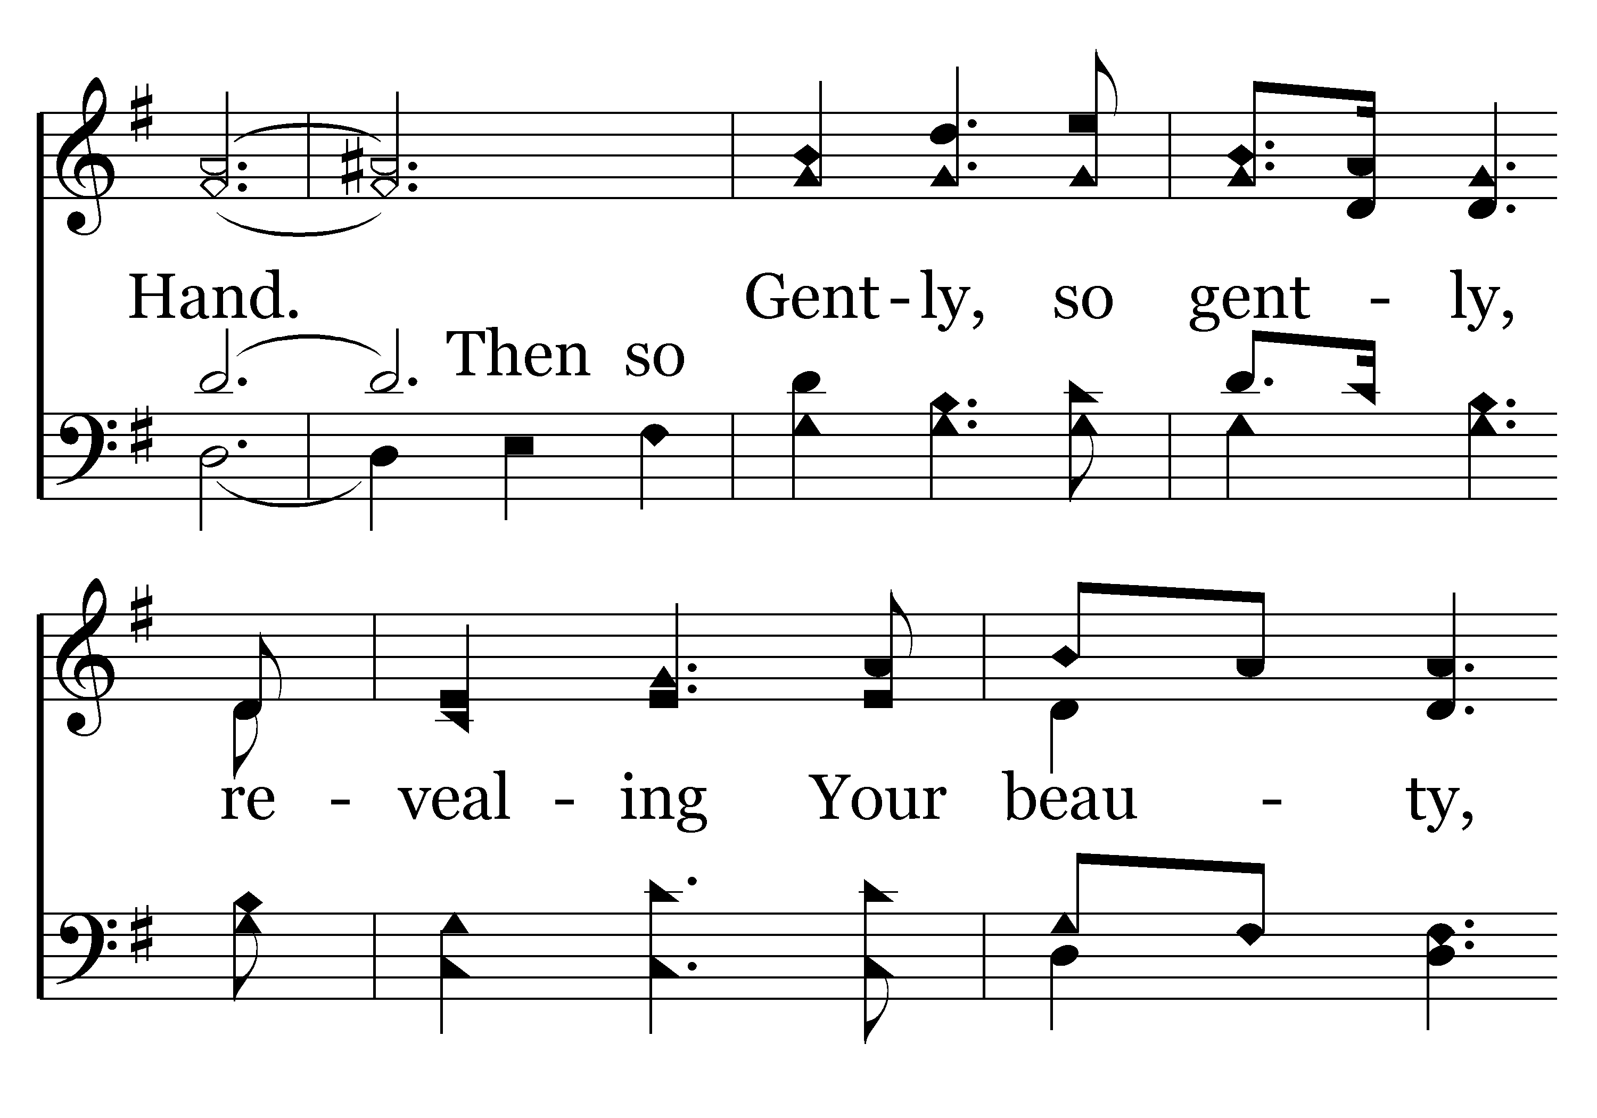
079 - Softly, So Softly - 1.2

Slide 12
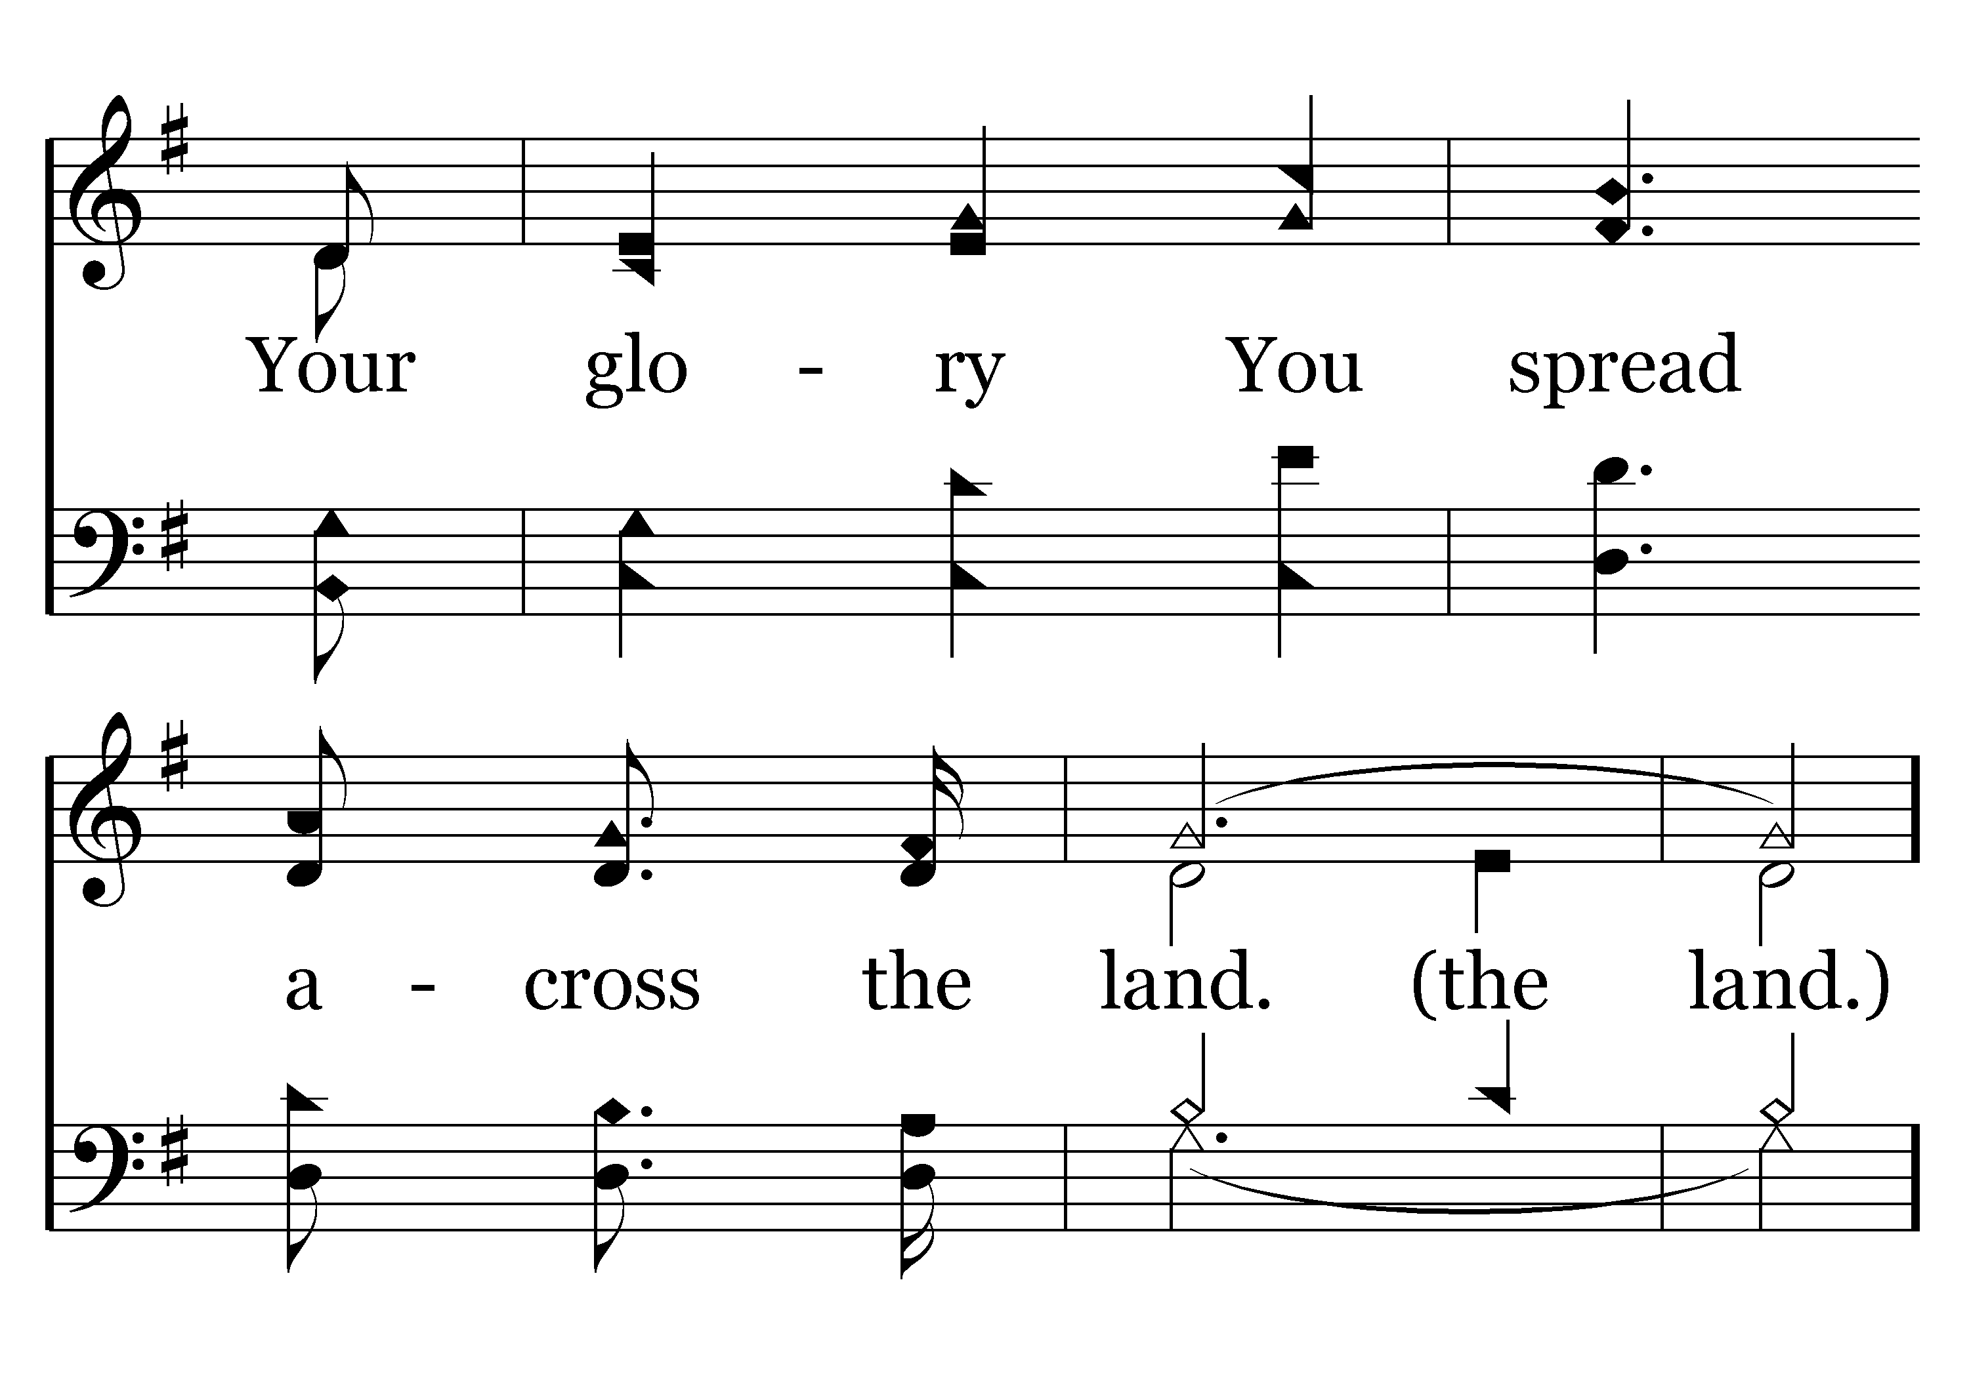
079 - Softly, So Softly - 1.3

Slide 13
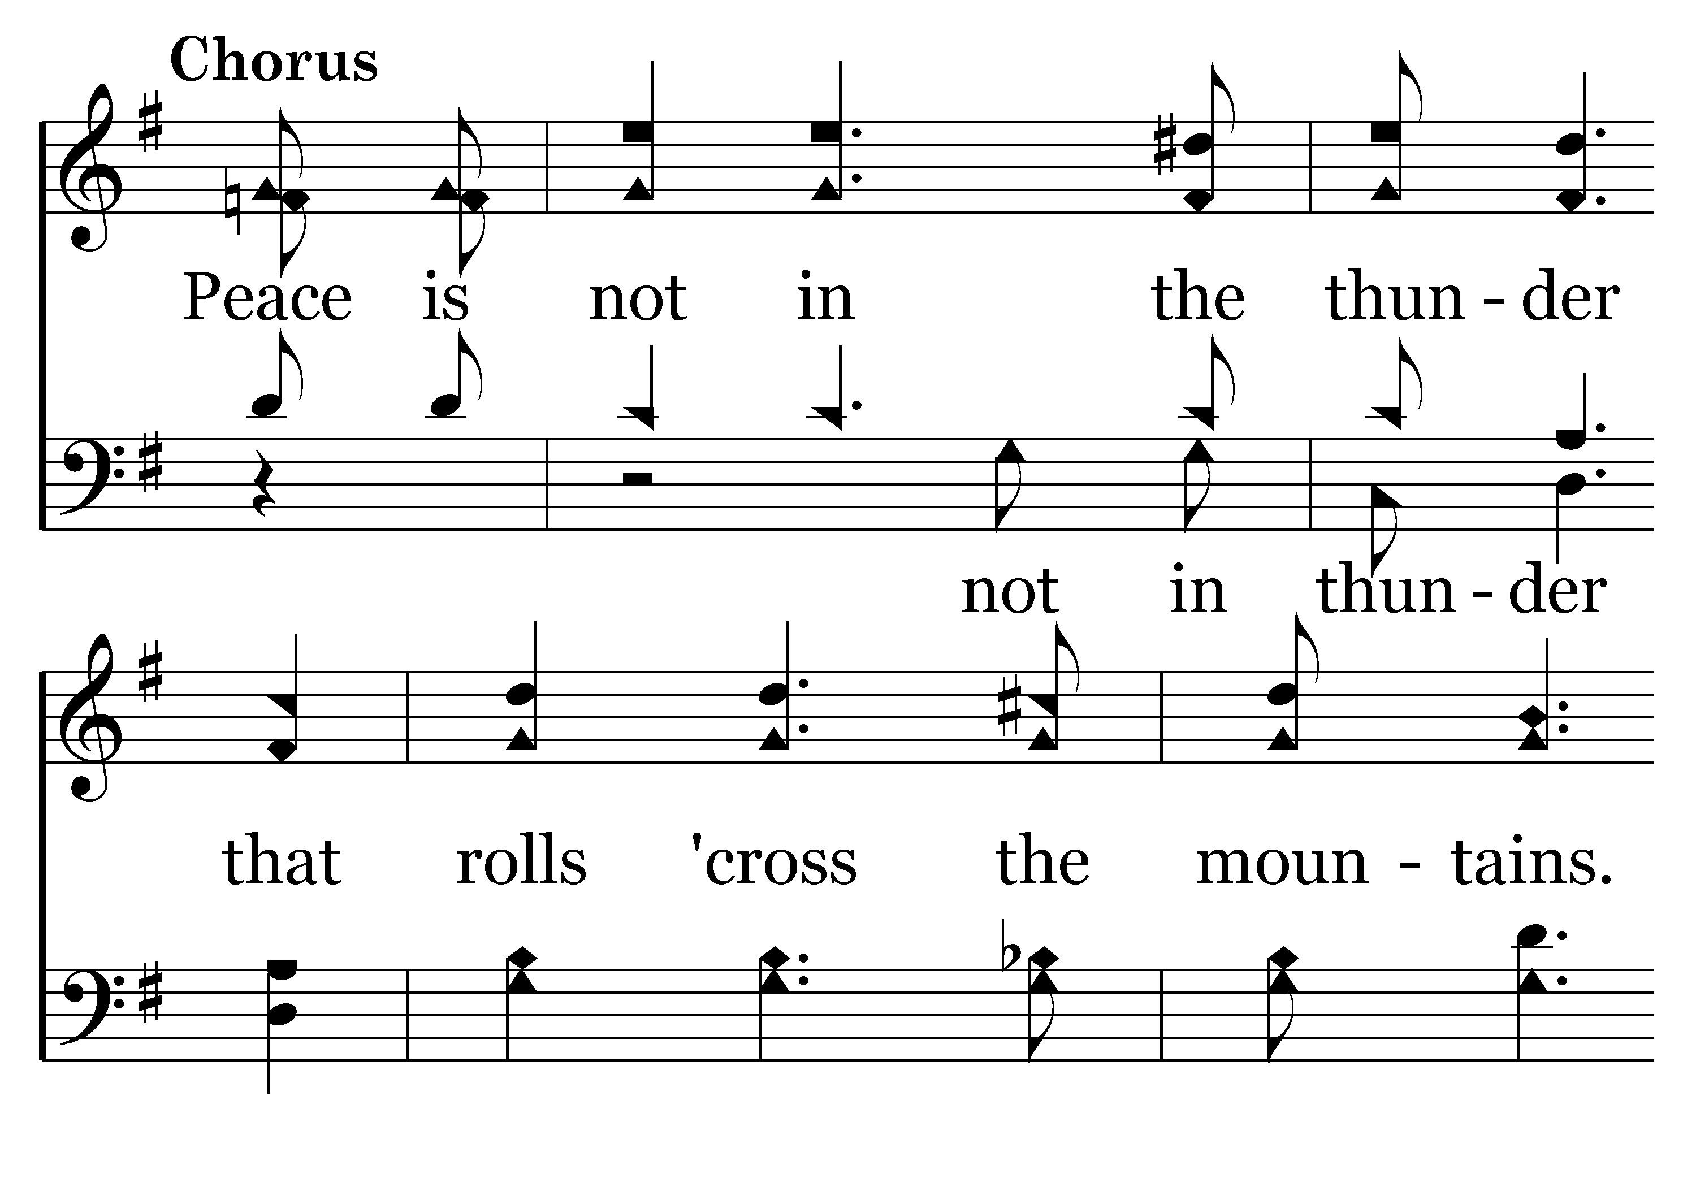
079 - Softly, So Softly - C.1

Slide 14
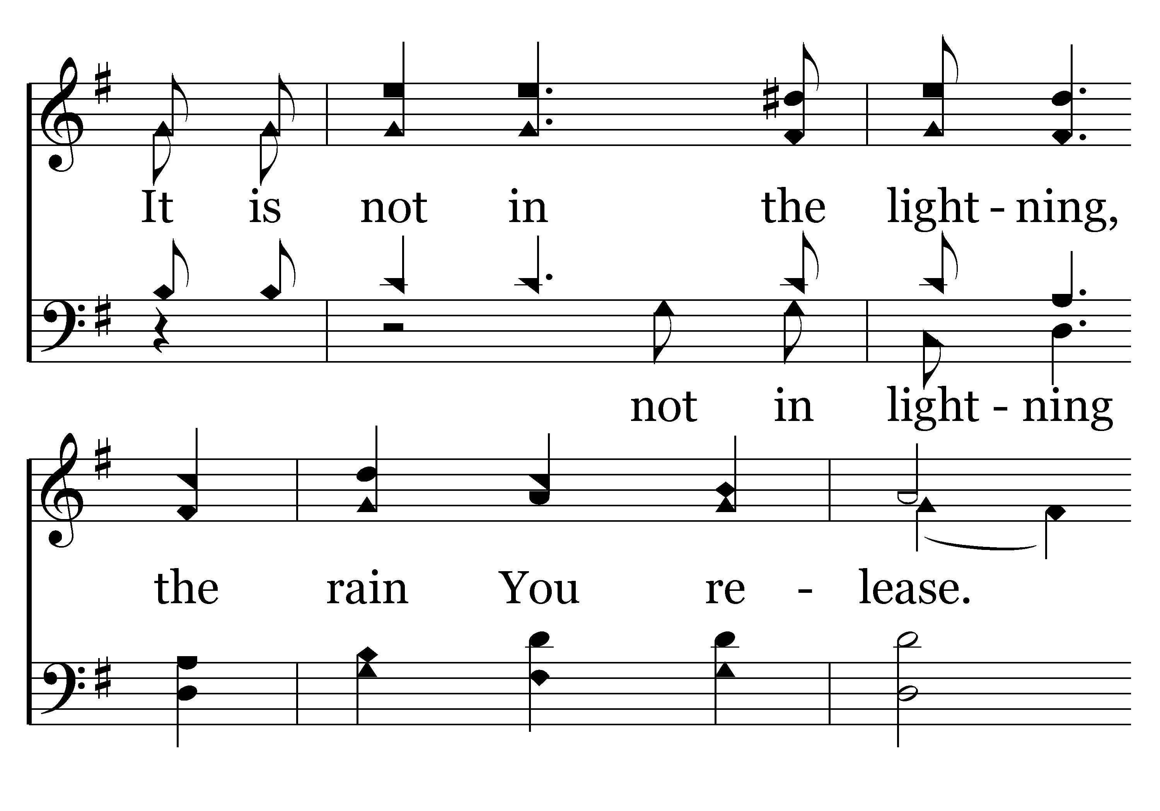
079 - Softly, So Softly - C.2

Slide 15
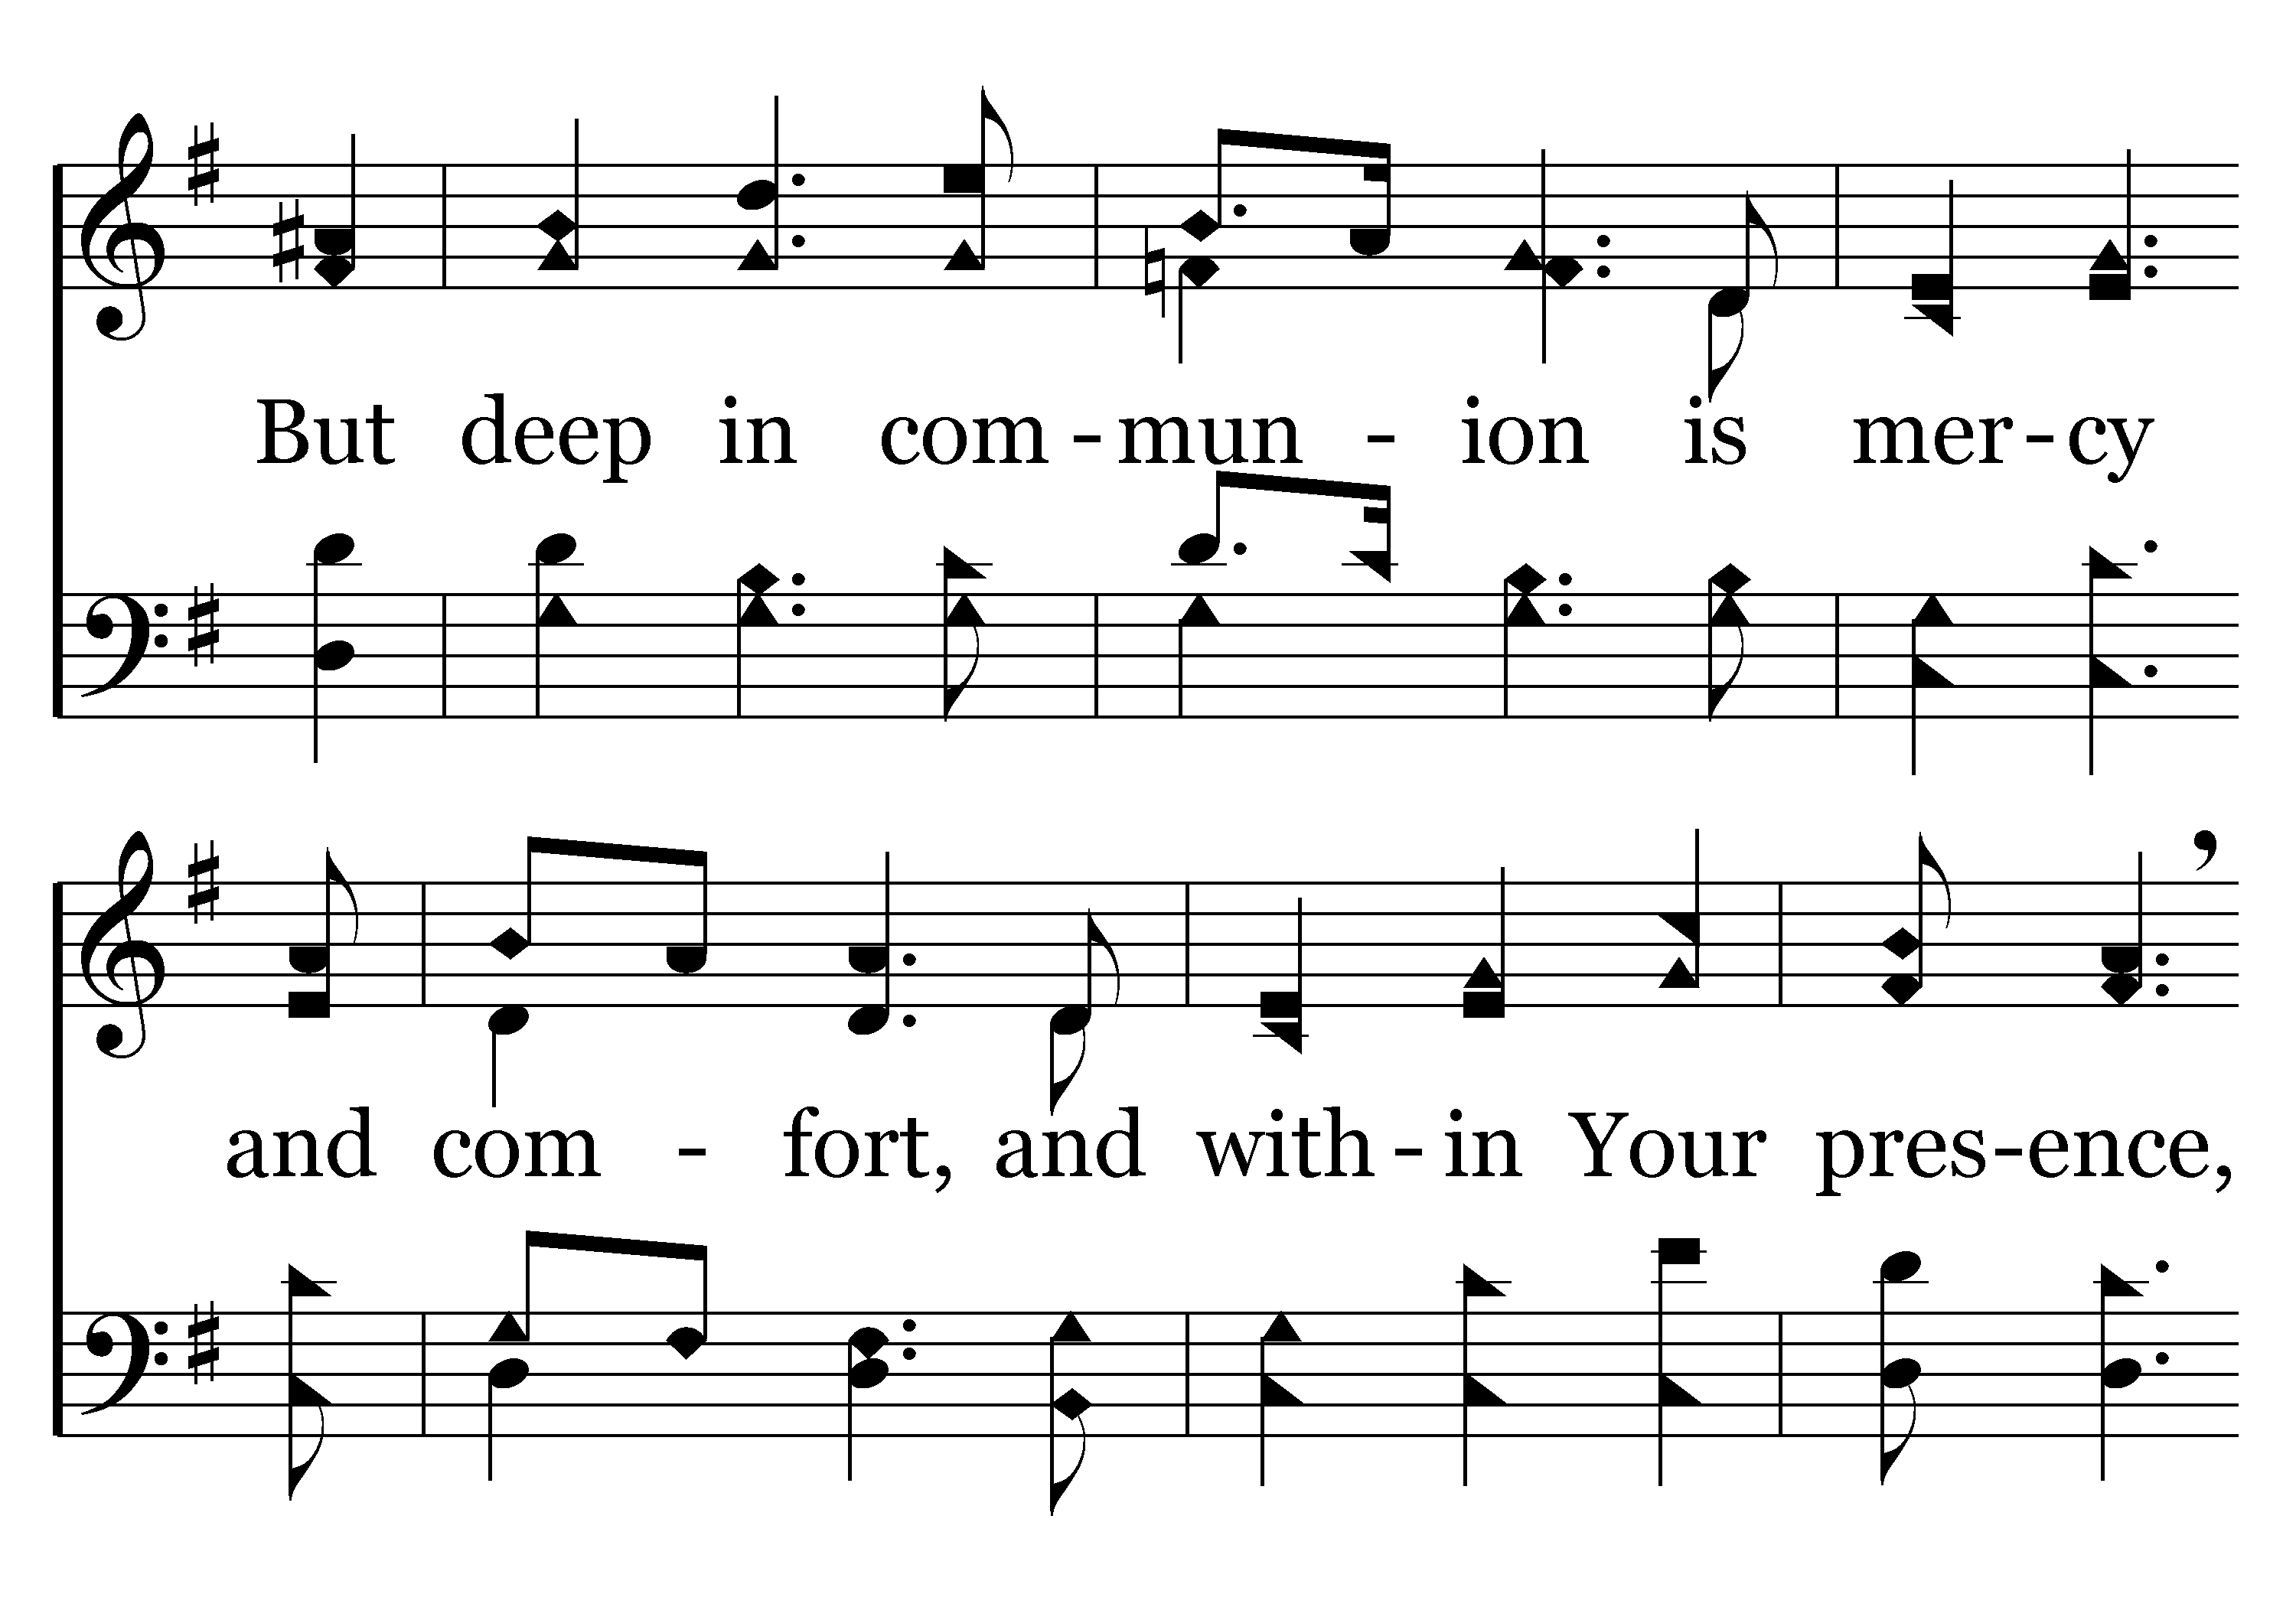
079 - Softly, So Softly - C.3

Slide 16
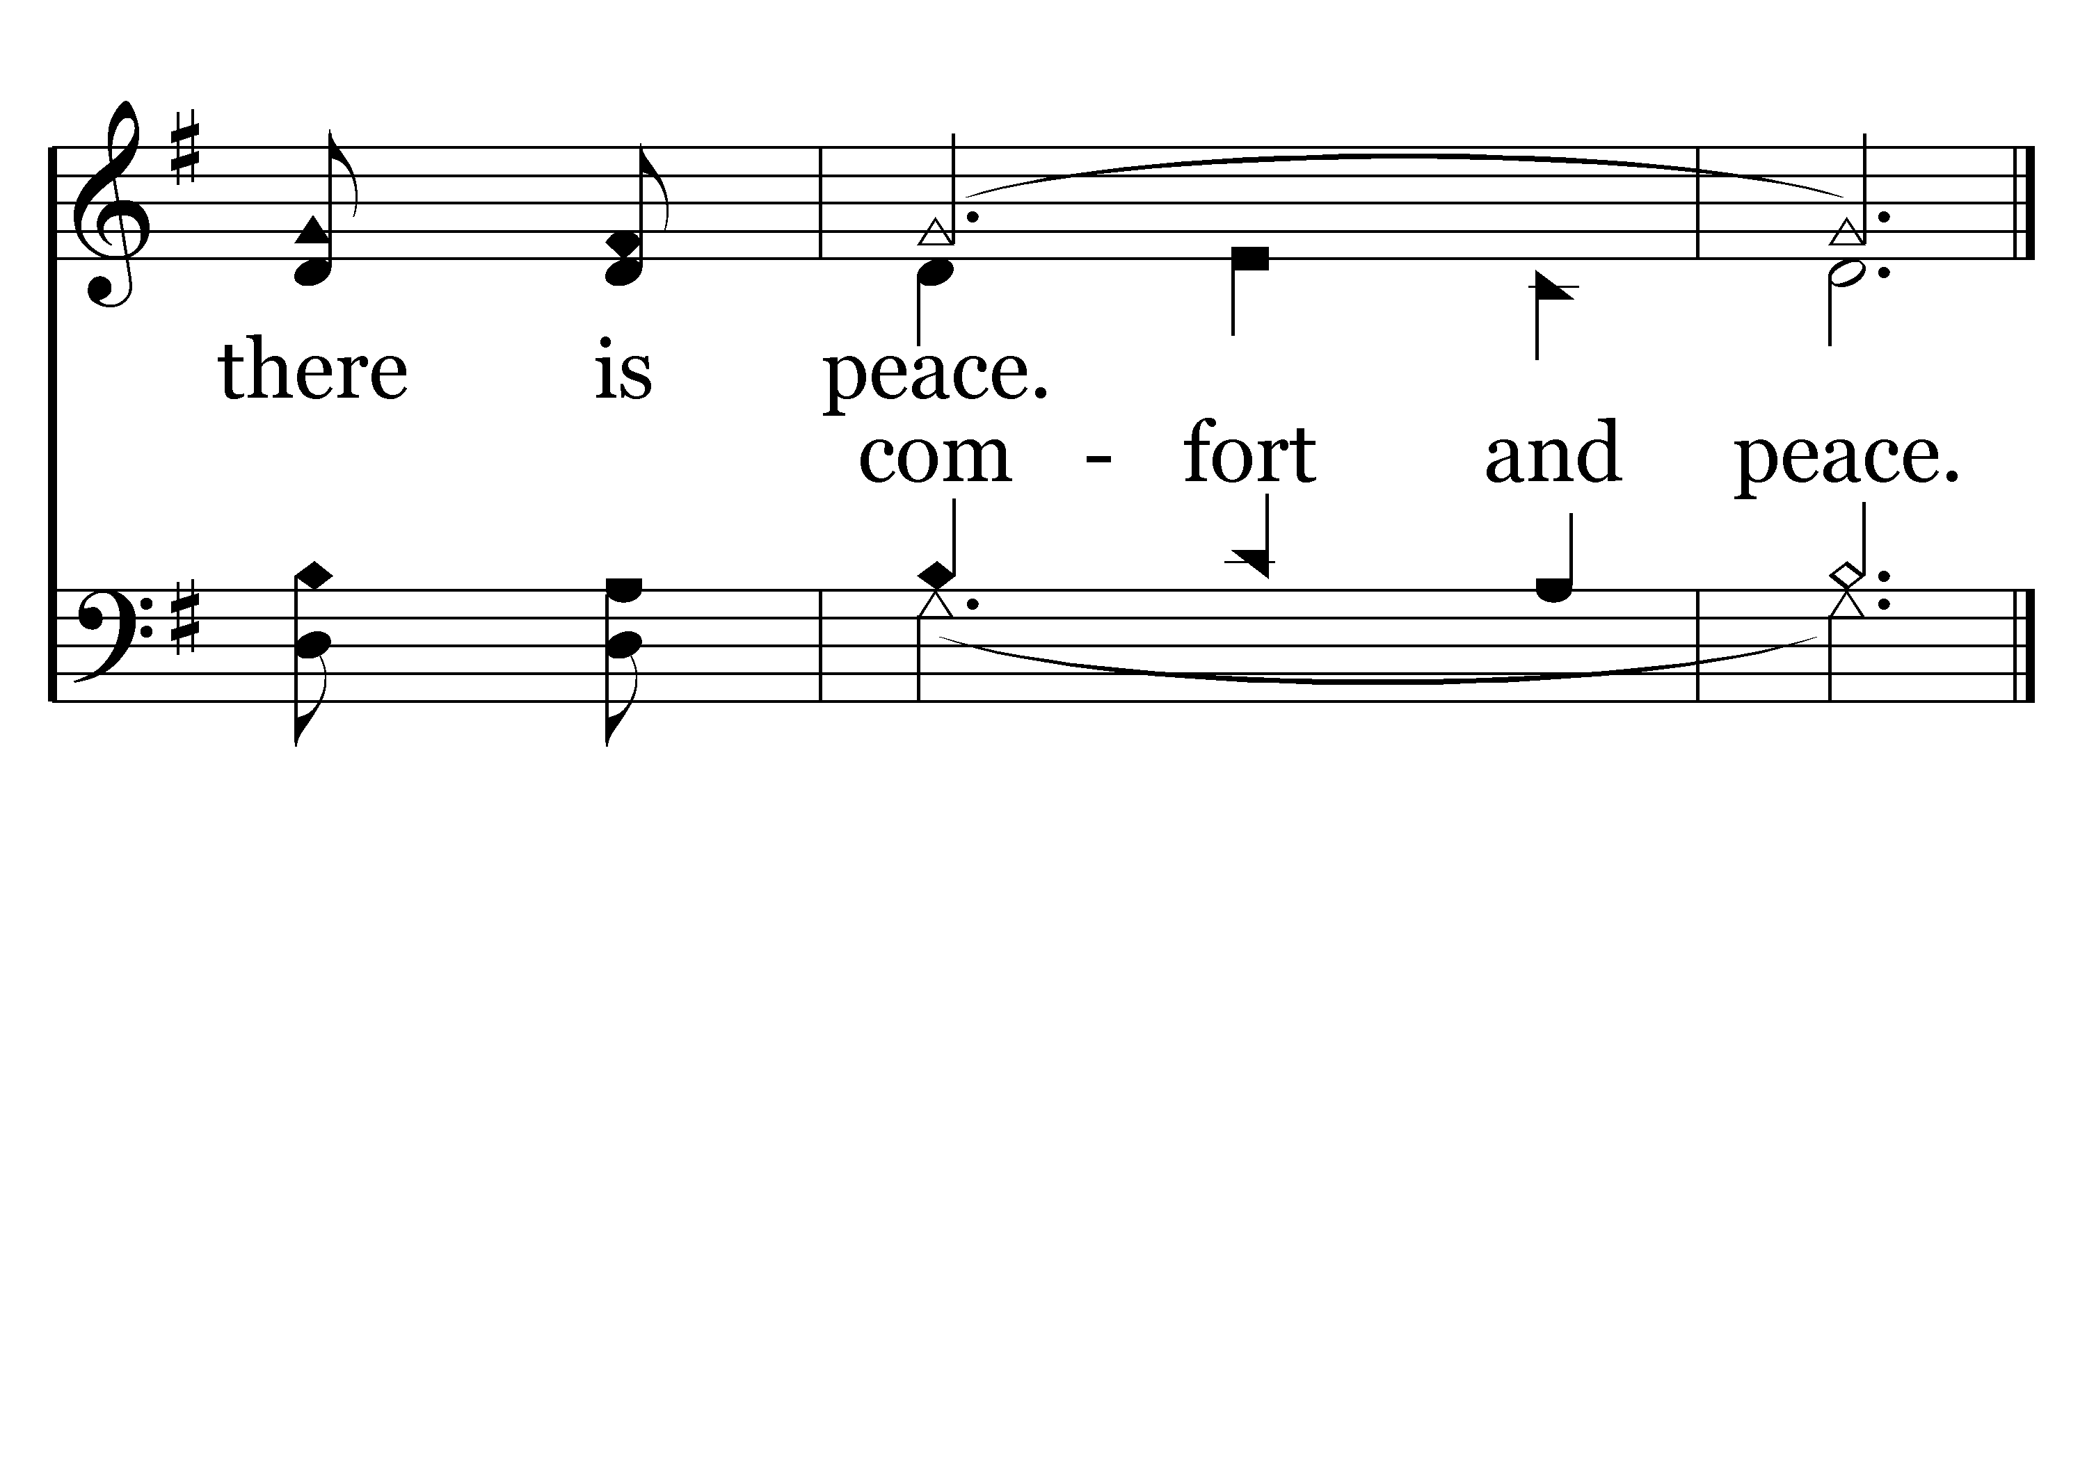
079 - Softly, So Softly - C.4
End of Verse 1

Slide 17
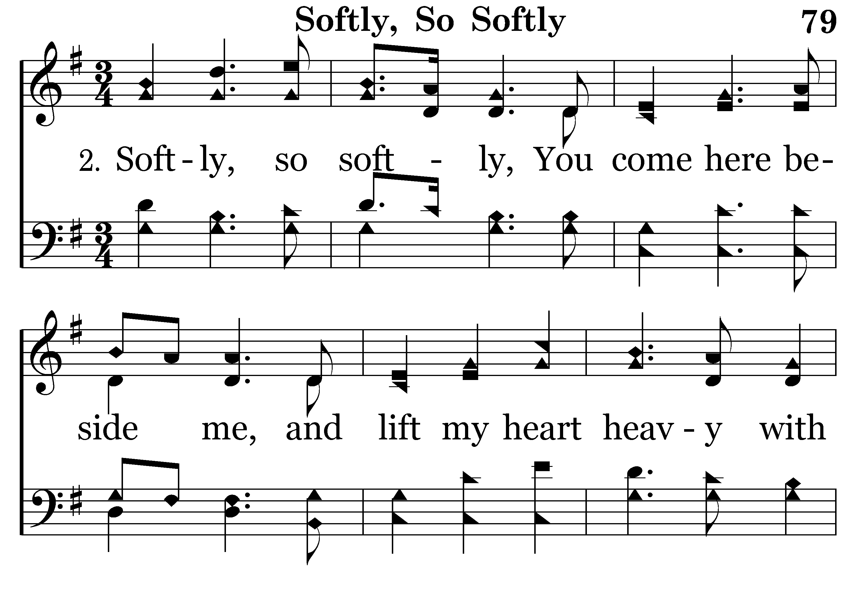
079 - Softly, So Softly - 2.1

Slide 18
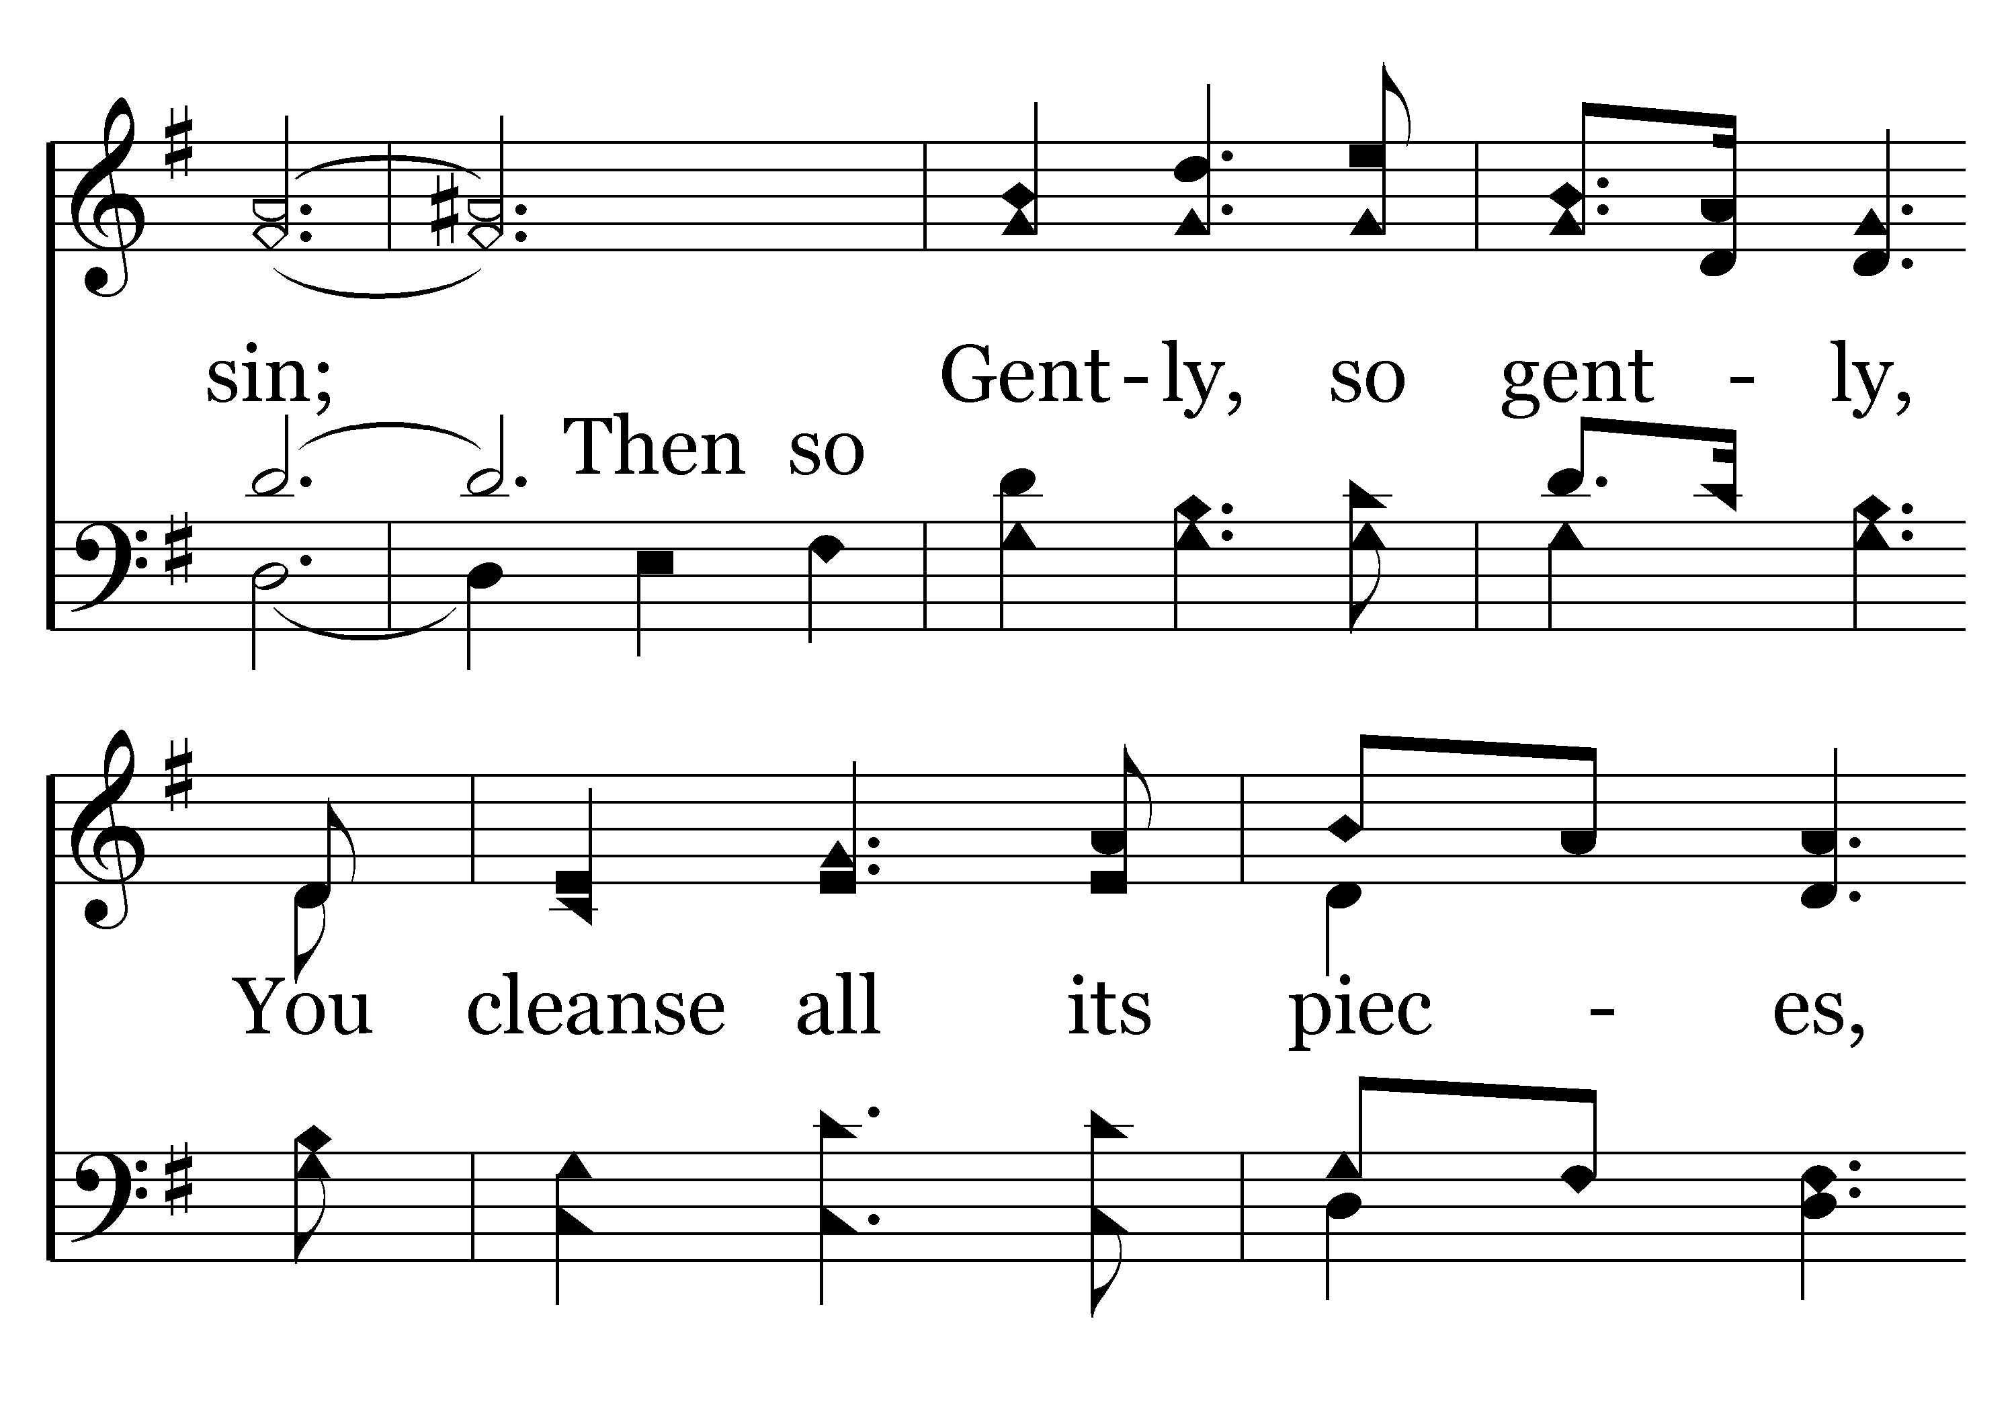
079 - Softly, So Softly - 2.2

Slide 19
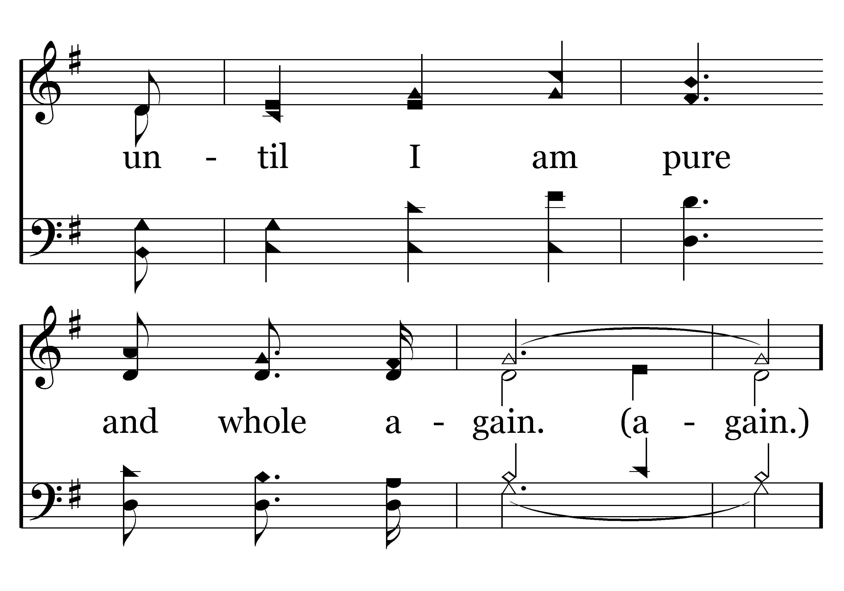
079 - Softly, So Softly - 2.3

Slide 20
079 - Softly, So Softly - C.1

Slide 21
079 - Softly, So Softly - C.2

Slide 22
079 - Softly, So Softly - C.3

Slide 23
079 - Softly, So Softly - C.4
End of Song

Slide 25
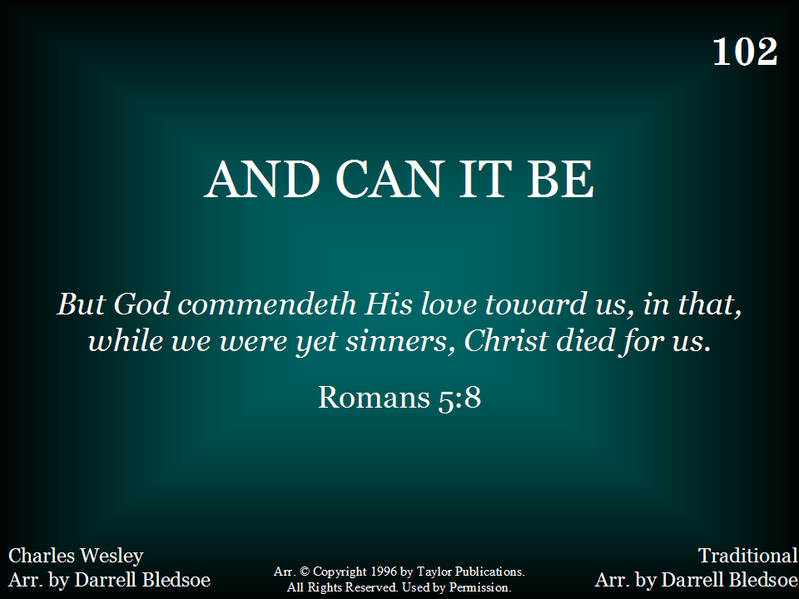
102 - And Can It Be - Title

Slide 26
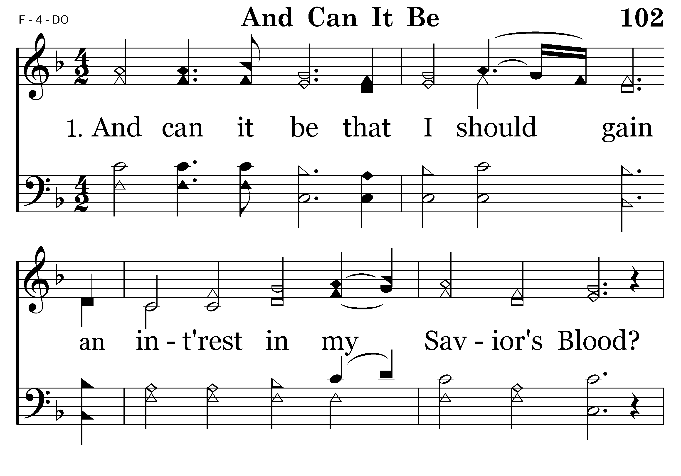
102 - And Can It Be - 1.1

Slide 27
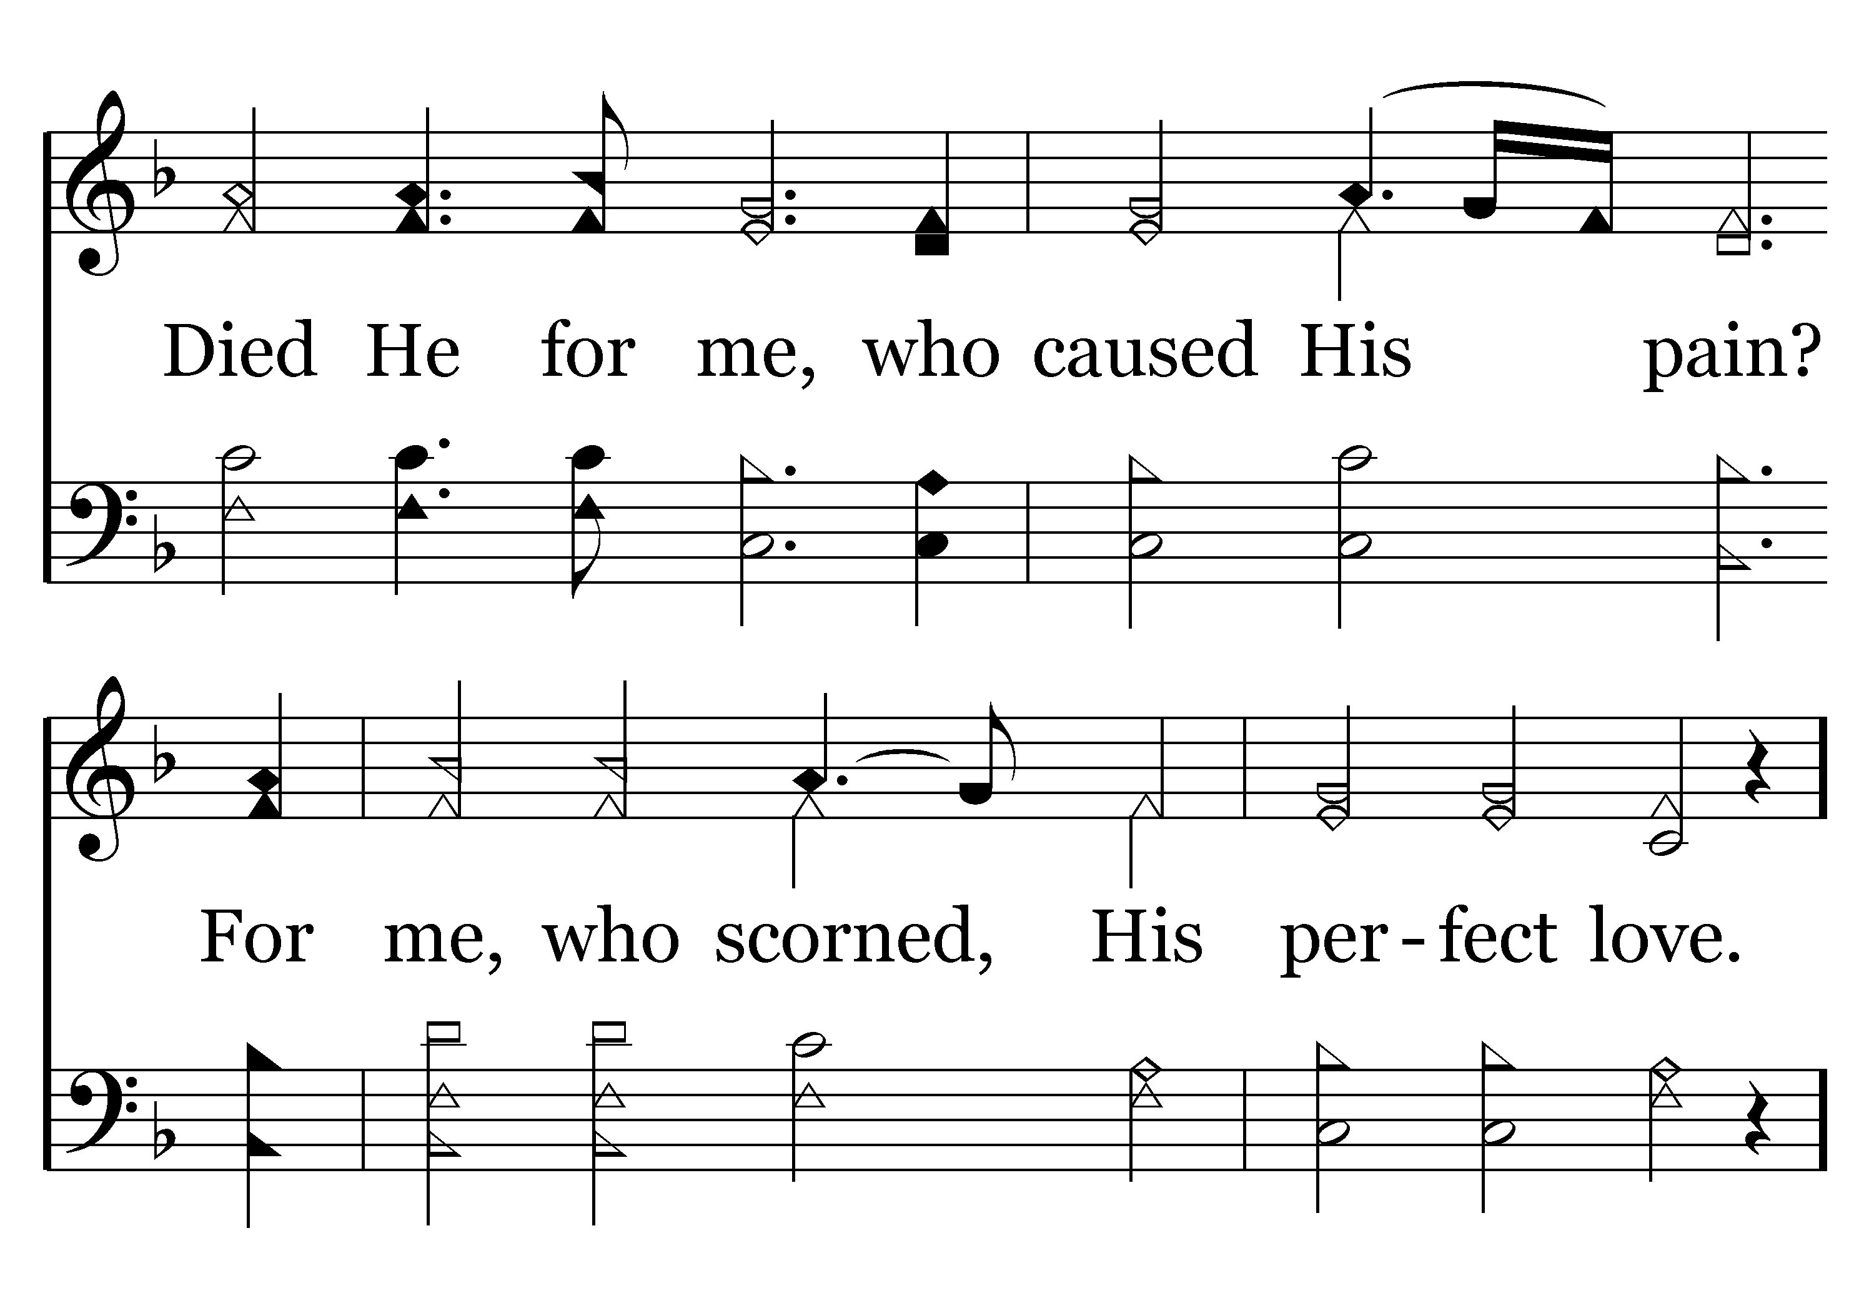
102 - And Can It Be - 1.2

Slide 28
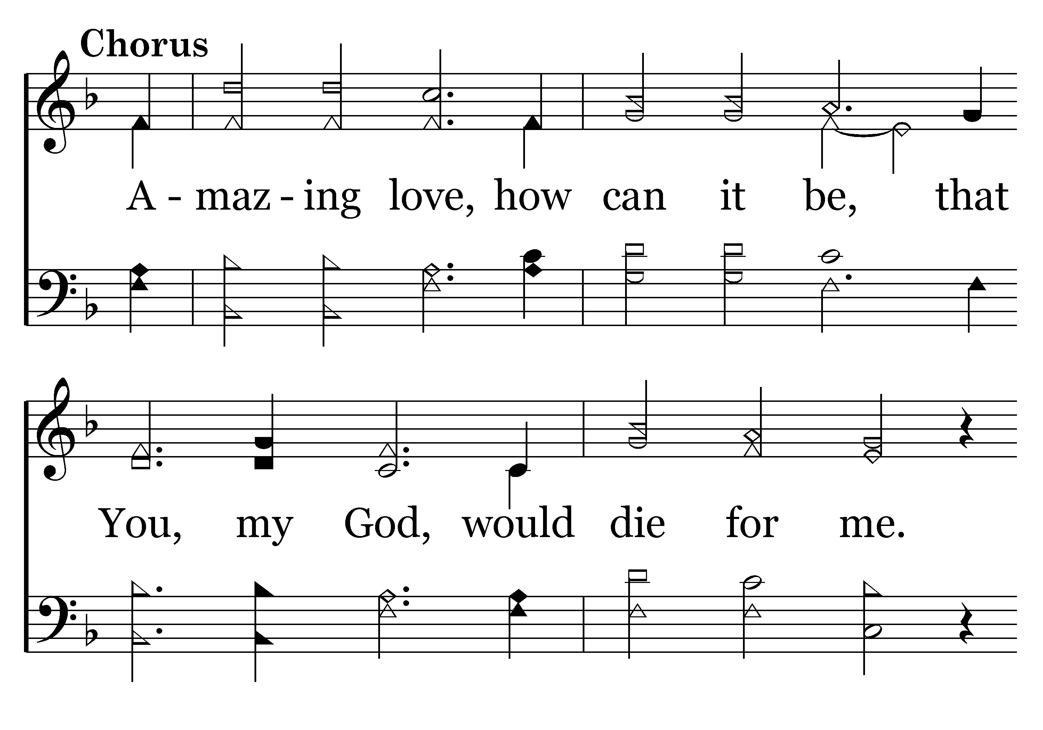
102 - And Can It Be - C.1

Slide 29
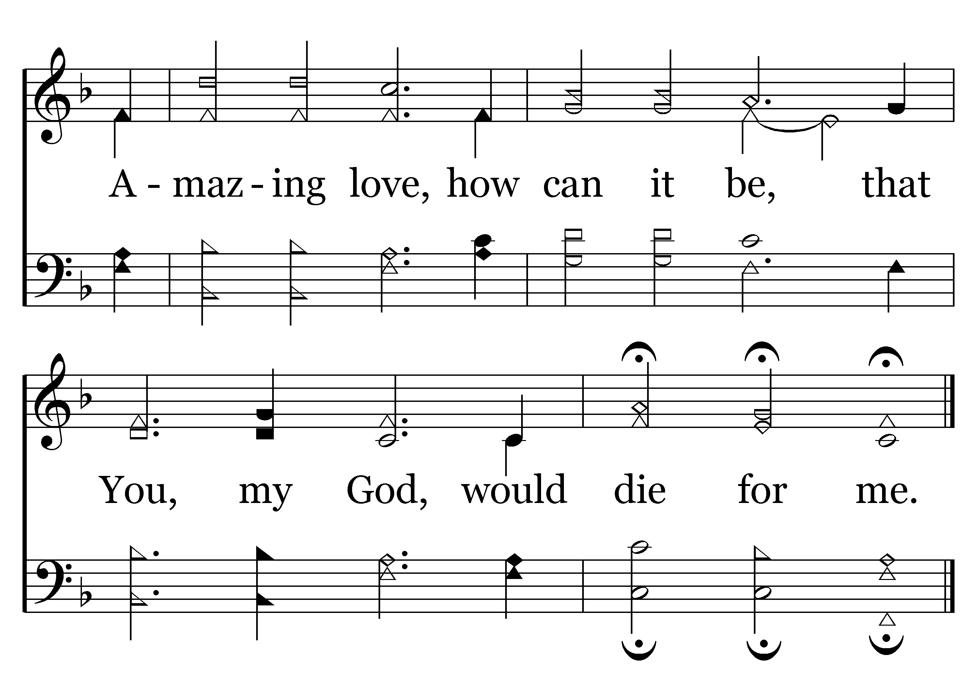
102 - And Can It Be - C.2
End of Verse 1

Slide 30
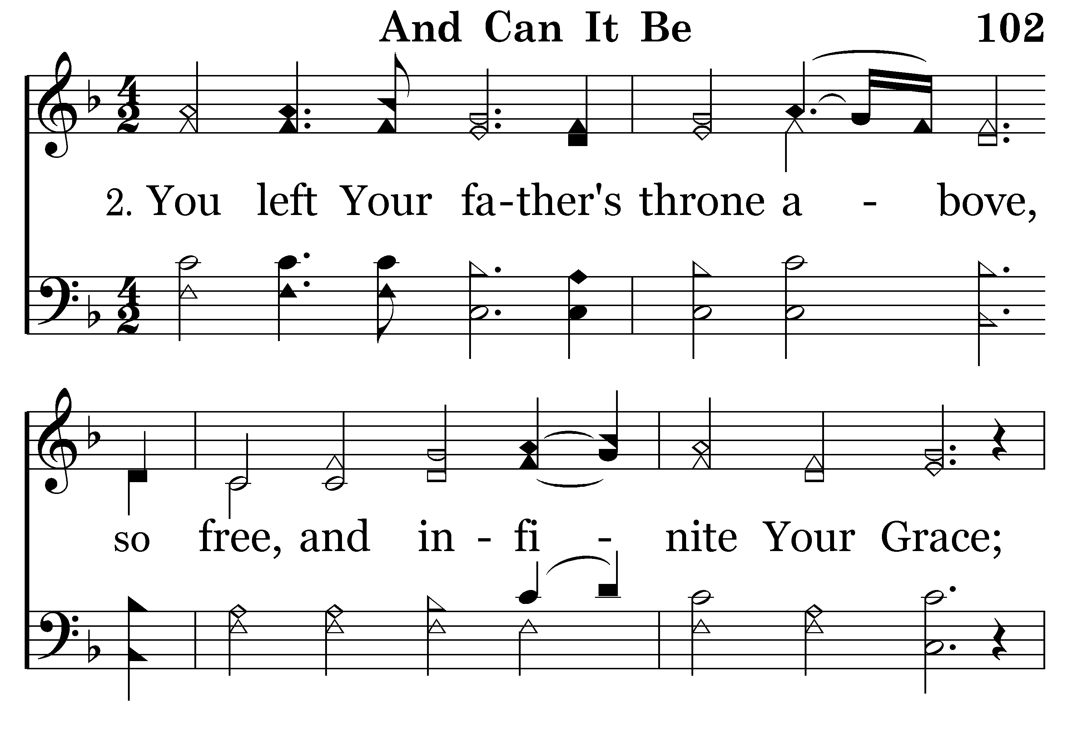
102 - And Can It Be - 2.1

Slide 31
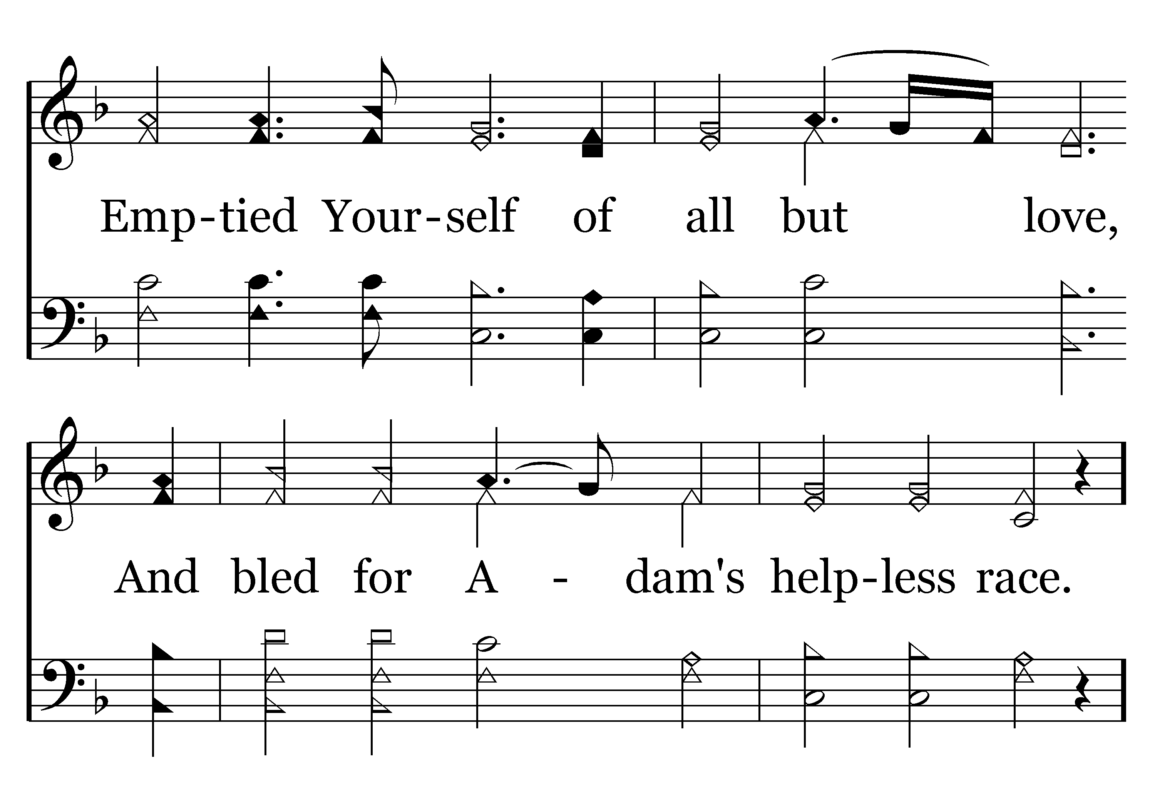
102 - And Can It Be - 2.2

Slide 32
102 - And Can It Be - C.1

Slide 33
102 - And Can It Be - C.2
End of Verse 2

Slide 34
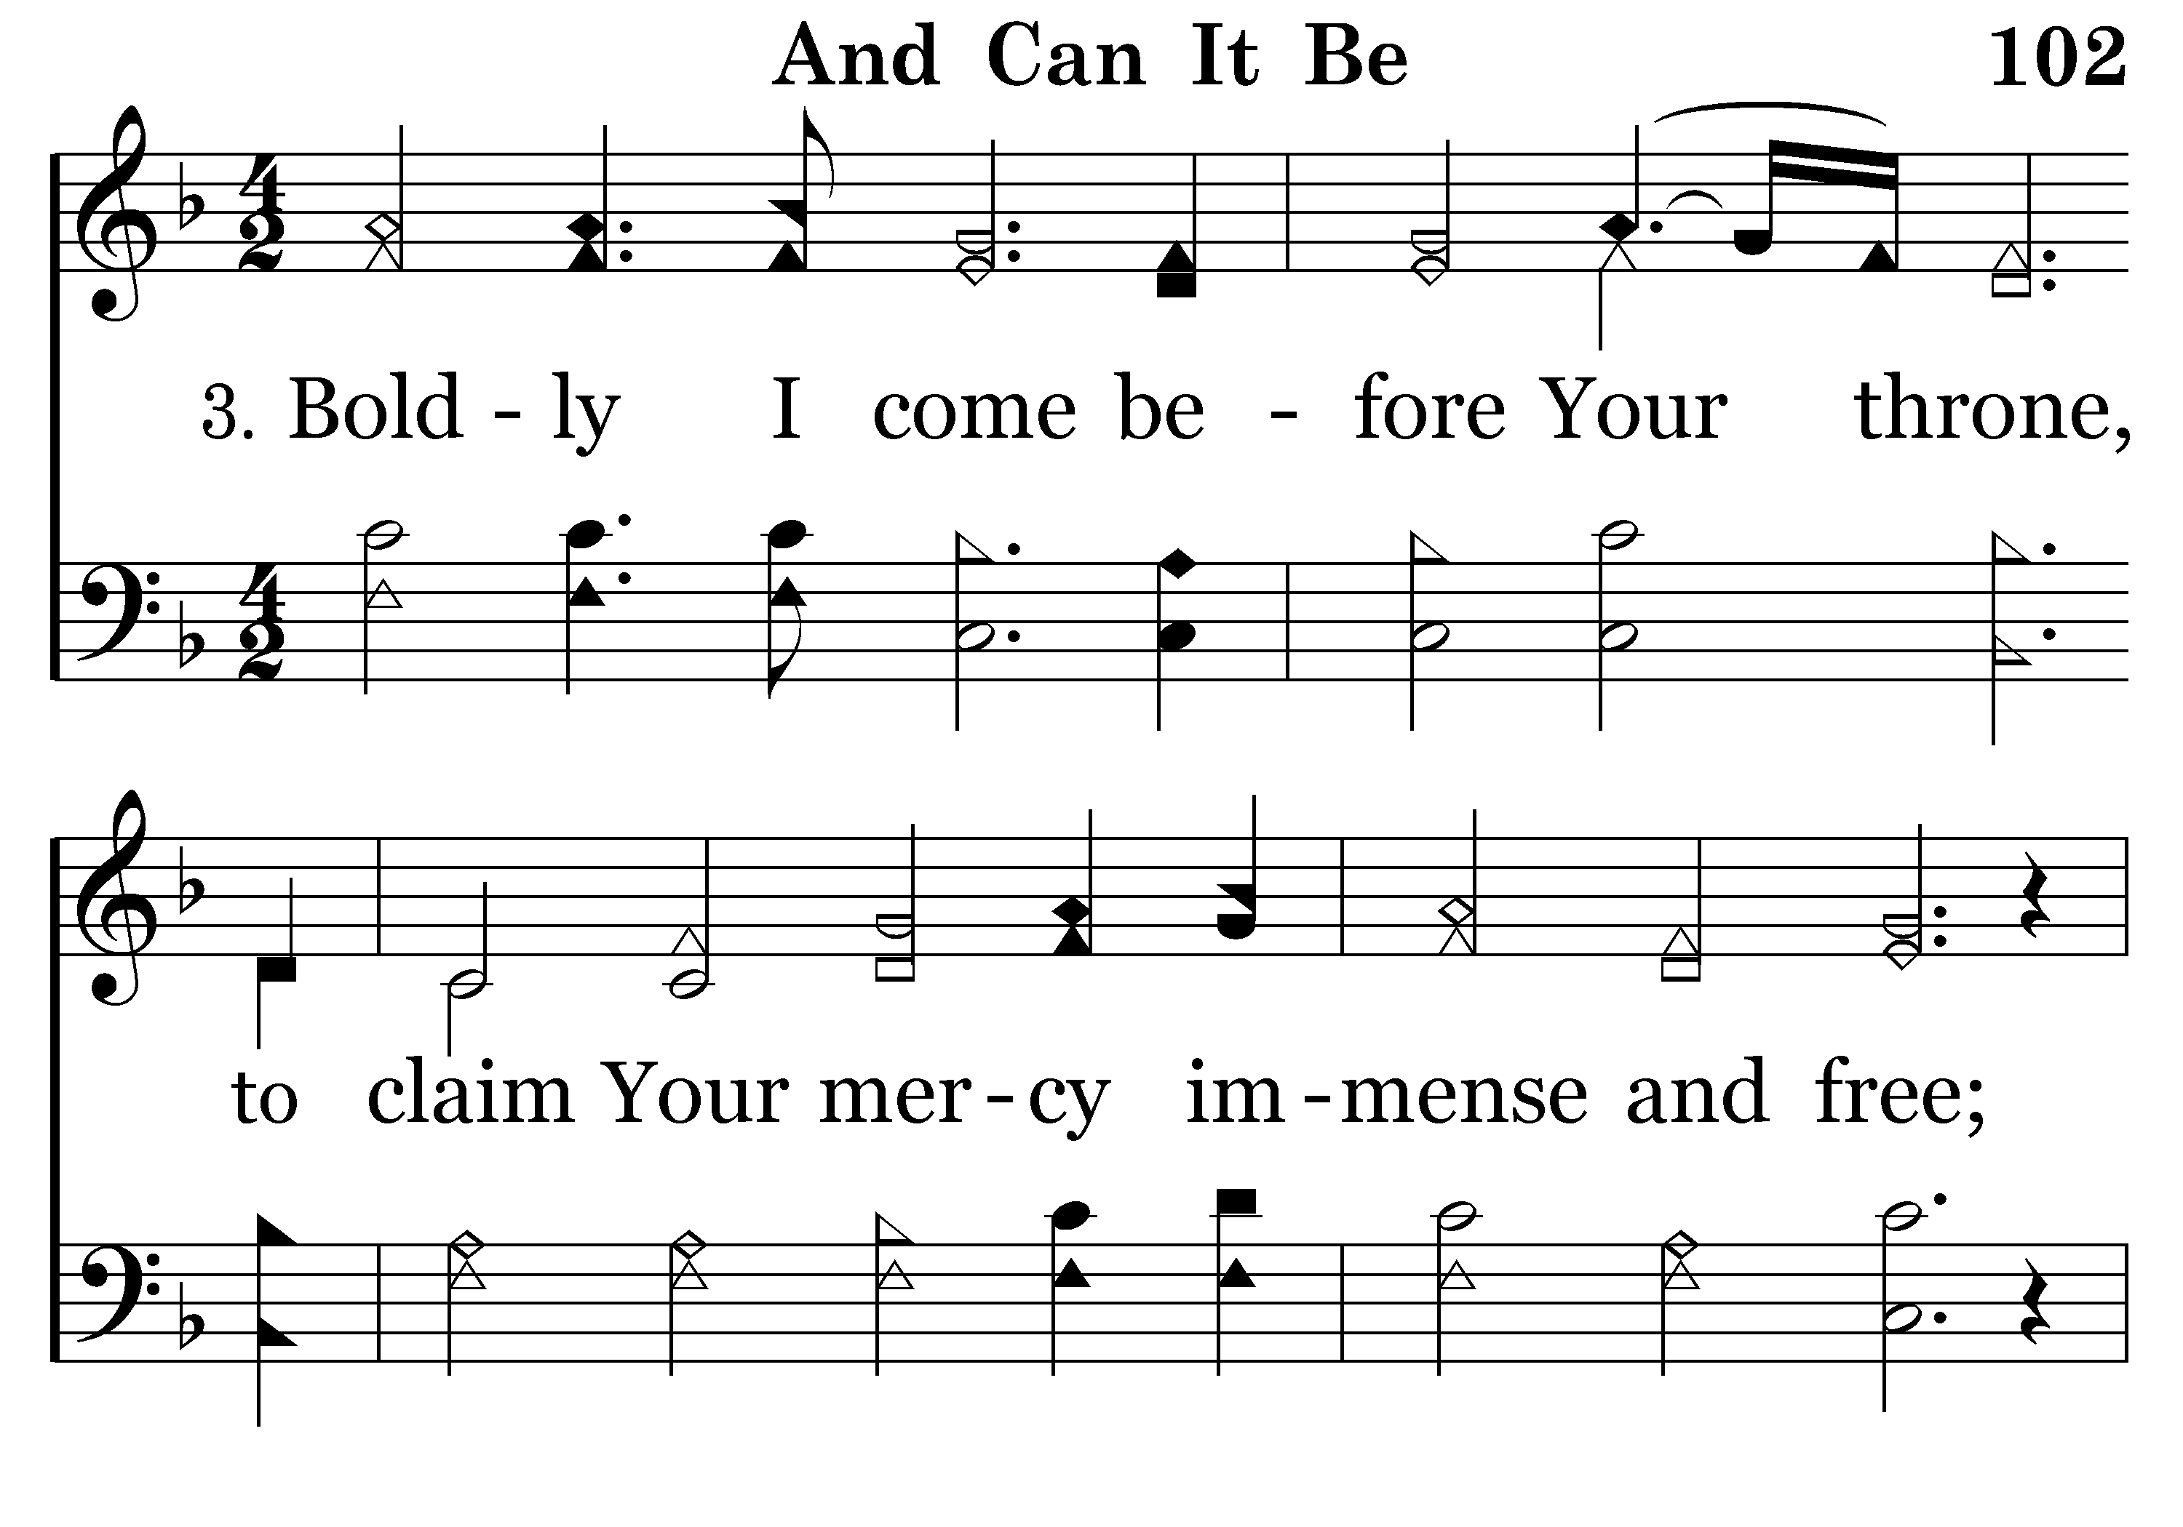
102 - And Can It Be - 3.1

Slide 35
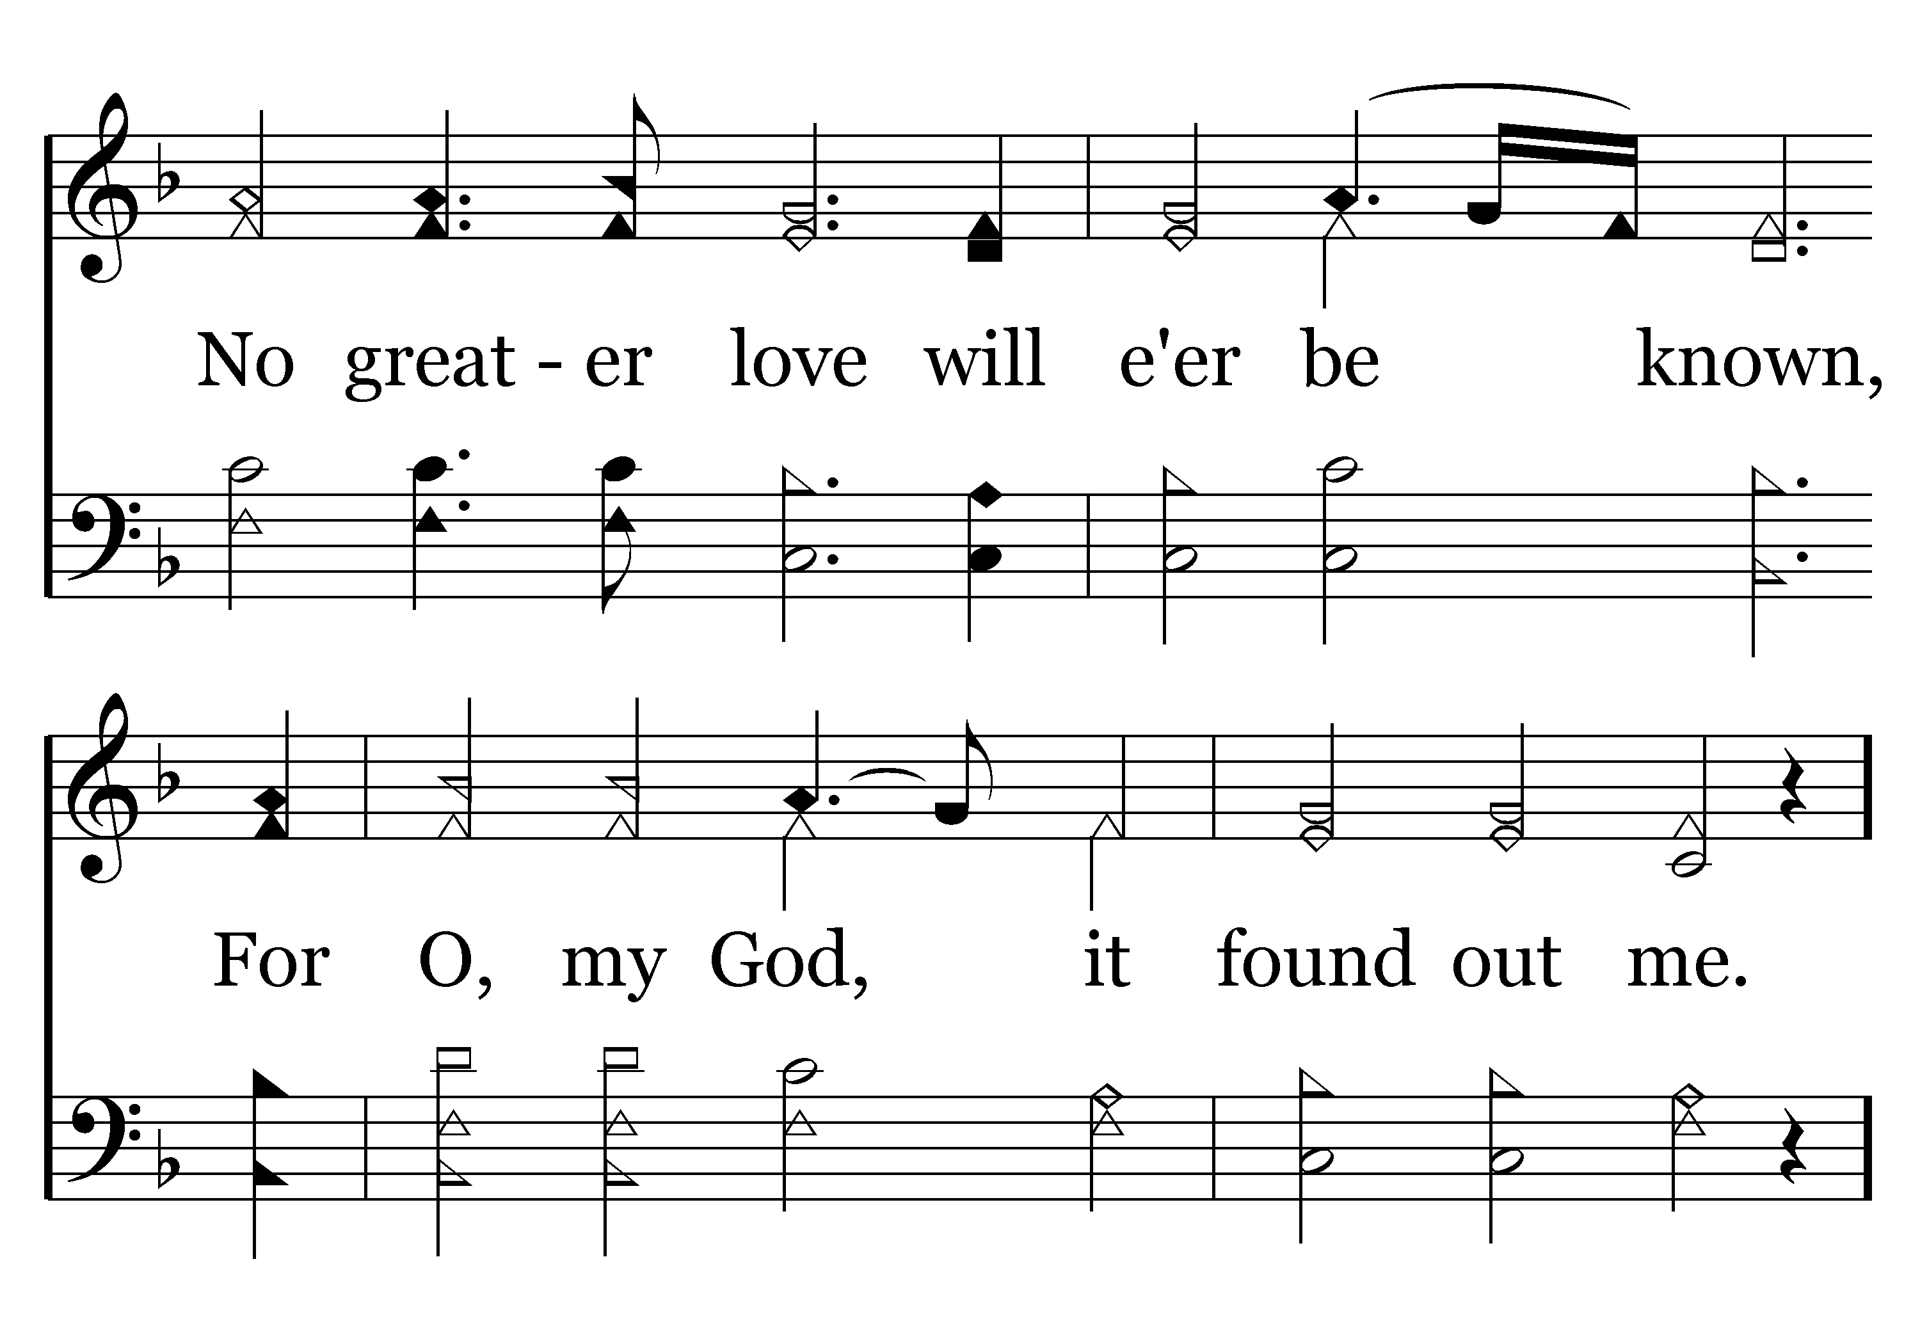
102 - And Can It Be - 3.2

Slide 36
102 - And Can It Be - C.1

Slide 37
102 - And Can It Be - C.2
End of Song

Slide 39
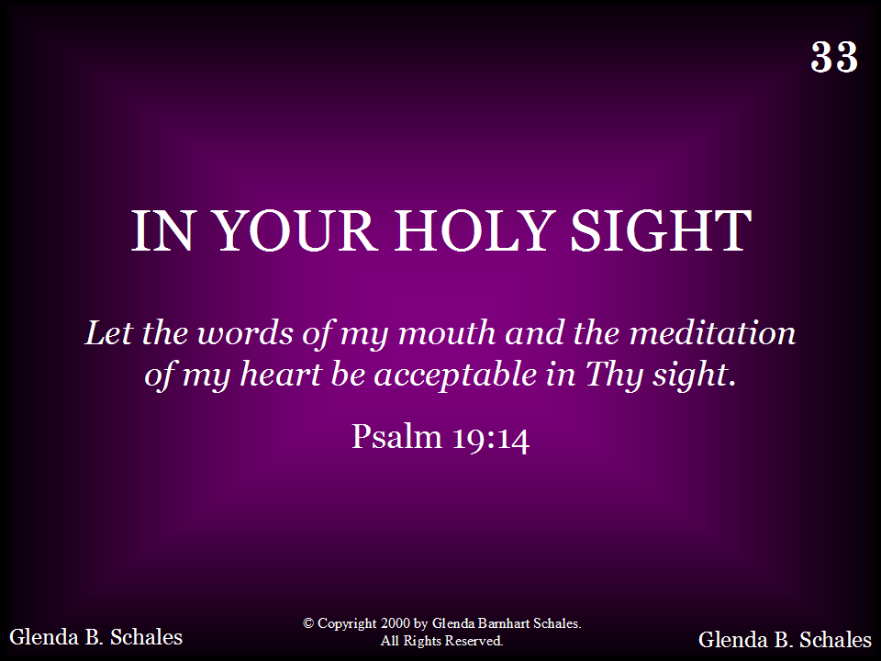
033 - In Your Holy Sight - Title

Slide 40
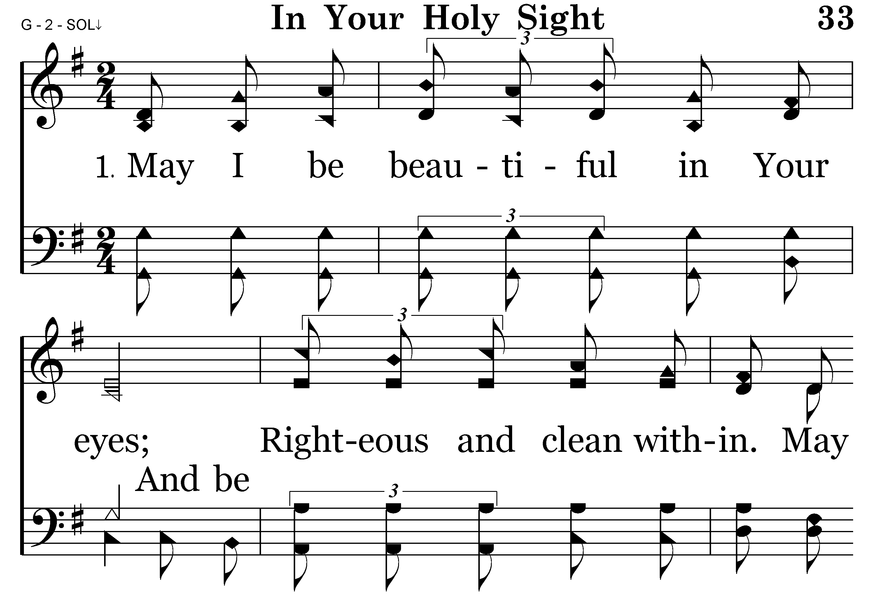
033 - In Your Holy Sight - 1.1

Slide 41
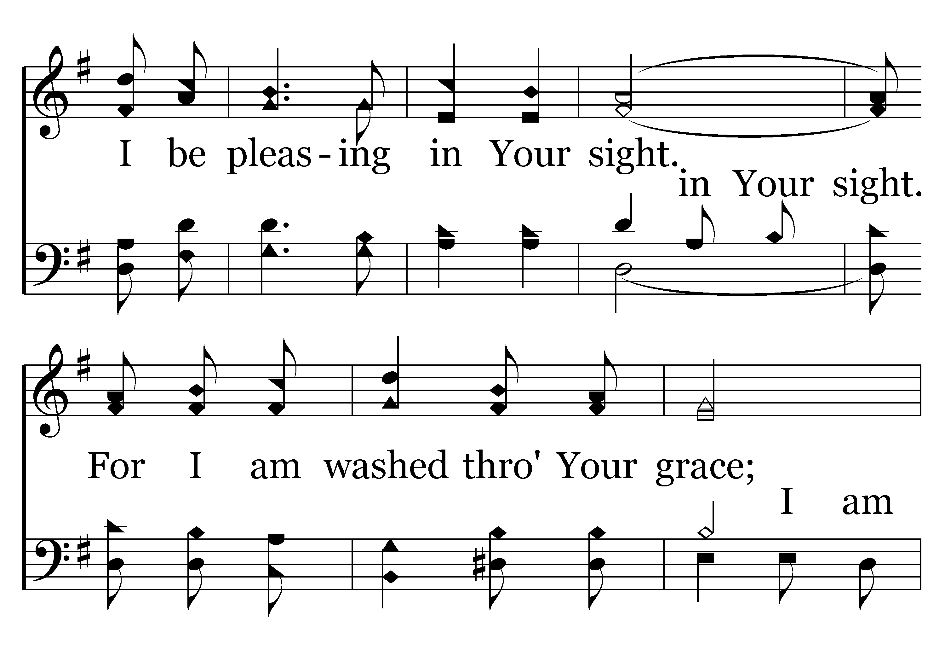
033 - In Your Holy Sight - 1.2

Slide 42
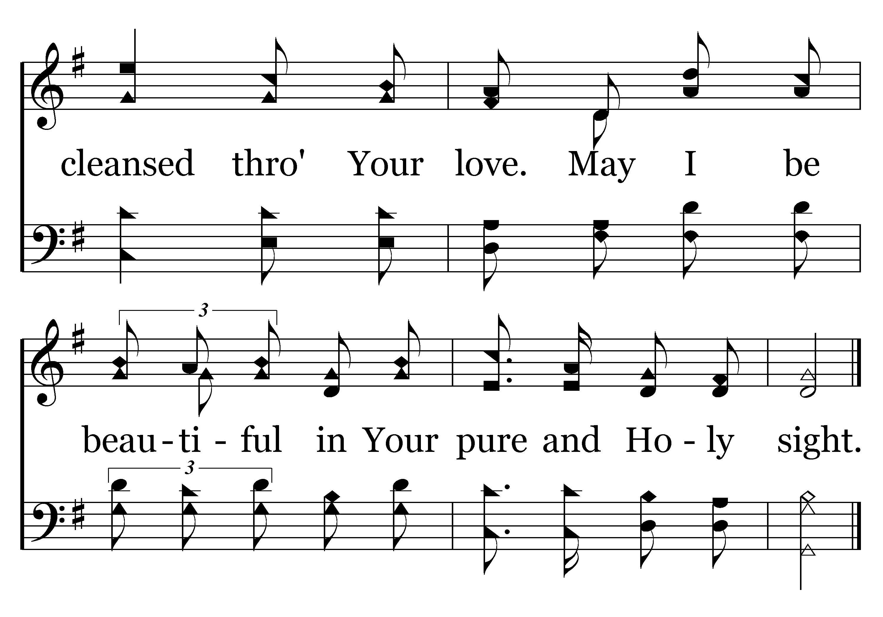
033 - In Your Holy Sight - 1.3
End of Verse 1

Slide 43
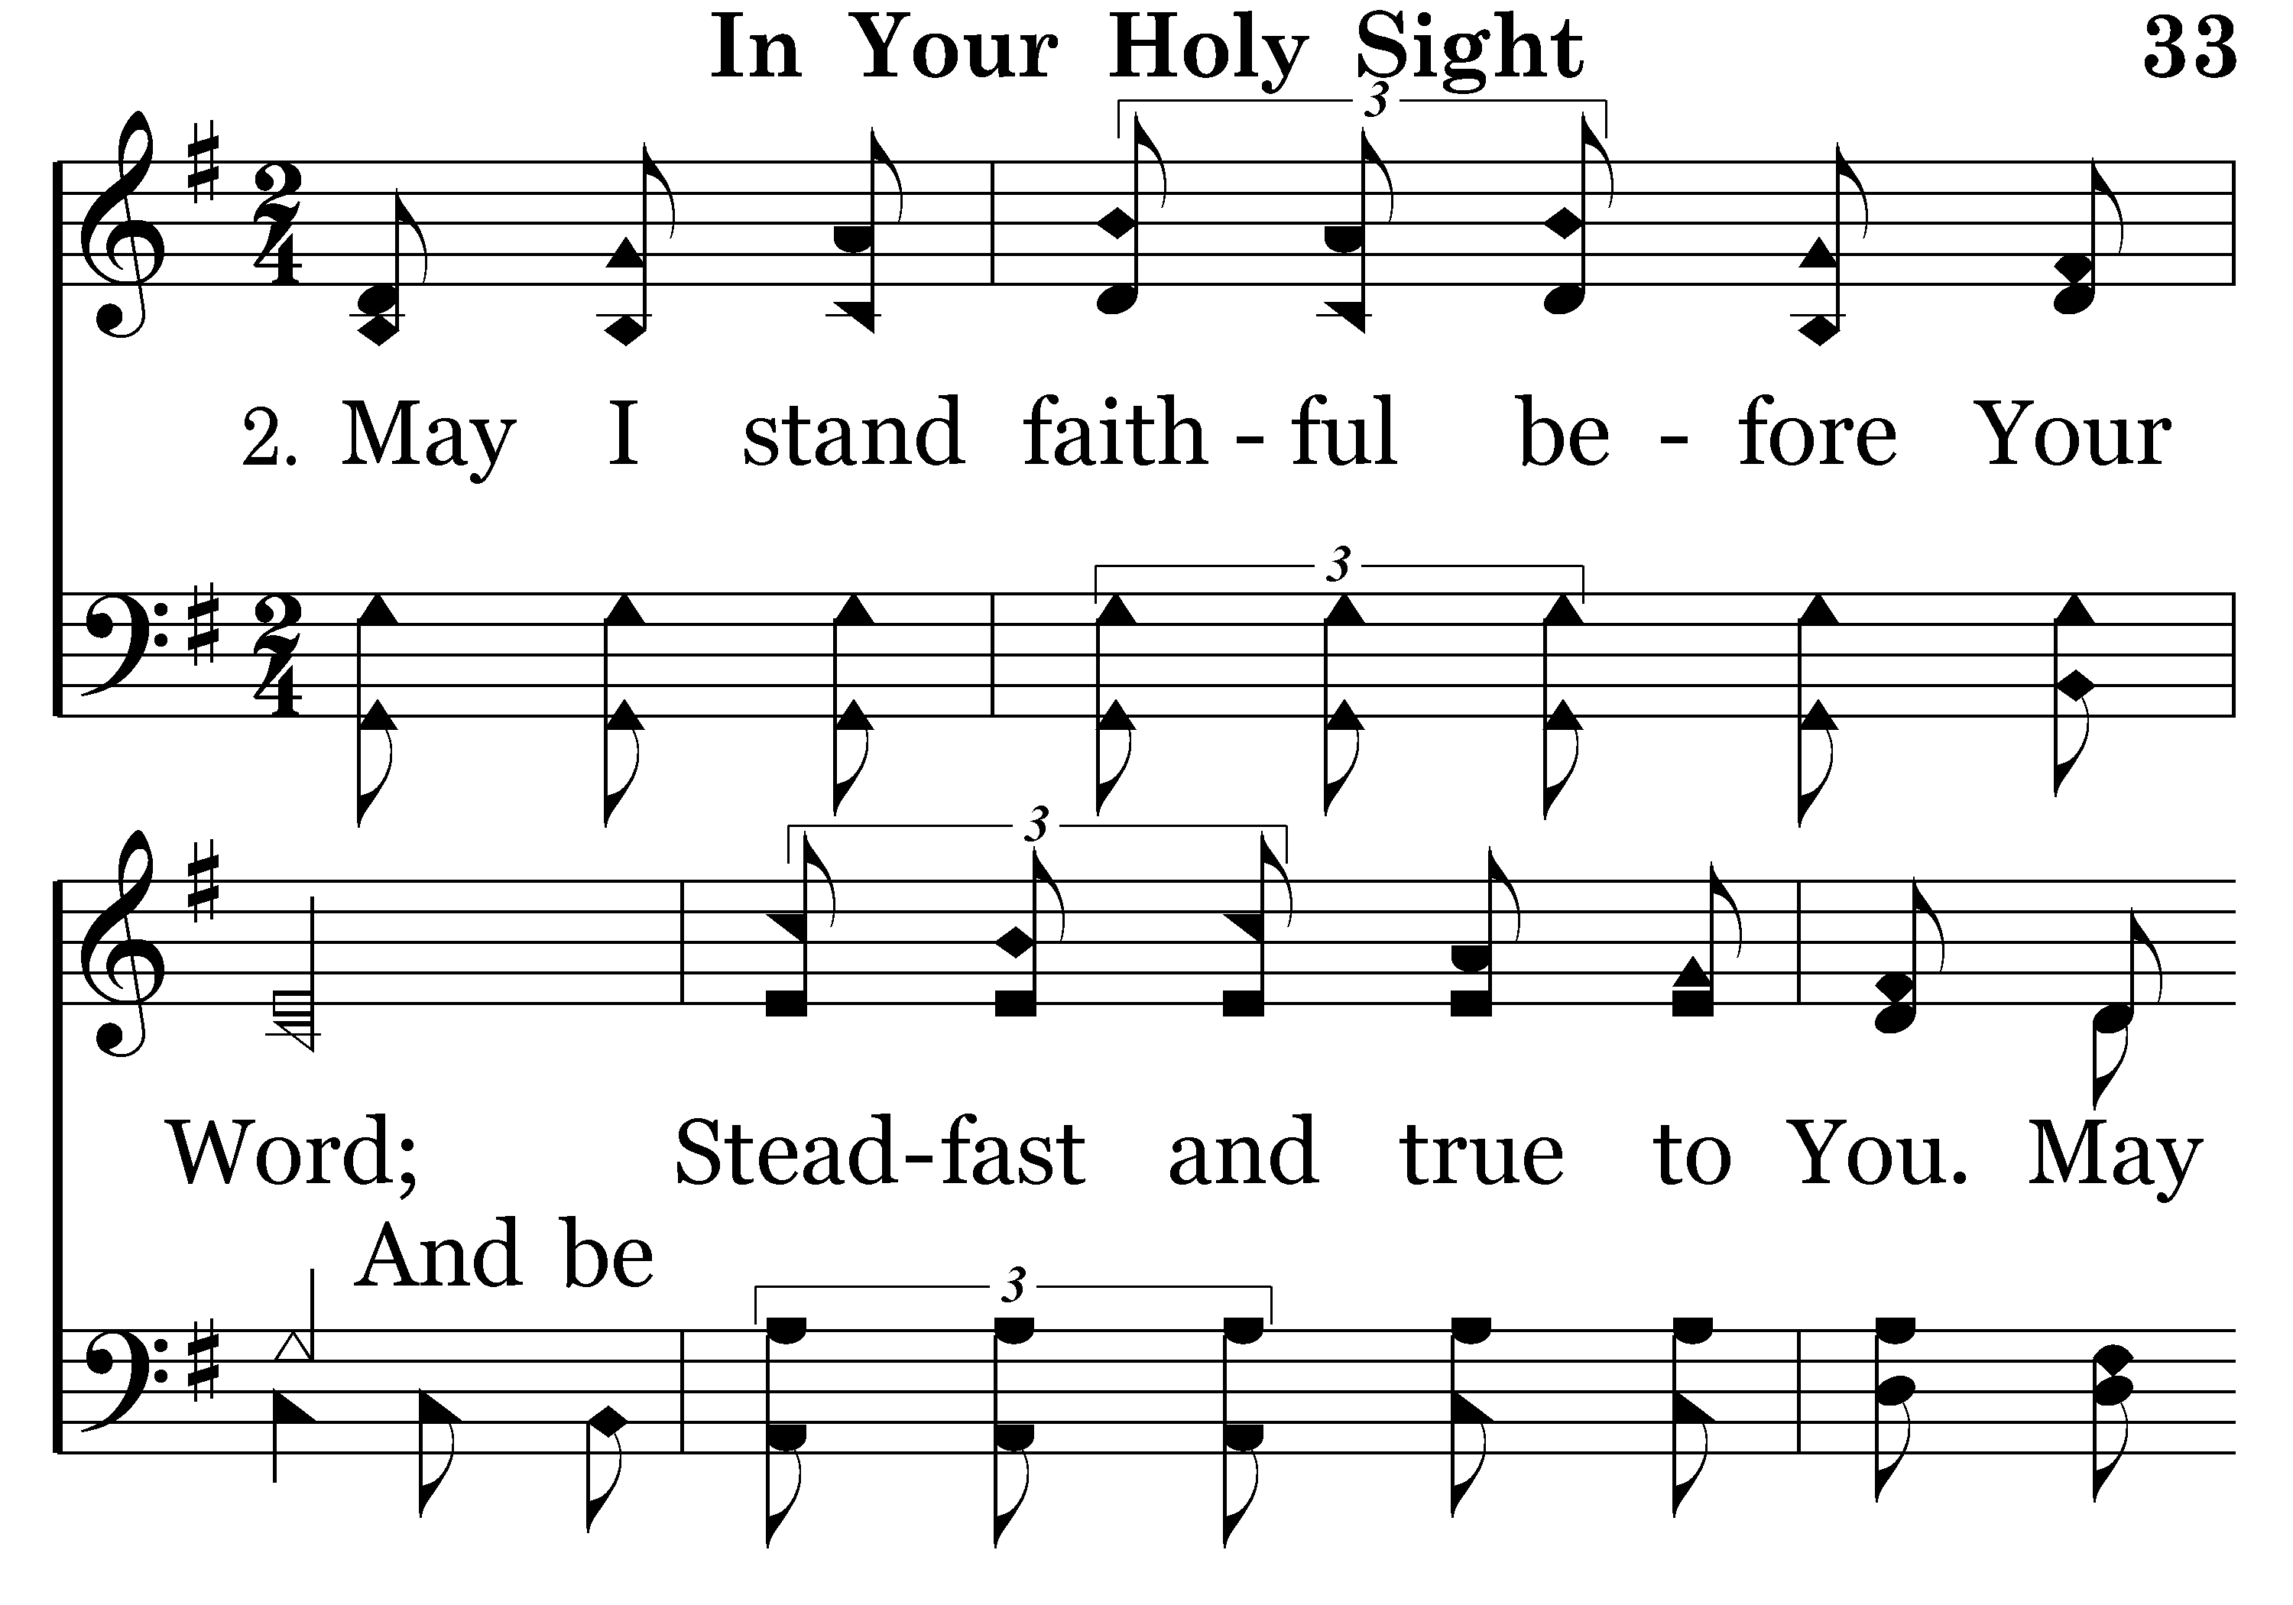
033 - In Your Holy Sight - 2.1

Slide 44
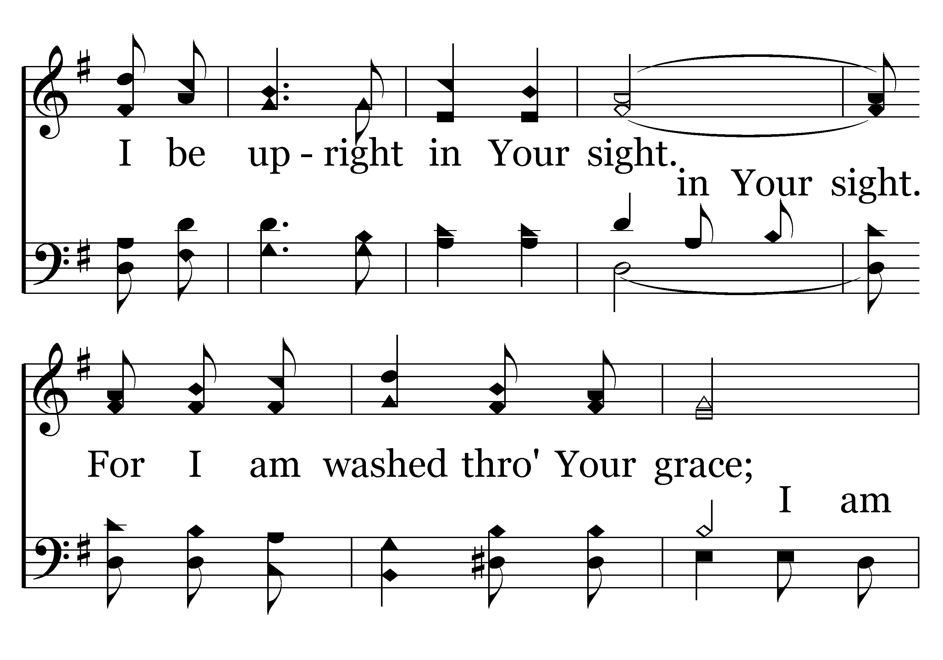
033 - In Your Holy Sight - 2.2

Slide 45
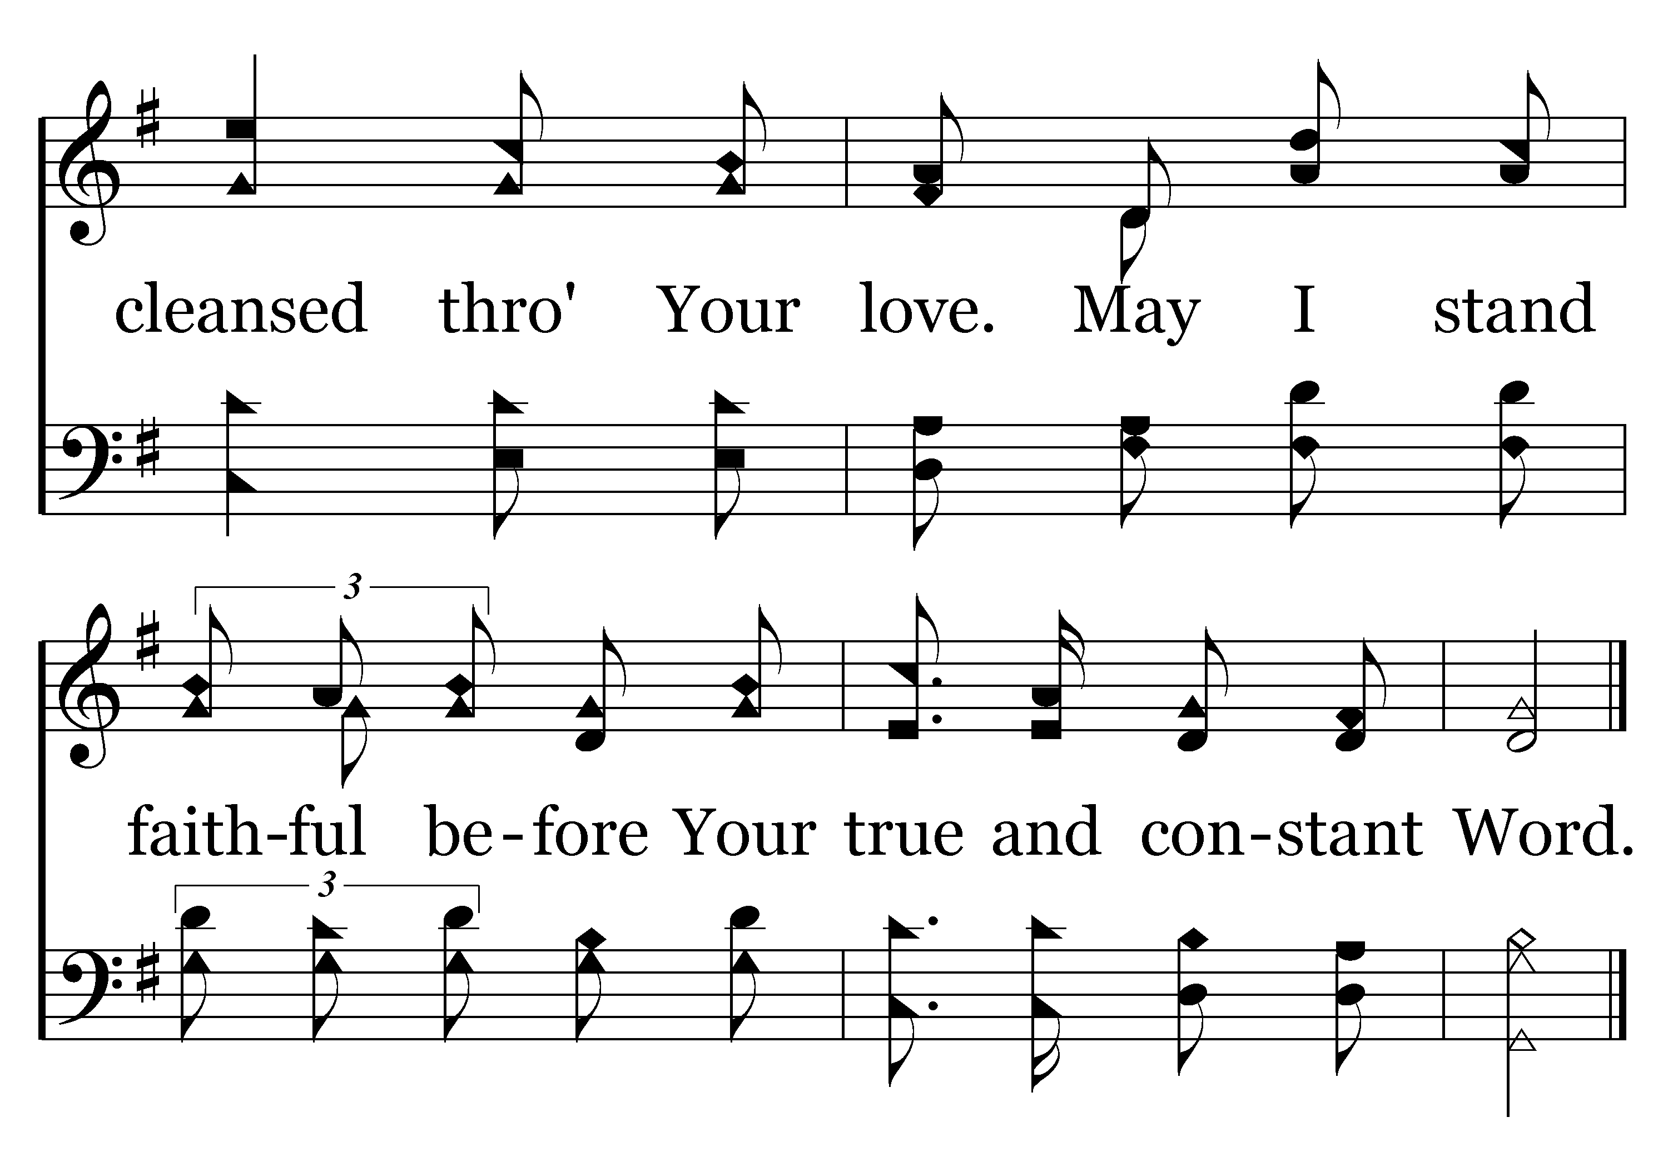
033 - In Your Holy Sight - 2.3
End of Verse 2

Slide 46
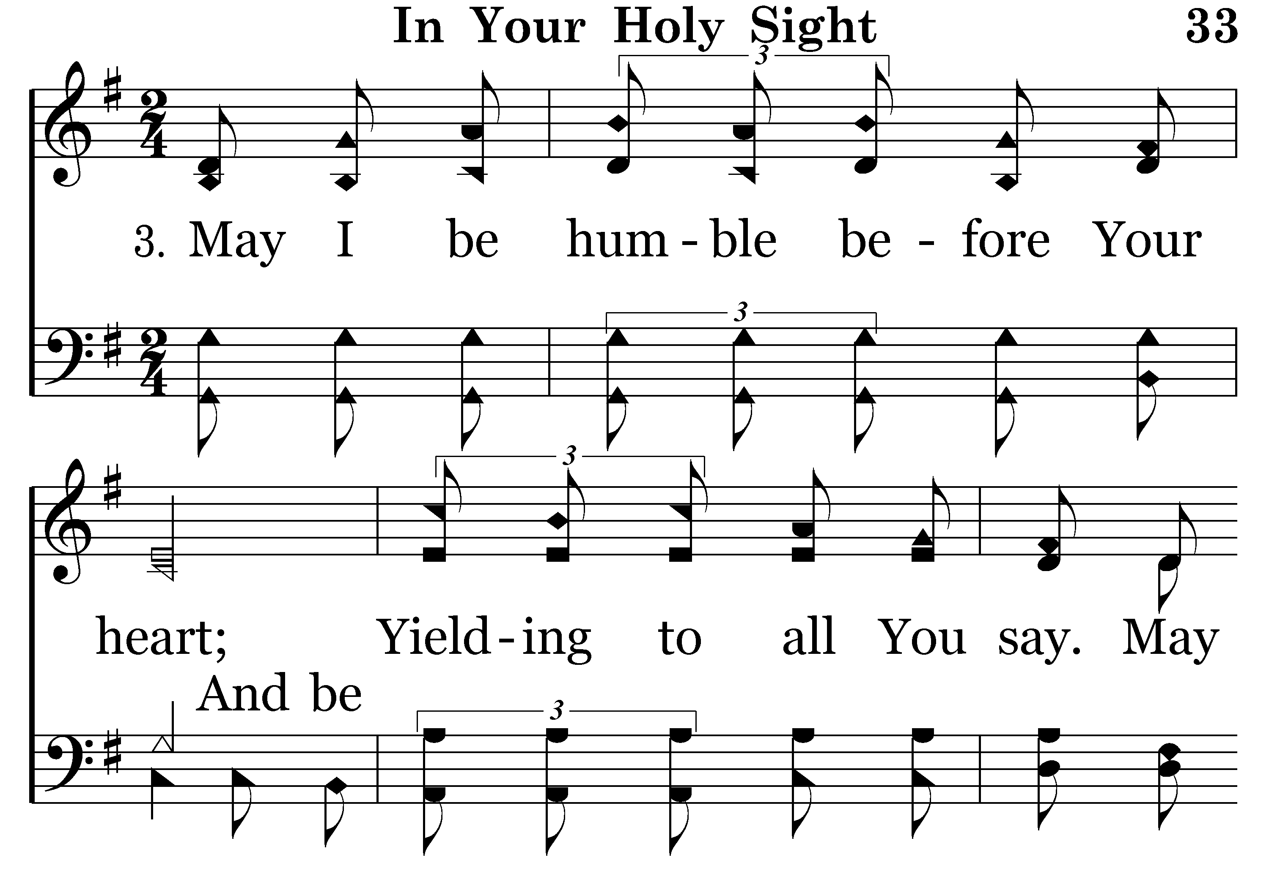
033 - In Your Holy Sight - 3.1

Slide 47
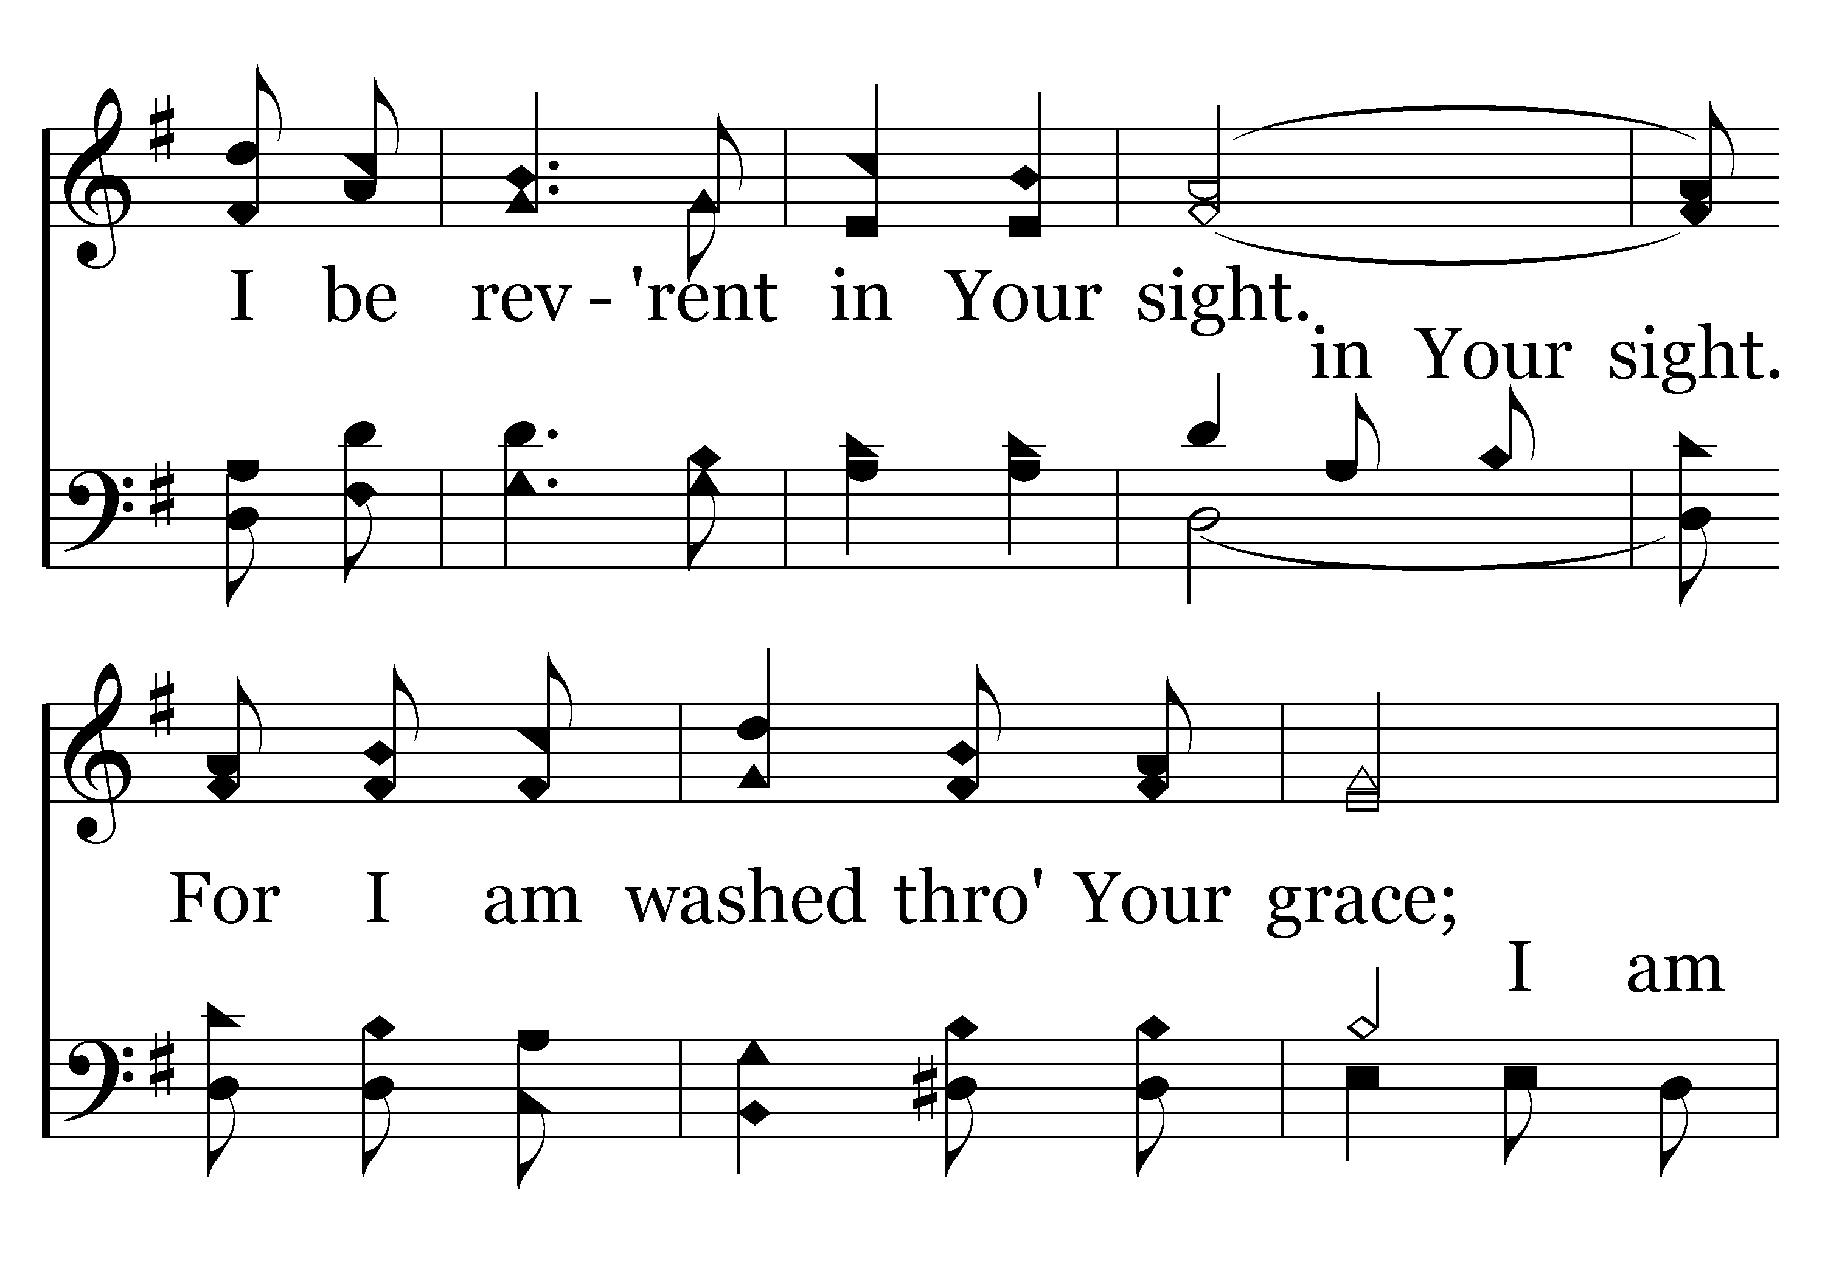
033 - In Your Holy Sight - 3.2

Slide 48
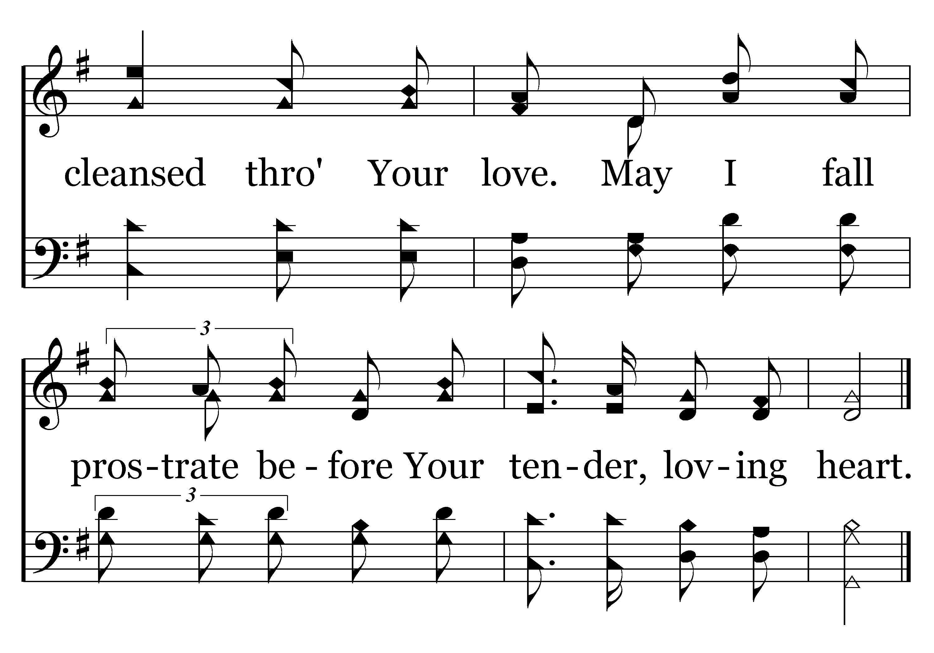
033 - In Your Holy Sight - 3.3
End of Song

Slide 50
Give Attention To:
Listening To Counsel
Proverbs 11:14
Where there is no counsel, the people perish;
But in the multitude of counselors there is safety”

Slide 51
Seeking Good Counselors
Prov. 12:15 “The way of a fool is right in his own eyes, but he who heeds counsel is wise”
Prov. 15:22 “Without counsel, plans go awry, but in the multitude of counselors they are established
Prov. 19:20-21 “Listen to counsel and receive instruction, that you may be wise in your latter days. There are many plans in a man’s heart, but the Lord’s counsel --- that will stand!

Slide 52
Seeking Good Counselors
Prov. 20:5 “Counsel in the heart of man is like deep water, but a man of understanding will draw it out!”
Prov. 24:6 “For by wise counsel you will wage your own war, and in the multitude of counselors there is safety.”
Prov. 27:9 “Ointment and perfume delight the heart, and the sweetness of a man’s friend gives delight by hearty counsel.”

Slide 53
Not Seeking Good Counsel
Joshua 9:14 “Then the men of Israel took some of their (Gibeonites) provisions; but they did not ask counsel of the Lord.”
Deut. 32:28 “For they are a nation void of counsel, nor is there any understanding in them”

Slide 54
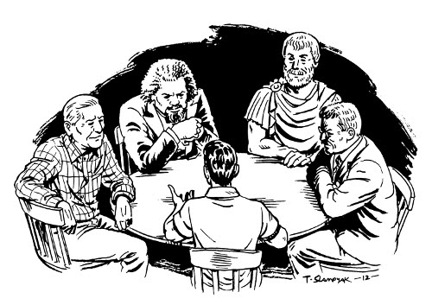
The Cabinet of
Invisible Counselors
Philippians 4:9
The things which you learned and received and heard and saw in me, these do, and the God of peace will be with you.

Slide 55
Napoleon Hill’s
“Cabinet of Invisible Counselors”
Book: “Think And Grow Rich”
Ralph Waldo Emerson
Charles Darwin
Luther Burbank
Teddy Roosevelt
Abraham Lincoln
Napoleon Bonaparte
Thomas Edison
Henry Ford
Thomas Paine
Andrew Carnegie

Slide 56
Napoleon Hill’s
“Cabinet of Invisible Counselors”
Book: “Think And Grow Rich”
Socrates / Plato / Aristotle
Jesus Christ
Apostle Paul
Confucius
Galileo Galilei
Woodrow Wilson
Copernicus
William James
Isaac Newton
Robert Ingersoll

Slide 57
“I regard my Cabinet meetings as being purely imaginary, but I feel entitled to suggest that, while the members of my Cabinet may be purely fictional, and the meetings existent only in my own imagination, they have led me into glorious paths of adventure, rekindled an appreciation of true greatness, encouraged creative endeavor, and emboldened the expression of honest thought.”

Slide 58
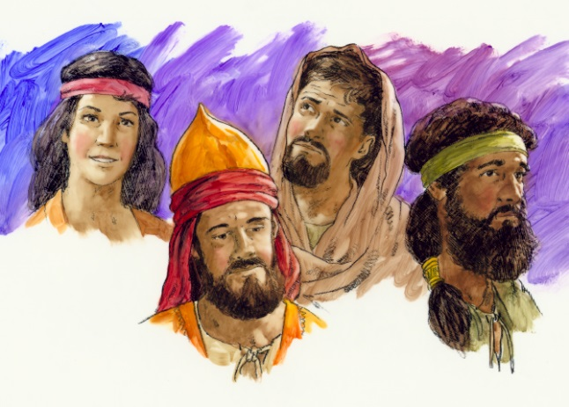
A Christian’s “Cabinet Of
Invisible Counselors”
Noah, Abraham, Job, Joseph, Moses, Joshua, Gideon, David, Elijah, Elisha, Daniel, Jeremiah…
Old Testament Cabinet Picks (Rom. 15:4)
Noah (lead my family in an immoral world)
Hebrews 11:7 (*Gen. 18:19)
By faith Noah, being divinely warned of things not yet seen, moved with godly fear, prepared an ark for the saving of his household, by which he condemned the world and became heir of the righteousness which is according to faith.

Slide 59
A Christian’s “Cabinet Of
Invisible Counselors”
Noah, Abraham, Job, Joseph, Moses, Joshua, Gideon, David, Elijah, Elisha, Daniel, Jeremiah…
Old Testament Cabinet Picks (Rom. 15:4)
Noah (lead my family in an immoral world)
Genesis 7
1 Then the LORD said to Noah, "Come into the ark, you and all your household, because I have seen that you are righteous before Me in this generation.
7 So Noah, with his sons, his wife, and his sons' wives, went into the ark because of the waters of the flood.
13 On the very same day Noah and Noah's sons, Shem, Ham, and Japheth, and Noah's wife and the three wives of his sons with them, entered the ark-

Slide 60
A Christian’s “Cabinet Of
Invisible Counselors”
Noah, Abraham, Job, Joseph, Moses, Joshua, Gideon, David, Elijah, Elisha, Daniel, Jeremiah…
Old Testament
Noah (lead my family in an immoral world)
Job (patience and endurance under unknown trials)
James 5:11 “Indeed we count them blessed who endure. You have heard of the perseverance of Job and seen the end intended by the Lord--that the Lord is very compassionate and merciful.
Ezekiel 14:14, 20 "Even if these three men, Noah, Daniel, and Job, were in it, they would deliver only themselves by their righteousness," says the Lord GOD.

Slide 61
A Christian’s “Cabinet Of
Invisible Counselors”
Noah, Abraham, Job, Joseph, Moses, Joshua, Gideon, David, Elijah, Elisha, Daniel, Jeremiah…
Old Testament
Noah (lead my family in an immoral world)
Job (patience and endurance under unknown trials)
Job 1:1 There was a man in the land of Uz, whose name was Job; and that man was blameless and upright, and one who feared God and shunned evil.
Job 1:8 Then the LORD said to Satan, "Have you considered My servant Job, that there is none like him on the earth, a blameless and upright man, one who fears God and shuns evil?"

Slide 62
A Christian’s “Cabinet Of
Invisible Counselors”
Noah, Abraham, Job, Joseph, Moses, Joshua, Gideon, David, Elijah, Elisha, Daniel, Jeremiah…
Old Testament
Noah (lead my family in an immoral world)
Job (patience and endurance under unknown trials)
Daniel (prayer and purpose for his life)
Ezekiel 14:14, 20 "Even if these three men, Noah, Daniel, and Job, were in it, they woulddeliver only themselves by their righteousness," says the Lord GOD.
Daniel 1:8 “But Daniel purposed in his heart that he would not defile himself with the portion of the king's delicacies, nor with the wine which he drank; therefore he requested of the chief of the eunuchs that he might not defile himself.

Slide 63
A Christian’s “Cabinet Of
Invisible Counselors”
Noah, Abraham, Job, Joseph, Moses, Joshua, Gideon, David, Elijah, Elisha, Daniel, Jeremiah…
Old Testament
Noah (lead my family in an immoral world)
Job (patience and endurance under unknown trials)
Daniel (prayer and purpose for his life)
Daniel 6:10 Now when Daniel knew that the writing was signed, he went home. And in his upper room, with his windows open toward Jerusalem, he knelt down on his knees three times that day, and prayed and gave thanks before his God, as was his custom since early days.

Slide 64
A Christian’s “Cabinet Of
Invisible Counselors”
Noah, Abraham, Job, Joseph, Moses, Joshua, Gideon, David, Elijah, Elisha, Daniel, Jeremiah…
Old Testament
Noah (lead my family in an immoral world)
Job (patience and endurance under unknown trials)
Daniel (prayer and purpose for his life)
Jeremiah (faithful to the call to preach “out of season”)
Jeremiah 1:4-5 “Then the word of the LORD came to me, saying: "Before I formed you in the womb I knew you; Before you were born I sanctified you; I ordained you a prophet to the nations."

Slide 65
A Christian’s “Cabinet Of
Invisible Counselors”
Noah, Abraham, Job, Joseph, Moses, Joshua, Gideon, David, Elijah, Elisha, Daniel, Jeremiah…
Old Testament
Noah (lead my family in an immoral world)
Job (patience and endurance under unknown trials)
Daniel (prayer and purpose for his life)
Jeremiah (faithful to the call to preach “out of season”)
Jeremiah 9:1 Oh, that my head were waters, And my eyes a fountain of tears, That I might weep day and night For the slain of the daughter of my people! 2 Oh, that I had in the wilderness A lodging place for travelers; That I might leave my people, And go from them! For they are all adulterers, An assembly of treacherous men.

Slide 66
A Christian’s “Cabinet Of
Invisible Counselors”
Noah, Abraham, Job, Joseph, Moses, Joshua, Gideon, David, Elijah, Elisha, Daniel, Jeremiah…
Old Testament
Noah (lead my family in an immoral world)
Job (patience and endurance under unknown trials)
Daniel (prayer and purpose for his life)
Jeremiah (faithful to the call to preach “out of season”)
Jeremiah 20:9 Then I said, "I will not make mention of Him, Nor speak anymore in His name." But His word was in my heart like a burning fire, shut up in my bones; I was weary of holding it back, And I could not.

Slide 67
A Christian’s “Cabinet Of
Invisible Counselors”
John the Baptist, Peter, John, Paul, Barnabas, Timothy, Luke, Nicodemus, Mary (Joseph), Stephen
New Testament Picks (Phil. 4:9)
Peter (leadership and forgiveness)
Matt. 15:15-16 “Then Peter answered and said to Him, "Explain this parable to us.” So Jesus said, "Are you also still without understanding?
Matt. 18:21-22 Then Peter came to Him and said, "Lord, how often shall my brother sin against me, and I forgive him? Up to seven times?“ Jesus said to him, "I do not say to you, up to seven times, but up to seventy times seven.

Slide 68
A Christian’s “Cabinet Of
Invisible Counselors”
John the Baptist, Peter, John, Paul, Barnabas, Timothy, Luke, Nicodemus, Mary (Joseph), Stephen
New Testament Picks (Phil. 4:9)
Peter (leadership and forgiveness)
Matt. 19:27-28 Then Peter answered and said to Him, "See, we have left all and followed You. Therefore what shall we have?” So Jesus said to them, "Assuredly I say to you, that in the regeneration, when the Son of Man sits on the throne of His glory, you who have followed Me will also sit on twelve thrones, judging the twelve tribes of Israel.

Slide 69
A Christian’s “Cabinet Of
Invisible Counselors”
John the Baptist, Peter, John, Paul, Barnabas, Timothy, Luke, Nicodemus, Mary (Joseph), Stephen
New Testament
Peter (leadership and forgiveness)
Matt 26:31 Then Jesus said to them, "All of you will be made to stumble because of Me this night, … 33 Peter answered and said to Him, "Even if all are made to stumble because of You, I will never be made to stumble." Jesus said to him, "Assuredly, I say to you that this night, before the rooster crows, you will deny Me three times."
John 21:15 So when they had eaten breakfast, Jesus said to Simon Peter, "Simon, son of Jonah, do you love Me more than these?" He said to Him, "Yes, Lord; You know that I love You." He said to him, "Feed My lambs."

Slide 70
A Christian’s “Cabinet Of
Invisible Counselors”
John the Baptist, Peter, John, Paul, Barnabas, Timothy, Luke, Nicodemus, Mary (Joseph), Stephen
New Testament
Peter
John (intimacy with Christ and endurance over decades)
John 13:23 Now there was leaning on Jesus' bosom one of His disciples, whom Jesus loved.
John 19:26 When Jesus therefore saw His mother, and the disciple whom He loved standing by, He said to His mother, "Woman, behold your son!"
Matt 17:1 Now after six days Jesus took Peter, James, and John his brother, led them up on a high mountain by themselves;

Slide 71
A Christian’s “Cabinet Of
Invisible Counselors”
John the Baptist, Peter, John, Paul, Barnabas, Timothy, Luke, Nicodemus, Mary (Joseph), Stephen
New Testament
Peter
John (intimacy with Christ and endurance over decades)
Mark 5:37 And He permitted no one to follow Him except Peter, James, and John the brother of James.
Mark 14:33 And He took Peter, James, and John with Him, and He began to be troubled and deeply distressed.

Slide 72
A Christian’s “Cabinet Of
Invisible Counselors”
John the Baptist, Peter, John, Paul, Barnabas, Timothy, Luke, Nicodemus, Mary (Joseph), Stephen
New Testament
Peter
John (intimacy with Christ and endurance over decades)
1 John 1:1 That which was from the beginning, which we have heard, which we have seen with our eyes, which we have looked upon, and our hands have handled, concerning the Word of life-- … 4 And these things we write to you that your joy may be full.
Revel. 1:9 I, John, both your brother and companion in the tribulation and kingdom and patience of Jesus Christ, was on the island that is called Patmos for the word of God and for the testimony of Jesus Christ.

Slide 73
A Christian’s “Cabinet Of
Invisible Counselors”
John the Baptist, Peter, John, Paul, Barnabas, Timothy, Luke, Nicodemus, Mary (Joseph), Stephen
New Testament Cabinet Picks
Peter
John
Paul (passion for Christ & souls throughout life of hardship)
Philippians 3:7-11 But what things were gain to me, these I have counted loss for Christ. Yet indeed I also count all things loss for the excellence of the knowledge of Christ Jesus my Lord, for whom I have suffered the loss of all things, and count them as rubbish, that I may gain Christ, and be found in Him, not having my own righteousness, which is from the law, but that which is through faith in Christ, the righteousness which is from God by faith; that I may know Him and the power of His resurrection, and the fellowship of His sufferings, being conformed to His death, if, by any means, I may attain to the resurrection from the dead.

Slide 74
A Christian’s “Cabinet Of
Invisible Counselors”
John the Baptist, Peter, John, Paul, Barnabas, Timothy, Luke, Nicodemus, Mary (Joseph), Stephen
New Testament Cabinet Picks
Peter
John
Paul (passion for Christ & souls throughout life of hardship)
1 Corinthians 9:19-22 For though I am free from all men, I have made myself a servant to all, that I might win the more; and to the Jews I became as a Jew, that I might win Jews; to those who are under the law, as under the law, that I might win those who are under the law; to those who are without law, as without law (not being without law toward God, but under law toward Christ), that I might win those who are without law; to the weak I became as weak, that I might win the weak. I have become all things to all men, that I might by all means save some.

Slide 75
A Christian’s “Cabinet Of
Invisible Counselors”
John the Baptist, Peter, John, Paul, Barnabas, Timothy, Luke, Nicodemus, Mary (Joseph), Stephen
New Testament Cabinet Picks
Peter
John
Paul
Barnabas (encourager and mentor of men)
Acts 4:36 And Joses, who was also named Barnabas by the apostles (which is translated Son of Encouragement), a Levite of the country of Cyprus,

Slide 76
A Christian’s “Cabinet Of
Invisible Counselors”
John the Baptist, Peter, John, Paul, Barnabas, Timothy, Luke, Nicodemus, Mary (Joseph), Stephen
New Testament Cabinet Picks
Peter
John
Paul
Barnabas (encourager and mentor of men)
Acts 11:22 Then news of these things came to the ears of the church in Jerusalem, and they sent out Barnabas to go as far as Antioch. 23 When he came and had seen the grace of God, he was glad, and encouraged them all that with purpose of heart they should continue with the Lord. 24 For he was a good man, full of the Holy Spirit and of faith. And a great many people were added to the Lord.

Slide 77
My Cabinet of
Invisible Counselors
Noah
Job
Daniel
Jeremiah
Peter
John
Paul
Barnabas

Slide 78
GOD’S IMMUTABLE COUNSEL
Hebrews 6:17-19
“Thus God, determining to show more abundantly to the heirs of promise the immutability of His counsel, confirmed it by an oath, that by two immutable things, in which it is impossible for God to lie, we might have strong consolation, who have fled for refuge to lay hold of the hope set before us. This hope we have as an anchor of the soul, both sure and steadfast, and which enters the Presence behind the veil, where the forerunner has entered for us, even Jesus, having become High Priest forever according to the order of Melchizedek.”

Slide 79

115 - Healing In Its Wings - Title

Slide 80
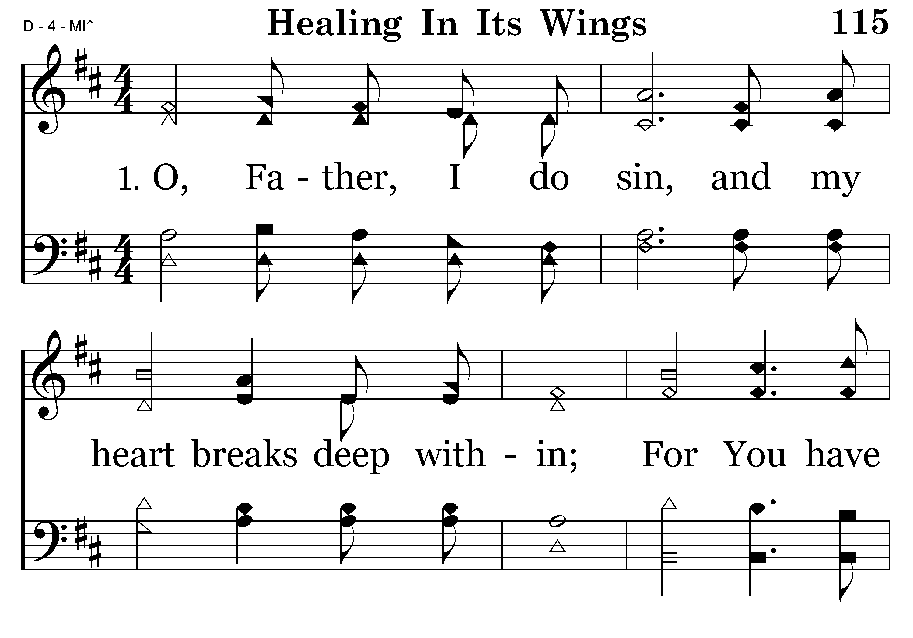
115 - Healing In Its Wings - 1.1

Slide 81
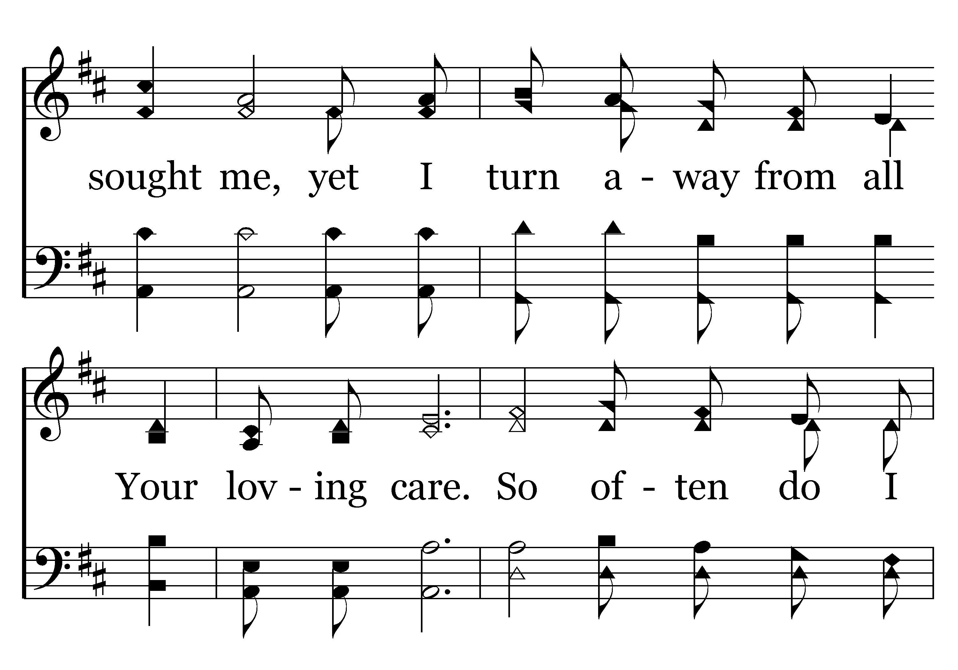
115 - Healing In Its Wings - 1.2

Slide 82
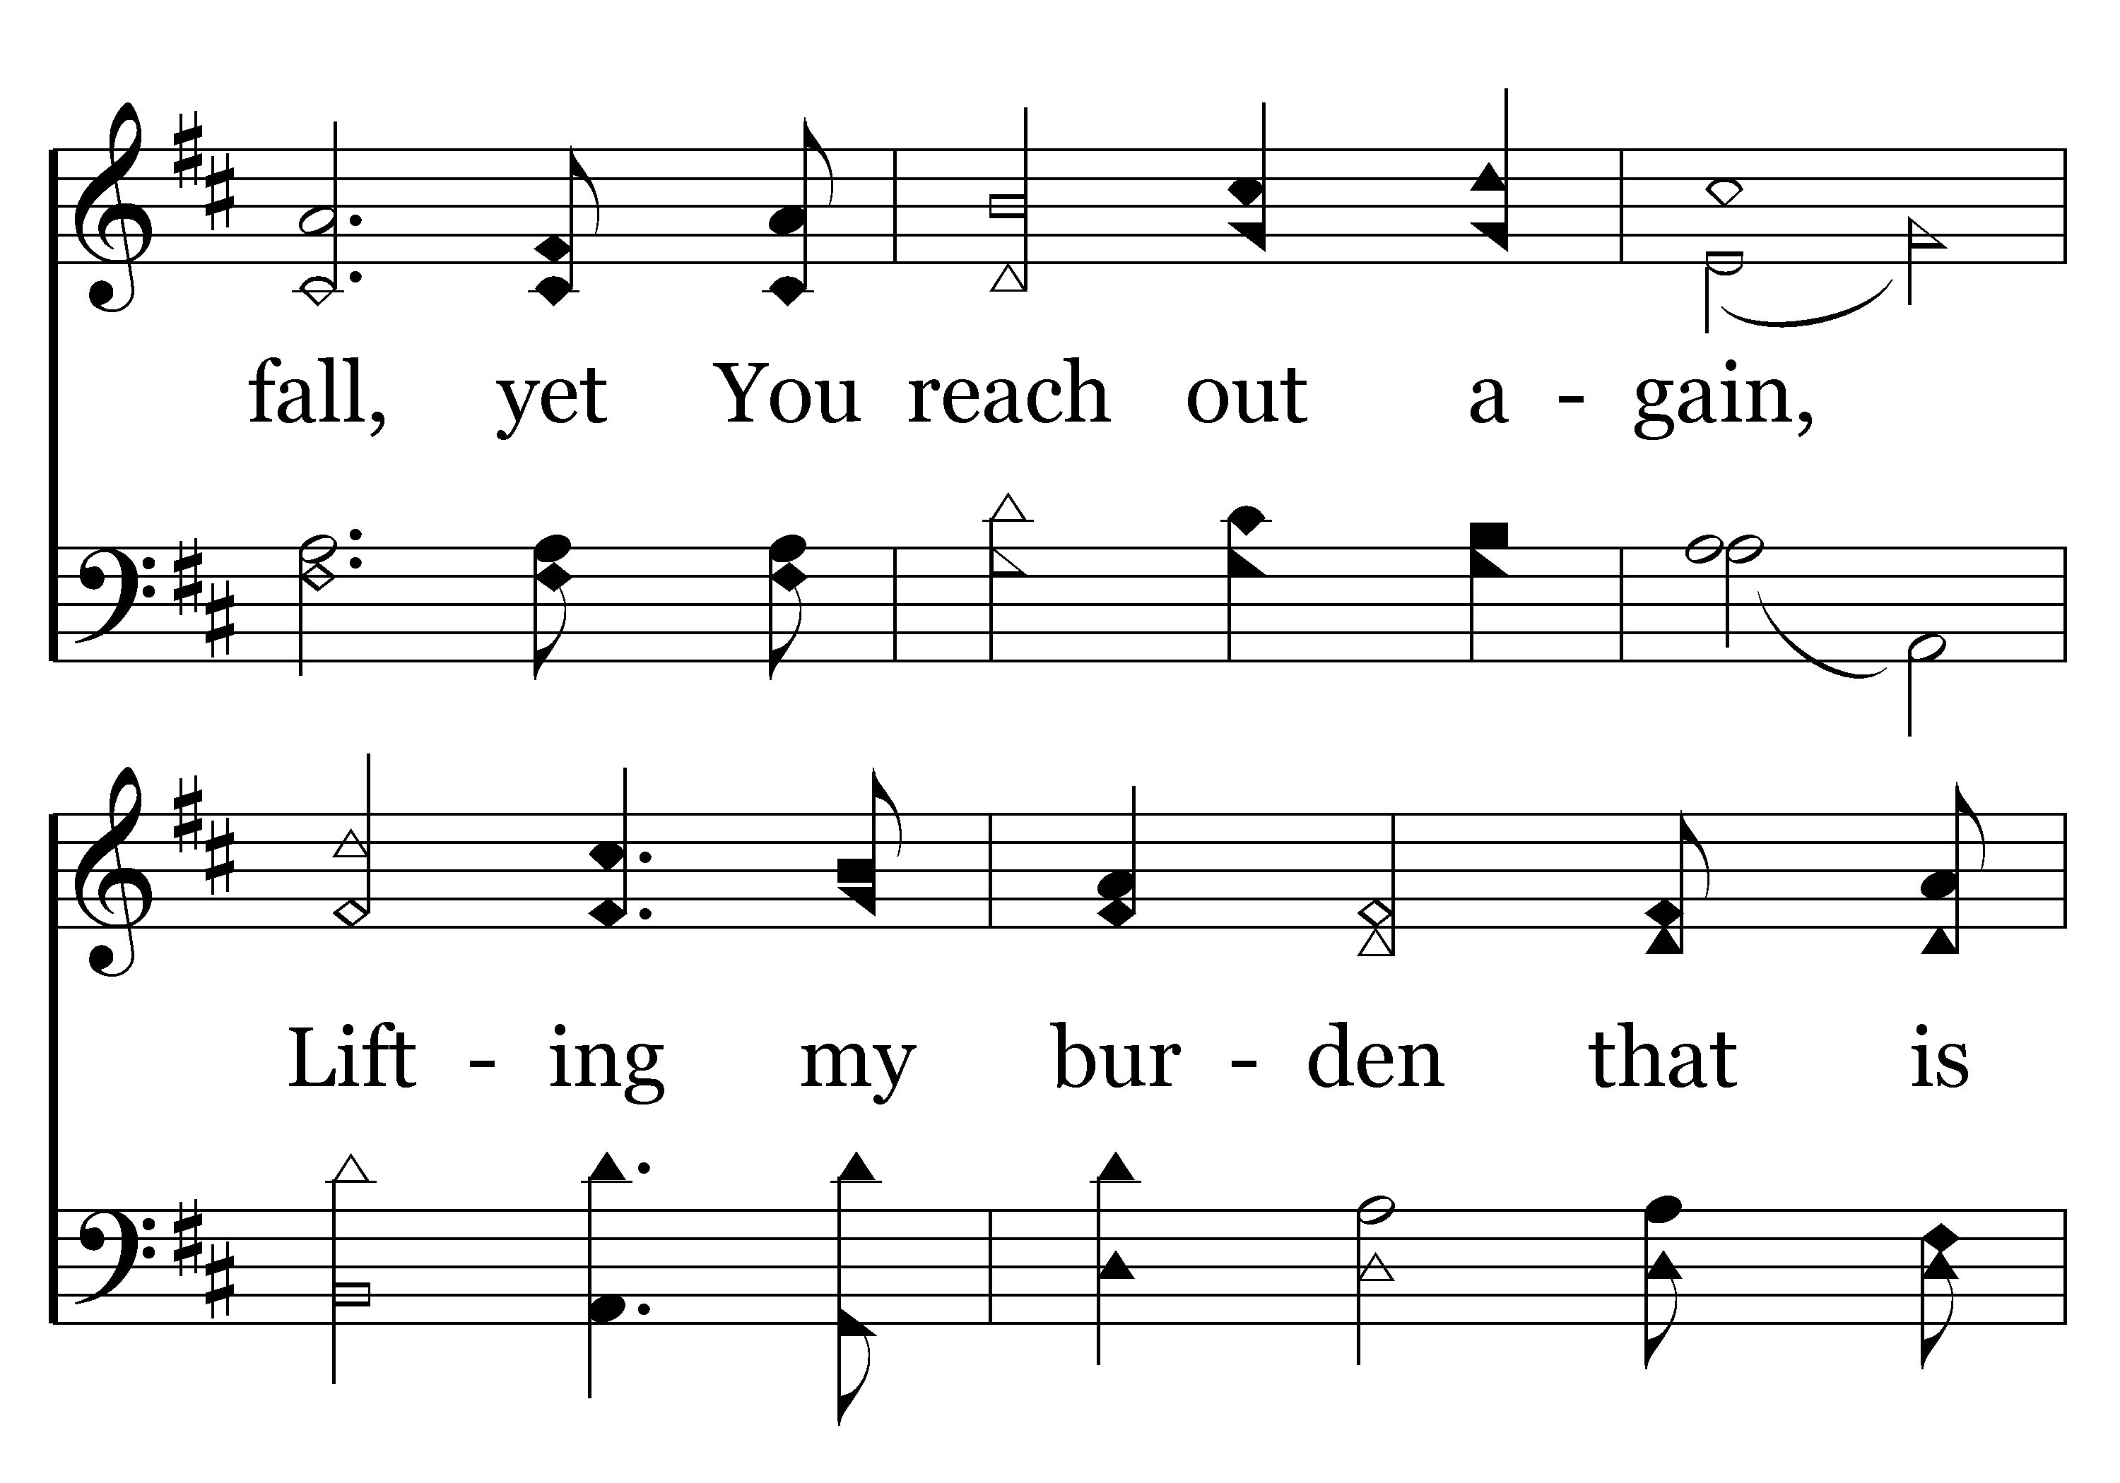
115 - Healing In Its Wings - 1.3

Slide 83
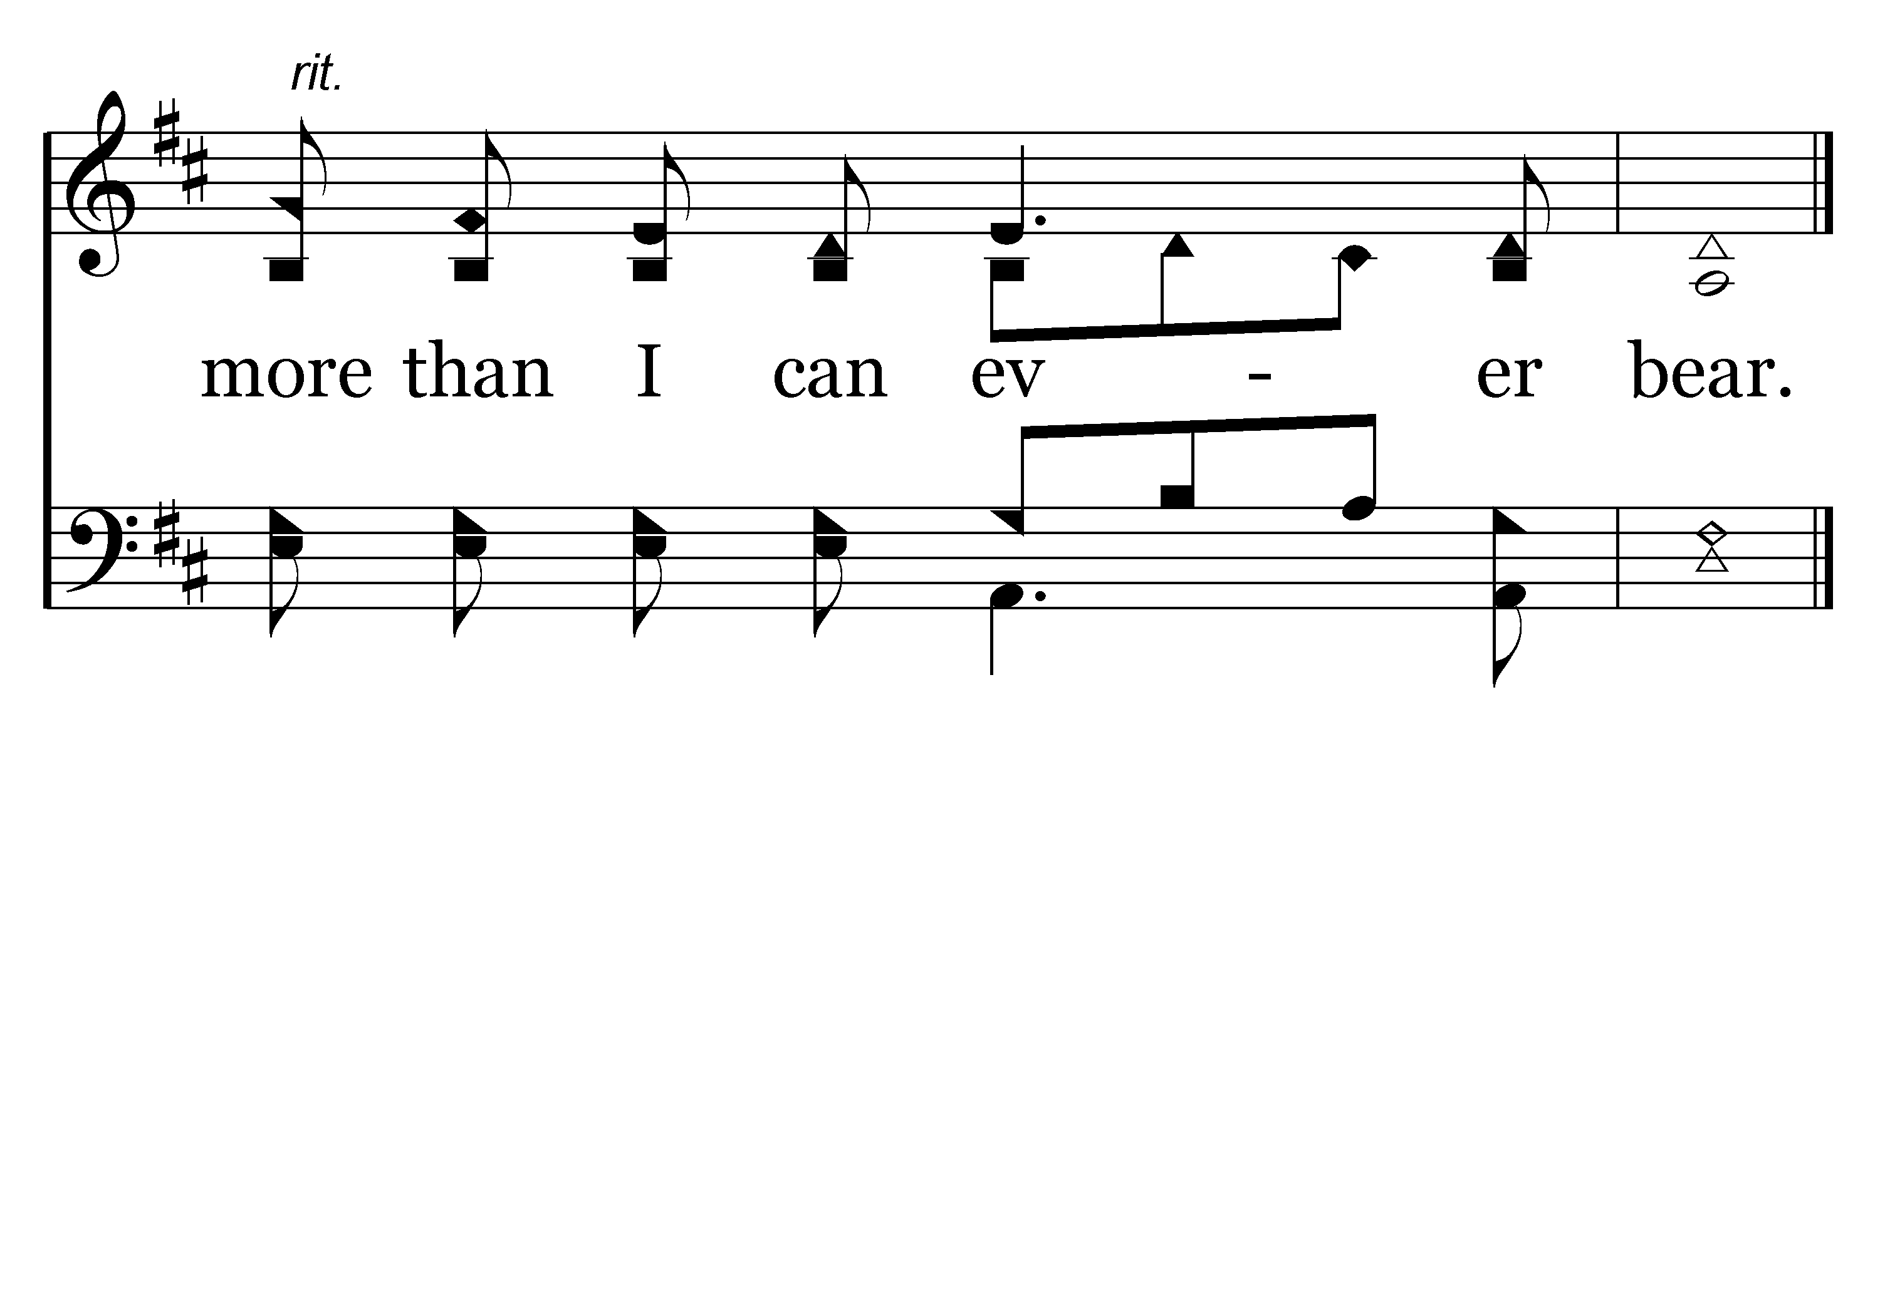
115 - Healing In Its Wings - 1.4
End of Verse 1

Slide 84
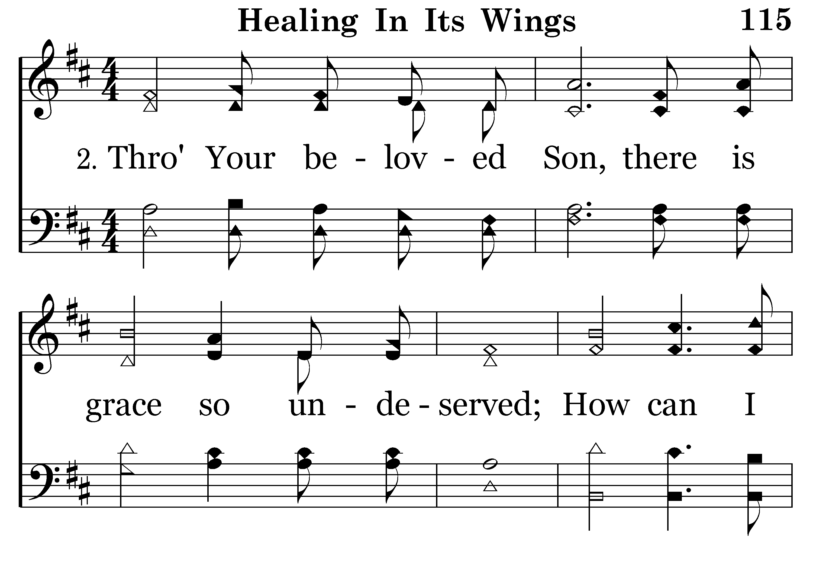
115 - Healing In Its Wings - 2.1

Slide 85
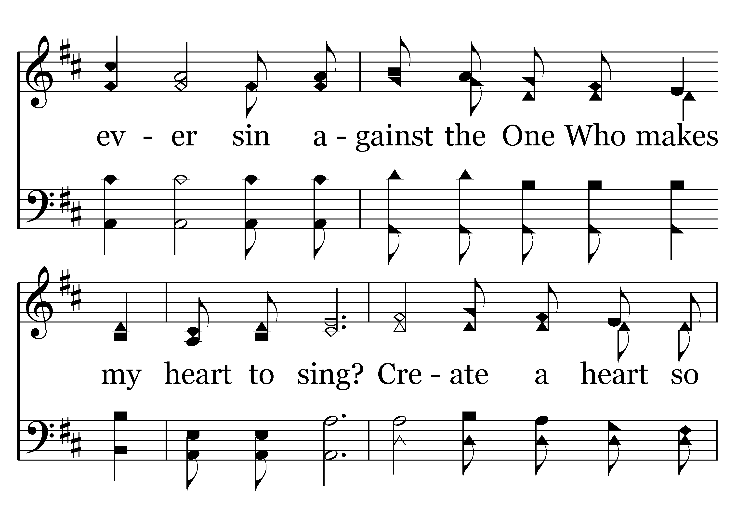
115 - Healing In Its Wings - 2.2

Slide 86
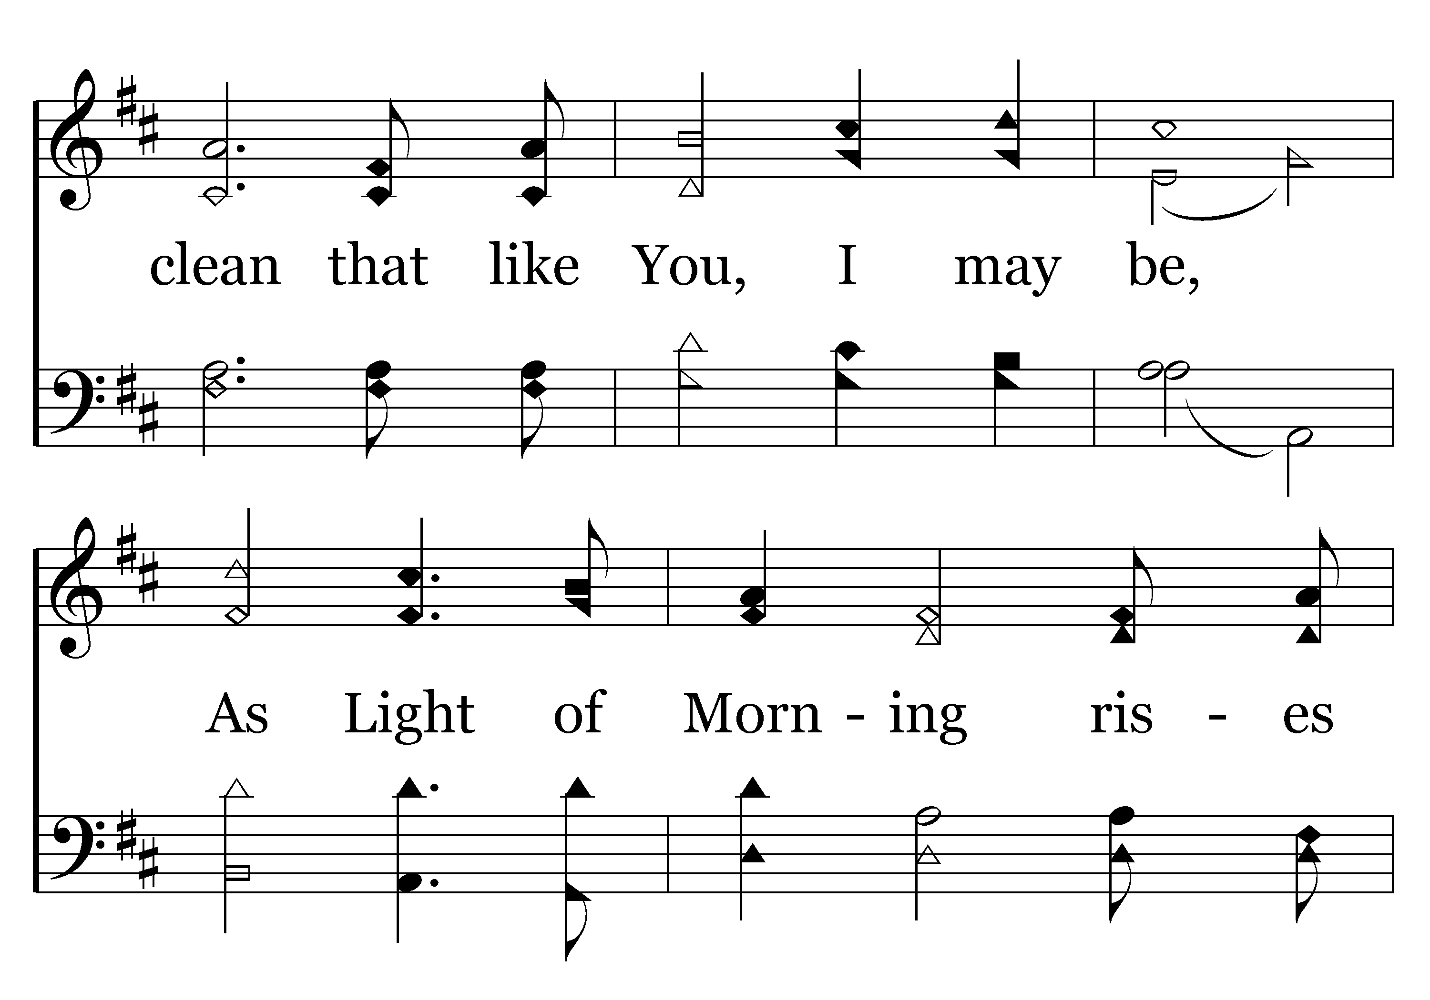
115 - Healing In Its Wings - 2.3

Slide 87
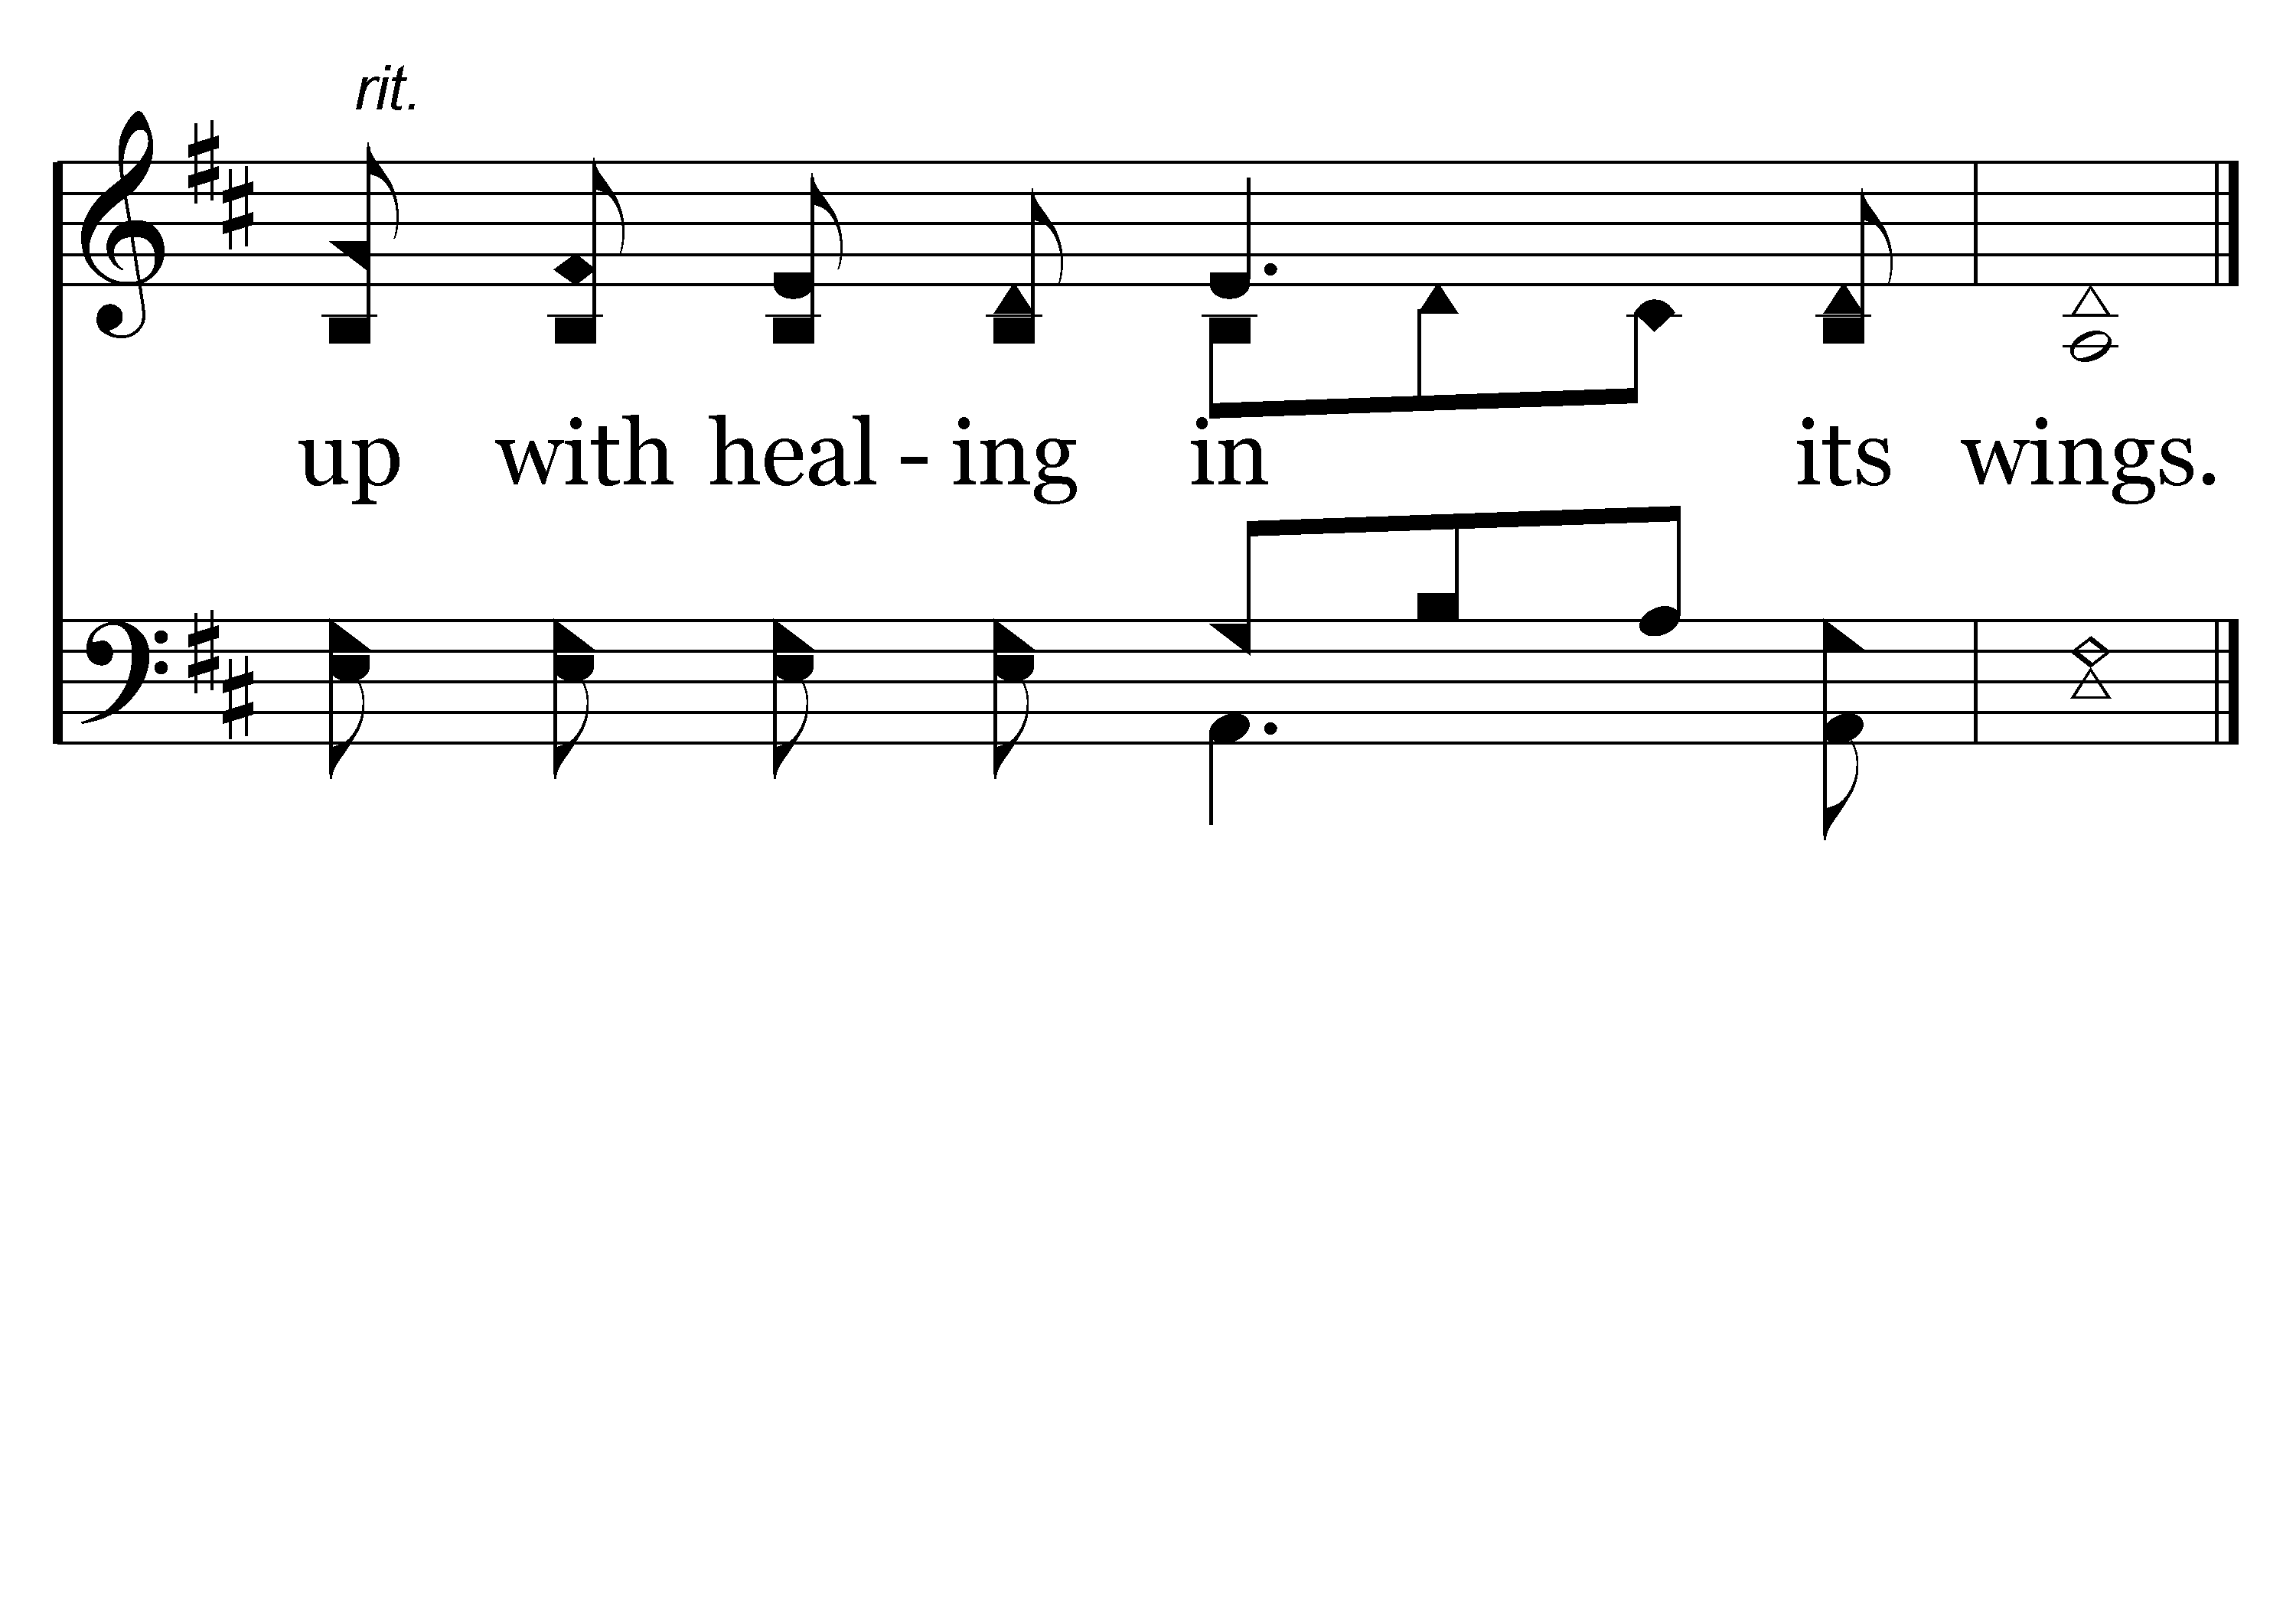
115 - Healing In Its Wings - 2.4
End of Verse 2

Slide 88
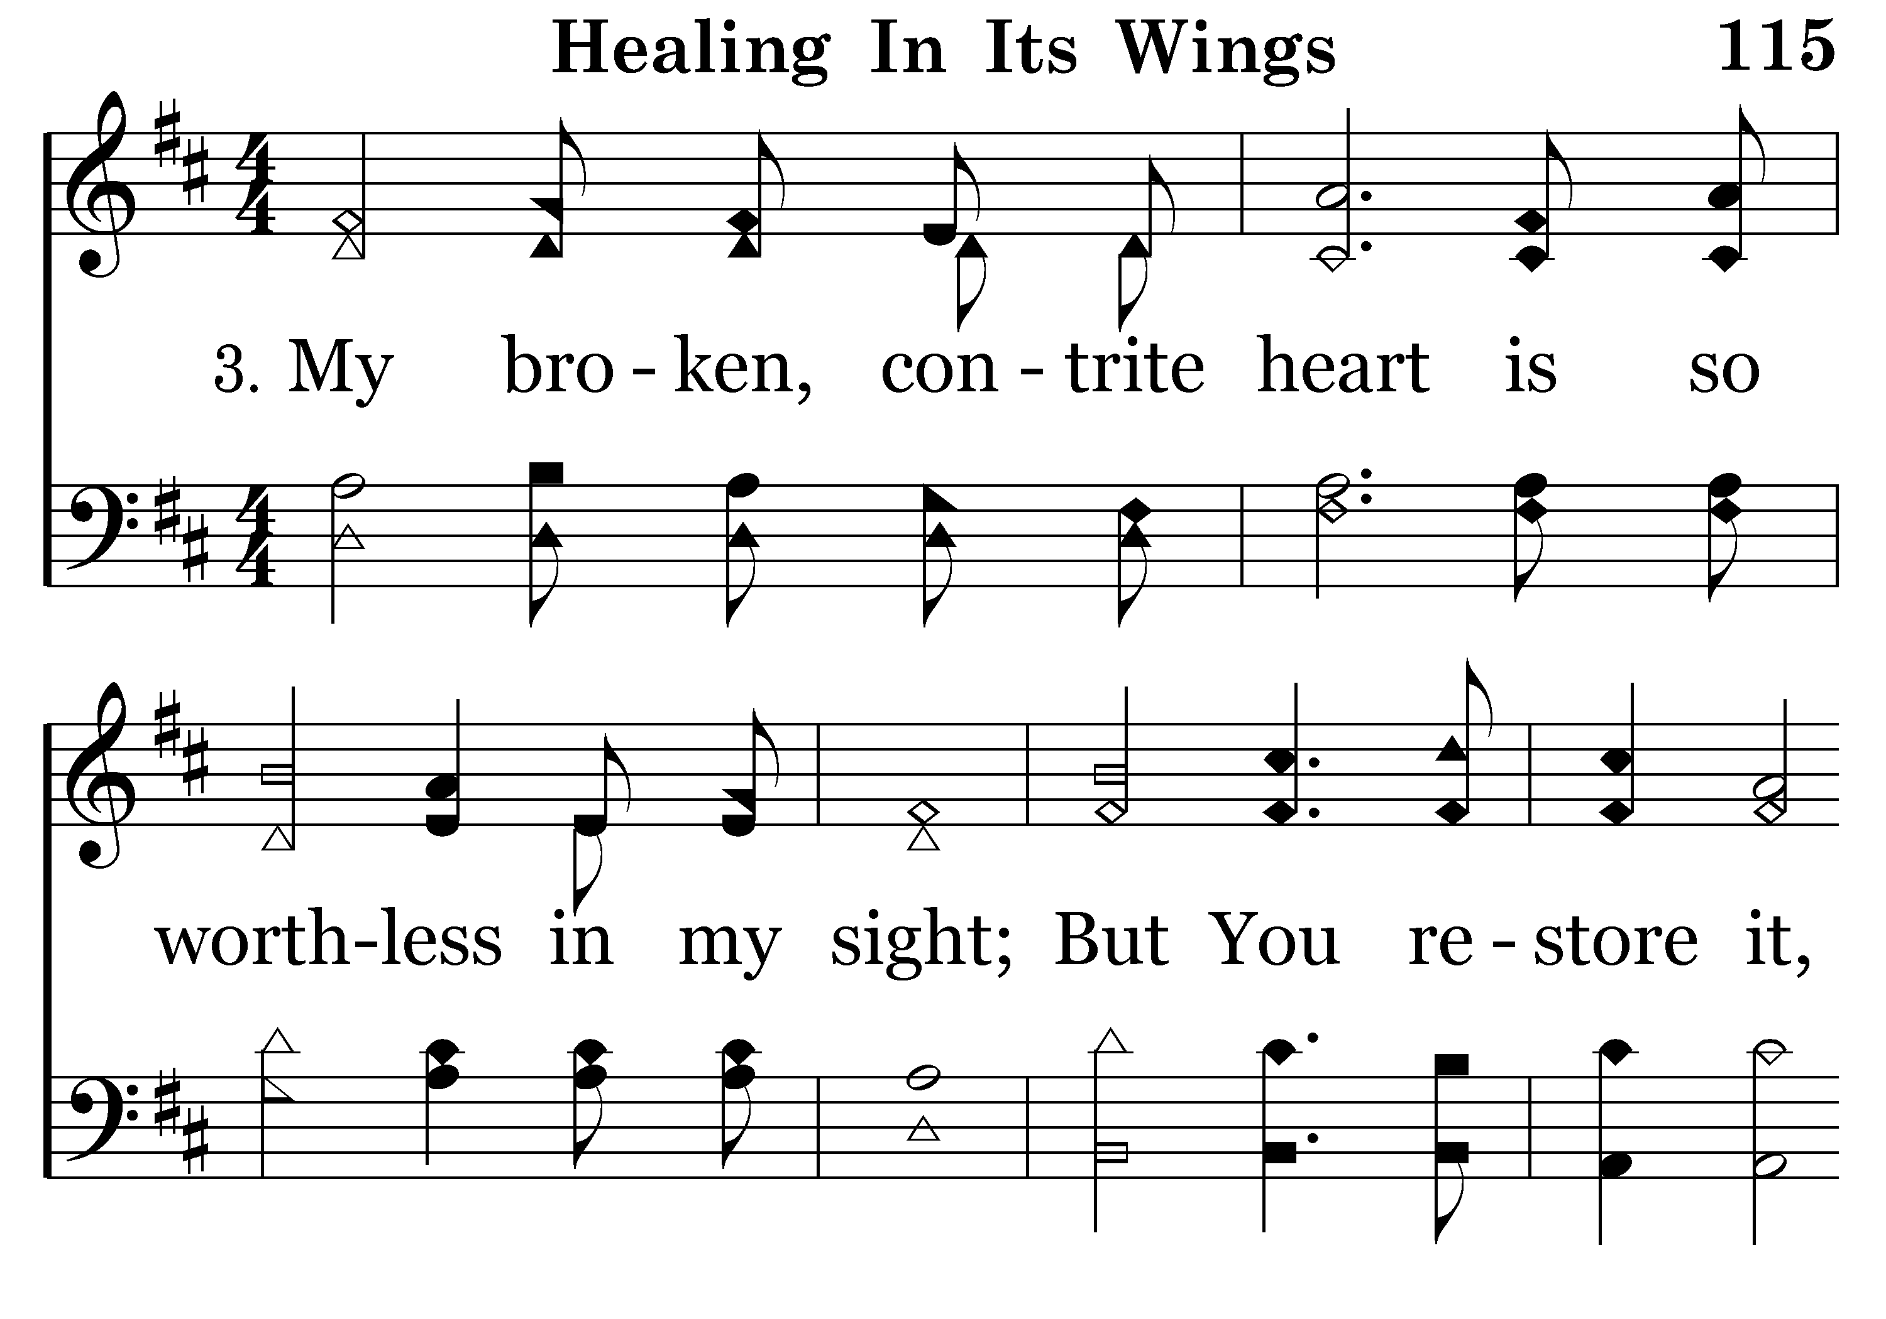
115 - Healing In Its Wings - 3.1

Slide 89
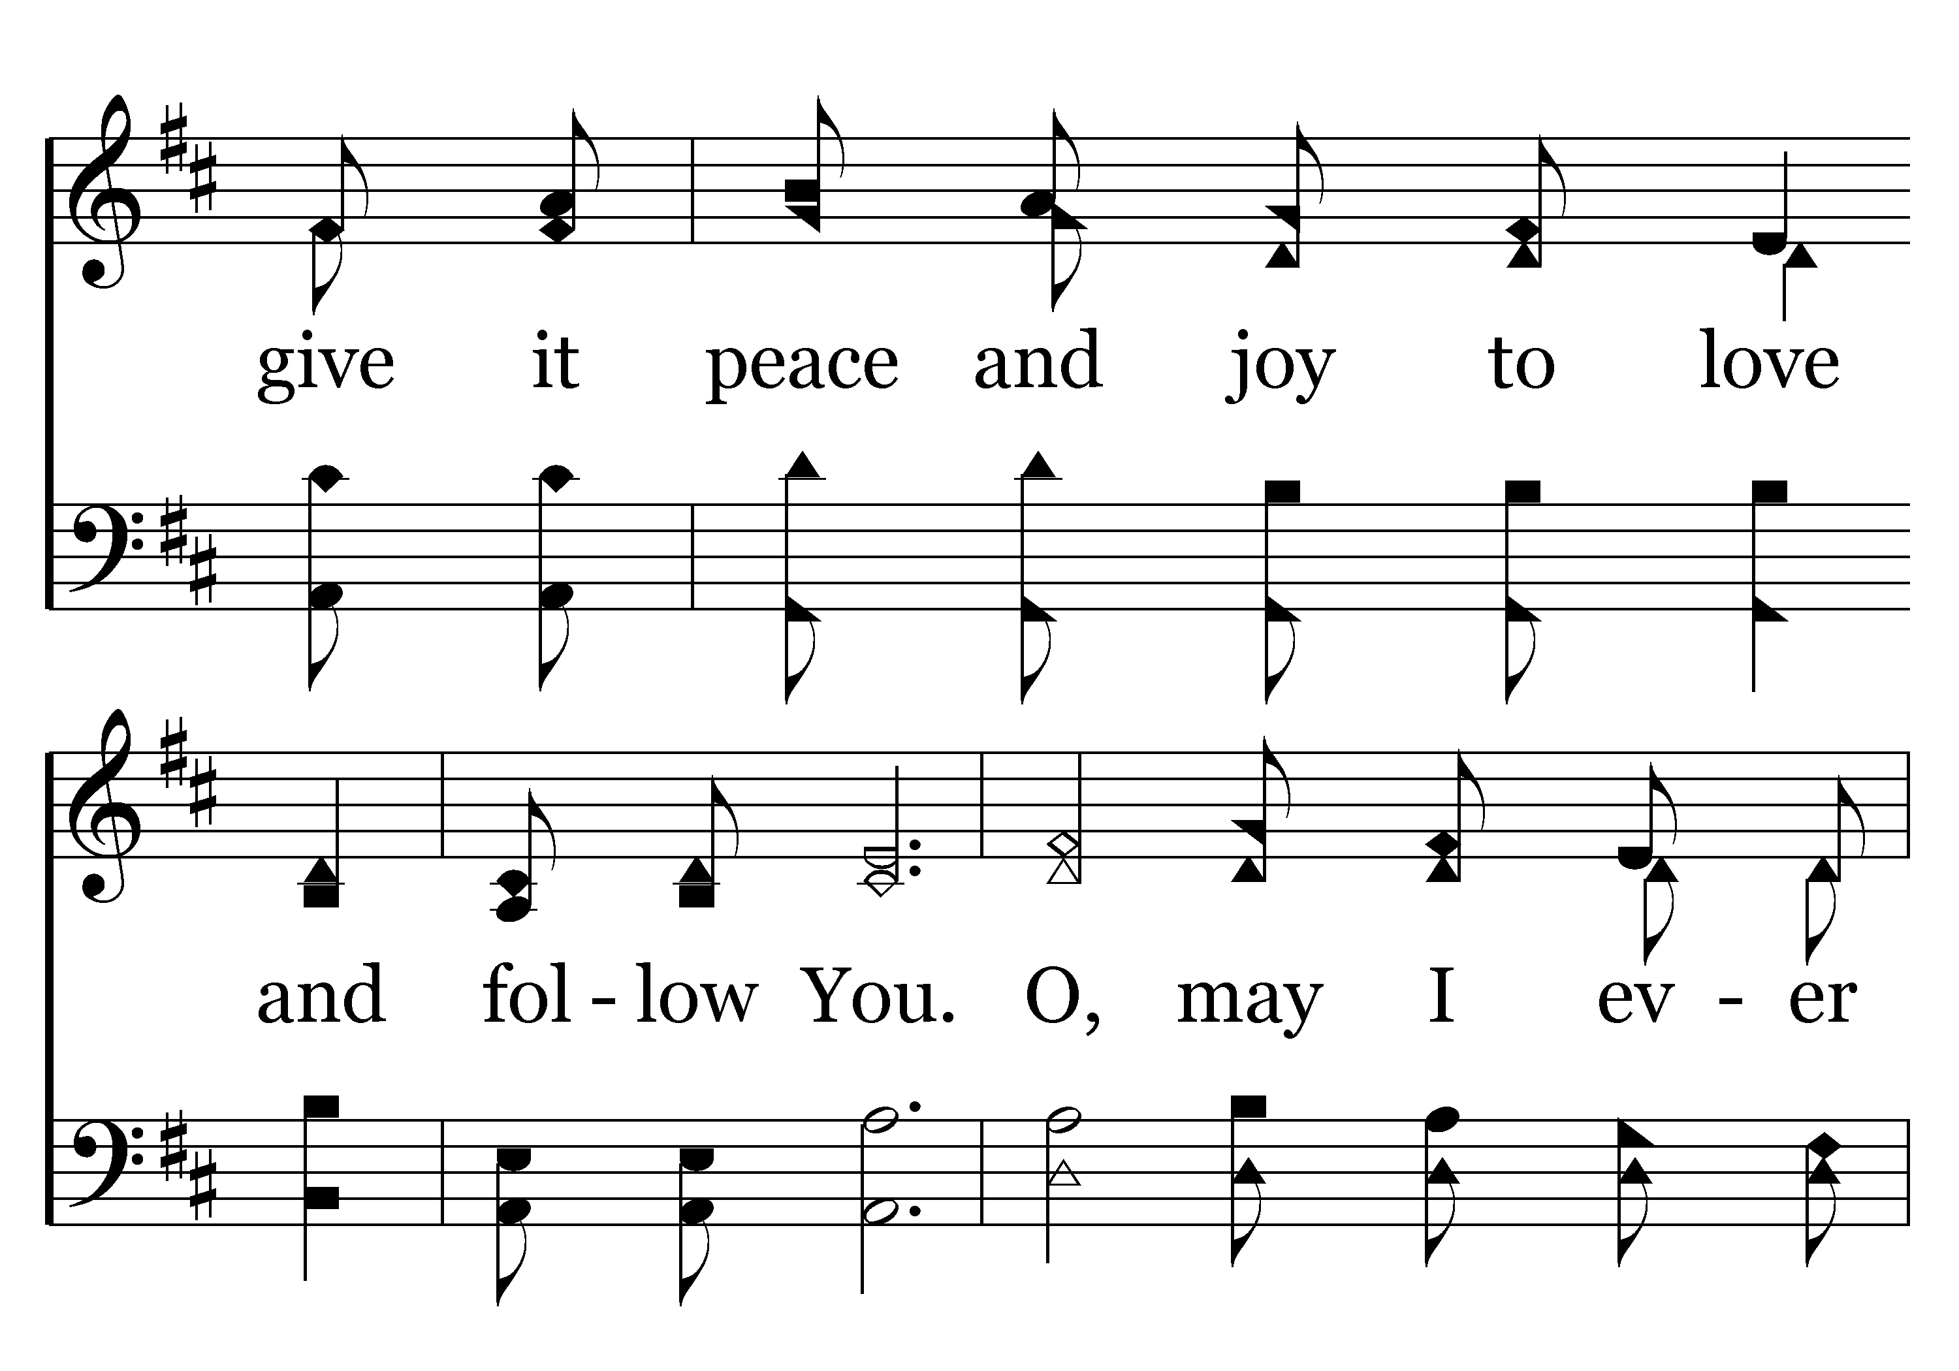
115 - Healing In Its Wings - 3.2

Slide 90
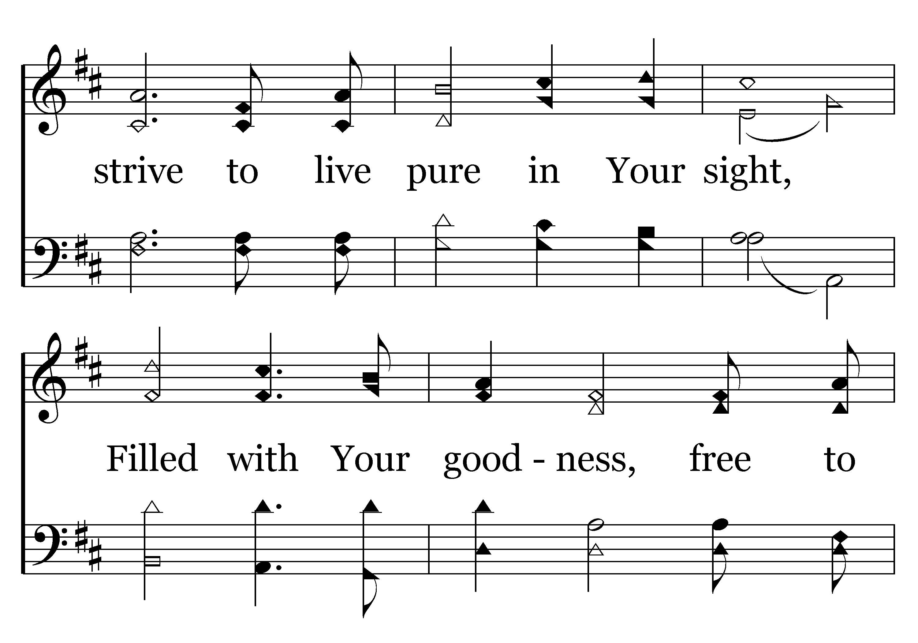
115 - Healing In Its Wings - 3.3

Slide 91

115 - Healing In Its Wings - 3.4
End of Song

