Slide 1
ARTIFACTS THAT MATTER

Slide 2
Purpose of this series
Support the Bible
Real places
Real people
Real events
Accurate descriptions
Better understand the Bible
To understand that more knowledge of history enriches our understanding of the Bible.

Slide 4
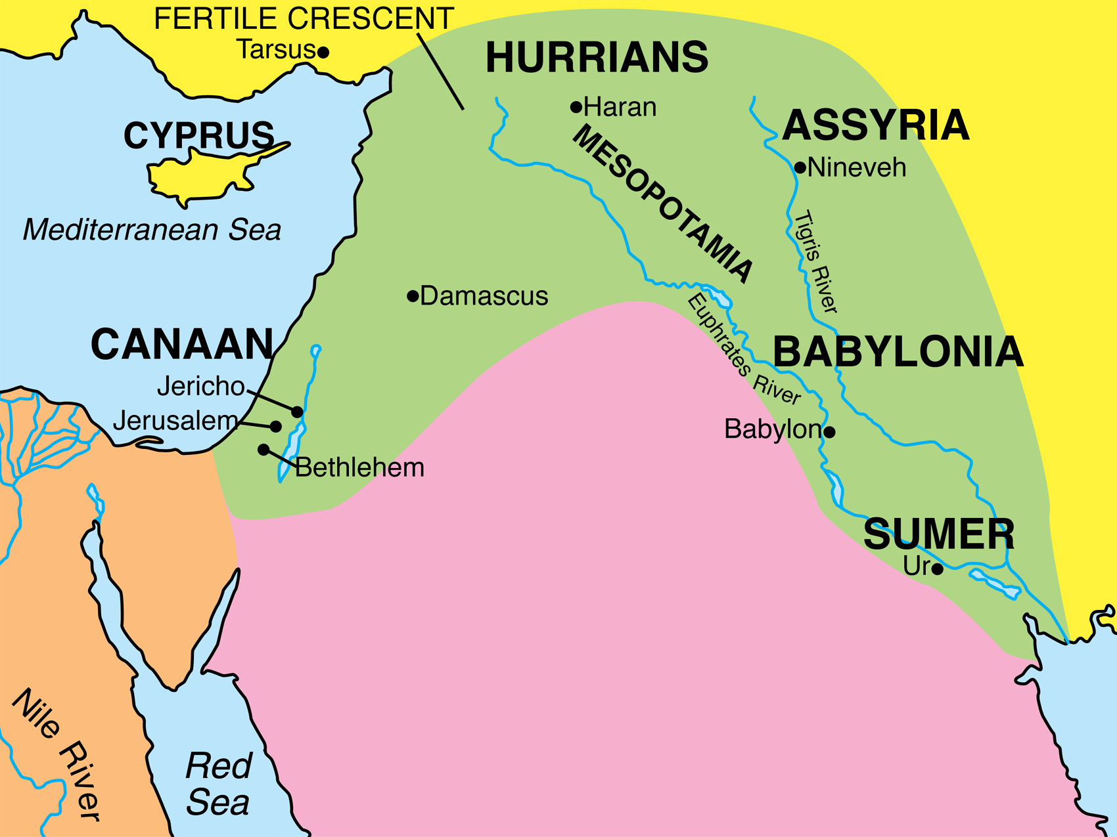

Slide 7
Notes:
The standard of Ur. From Abraham’s time period

Slide 8
Notes:
Playing the lyre. This predates Abraham.

Slide 9
Notes:
Queen’s lyre from Ur. Predates Abraham, but typical of his time.

Slide 10
Notes:
Silver lyre. Nobs in foreground our original. This predates Abraham but is typical of the lyres of his time.

Slide 11
Genesis 31:26-27
26 Then Laban said to Jacob, “What have you done by deceiving me and carrying away my daughters like captives of the sword?
27 “Why did you flee secretly and deceive me, and did not tell me so that I might have sent you away with joy and with songs, with timbrel and with lyre;

Slide 13
Notes:
Dagger from Ur. Also predates Abraham. Few thought such intricate designs were possible in ancient times until this dagger was discovered. This might have been ceremonial.

Slide 14
Genesis 14:14-16
14 When Abram heard that his relative had been taken captive, he led out his trained men, born in his house, three hundred and eighteen, and went in pursuit as far as Dan.
15 He divided his forces against them by night, he and his servants, and defeated them, and pursued them as far as Hobah, which is north of Damascus.
16 He brought back all the goods, and also brought back his relative Lot with his possessions, and also the women, and the people.

Slide 21
"This is ________, the royal steward. There is no silver or gold here, only _________ and the bones of his maidservant with him. Cursed be the man who opens this."

Slide 22
Isaiah 22:15-19
15 Thus says the Lord GOD of hosts,
“Come, go to this steward,
To Shebna, who is in charge of the royal household,
16 ‘What right do you have here,
And whom do you have here,
That you have hewn a tomb for yourself here,
You who hew a tomb on the height,
You who carve a resting place for yourself in the rock?
‘Behold, the LORD is about to hurl you headlong, O
man.
And He is about to grasp you firmly
18 And roll you tightly like a ball,
To be cast into a vast country;
There you will die
And there your splendid chariots will be,
You shame of your master’s house.’
19 “I will depose you from your office,
And I will pull you down from your station.
Notes:
What I didn’t get a picture of was a seal that was also in this museum room that mentions Sheba by name.

Slide 23
Notes:
Phoenician ivory. Woman at the window (reminds of Jezebel and her death, pushed from a window). Ahab’s kingdom had similar ivory during his time (a sign of excess and splendor). Remember, Jezebel was from Phoenicia / Sidonian (I Kings 16:31)

Slide 24
Notes:
Inlaid ivory. Ivory plated with gold among other things.

Slide 25
Notes:
Ivory from Samaria. Perhaps Ahab’s palace. Part of the ivory furniture Ahab’s kingdom was famous for.

Slide 26
Now the rest of the acts of Ahab and all that he did and the ivory house which he built and all the cities which he built, are they not written in the Book of the Chronicles of the Kings of Israel?
I Kings 22:39

Slide 27
“I will also smite the winter house together with the summer house;
The houses of ivory will also perish
And the great houses will come to an end,”
Declares the LORD.
Amos 3:15

Slide 28
Amos 6:4-7
4 Those who recline on beds of ivory
And sprawl on their couches,
And eat lambs from the flock
And calves from the midst of the stall,
5 Who improvise to the sound of the harp,
And like David have composed songs for
themselves,
6 Who drink wine from sacrificial bowls
While they anoint themselves with the finest of
oils,
Yet they have not grieved over the ruin of
Joseph.
Therefore, they will now go into exile at the
head of the exiles,
And the sprawlers’ banqueting will pass away.

Slide 29
Notes:
Divided kingdom time period arrows and spearheads from Lachish (Major city in Judah)

Slide 31
Pottery pieces with scribbled messages found in Lachish

Slide 32
Jeremiah 34:6-7
6 Then Jeremiah the prophet spoke all these words to Zedekiah king of Judah in Jerusalem
7 when the army of the king of Babylon was fighting against Jerusalem and against all the remaining cities of Judah, that is, Lachish and Azekah, for they alone remained as fortified cities among the cities of Judah.

Slide 33
“We are watching for the beacon from Lachish, following the signals you, sir, gave, but we do not see Azekah.”

Slide 34
“May Yahweh cause my lord to hear news of peace, even now, even now.”
Notes:
Mentions Yahweh on the second line on the right. This is a scribbled note as Jerusalem is about to fall.

Slide 35
“Not everyone who says to Me, ‘Lord, Lord,’ will enter the kingdom of heaven, but he who does the will of My Father who is in heaven will enter.
Matthew 7:21

