Slide 1
A SUCCESSFUL SPIRITUAL HERITAGE
Pleasing God
For
Generations To Come

Slide 2
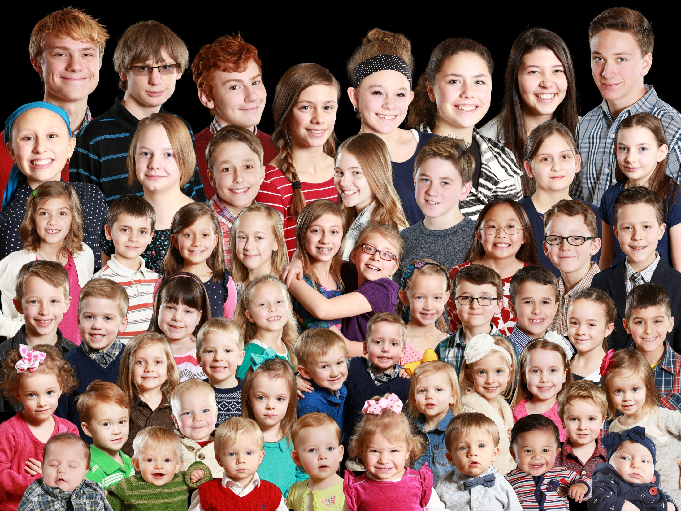

Slide 3
A HERITAGE OF SPIRITUAL SUCCESS
Deuteronomy 6:2
You (1st generation)
Your children (2nd generation)
Your grandchildren (3rd generation)

Slide 4
LOVE GOD
Deuteronomy 6:4-5
One God
Complete focus and affection
Mark 12:28-30 – the greatest command is the best place to start

Slide 5
TEACH OBEDIENCE
Deuteronomy 6:2
Explain why…
  What God has done for us (Deut. 6:20-23)
  Because God has commanded it (Deut. 6:24)
  It is for our good (Deut. 6:3,24)
  It is a test of our hearts (Deut. 8:2)

Slide 6
SCRIPTURE EVERYWHERE
In your heart (Deut. 6:6)
  Unwavering respect for God’s word
  Internal knowledge of God’s word
In your conversation (Deut. 6:7)
On your body (Deut. 6:8)… Mt. 23:5
On your homes (Deut. 6:9)
(Col. 3:16; Mt. 4:1-10)

Slide 7
BE SEPARATE
Deuteronomy 7:1-6
Compare verse 6 to Titus 2:14; II Cor. 6:14-18
Don’t fear them (Deut. 7:17-21)
Israel’s great failure
  Judges 1:16-36 – didn’t remove
  Judges 2:10 – next generation didn’t know
  Judges 2:20-3:6 – other nations left to test God’s people. Israel gets closer to them and farther from God.

Slide 8
A SUCCESSFUL
SPIRITUAL HERITAGE
Love God
Teach Obedience
Have Scripture Everywhere
Be Separate

