Slide 1
Fencing lessons in
How to wield the
Sword of the spirit.

Slide 2
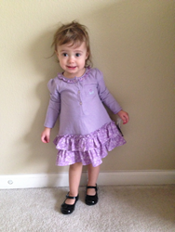
First Steps To Take
#1. To see yourself
as a soul winner!
#2. Have assurance
of your salvation!
#3. Get the proper tools and training!

Slide 3

First Steps To Take
#4. What works best
in the 21st Century?
“If we want to go beyond where we have been, we must be willing to do things differently than we have done in the past!”

Slide 4

First Steps To Take

Slide 5
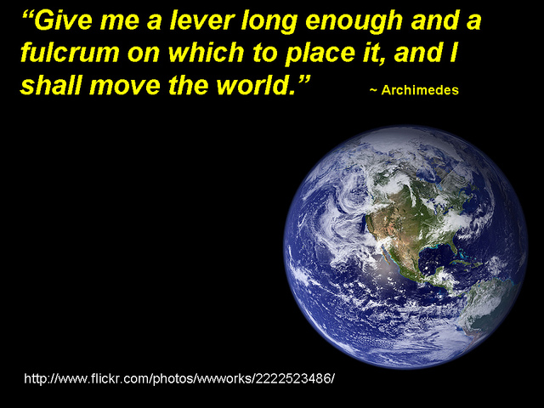
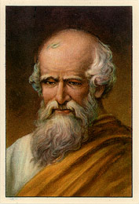
287 BC

Slide 6

Sharing the Big Picture!
It is amazing what a difference the proper tool can make in evangelism!

Slide 7
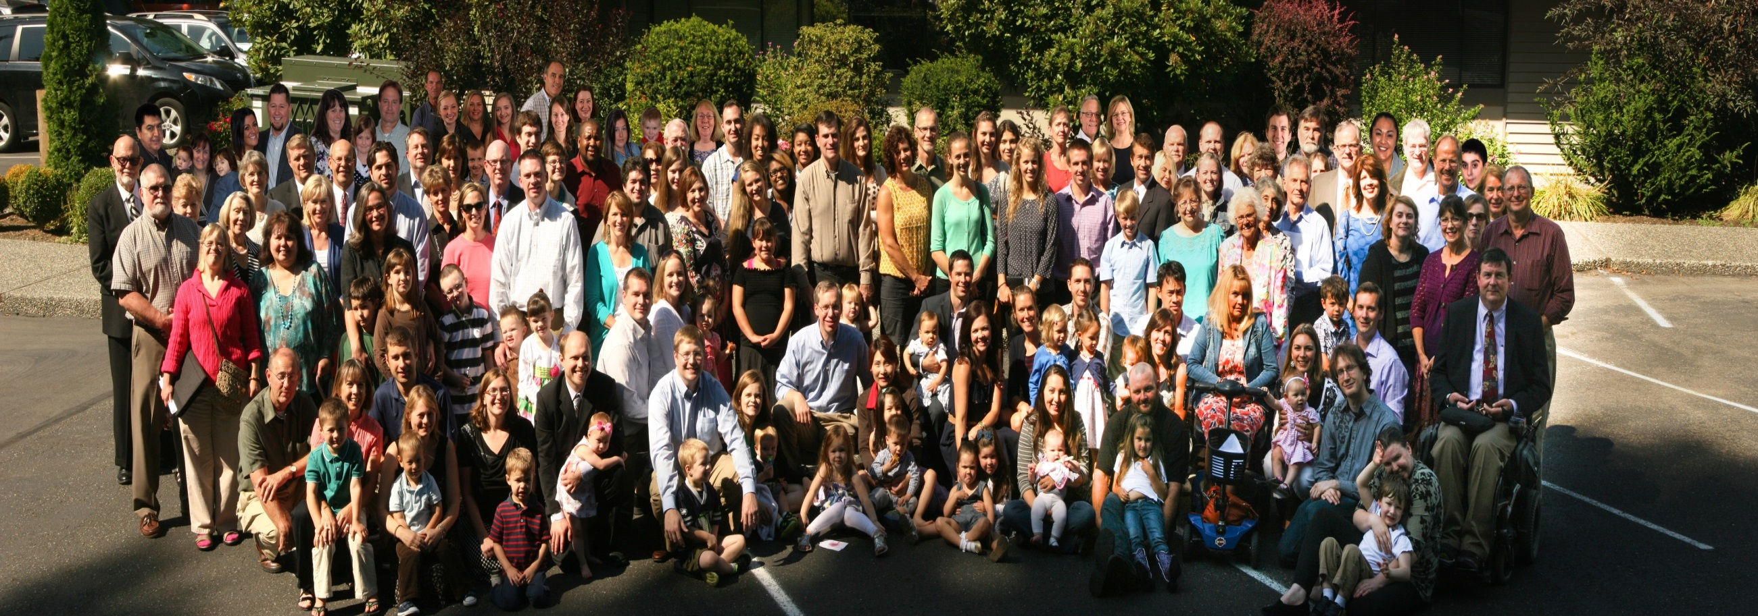
Welcome from the Kirkland church family!
“Born to belong to each other”
September 8, 2013

Slide 8
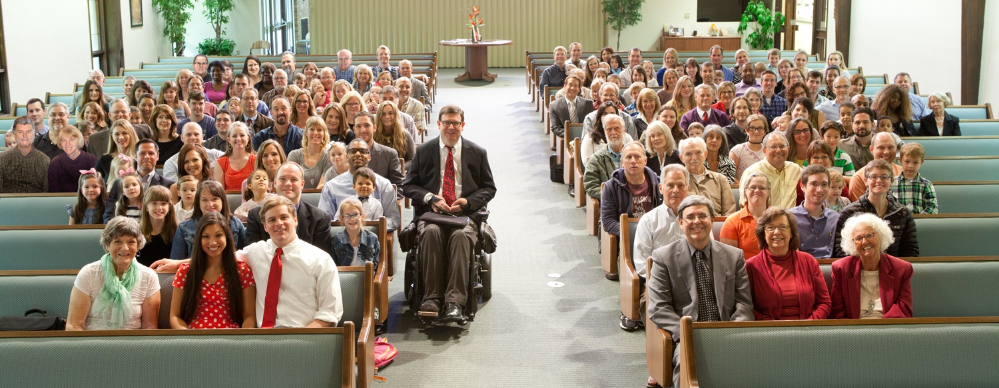
Welcome from the
Kirkland church family!
“Born to belong to each other”
September 13, 2015

Slide 9
Vision Statement
“At Kirkland, we are people redeemed by Christ’s blood, who seek to worship God reverently in truth, who glorify God through our un-conditional love, caring and service of one-another. We are growing in knowledge of truth and in joy and commitment, sharing our hope with others that God’s light might shine in a dark world.”
We desire to grow to 200 in Sunday AM attendance

Slide 10
Vision Statement
“At Kirkland, we are people redeemed by Christ’s blood, who seek to worship God reverently in truth, who glorify God through our un-conditional love, caring and service of one-another. We are growing in knowledge of truth and in joy and commitment, sharing our hope with others that God’s light might shine in a dark world.”
We desire to grow to 200 in Sunday AM attendance

Slide 11

5 Stages of Evangelistic “Maturity”
1
2
3
4
5
STAGE
AVOIDANCE
RELUCTANCE
EQUIPPED
CONFIDENT
COMMITTED
Never share the gospel with anyone
Occasion-ally will discuss religion with someone
Occasion-ally will share the gospel with someone
Ready, willing, and able to share the gospel with anyone
Actively pursue sharing the gospel with anyone, anytime, anywhere
Let others do it
If the subject comes up, retreat
Unprepared and unwilling to share the gospel
That is what my money is for!
But they have to bring it up
Usually only when backed into a corner
Not very prepared
That’s what my preacher is for!
Need a “church program” or a push
Have spent some time in preparation
Prefer to assist someone else
Still afraid of rejection
Will go for it when the opportunity presents itself
Spent significant time preparing
Comfortable with message but lack zeal
Guilt Motivated
Passionate & consumed with the mission to sow the seed
Seek opportunities to share!
Encourages and tries to help others
Joy motivated
Notes:
Technique used in business analysis. I decided to try this on assessment of evangelism. It’s time we get practical and examine ourselves
In business can’t jump levels. The good news is that in evangelism, you can go from a 1 to a 5 in a finger snap. I have seen it many times.

Slide 12

It only took fifty five minutes, and my whole purpose in life was changed forever. The Big Picture is truly genius! I personally had little bible knowledge but I desired to know more about coming to Christ and what the Holy Bible is really all about. I wanted to understand it, know it and apply it to my life, but when I opened the bible, I was often confused by the language and misunderstood what the messages were telling me. However, The Big Picture, explained all the key main points of what the truth is. I’m living proof that when you keep things simple, short and sweet, like The Big Picture, the message that is taught to you is going to have an everlasting impact within you.
I’m truly grateful to the Big Picture message. I didn’t think I could ever hear about the Bible’s truth in such an incredible way!
Krissey Bottomley

Slide 13
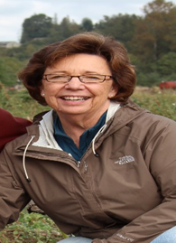

Mariana Fisher
1. It was simple and started exactly where I have started when I teach the young children's classes. I was amazed at the simplicity yet conciseness of presenting God's plan of salvation.
2.There is a lot of material to cover but manageable with study and practice.
3. The affirming power of my own faith each time I go through the presentation is indescribable.
4. I came to a much deeper understanding of the price of sin, the meaning and purpose of animal blood sacrifices, more importantly the sacrifice Christ made for us and why baptism is so important.

Slide 14
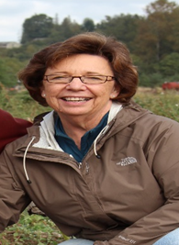

Mariana Fisher
5. More importantly, this gives me a tool to set myself aside and simply present the gospel of our Lord and God to anyone who is willing. It freed me
from feeling responsible for "converting" anyone and allowed the Lord to simply use me as a tool to plant seed. In that respect, it took much of the apprehend-
sion out of sharing the Good News.
6. I've really learned that it is very difficult for people to change and there are many different hearts out there. I need to be more self examining of my own heart so The Lord can say of me, "She did all that she could".
7. It has definitely brought about a change in attitude for me!

Slide 15
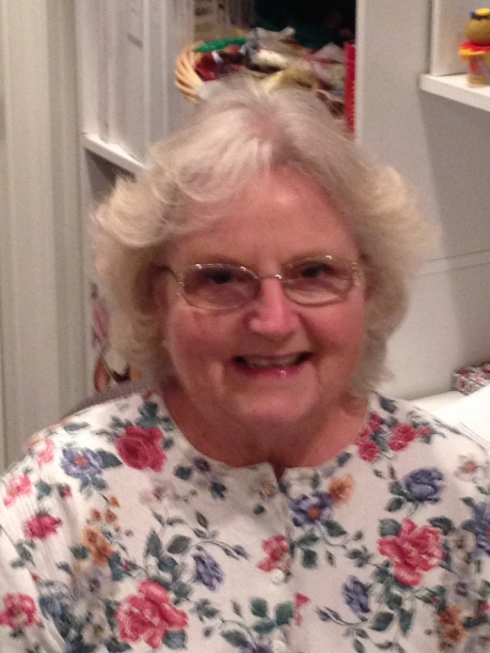
Kathy Adams
“My experience with the Big Picture of the Bible teaching tool began in April of 2013. The PP presentation, flip chart, business cards, and Ken Craig’s booklet, were all made available. I found this method of reaching the lost was understand-able and relatively easy to learn.
For years I have tired to invite friends, neighbors, co-workers to hear the gospel at a church service, or attend a home Bible study with little success. I learned the “Big Picture” presenta-tion and was eager to share it. I presented the PP slide show from my laptop. The young college age women heard the message and two weeks later she was baptized into Christ!! She is now faithfully attending services and attends a weekly class to help her as she grows in grace.
6/21/13

Slide 16
Kathy Adams
I believe this is a scriptural way to teach the lost in a form that is comprehensive and in an easy to follow format. I believe that any willing Christian can learn “The Big Picture of the Bible” and teach it to others.
I will never be the same again. I finally have hope our congregation can grow.
I am 72 years young!!
6/21/13

Slide 17
Sharing the Big Picture!

Slide 18
The Gospel can be Shared in One Session!
One Session
Pentecost Acts 2:14-41 | Believed, Confessed | Believed, Confessed
Samaritans Acts 8:5-13 | Believed | Believed
Ethiopian Eunuch Acts 8:35-39 | Believed, Confessed | Believed, Confessed
Cornelius Acts 10:34-48 | Believed | Believed
Lydia Acts 16:13-15 | Believed | Believed
The Jailor Acts 16:25-34 | Believed | Believed
First Gospel Sermon
Jews
Baptized
V38-41
One Session
Preached Christ
Non-Jews
Baptized
V12-13
One Session
Preached Jesus
Proselyte
Baptized
V38
One Session
Preached gospel
Gentile
Baptized
V48
One Session
Preached gospel
Worshipper
Baptized
V15
One Session
Word of the Lord
Pagan
Baptized
V33

Slide 19

Results Demand Respect
August 20, 2010 to August 20, 2013
57 baptisms
  3 never said members JA
  35 of 54 faithful in attendance
38/38 placed membership are still faithful
10 restored – 9/10 faithful
105 SOULS!

Slide 21
What is JA’s Net Growth Rate?
August 2010 – December 2011
55 Total retention of souls
-10 -- Attrition (5%) Deaths/moved away =
45 net growth + 10 babies = 55 total
Approx. 10 % net growth rate!
Double in 7.2 years!
Need a bigger auditorium!!
State of the church address

Slide 22
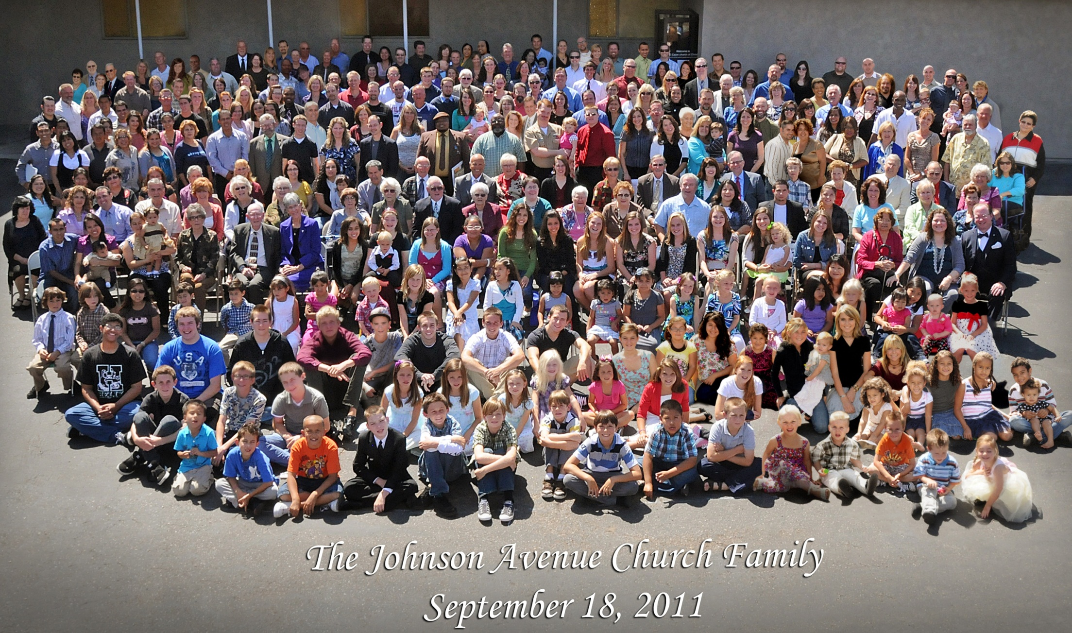
Welcome from the Johnson Ave
Church family!

Slide 23
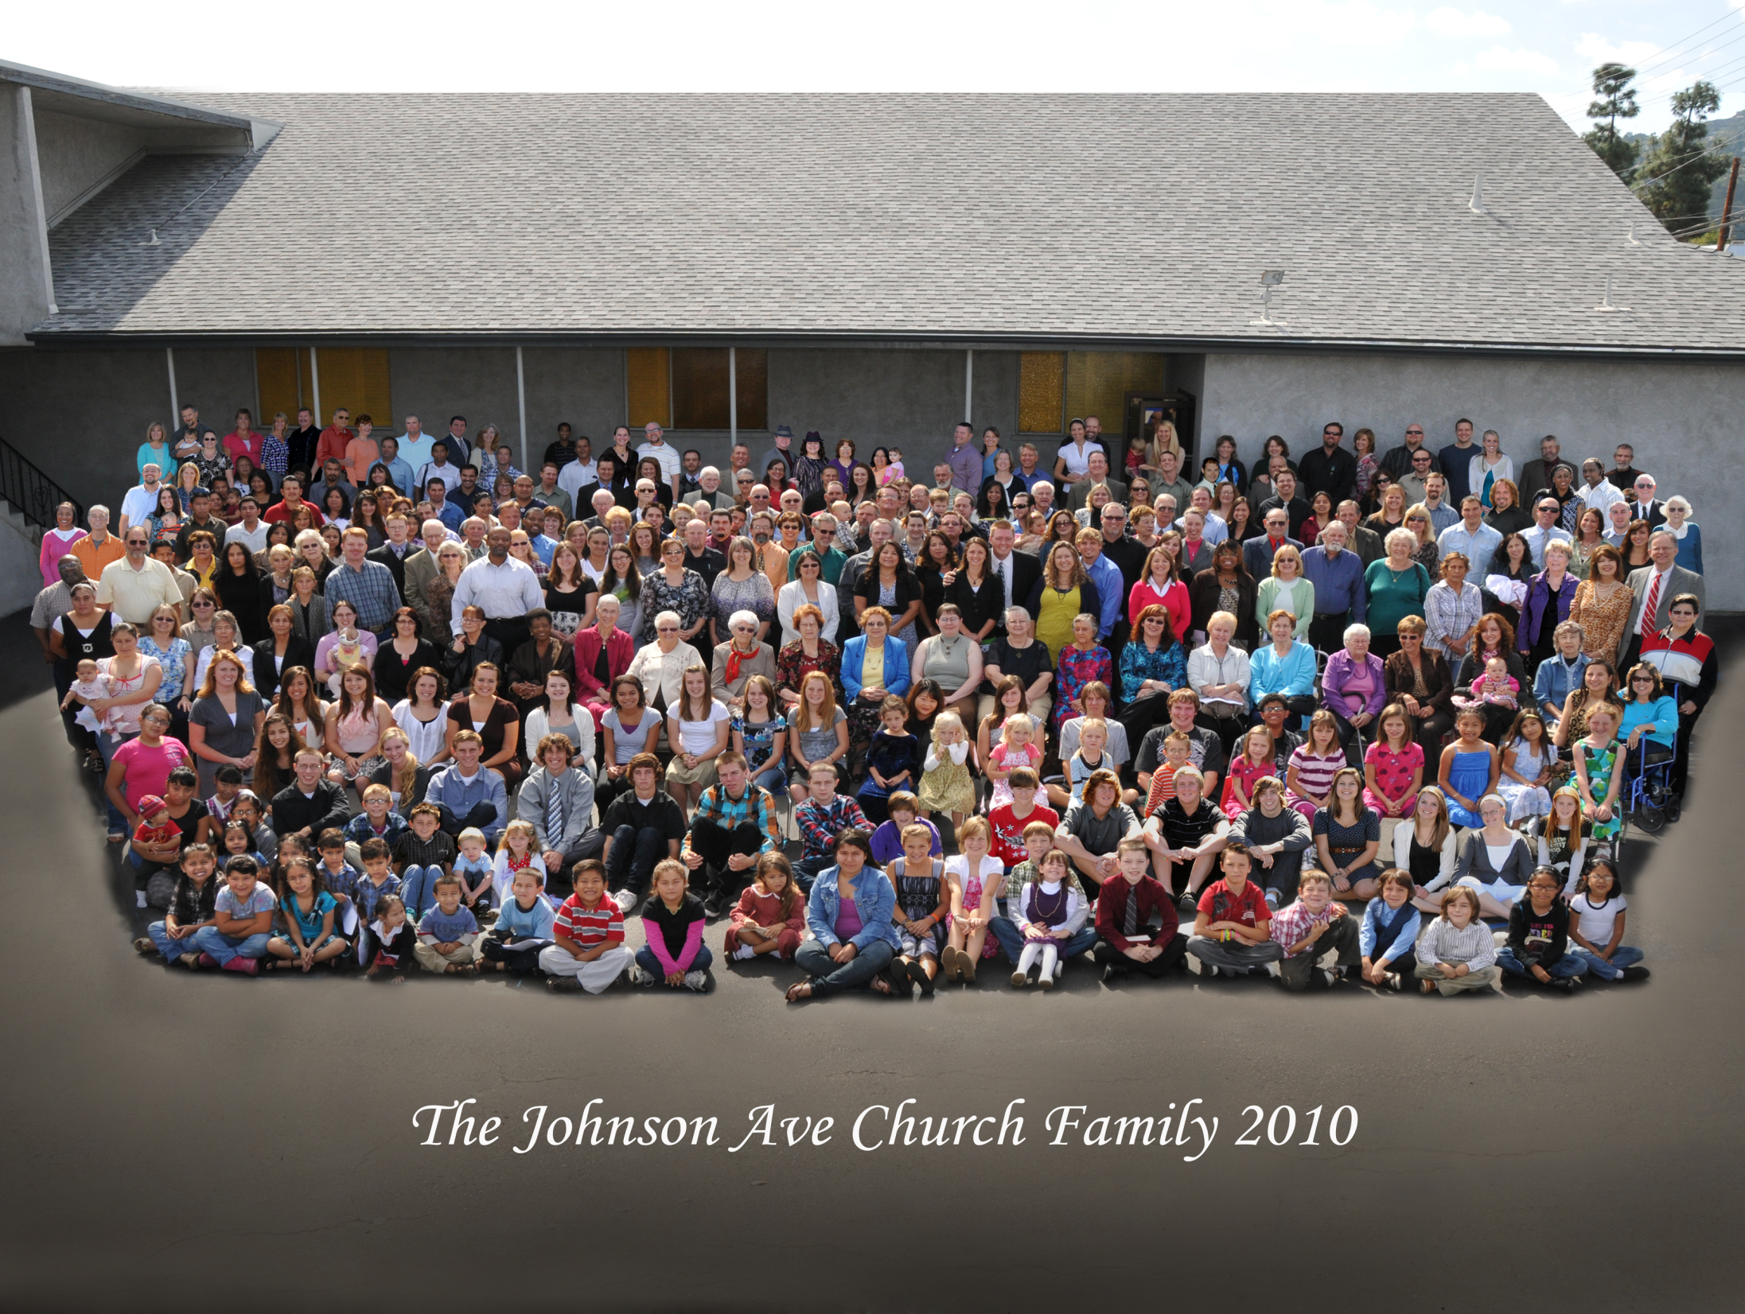
Welcome from the Johnson Ave
Church family!

Slide 24
Welcome from the Johnson Ave
Church family!

Slide 25
Welcome from the Johnson Ave
Church family!

Slide 26
Welcome from the Johnson Ave
Church family!

Slide 27

Why so superior?
Focus is on where the power is (Rom1:16)!
Discusses who and what God and Jesus have done and why He had to die first.
Lays out the importance of the true gospel and its connection to baptism.

Slide 28
Why so superior?
Approach is more practical.
  Easier to get someone to agree to a one-lesson presentation.
It is duplicable (Eph 4:12)!
  Not necessary to be eloquent of speech.
  Why did God choose Moses and Paul?

Slide 29
Tips on Sharing
Don’t focus on having a “Bible study,” but simply, “a presentation.”
  Keeps it from appearing confrontational (2 Tim 2:24-25).
  Deflect questions until the presentation is complete.
  “Join one of our on-going small groups at your convenience.”

Slide 30


Tips on Learning
Take a copy of the booklet and read it over in one sitting.
Two levels of learning:
  1. I get it. I understand.
  2. I know it well enough so that I can explain it to someone else!
Listen to the lessons/CD, mp3

Slide 31
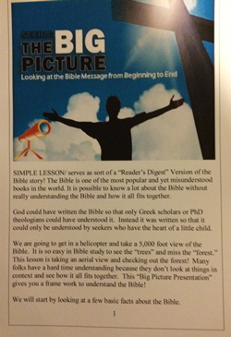
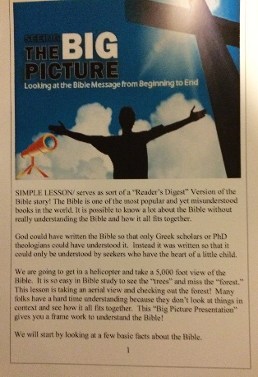
Tips on Learning
The “Study Guide version” of Flip charts takes away fear.
The Key is to practice sharing. Role-playing is helpful!
Make it your own!
You can get to stage 4-5!
You will need three groups and a way to communicate with and motivate all three together.

Slide 32
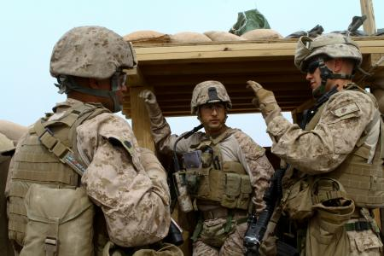
FRONT LINE
Peter, Paul,
& Priscilla group
Commit to learning and to being mentored, in how to present the Big Picture.
Put on a list -- those willing to present “on call.”

Slide 33

FRONT LINE
The Andrew group
Jn 1:40-41
Focuses in on introducing people to the Big Picture.
Pair up with friends who are in the P, P, and P group.

Slide 34
Front of Business Card

Slide 35


Back of Business Card
Understand how the Bible fits together and what the true gospel is all about in less than one hour!
The Bible is the most popular book in history
yet also the most misunderstood. I would
love to present “The Big Picture of the Bible” to you at your convenience.
Give me a call!
Email:

Slide 36
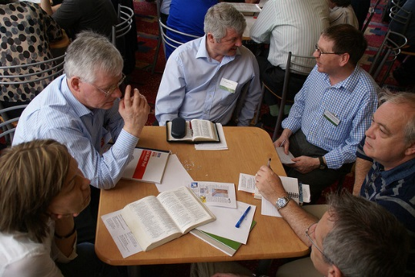
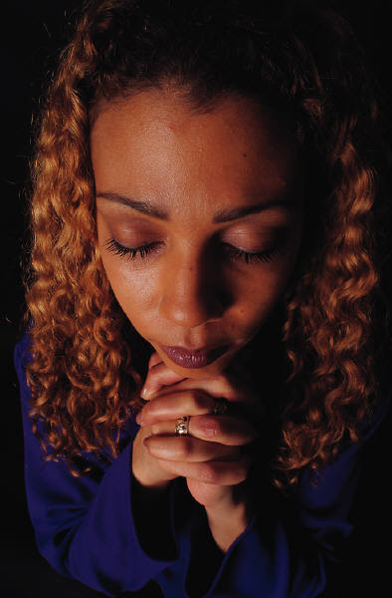
The Alpha and Omega
The Start!
  Always get their “salvation experience” or “spiritual journey.”
  Use 3 by 5 cards to write down.
  Begin with prayer.

Slide 37

The Alpha and Omega
The Closing!
  Use: “Asking for a decision” outline.
  Then.. Are you sure?
  Use “Counting the cost” outline.
Personal Walk
The Church
The Lost

Slide 38

“Behind the Scenes”
I Sam 30:24
“Barnabas group”
Acts 11:23
Focus on being encouragers and cheerleaders!
Teaching and admonishing Christians to “cleave unto the Lord” (Acts 11: 23).

Slide 39
“Andrew’s” & “Barnabas” Mission!
Three-fold
Discipleship (grounding of new Christians)!
Assimilation of new Christians and new members! (hospitality)
Spiritual care of our members
IMPORTANT!

Slide 40
E-Teams create synergy where everyone works together
Deal with Saturday after lunch!

Slide 41

Setting Goals and
Planning for the Future
#1. How many are willing to be a part of the Peter, Paul, and Priscilla group?
  Groups of 10-12 work best.
  Takes about 3 months to do right.
  Requires practice and role-playing, mutual assistance.

Slide 42
Setting Goals and
Planning for the Future
A two fold beautiful serendipity results.
  Tremendous strengthening of one’s faith.
  Great closeness and fellowship is enjoyed.

Slide 43

Setting Goals and
Planning for the Future
#1. How many are willing to be a part of the Peter, Paul, and Priscilla group?
  Kirkland Goal is 25.
#2. How many will be mentored as future trainers so it will not be left up to just a few?
  Kirkland Goal is 4.

Slide 44
Setting Goals and
Planning for the Future
#3. How many will be courageous enough and trained to invite people regularly to hear BP presentations?
  P, P, and P’s, and the Andrew’s commit to this very important step.
  “Knowledge is of no value unless you put it to work.”
  Keep track of your weekly efforts and report to the E-Team for prayers and accountability!
  Our goal at Kirkland is to have 50 Andrews.
  What is a reasonable goal per month for invitations to hear the BP? 15-25 per mo?

Slide 45
Setting Goals and
Planning for the Future
#4. How many actual presentations per month? What is a reasonable goal once people are trained and the three groups established?
  Five a month is a good starting place.
  60 presentations a year.
  A conservative 30% response rate would equal about 18-20 new converts a year.
#5. Follow-up and After-care. Discipleship.
  OPERATION ASSIMILATION
  Hospitality and Teaching are equally important.

Slide 46
Setting Goals and
Planning for the Future
Who gives the increase?
  God (I Cor 3:7)!
  Set goals for faithfulness for your group and let God work out the eventual numbers.
How do you make this sustainable and a part of the culture?

Slide 47
IS PLENTEOUS
BUT THE LABORERS
ARE FEW

Slide 48
First Steps To Take

