Slide 1

An Urgent and Important Command
THE GREAT COMMISSION
“Go into all the world and
preach the gospel
to all creation.”
Mark 16:15

Slide 2
The Gospel –
The Power of God
“I am not ashamed of the gospel
for it is the
power of God
for salvation...”
Romans 1:16
Notes:
2
The gospel stands between man and salvation
The gospel is the power of God – not a fuzzy feeling, not money, or wealth or fame – but the gospel
<Here we learn additional information about the gospel>

Slide 3


THE GOSPEL –
A Message of Salvation
The gospel is a MESSAGE that is to be COMMUNICATED to every person - a message of SALVATION.
The Gospel is Objective Truth!
Notes:
It is objective truth . It is the truth that sets us free! (Jn 8:32).
We don’t go out and convert folks like Islam at the point of a sword, we simply share this powerful message that folks can either receive or reject. How one responds to the gospel is a critical turning point in each person’s life.
And interestingly, it must not just be believed, but obeyed!
<That is what 2 Thess 1:7-9 makes clear…>

Slide 4

The ONE Gospel
“I am amazed that you are so quickly deserting Him who called you by the grace of Christ, for a different gospel; which is really not another; only there are some who are disturbing you and want to distort the gospel of Christ.
But even if we or an angel from heaven should preach a gospel other than the one we preached to you, let him be eternally condemned!”
Galatians 1:6-12
How can I be certain?
Where would we start?
GOSPEL
Notes:
So, There is only one gospel and we have to get it right.
How can we be sure that we get this right, for we must get this right!
<The NT gives us a pointer or direction of where to begin to understand the theme of the Bible

Slide 5
Galatians 3:24
Also: Rom. 15:4
For whatever things were written before were written for our learning, that we through the patience and comfort of the Scriptures might have hope.
1 Cor. 10:11
Now these things happened to them as an example, and they were written for our instruction
(see also 2 Tim 3:14-15)
OLD LAW
TEACHER
TO BRING US TO CHRIST
JUSTIFIED BY FAITH
Notes:
There’s gold in them thar hills.
The OT is supposed to teach us something. Something very important.
What we learn from the OT is to “bring us to Christ” so that “we may be justified by faith”
<TR> There are some fundamental things we need to look at and learn from the history of the OT

Slide 6





GOD IS HOLY
Notes:
This is it. God is holy. All of the interaction that we have with and from God is determined by this fact.
We could spend all of out time just examining the various facets of God’s holiness.
<But we must grasp the importance of this fact and what it means to us>

Slide 7


Sin Separates us from God
“Your iniquities have separated you from your God; and your sins have hidden his face from you.”
Is 59:2
Notes:
God is of such purity and sin is such a revulsion that he cannot look upon sin. (Charged filings when confronted with a magnet).
<TR> It is even worse

Slide 8




SPIRITUAL
DEATH
“you were dead in your trespasses and sins” Eph 2:1
Notes:
That’s why when sin (any sin) separates us from God is described in most drastic terms.
Spiritual Death – (not 5 minutes in the naughty corner for you Supernanny fans)
Our culture continues to diminish sin, while God demands holiness
<TR> This is what Romans 6:23 tells us about the wages of sin…

Slide 9
Romans 3:23
...for all have sinned and fall short of the glory of God
Romans 6:23
...for the wages of sin is death
SIN
DEATH
Notes:
Notice how the terms SIN and DEATH are related
<TR>But here is where the problem gets serious…

Slide 10


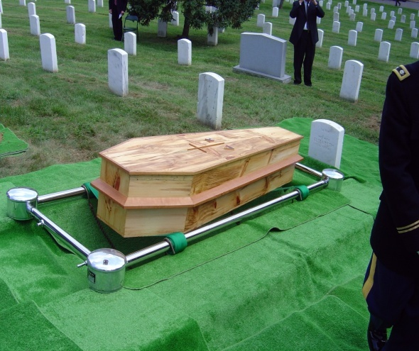

Two Deaths
SPIRITUAL
MORTAL
JUDICIAL
CONSEQUENCES
PAYMENT
Separation
From God
Death of our bodies
Life payment
for sin
Result of individual sin
Result of Adam and Eve’s first sin
Required of every sinner
“The wages of sin
is death”
Romans 6:23
“for dust you are, and to the dust you shall return.”
Genesis 3:19
“without the shedding of blood there can be no forgiveness of sin”
Hebrews 9:22

Slide 11
God’s Love Provides a Way to Pay the Price
LIFE!
GRACE
God gives
what is not deserved
(Romans 3:23-26; 5:6-11)
God does not give
what is deserved
(Romans 1:18)
DEATH!
MERCY
Notes:
If we only experienced the JUSTICE of God it would be a short story for all of us.
But the other side of His holiness is His LOVE as demonstrated in His grace and mercy.

Slide 12
MERCY
BLOOD
Notes:
This is where we see that God’s lovingkindness comes in to help man out from the penalty demanded by His justice.
All that blood in the OT is the mechanism that God uses to demonstrate His mercy
This is why the Bible is a book that drips blood. This is what animal sacrifice was all about. It was God’s way to demonstrate His grace or mercy
<TR>Man’s redemption is all wrapped up in the idea of Atonement

Slide 13
Atonement
Leviticus 17:11
'For the life of the flesh is in the blood, and I have given it to you on the altar to make atonement for your souls; for it is the blood by reason of the life that makes atonement.'
Notes:
Life makes atonement.
One thing we must realize is that God is not a God with some sort of bloodlust. Like the “throw the virgin in the volcano and appease the gods” kind of God.
(Animal sacrifice is another tremendous evidence of God. Every culture in the world, all over the world, has practiced sacrifice. I read that the scholars are puzzled as to how man could have gotten this universal idea that killing something would bring good fortune)
<TR> No. God uses blood (or life) to make atonement due to its representative nature and the seriousness of the crime

Slide 14
Payment
REPRESENTS
BLOOD
LIFE
ATONES FOR
Innocent LIFE
SINNER
REPRESENTS or
SUBSTITUTES for
Guilty LIFE
Innocent LIFE
Heb 9:22 …without the shedding of blood there can be no forgiveness
Notes:
<Sin is bad>

Slide 15



Animal Sacrifice
SINS
(FIGURATIVE)
JUSTICE
MERCY
REPRESENTATIVE DEATH
INNOCENT SACRIFICE
SINNER
SANCTIFIED
DEATH
Notes:
SO here is a visual of how animal sacrifice worked.

Slide 16
“Behold the
LAMB OF GOD
that
takes away the sin of the world”
Notes:
There it is. The plan of redemption in a nutshell
Why did he call Jesus an animal?
What was he communicating to the Jewish mind by calling Jesus and animal? Particularly a lamb?
God’s lamb. Did Jesus come to die by accident? Hardly. He was announced to be God’s lamb which meant he had to be God’s sacrifice.
[Explain that OT contains much more information – the promises made to Abraham, the chosen people the Jews, the law and the covenants – but the reason for all of those was ultimately the choosing of His people through Christ]

Slide 17
An Important Prophecy
5 He was pierced through for our transgressions, He was crushed for our iniquities ; the chastening for our well-being fell upon Him, and by His scourging we are healed.
All of us like sheep have gone astray, Each of us has turned to his own way; But the LORD has caused the iniquity of us all To fall on Him.
He was cut off out of the land of the living for the transgression of my people, to whom the stroke was due.
10. But the Lord was pleased to crush Him, putting Him to grief; as He will bear their iniquities.
Notes:
1

Slide 18

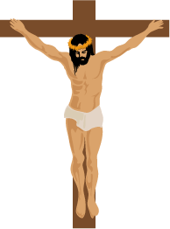
Christ’s Blood in Prophecy
Isaiah 53
1400 BC
750 BC
0 AD
30 AD
First five books of Bible written
Jesus’ Birth
Jesus’ Death
Isaiah’s Prophecy written
750 years before Christ!
Notes:
1

Slide 19
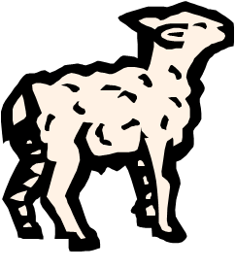
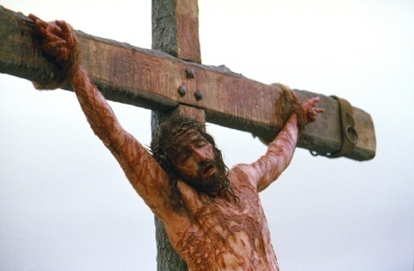
The Lamb of God - Ransomed
Mt. 20:28
the Son of Man did not come to be served, but to serve, and to give His life a ransom for many
Mt. 26:28
for this is My blood of the covenant, which is poured out for many for forgiveness of sins.

Slide 20


Christ’s Sacrifice – OT Fulfillment
Matthew 5:17
"Do not think that I came to abolish the Law or the Prophets; I did not come to abolish but to fulfill.
Heb 9:22 …without the shedding of blood there is no remission.

Slide 21

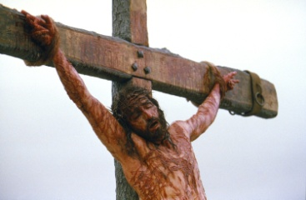
Christ’s Sacrifice – A Judicial Death
1 Peter 2:24
He Himself
bore our sins
in His body
on the cross,
that we might die to sin.
SINS
Literally
JUDICIAL
DEATH
REPRESENTATIVE DEATH
DEATH
Heb 9:22 …without the shedding of blood there can be no forgiveness

Slide 22
Christ’s Sacrifice – A Spiritual Death
SINS
2 Cor 5:21 –Sin bearer
“Him who knew no sin, He was made to be sin on our behalf.”
TOOK CARE OF THE
SECOND
DEATH
REPRESENTATIVE DEATH
Ezekiel 18:20
“The soul that sinneth
It shall die.”
DEATH
Heb 9:22 …without the shedding of blood there can be no forgiveness

Slide 23
Christ’s Sacrifice - Reconciliation
Colossians 1:22
SINS
But now he has reconciled you by Christ's physical body through death to present you holy in his sight, without blemish and free from accusation
JUDICIAL
DEATH
REPRESENTATIVE DEATH
DEATH
Also
Hebrews 13:12
Hebrews 10:10
Heb 9:22 …without the shedding of blood there can be no forgiveness

Slide 24
Propitiation – By Faith
Romans 3:23-25
SINS
for all have sinned, and fall short of the glory of God; being justified freely by his grace through the redemption that is in Christ Jesus: whom God set forth to be a propitiation, through faith, in his blood...
JUDICIAL
DEATH
REPRESENTATIVE DEATH
DEATH
Heb 9:22 …without the shedding of blood there can be no forgiveness
Notes:
<TR> Who died?

Slide 25
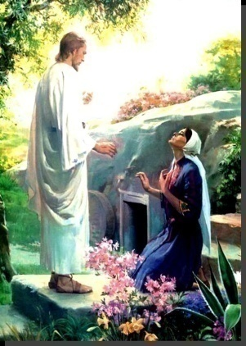
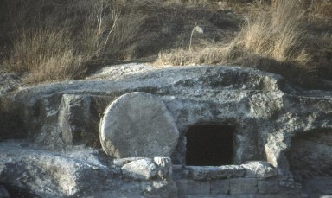
RESURRECTION!
“…who [Christ],
was declared the Son of God
with power by the resurrection
from the dead…” Romans 1:4
RESURRECTION
DEATH & BURIAL
& APPEARANCES!

Slide 26


Christ’s Sacrifice – Who Died?
1 Peter 2:24
He Himself bore our sins in His body on the cross, that we might die to sin.
1 Peter 1:18-19
you were redeemed with precious blood, as of a lamb unblemished and spotless, the blood of Christ.
Romans 6:6
Our old self was crucified with Him,
That our body of sin might be done away with.
Jesus Died
literally on the cross to pay the judicial price for our sin.
The Sinner Died
representatively through Jesus, thus paying our judicial price for sin.
Heb 9:22 …without the shedding of blood there can be no forgiveness

Slide 27
The Death of the Believer
“I have been crucified with Christ and it is no longer I who live,
but Christ lives in me”
Galatians 2:20
“crucified
with Christ”
Christ’s death represents the death of the believer!

Slide 28
Our sins can not and will not be forgiven
UNLESS:
We have died with Christ
We have been united with Christ in His death
We have been crucified with Christ
We have died to sin
This is according to the plan of redemption for “without the shedding of blood there is no forgiveness of sins.”
Notes:
So…. Our sins can not and will not be forgiven unless we have:
Died with Christ
Been united with Him in His death
Have been crucified with Christ
We have died to Sin!
Now, if this is the gospel message that Christ died in my place when he died for me. These four points become important requirements connected with the death of Christ.
What would be the question if you heard this gospel message and believed it? You heard this message, that by dying with Him you by faith and accepting God’s grace you could have your sins forgiven….what would be the first question you would ask?
What is the question? Don’t think of the answer, what is the question?
Hint - One word.

Slide 29
The fundamental question of the gospel is:
When?
Or How?
At what point in my faith . . .
do I die to sin?
do I die with Christ?
When does God view me as . . .
uniting with Christ in his death?
crucified with Christ?
Notes:
Now if you ask this to people today you get a lot of different answers. Why? Different gospels. Believe? (James says No) Pray?
Do you suppose that God would put in place the scheme of redemption and have millions of animals killed over thousands of years just to prepare the way for His son (the Lamb of God) and then have Christ go through the anguish, suffering, and cruel death on the cross – to die in my place – and then leave us in confusion as to where Christ’s death became mine! Can you believe it.
The confusion doesn’t come from God. It comes from man.
We need a Bible answer, not an answer based on human reasoning, tradition, or human emotion. We want God to answer the question and we want to accept His answer.
<TR> Let’s go to the book

Slide 30
We must have a Bible answer to our four questions!
ROMANS 6
When?
Or How?
“What shall we say, then? Shall we go on sinning so that grace may increase? By no means!
We died to sin;
How can we live in it any longer? V 1-2
We died to sin.
“We died to sin.” …. How?/When?

Slide 31

v3 Or don’t you know
that all of us who have been
baptized into Christ Jesus
baptized into His death?
have been
INTO CHRIST
INTO HIS DEATH

Slide 32
v4 Therefore we have been buried with Him through baptism into death, in order that as Christ was raised from the dead through the glory of the Father, so we too might walk in newness of life.
INTO DEATH
NEW LIFE
NEW BIRTH
NEW CREATION
Jn. 3:5
2 Cor. 5:17

Slide 33
5 For if we have become
united with Him
in the likeness of His death, certainly we shall be also in the likeness of His resurrection,
INTO DEATH
NEW LIFE
United with
Christ’s Death

Slide 34
6 knowing this, that our
old self was crucified with Him, that our body of sin
might be done away with,
that we should no longer be slaves to sin;
INTO DEATH
NEW LIFE
United with
Christ’s Death

Slide 35
7 for he who has died is
freed from sin
JUDICIAL
DEATH
INTO DEATH
NEW LIFE
United with
Christ’s Death

Slide 36
8 Now if we have
died with Christ,
we believe that we shall also
live with Him…
INTO DEATH
NEW LIFE
United with
Christ’s Death

Slide 37
12 Therefore do not let sin reign in your mortal body that you should obey its lusts,….
INTO DEATH
REPENTANCE
NEW LIFE
United with
Christ’s Death
Notes:
You’ve just been cleaned up. Don’t go out and get dirty again!
Jay Reynolds, old navy man tried to quit smoking.
He tried behavioral conditioning, gum, nicotine patches, you name it. Nothing worked. One day he goes to the doctor for a checkup. He lingers outside and has a smoke. Goes in and the doctor found a spot on his lungs!
He walked out and never touched another cigarette. What happened?
He changed his mind immediately, dramatically. That spot on his lung changed him.
What does your spirit look like? Has it been washed in the blood of the lamb and made spotless or is like that lung that is the product of years of smoking?
We can do whatever we set our minds to do.

Slide 38
17 But thanks be to God that though you were slaves of sin, you became
obedient from the heart
to that form of teaching to
which you were committed,
INTO DEATH
NEW LIFE
FAITH
United with
Christ’s Death

Slide 39
17 But thanks be to God that though you were slaves of sin, you became
obedient from the heart
to that form of teaching to
which you were committed,
INTO DEATH
NEW LIFE
OBEY THE
GOSPEL
United with
Christ’s Death
Notes:
Notice: One here must be obedient to that “form of teaching” to which you were committed.
Eg. I can’t obey a fact – like the Death, Burial, and Resurrection of Christ, but I can obey a form of that fact….when I participate in the Death , Burial, and Resurrection of Christ when I am buried with Christ and arise to walk with Him in newness of life!
Remember, it is not enough to just believe the Gospel, one must obey it! (2 Thess 2:1-7). This is how one applies to his account in heaven the blood of Jesus to cover his sins!
Think of baptism as the “Believer’s Wedding Ceremony.” The important thing in marriage is that you have love and faith in the person you want to marry. However, you are not married, you do not become one until you exchange your marriage vows! Similarly, until you are baptized into Christ, you are not one with Him. Only now are you able to take on His name!

Slide 40
23 For the wages of sin is death, but the free gift of God is eternal life in Christ Jesus our Lord..
INTO DEATH
GIFT
NEW LIFE
United with
Christ’s Death

Slide 41


but you were washed,
you were sanctified,
you were justified
in the name of the Lord Jesus Christ
and in the Spirit of our God. 1 Cor. 6:11
BAPTIZED INTO CHRIST
BAPTIZED INTO HIS DEATH
DEAD MAN
RECONCILIATION (Relationship with a Holy God restored)
United with
Christ’s Death –
Died with Christ
CRUCIFIED
WITH CHRIST
(Buried with Christ INTO
His death)
JUSTIFICATION (Penalty removed)
SANCTIFICATION (Sins removed –
made Holy and righteous)

Slide 42
Eph 4:3-6
Make every effort to keep the unity of the Spirit through the bond of peace.
There is one body and
one Spirit -just as you were called to
one hope when you were called
one Lord,
one faith,
one baptism,
one God and Father of all
who is over all and through all and in all.
!!?
one baptism,
Notes:
Here we have a very important list
Why is baptism on this list?
John’s baptism, Holy Spirit baptism
Many baptisms today- different purposes: infant baptism, baptism of the heart, Holy Spirit baptism, baptism to show commitment or to join a church, baptism by proxy
Different subjects: infants, non-believers
Different mediums: sprinkling, pouring, immersion
How could we find out what the one baptism is? Acts finally

Slide 43
What Shall We Do?
Now when they heard this,
they were pierced to the heart,
and said to Peter and the rest of the apostles,
"Brethren, what shall we do?"
They believed the gospel
First gospel sermon Pentecost

Slide 44
What Shall We Do?
Now when they heard this,
they were pierced to the heart,
and said to Peter and the rest of the apostles,
"Brethren, what shall we do?"
DIFFERENT
GOSPELS
Do? There is nothing you can do! Christ did it all!
Accept Jesus into your heart.
Just believe.
Pray through.
Pray the sinners prayer.
Call out Jesus’ name.

Slide 45
What Shall We Do?
Now when they heard this,
they were pierced to the heart,
and said to Peter and the rest of the apostles,
"Brethren, what shall we do?"
Peter said to them, "Repent, and each of you be baptized in the name of Jesus Christ for the forgiveness of your sins; and you will receive the gift of the Holy Spirit. …
The
GOSPEL
RESPONSE

Slide 46

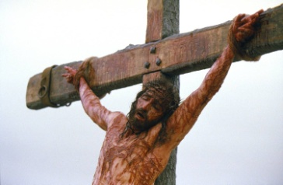
OLD TESTAMENT PERIOD
NEW TESTAMENT PERIOD
PATRIARCHAL
CHRISTIAN
MOSAIC
CREATION
DAY OF JUDGEMENT
Notes:
Do you understand the “Big Picture” of the Bible and what the true gospel is now and how you obey that gospel? (Review chart). In the OT period through faith in God and the animal sacrifices looking forward to the coming of Christ, sins were forgiven sort of “on credit” awaiting the coming of the Messiah.
In the NT, faith in Christ as the perfect sacrifice and the lamb of God is accredited to your account in heaven when you respond to the gospel by participating in the death/burial/and resurrection which is how you “obey the gospel.”
Now, turn and read Eph 1:3. It says “All spiritual blessings in the heavenly places are found in Christ Jesus.” What are some of those blessings? Discuss which ones mean the most to them…. Salvation, Fellowship, Hope of Heaven, Purpose in Life, Freedom from sin, etc. Then ask again..
Would you like to have those blessings? Where are they found? They are found in Christ! (See Eph 1:3, Gal 3:27).
Would you allow me to baptize you into Christ now so that you might die with Him and arise to walk in a new life having Christ’s blood applied to your account in heaven?
How quickly did they respond to the gospel message in Acts 16: 33 they responded “in the same hour of the night and immediately he was baptized.” Would you die with Christ now?

Slide 47
An Urgent and Important Command
The great commission –
“Go into all the world and
preach the gospel to all creation.
He who believes and is baptized shall be saved;
but he who has not believed
shall be condemned.
Mark 16:15-16
Notes:
Let’s complete the command of Christ…
This is exactly what we see the apostles carrying out in Acts

Slide 48
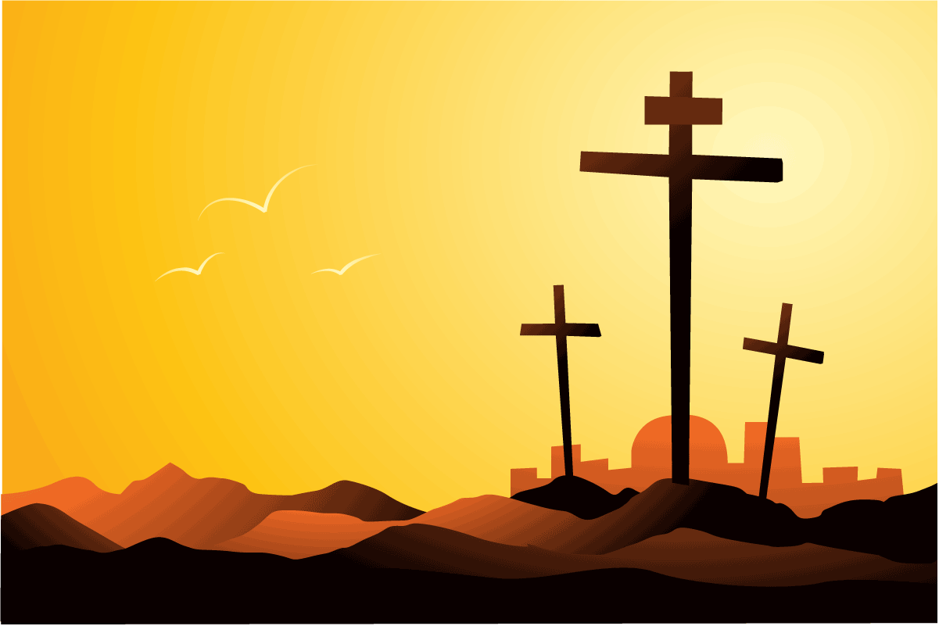
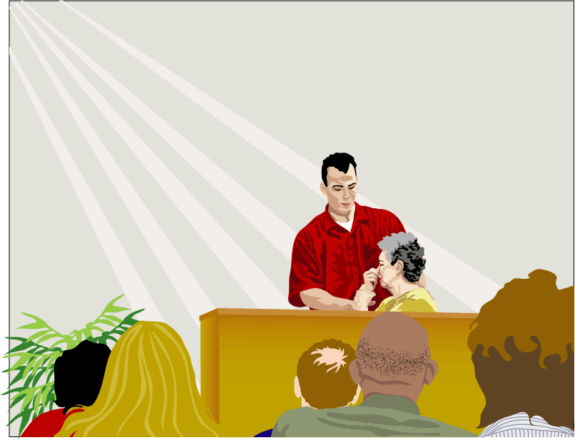
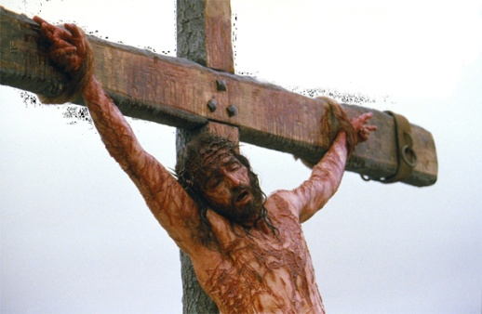
Do you want to die with Christ?
Notes:
Won’t you accept the promise and gift of God’s son today?
If you believe in Christ and and have faith in His blood, and are willing to repent of your sins and confess His name… then you are ready to die with Him and have your sins removed, and enter His kingdom and live a life of faithful loving obedience to Christ as king and have every confidence that you will spend eternity in heaven.
But if you reject this gift there will be no hope for you… there is no other basis on which God will forgive sin…nothing but the blood of Jesus.
Turn and read Eph 1:3. It says “All spiritual blessings in the heavenly places are found in Christ Jesus.” What are some of those blessings? Discuss which ones mean the most to them…. Salvation, Fellowship, Hope of Heaven, Purpose in Life, Freedom from sin, etc. Then ask again..
Would you like to have those blessings? Where are they found? They are found in Christ! (See Eph 1:3, Gal 3:27).
Would you allow me to baptize you into Christ now so that you might die with Him and arise to walk in a new life having Christ’s blood applied to your account in heaven?
How quickly did they respond to the gospel message in Acts 16: 33 they responded “in the same hour of the night and immediately he was baptized.”
If yes, count the cost… remind them that you can’t have Christ and reject his body, which is the church family! They need to continue to die with Christ and to sin and live for Him or this new relationship meaningless. Baptism is the believer’s wedding ceremony. It is the point where one comes to be “wed” to Christ and wear His name but it is the day you make your commitment to him to serve Him and “be faithful until death” (Rev 2:10). The church family is here to help you and that is God’s plan!
Keep in mind that once you “obey the gospel” you are added to the church universal. A separate decision need to be made concerning where you choose to worship.
Would you like to become a part of the congregation here and worship with us as well as a part of your commitment?

