Slide 1
Samuel Transition Man
Outstanding Old Testament Characters study
3/1/23

Slide 2
Contents
His Birth
His early life
His life as priest, judge, prophet
His role anointing 2 kings
His death and reappearance
Summary of his character

Slide 3
Some interesting facts about Samuel:
Born around 1105 B.C. and died around 1015 B.C. (90 years)
His life is recorded in 1 Sam. 1-28
II Samuel does not mention him, why?
What time period(s) did he live in?
Bible only includes a handful of pregnancies, Samuel was one
(Isaac, Ishmael, Jacob & Esau, Perez, Samson, John the Baptist, and Jesus)
He was a priest, judge, and prophet
He was the last judge and first prophet after Moses (Ac. 13:20; 3:24)
Filled the key role of helping Israel transition from tribal confederacy to monarchy

Slide 4
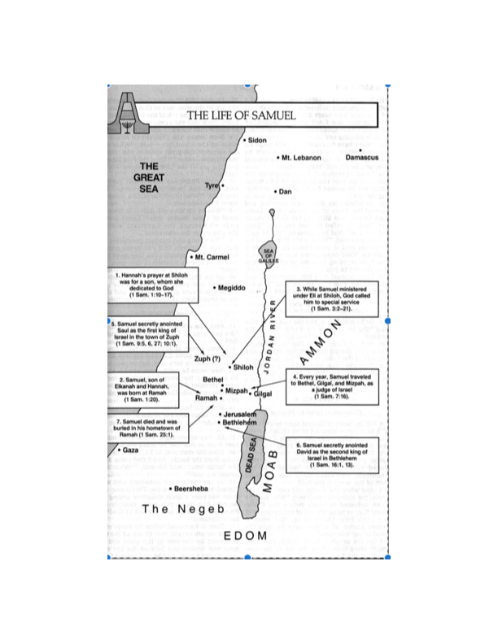

Slide 5
1. His birth
Elkhanah (a Levite, 1 Ch. 6:16-30) had two wives; Peninnah (with children) and Hannah (no children)
At the yearly worship and sacrifice to the Lord in Shiloh he gave one portion to Peninnah and a double to Hannah (for he loved her)
Peninnah provoked Hannah severely to make her miserable
Hannah prayed to the Lord and made a vow:
”O Lord of hosts, if You will indeed look on the affliction of your maidservant and remember me, and not forget your maidservant, but will give your maidservant a male child, then I will give him to the Lord all the days of his life, and no razor shall come upon his head” 1 Sam. 1:11
He would be a Nazarite

Slide 6
1. His birth (cont.)
Eli, the priest, saw Hannah moving her lips but did not speak, therefore he thought she was drunk
This is an example of someone praying in their heart
Hannah explained and Eli answered and said, “Go in peace, and the God of Israel grant your petition which you have asked of Him.” 1 Sam. 1:17
Hannah rose and ate and was no longer sad.
This was a display of faith that her request was heard by the Lord
It came to pass she conceived and bore a son and called him Samuel
“Because I have asked for him from the Lord.” 1 Sam. 1:20

Slide 7
1. His birth (cont.)
Reminds me that Isaac also prayed to God for Rebekah to bear a child
Hannah followed through on her vow; waiting until the child was weaned to take him to Eli
Samuel was going to live a special life from the start (a miracle baby)
They slaughtered a bull and brought the child to Eli
She said, “O my lord! As your soul lives, my lord, I am the woman who stood by you here, praying to the Lord. For this child I prayed, and the Lord has granted me my petition which I asked of Him. Therefore I also have lent him to the Lord; as long as he lives he shall be lent (granted) to the Lord.” So they worshipped the Lord there. 1 Sam. 1:26-28

Slide 8
2. His early life
Hannah’s prophetic prayer is included in chapter 2 and shows what is in her heart
Even though Eli’s sons were corrupt, Samuel ministered before the Lord, even as a child, wearing a linen ephod, 1 Sam. 2:18
Hannah would bring him a little robe year by year when she came with her husband to offer the yearly sacrifice
Eli blessed Hannah and she had 3 sons and 2 daughters
Samuel grew in stature, and in favor both with the Lord and man, 1 Sam. 2:26
Very similar words were spoken of Jesus as a boy, Luke 2:52

Slide 9
2. His early life (cont.)
“Then the boy Samuel ministered to the Lord before Eli. And the word of the Lord was rare in those days; there was no widespread revelation.” 1 Sam. 3:1
God calls Samuel’s name 3 times, and he believes it is Eli
Finally, Eli realizes it is God speaking to Samuel and tells him to say “Speak, Lord, for Your servant hears.”
God called “Samuel! Samuel!”
(8 people God calls by name twice; Abraham, Jacob, Moses, Martha, Simon, “My God, and Saul)
The Lord speaks to Samuel about Israel and Eli’s family, 1 Sam. 3:11-14
Eli demands to hear the Lord’s message in the morning from Samuel

Slide 10
3. His life as a priest, judge, prophet
All Israel knew that Samuel had been established as a prophet of the Lord, 1 Sam. 3:20
Samuel observes how God’s word comes true for the death of Eli and his two sons during a battle with the Philistines, 1 Sam. 4:11-18
The Philistines defeat the Israelites and then they take the ark of God into battle and loose it. Why didn’t that work? 1 Sam. 4
Israelites thought the ark had power; didn’t inquire of God w/prayer
The Philistines suffered greatly from the ark for 7 months before returning it
The Lord struck 50,070 men at Beth Shemesh for mishandling the ark
Then the men of Kirjath Jearim came to take proper care of it, ch. 6-7

Slide 11
3. His life as a priest, judge, prophet (cont.)
Samuel speaks to all the house of Israel to return to the Lord, 1 Sam. 7:3-6
This was a tough message to deliver but Samuel was bold
The next battle with the Philistines was different. Israelites said to Samuel, “Do not cease to cry out to the Lord our God for us, that He may save us from the hand of the Philistines.” 1 Sam. 7:8-9
The Lord responded with thunder and confused the Philistines, and they were overcome before Israel, 1 Sam. 7:10
Samuel set a stone and called it “Ebenezer, “Thus far the Lord has helped us.” 1 Sam. 7:12
What was the difference in this battle from the previous one?
The Philistines were subdued all the days of Samuel

Slide 12
3. His life as a priest, judge, prophet (cont.)
Samuel judged Israel all the days of his life
His year-to-year circuit was to Bethel, Gilgal, and Mizpah
He always returned to Ramah, his home, 1 Sam. 7:15-17

Slide 13
4. He anoints 2 kings
When Samuel was old, he made his 2 sons judges but they did not walk in his ways
The elders of Israel said, “Look, you are old, and your sons do not walk in your ways. Now make for us a king to judge us like all the nations.” 1 Sam. 8:5
How did Samuel react? 1 Sam. 8:6-9 How does this apply to us today?
They have rejected Me, not you
What was God’s message? 1 Sam. 8:10-22
King will make soldiers and servants of you, take your land
Heed their voice and make them a king
God speaks to Samuel in his ear to tell him who to anoint commander (ruler) over My people Israel, 1 Sam. 9:15-16
Samuel anoints Saul privately and gives him special instructions

Slide 14
4. He anoints 2 kings (cont.)
Samuel later announces that Saul is the one who the Lord has chosen
The people shouted, “Long live the king!” 1 Sam. 10:24
Samuel joined Saul in battle to defeat the Ammonites at Jabesh Gilead, then made sacrifices of peace offerings to the Lord in Gilgal, 1 Sam. 11:7-15
Samuel speaks to all Israel with a strong message about their wickedness in asking for a king, 1 Sam. 12
Many times the Lord has heard you and saved you
Warning them if they do not obey the voice of the Lord, then the hand of the Lord will be against you
The Lord sent thunder and rain that day and they greatly feared the Lord and Samuel. Israel said they have sinned and asked Samuel to pray for them
Samuel reaffirms that the Lord will not forsake them for His great name’s sake

Slide 15
4. He anoints 2 kings (cont.)
Samuel rebukes Saul for not waiting for him to offer sacrifices to the Lord before the battle with the Philistines at Gilgal, 1 Sam. 13:13-14
Samuel tells Saul that due to his disobedience “The Lord has sought for himself a man after His own heart”
Samuel said to Saul to go attack the Amalekites and utterly destroy all that they have and do not spare them, 1 Sam. 15:1-3
The Lord shares his disappointment with Samuel about Saul’s disobedience and Samuel cried out to the Lord all night, 1 Sam. 15:11
Samuel strongly rebukes Saul and tells him that the Lord has rejected him from being king over Israel and will replace him, 1 Sam. 15:26-28
Samuel hacked king Agag into pieces before the Lord in Gilgal and went no more to see Saul until the day of his death, 1 Sam. 15:33-35

Slide 16
4. He anoints 2 kings (cont.)
God tells Samuel to stop mourning for Saul and get prepared to anoint someone from Jesse the Bethlehemite, 1 Sam. 16:1
God calms Samuels concerns and guides him to anoint David in the midst of his brothers and the Spirit of the Lord came on David, 1 Sam. 16:4-13
Samuel returned to Ramah his home
When Saul was seeking to kill David, David fled to be with Samuel in Ramah for safety. Saul sent messengers to take David 3 times, but they all began prophesying. Saul went and the same thing happened to him, 1 Sam. 19:18-24

Slide 17
5. His death and reappearance
Samuel dies and the Israelites gathered to lament for him and buried him in Ramah, 1 Sam. 25:1
Saul became afraid of the Philistines encamped at Shunem and tried to inquire of the Lord but didn’t get a response
He became desperate and went to a medium to bring Samuel up
The woman cried out with a loud voice accusing Saul of deceiving her
Samuel spoke to Saul what the Lord’s message to him was which was the same as before, 1 Sam. 28:13-19
Samuel did not waiver from delivering God’s message even after death

Slide 18
6. Summary of his character
What roles did he fill?
Priest, Judge, prophet, soldier, father, husband, national leader, …
What do you admire most about Samuel?
His faithfulness, his humble attitude, his integrity, his boldness, his ability to communicate, how he spoke to God, he was a man that prayed, his ability to command respect, his obedience
Did Samuel have any weaknesses?
His sons did not walk in his way

