Slide 1
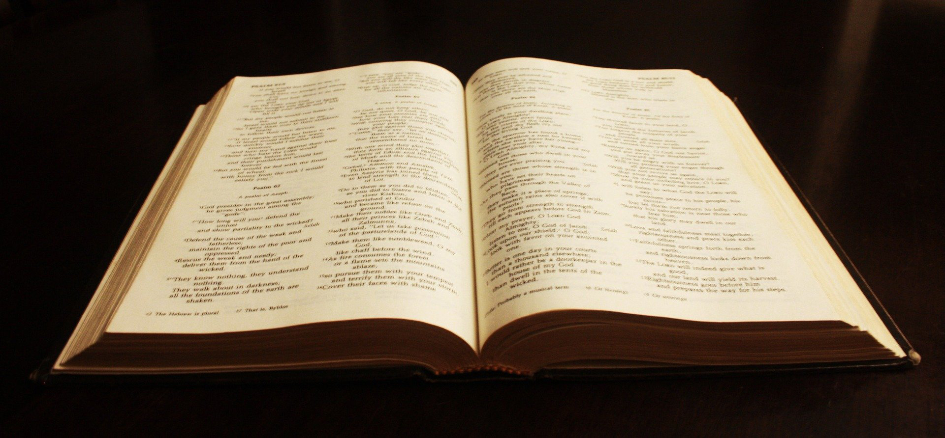
TWISTING GOD’S WORD

Slide 2
USING GOD’S WORD
Accurately handling (II Tim. 2:15)
Distorting (Gal. 1:7; II Pet. 3:16)

Slide 3
HOW TO DISTORT GOD’S WORD
Redefine the words as you see fit
Take figurative language literally
Take literal language figuratively
Deny the miracles
Say the passage doesn’t apply to us today

Slide 4
HOW TO DISTORT GOD’S WORD
Take a passage out of context
Use one passage to nullify another
Don’t pay attention to details
Hyper-focus on a single verse
Prove your point by listing the experts who agree with you

Slide 5
WHAT TO WATCH OUT FOR
Being told the Bible doesn’t say what it says
Being told the Bible doesn’t apply today
Misusing the language (genre)
Any tricky way that gets you following a person rather than what you read for yourself in God’s word

