Slide 2
Notes:
Video from BibleProject — summary of 1 Samuel

Slide 3
End of Act 1
Saul’s rise and fall, death, and end of dynasty.
David:
Has been anointed in secret by Samuel.
Has been praised & exalted by his people.
Has been hunted and persecuted by royalty.
Has been a friend of his enemies and enemy of his friends.
Has protected his own people and gained a following.
…is waiting for news of the battle between Israel & Philistia.

Slide 5
David Responds To Saul’s Death
Saul’s killer brings the news of his & Jonathan’s deaths
Probably expects a hero’s welcome…
But he doesn’t think of “the Lord’s anointed” as David does.
David’s response is surprising.
Instead of bitterness… Praise.
Instead of relief… Mourning.
Instead of gloating… Honor.
A song written in Jonathan & Saul’s honor (vv. 19-27)
Notes:
This slide = 2 Samuel 1:1-27

Slide 6
David’s Second Anointing
First anointing: Samuel’s visit to his house.
This occasion: probably a limited group in attendance.
Notes:
2 Sam. 2:1-7
*first one = when Samuel anointed him at his Bethlehem home in 1 Samuel 16*

Slide 7
The United Kingdom, Divided
Both end up dead by betrayal by end of this short story
Tying up lose ends from Saul’s story
Providence brings about the death’s of David’s enemies…
David remains steadfast in character throughout.
Ish-bosheth – Saul’s remaining son who stakes a claim on throne.
Abner – Saul’s general who is eventually won over by David.
Joab – David’s general who thinks like a warrior; his brother is killed by Abner. Joab gets personal revenge.
Notes:
This slide = 2 Sam. 2:8-4:12

Slide 8
David’s Third Anointing
Then all the tribes of Israel came to David at Hebron and said, “Behold, we are your bone and flesh. In times past, when Saul was king over us, it was you who led out and brought in Israel. And the LORD said to you, 'You shall be shepherd of my people Israel, and you shall be prince over Israel.’”
So all the elders of Israel came to the king at Hebron, and King David made a covenant with them at Hebron before the LORD, and they anointed David king over Israel.
Then all the tribes of Israel came to David at Hebron and said, “Behold, we are your bone and flesh. In times past, when Saul was king over us, it was you who led out and brought in Israel. And the LORD said to you, 'You shall be shepherd of my people Israel, and you shall be prince over Israel.’”
So all the elders of Israel came to the king at Hebron, and King David made a covenant with them at Hebron before the LORD, and they anointed David king over Israel.
Then all the tribes of Israel came to David at Hebron and said, “Behold, we are your bone and flesh. In times past, when Saul was king over us, it was you who led out and brought in Israel. And the LORD said to you, 'You shall be shepherd of my people Israel, and you shall be prince over Israel.’”
So all the elders of Israel came to the king at Hebron, and King David made a covenant with them at Hebron before the LORD, and they anointed David king over Israel.
Then all the tribes of Israel came to David at Hebron and said, “Behold, we are your bone and flesh. In times past, when Saul was king over us, it was you who led out and brought in Israel. And the LORD said to you, 'You shall be shepherd of my people Israel, and you shall be prince over Israel.’”
So all the elders of Israel came to the king at Hebron, and King David made a covenant with them at Hebron before the LORD, and they anointed David king over Israel.
Those present: the whole nation
David’s rule is appointed by God
David’s rule is accepted by Israel
Notes:
“bone and flesh” = statement of solidarity (close to “United” kingdom)

Slide 9
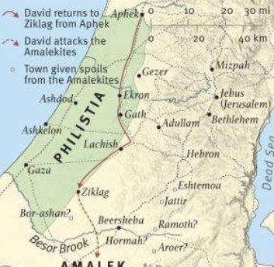
New Era, New Capital City
Hebron to Jerusalem = theologically, Historically important
HEBRON history:
- Abraham’s first possession in Canaan -
- Burial place of Abraham, Isaac, Jacob -
- Caleb’s inheritance by conquest (tribe of Judah) -
- David’s first capital city (by God’s direction) -
Jesus’ genealogy (Matt. 1:17) presented under 3 main headings: Abraham & David & Deportation
From a city with a powerful past… To a city with a glorious future.
Notes:
Burial place of patriarchs — you might remember seeing “Cave of Machpelah.” That’s in Hebron.
- Interesting note: their wives are also buried there — one of each patriarch (Sarah, Rebekah, and Leah).

Slide 10
New Era, New Capital City
Jerusalem Future:
- David captures it from pagans, for God’s glory -
- A pagan king’s gift = build a house for King David -
- God’s presence comes into the city (Ark of the Covenant) -
- God’s presence remains in the city for centuries (Temple) -
- Even after departing, He will return there (cf. Lk. 2) -
For out of Zion shall go forth the law, and the word of the LORD from Jerusalem.
- Isaiah 2:3, Micah 4:2
The central city for God’s plan until the church era.
David’s move = the beginning of a long effort to send forth the Gospel to the whole world.
Notes:
Burial place of patriarchs — you might remember seeing “Cave of Machpelah.” That’s in Hebron.
- Interesting note: their wives are also buried there — one of each patriarch (Sarah, Rebekah, and Leah).

Slide 11
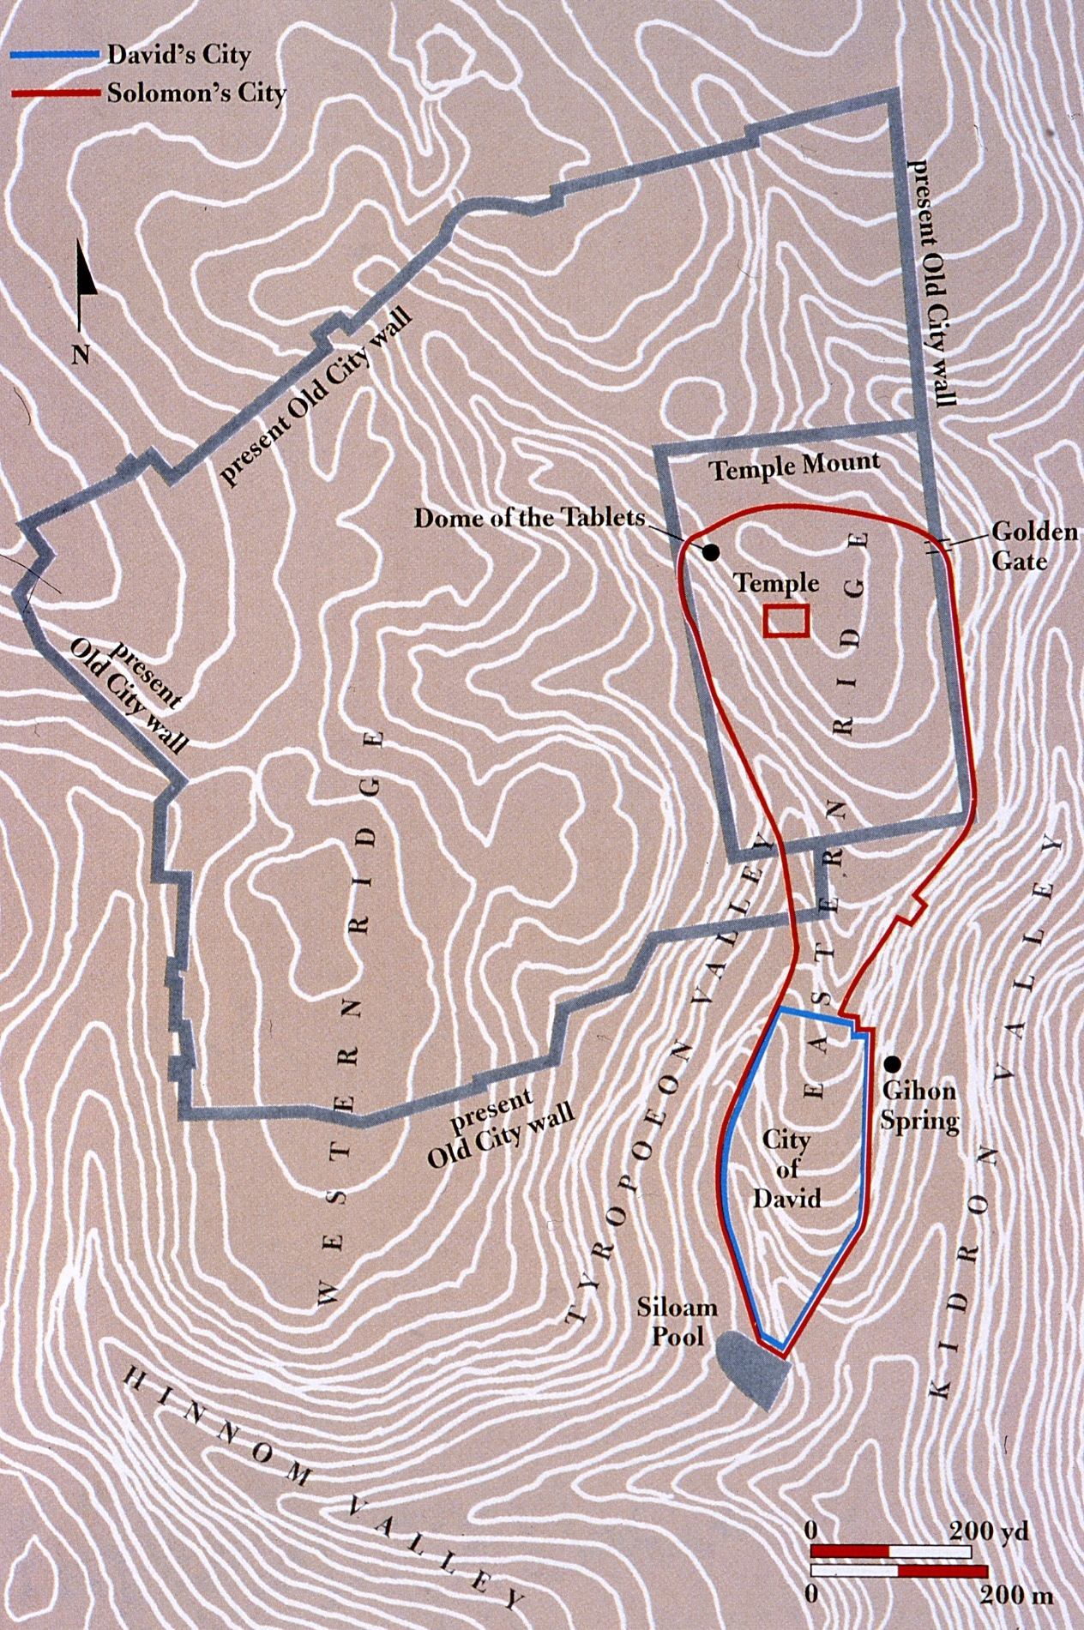
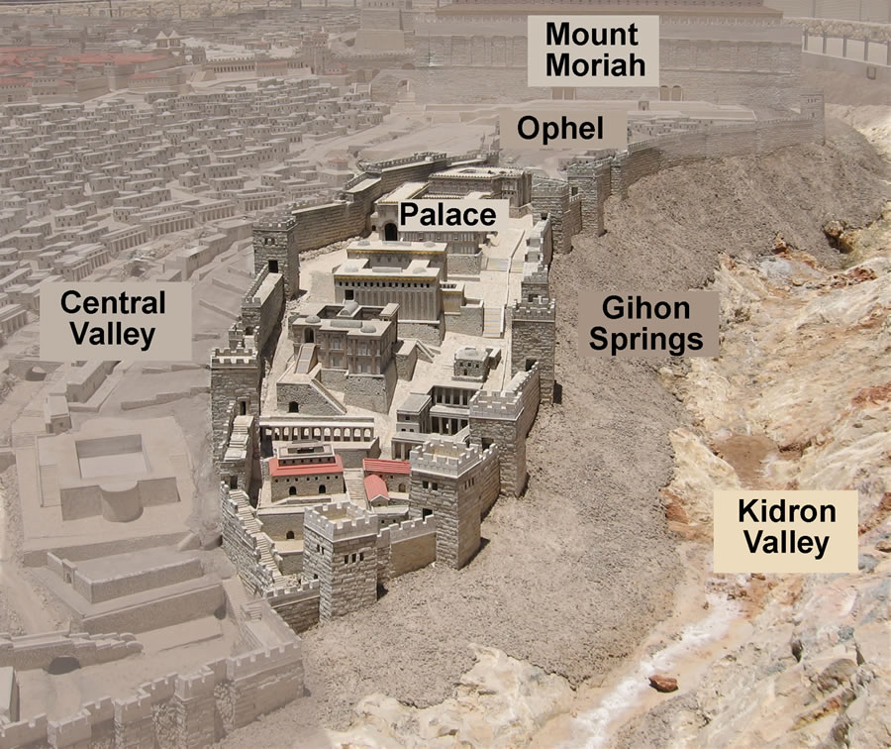
New Era, New Capital City
David conquers Jerusalem from Canaanites
Builds “the city of David” – first Hebrew quadrant of Jerusalem
Builds his palace, establishes a permanent place for God’s house
The Ark of the Covenant comes into the city…

Slide 12
The Ark Comes to Jerusalem
2 Samuel 6
The Ark has been sojourning… David wants it to come home.
The 20-yr custodian’s sons are watching over it.
One of those sons is struck dead for violating holy space.
(cf. Lev. 10:1-3)
Notes:
1 Samuel 7:1-2 — the Ark has been “out of pocket” (not at Shiloh) for 20 years.

Slide 13
The Ark Comes to Jerusalem
2 Samuel 6
1 Chron. 15-16
Press pause: Ark stops for 3mos. at someone else’s house.
No mention of Uzzah… this is only about attempt 2.
Things go well;
resume installation.
Present in this version of the story:
- Priests -
- Levites carrying the ark -
- Singers / worshipers -
- A tent for the Ark -
- A song of Thanks/Praise -
David & his people celebrate mightily before the Lord.
Why?
The presence of YHWH is among them.
Notes:
1 Samuel 7:1-2 — the Ark has been “out of pocket” (not at Shiloh) for 20 years.

Slide 14
God’s Promise Comes to David
“A House For My Name”
Double-meaning connection to David:
- The temple David designs for God
- David’s household; an eternal lineage of kings

Slide 15
Now when the king lived in his house and the LORD had given him rest from all his surrounding enemies…
- 2 Samuel 7:1
Now when the king lived in his house and the LORD had given him rest from all his surrounding enemies…
- 2 Samuel 7:1
But that same night the word of the LORD came to Nathan, “Go and tell my servant David, ‘Thus says the LORD: Would you build me a house to dwell in?’”
- 2 Samuel 7:4
But that same night the word of the LORD came to Nathan, “Go and tell my servant David, ‘Thus says the LORD: Would you build me a house to dwell in?’”
- 2 Samuel 7:4

Slide 16
When your days are fulfilled and you lie down with your fathers, I will raise up your offspring after you, who shall come from your body, and I will establish his kingdom. He shall build a house for my name, and I will establish the throne of his kingdom forever. I will be to him a father, and he shall be to me a son. When he commits iniquity, I will discipline him with the rod of men, with the stripes of the sons of men, but my steadfast love will not depart from him, as I took it from Saul, whom I put away from before you.
When your days are fulfilled and you lie down with your fathers, I will raise up your offspring after you, who shall come from your body, and I will establish his kingdom. He shall build a house for my name, and I will establish the throne of his kingdom forever. I will be to him a father, and he shall be to me a son. When he commits iniquity, I will discipline him with the rod of men, with the stripes of the sons of men, but my steadfast love will not depart from him, as I took it from Saul, whom I put away from before you.

Slide 17
And your house and your kingdom shall be made sure forever before me. Your throne shall be established forever.
And your house and your kingdom shall be made sure forever before me. Your throne shall be established forever.

Slide 18
God’s Promise Comes to David
“A House For My Name”
Double-meaning connection to David:
- The temple David designs for God
- David’s household; an eternal lineage of kings
Culmination: an Eternal King
(cf. Luke 1:32-33)
Contrast: “Your kingdom shall not continue.”

Slide 19
God’s Praise Spoken By David
Who am I, O LORD God, and what is my house, that you have brought me thus far?
There is none like you, O LORD, and there is no God besides you, according to all that we have heard with our ears.
And now, O LORD, let the word that you have spoken concerning your servant and concerning his house be established forever, and do as you have spoken, and your name will be established and magnified forever, saying, ‘The LORD of hosts, the God of Israel, is Israel's God,’ and the house of your servant David will be established before you.

Slide 20
God’s Praise Spoken By David
And now, O LORD, you are God, and you have promised this good thing to your servant. Now you have been pleased to bless the house of your servant, that it may continue forever before you, for it is you, O LORD, who have blessed, and it is blessed forever.

