Slide 1
Before the Flood
Flood
Scattering
Patriarchs
Exodus
Wandering
INVASION AND CONQUEST
Judges
WEEK 4: SOUTHERN AND NORTHERN CAMPAIGNS
(Josh. 9-12)

Slide 2
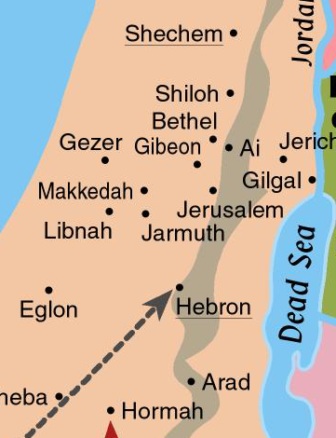
The Conquest of Canaan
Since Jericho, Ai, and Bethel were destroyed, the Israelites were able to move freely into the central hill country
New camp is at another “Gilgal,” near Shiloh.
Good location from which to continue campaign.

Slide 3
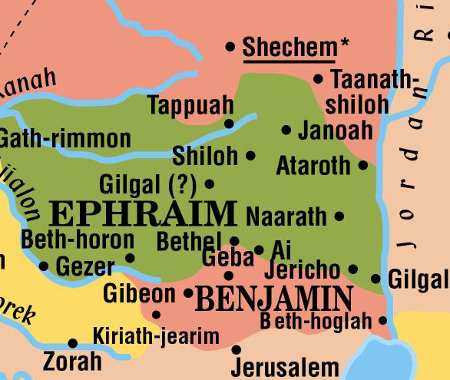
Where was the “second” Gilgal? (Deut. 11:30)

Slide 4
GIBEON-NOT FAR FROM THE ISRAELITES

Slide 5
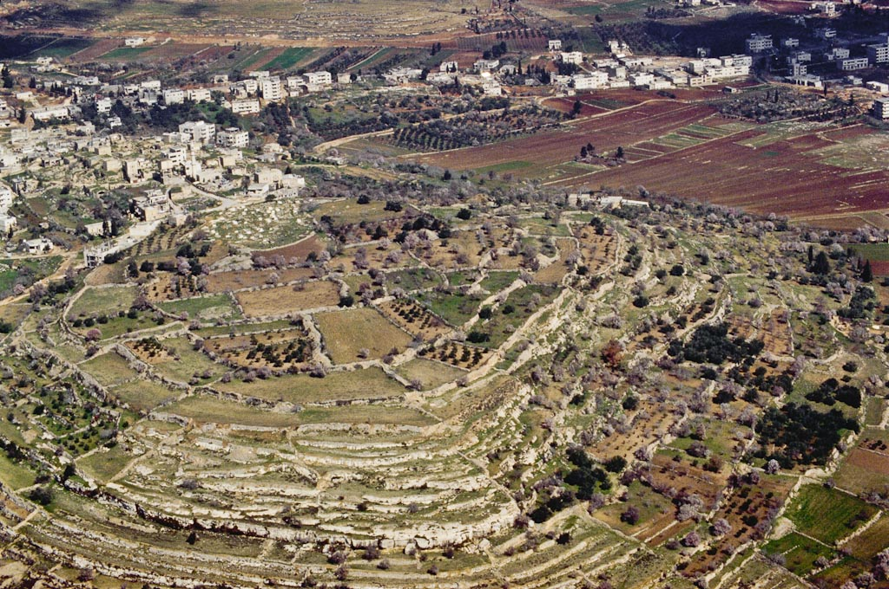
Gibeon from southwest aerial
Notes:
bb00010005

Slide 6
QUESTION 1: Why were the Gibeonites so determined to enter into a treaty with Israel?
They, along with other kings west of the Jordan River, knew of the Israelite successes at Jericho and Ai, as well as what the LORD had done in Egypt and to the Amorites (Sihon and Og). (Josh. 9:3, 9-10)
Gibeon now looked to be next in line—a worse situation than the other kings faced.
Gibeonites were aware of God’s instructions about how Israelites were to treat inhabitants of the land—that they were to be “destroyed.” (Josh. 9:24)
At the same time, they seemed to understand that peoples/cities not within the promised land of Canaan would receive less harsh treatment.

Slide 7
Exod. 23:31-33—”31 ….and YOU SHALL DRIVE THEM OUT BEFORE YOU. 32 YOU SHALL MAKE NO COVENANT WITH THEM AND THEIR GODS. 33 THEY SHALL NOT DWELL IN YOUR LAND, lest they make you sin against me; for if you serve their gods, it will surely be a snare to you.” (ESV)

Slide 8
Deut. 20:16-18 —”16 But in the cities of these peoples that the LORD your God is giving you for an inheritance, YOU SHALL SAVE ALIVE NOTHING THAT BREATHES, 17 but you shall devote them to complete destruction….18 that they may not teach you to do according to all their abominable practices that they have done for their gods, and so you sin against the LORD your God.” (ESV)

Slide 9
QUESTION 2: What serious mistake did the Israelites make in considering the Gibeonites’ story (and their request for a covenant)?
The Israelites were suspicious and carefully inspected the Gibeonites’ provisions and clothing.
But they failed to consult God.
This would prove to be a significant omission.

Slide 10
Josh. 9:18-19—”18 But the people of Israel did not attack them, because the leaders of the congregation had sworn to them by the LORD, the God of Israel. Then all the congregation murmured against the leaders. 19 But all the leaders said to the congregation, ‘We have sworn to them by the LORD, the God of Israel, and now we may not touch them.’” (ESV)

Slide 11
QUESTION 3: Do you think that the treaty between Gibeon and Israel was truly binding upon Israel? Why or why not?
Factors seeming to weigh against it being binding:
It had been based on Gibeonites’ massive fraud.
Deception caused the Israelites to violate a key warning from God: They were not to enter into any covenants with inhabitants of the land.
If the treaty were honored, that violation of God’s instruction would be ongoing, with significant implications.
The prohibition against covenants with land inhabitants was important to God—in effect, it required killing of many thousands of people.

Slide 12
QUESTION 3 (cont.)
Factors in favor of it being binding:
Israelite leaders seemed to base position not only on fact they had made an oath, but on the fact that they had sworn “by the LORD.”
(The big one) We will later see that God viewed the covenant as binding.
Saul will kill Gibeonites, in violation of Israel’s covenant (Josh. 9), reasoning that they were a “remnant” of the Amorites.
During David’s reign, Israel will suffer 3 years of famine which, the LORD said, resulted from the “bloodguilt” on “Saul and on his house.” (See 2 Sam. 21:1-9)

Slide 13
QUESTION 4: What was the significance of the Gibeonite deception?
The result would be that, contrary to God’s explicit instructions to Israel, the Israelites would be living among Canaanites.

Slide 14
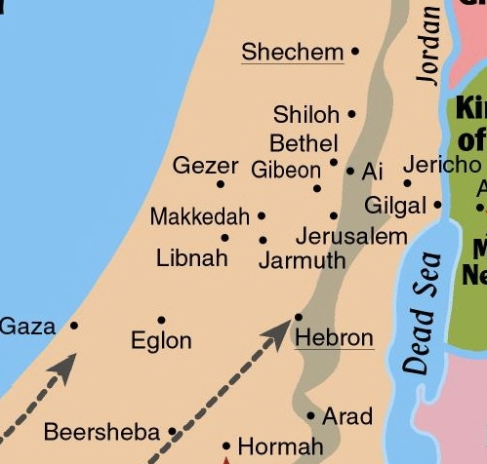
The Conquest of Canaan
Adoni-Zedek, king of Jerusalem was upset over Israel’s victories.
Especially alarmed when he learned Gibeon had made peace with them.
Asked help from the kings of Hebron, Jarmuth, Lachish and Eglon.
Lachish

Slide 15
The Conquest of Canaan
Israelites marched all night from Gilgal, near Shiloh.
The LORD inflicted a “great slaughter” upon the 5 kings at Gibeon.
Pursued 5 kings as far as Makkedah (actual location in doubt). (Josh. 10:10)
Beth-horon
Azekah
Makkedah?

Slide 16
JOSH. 10:13-14—”13 And the sun stood still, and the moon stopped, until the nation took vengeance on their enemies. Is it not written in the Book of Jashar? The sun stopped in the midst of heaven and did not hurry to set for about a whole day. 14 There has been no day like it before or since, when the LORD heeded the voice of a man, for the LORD fought for Israel.” (ESV)

Slide 17
MIRACLES IN THE INVASION AND CONQUEST SO FAR
The crossing of the Jordan River (Josh. 3, technically within the WITW period)
The collapsing of the Jericho walls (Josh. 6)
The “large stones from heaven” as the 5 kings fled before Israel after Gibeon (??) (Josh. 10)
The stopping of the sun and the moon to allow the Israelites an extra day to increase the killing of the 5 kings’ armies (Josh. 10)

Slide 18
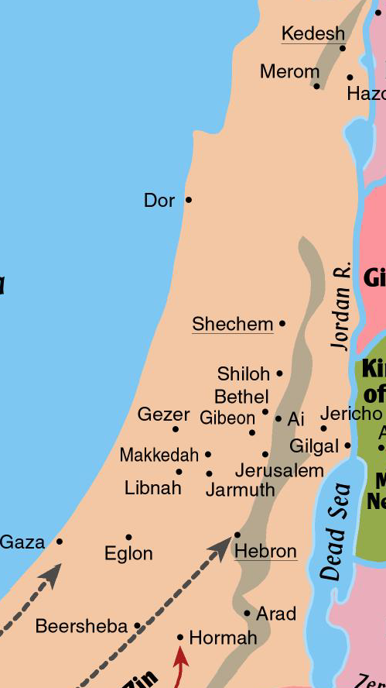
The Battle Aftermath
5 Amorite kings hid in a cave at Makkedah.
Joshua penned them in the cave with large stones and guards.
While most Amorite soldiers had been slaughtered, survivors took refuge in fortified cities.
After the fighting, the 5 kings were brought out of the cave, executed, and their bodies sealed up in the cave.
Makkedah?

Slide 19
The Conquest of Canaan
While Joshua had the advantage, he pushed through all the major cities of the south. (Josh. 10:28-39)
Makkedah - killed 5 kings
Libnah
Lachish
Gezer
Eglon
Hebron
Debir
Every person in these cities was “devoted to destruction.”
Lachish
Debir

Slide 20
The Conquest of Canaan
SUMMARY OF THE SOUTHERN CAMPAIGN:
Josh. 10:40—”So Joshua struck the whole land, the hill country and the Negeb and the lowland and the slopes, and all their kings. He left none remaining, but devoted to destruction all that breathed, just as the LORD God of Israel commanded.” (ESV)
(So far, the Israelites are following God’s instruction to kill all city-dwellers.)
Lachish
Debir

Slide 21
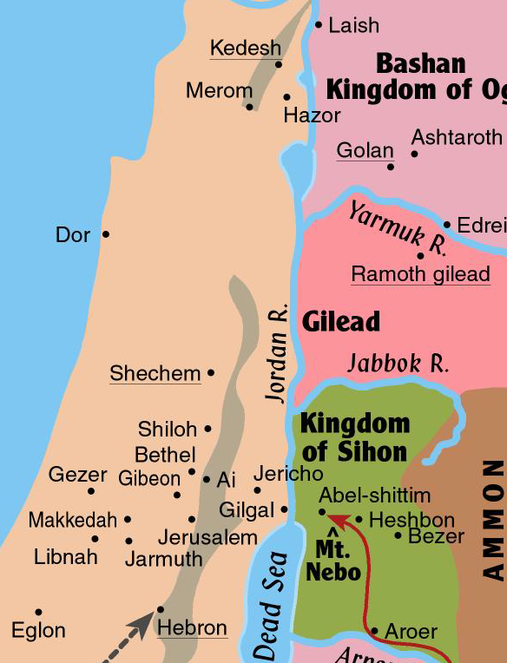
The Conquest of Canaan
Kings of the north formed a coalition.
Jabin, king of Hazor, was the leader.
They gathered a huge army from the northern third of the land.
Assembled at the waters of Merom.

Slide 22
QUESTION 5: As Israel was preparing to fight against the large force that Jabin and the other northern kings had assembled, why do you think that God instructed Joshua that the enemy’s horses should be hamstrung and their chariots burned?
We can surmise that God did not want the Israelites to have the mindset of depending upon horses and chariots for military power—He wanted them to depend upon Him.

Slide 23
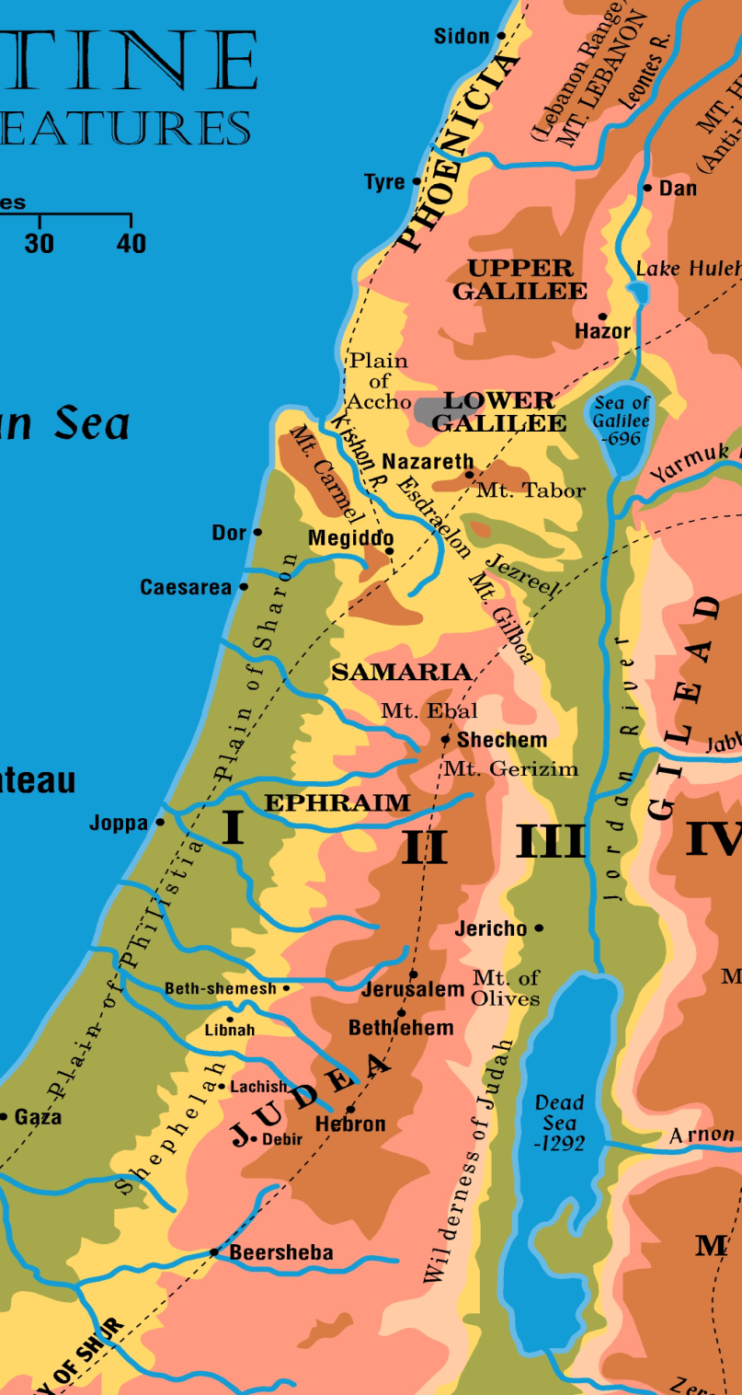
Flight of the Defeated Northern Armies (Josh. 11:8-9)
Leontes River Valley
Valley between the Lebanon Mountains and the Anti-Lebanons
“8 …And they struck them until he left none remaining. 9 And Joshua did to them just as the LORD said to him: he hamstrung their horses and burned their chariots with fire.” (ESV)
Merom

Slide 24
The Conquest of Canaan
Next, Joshua backtracked and took Hazor.
Killed inhabitants; burned city
A major conquest—probably largest city in the land, with 200 acres within massive walls.
After these victories in the north, there was no king or coalition of kings left to fight Israel.

Slide 25
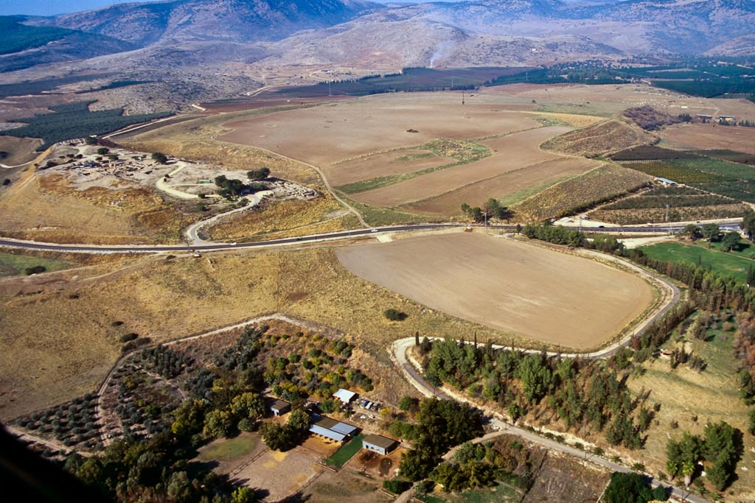
upper tell
lower city
lower city
Hazor aerial from southeast—upper and lower cities were within walls
Notes:
tbs112120011

Slide 26
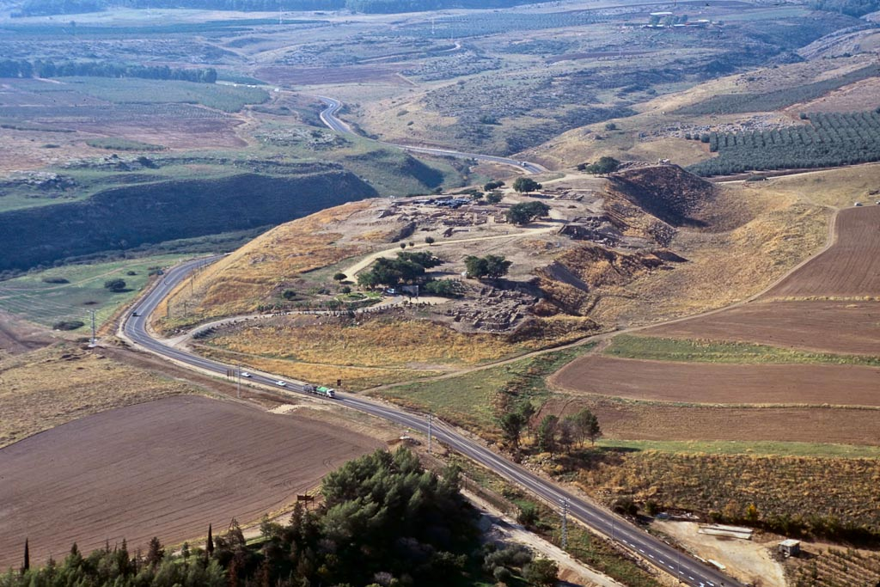
Hazor upper city aerial from east
Notes:
Biblical History
Hazor was destroyed by Joshua (Josh 11:10).
Jabin’s army, led by Sisera, was destroyed by Deborah and Barak at Hazor (Judg 4).
Solomon built Hazor (1 Kgs 9:15).
Hazor was captured by Tiglath-Pileser III, king of Assyria (2 Kgs 15:29).
tbs112290011

Slide 27
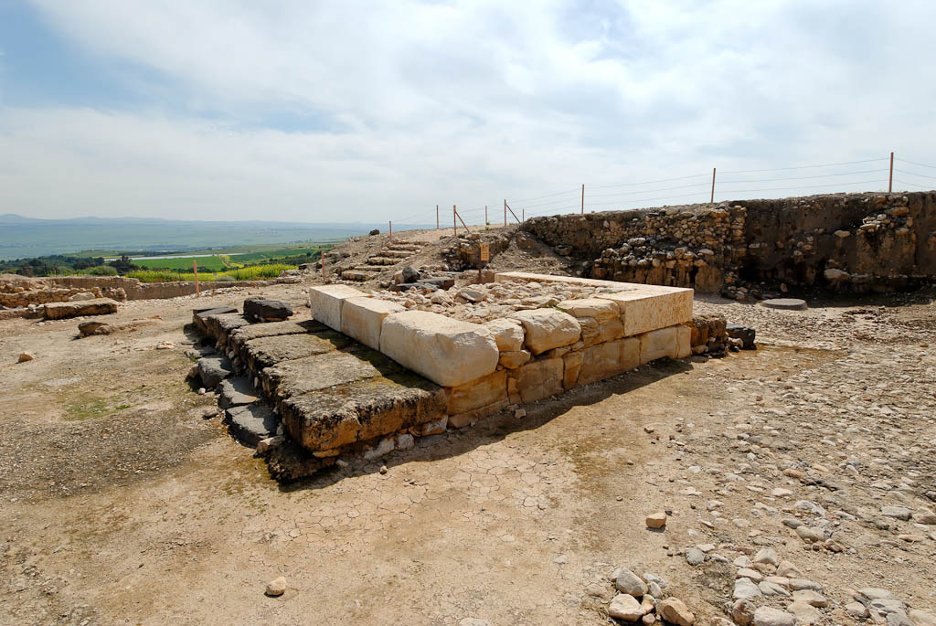
Hazor Canaanite altar near palace
Notes:
The altar was located in the center of the courtyard in front of the Late Bronze palace.
tb032607742

Slide 28
JOSH. 11:14-15—”14 And all the spoil of these cities and the livestock, the people of Israel took for their plunder. But every person they struck with the edge of the sword until they had destroyed them, and they did not leave any who breathed. 15 Just as the LORD had commanded Moses his servant, so Moses commanded Joshua, and so Joshua did. He left nothing undone of all that the LORD had commanded Moses.” (ESV)

Slide 29
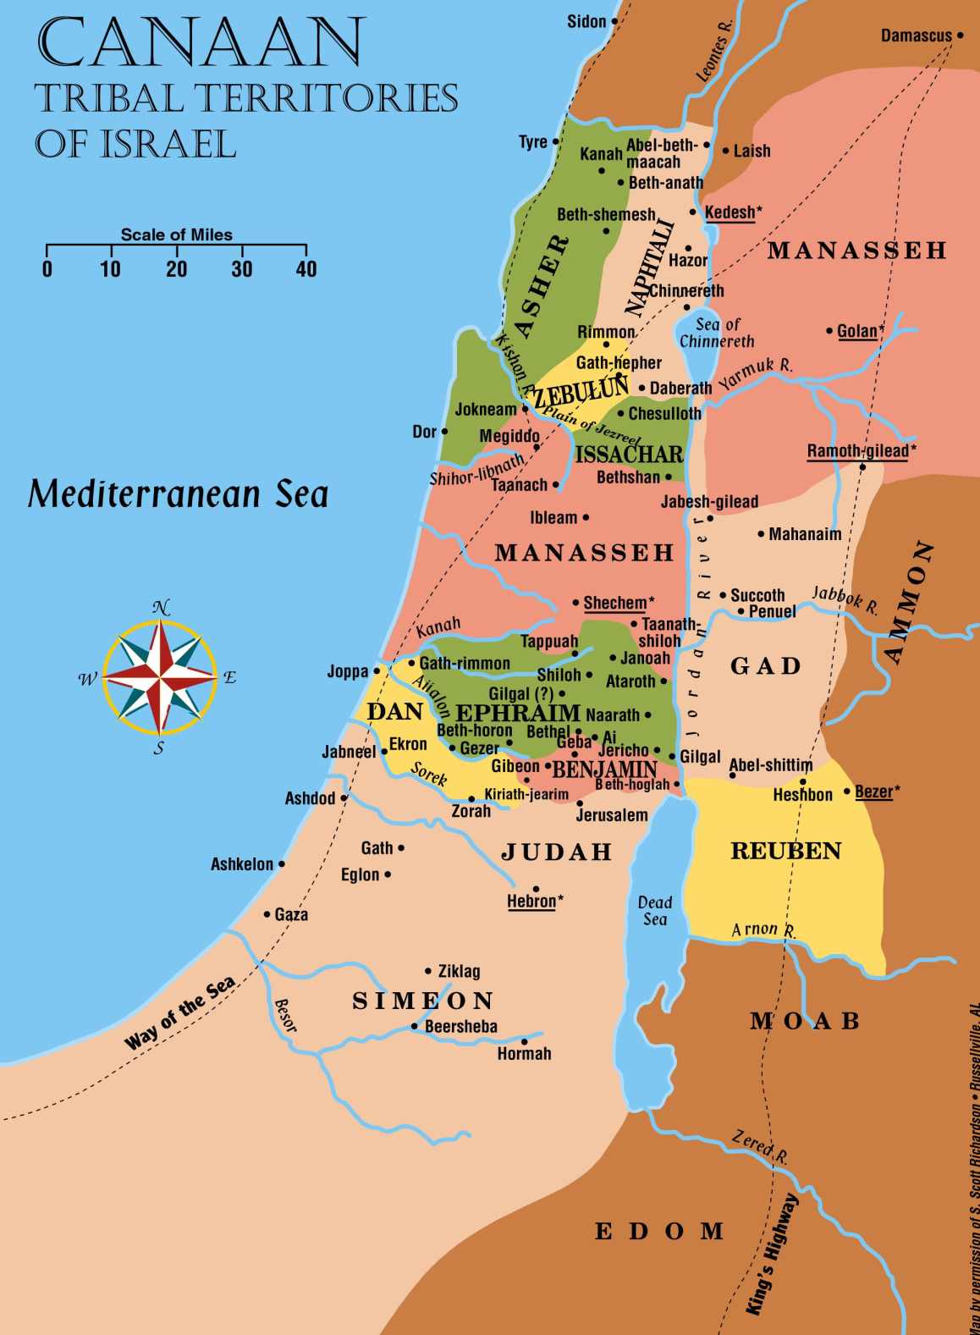
3
In what order were the sections of the land taken?
1
2

Slide 30
JOSH. 11:19-20—”19 There was not a city that made peace with the people of Israel except the Hivites, the inhabitants of Gibeon. They took them all in battle. 20 For it was the LORD’s doing to harden their hearts that they should come against Israel in battle, in order that they should be devoted to destruction and should receive no mercy but be destroyed, just as the LORD commanded Moses.” (ESV)

Slide 31
AS TO THE GIANTS…
JOSH. 11:21-22—”21 And Joshua came at that time and cut off the Anakim from the hill country, from Hebron, from Debir, from Anab, and from all the hill country of Judah, and from all the hill country of Israel. Joshua devoted them all to destruction with their cities. 22 There was none of the Anakim left in the land of the people of Israel. Only in Gaza, in Gath, and in Ashdod did some remain.” (ESV)

Slide 32
AN OVERALL SUMMARY:
JOSH. 11:23—”23 So Joshua took the whole land, according to all that the LORD had spoken to Moses. And Joshua gave it for an inheritance to Israel according to their tribal allotments. And the land had rest from war.” (ESV)

Slide 33
Joshua 12—Defeated Kings and Cities
Joshua 12 is a summary of all the kings and cities Israel has conquered.
The conquered land includes the territory on both sides of the Jordan River.

