Slide 1
GEOGRAPHY OF THE PROMISED LAND

Slide 2
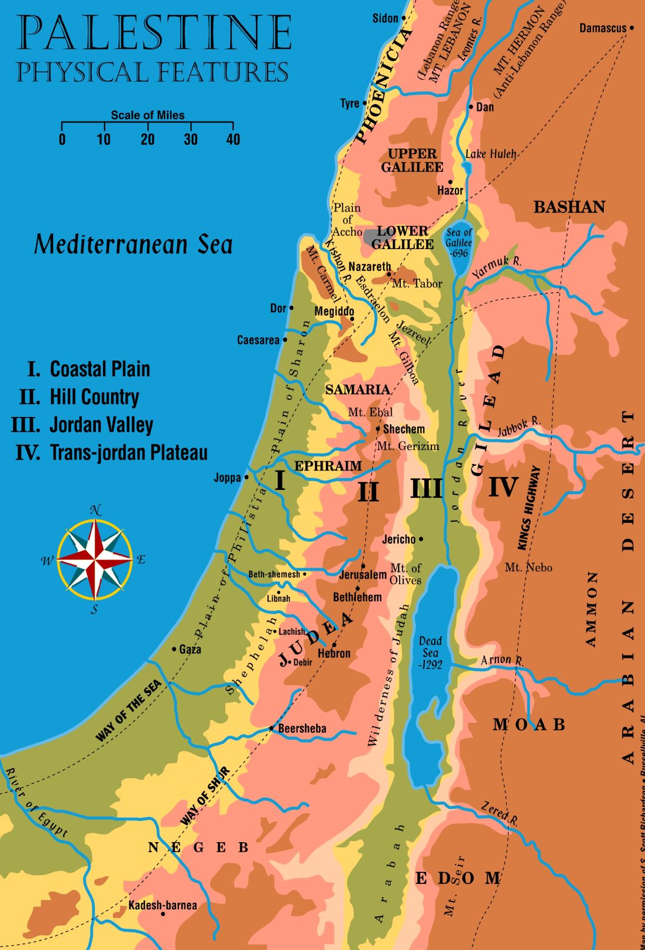
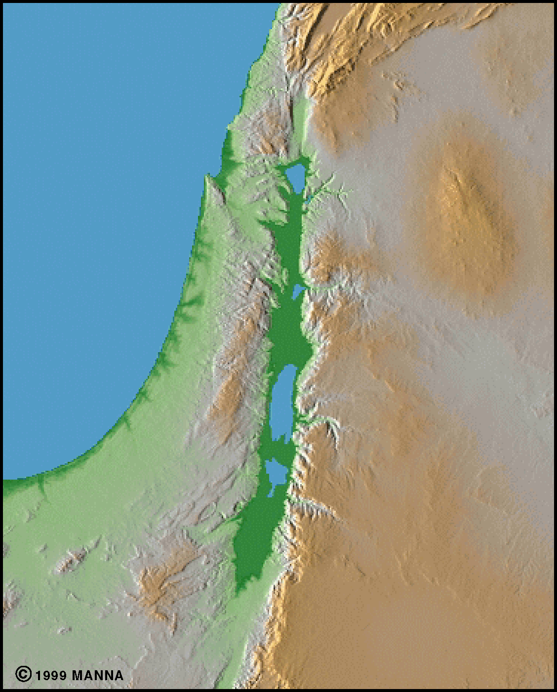
Note the topography.

Slide 3
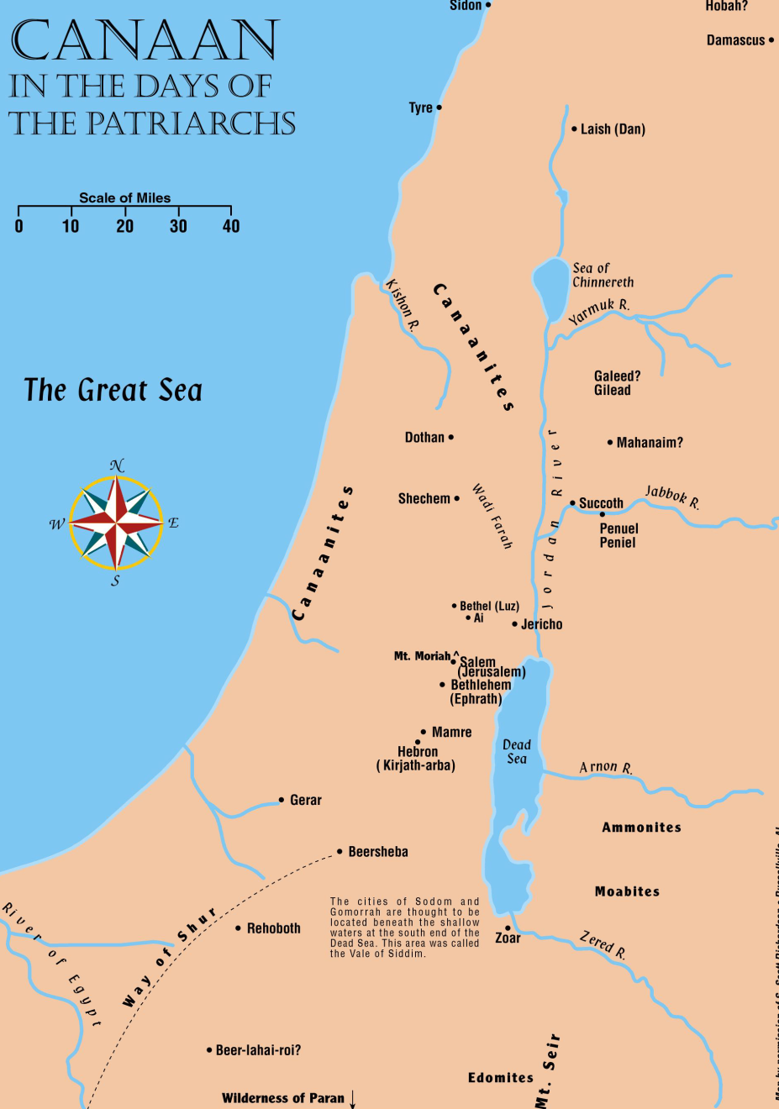
A Tiny Country
Dan to Beersheba is 150 miles
Mediterranean Sea to the Jordan Valley is 30 miles
Gaza to the Dead Sea is 50 miles
The term “Canaan” only applied to the west side of the Jordan River
30
150
50

Slide 4
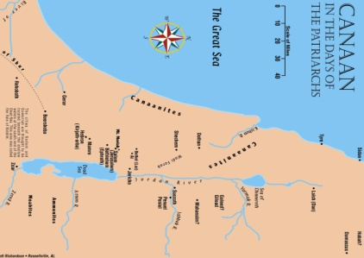
Palestine in New Mexico
Palestine
12,000 Sq Miles
New Mexico
121,000 Sq Miles
New Mexico

Slide 5




Palestine in the United States

Slide 6
A BOUNTIFUL LAND
“WE WENT INTO THE LAND WHERE YOU SENT US, AND IT CERTAINLY DOES FLOW WITH MILK AND HONEY, AND THIS IS ITS FRUIT.” (NUM. 13:27, report of spies) (ESV)

Slide 7
A BOUNTIFUL LAND
“FOR THE LORD YOUR GOD IS BRINGING YOU INTO A GOOD LAND, A LAND OF BROOKS AND WATER, OF FOUNTAINS AND SPRINGS, FLOWING FORTH IN VALLEYS AND HILLS; A LAND OF WHEAT AND BARLEY, OF VINES AND FIG TREES AND POMEGRANATES, A LAND OF OLIVE OIL AND HONEY; A LAND WHERE YOU WILL EAT FOOD WITHOUT SCARCITY, IN WHICH YOU WILL NOT LACK ANYTHING; A LAND WHOSE STONES ARE IRON, AND OUT OF WHOSE HILLS YOU CAN DIG COPPER.” (DEUT. 11:14-17) (ESV)

Slide 8

Distinct Parallel Zones
  Mediterranean Sea
  Coastal Plain
  Hill Country
  Jordan Valley
  High Tableland
  Arabian Desert

Slide 9
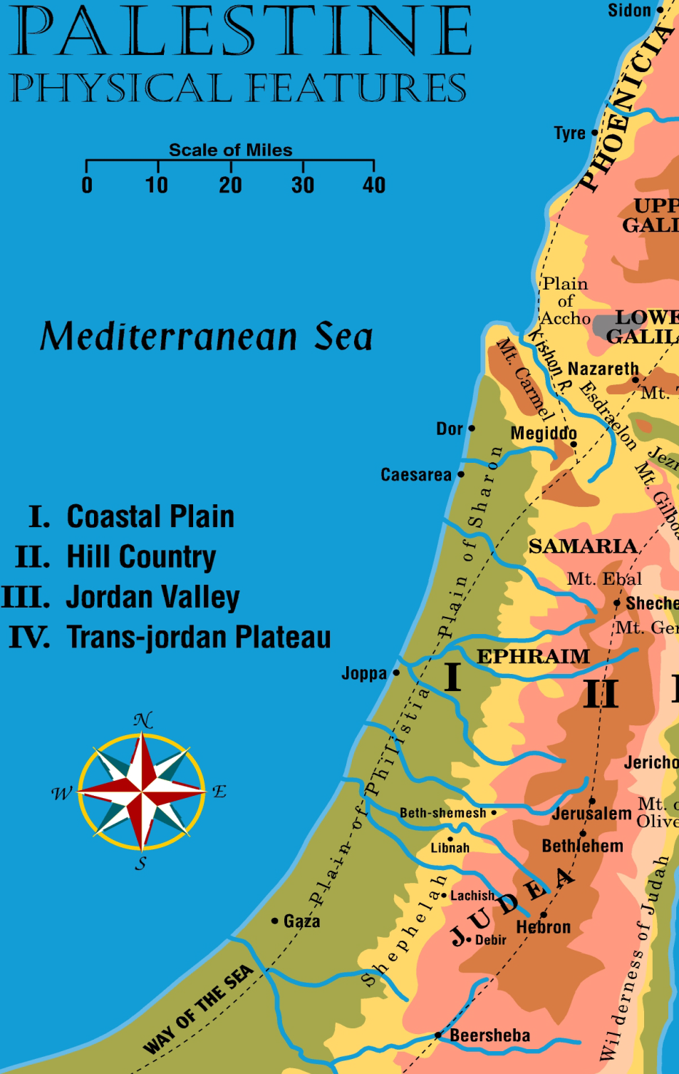
The Coastal Plain
Three Divisions
  Plain of Phoenicia
    Sea Trade
    Canaanites
  Plain of Sharon
    Wet, marshy, crocs
    Canaanites occupied
  Plain of Philistia
    Very fertile
    Land of the Philistines

Slide 10
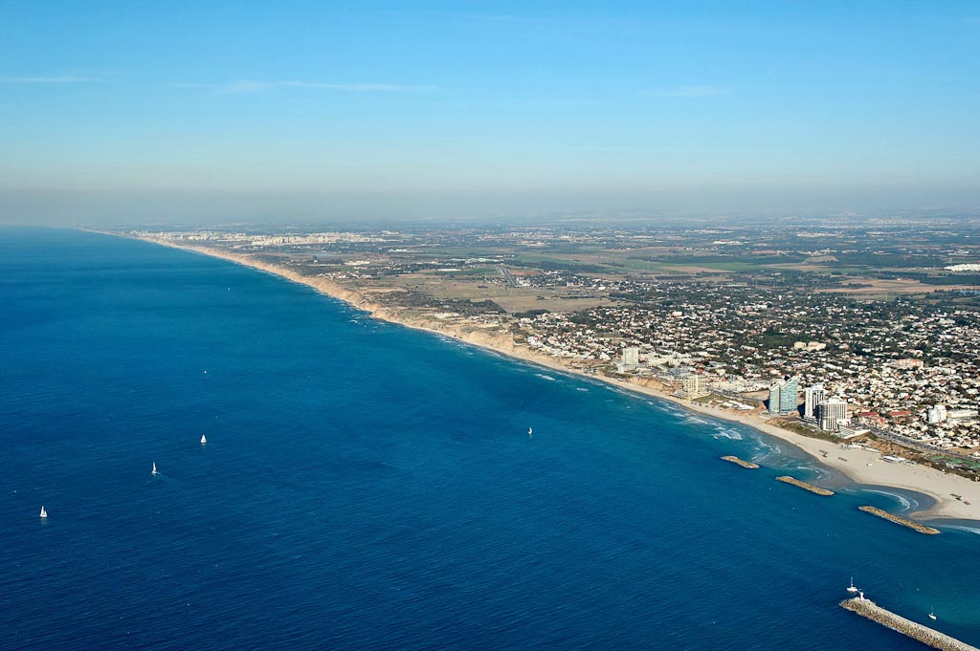
Plain of Sharon coastline north of Tel Aviv from southwest
Notes:
tb121704900

Slide 11
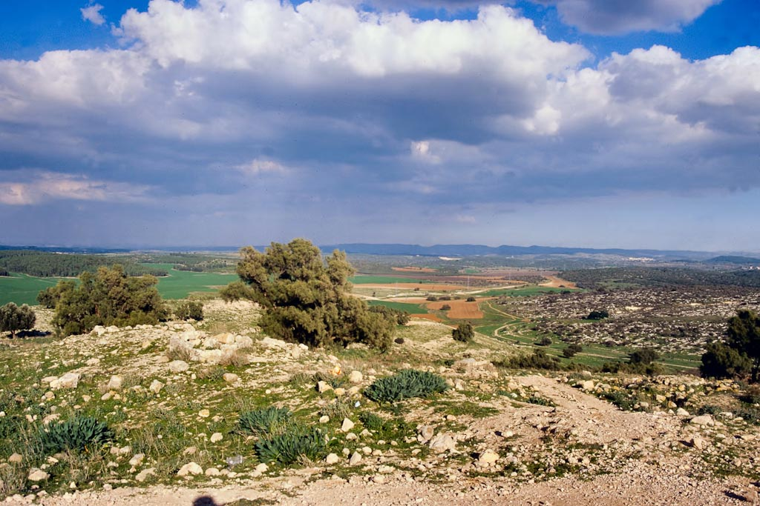
Plain of Philistia--Gath, Tell es-Safi, view north
Notes:
tbs96139801

Slide 12
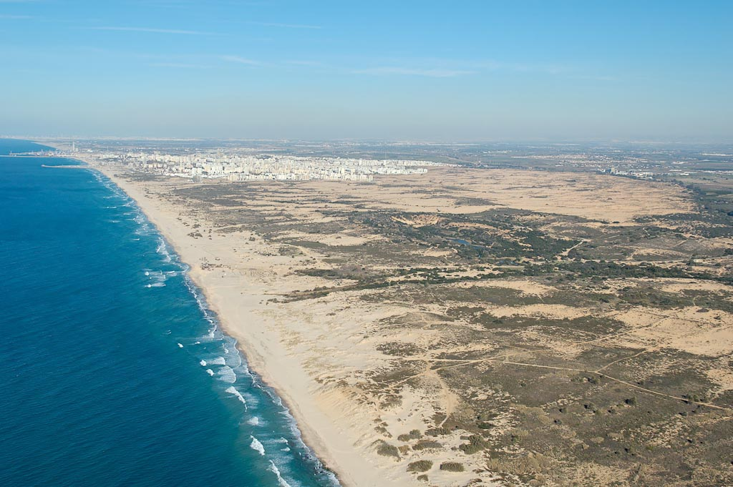
Plain of Philistia south of Ashdod
Notes:
tb121704850

Slide 13
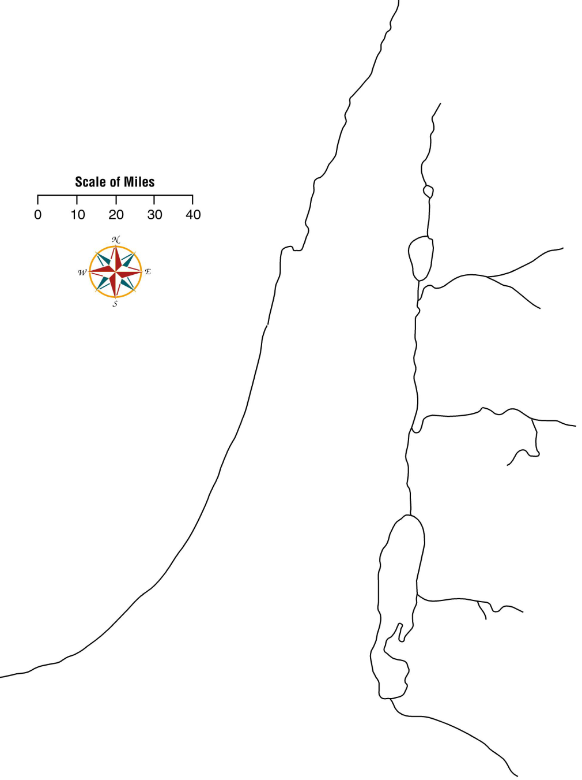
Mediterranean Sea
The Great Sea
No decent harbor South of Mt. Carmel
Fair weather harbors
  Joppa
  Dor
Philistines inhabited the southern portion of the coastal plain
  Came from Crete
  Capital city of Gaza
Mt Carmel
Dor
Mediterranean Sea
Joppa
Gaza

Slide 14

Mediterranean Sea
The Great Sea
Excellent harbors North of Mt. Carmel
  Plain of Accho
  Tyre
  Sidon
Sidon
Tyre
Plain of Accho
Mediterranean Sea

Slide 15
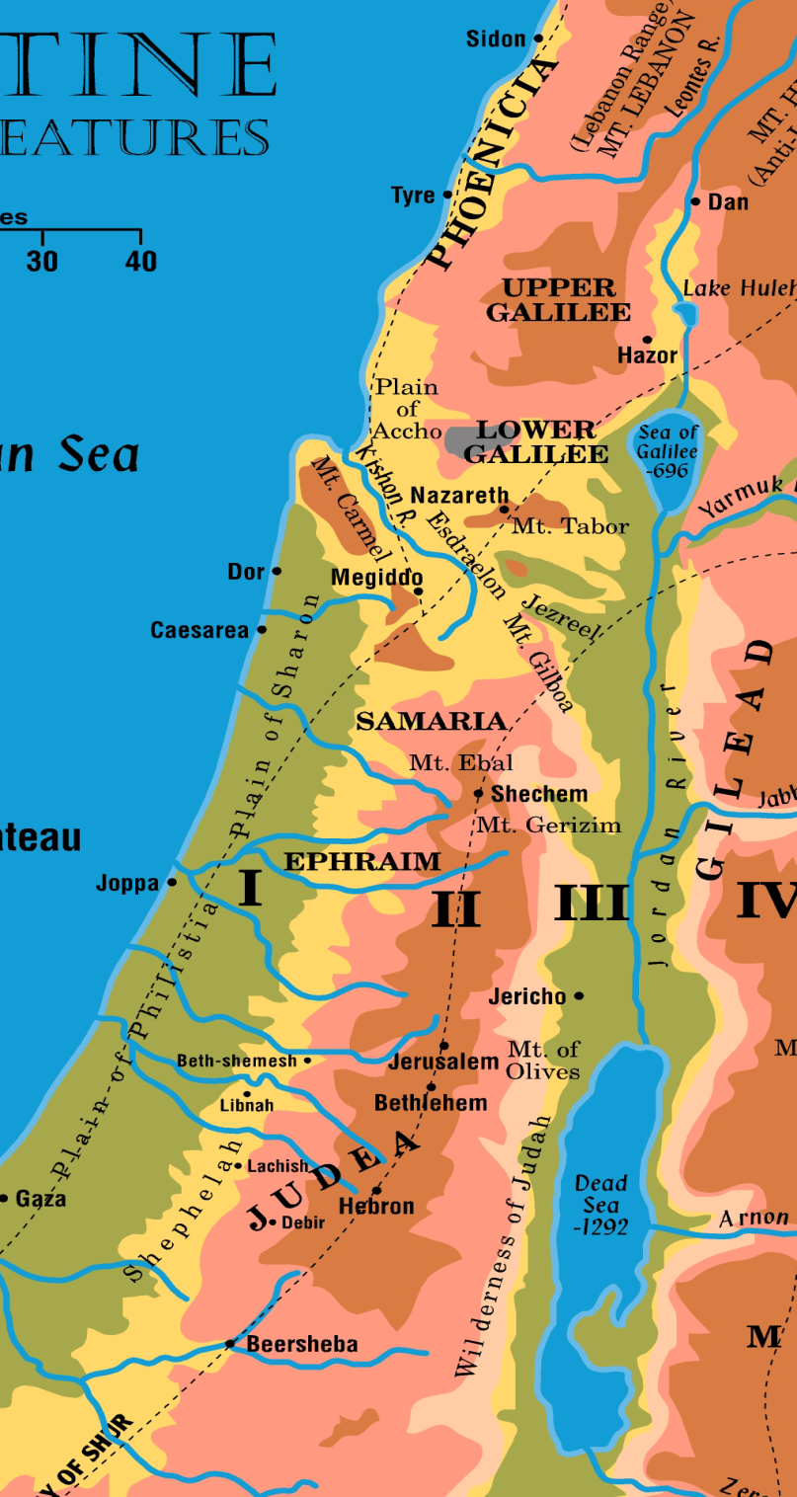
The Hill Country
Hill country west of Jordan was the Israelite stronghold
Lebanon Mountain Range
  Range nearest the Sea called Lebanon
    10,000 ft above sea level
  Range to the East is called the Anti-Lebanons
    Considered the northern boundary of Palestine during most of Bible history

Slide 16

The Hill Country
Leontes River runs between Lebanon and the hills of Galilee
  2,000 foot gorge
  Impassable barrier between Phoenicia and Israel

Slide 17
The Hill Country
Galilee
  50 mile section from Leontes River to the Valley of Jezreel
  Upper Galilee – high, rugged, 2,000-4,000 feet above sea level
  Lower Galilee – rounded hills, 700 feet above sea level

Slide 18
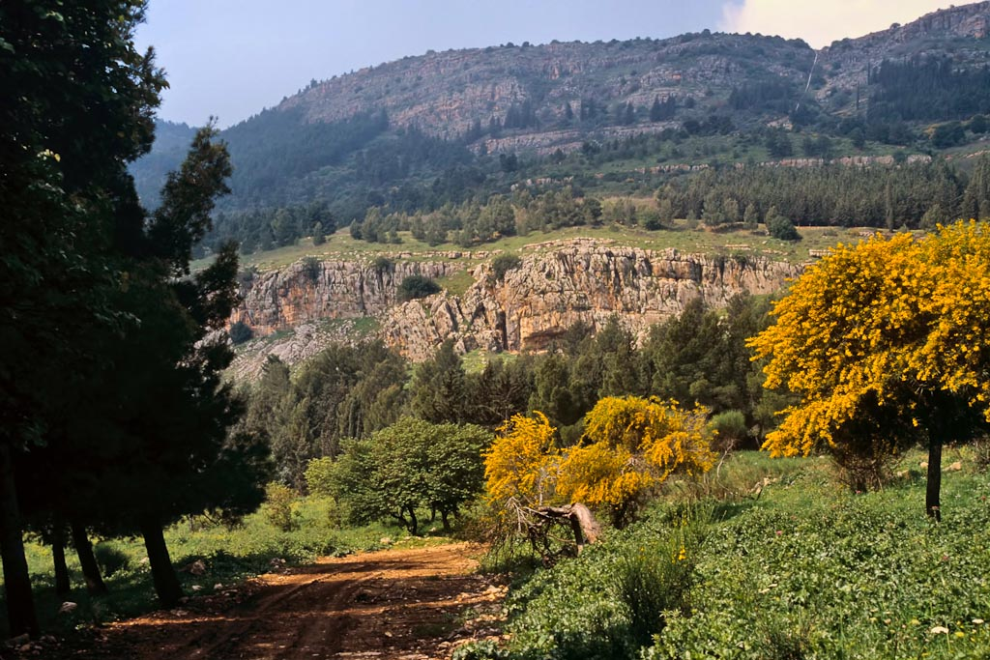
UPPER GALILEE
Notes:
This photo was taken on the eastern slopes of the tribal territory of Naphtali, above the Israeli city of Kiryat Shemona.
tbs103179904

Slide 19

The Hill Country
Valley of Jezreel
  Series of valleys and plains that open together
  Western portion of the plain is drained by the Kishon River that empties into the Sea

Slide 20
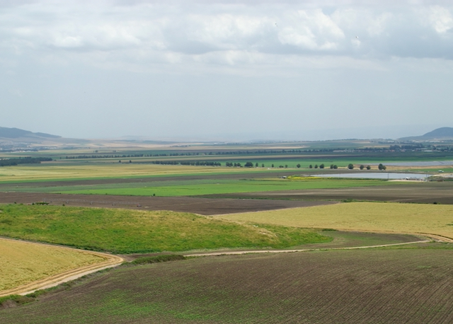
GALILEE—JEZREEL VALLEY

Slide 21
The Hill Country
Central Hill Country
  Highest peaks = 3,000 feet
  Mt. Gilboa
  Mt. Ebal
  Mt. Gerizim

Slide 22
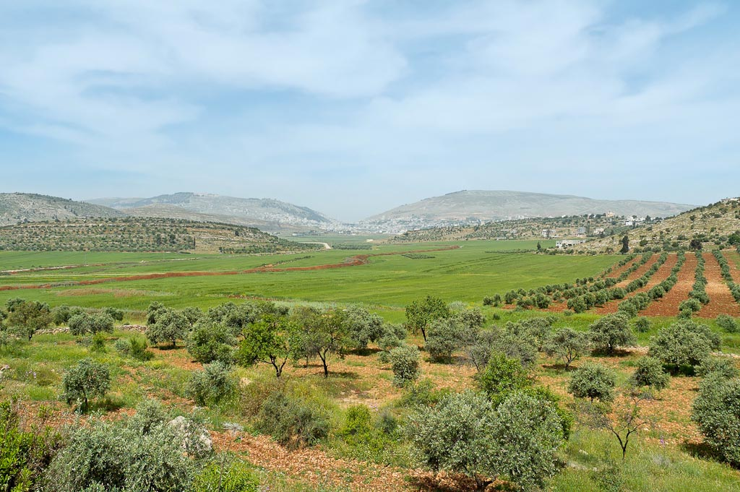
Central Hill Country—Mt. Gerizim, Shechem, and Mt. Ebal from east
Notes:
tb050106458

Slide 23
The Hill Country
Hill Country of Judah
  50 mile stretch of land averaging about 2,000 feet above sea level
  Shallow valleys and domelike mountains
  Bethlehem is 3,800 feet above the Dead Sea 14 miles away

Slide 24
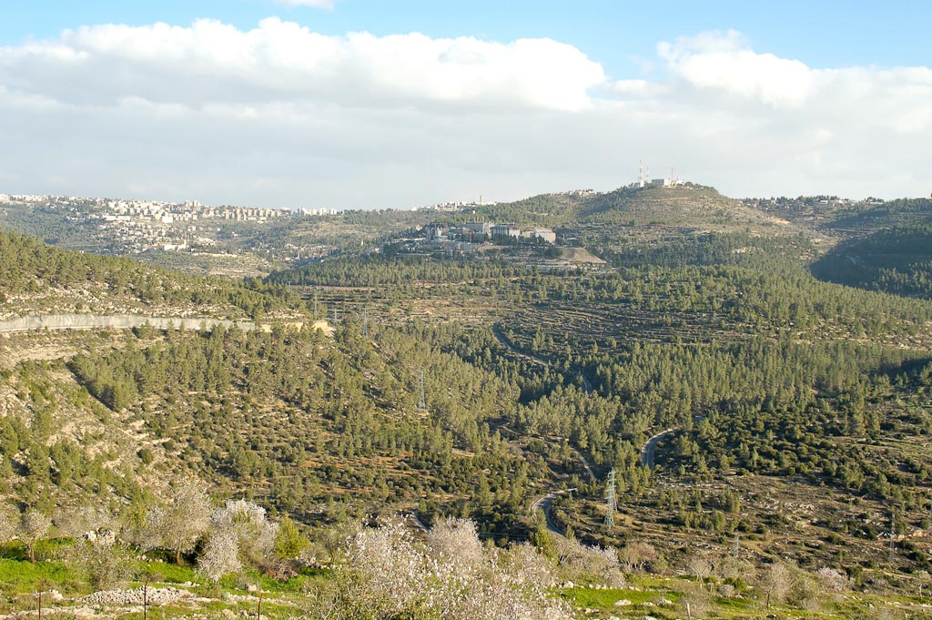
Judah Hill Country--Jerusalem and Ein Kerem from northwest
Notes:
Luke does not give a specific location for the home of Elizabeth and Zechariah, but writes that Elizabeth lived in “a town in the hill country of Judea” (Luke 1:39). Literary tradition from the 6th century, however, identifies Elizabeth’s hometown with Ein Karem, and the presence of two fourth-century churches indicates that the tradition is even older.
tb020305202

Slide 25
The Hill Country
Hill Country of Judah
  From Mt. of Olives to the Dead Sea the land falls from 2,680 feet above sea level to 1,292 feet below sea level!

Slide 26
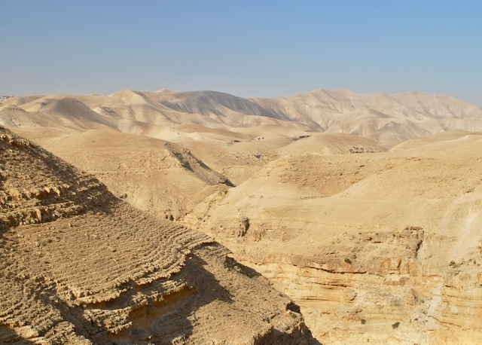
JUDEAN HILL COUNTRY--WILDERNESS

Slide 27
The Hill Country
Negev
  Name is usually applied to the semi-desert region between Beersheba and Kadesh-barnea
  South of Hebron the hills descend gradually to the rolling hills of the Negev “the south”
  Forms a buffer zone between Canaan and the true desert of the Sinaitic Peninsula

Slide 28
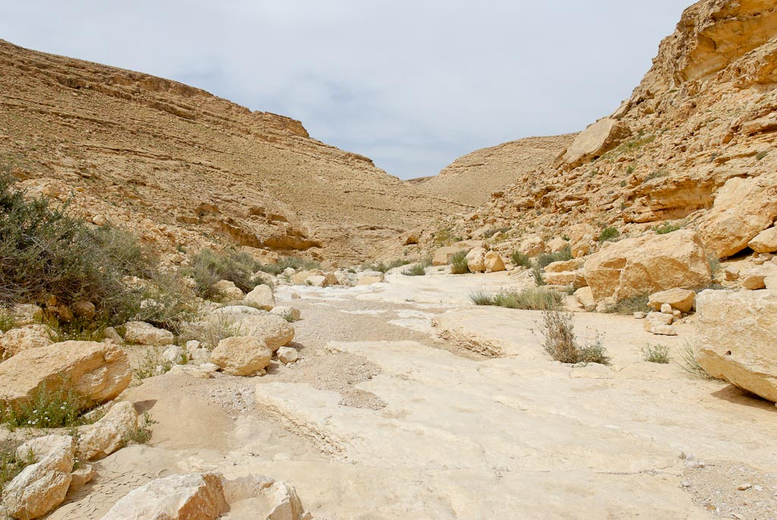
Judean Hill Country—The Negev
Notes:
Nahal Hava (Wadi Hava) is a beautiful canyon located north of Machtesh Ramon. It is not easily accessible today except by four-wheel drive and some good hiking boots. Its name is translated “Wadi of Winds” or “Wadi of Spirits.” For more information about this trek, see Aviva Bar-Am and Yisrael Shalem, Israel’s Southern Landscapes, pages 177-82. The following photos were taken on a day-long hike.
tb042107662

Slide 29

The Jordan Valley
Part of the Great Rift Valley
  Rift: A crack in the earth’s crust. Runs along two fault lines

Slide 30

The Jordan Valley
Begins on the NE shores of the Mediterranean and extends down the Jordan through Palestine, Arabah, Gulf of Aqaba, the Red Sea, and into Eastern Africa
  4,000 miles long
    The portion from the Sea of Galilee to the Dead Sea is called
    “El Ghor” today

Slide 31

The Jordan Valley
Valley is narrow
  2–15 miles wide with cliffs on either side
  Tropical growth (jungle like) in the valley (with lions back in the day)

Slide 32
The Jordan Valley
The Jordan River
  Eleven miles from Lake Huleh (no longer in existence today) to the Sea of Galilee. The river drops 900 feet
  (80 feet per mile)
  Descends another 600 feet in 65 miles to reach the Dead Sea

Slide 33

The Jordan Valley
The Jordan River
  Covers 80 miles from Mount Hermon to the Dead Sea
    It takes 200 miles of wandering river to cover the 80 miles

Slide 34
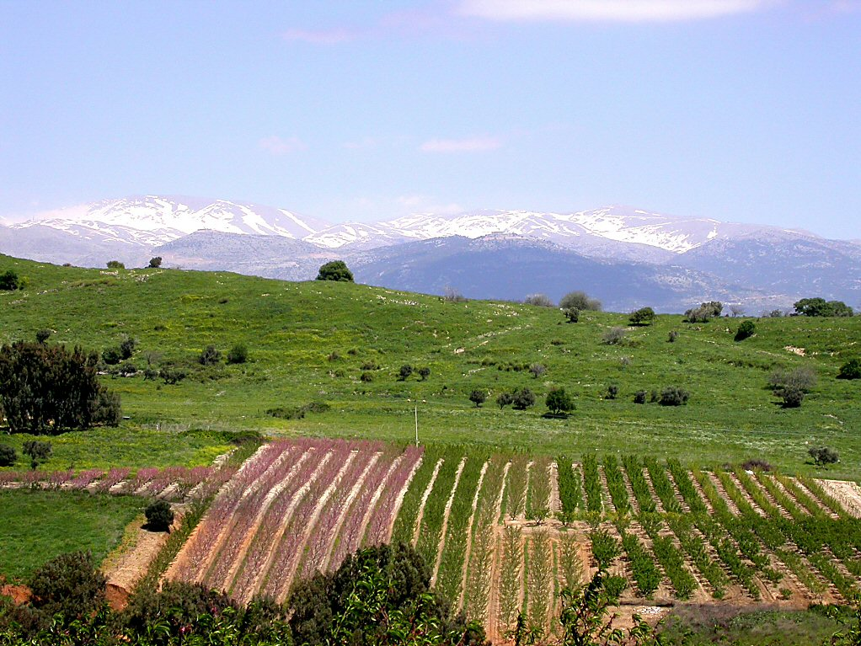
Mount Hermon from southwest
Notes:
tb040903241

Slide 35
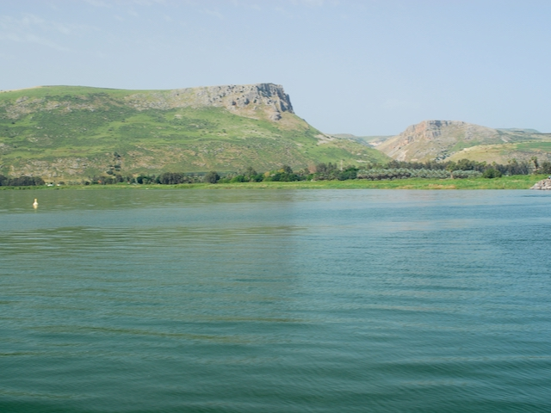
SEA OF GALILEE—LOOKING WEST AT CLIFFS OF ARBEL

Slide 36
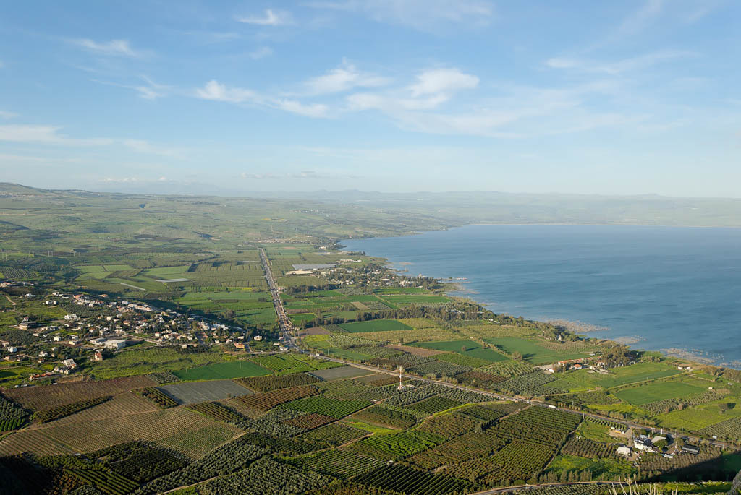
Plain of Gennesaret from Arbel
Notes:
The Plain of Gennesaret: Fertility
The plain is temperate and has a productive climate, due partly to its location at 650 feet (200 m) below sea level.
Josephus gave a good description of this fertile plain. He said that it produced crops ten months of the year: “Alongside Lake Gennesaret is a stretch of country with the same name, wonderful in its characteristics and in its beauty. Thanks to the rich soil there is not a plant that does not flourish there, and the inhabitants grow everything: the air is so temperate that it suits the most diverse species. Walnuts, most winter-loving of trees, flourish in abundance, as do palms, which thrive on heat, side by side with figs and olives, for which a milder air is indicated. One might deem it nature’s crowning achievement to force together into one spot natural enemies and to bring the seasons into healthy rivalry, each as it were laying claim to the region. For not only does it produce the most surprisingly diverse fruits but it maintains a continuous supply. Those royal fruits the grape and fig it furnishes for ten months on end, the rest ripening on the trees all year round; for apart from the temperate atmosphere it is watered by a spring with great fertilizing power, known locally as Capernaum. Some have thought this an off-shoot of the Nile….Such is the character of the locality” (War 3.506-515).
tb032507715

Slide 37

The Jordan Valley
The Jordan River
  River bed varies from 80 to 180 feet wide with an average depth of
  5-12 feet
  Jordan Valley is 14 miles wide at Jericho. It was flood season when the Israelites crossed the river to take Jericho
    Joshua 3:15-16

Slide 38
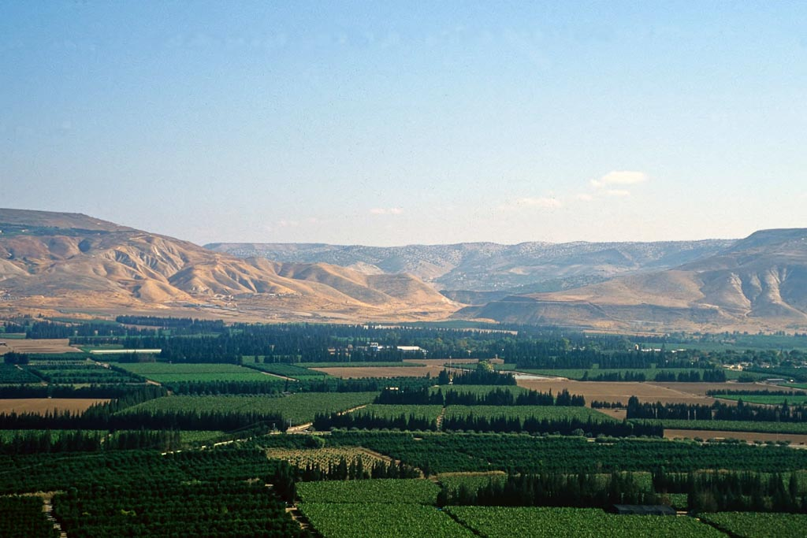
Jordan Valley, tableland from west—at Yarmuk River Valley
Notes:
The Yarmuk River forms the northern border of Gilead and the southern border of Bashan (modern Golan Heights) but is never specifically mentioned in Scripture by name.
tbs117130011

Slide 39
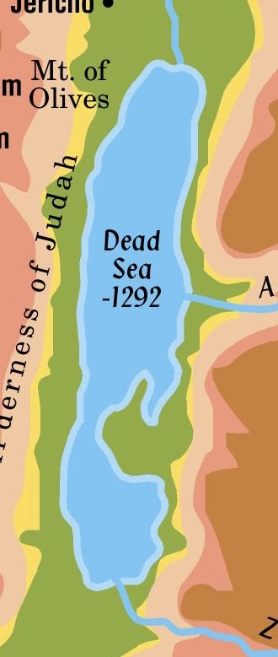
The Jordan Valley
The Dead Sea
  48 miles long
  Maximum width is
  10 miles
  Deepest point on land (-1292 ft.)
  Depth of Sea another 1300 ft.

Slide 40
The Jordan Valley
The Dead Sea
  6 ½ million tons of water flow into the Dead Sea each day
    Jordan, Arnon, Zered rivers flow into it
    NOTHING flows out of it because the evaporation rate is so great
  Water is 25% solid substance – five times saltier than the oceans

Slide 41
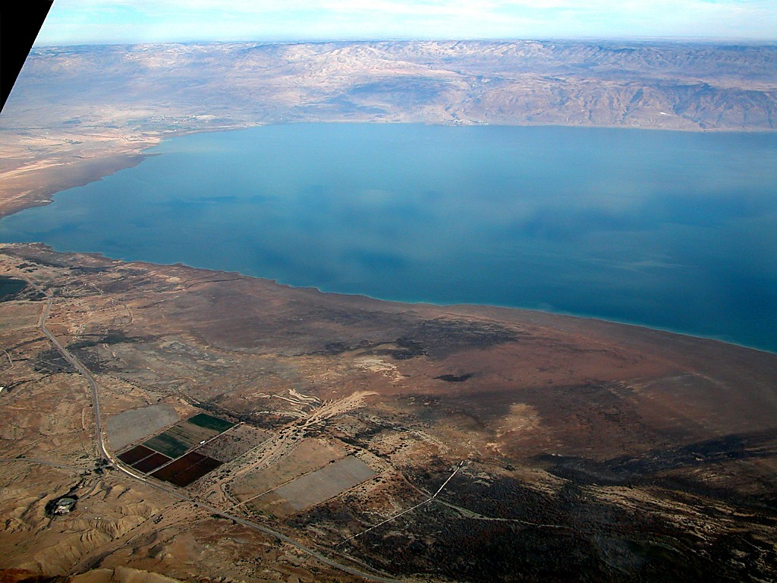
Mt. Nebo
Plains of Moab
Dead Sea
Qumran
Jordan Valley--Dead Sea northern end and Qumran aerial from west
Notes:
tb010703243

Slide 42
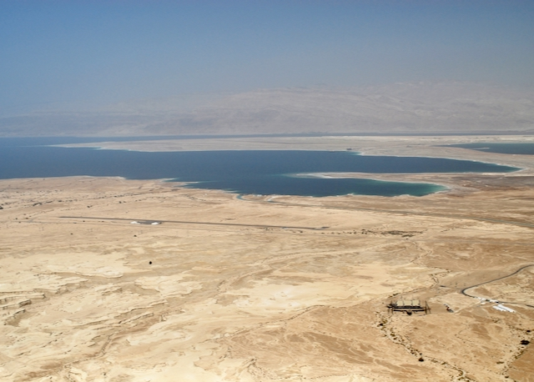
DEAD SEA—FROM SOUTHWEST

Slide 43
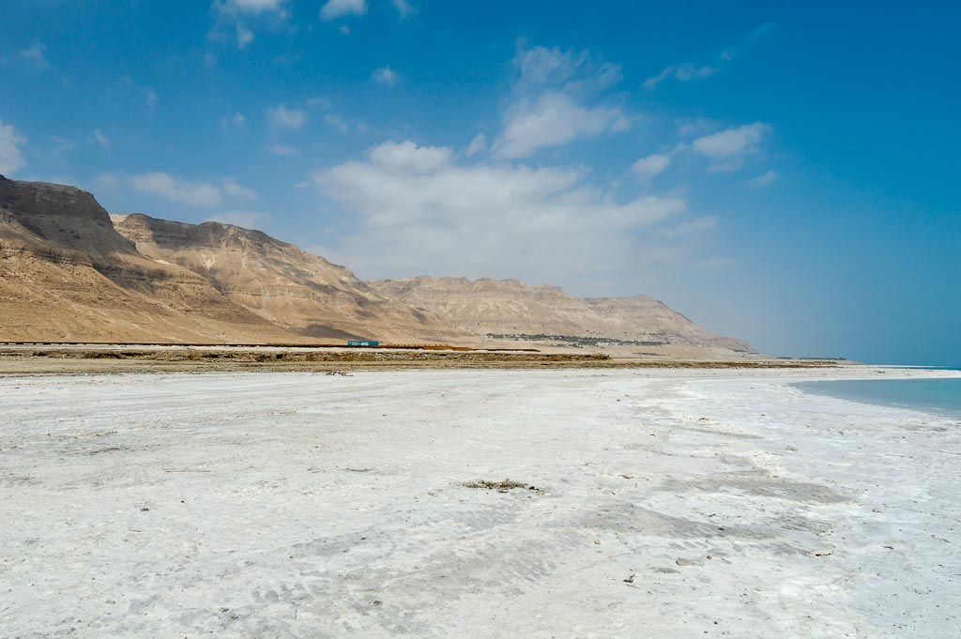
Jordan Valley--Dead Sea, lowest point on earth
Notes:
tb030206539

Slide 44
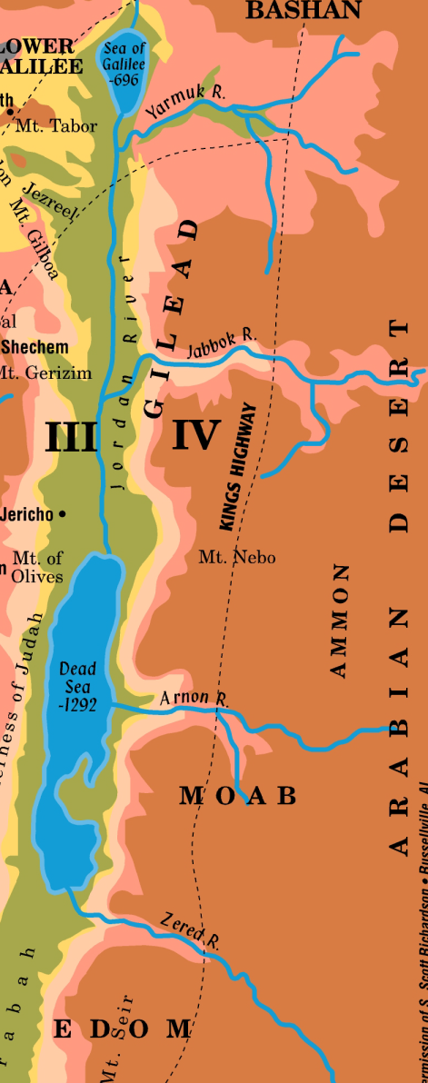
Trans-Jordan Plateau
Extension of the
Anti-Lebanons
  Plateau of Moab forms a wall 3,000 feet high
  Mountains on the east side are higher than those on the west
    Moses viewed the Promised Land from one of the peaks on Mt. Nebo (Deuteronomy 34)

Slide 45
Trans-Jordan Plateau
Regions of the Trans-Jordan:
  Bashan (taken from King Og)
  Gilead (good pasture)
  Moab
  Edom
  Ammon

Slide 46

Trade Routes
Way of the Sea
  Coastal plain
  Through Megiddo
  Busy route

Slide 47
Trade Routes
Way of Shur
  Along hill country
  Israelite
  main route

Slide 48
Trade Routes
King’s Highway
  Trans-Jordan Plateau
Wars fought to gain control of the routes

Slide 49
The People of the Land
Moses listed seven tribes the Israelites would find living in the land of Canaan.
  Hittites, Girgashites, Amorites, Canaanites, Perizzites, Hivites and Jebusites
  Also giants called Anakim, Rephaim, Emim or Zamzummim
  Tribes were descendants of Ham through his son Canaan.
    Lived closely with the descendants of Shem in the Fertile Crescent and Arabia.

Slide 50
The People of the Land
The name “Canaanite” is used most frequently in a collective sense to include all these tribes.
Amorites were the largest and strongest
of the tribes.
  Israelites conquered two groups of Amorites on the eastern side of the Jordan before Moses died (Sihon and Og).

Slide 51
The People of the Land
Hittites were descendants of Canaan through his son Heth.
  Established an early kingdom along the Halys River (in the area later called Asia Minor).

Slide 52
The People of the Land
Hivites, Girgashites, Perizzites, and Jebusites were smaller and less powerful.
  Jebusite stronghold was the city of Jerusalem.
    They proved to be particularly difficult to dislodge.

Slide 53
The People of the Land
Giants were in the land before Abraham’s day.
  Israelites killed Og and took his territory, though he was so large he had a bedstead of iron 13 feet long and 6 feet wide
  (Deuteronomy 3:11).
  Goliath, who fought David, was from Gath. He was nine and a half feet tall.

Slide 54
THE POLITICAL SITUATION IN THE LAND WHEN THE ISRAELITES ARRIVED…
MANY TRIBES--NO STRONG, WIDE-RANGING POLITICAL ORGANIZATIONS
  UNLIKE TIGRIS-EUPHRATES AREA AND NILE VALLEY, WHERE SMALL KINGDOMS, PRINCIPALITIES HAD UNITED
  TOPOGRAPHY NOT CONDUCIVE TO UNITY
MANY CITY-STATES EXISTED IN CANAAN.
  FORTIFIED AGAINST ATTACK—OFTEN WALLED
  SOMETIMES PAID TRIBUTE TO INVADERS FROM EUPHRATES OR NILE
  SOMETIMES FORMED LEAGUES FOR COMMON DEFENSE AGAINST INVADERS SEEKING TO OCCUPY LAND

Slide 55
THE RELIGIOUS SITUATION IN THE LAND WHEN THE ISRAELITES ARRIVED…
POLYTHEISM WIDELY PRACTICED
  EL WAS SUPREME GOD, WITH ASHERAH AS “WIFE”
    EL REGARDED AS CREATOR
70 GODS, GODDESSES VIEWED AS OFFSPRING OF EL AND ASHERAH
  CHIEF AMONG THEM WAS “HADAD” OR BAAL.
GODS HAD NO MORAL CHARACTER; SORDID RELIGIOUS PRACTICES RAMPANT
  IDOL WORSHIP
  “SACRED” PROSTITUTION
  CHILD SACRIFICE
  SNAKE WORSHIP

Slide 56
WHEN THE ISRAELITES ARRIVED…
FERTILE FARMLAND; ADVANCED AGRICULTURE
ESTABLISHED TRADE ROUTES
PEOPLE—LOTS OF THEM, BUT POLITICALLY AND MILITARILY WEAK
  7 TRIBES
  CITIES, OFTEN WALLED
  GIANTS
  SORDID, DEPRAVED, IDOLATROUS, POLYTHEISTIC RELIGION

