Slide 1
Bringing man back to god
The central theme of the Bible

Slide 2
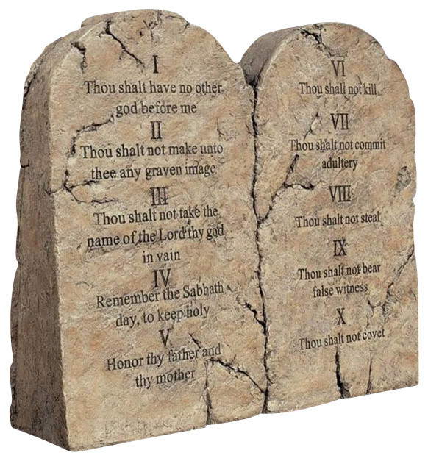
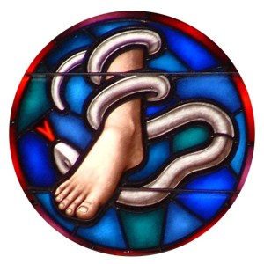
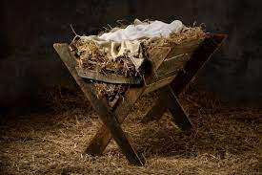
Genesis 1:1
Exodus 20 - Deuteronomy
Lord’s Supper
Creation
Matthew 26:26-28
I Corinthian 11:23-26
Genesis 3:15
~ 4000 yrs
Old Law
Promise
~ 1800 yrs
~ 2600 yrs
Today
Fall of Man
Start of God’s People
Abraham
All People are God’s People
Birth of Jesus
Genesis 3:6
Genesis 12:1-3
Luke 2:1-20
Galatians 3:28

Slide 3
Bringing man back to god
Promise of Jesus immediately after man’s fall – Gen 3:15
Jesus’ death was for the remission of sins – Matt 26:27-28
Only His death could bring forgiveness – Hebrews 10:11-15
Doesn’t come for about 4,000 years

Slide 4
Bringing man back to god
Why did God have a chosen people?
Abraham was pleasing to God and God made a promise to Him – Gen 12:1-3
Notice all nations would be blest
God’s people should have been an example to the other nations
Gen 32:11-12 → Moses and God
Daniel 4:8, 34 → Nebuchadnezzar

Slide 5
Bringing man back to god
Why was there an old law?
The law was the tutor to bring man to Christ – Gal 3:19-25
The law showed sin, but didn’t have a way for forgiveness – Rom 7:7-12

Slide 6
Bringing man back to god
God’s plan was from before the foundation of the world – Eph 1:3-6
God had the plan formed before man sinned
Could have not created us
Shows His love for us
Jn 3:16 – For God so loved…
We remember God’s love manifested the same way today as in the New Testament

