Slide 2
IS THE BIBLICAL WITNESS WORTH BELIEVING?

Slide 3
REAL PEOPLE

Slide 4
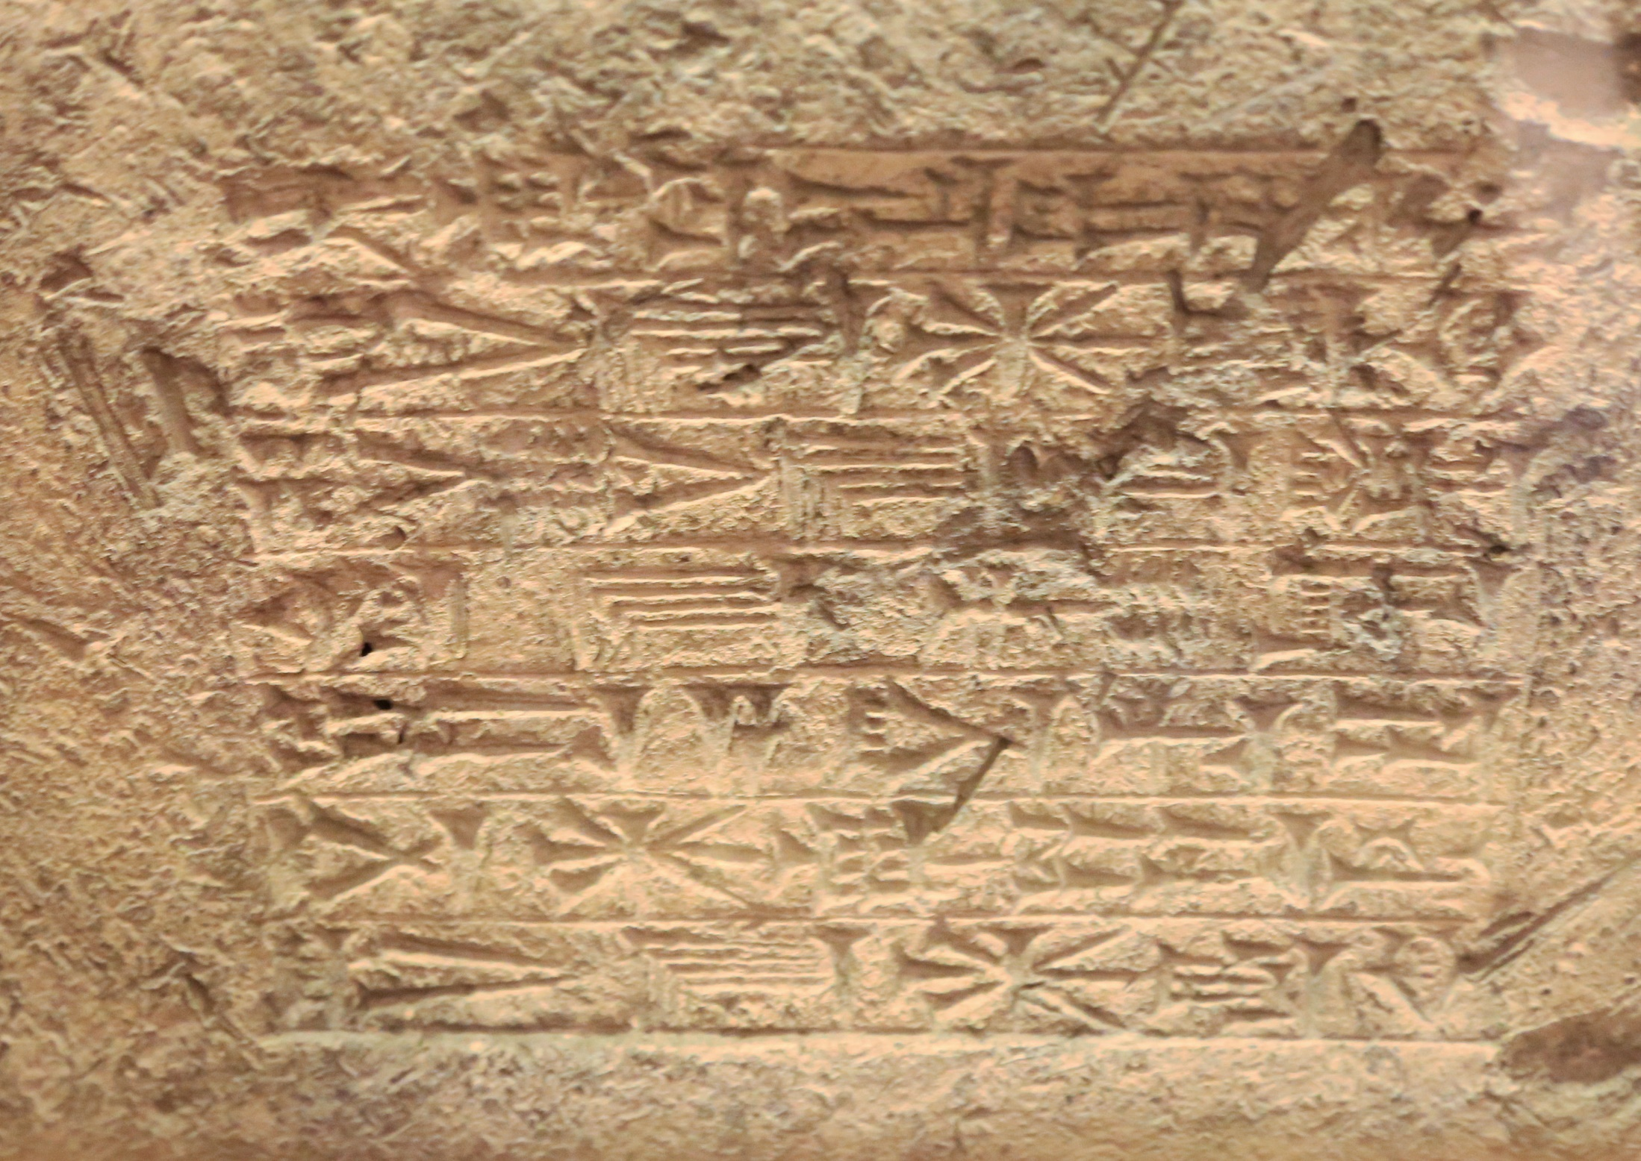
“I am Nebuchadnezzar, king of Babylon… the eldest son of Nabopolassar”
Mentioned 91 times in the Bible

Slide 5
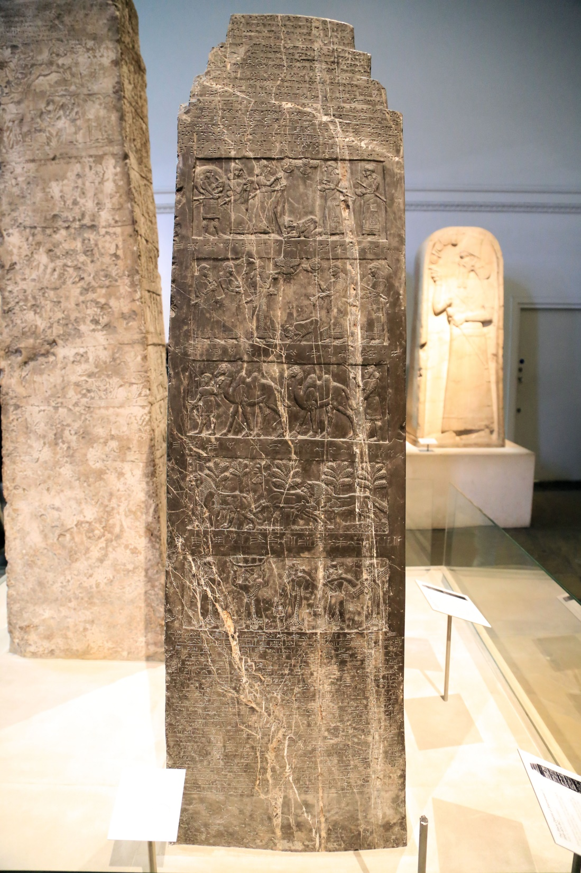
BLACK OBELISK
Mentions Ben-Hadad of Damascus (I Kings 15:18 and 26 more occasions)
Mentions Hazael of Damascus (II Kings 8:7-15)
Notes:
Exploits of Shalmaneser III, king of Assyria (not specifically mentioned in the Bible)

Slide 6
IF BEN-HADAD AND HAZAEL ARE REAL…
THEN WHAT ABOUT ELISHA?
II Kings 8:7-8
7 Then Elisha came to Damascus. Now Ben-hadad king of Aram was sick, and it was told him, saying, “The man of God has come here.”
8 The king said to Hazael, “Take a gift in your hand and go to meet the man of God, and inquire of the LORD by him, saying, ‘Will I recover from this sickness?’ ”

Slide 7
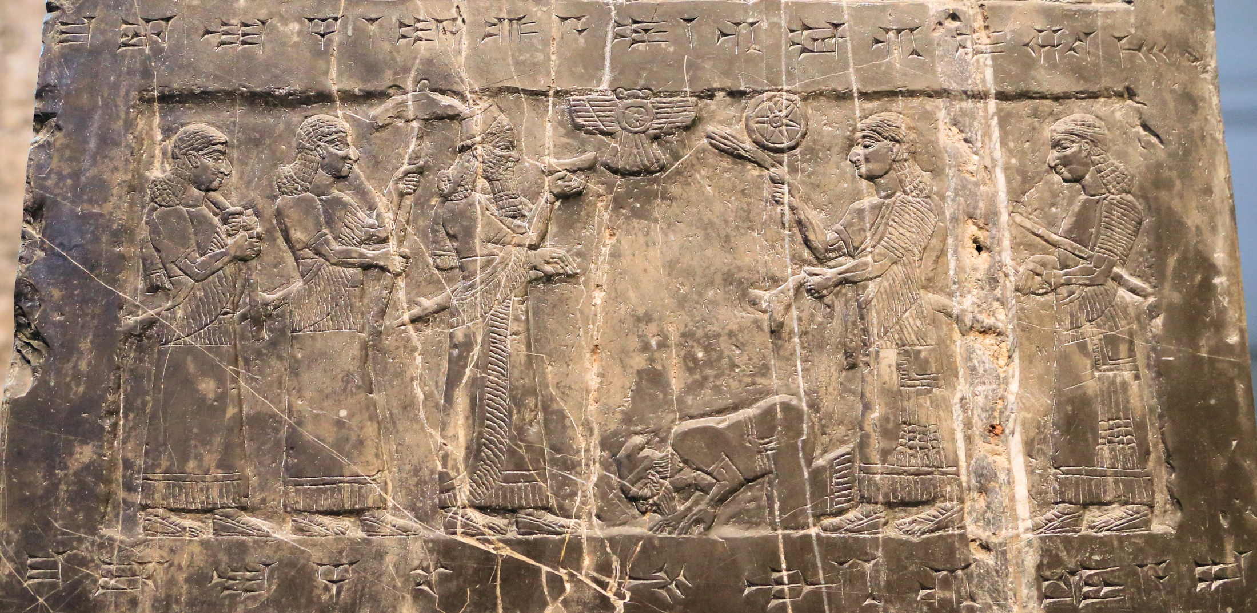
Depicts Jehu (II Kings 9-10)
Mentions Omri (I Kings 16:16-30)
Notes:
Part of the black obelisk

Slide 8
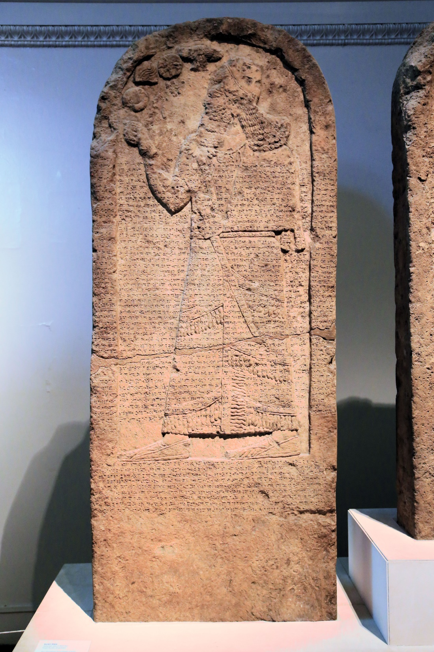
References:
Ben-Hadad (I Kings 15:18; etc.)
and
Ahab, King of Israel
(I Kings 16:28; etc. Mentioned 94 times in the Bible)
Notes:
One part of the “Stele of Three kings”. This depicts Shalmaneser III. In his records, Ahab is menioned, besides Jehu, Omri, Ben-Hadad and Hazael, Ahab is also menioned.

Slide 9
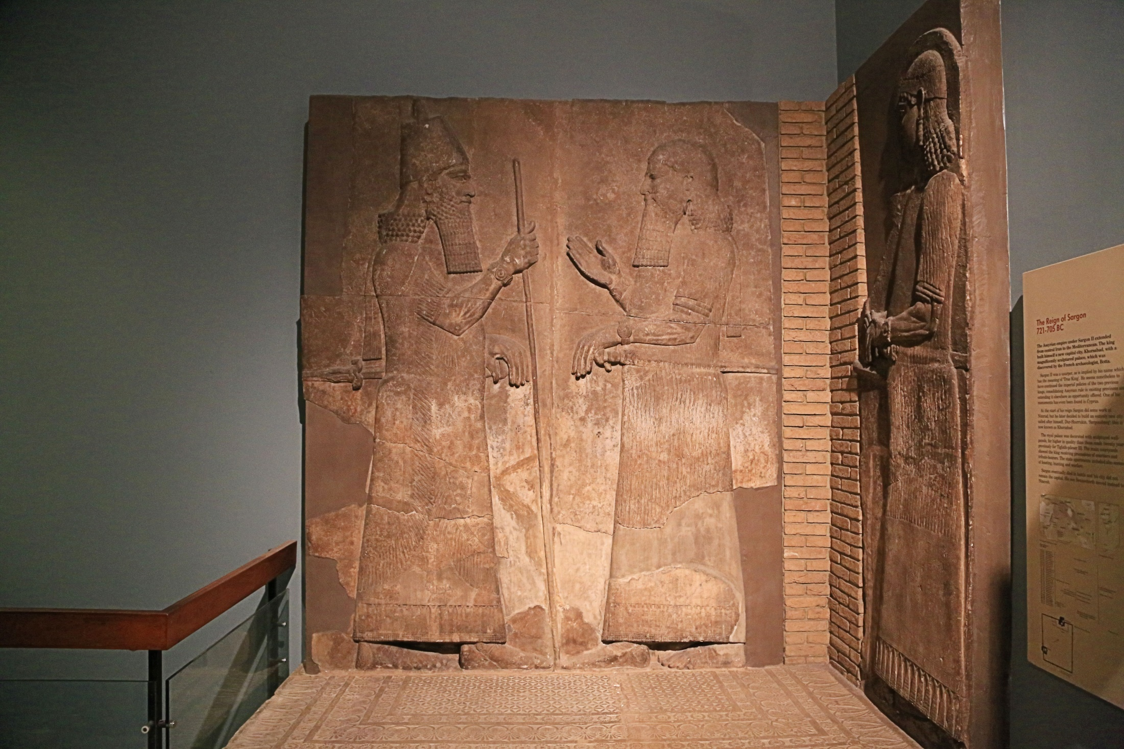

Slide 10
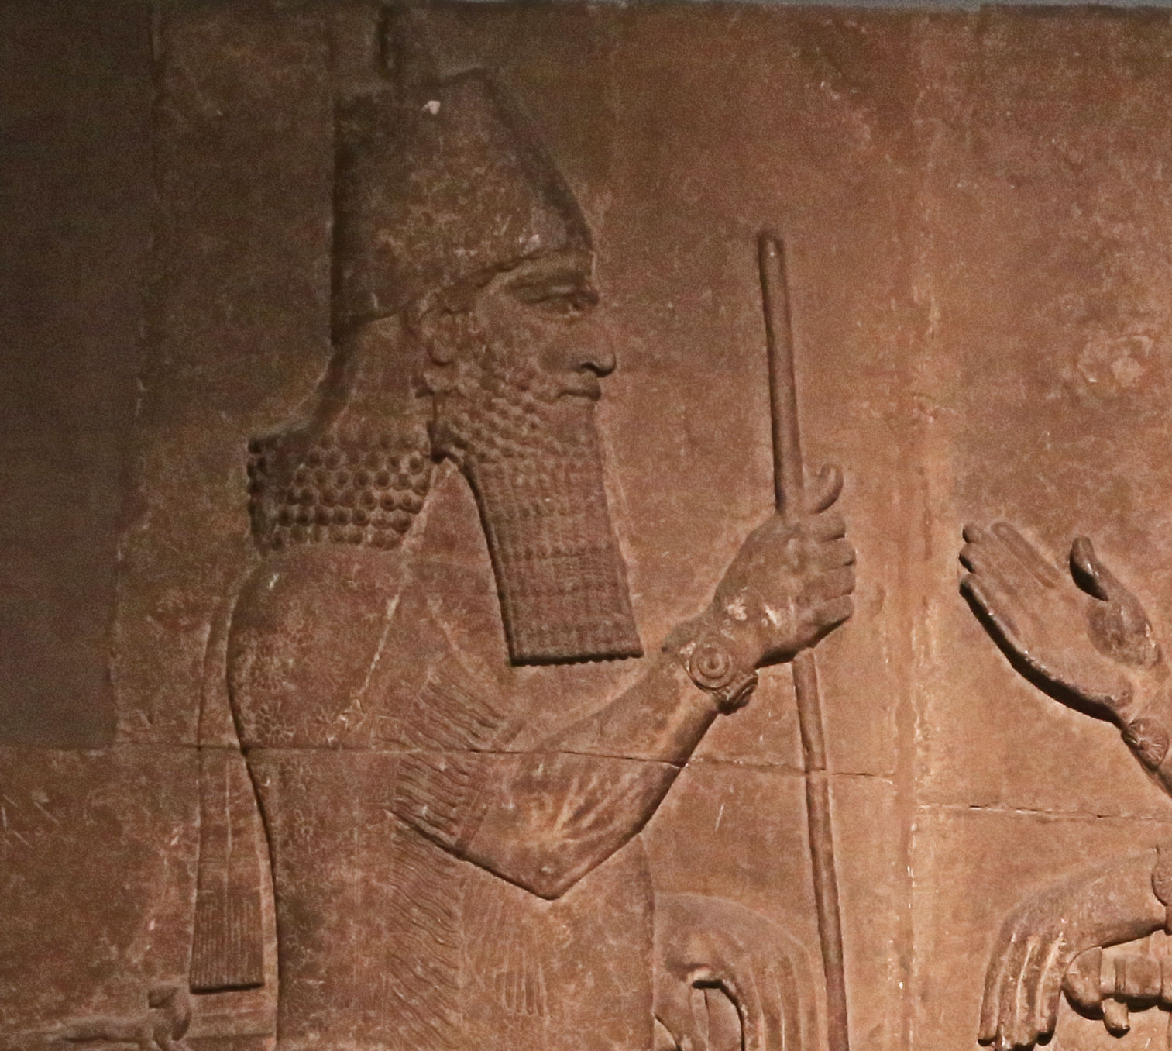
“In the year that the commander came to Ashdod, when Sargon the king of Assyria sent him and he fought against Ashdod and captured it,”
Isaiah 20:1

Slide 11
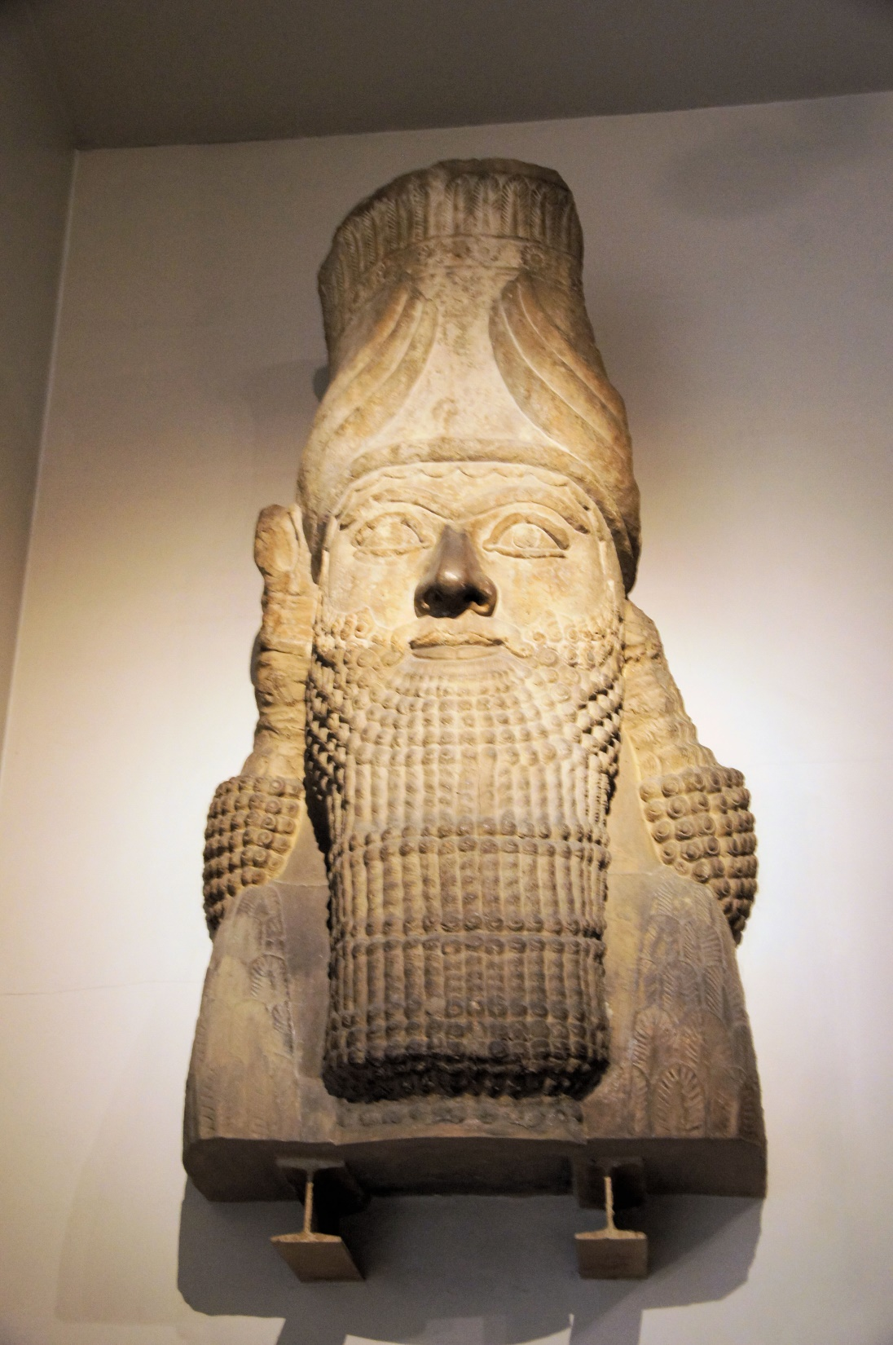
From the Palace of Esarhaddon
II Kings 19:36-37
36 So Sennacherib king of Assyria departed and returned home, and lived at Nineveh.
37 It came about as he was worshiping in the house of Nisroch his god, that Adrammelech and Sharezer killed him with the sword; and they escaped into the land of Ararat. And Esarhaddon his son became king in his place.
Notes:
Another head from a human headed bull statue. This was found in the palace of Esarhaddon

Slide 12
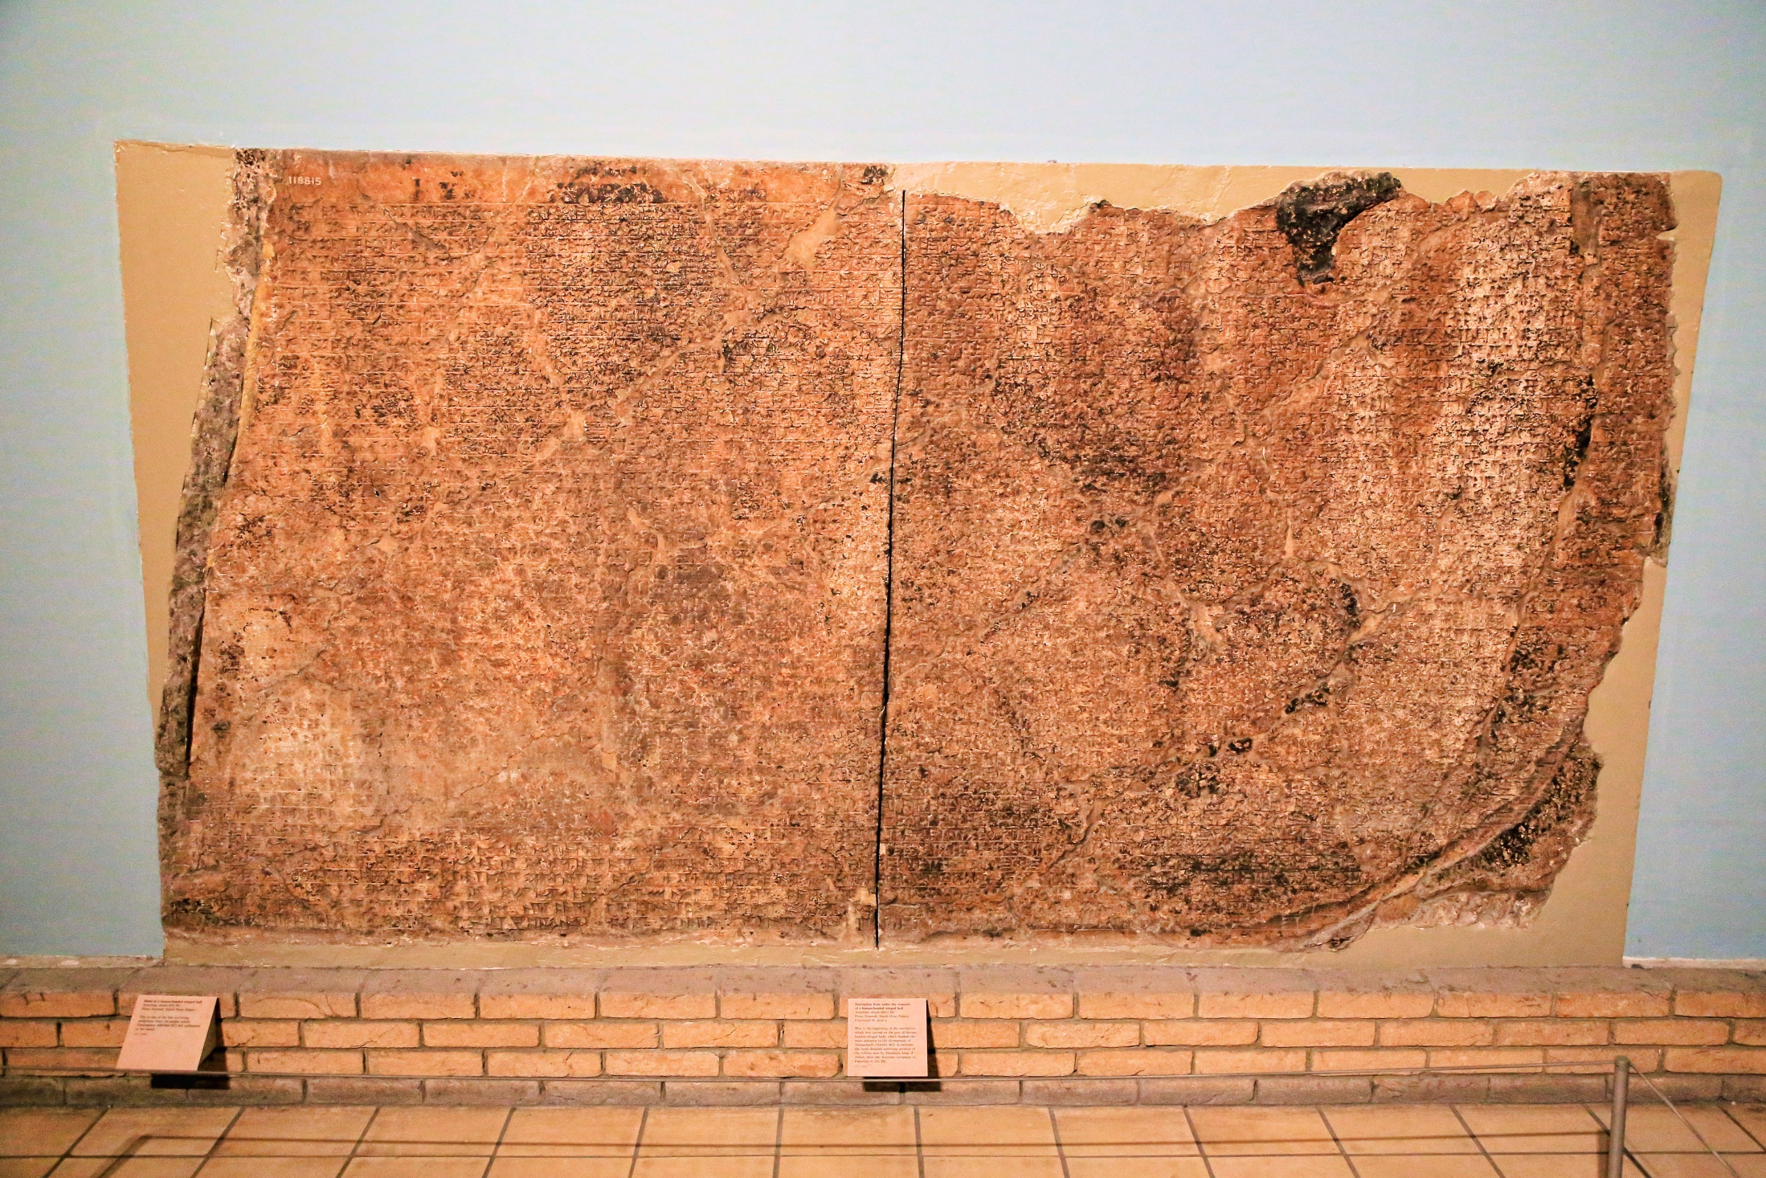
Mentions Hezekiah
(II Kings 18:13)
Notes:
Faded inscription details the tribute that Hezekiah paid to Sennacherib, King of Assyria.

Slide 13
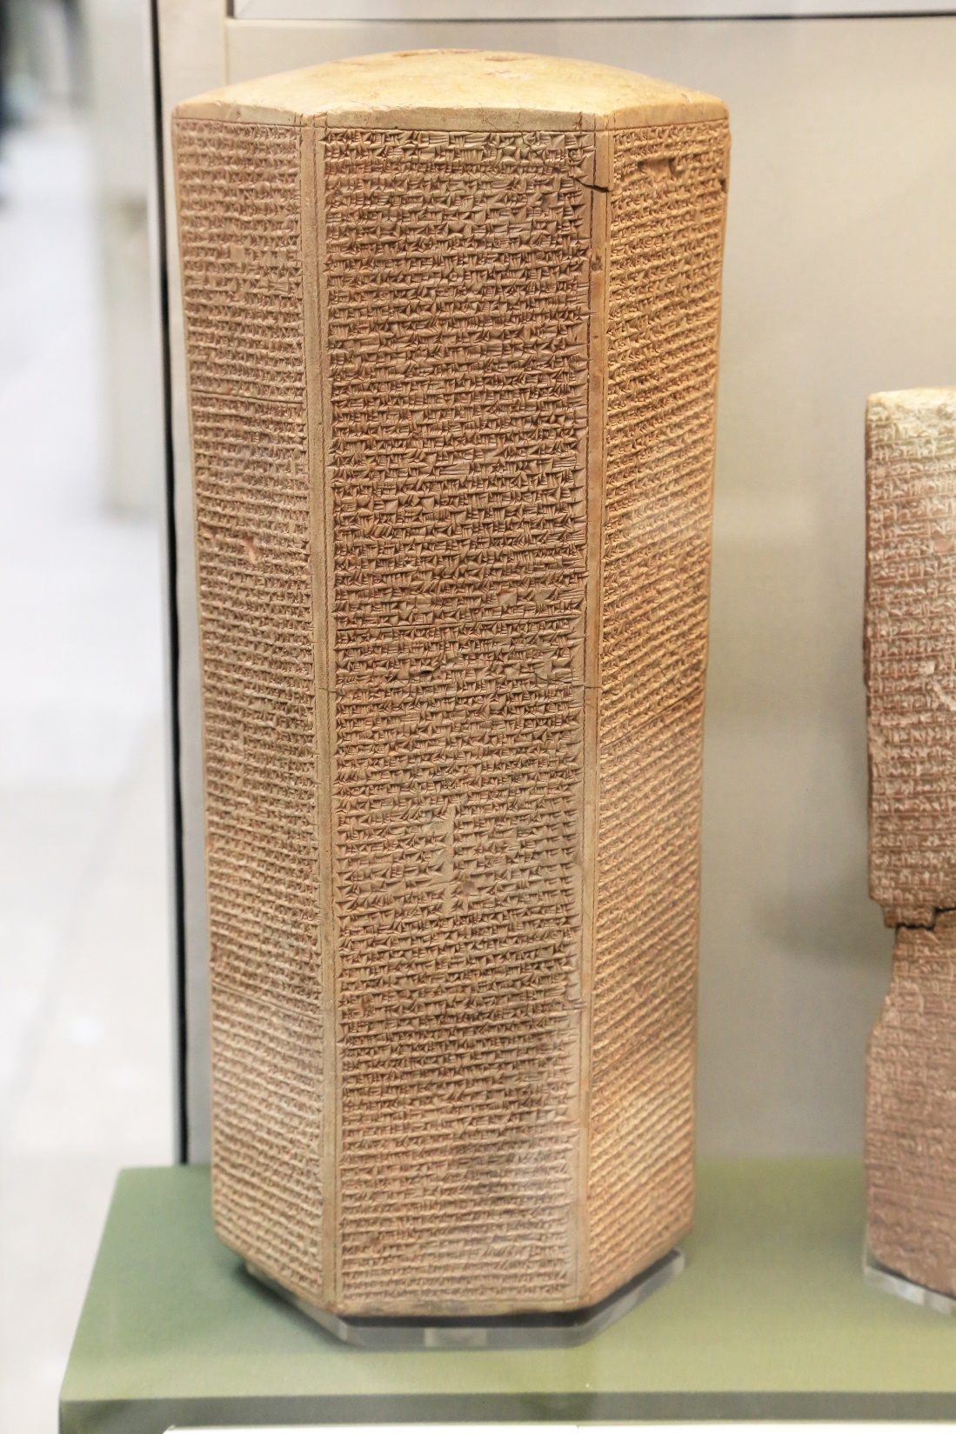
TAYLOR PRISM
Mentions Merodach-Baladan, king of Babylon (Is. 39:1)
Mentions Hezekiah
Mentions Sennacherib (II Kings 18:14-16)

Slide 14
If Hezekiah and Sennacherib are real… then what about Isaiah?
Then Isaiah the son of Amoz sent to Hezekiah saying, “Thus says the LORD, the God of Israel, ‘Because you have prayed to Me about Sennacherib king of Assyria, I have heard you.’
II Kings 19:20

Slide 15
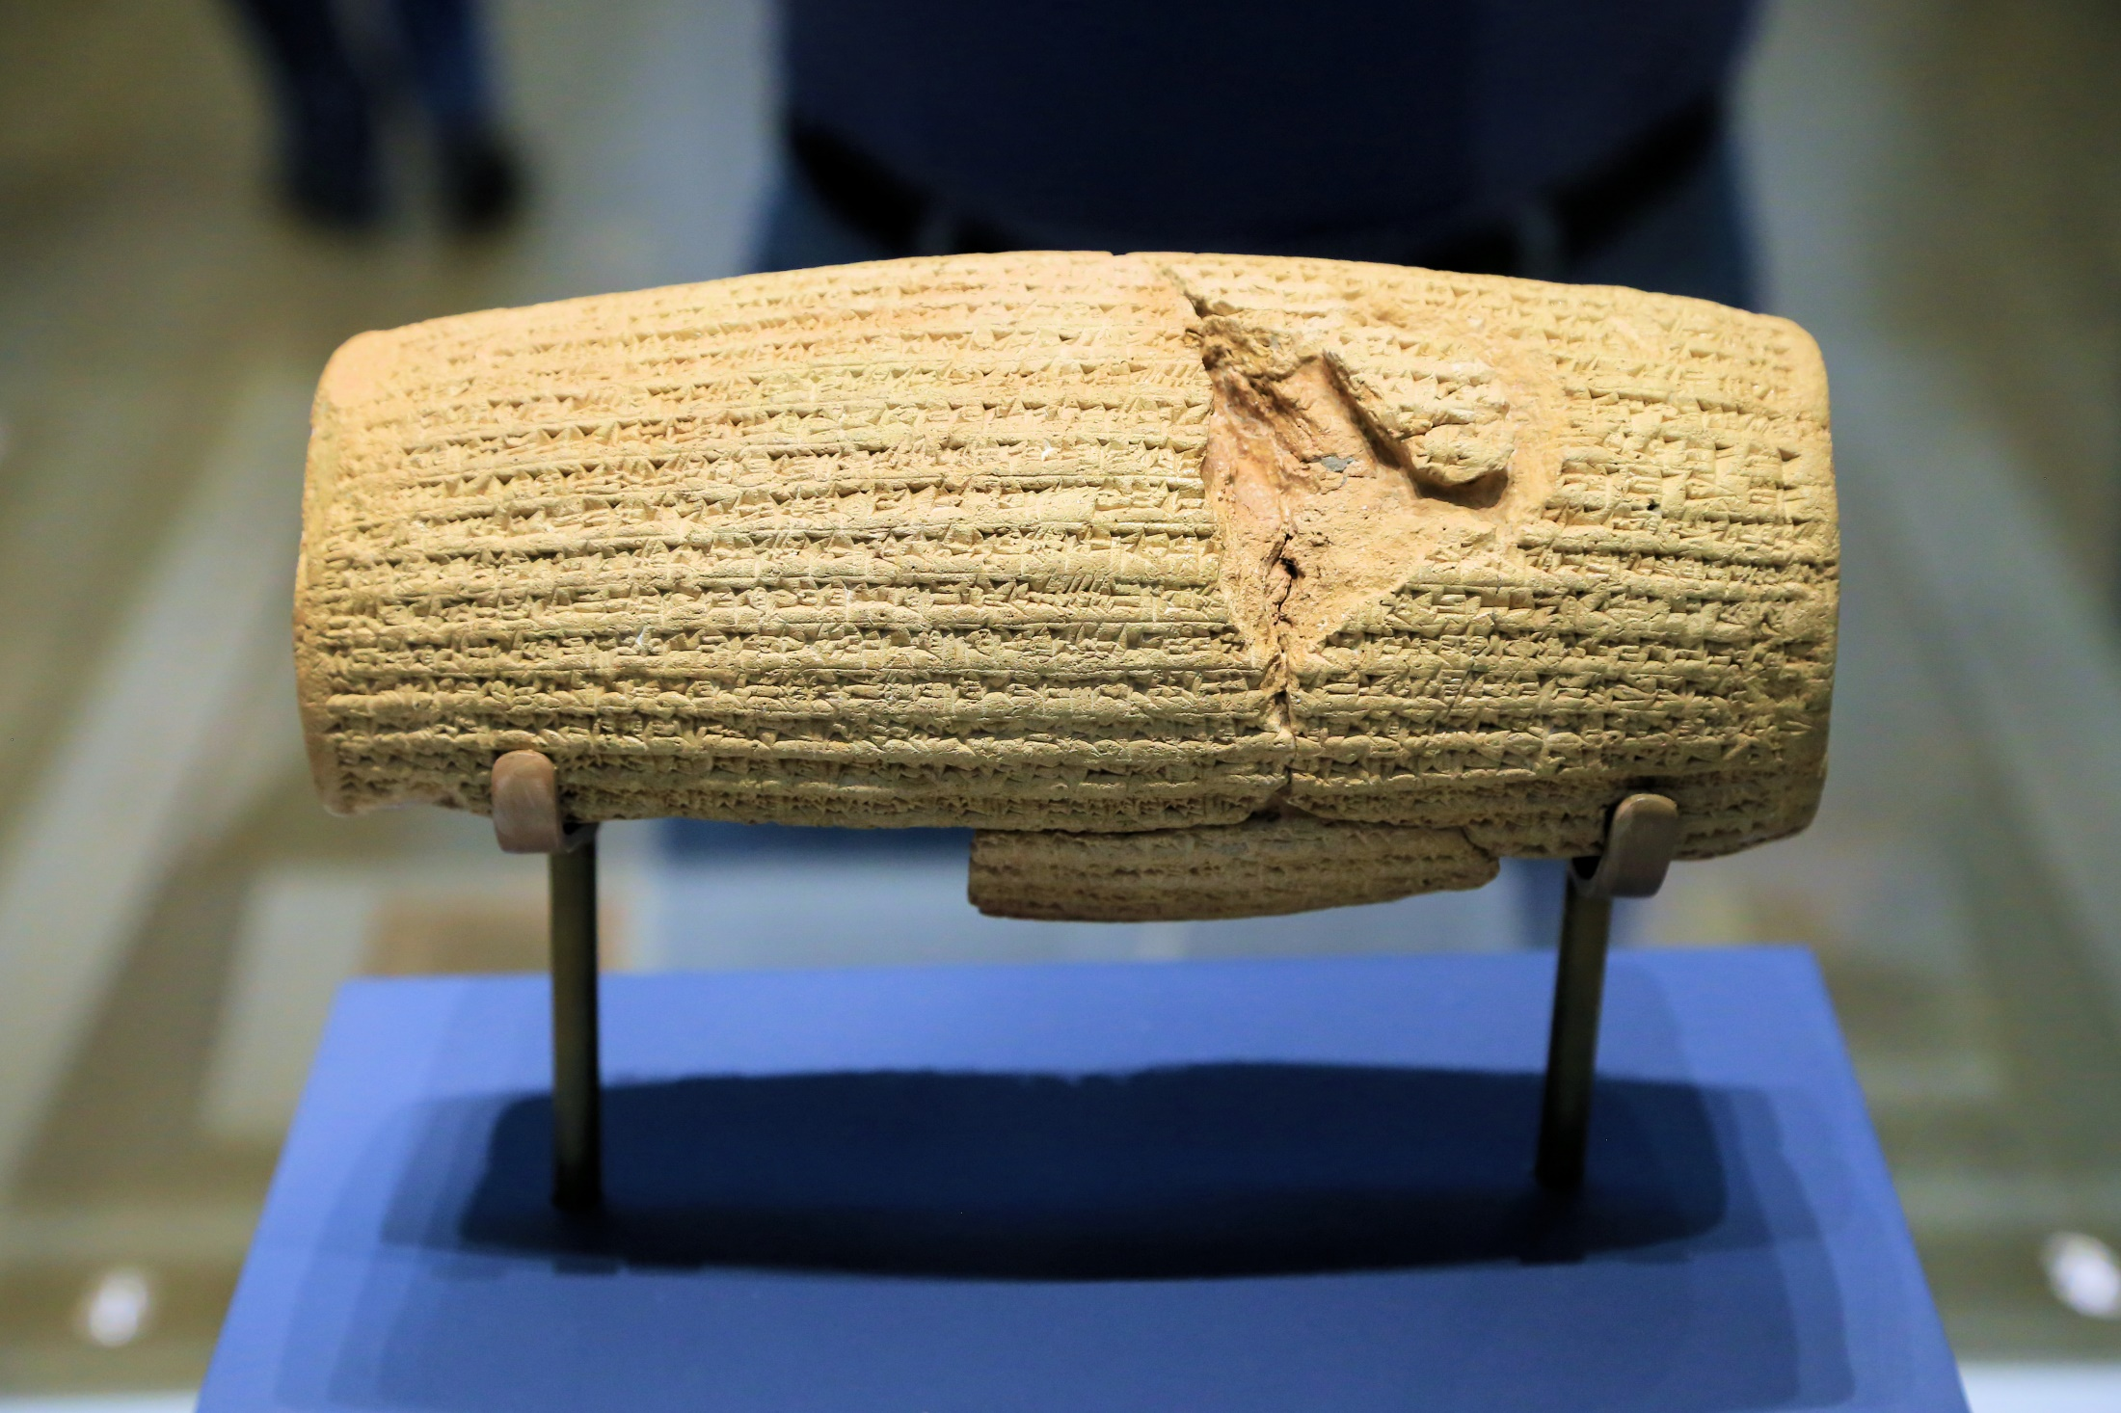
THE CYRUS CYLINDER
Cyrus
Predicted by Isaiah (Is. 44:28)
Named several times in the Bible (Dan. 6:28; etc.)
Notes:
The Cyrus cylinder

Slide 16
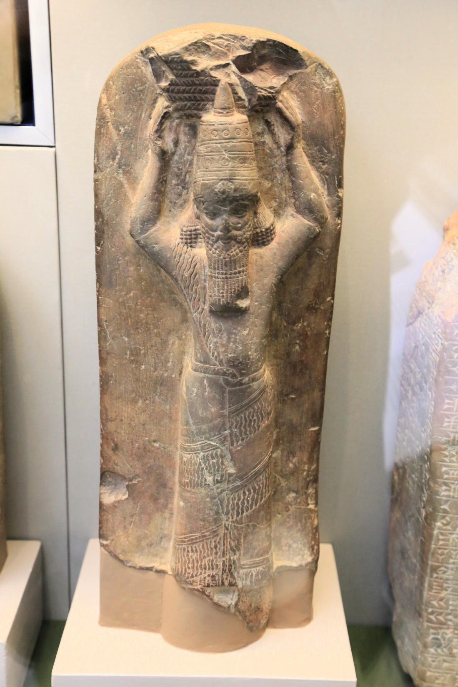
Asherbanipal / Osnapper (Ezra 4:10)
Notes:
This (and a few other depictions like it) are of Ashurbanipal, grandson of Sennacherib. His name in Aramaic is Osnapper. He is mentioned in Ezra 4:10 (NIV gives his orignal name) and is the king who released Manassah from his exile after he turned to God (II Chron. 33:10-13).

Slide 17
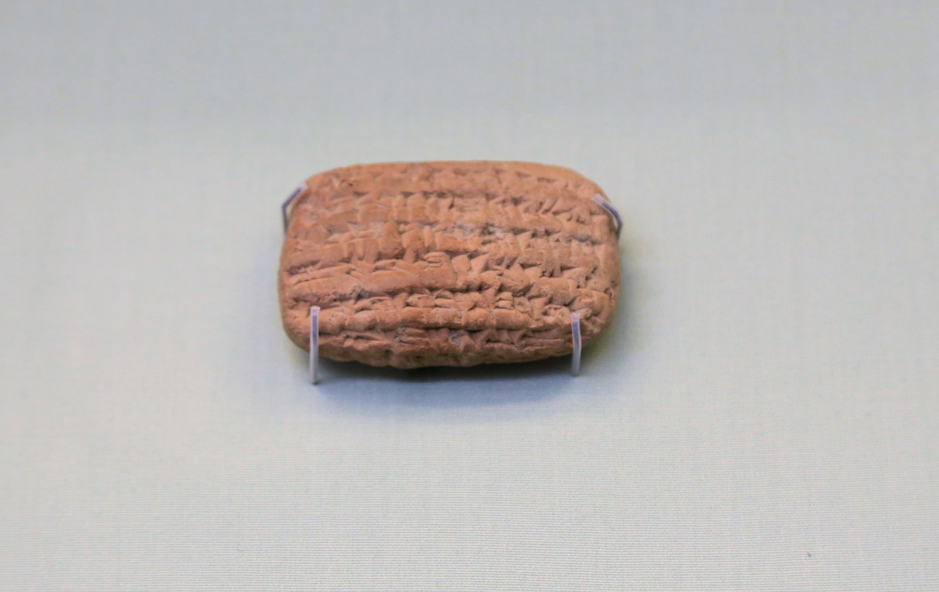
Mentions Nebuchadnezzar’s officer, Nabu-sar-sekim.
Jeremiah 39:3
Notes:
Mentions man from Jeremiah 39:3. This tablet was deciphered in 2007 so it is a fairly recent find.

Slide 18
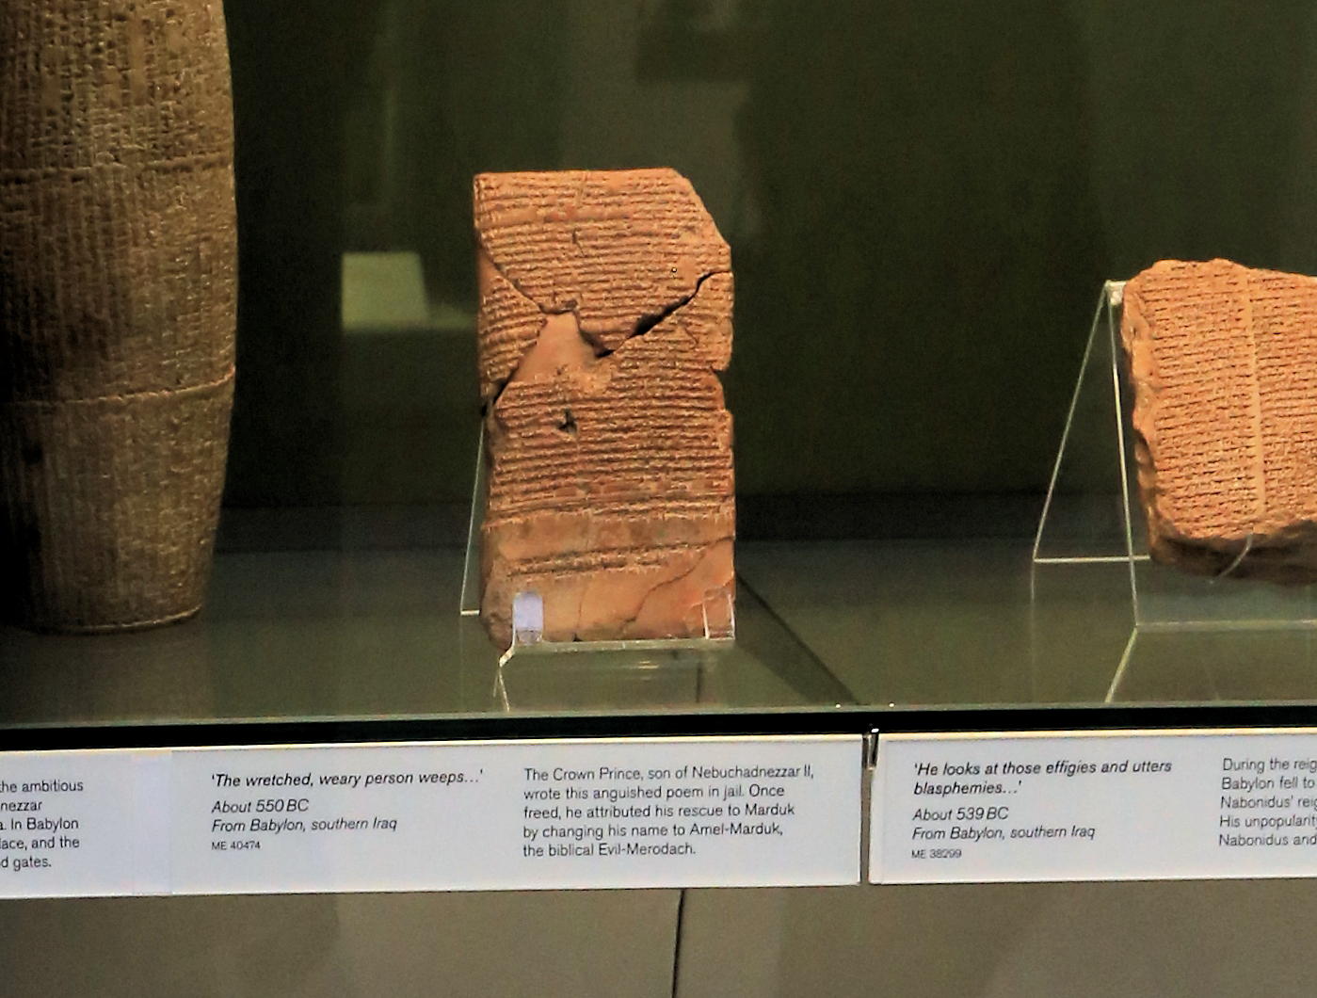
Prayer of the imprisoned son of Nebuchadnezzar.
Amel-Markuk / Evil Mordach (II Kings 25:27)
Notes:
This is a prayer of the son of Nebuchadnezzar who was in prison for bad behavior before becoming king himself. Guess who else was in prison at that time. Jehoichin. Once this son was freed he changed his name to Amel-Marduk (in the Bible he is called Evil-Merodach) and once he becomes king he sets Jehoichin free (II Kings 25:27). The Berlin museum has record of “Yaukin king of Judah” receiving allowance (see II Kings 25:30).

Slide 19
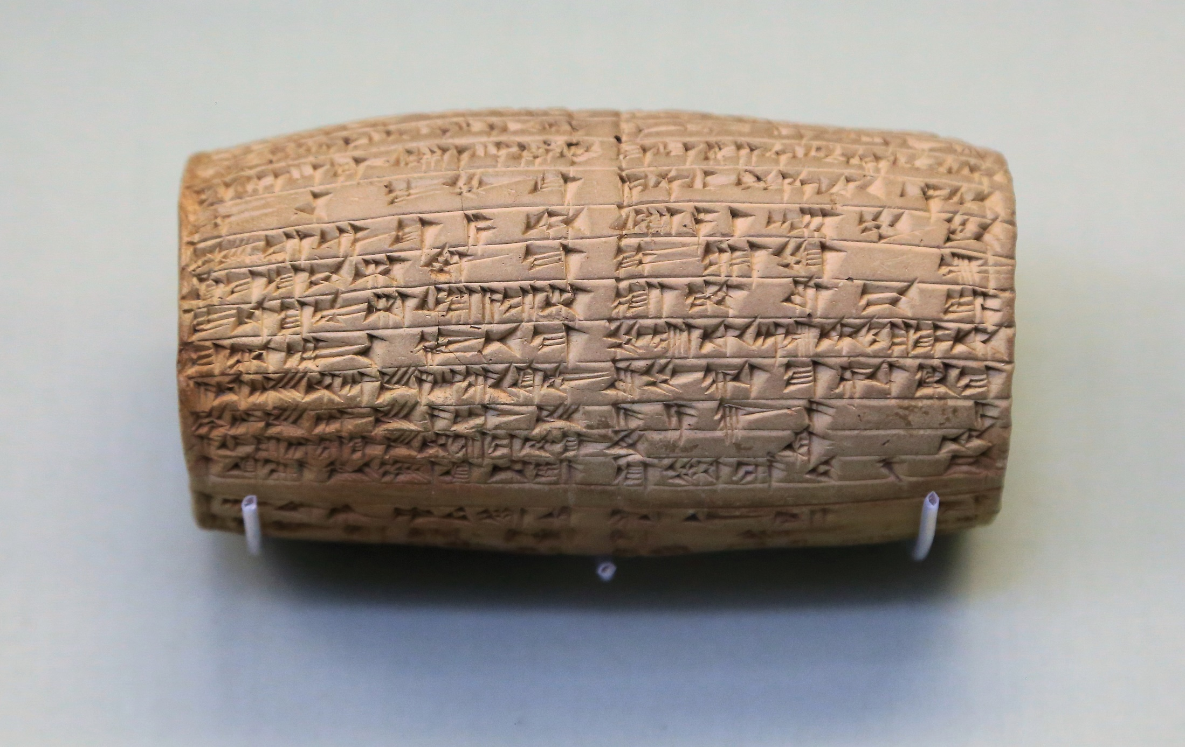
THE NABONIDUS CYLINDER
Belshazzar (Dan. 5:1)
Notes:
Mentions Nabonidus and his son Belshazzar. Until 1854, Daniel was the only ancient record of Belshazzar and many thought he was an imagined person. Nabonidus was king but was frequently away and so his son became co-king in his absence. This also explains why Daniel stated that Belshazzar was king (Dan. 5:1) and why Daniel was made third in the kingdom (Dan. 5:29 – there were two kings, so third was next best) and also how Cyrus could capture the king (Nabonidus) when Daniel records that the king (Belshazzar) was killed (Dan. 5:30).

Slide 20
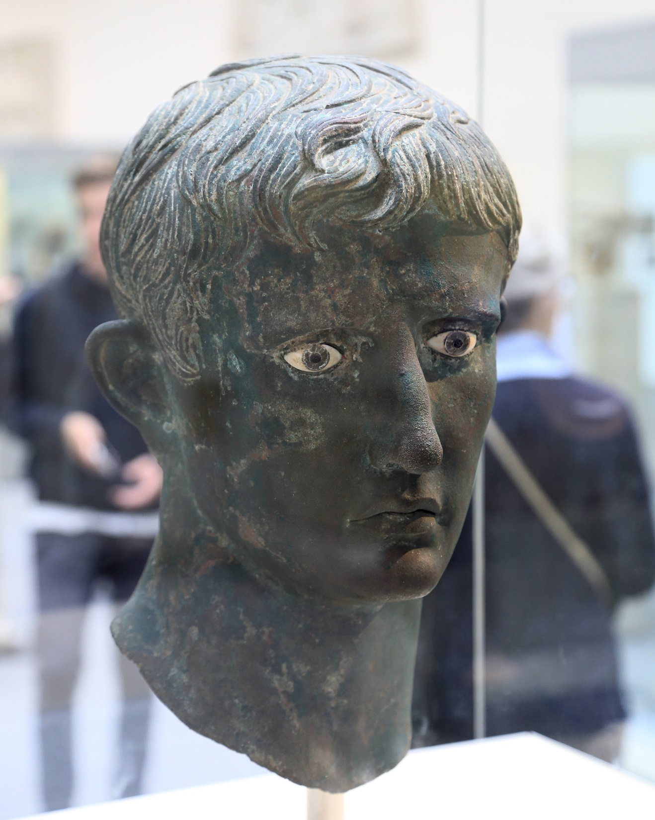
“Now in those days a decree went out from Caesar Augustus, that a census be taken of all the inhabited earth.”
Lk. 2:1
Notes:
Bronze bust of Caesar Augustus (Lk. 2:1) – Caesar when Jesus was born

Slide 21
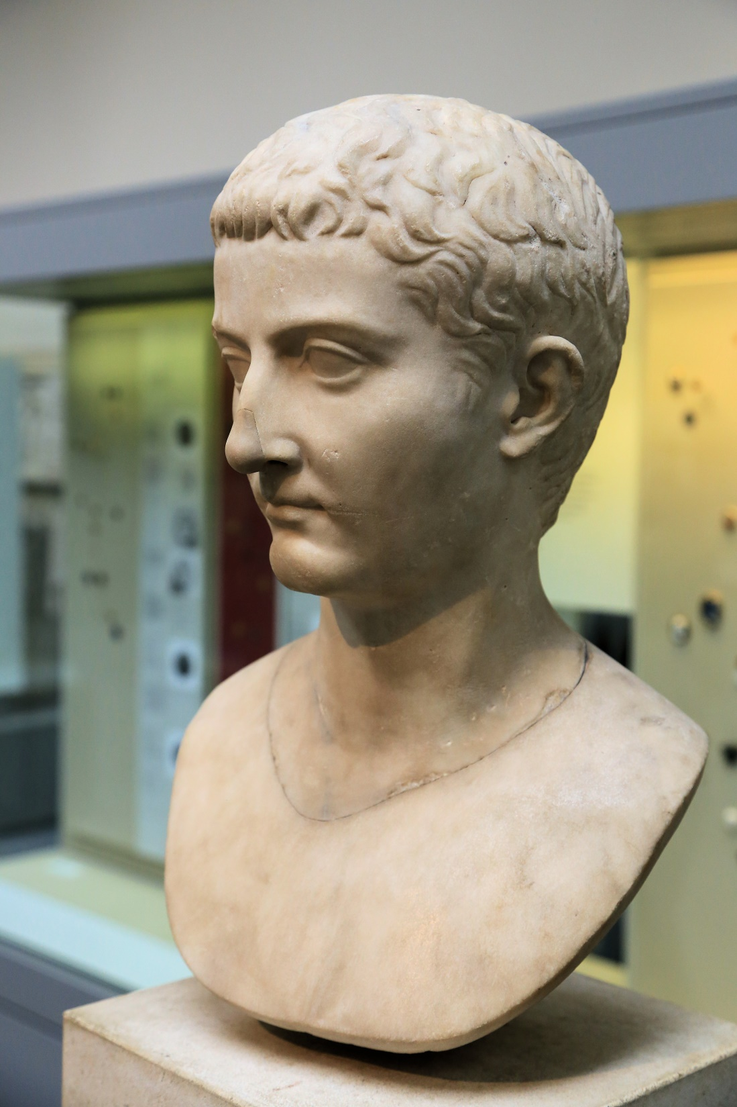
Now in the fifteenth year of the reign of Tiberius Caesar, when Pontius Pilate was governor of Judea, and Herod was tetrarch of Galilee, and his brother Philip was tetrarch of the region of Ituraea and Trachonitis, and Lysanias was tetrarch of Abilene,
Luke 3:1
Notes:
Caesar Tibirius (Lk. 3:1) – reigns during Jesus’ life

Slide 22
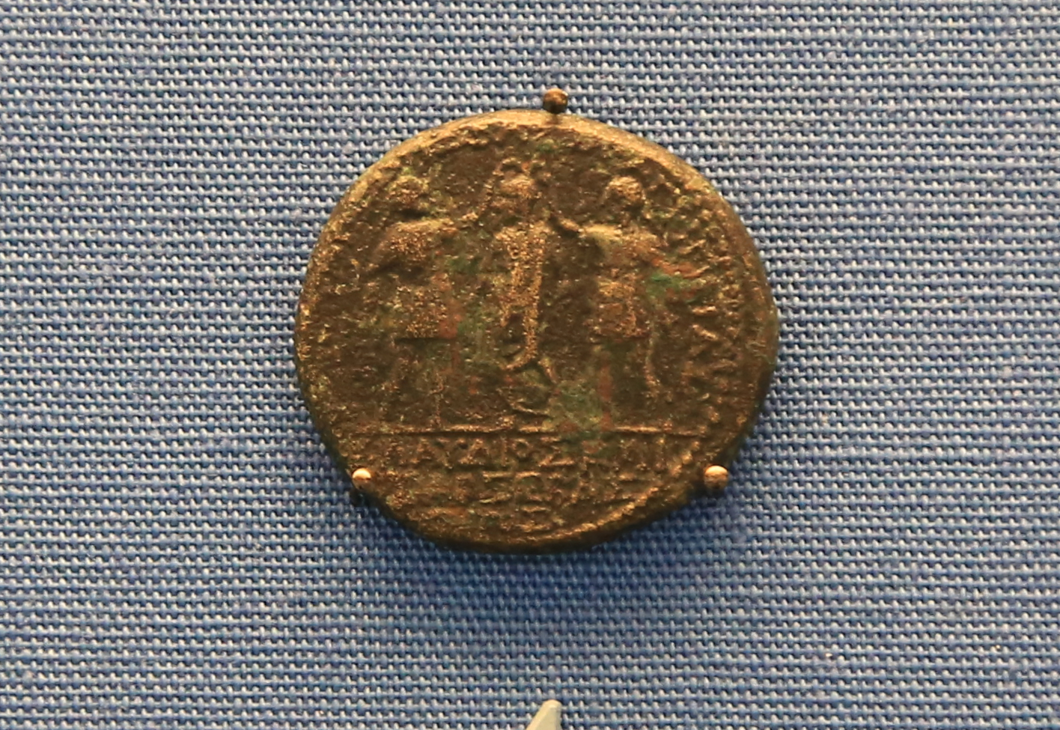
Caesar Claudius (Acts 11:28; 18:2)
Herod Agrippa (Acts 12 – only referred to as Herod)
Notes:
Claudius being crowned by two Herods. One of whom is Herod Agrippa, who had James put to death before meeting his demise in Ceasarea (Acts 12)

Slide 23
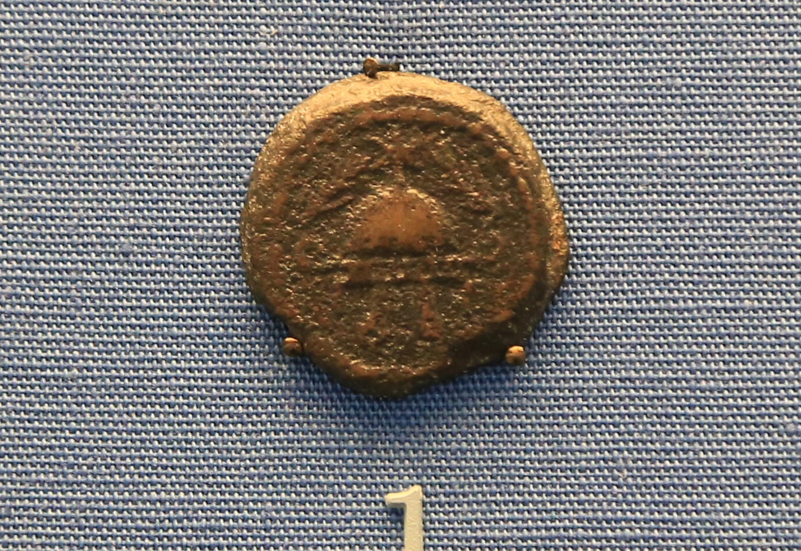
Herod the Great
(Mt. 2:1; etc.)
Notes:
Herod the Great

Slide 24
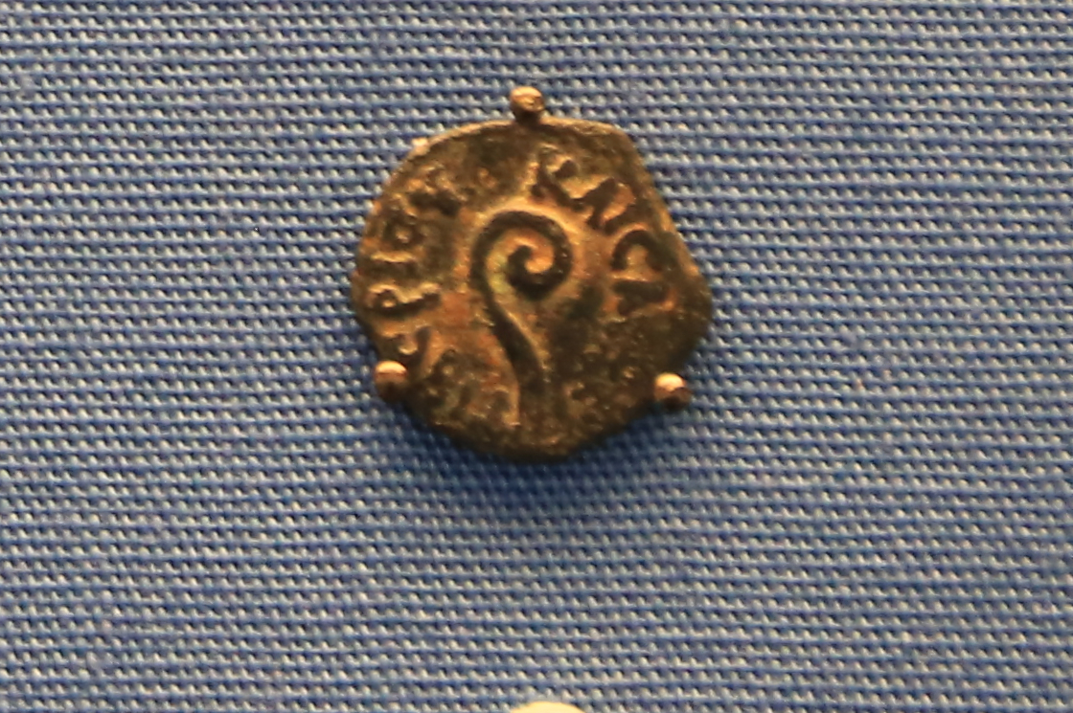
Pontius Pilate
(Mt. 27:2; etc.)
Notes:
Pontius Pilate

Slide 25
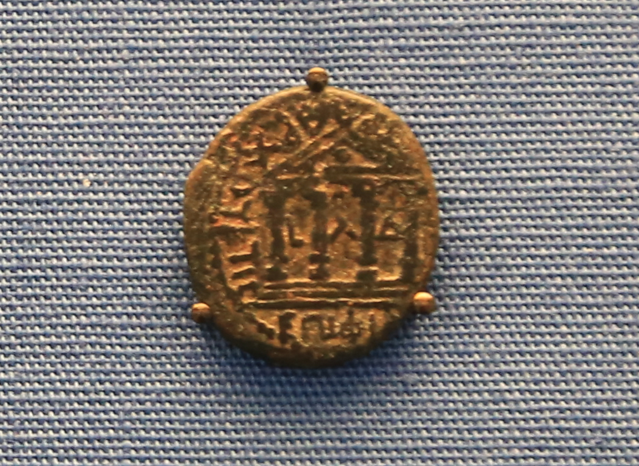
Philip the Tetrarch
(Mt. 14:3; Mk. 6:17; Lk. 3:1)
Notes:
Philip the tetrarch (Mt. 14:3; Mk. 6:17; Lk. 3:1) – Caesarea Philippi (is named after him. His wife marries Herod which leads to John the Baptist’s death.

Slide 26
REAL EVENTS

Slide 27
Sargon conquers Samaria and replaces the inhabitants with foreigners. The Bible also records the king of Assyria doing this (II Kings 17:24 ).

Slide 28
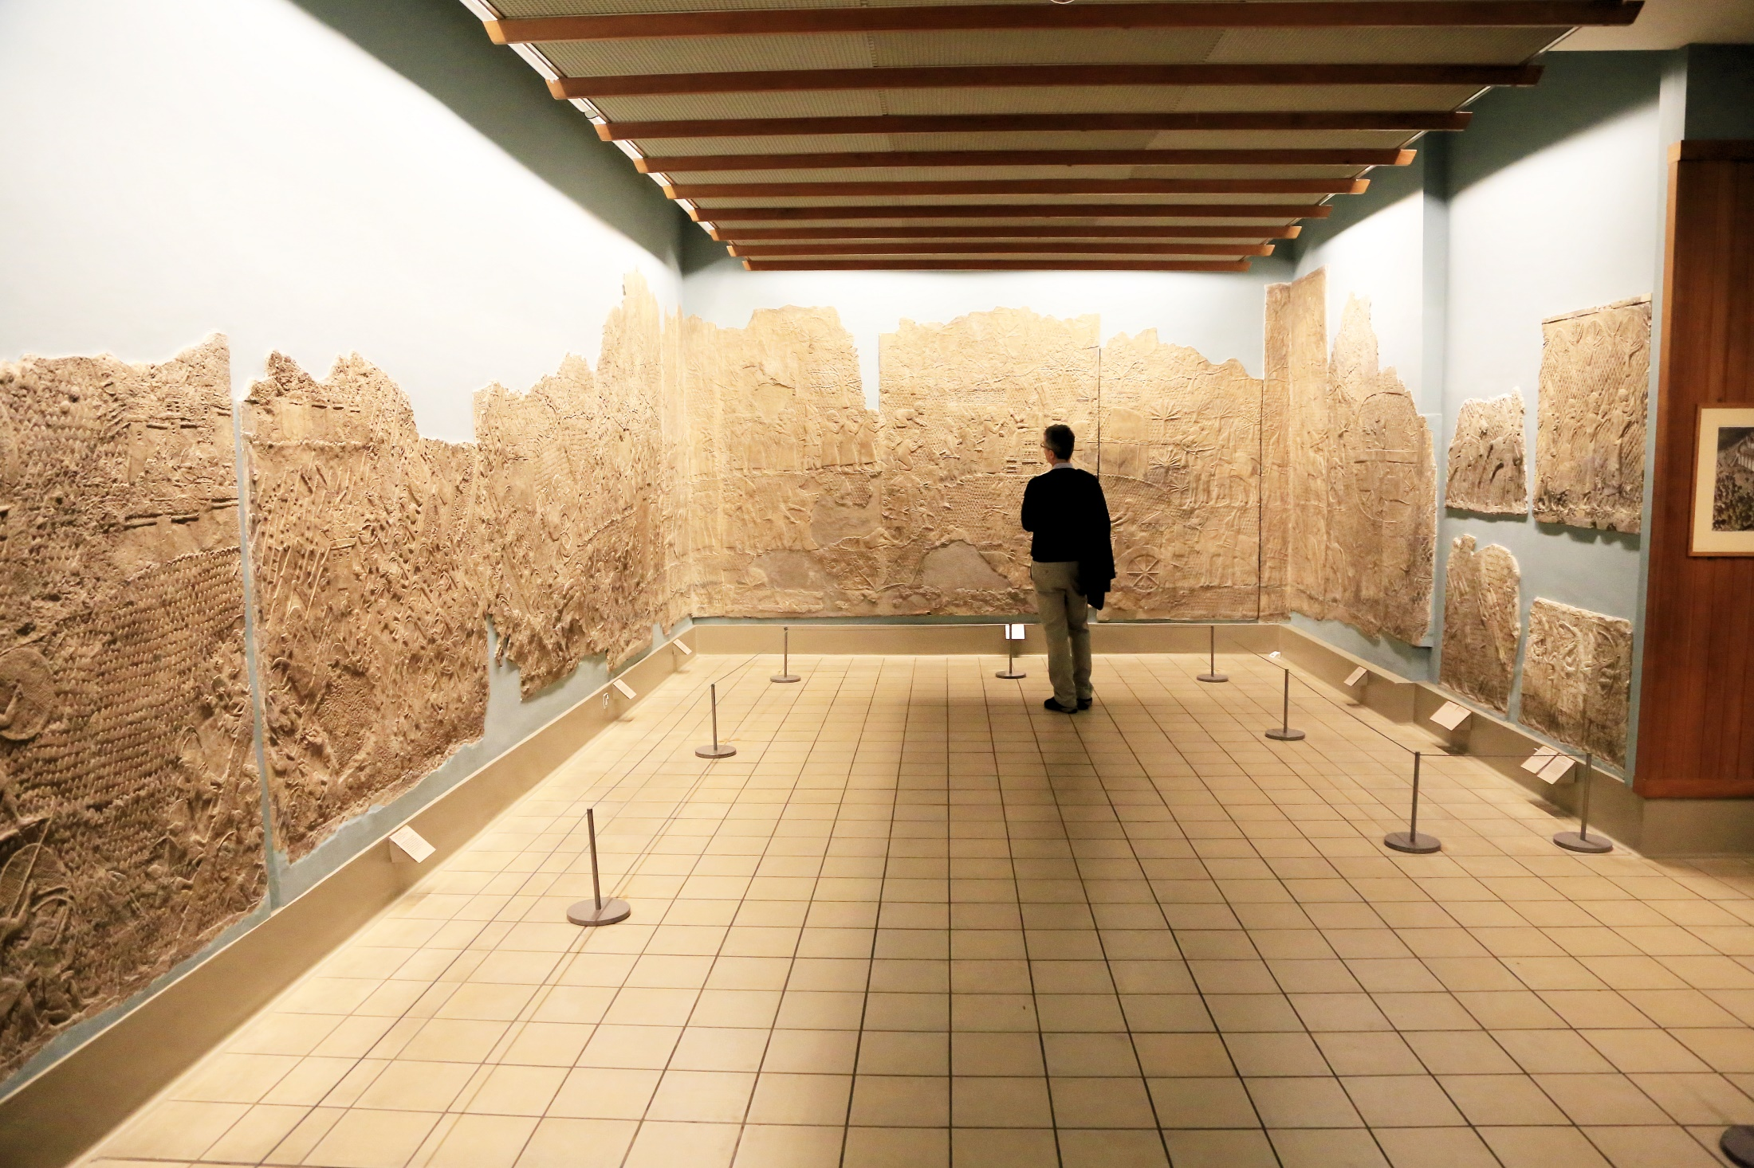
Sennacherib lays siege to Lachish (II Chron. 32:9)

Slide 29
TAYLOR PRISM
Describes how Sennacherib laid siege to Jerusalem, “like a bird in a cage”
This is also recorded in II Kings 18-19

Slide 30
Hezekiah pays tribute
(II Kings 18:13-16)
Notes:
Faded inscription details the tribute that Hezekiah paid to Sennacherib, King of Assyria.

Slide 31
From the Palace of Esarhaddon
He tells how Sennacherib was killed while worshiping
II Kings 19:36-37
36 So Sennacherib king of Assyria departed and returned home, and lived at Nineveh.
37 It came about as he was worshiping in the house of Nisroch his god, that Adrammelech and Sharezer killed him with the sword; and they escaped into the land of Ararat. And Esarhaddon his son became king in his place.
Notes:
Another head from a human headed bull statue. This was found in the palace of Esarhaddon

Slide 32
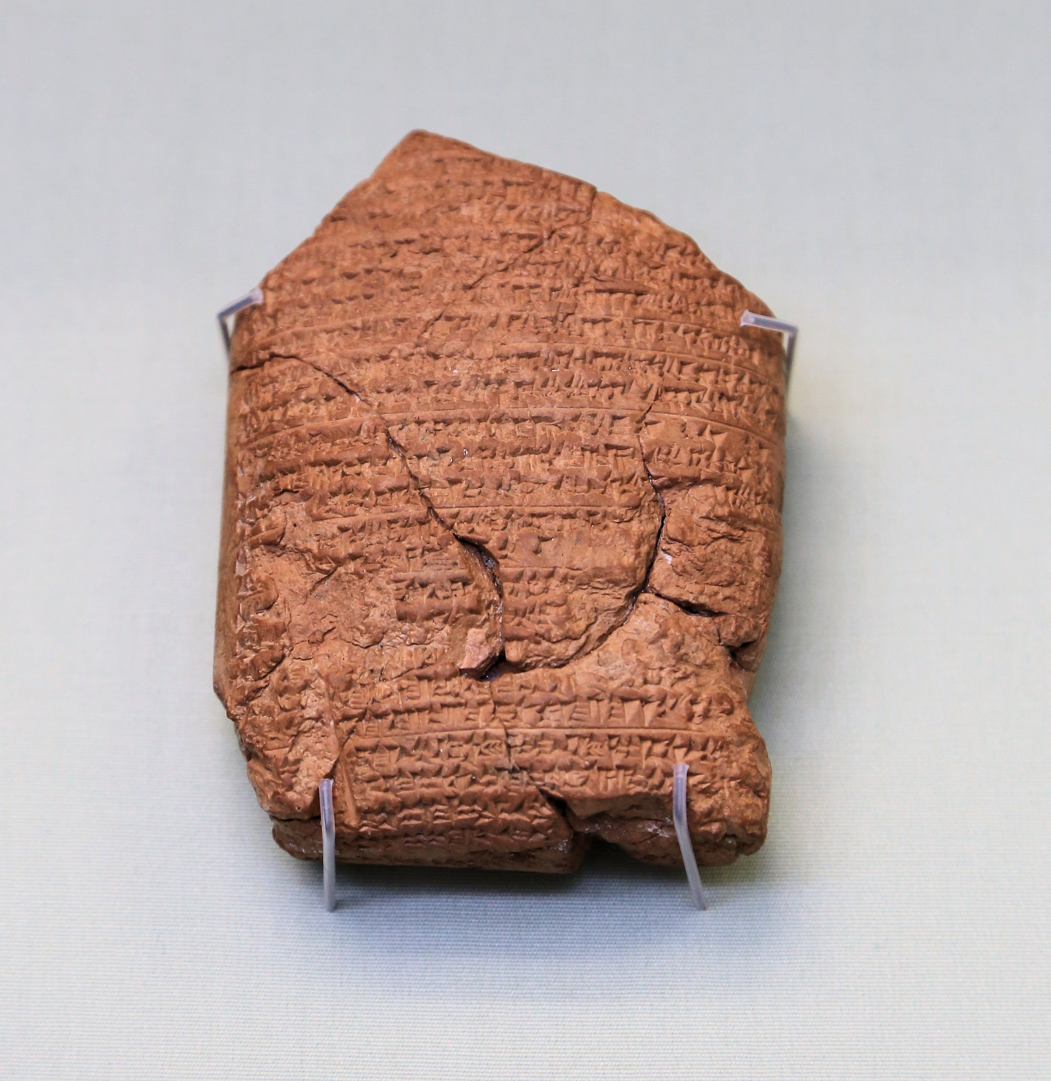
Compare to II Kings 24:8-17
The king “encamped against the city of Judah and on the second day of the month of Adar, he seized the city and captured the king. He appointed there a king of his own choice, received its heavy tribute and sent [them] to Babylon.”
Notes:
This details the events of II Kings 24:8-17 and Nebuchadnezzar’s conquering of Jerusalem (“The city of Judah”). It has detailed dates added to it to help us better date the events of the Bible. Jehoiachin is taken captive, his uncle Mattaniah is put on the throne after his name is changed to Zedekiah.

Slide 33
THE CYRUS CYLINDER
Describes how king Cyrus of Persia allowed captives to return to their homes and rebuild their temples.
(Ezra 1:1-4; II Chron. 36:22-23)
Notes:
The Cyrus cylinder

Slide 34
REAL PLACES

Slide 35
PLACES I’VE WITNESSES
The Appian Way
Athens
Bethlehem
Bethsaida
Bethshan
Caesarea (Maritima)
Caesarea Philippi
Capernaum
Chorazin
Colossae
Corinth
Dan
Ephesus
Hazor
Hierapolis
Jericho
Jerusalem
Joppa
Laodicea
Meggido
Miletus
Nazareth
Pergamum
Philadelphia
Rome
Sardis
Smyrna
Thyatira
Tiberias

Slide 36
IS THE BIBLICAL WITNESS WORTH BELIEVING?

Slide 37
BUT THERE IS MORE!
Ancient Historians
Notes:
What we have covered so far are just artifacts from the British museum that specifically relate to names and events of the Bible. There are other museums. But there is more than that too. There are historical writings. Ancient, non-biblical texts.

Slide 38
SUETONIUS
“Since the Jews constantly made disturbances at the instigation of Chrestus, he expelled them from Rome.”
(Life of Claudius, XXV.4)
Compare to Acts 18:2
Notes:
*** This particular section (and only this section) are frequently doubted by scholars. This isn’t because there are any manuscripts of Josephus that have survived which lack this section. But there is another historian who says that Josephus was not a Christian.

Slide 39
Pliny the Younger
“They maintained, however, that the amount of their fault or error had been this, that it was their habit on a fixed day to assemble before daylight and recite by turns a form of words to Christ as a god; and that they bound themselves with an oath, not for any crime, but not to commit theft or robbery or adultery, not to break their word, and not to deny a deposit when demanded.”
(Epp. X.96)
Notes:
*** This particular section (and only this section) are frequently doubted by scholars. This isn’t because there are any manuscripts of Josephus that have survived which lack this section. But there is another historian who says that Josephus was not a Christian.

Slide 40
Tacitus
“Nero fastened the guilt and inflicted the most exquisite tortures on a class hated for their abominations, called Christians by the populace. Christus, from whom the name had its origin, suffered the extreme penalty during the reign of Tiberius at the hands of one of our procurators, Pontius Pilate, and a deadly superstition, thus checked for the moment, again broke out not only in Judea, the first source of the evil, but also in the City {Rome}… Accordingly, an arrest was first made of all who confessed; then, upon their information, an immense multitude was convicted, not so much of the crime of arson, as of hatred of the human race.”
(Annals, 15:44,2-5)
Notes:
*** This particular section (and only this section) are frequently doubted by scholars. This isn’t because there are any manuscripts of Josephus that have survived which lack this section. But there is another historian who says that Josephus was not a Christian.

Slide 41
JOSEPHUS
Treats Old Testament like history
References righteous man, John the Baptist, who was killed by Herod. (Ant. XVIII.5.5)
References James, the brother of Jesus Christ (Ant. XX.9.1)
References Jesus, doer of wonderful works, crucified by Pilate, resurrected the third day (Ant. XVIII.3.3)***
Notes:
*** This particular section (and only this section) are frequently doubted by scholars. This isn’t because there are any manuscripts of Josephus that have survived which lack this section. But there is another historian who says that Josephus was not a Christian.

