Slide 1
The Wandering in The Wilderness
Numbers 14-36
Deuteronomy 1-34
Joshua

Slide 2
17 Time Periods
Before the Flood
Flood
Scattering of the People
The Patriarchs
The Exodus
Wandering in the Wilderness
Invasion and Conquest
Judges
United Kingdom
Divided Kingdom
Judah Alone
Captivity
Return
Years of Silence
Life of Christ
Early Church
Letters to Christians
Notes:
2
2

Slide 3
The People React to the Report
Cried, Wept, and Murmured
If only we had died in Egypt or the wilderness
Why has the Lord brought us to this land?
Let us select a leader and return to Egypt
Notes:
3

Slide 4
The faithful respond
Moses and Aaron fall on their faces.
Joshua and Caleb tore their clothes.
Joshua and Caleb tell the congregation what they saw and not to rebel against God.
The Congregation wants to stone them.

Slide 5
The Lord speaks to Moses
God asks how long will they treat me with contempt?
How long will they refuse to believe me?
I will smite them with a plague and disinherit them.

Slide 6
Moses Intercedes
Moses speaks to the way the nations round about will view Jehovah
The guilty will not go unpunished. 14:18
God agrees to Moses pleas. 14:20
But they will be punished and will not received the promised land. 14:23-35

Slide 7
God instructs Moses
Those who spied the land and brought back a evil report will die.
The evil congregation will die.
The only exceptions will be Joshua and Caleb
Moses warned that the Lord is not with them and they should not go out to fight the Amalekites and the Canaanites.

Slide 8
Instructions for offerings
Supplementary Offerings
Offerings for Unintentional Sins
The Sabbath-Breaker is stoned
Tassels on Garments

Slide 9
Rebellion of Korah
Korah the great grandson of Levi along with Dathan and Abiram of the tribe of Reuben led a rebellion of 250 prominent men against Moses.
They said Moses had gone too far and was not speaking as the authority of God.
Moses has Korah and his allies meet at the tabernacle where God speaks to Moses and Aaron.

Slide 10
Rebellion of Korah
Moses calls for them and they will not come to him
Moses goes to their homes
Moses says if they die normally or make it to the day of visitation then he is not from God
If he is from God the ground will swallow them up.

Slide 11
The Israelites miss the point
This point was that only the approved of God should offer up offerings and incense to God.
The Israelites murmured and said that Moses and Aaron killed the people of the Lord.
Now the congregation was gathered against them and God starts killing them
Lesson for us?

Slide 12
Aaron’s Rod Buds
God gives Aaron a sign that he is with him by making his rod bud and bear almonds in front of the entire congregation
Aaron’s rod is placed before the Testimony as a sign against the rebels.

Slide 13
Laws For The Levites & Priests
The Levites were a gift from God to the Priests.
The Lord provided for the Priests and Levites from the offerings of the people.
The Lord provided a way for those serving at the Tabernacle to be clean.

Slide 14
Miriam Dies
In the first month at Kadesh Miriam died.
Numbers 33:38 tells us when this happened.
40th year – They are getting ready to enter the Promised Land!

Slide 15
Moses and Aaron Sin
“the people contended with Moses” – 20:3
The continual complaining of the people angered Moses – “Hear now, you rebels!”
Moses and Aaron sin – “Because, you did not believe me to hallow me in the eyes of the children of Israel,”
Their sorrow didn’t remove the punishment

Slide 16
Aaron Dies On Mt. Hor
“So Moses did just as the Lord commanded, and they went up to Mount Hor in the sight of all the congregation. Moses stripped Aaron of his garments and put them on Eleazar his son; and Aaron died there on the top of the mountain.”
Aaron would have been 123 years old when he died.

Slide 17
The Bronze Serpent
“And the people spoke against God and against Moses”
“Our soul loathes this worthless bread”
“We have sinned… pray to the Lord that He take away the serpents from us”
“Make a fiery serpent”
“everyone who is bitten, when he looks at it, shall live”

Slide 18
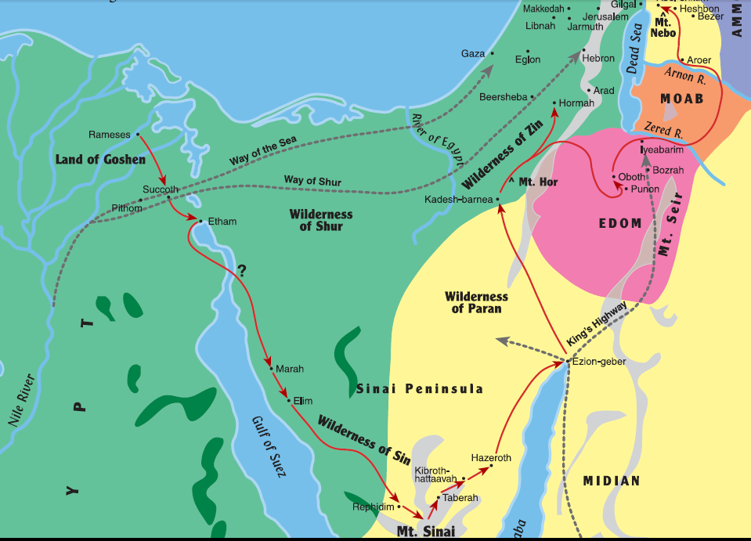

Slide 19
Balak calls for Balaam
Balak is the king of Moab
Sent officials to Balaam a soothsayer/ diviner according to Joshua 13:22
Balak asked that he curse the Israelites
They were scared of the Israelites.
Balaam responds how?
What does God tell Balaam?

Slide 20
Balak calls again
Balak sends higher ranking officials and asks for him to come to him.
Balak also offers him great wealth and honor if he will come.
How does Balaam respond?
Does God allow Balaam to go?
Was this God’s will?

Slide 21
Balaam’s Donkey
Was God pleased with Balaam’s choice?
Why did Balaam strike his donkey 3 times?
The angel stood to block his path.
After the 3rd strike what did the donkey do?
Why was the angel there?
What was the angel’s message to Balaam?

Slide 22
Balaam’s 1st Oracle
They build 7 altars in view of part of Israel’s camp.
Balaam offers 7 bullocks and 7 rams.
God gives Balaam a message
How can I curse what the Lord has not cursed? How can I defy what the Lord has not defiled?
How does Balak respond?

Slide 23
Balaam’s 2nd Oracle
They build 7 altars in view of part of Israel’s camp.
Balaam offers 7 bullocks and 7 rams.
God gives Balaam a message
23:18-24

Slide 24
Balaam’s 3rd Oracle
They build 7 altars in view of part of Israel’s camp.
Balaam offers 7 bullocks and 7 rams.
God gives Balaam a message
24:2-9
What was Balak’s response?

Slide 25
Balaam’s Message and Final Oracles
Balaam repeats that even if Balak offers his palace filled with silver and gold he will not speak of his own accord.
Final Oracles
24:15-19
24:20-24

Slide 26
Moab seduces Israel
What did the Israelites start to do with the Moabites?
How did God respond?
What angered Phinehas?
What was the result of Phinehas’s actions? 25:11
God instructs Moses to vex the Midianites.
What did God mean by vex?

Slide 28
The 2nd Census
Tribe 1st Census 2nd Census
Reuben 46,500 43,730
Simeon 59,300 22,200
Gad 45,650 40,500
Judah 74,600 76,500
Issachar 57,400 60,500
Zebulon 57,400 60,500
Ephraim 40,500 32,500

Slide 29
The 2nd Census
Tribe 1st Census 2nd Census
Manasseh 32,200 52,700
Benjamin 35,400 45,600
Dan 62,700 64,400
Asher 41,500 53,400
Naphtali 53,400 45,400
Total 603,550 601,730

Slide 30
Zelophehad’s Daughters
Zelophehad had 5 daughters and no son’s
They gathered at the Tent of meeting to speak to Moses and Eleazar
They tell them that their father died because of his own sin and left no son, and why should our father’s name disappear because he had no son?
Moses goes to God and they are given inheritance.

Slide 31
Joshua to Succeed Moses –ch 27
God tells Moses to go up the mountain so he can see the land before he is gathered to his people.
Moses asks God to appoint a man over the people so they will have someone to follow.
So God tells Moses take Joshua the son of Nun to Eleazar and consult the Urim.
Once this was done Joshua was commissioned to lead the people.

Slide 32
Offerings
Daily Offerings of 2 lambs (AM and PM) with 1/10 ephah of flower and 1/4 hin of oil.
Sabbath Offerings of 2 Lambs (AM and PM) 2/10 of ephah of flower mixed with oil.
Monthly Offerings of 2 young bulls with 2/10 of ephah of flower mixed with oil and half a hin of wine, 1 ram with 2/10 of ephah of flower mixed with oil and 1/3 hin of wind, and a lamb with 1/10 of ephah of flower mixed with oil.

Slide 33
Passover
Lasted 7 days. They were to eat no bread with leaven for the entirety of the week.
Offer 2 young bulls with 3/10 an ephah of flower mixed with oil, 1 ram with 2/10 an ephah of flower, and with each of the 7 lambs 1/10 an ephah. Include 1 male goat as a sin offering to make atonement.
All is in addition to the normal offerings
The Passover ends with a sacred assembly

Slide 34
Feast of Weeks & Trumpets
50 days after Passover. AKA?
Sacred Assembly is held
Same sacrificial offering is made as at the Passover
F. Of trumpets is held on 1st day of 7th month and opens with a sacred assembly.
Same offering as at Passover and Pentecost except for one less young bull is offered

Slide 35
Day of Atonement & Feast of Tabernacles
Day of Atonement is the 10th day of the 7th month.
For Atonement they offer the same sacrificial offering as at the Feast of Trumpets.
Feast of Tabernacles was the 15th day of the 7th month
Tabernacles opens with a sacred assembly and offer 13-7 bulls, 2 rams, 14 lambs, & 1 goat as a sin offering .

Slide 36
Vows
Vows made to God must be kept.
If a woman makes it while at home the father can annul the vows, once married the husband can annul the vows.
If the husband hears of the vow and says nothing but later nullifies he bears her guilt.

Slide 37
Revenge on the Midianites
1000 men from each tribe should be sent to battle with Phinehas.
When they fought the Midianites they killed every man. Including Balaam.
They took all the children, women, and flocks home as plunder.
They then brought them to Moses and he commanded them to kill all the women who had known a man and every boy.
The men must stay out 7 days and items must be cleansed

Slide 38
Dividing the Spoils
The Lord told Moses to divide 1/2 between the soldiers and 1/2 between the congregation
1/50th must be given to God as a tribute
They took 675k sheep, 72k cattle, 61k donkeys, and 32k women.
The men who fought all survived and wanted to thank God by giving all the gold. 16,750 shekels of gold.

Slide 39
Transjordan Tribes
Reubenites and Gadites had large flocks and herds and asked Moses and Eleazar if they could have the land on the east side of the Jordan as their own.
Moses asked shall your country men go to war and while you sit here? And retells why they were sentenced to wander for 40 years.
The men returned and said they would go and fight but asked to leave their women and herds behind.
The Reubenites, Gadites and 1/2 Manasseh were given the land as requested.

Slide 41
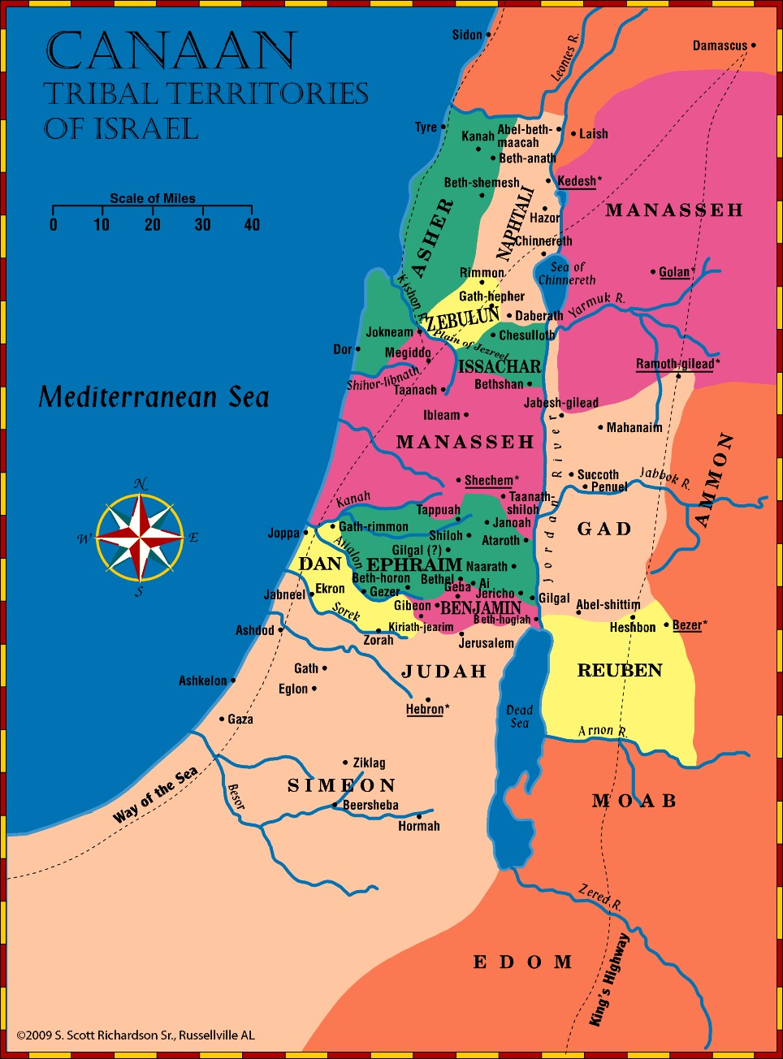

Slide 42
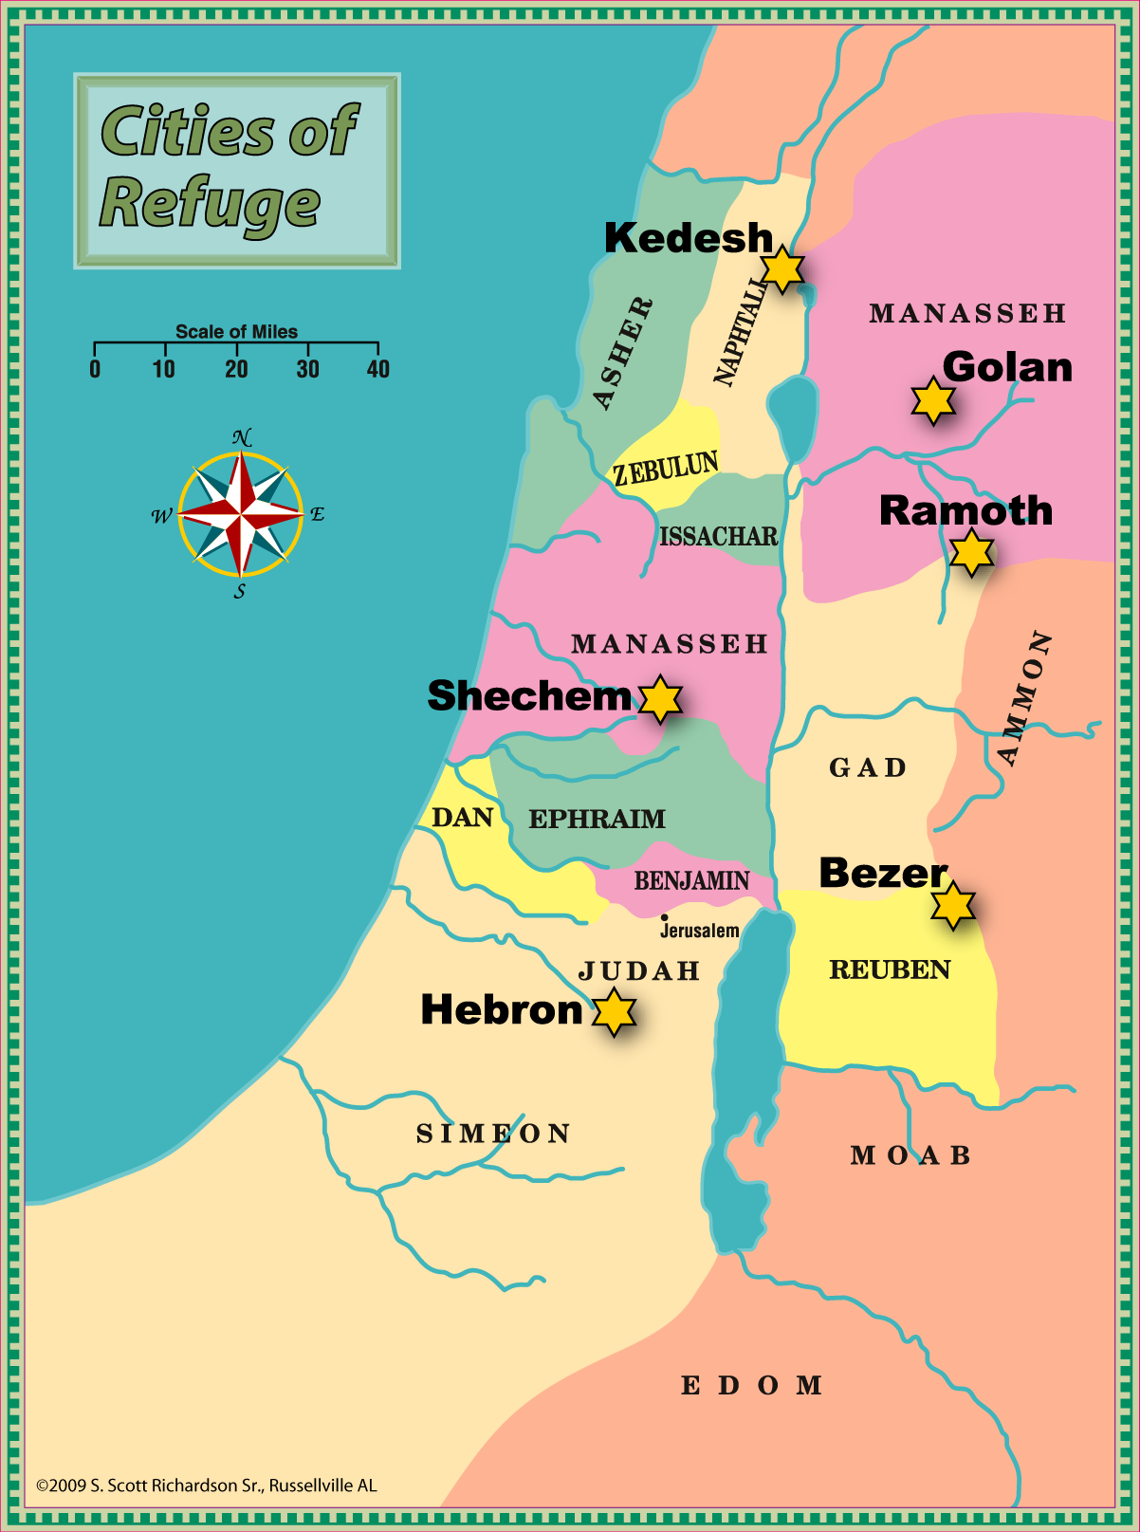
Cities of Refuge

Slide 43
Inheritance of Zelophehad’s Daughters
The family heads came to Moses and asked what happened to the land if the girls married someone out of their tribe.
The daughters of Zelophehad were then restricted to marry outside of their tribe.
No inheritance was to pass from tribe to tribe.
The daughters did marry within the tribe.

Slide 44
Warnings Against Disobedience
Chapter 1
v’s 6-33 – Quick review of Israel’s original journey from Sinai to Kadesh-barnea
v’s 34-46 – Reminder of why they have wandered for 40 years

Slide 45
Reviewing Recent History
Chapter 2
v’s 1-15 – 38 The journey from Kadesh-barnea to the Valley of Zered
v’s 16-25 – God has always fulfilled His promises.
v’s 26-37 – God had been with them in the battle against Sihon and given them the land of Heshbon

Slide 46
Reviewing Recent History
Chapter 3
v’s 1-11 – They had defeated Og, king of Bashan - a giant, and took his fortified cities with high walls.
v’s 12-22 – 2 ½ tribes had already received their portion of the land
v’s 23-29 – Moses had seen the beginnings of great things and longed for more.

Slide 47
Don’t Stop Short
Chapter 4
v’s 1-14 – Listen to the Lord and obey Him.
v’s 15-31 – “Take careful heed to yourselves”
v’s 32-40 – Remember how special you are
v’s 41-49 – The tribes east of the Jordan begin to settle in the land.

Slide 48
The Lord Made a Covenant
Chapter 5
v’s 1-22 – Ten Commandments reviewed
v’s 23-33 – Fear God always (v.29)

Slide 49
The Commandments of God
Chapter 6
v’s 1-9 - Love the Lord with all your heart, soul, and strength - Keep God’s words in your heart - Teach them to your children
v’s 10-25 – Beware, lest you forget the Lord

Slide 50
A Holy People
Chapter 7
v’s 1-11 – Drive out the other nations. Be holy and separate; remember what the Lord has done for you
v’s 12-26 – The Lord will bless your obedience; drive out the inhabitants of the land and do not be defiled by them

Slide 51
Remember
Chapter 8
v’s 1-6 – Remember the wilderness and what the Lord did for you.
v’s 7-20 – When you have entered the land continue to remember the Lord and how He dealt with you in the wilderness.

Slide 52
Don’t Rebel Again
Chapter 9
v’s 1-5 – God was driving out the inhabitants of the land because of their wickedness.
v’s 6-29 – God will not tolerate wickedness among His people either.

Slide 53
God of gods and Lord of lords
Chapter 10
v’s 1-11 – Review continued
v’s 12-22 – A reminder of who God is and how they should respond as His people

Slide 54
Therefore you shall love the Lord your God
Chapter 11
v’s 1-7 – Moses was speaking to a people who were eye witnesses to the great works God had done among them.
v’s 8-17 – Through obedience they could enter and dwell in that Promised Land watered by God.
v’s 18-32 – They were to keep God’s word in their heart. There were blessings and cursings to be had, it was up to them to choose.

Slide 55
Worship God in the place that He chooses
Chapter 12
v’s 1-14 – Upon entering the land they were not to use the high places to worship God, they were to go to the place the Lord would choose.
v’s 15-28 – They could kill and eat meat throughout the land but were not to eat the blood.
v’s 29-32 – Another warning against idolatry is given

Slide 56
Dealing with Apostates
Chapter 13
v’s 1-5 – Anyone guilty of leading others into idolatry was to be put to death.
v’s 6-11 – Even those of your own family were to be killed; you were to make it known and cast the first stone.
v’s 12-18 – If a city is given over to idolatry the city was to be completely destroyed.

Slide 57
A Holy People
Chapter 14
v’s 1-2 – Were not to follow the practices of the people around them.
v’s 3-21 – A reminder about eating only clean animals.
v’s 22-29 – They were to remember where their blessing came from, returning a tenth back to God of all they received.

Slide 58
Every Seven Years
Chapter 15
v’s 1-6 – Debts were to be cancelled
v’s 7-11 – This was not an excuse to oppress the poor.
v’s 12-18 – Hebrew servants were to be released unless he chose to stay.
v’s 19-23 – Laws concerning the firstborn animals were in affect year by year.

Slide 59
Review of Feasts
Chapter 16
v’s 1-8 – Passover
v’s 9-12 – Feast of weeks
v’s 13-17 – Feast of Tabernacles
v’s 18-22 – Follow what is altogether just, that you may live and inherit that land which the Lord your God is giving you.

Slide 60
Judges and Kings
Chapter 17
v’s 1-7 – Two or Three witnesses were needed to confirm an accusation
v’s 8-13 – Difficult matters were to be taken to the priests, the Levites, and the judge; their sentence was to be carried out.
v’s 14-20 – Laws regarding kings

Slide 61
Miscellaneous Reminders
Chapter 18
v’s 1-8 – The priests and Levites had no portion of the inheritance and so were to be provided for by the people
v’s 9-14 – Don’t follow the abominations of the people the Lord is driving out before you.
v’s 15-22 – God promised to raise up a Prophet like Moses and Israel was to hear Him.

Slide 62
Cities of Refuge
Chapter 19
v’s 1-13 – Cities were to be separated and roads built so that the manslayer could flee there and save his life.
v 14 – They were not to remove their neighbor’s landmark
v’s 15-21 – False witnesses beware!

Slide 63
When You Go To War
Chapter 20
v’s 1-9 – Those engaged in battle were to be undistracted and unwavering.
v’s 10-18 – Offer peace when possible but not at the expense of disobeying the Lord.
v’s 19-20 – Don’t cut down trees good for food for use in besieging a city.

Slide 64
Possible Disputes
Chapter 21
“If anyone is found slain…and it is not known who killed him”
“and you see among the captives a beautiful woman…and would taker her for your wife”
“If a man has two wives, one loved and the other unloved”
“If a man has a stubborn and rebellious son”
“If a man has committed a sin deserving of death”

Slide 65
Various Laws
Chapter 22
No “finder’s keepers”
Don’t look the other way
Proper treatment of animals
Yes, you are your brother’s keeper
Certain things do not mix
Remember the commandments of God

Slide 66
Punishing Sexual Immorality
Chapter 22
A husband’s claim will be checked
Adultery should be punished
A young woman must object, loudly
An unbetrothed virgin must be married when defiled.
A man shall not take his father’s wife

Slide 67
Citizenship Laws
Chapter 23
No emasculated man
No one of illegitimate birth to the 10th gen.
No Ammonite or Moabite to the 10th gen.
No Edomite to the 3rd generation

Slide 68
More Misc. Laws
Chapter 23
Keep the camp clean
Must receive escaped slaves
No Prostitutes
Do not offer money received from harlotry
Do not charge interest to a brother
Keep vows to the Lord in a timely manner
Do not take excess from a neighbor’s produce

Slide 69
Marriage Laws
Chapter 24
No divorce for just any reason
Do not reconcile with a wife who has remarried
A man with a new wife shall not go to war for a year

Slide 70
Laws Against Oppression
Chapter 24
Remember the needy and treat them fairly
The one who sins shall die
Remember that you were a slave in Egypt

Slide 71
More Misc. Laws
Chapter 25
Even criminals are to be treated fairly
Do not muzzle an ox while he works
Marriage duty of a surviving brother
Fight fair
Be honest
Destroy the Amalekites

Slide 72
Firstfruits and Tithes
Chapter 26
Offer your firstfruits to God
Remember what God has done for Israel
Do not offer your offering with sin
“The Lord has proclaimed to you to be His special people.”

Slide 73
On Mt. Ebal
Chapter 27
Set up three large stones on Mt. Ebal
Write on them all the words of this law
Build an altar and offer burnt offerings on it
Curses pronounced from Mt. Ebal

Slide 74
Blessings and Curses
Chapter 28
Blessings given from Mt. Gerizim
Disobedience would bring curses
Follow God or return to bondage

Slide 75
Blessings and Curses
Chapter 29
The covenant renewed
Warnings against breaking the covenant

Slide 76
Life or Death
Chapter 30
“Now it shall come to pass, when all these things come upon you…”
“I have set before you today life and good, death and evil,”

Slide 77
Be Strong and Courageous
Chapter 31
Joshua will lead you
God will go before you
Give attention to the law

Slide 78
The Song Of Moses
Chapter 32
Israel’s future is dim
The world’s future is bright

Slide 79
Moses Blesses The Tribes
Chapter 33
Much like Jacob, Moses pronounces blessings on the tribes of Israel
Simeon is not mentioned specifically but would be included in the general blessing of the nation of Israel (26-29)

Slide 80
A Great Leader Dies
Chapter 34
Moses sees the land from Mt. Nebo
His eyes were not dim nor his natural vigor diminished
“But since then there has not arisen in Israel a prophet like Moses, whom the Lord knew face to face,”

Slide 81
The Lord Commands Joshua
Moses has died
God commands Joshua and the people to prepare to enter into the land.
God reassures and encourages Joshua. To…
Joshua directs the officers and reminds the eastern tribes of their commands
The people respond, “whatever you have commanded we will do.”

Slide 82
Rahab and the Spies
Joshua sent 2 spies to look over the land, especially Jericho
The king of Jericho sends a message to Rahab to send out the spies
Rahab hides them and tells of the city’s fear
Rahab then makes her deal with the spies to save her and her house
Rahab instructs the spies how to escape

Slide 83
Crossing the Jordan
The Israelites gathered at the river and waited until the Levites led the way with the Ark of the Covenant.
God instructs them that when the feet of the priest hit the water the water will be cut off.
God cut off the water and the entire nation was able to cross again on dry land, while the water piled up at Adam near Zarethan.

Slide 84
Crossing the Jordan
Once the nation had crossed God told Joshua to choose 12 men to gather stones so that they may set up an memorial.
The armed of Reuben, Manasseh, and Gad came up.
The Ark and the priest stood in the midst of the river while the entire nation crossed.
God explains his memorial.

Slide 85
Circumcision at Gilgal
The news of the Israelites crossing in struck great fear into all the kings of the area
Once the crossing was complete God instructed Joshua to make knives and circumcise the people a Gibeath Haaraloth.
They also observed the Passover at Gilgal.
The Manna Stopped while they were camped here at Gilgal.
The Wandering in the Wilderness is over.

