Slide 1
QUICK REVIEW
Israel has become a large nation, oppressed in Egypt
God calls Moses to lead His people out of Egypt
10 Plagues
Crossing of the Red Sea
God provides water and food in the wilderness
God speaks from Mount Sinai and delivers the 10 Commandments
The people are terrified of God

Slide 2
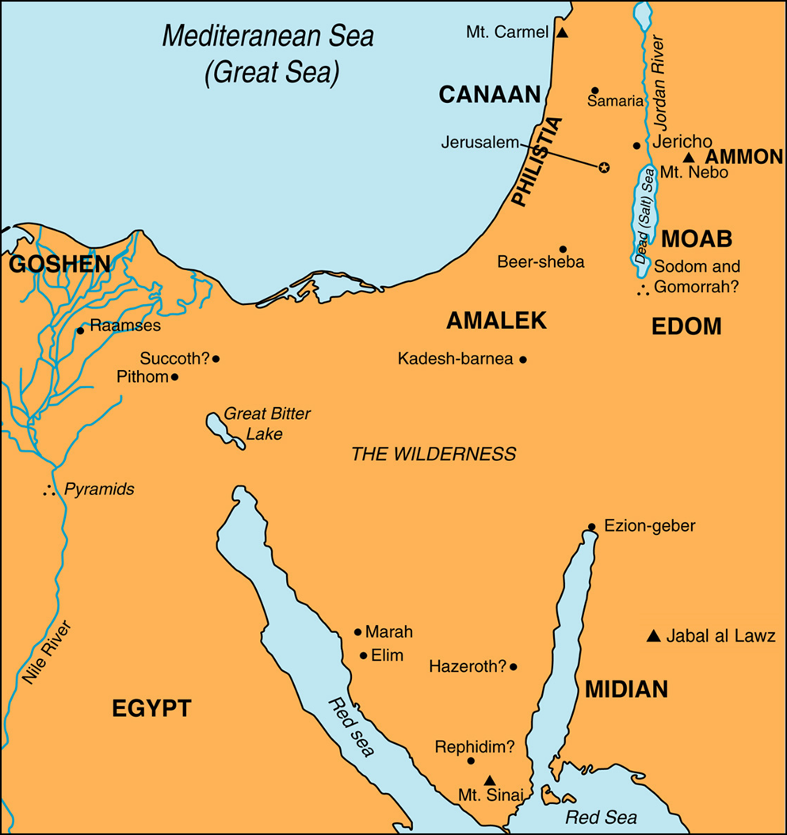

Slide 3
Exodus 21-24; 31:12-18 The Law of Moses

Slide 4
1. What were the laws regarding slaves (Ex. 21:2-11,20-21,26-27)?

Slide 5
2. Who should be killed and who shouldn't be (Ex. 21:12-25)?

Slide 6
3. Why should foreigners be treated respectfully (Ex. 22:21)?

Slide 7
4. Why should widows and orphans be treated properly (Ex. 22:22-24)?

Slide 8
5. How should the poor be treated (Ex. 22:25-27)? Why?

Slide 9
6. Why were the people not to eat meat from an animal that had been killed by another animal (Ex. 22:31)?

Slide 10
7. Justice is very important to God. What actions were to be avoided to make certain justice was not perverted (Ex. 23:1-3,6-9)?

Slide 11
8. What was the Sabbath year (Ex. 23:10-11)? What was its purpose(s)?

Slide 12
9. What was the purpose(s) of the Sabbath (Ex. 20:8-11,23:12; 31:12-17; 34:21; 35:2-3)? How important was it to keep the Sabbath properly? How was it kept?

Slide 13
10. On what three feasts were all Jewish men to appear before the Lord (Ex. 23:14-17)?

Slide 14
11. Having read the commandments described in Exodus 20-23, how would you summarize what God wanted from the people of Israel?

Slide 15
12. After Moses had detailed what God wanted, how did the people respond (Ex. 24:3-8)? What is the blood of the covenant (Ex. 24:8... Compare to Mt. 26:28)?

Slide 16
13. Moses returns to the top of the mountain. How long does he have to wait before God speaks to him? How long is Moses up there (Ex. 24:18)? What does God (or Moses) tell the people to do in the meantime (Ex. 24:14)? What does the mountain look like while they wait (Ex. 24:15-17)?

Slide 17
14. God gave Moses two tablets (Ex. 31:18; 32:15-16). What were on them? Who had written them?

