Slide 2
QUICK REVIEW
Israel has become a large nation, oppressed in Egypt
God calls Moses to lead His people out of Egypt
10 Plagues
Crossing of the Red Sea
God provides water and food in the wilderness
The people have received the Law of God
The people have broken the Law of God
While the people will be punished, the plan to proceed to the Promised Land remains.

Slide 3
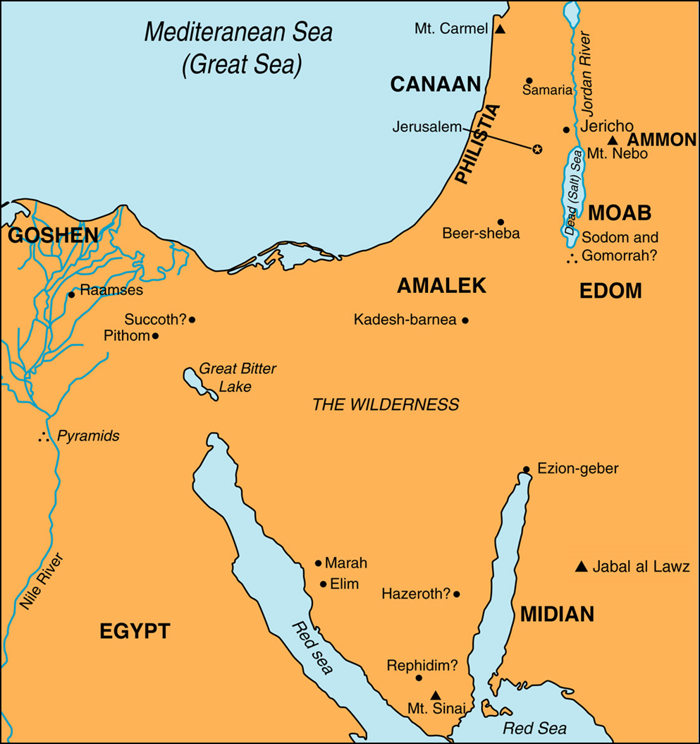

Slide 4
Exodus 25-31; 35-40
The Tabernacle

Slide 5
1. Where were the people to get the materials for making the tabernacle (Ex. 25:1-9; 35:4-9,20-29)? How successful was this (Ex. 36:2-7)?

Slide 6
2. How was the ark of the covenant to be carried (Ex. 25:10-15)? What was to be in the ark of the covenant (Ex. 25:16)? What was to be on top of the ark of the covenant (Ex. 25:17-22)?

Slide 7
3. What size was the tabernacle? How many rooms? What material was it made of? What color was it?

Slide 8
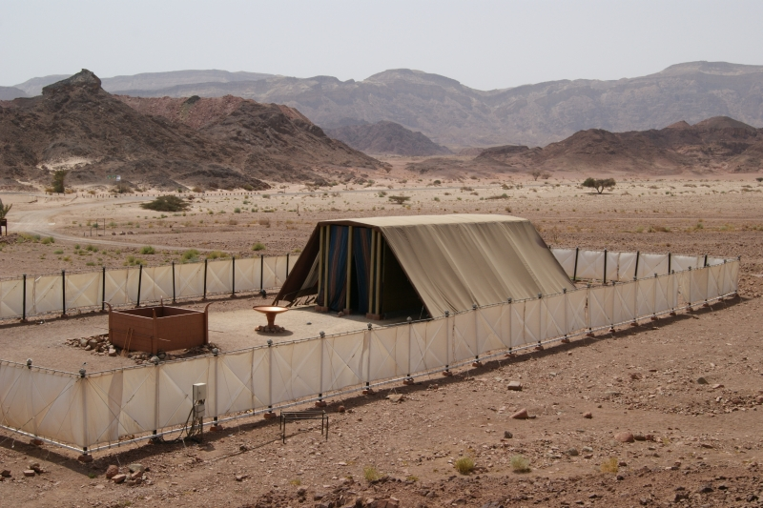

Slide 9
4. What items were to be in and around the tabernacle?

Slide 11
5. Were these instructions suggestions or precise instructions (Ex. 25:40; 26:30; 27:8; 31:11; 36:1; 39:32,42-43; Heb. 8:5)?

Slide 12
6. How did the Israelites, who were previously a slave people tasked with making bricks, gain the knowledge necessary to make a glorious and intricate tabernacle (Ex. 28:3; 31:1-11; 35:30-35)? Since this is the case, how amazing do you think the tabernacle and its furniture and utensils looked? Can you see a New Testament parallel?

Slide 13
7. Describe the priests' outfit and breastplate. Why did the priests wear bells (Ex. 28:33-35)?

Slide 14
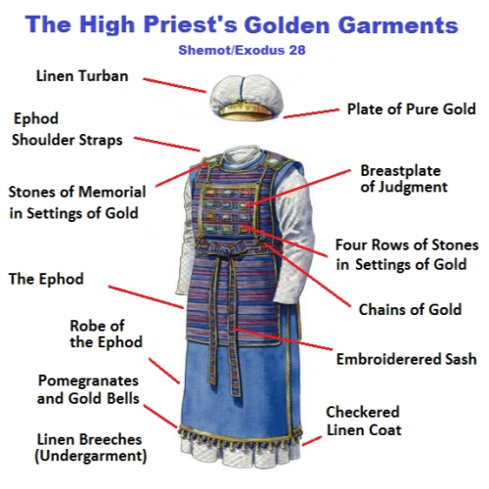

Slide 15
8. Who chose Aaron and his sons to be priests? Still, what did they have to do before they served God (Ex. 29)?

Slide 16
9. What were the people to give when they were counted (Ex. 30:12-16)? Why was this necessary in addition to redeeming every firstborn male?

Slide 17
10. What was one way that God wanted the tabernacle and the things in it and the priests to be holy and unlike anything else in the nation (Ex. 30:22-38)? What happened if someone tried to imitate this for any other reason?

Slide 18
11. The book of Exodus ends with two facts (one of which was already covered earlier in the book) (Ex. 40:34-38). What are the two events? Why do you think the book ends this way (or in other words, what is the significance of these two events)?

Slide 19
LESSONS
God is holy
God was at once with the people and also separated from the people

