Slide 2
QUICK REVIEW
Israel is a large nation, oppressed in Egypt
Moses is born and chooses to be an Israelite rather than Egyptian royalty
God calls Moses to lead the people out of Egypt
After 10 plagues, Pharaoh releases Israel.
Israel is instructed to remember the Passover and plunder Egypt.
The people don’t take the direct route to the Promised Land
God leads Israel in a pillar of cloud / fire

Slide 3
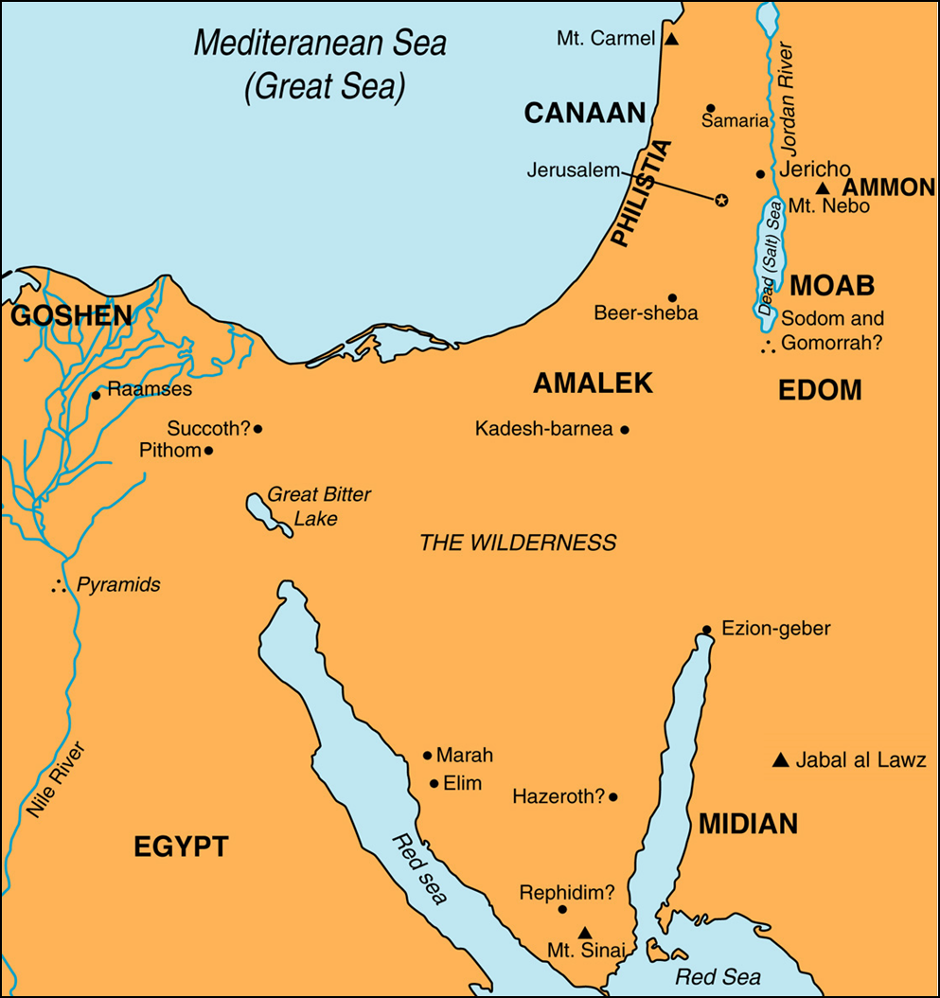

Slide 4
EXODUS 14-15

Slide 5
2. What did the people do when they saw the Egyptian army chasing them (Ex. 14:10-12)? How did Moses respond (Ex. 14:13-14)? What was expected of the people in the coming conflict? Would this always be the case?

Slide 6
3. What did the angel of God / pillar of God do (Ex. 14:19-20)?

Slide 7
4. How long did it take for the Red Sea to divide (Ex. 14:21)? Where did the water go?

Slide 8
5. As the people passed through the Red Sea, where did the pillar of cloud go (Ex. 14:24)? What does Paul call this moment (I Cor. 10:1-2)?

Slide 9
6. What did the Egyptians recognize (Ex. 14:24-25)? When did they figure this out? Why should they have known earlier? In comparison, what are we warned not to do (Heb. 3:8,15; 4:7)?

Slide 10
7. Once the water crashes down, what do the Israelites see and how do they respond (Ex. 14:30-31)?

Slide 11
8. Describe Moses' song (Ex. 15:1-18). Who joined in singing this song?

Slide 12
1. How did God harden Pharaoh's heart (Ex. 14:1-4)? Why did God do it?

Slide 13
PHARAOH’S HARD HEART
His heart is hardened on twelve separate occasion.
With the rod / snake
9 times in the first 9 plagues
Once when the people wander
Once at the Red Sea*

Slide 14
WHO HARDENED PHARAOH’S HEART?
When Pharaoh hardened his own heart (8:15,31; 9:34)
As the Lord said (8:15; 9:35)
When God hardened Pharaoh’s heart (Ex. 4:21; 7:3; 9:12; 10:1,20,27; 14:4,8,17)
As the Lord said (9:12)
When it does not say who (Ex. 7:13,22; 8:19; 9:7)
As the Lord said (7:13,22; 8:19)

Slide 15
WHAT HARDENED HIS HEART?
When he saw there was relief from the frogs (Ex. 8:15)
When he saw that the rain and hail and thunder had ceased (Ex 9:34)
By having the people of Israel wander, appearing lost and trapped (Ex. 14:1-5)
No specification (Ex. 8:19; 9:7,12; 14:17)
Potential reasons stated in context but without a direct connection saying this is what hardened Pharaoh’s heart.
His magicians match the snakes (Ex. 7:11-13) *** - does not make direct connection
His magicians match the water to blood (Ex. 7:22) ***- does not make direct connection
Flies are removed (Ex. 8:31)
Not on locust was remaining (Ex. 10:19-20) ***- does not make direct connection
Moses refuses to leave their livestock behind (Ex. 10:24-28) *** - does not make direct connection

Slide 16
ADDITIONAL THOUGHTS
Do not harden your hearts (Deut. 15:7; Ps. 95:8; Heb. 3:8,15; 4:7)
Do not let hearts be hardened (Heb. 3:13 – encourage one another so that none will be hardened by the deceitfulness of sin)
Romans 1:18-32 – the process and our part
Romans 9:14-26 – God’s right to choose

Slide 17
LESSONS
Our God is mighty. If God is for us, who can be against us?
The journey to the Promised Land begins with a point of no return / baptism

