Slide 1
QUICK REVIEW
Jacob’s family in Egypt
Joseph dies
The people are oppressed but continue to increase in number.
Moses is born, hidden, brought up.
Moses makes his choice, flees, gets married.

Slide 2
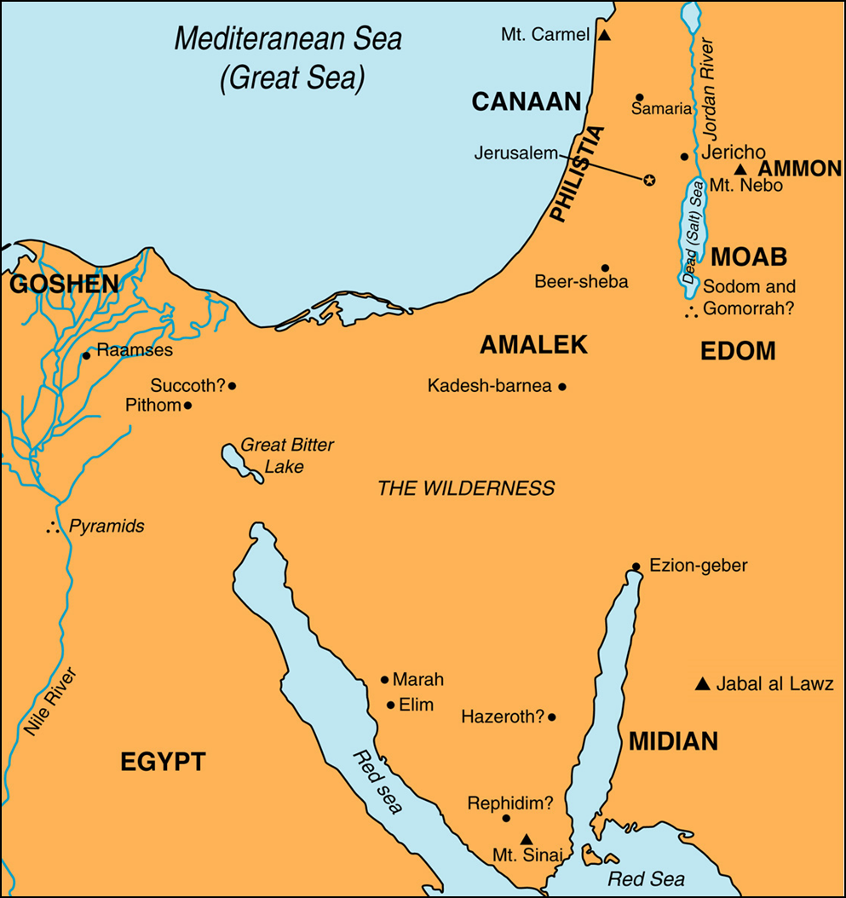

Slide 3
EXODUS 3-5

Slide 4
1. How much time had gone by from the time Moses murdered the Egyptian to the events of chapter 3 (Ex. 7:7; Acts 7:30)?

Slide 5
2. To what mountain did Moses go (Ex. 3:1)? What was Moses doing there? What other leaders does this compare to (I Sam. 16:11; John 10:11)?

Slide 7
3. What caught Moses' eye (Ex. 3:2-6)? When Moses approached, what three things did God say to him? How did Moses respond? Why?

Slide 8
4. What promise was God intending to fulfill (Ex. 3:8)?

Slide 9
5. How had Moses changed in the last 40 years (Ex. 3:10-11 Vs Ex. 2:11-14)?

Slide 10
6. Where was Moses supposed to lead the people (Ex. 3:12)?

Slide 11
7. What information did Moses say he needed (Ex. 3:13-17)? What was God's answer? What message did God want Moses to deliver to the people?

Slide 12
8. What was Moses to ask Pharaoh for (Ex. 3:18-22)? God knew Pharaoh's response and what it would take to change his mind. What would it take? What would be the outcome?

Slide 13
9. How did Moses think the Hebrews might respond to him (Ex. 4:1)? Is this a reasonable concern? What was God's solution to Moses' concern (Ex. 4:2-9)?

Slide 14
10. What other concern did Moses have (Ex. 4:10-12)? Is this reasonable? What is God's response? What lessons can we learn from this?

Slide 15
11. What does Moses request and how does God respond (Ex. 4:13-17)?

Slide 16
12. What was God going to do to Pharaoh's heart (Ex. 4:21)? What does God call Israel? What warning does God send to Pharaoh?

Slide 17
13. What nearly happened to Moses on his way to Egypt (Ex. 4:24-26)? Why?

Slide 18
14. God calls Aaron and tells him to meet Moses. Together, Moses and Aaron address the people. How do the people respond (Ex. 4:27-31)?

Slide 19
15. Why did Pharaoh refuse to let Israel go (Ex. 5:2)? His question may be the most important in the book of Exodus as much of the book is about the answer to that question for Pharaoh's sake as well as Israel's and ours.

Slide 20
16. How does Pharaoh respond to Moses' request (Ex. 5:3-14)?

Slide 21
17. Who do the people blame for their predicament (Ex. 5:20-21)? Who does Moses blame (Ex. 5:22-23)? Why would they do this? Why shouldn't they have done this? How does this relate to modern circumstances when people assign blame in their lives?

Slide 22
EXODUS 1-2
Those who came to Egypt / 70 people from Jacob (Ex. 1:1-5)
That generation dies (Ex. 1:6)
***Passage of time*** (around 300 years, potentially)
Israelite population explosion (Ex. 1:7)
A new king doesn’t remember Joseph but instead fears Israel and tries to squash them first by slavery (Ex. 1:8-14)
The king attempts to have all of the newborn Israelite males be killed but two women protect the kids and are blessed by God as a result (Ex. 1:15-22)

Slide 23
EXODUS 1-2
Moses is born, hidden, then put in the basket where he is found and raised by an Egyptian princess (Ex. 2:1-10)
***Passage of time*** (about 40 years)
Moses choses to side with the Hebrews, murdering an Egyptian, but then flees Egypt (Ex. 2:11-14)
Moses goes to Midian where he helps some women deal with rude shepherds (Ex. 2:15-17)
Moses gets married and has a son (Ex. 2:18-22)
God hears Israel (Ex. 2:23-25)

Slide 24
LESSONS
We have to make our decision as to which world we will accept and which we will reject. (II Cor. 6:14 – 7:1)
Those who serve God and serve His servants, will be blessed. (Mt. 10:40-42)
God hears the plights of His people (I John 5:14; Jam. 5:4)
God remembers His word. He will not forget. (Heb. 13:5-6)

