Slide 1
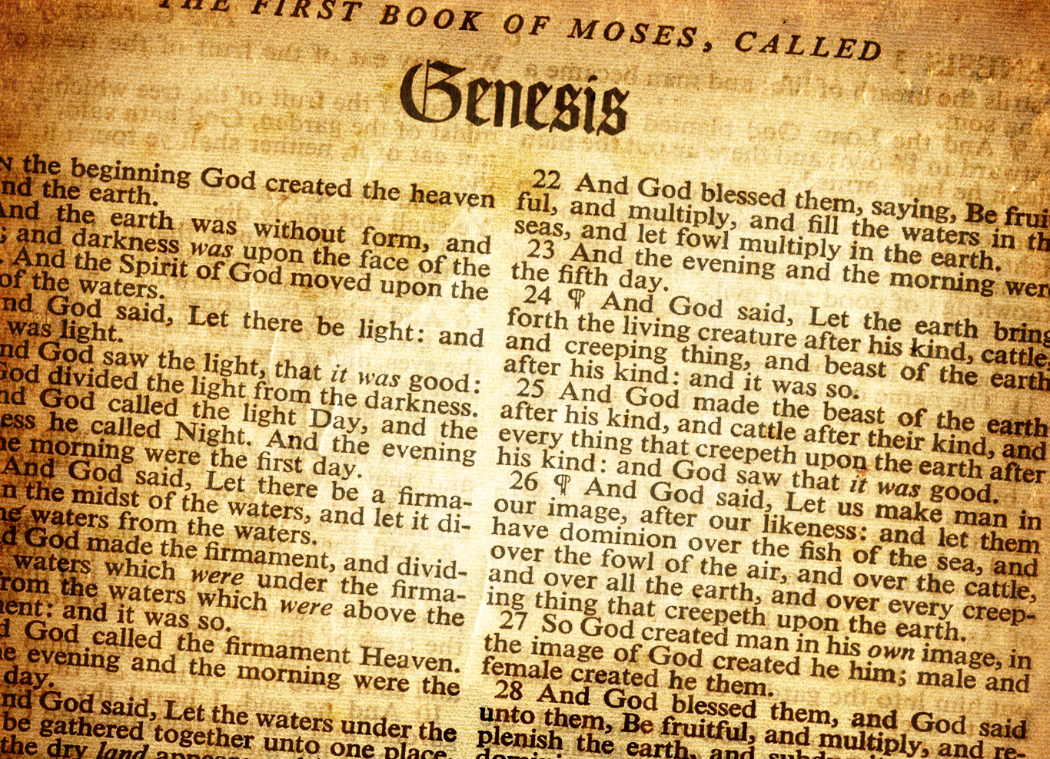
Lesson 10 Joseph’s Dreams to Slavery Genesis 37 – 39

Slide 2
Review
Before the Flood
Flood
Scattering
Patriarchs
Genesis
Creation
0
Flood
1650
Abraham’s Birth
2008
Joseph’s Birth
~2259
Isaac’s Birth
2108
Joseph’s Death
~2369
Jacob’s Birth
2168

Slide 3
Review
Abram in Egypt
Abram rescues Lot
Abram meets Melchizedek
Ishmael born
86
Isaac born
100
Abraham dies
175
Sodom & Gomorrah destroyed
Abraham lies to Abimelech
Life of Abraham
3-fold promise, Abram departs Haran
75
Renamed Abraham,
Circumcision
99
Sarah dies
127
Finds wife for Isaac
Abraham Marries Keturah
Abraham’s faith tested with Isaac

Slide 4
Timeline of Abraham, Isaac, Jacob together
Isaac born
Abraham 100
Gen 21:5
Jacob born
Isaac 60
Gen 25:26
Life of Abraham
Life of Isaac
Life of Jacob
Isaac marries Rebekah
Isaac 40
Gen 25:20

Slide 5
Timeline of Abraham, Isaac, Jacob, Joseph
Isaac born
Abraham 100
Gen 21:5
Jacob born
Isaac 60
Gen 25:26
Joseph born
Jacob ~91
Jacob goes to Egypt when 130 Gen 47:28
Abraham dies 175
Gen 25:7
Life of Abraham
Isaac dies 180
Gen 35:28
Life of Isaac
Jacob dies 147
Gen 47:28
Life of Jacob
Life of Joseph
Isaac marries Rebekah
Isaac 40
Gen 25:20
Joseph dies 110
Gen 50:26
Joseph interprets Pharaoh's dreams when ~30
Joseph about 17 sold when by bothers Gen 37:2

Slide 6
Preview
Patriarchs – Genesis chapters 13 – 50:
37 | 38 | 39
Joseph’s dreams Joseph sold | Judah and Tamar | Joseph and Potiphar’s wife

Slide 7
Why did Joseph’s brothers hate him?
Genesis 37:4 → When his brothers saw that their father loved him more than all his brothers, they hated him and could not speak peaceably to him
Genesis 37:2 → When Joseph was 17, he brought a bad report of the sons of Bilhah and Zilpah to his father (Dan, Naphtali, Gad Asher)
Genesis 37:3 → Israel made Joseph a coat of many colors (this probably added to the brother’s hatred)
Genesis 37:5 → When Joseph told his brothers of his dream, they hated him even more

Slide 8
Describe Joseph’s two dreams and his family’s reaction to them.
First Dream – Gen 37:7-8
Joseph and his brothers were binding sheaves in the field. Then Joseph’s sheaf stood upright and all his brother’s sheaves stood all around and bowed down to Joseph’s sheaf.
Brothers’ reaction → “Shall you indeed reign over us? Or shall you indeed have dominion over us?” They hated him even more for his dreams and his words.
Second Dream – Gen 37:9-11
The sun, moon, and eleven stars bowed down to Joseph
Father’s reaction → rebuked him and said “Shall your mother and I and your brothers indeed bow down to you?” Father kept the matter in mind.
Brothers’ reaction → his brothers envied him

Slide 9
When do you think Joseph dreamed his dreams, before or after Rachel died? What makes this question hard to answer?
Support for before Rachel died
Genesis 37:10 → Israel says shall your mother bow down before you
Genesis 37:3 → Joseph was called the son of Israel’s old age (wouldn’t Benjamin be called the son of Israel’s old age if was born by this time?)
Genesis 44:32 – 34 → Benjamin is referred to as “the lad” which doesn’t seem to indicate he would have been old enough
Genesis 37:3 → Israel loved Joseph more than all his children. Why would he have loved Joseph more than Benjamin?

Slide 10
When do you think Joseph dreamed his dreams, before or after Rachel died? What makes this question hard to answer?
Support for after Rachel died
Genesis 37:9-10 → Joseph dreams of 11 stars bowing down which refers to his brothers
Genesis 46:21 → Appears that Benjamin had 10 sons when he came to Egypt
If before Rachel died, then the 11th star could be prophetic
If after Rachel died, then mother could refer to Leah as his step-mother

Slide 11
When do you think Joseph dreamed his dreams, before or after Rachel died? What makes this question hard to answer?
Jacob & family leave Haran (Joseph 6)
Gen 30:25, 31:41
Joseph was 30 when he interpreted Pharaoh’s dreams
Gen 41:46
Gen 47:28 → Israel was 130 when he came to Egypt
(died at 147 and lived in Egypt for 17 years)
Jacob was therefore about 91 when Joseph was born
Joseph was born after Jacob had been in Haran for 14 years → Gen 30:25
After Joseph’s birth, Jacob asked to be sent away, but then stayed and worked 6 more years for Laban
Joseph dreams
Joseph sold
Life of Joseph
Appears Benjamin comes to Egypt with 10 sons
Gen 46:8, 21, 27 (don’t know how many wives he had)
After leaving Haran, Jacob went to Mahanaim (Gen 32:1-2), then to Penuel (Gen 32:30-32), then to Succoth, where he built a house and shelters for his cattle (Gen 33:17). After an unspecified amount of time, he left there and moved to Shechem, where he bought land (Gen 33:18-20). After another unspecified period of time, he went to Bethel in Canaan (Gen 35:1), and they lived there for a period of time (Gen 35:4-15). Then, they left Bethel and traveled towards Ephrath (Gen 35:16). It was during this journey that Rachel gave birth to Benjamin, and she died in childbirth (Gen 35:16-20).
Joseph was 17 when he gave a bad report of his brothers
Gen 37:2
Joseph was about 39 when Israel came to Egypt
Gen 45:6, 11
(five years of famine left)

Slide 12
When do you think Joseph dreamed his dreams, before or after Rachel died? What makes this question hard to answer?
Jacob & family leave Haran (Joseph 6)
Gen 30:25, 31:41
Joseph was 30 when he interpreted Pharaoh’s dreams
Gen 41:46
Gen 47:28 → Israel was 130 when he came to Egypt
(died at 147 and lived in Egypt for 17 years)
Jacob was therefore about 91 when Joseph was born
Joseph was born after Jacob had been in Haran for 14 years → Gen 30:25
After Joseph’s birth, Jacob asked to be sent away, but then stayed and worked 6 more years for Laban
Joseph dreams
Joseph sold
Life of Joseph
Appears Benjamin comes to Egypt with 10 sons
Gen 46:8, 21, 27 (don’t know how many wives he had)
If Rachel was still alive when Joseph had these dreams, then Benjamin’s max age would be about 22 years old
If Rachel had already died when Joseph had the dreams, then Benjamin could have been up to about 33 years old (likely years less because of all that occurred after leaving Haran)
Joseph was 17 when he gave a bad report of his brothers
Gen 37:2
Joseph was about 39 when Israel came to Egypt
Gen 45:6, 11
(five years of famine left)

Slide 13
Israel tells Joseph to go check on his brothers who were feeding the flock in Shechem. What happened when Joseph found his brothers?
Genesis 37:12 – 36
Brothers went to Shechem to feed their flock
Israel tells Joseph to see if his brothers are well
Joseph went to Shechem and met a man who told him that his brothers went to Dothan
When Joseph’s brothers saw him afar off, they conspired to kill him
Rueben said not to kill him, but to cast him into a pit in the wilderness
Rueben planned to deliver Joseph and bring him back to his father
When Joseph had come, they took his coat and cast him into the pit
While the ate, they saw a company of Ishmaelites coming from Gilead
Judah has the idea to sell Joseph to the Midianite traders
They sold Joseph for 20 shekels of silver
The Midianites took Joseph to Egypt

Slide 14
Israel tells Joseph to go check on his brothers who were feeding the flock in Shechem. What happened when Joseph found his brothers?
Genesis 37:12 – 36
Reuben returned to the pit and tore his clothes when Joseph was not there
They killed a goat and dipped Joseph’s coat in the blood
They brought the coat to Jacob and said they found this coat and asked if it was Joseph’s
Jacob concluded an animal killed Joseph
Jacob tore his clothes, put on sackcloth and mourned many days
All Jacob’s sons and daughters tried to comfort him, but he would not be comforted
Joseph was sold to Potiphar, an officer of Pharaoh and captain of the guard

Slide 15
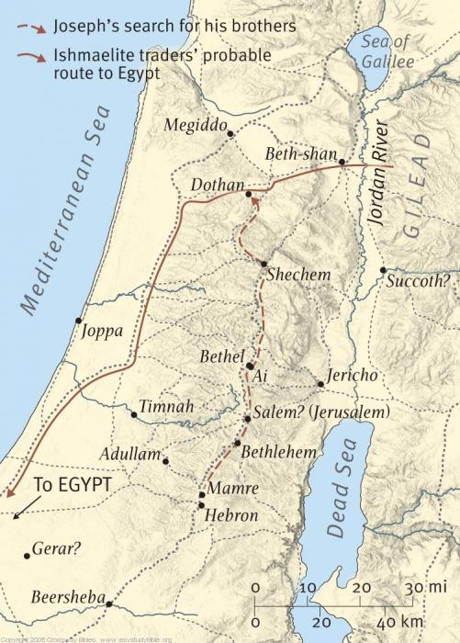
Israel tells Joseph to go check on his brothers who were feeding the flock in Shechem. What happened when Joseph found his brothers?
Going to Bethlehem from Bethel when Rachel died
Gen 35:16-21
Jacob came to his father in Mamre (Hebron)
Gen 35:27
Jacob dwelt where his father was a stranger
Gen 37:1
Dothan
Shechem
Bethel
Bethlehem
Mamre/Hebron

Slide 16
Genesis 38 switches from Joseph to focus briefly on Judah. Describe the events with Tamar. What is notable about Perez?
Judah marries a Canaanite named Shua and they have 3 children: Er, Onan, Shelah – Gen 38:2-5
Judah takes a wife for Er named Tamar – Gen 38:6
The LORD killed Er because Er was wicked – Gen 38:7
Judah told Onan to marry Tamar and raise an heir to Er. Onan marries her but does not raise an heir to Er on purpose, so the LORD killed him – Gen 38:8 -10
Judah told Tamar to remain a widow in her father’s house until Shelah was old enough to marry her, lest he die as his brothers did – Gen 38:11
Next, Judah’s wife, Shua, died, and Shelah became grown but Tamar wasn’t given to Shelah – Gen 38:12, 14
While Judah went to his sheep shearers in Timnah, Tamar dressed like a harlot, but her face was covered. She made a deal with Judah that he could go in to her for a goat. In the meantime, Judah would give her his signet and cord and his staff as a pledge for the goat. Tamar conceives. – Gen 38:12-18

Slide 17
Genesis 38 switches from Joseph to focus briefly on Judah. Describe the events with Tamar. What is notable about Perez?
Judah sends the goat with his friend the Adullamite to receive the pledge, but his friend cannot find her and is told there was no harlot in this place – Gen 38:20-23
After about 3 months, Judah is told that Tamar played the harlot and is with child by her harlotry. Judah says to bring her out to be burned. – Gen 38:24
Tamar says to Judah that she is pregnant by the man who owns the signet and cord, and staff – Gen 38:25
Judah says Tamar has been more righteous than him because he did not give her to Shelah. Judah never knew her again. – Gen 38:26
Tamar has twins and during birth, one of the twins’ arm came out. The Midwife tied a scarlet thread around his hand, and his hand went back in. Then the other twin came out first. Gen 38:27-30
Zerah’s arm came out first, but Perez came out first – Gen 38:29-30
Perez is in the genealogy of Jesus – Matt 1:3

Slide 18
When Joseph was brought to Egypt, he was bought by Potiphar, the captain of the guard. How does Joseph rise to be overseer of Potiphar’s house?
Genesis 39:2
The LORD was with Joseph, and he was a successful man
Genesis 39:3
Joseph’s master saw that the LORD was with Joseph and that the LORD made all Joseph did to prosper
Genesis 39:4
So Joseph found favor in Potiphar’s sight and Potiphar made him overseer of his house and all that he had he put in Joseph’s care
Sound similar to how God bless Jacob while he was in Haran

Slide 19
How did Joseph end up in prison?
Genesis 39:6 – 7
Joseph was handsome in appearance
Potiphar’s wife desired Joseph and tells Joseph to lie with her
Joseph refused
Genesis 39:9
Potiphar’s wife spoke like this to Joseph day by day
Joseph did not heed her
Genesis 39:11 – 20
One of the times, none of the men were in the house and Potiphar’s wife caught Joseph by the garment and told him to lie with her
Joseph left his garment in her hand and fled
She called to the men of the house and said that Joseph tried to lie with her, and when she called out, he left his garment and fled
She kept Joseph’s garment until Potiphar came home and told him the same lie
Potiphar became angry and cast Joseph into prison where the king’s prisoners were confined.

Slide 20
What can we learn about sin and temptation from Joseph’s time in Potiphar’s house?
Even if the sin you commit is evil toward another, it is sin against God
Genesis 39:9
Fleeing from the situation is way to avoid sinning
Genesis 39:12

Slide 21
How did Joseph fare in prison?
Genesis 39:21 – 23
The LORD was with Joseph and showed him mercy, and He gave Joseph favor in the sight of the keeper of the prison
The keeper of the prison committed all the prisoners into Joseph’s hand
The keeper of the prison didn’t look into anything that was under Joseph’s hand because the LORD was with Joseph
Whatever Joseph did, the LORD made it prosper

