Slide 1
MORE THAN DEATH… CRUCIFIXION
The demand of the crowd (John 19:6)
As observed by the disciples (Lk. 24:19-20)
Observation of the angel (Mt. 28:5; Mk. 16:6)
The observation of Peter (Acts 2:36; 4:10)
Paul’s observation (I Cor. 1:13; II Cor. 13:4; Gal. 3:1)
What we teach (I Cor. 1:23; 2:2)
Observation in Revelation (Rev. 11:8)
Relevant to what we do spiritually (Rom. 6:6; Gal. 2:20; 5:24; 6:14; Heb. 6:6)

Slide 2
NOT ALL CRUCIFIXIONS
ARE THE SAME
Tied to the cross
Nailed to the cross (John 20:25; Acts 2:23; Col. 2:14)

Slide 3
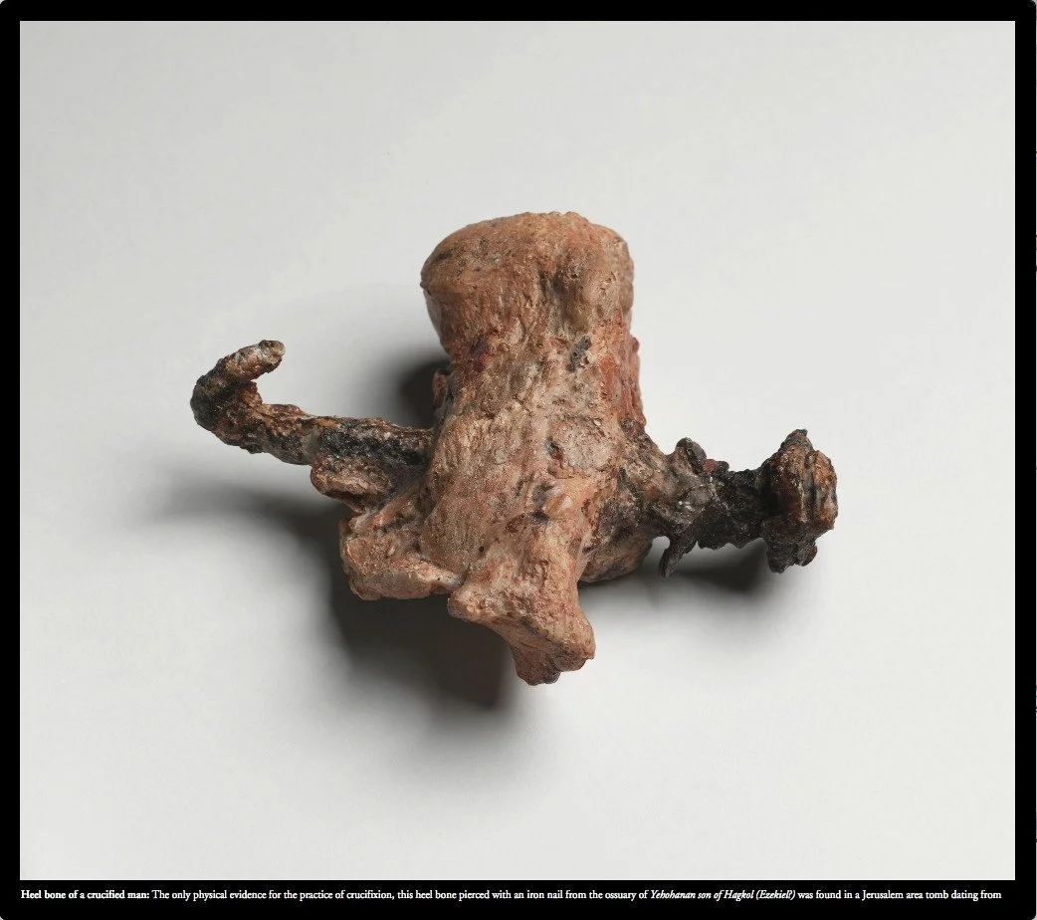
Notes:
https://www.reddit.com/r/pics/comments/2nq3lt/the_only_physical_evidence_of_the_ancient/

Slide 4
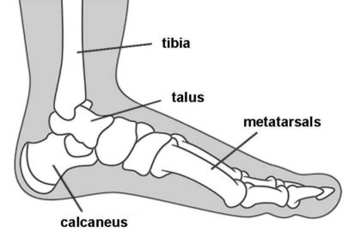
Notes:
https://thefederalist.com/2018/03/30/yes-ancient-romans-really-practice-crucifixion/

Slide 5
Notes:
https://www.reddit.com/r/pics/comments/2nq3lt/the_only_physical_evidence_of_the_ancient/

