Slide 1
ARTIFACTS THAT MATTER

Slide 2
Purpose of this series
Support the Bible
  Real places
  Real people
  Real events
  Accurate descriptions
Better understand the Bible
To understand that more knowledge of history enriches our understanding of the Bible.

Slide 3
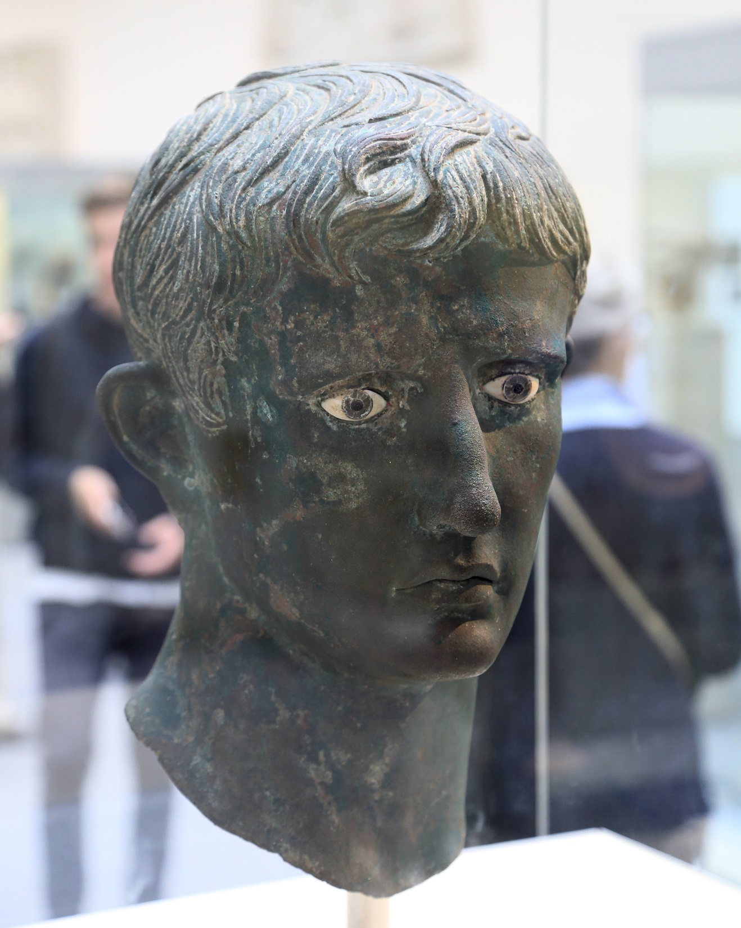
“Now in those days a decree went out from Caesar Augustus, that a census be taken of all the inhabited earth.”
Lk. 2:1
Notes:
Bronze bust of Caesar Augustus (Lk. 2:1) – Caesar when Jesus was born

Slide 4
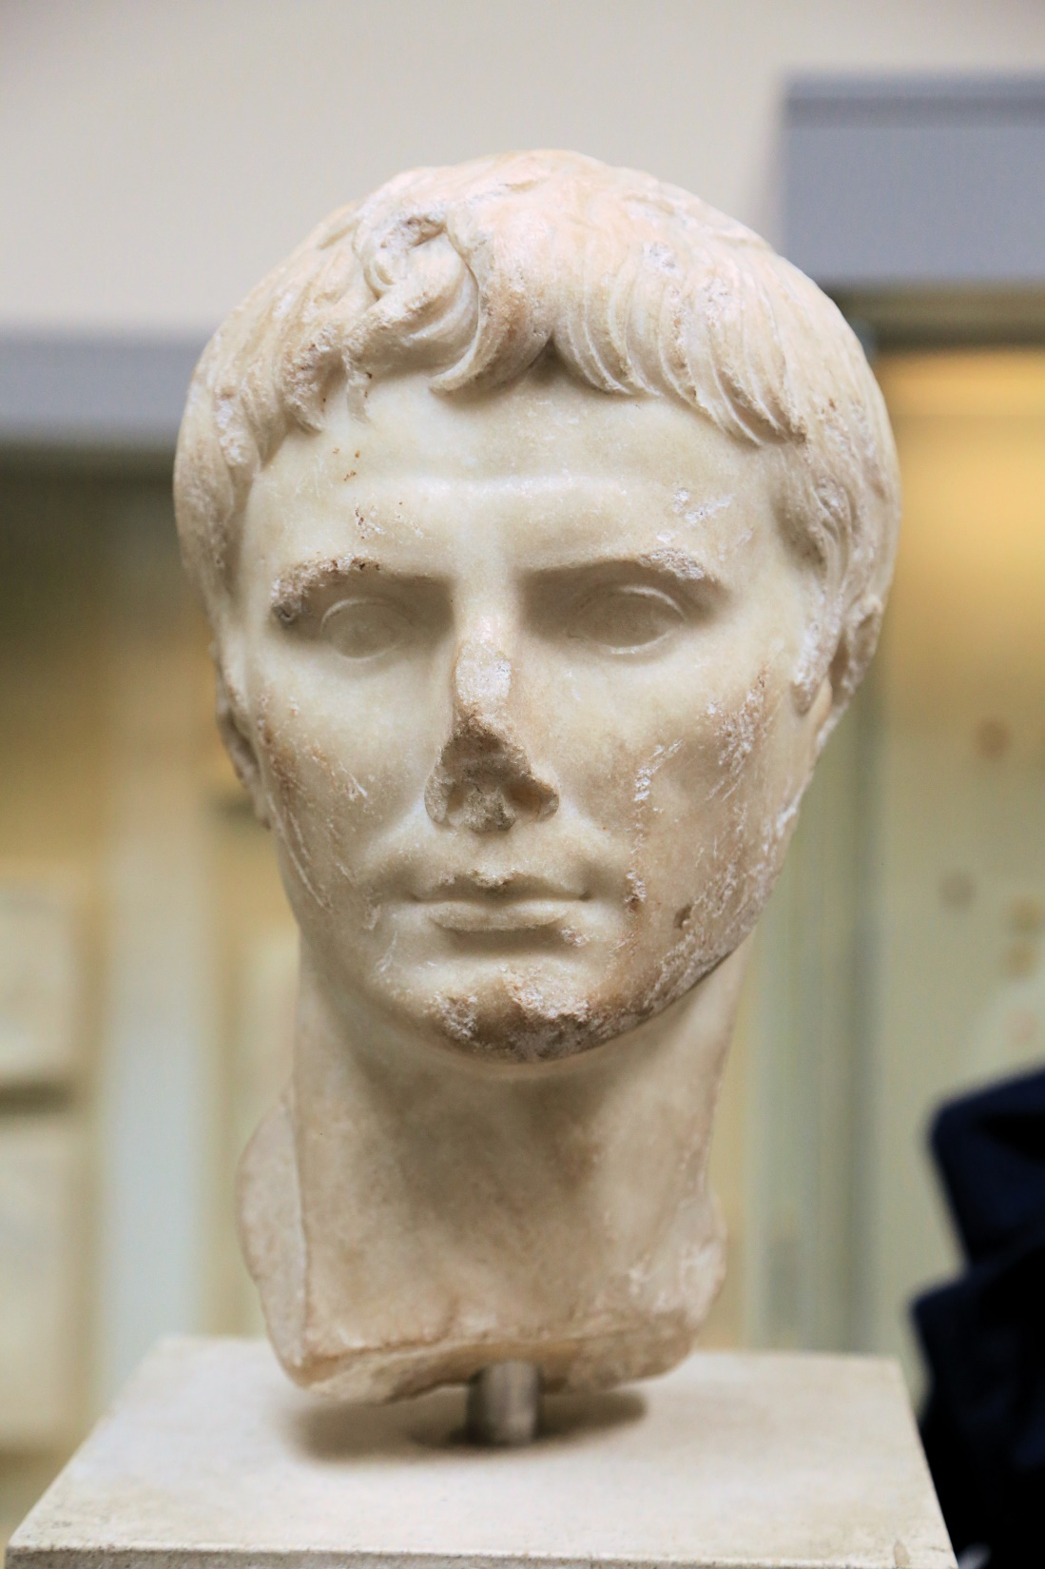
Notes:
Augustus, son of Julius. In order to solidify himself as deity, Augustus was referred to as “son of a god”. So it isn’t hard to know what the Jews thought was being referred to regarding Jesus when He was called the Son of God.

Slide 5
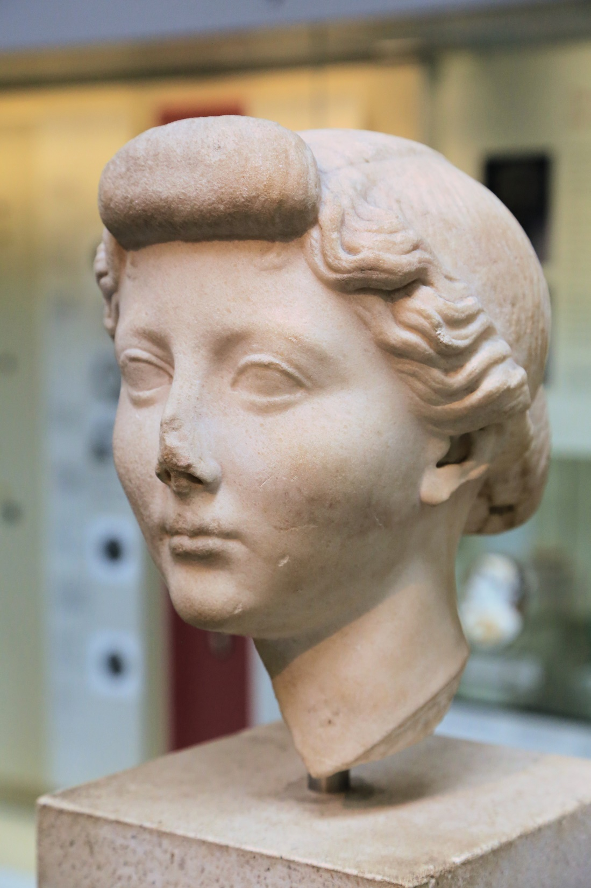

Slide 6
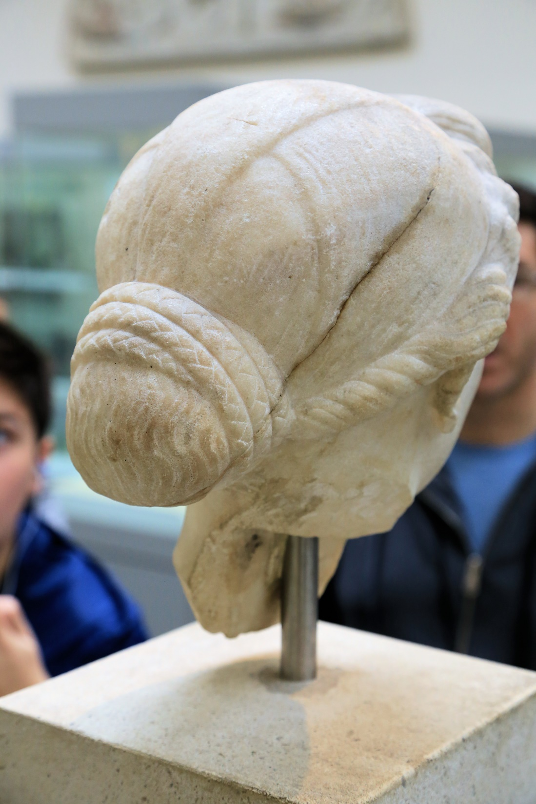
Likewise, I want women to adorn themselves with proper clothing, modestly and discreetly, not with braided hair and gold or pearls or costly garments, but rather by means of good works, as is proper for women making a claim to godliness. A woman must quietly receive instruction with entire submissiveness.
I Timothy 2:9-11

Slide 7
Your adornment must not be merely external—braiding the hair, and wearing gold jewelry, or putting on dresses; but let it be the hidden person of the heart, with the imperishable quality of a gentle and quiet spirit, which is precious in the sight of God.
I Pet. 3:3-4

Slide 8
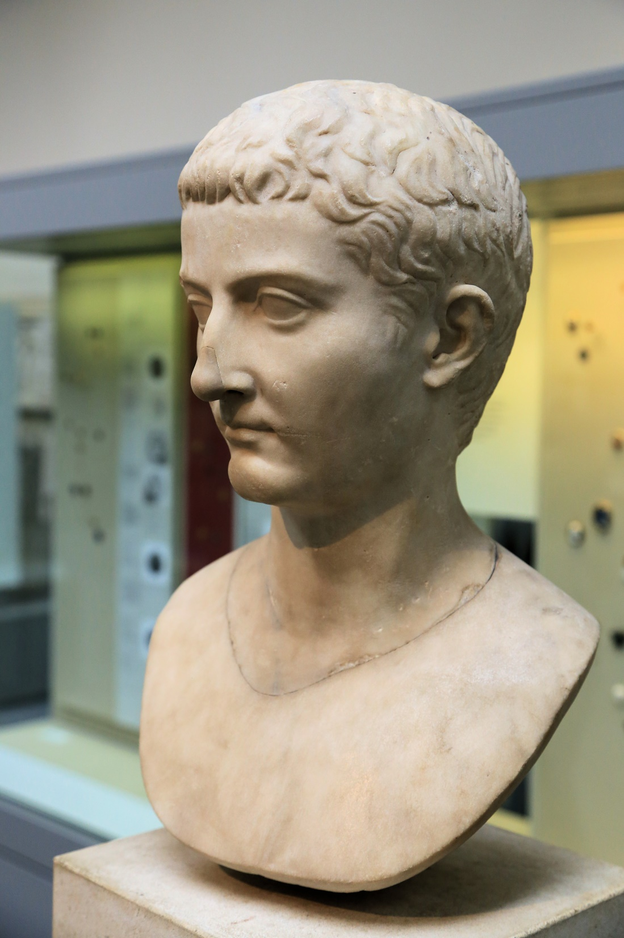
Now in the fifteenth year of the reign of Tiberius Caesar, when Pontius Pilate was governor of Judea, and Herod was tetrarch of Galilee, and his brother Philip was tetrarch of the region of Ituraea and Trachonitis, and Lysanias was tetrarch of Abilene,
Luke 3:1
Notes:
Caesar Tibirius (Lk. 3:1) – reigns during Jesus’ life

Slide 9
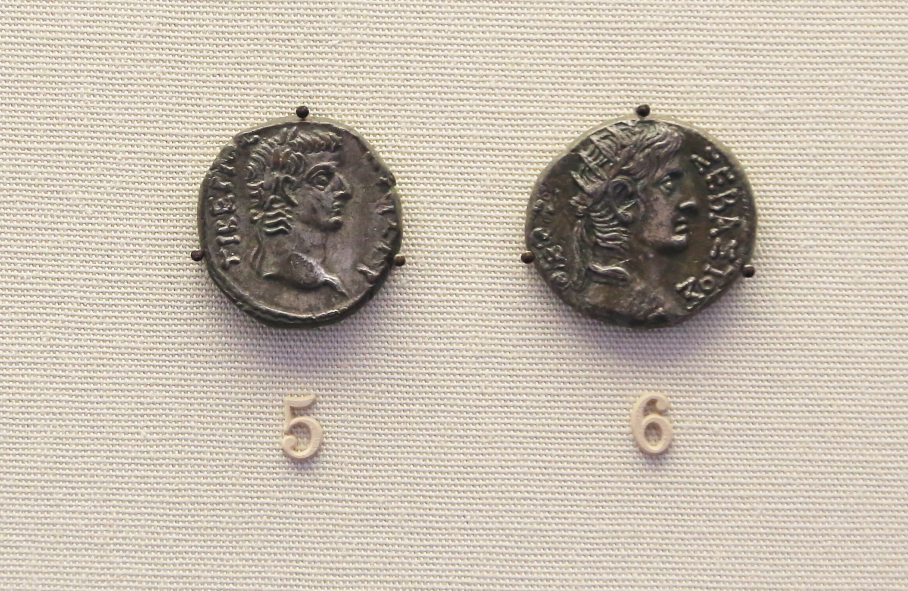
Notes:
Tiberius (left) and Nero (right)

Slide 10
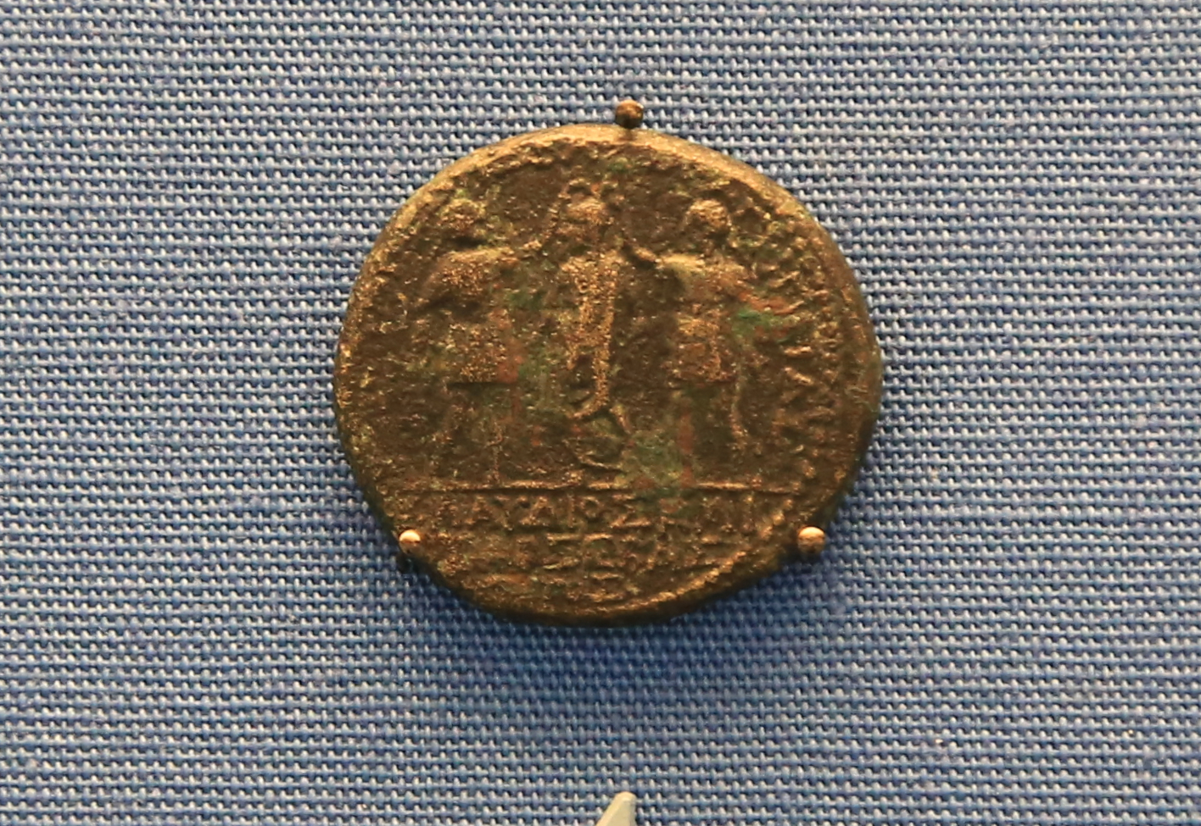
Caesar Claudius (Acts 11:28; 18:2)
Herod Agrippa (Acts 12 – only referred to as Herod)
Notes:
Claudius being crowned by two Herods. One of whom is Herod Agrippa, who had James put to death before meeting his demise in Ceasarea (Acts 12)

Slide 11
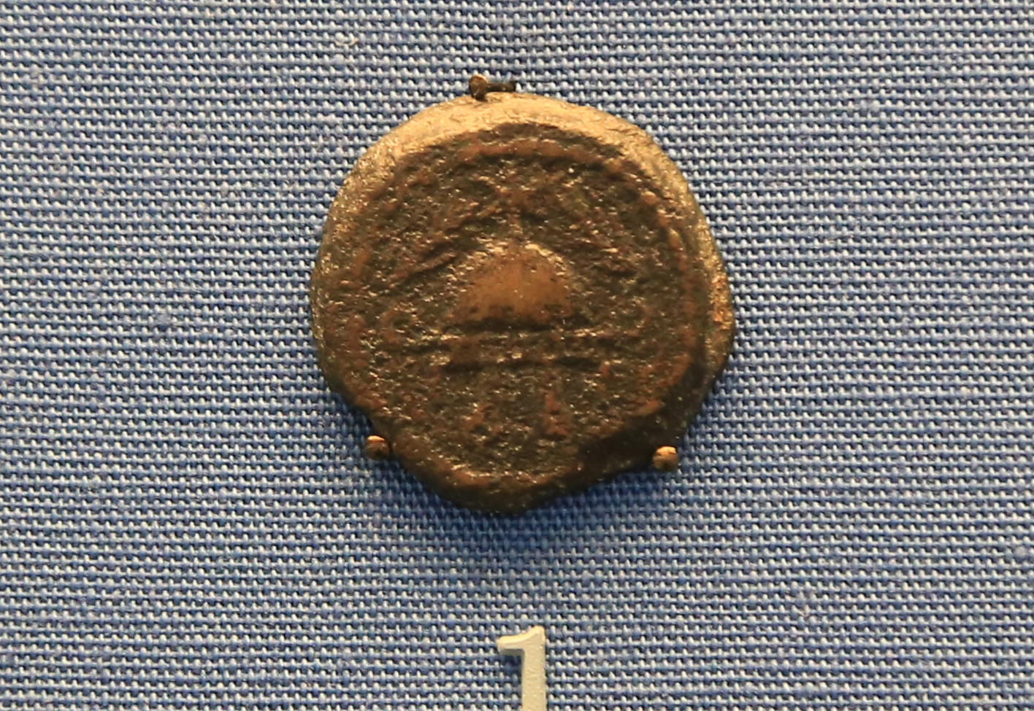
Herod the Great
Notes:
Herod the Great

Slide 12
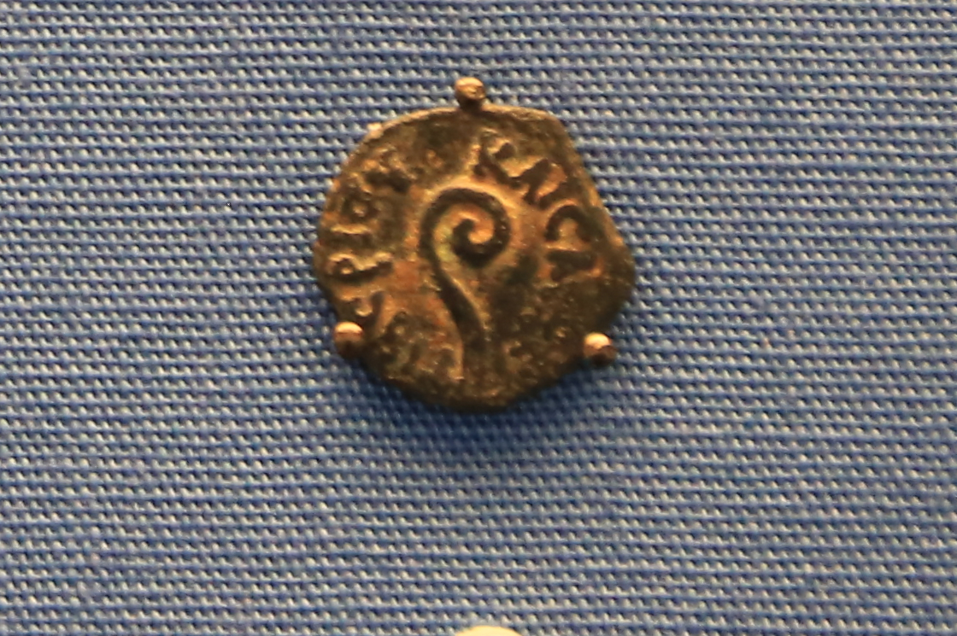
Pontius Pilate
Notes:
Pontius Pilate

Slide 13
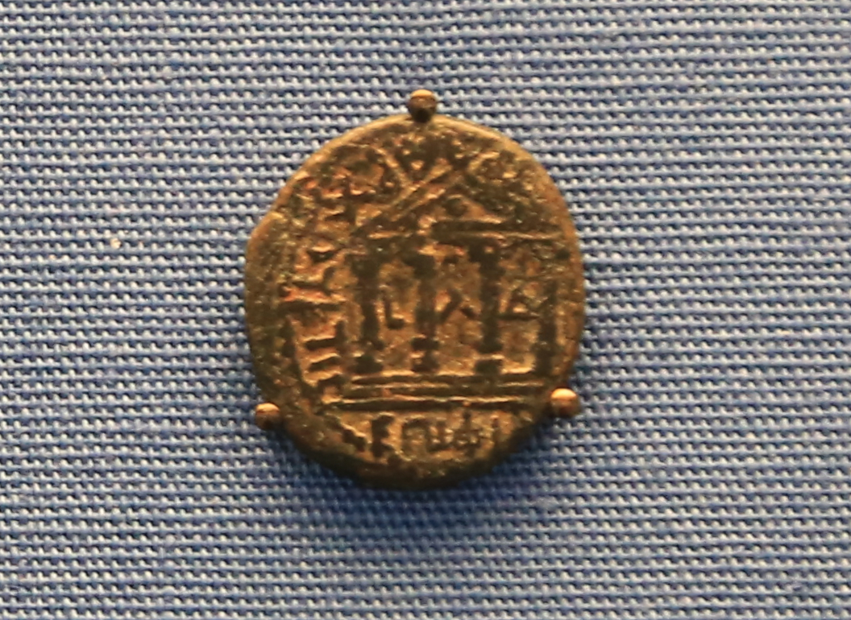
Philip the Tetrarch
(Mt. 14:3; Mk. 6:17; Lk. 3:1)
Notes:
Philip the tetrarch (Mt. 14:3; Mk. 6:17; Lk. 3:1) – Caesarea Philippi (is named after him. His wife marries Herod which leads to John the Baptist’s death.

Slide 14
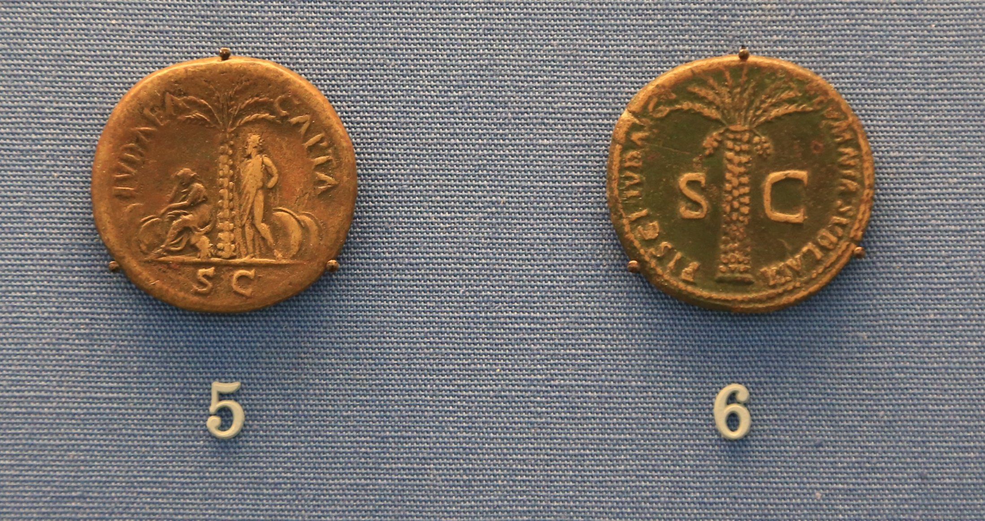
“Judea Capta”
Matthew 24

Slide 15
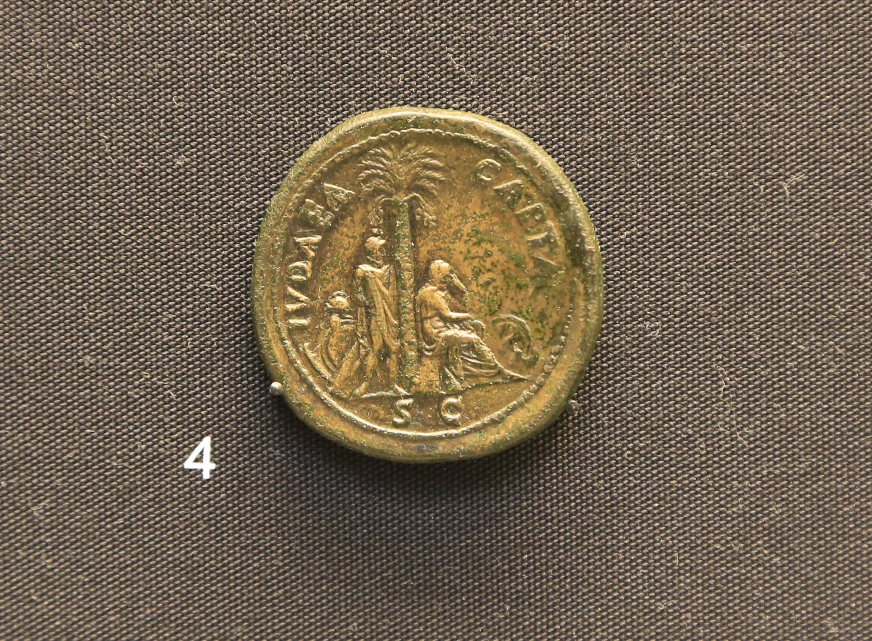
Notes:
Sort of like how we have quarters with states on them and national parks, they had coins with victory over Judea.

Slide 16
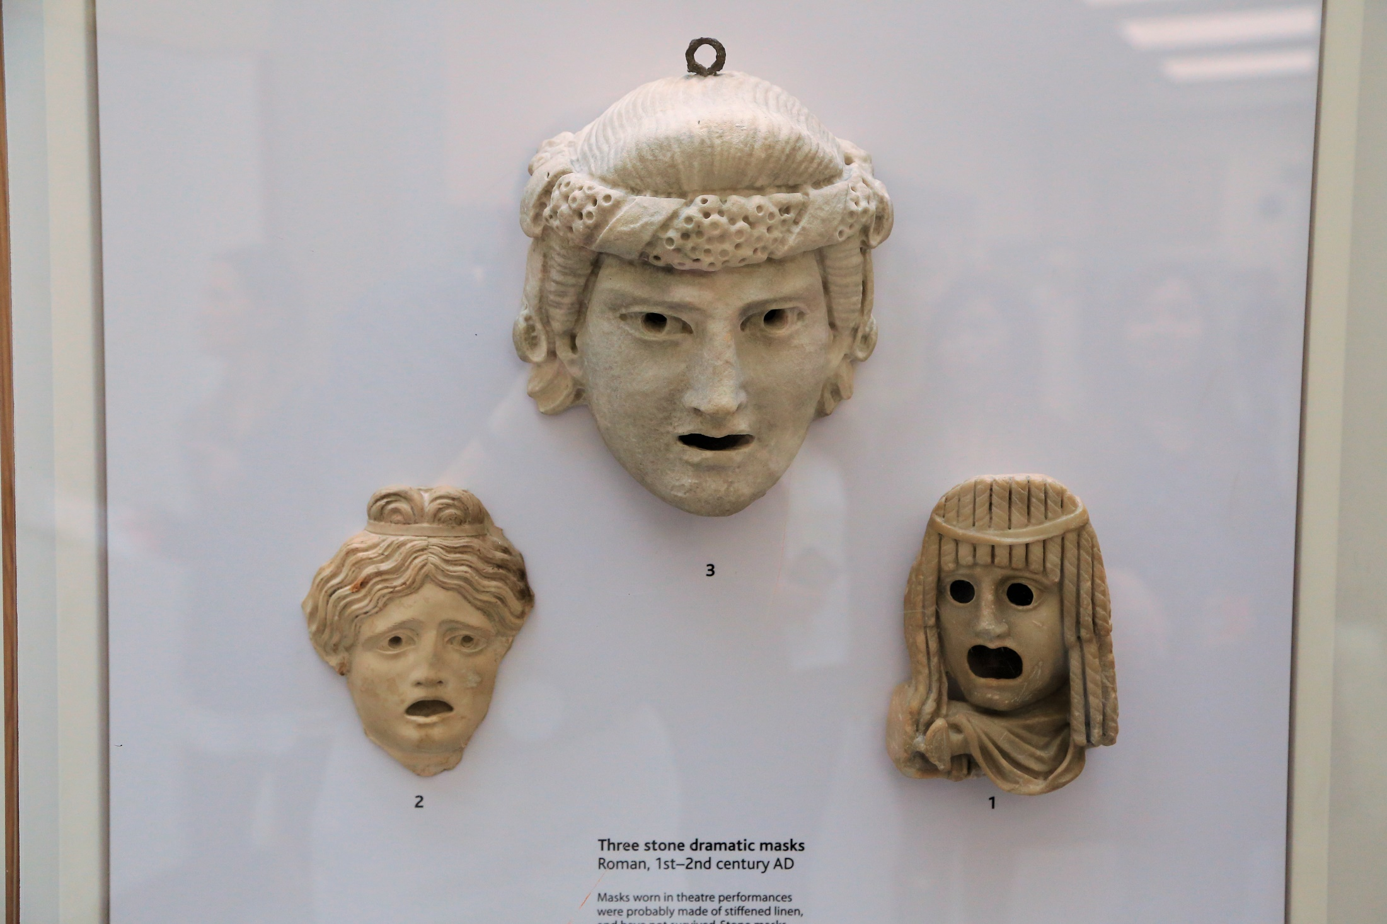
“Hypocrites”
Drama masks
Notes:
Stone version of drama masks. These were likely decorations. The actual masks would have been of a material that wouldn’t survive.

Slide 17
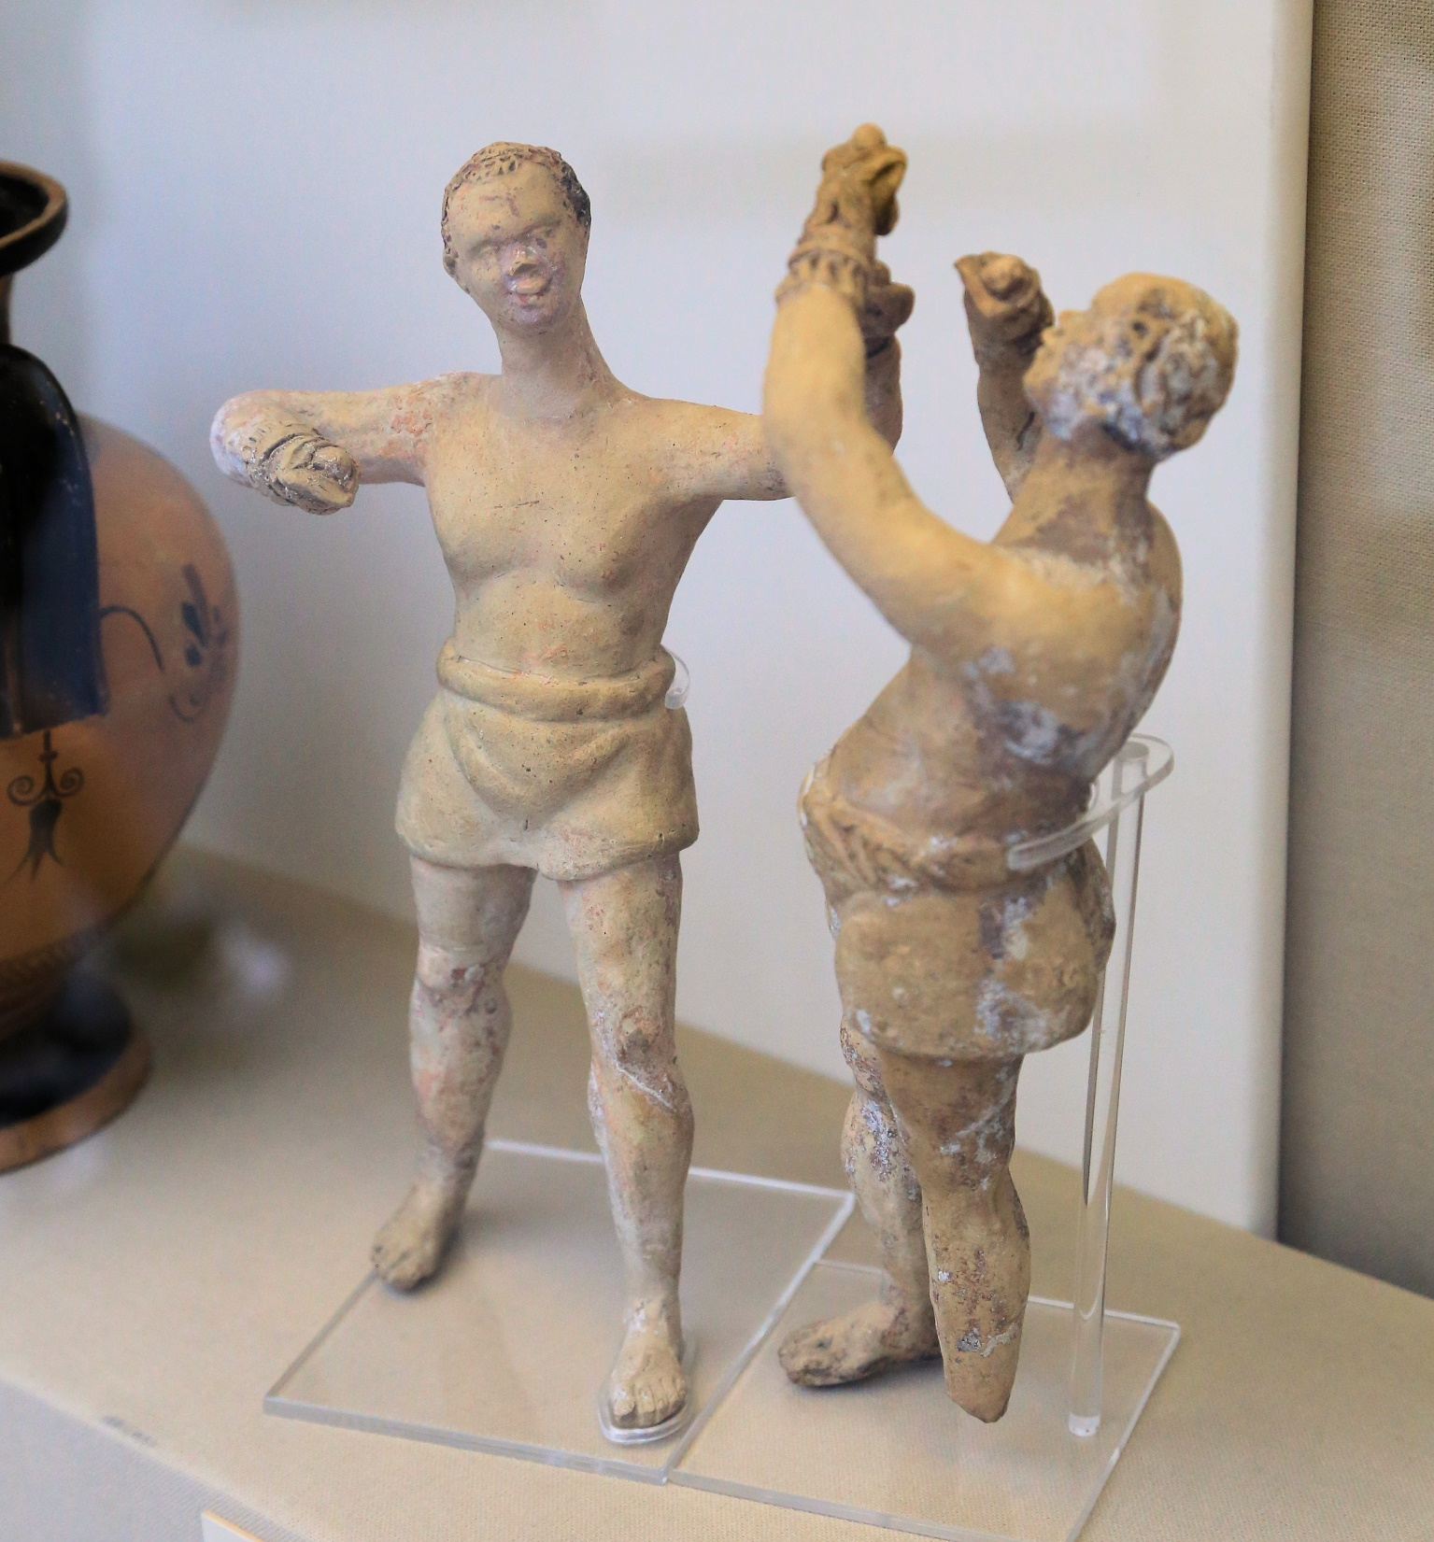
“I box in such a way, as not beating the air”
I Corinthians 9:26b

Slide 18
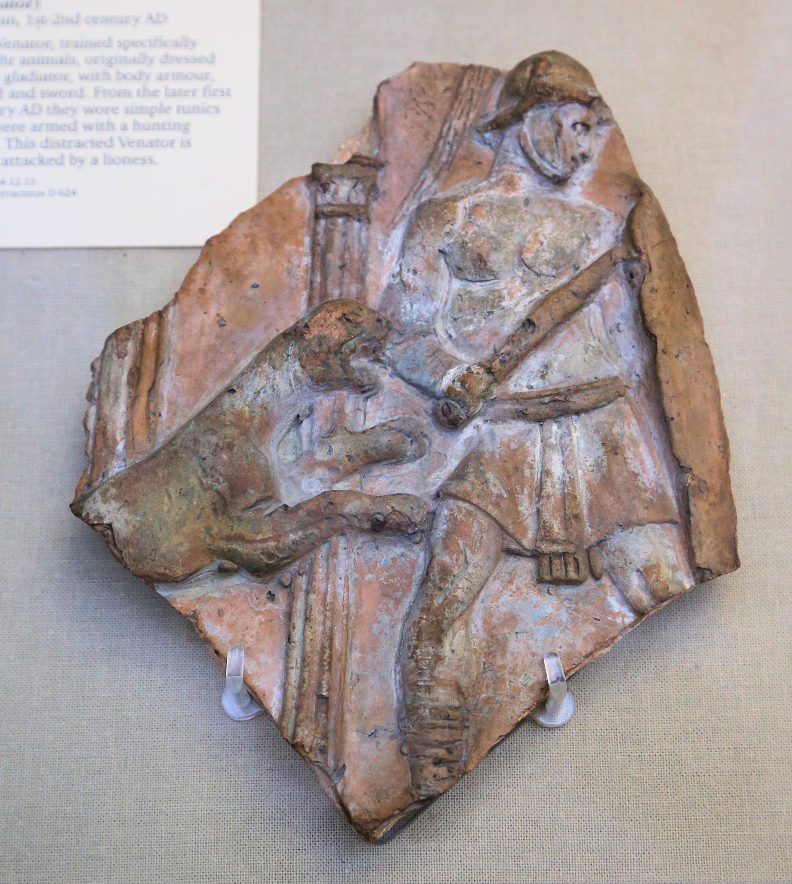
If from human motives I fought with wild beasts at Ephesus, what does it profit me? If the dead are not raised, LET US EAT AND DRINK, FOR TOMORROW WE DIE.
I Corinthians 15:32

Slide 19
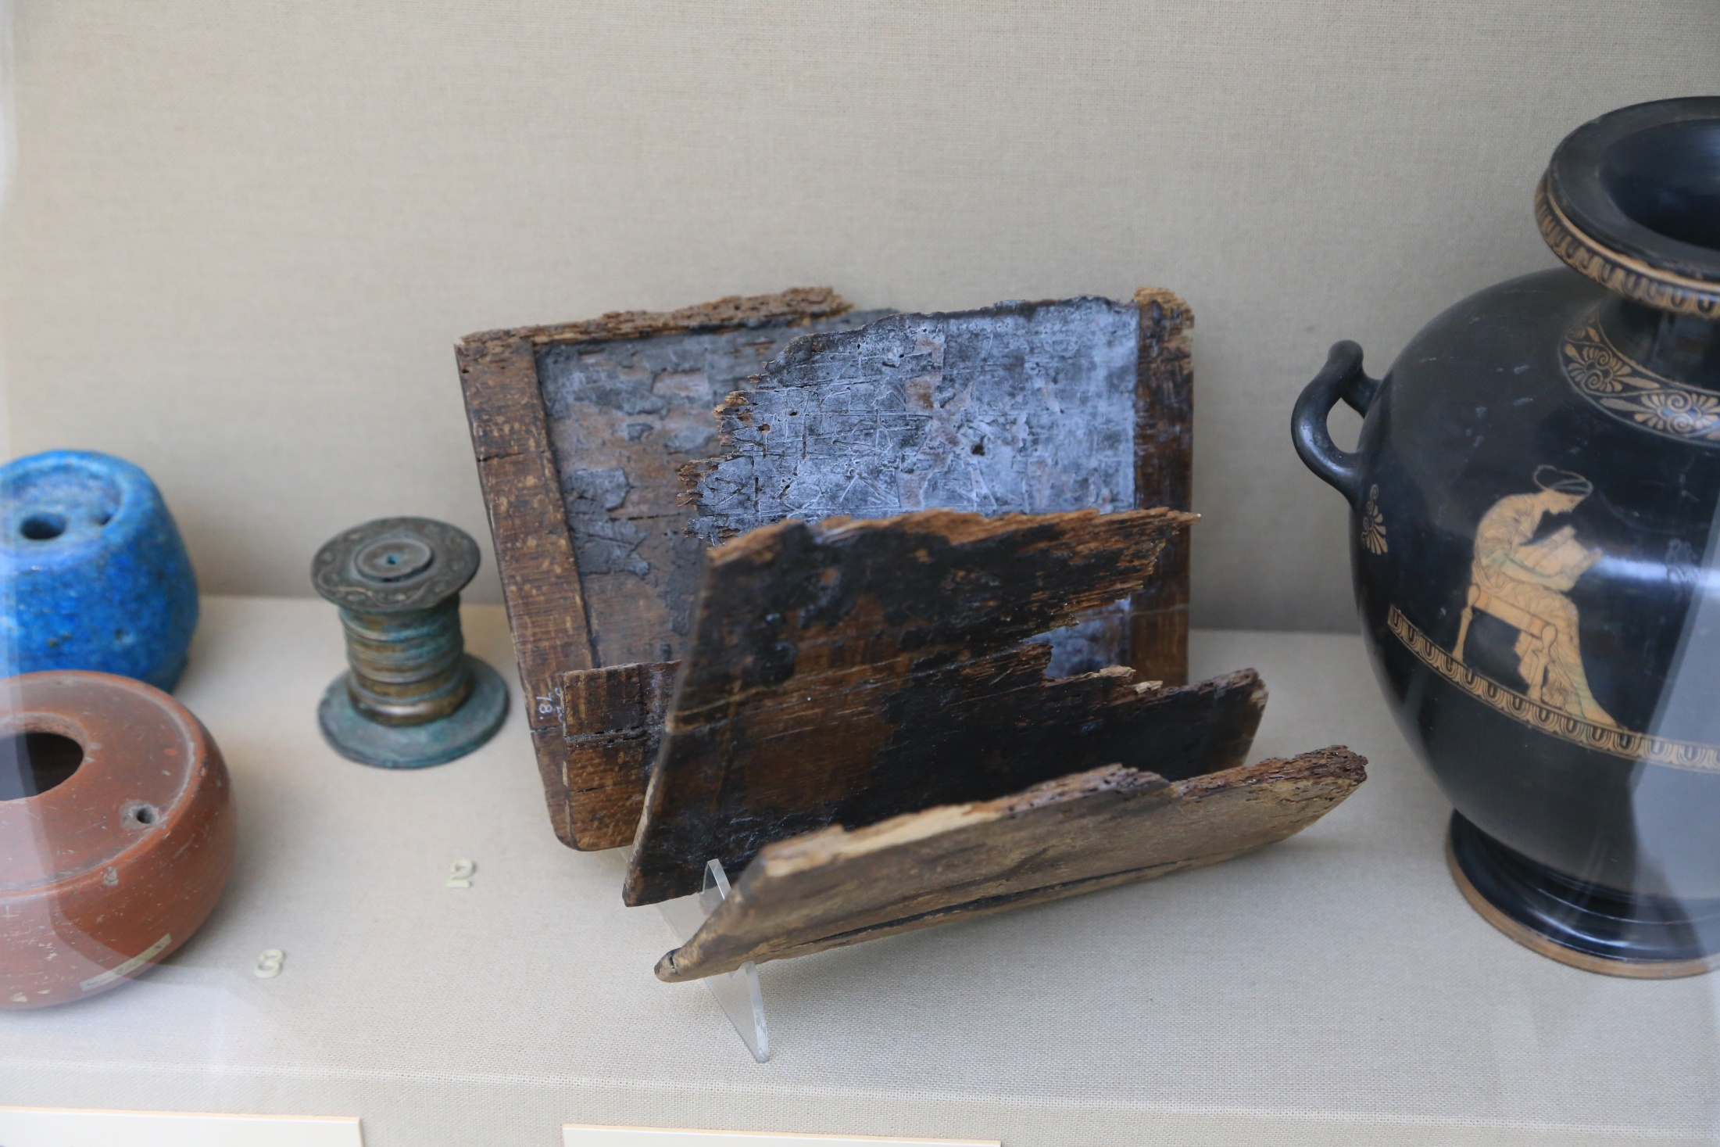

Slide 20
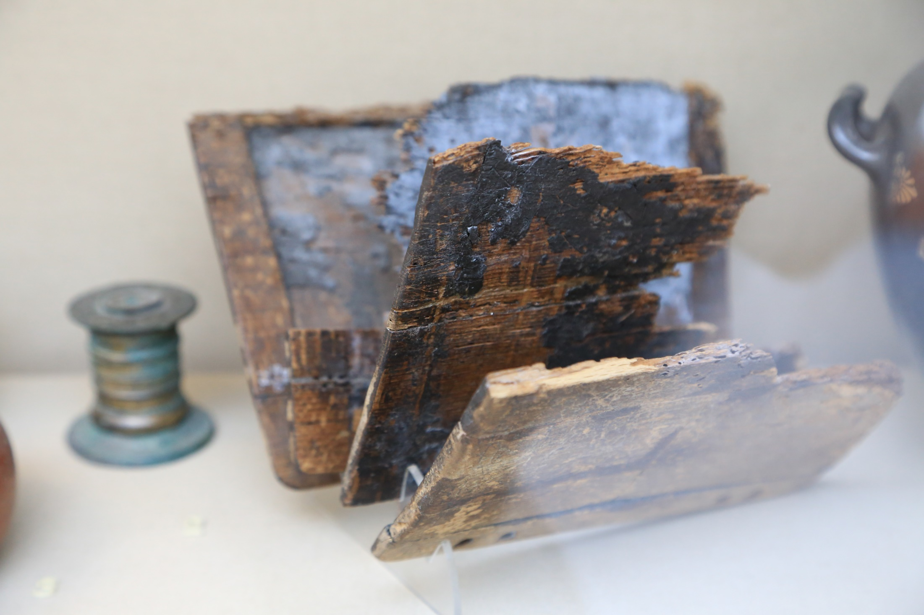
Writing Tablet
Luke 1:63 and II Timothy 4:13
Notes:
Lk. 1:63; II Tim. 4:13

Slide 21
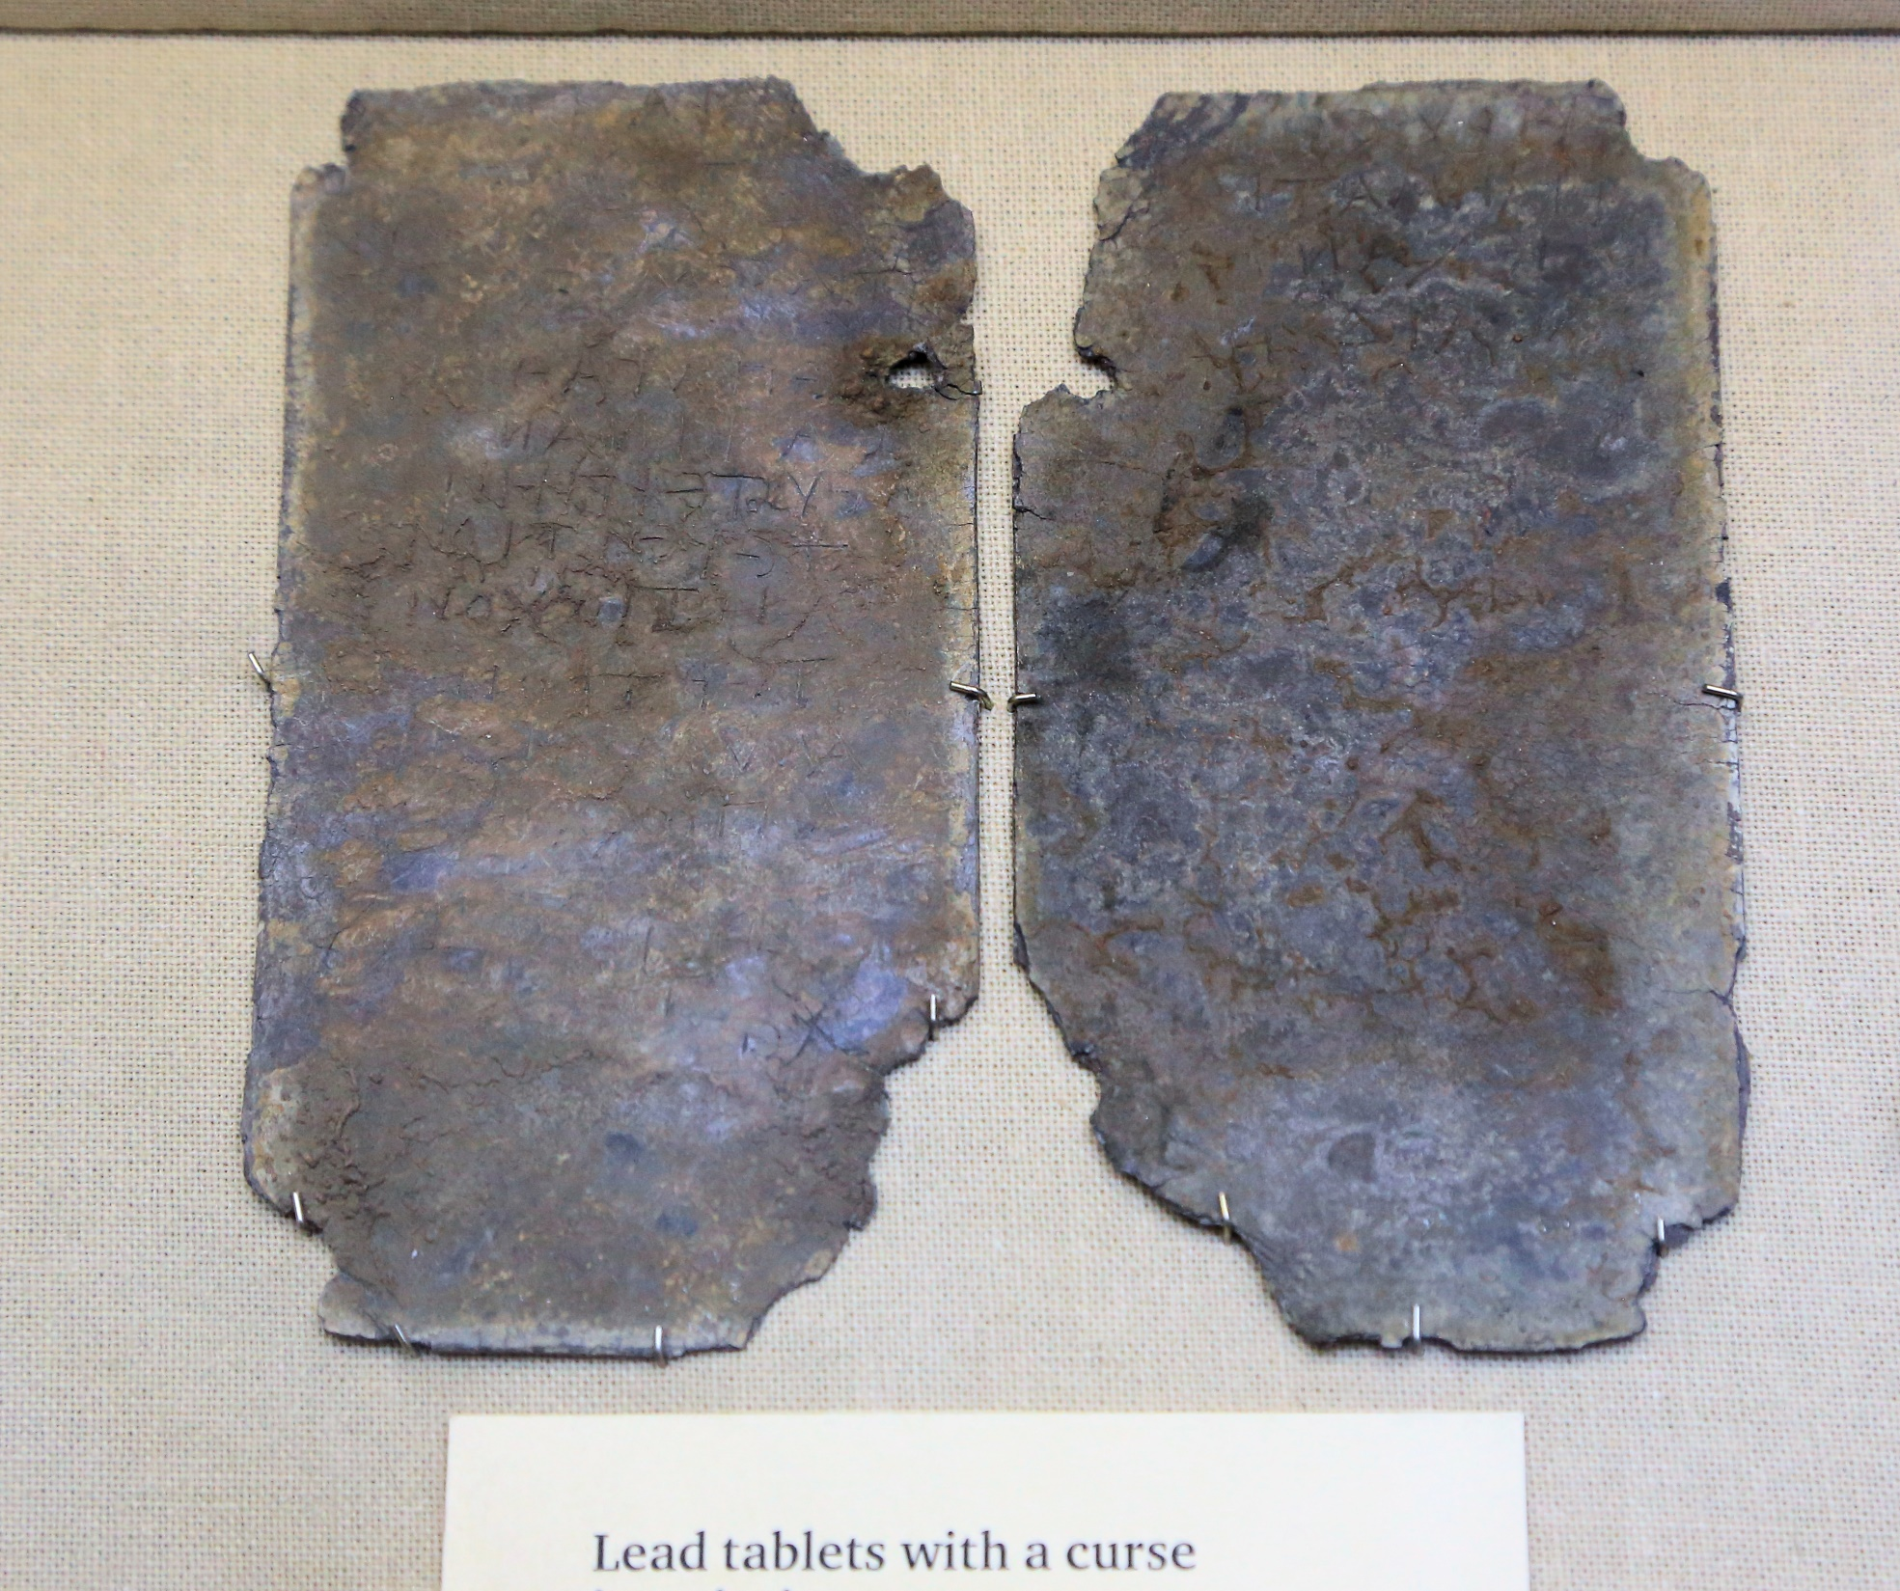
“Bless those who persecute you; bless and do not curse.”
Romans 12:14
Notes:
Lead Curse. To seal these, they were normally nailed to a wall (this one wasn’t, it was put in a pot of bones. Gal. 3:13 – the Law is our curse. Rom. 12:14 “Bless those who persecute you; bless and do not curse”

Slide 22
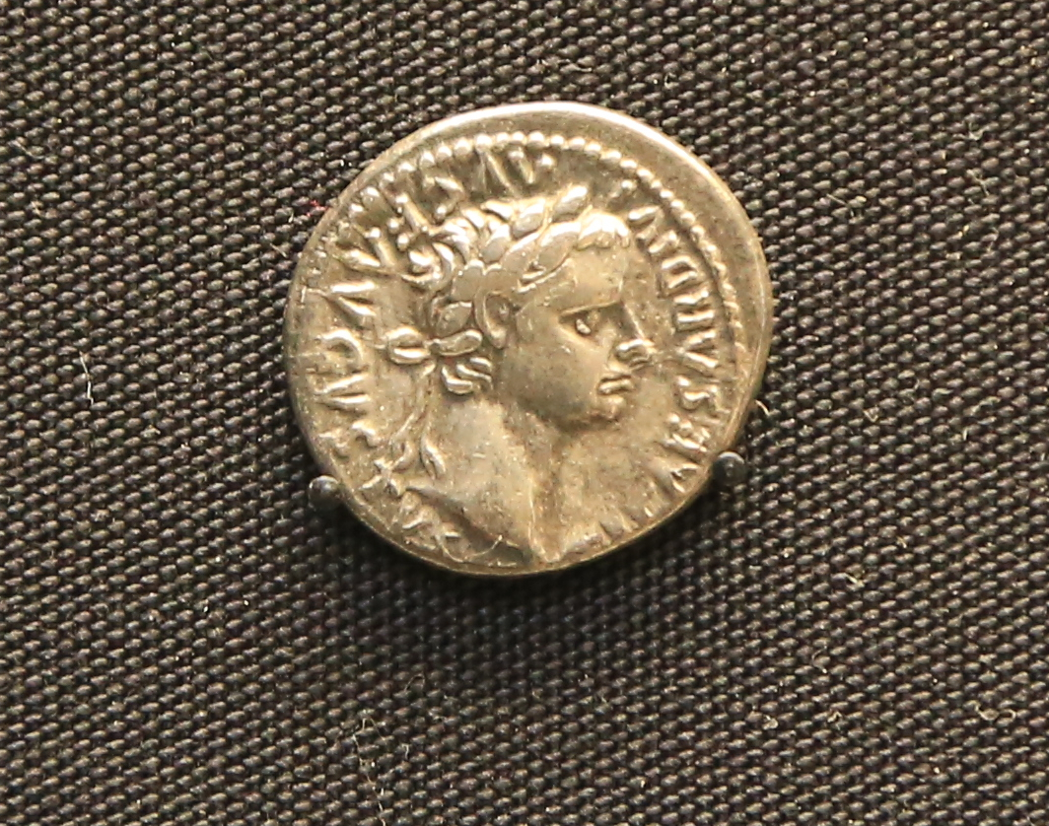
Notes:
Tiberius. Render unto Caesar

Slide 23
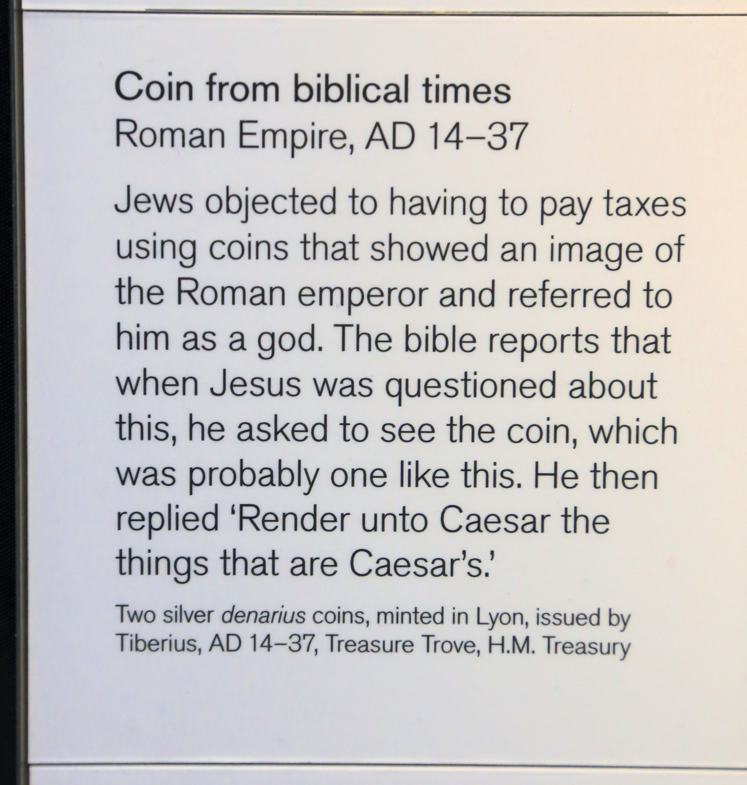

Slide 24
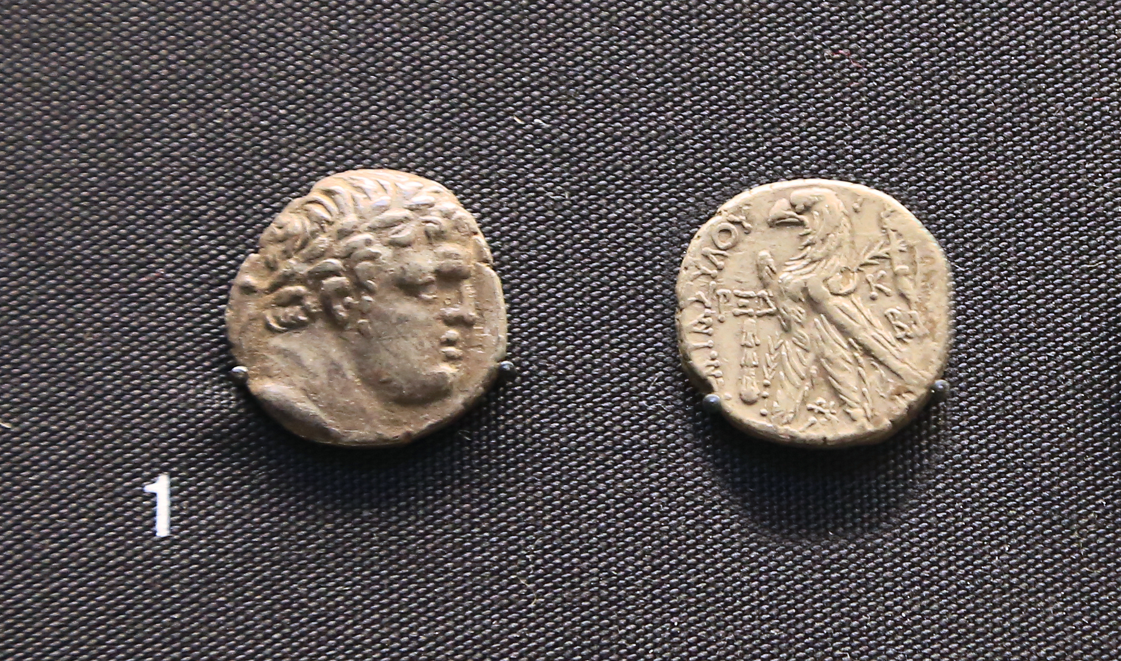

Slide 25
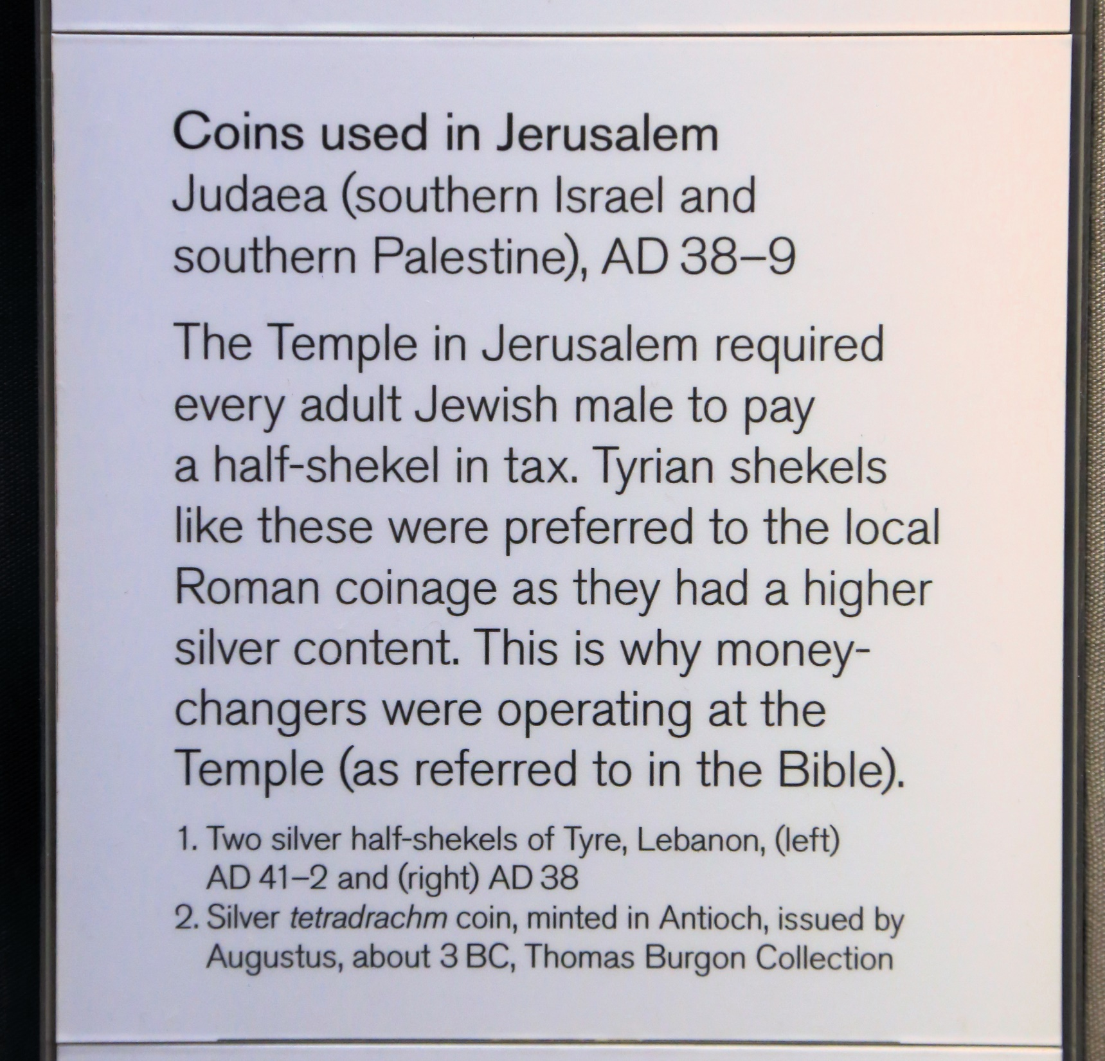

Slide 26
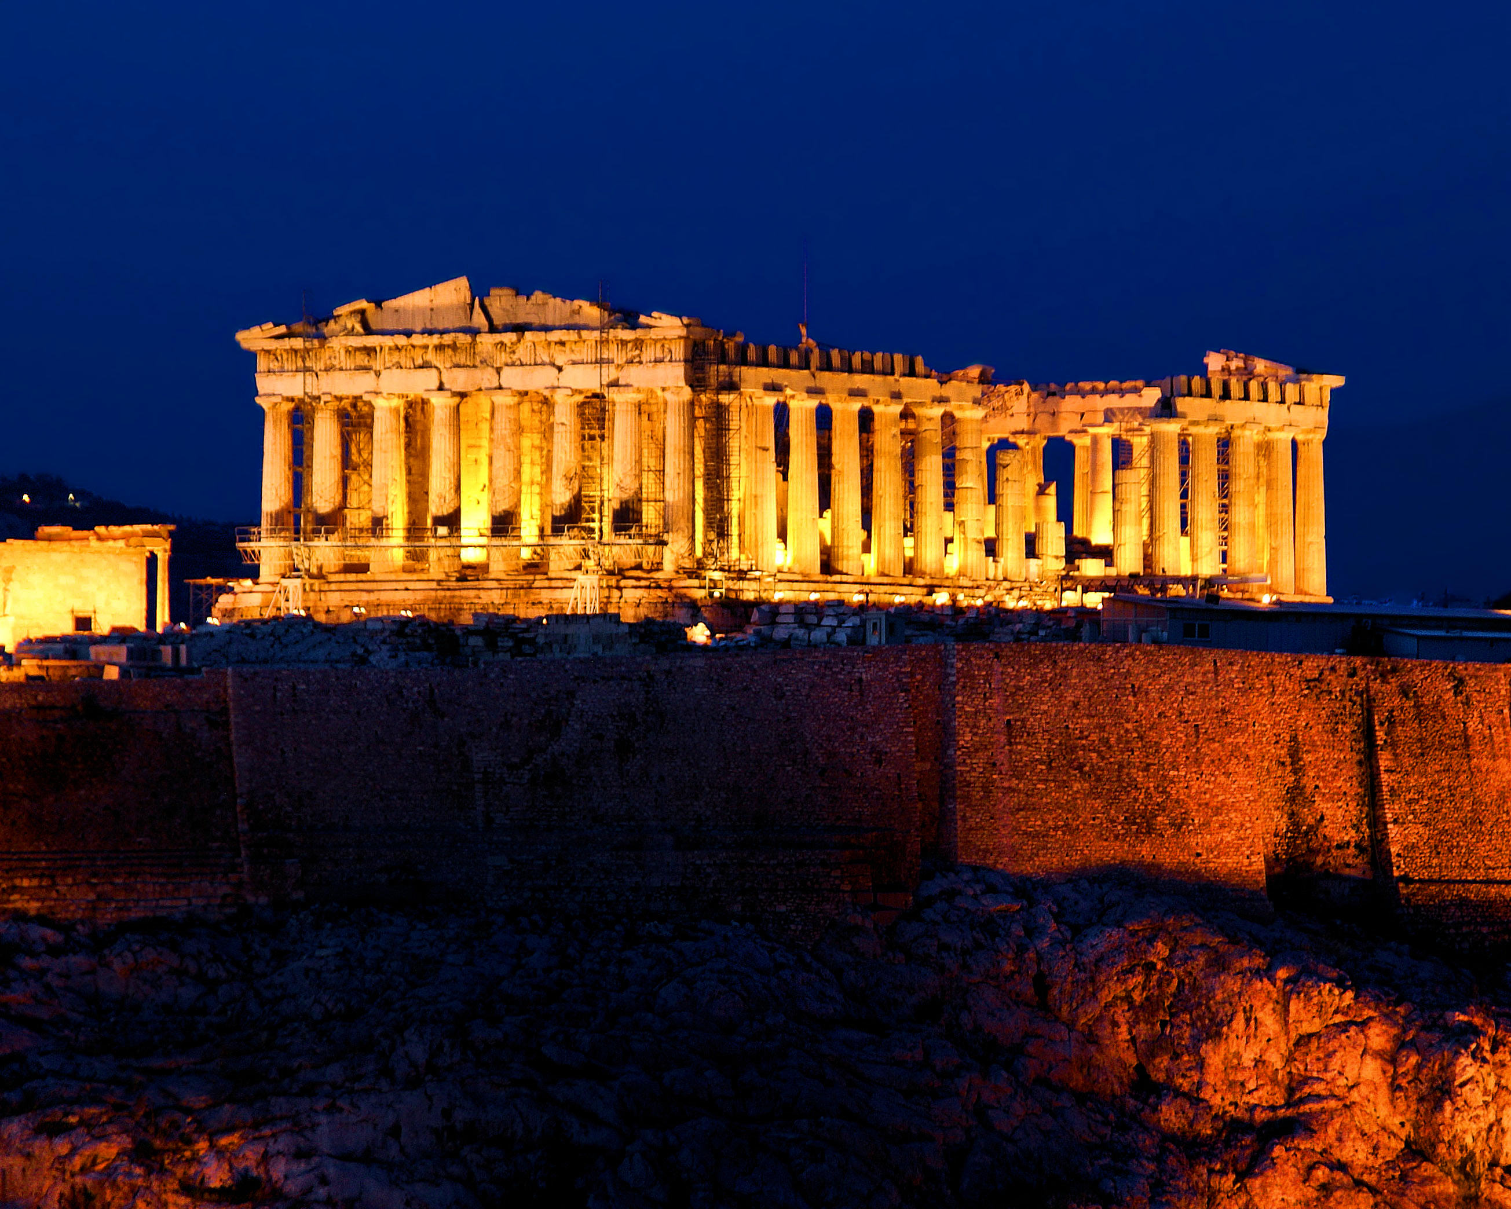

Slide 27
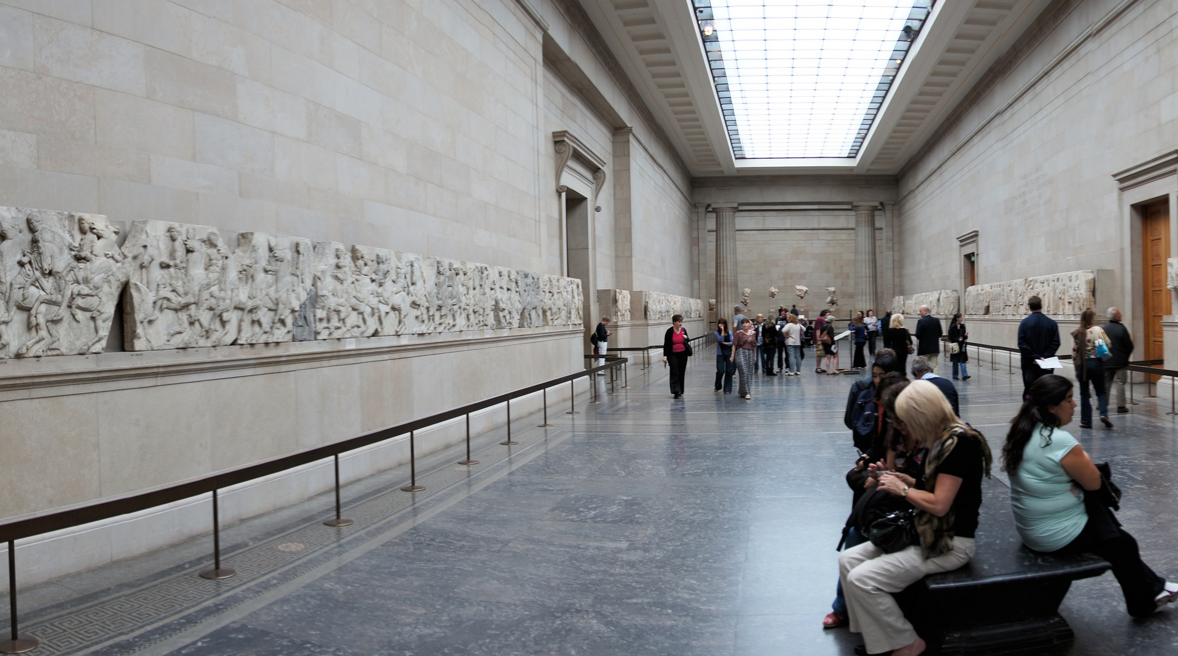

Slide 28
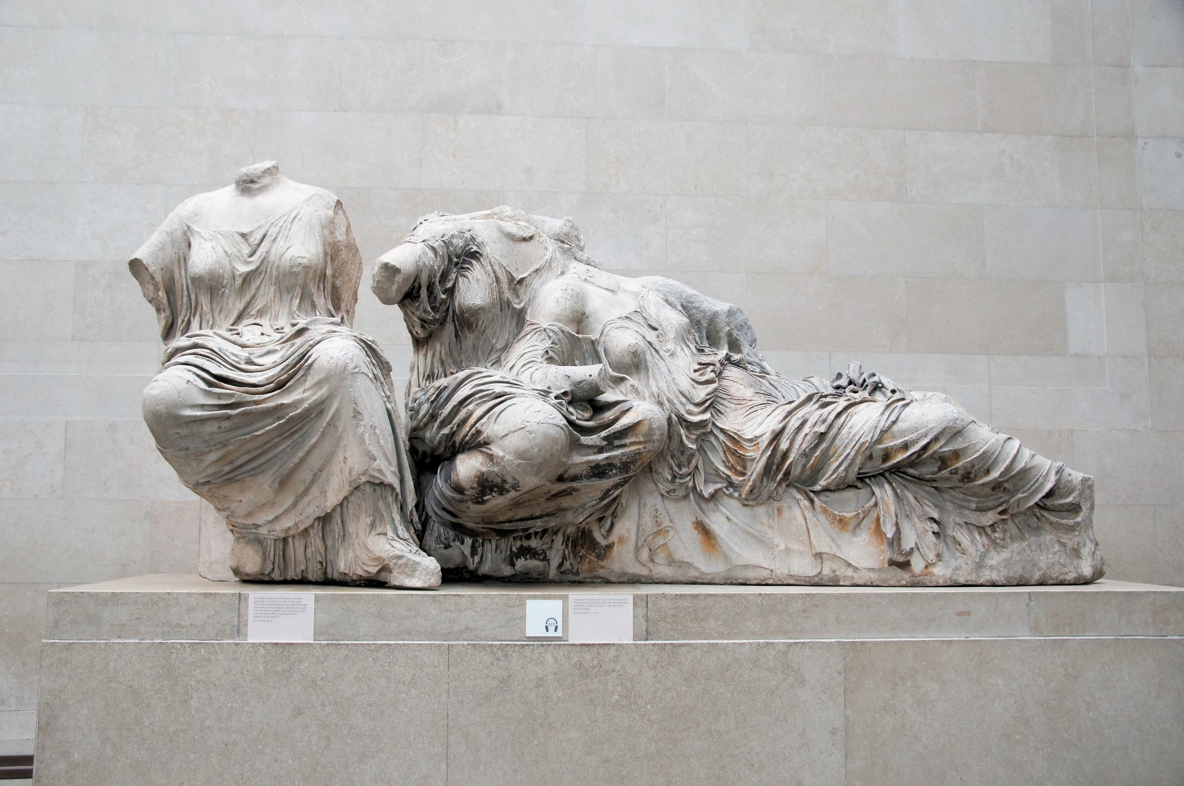

Slide 29
Is any other religious text so richly filled with historical accuracy as the Bible is?

