Slide 1
ARTIFACTS THAT MATTER
THE PERSIAN EMPIRE

Slide 2
Purpose of this series
Support the Bible
Real places
Real people
Real events
Accurate descriptions
Better understand the Bible
To understand that more knowledge of history enriches our understanding of the Bible.

Slide 3
A BRIEF HISTORY
The kingdom of Israel divides (930 B.C)
The northern kingdom taken by Assyria (722 BC)
The southern kingdom taken captive by Babylon (605 BC)*
Babylon falls overnight. Persian empire begins (539 BC)
Southern kingdom returns
Esther becomes queen of Persia (478 BC)
Nehemiah sent to Judah (445 BC)
Dates subject to change

Slide 5
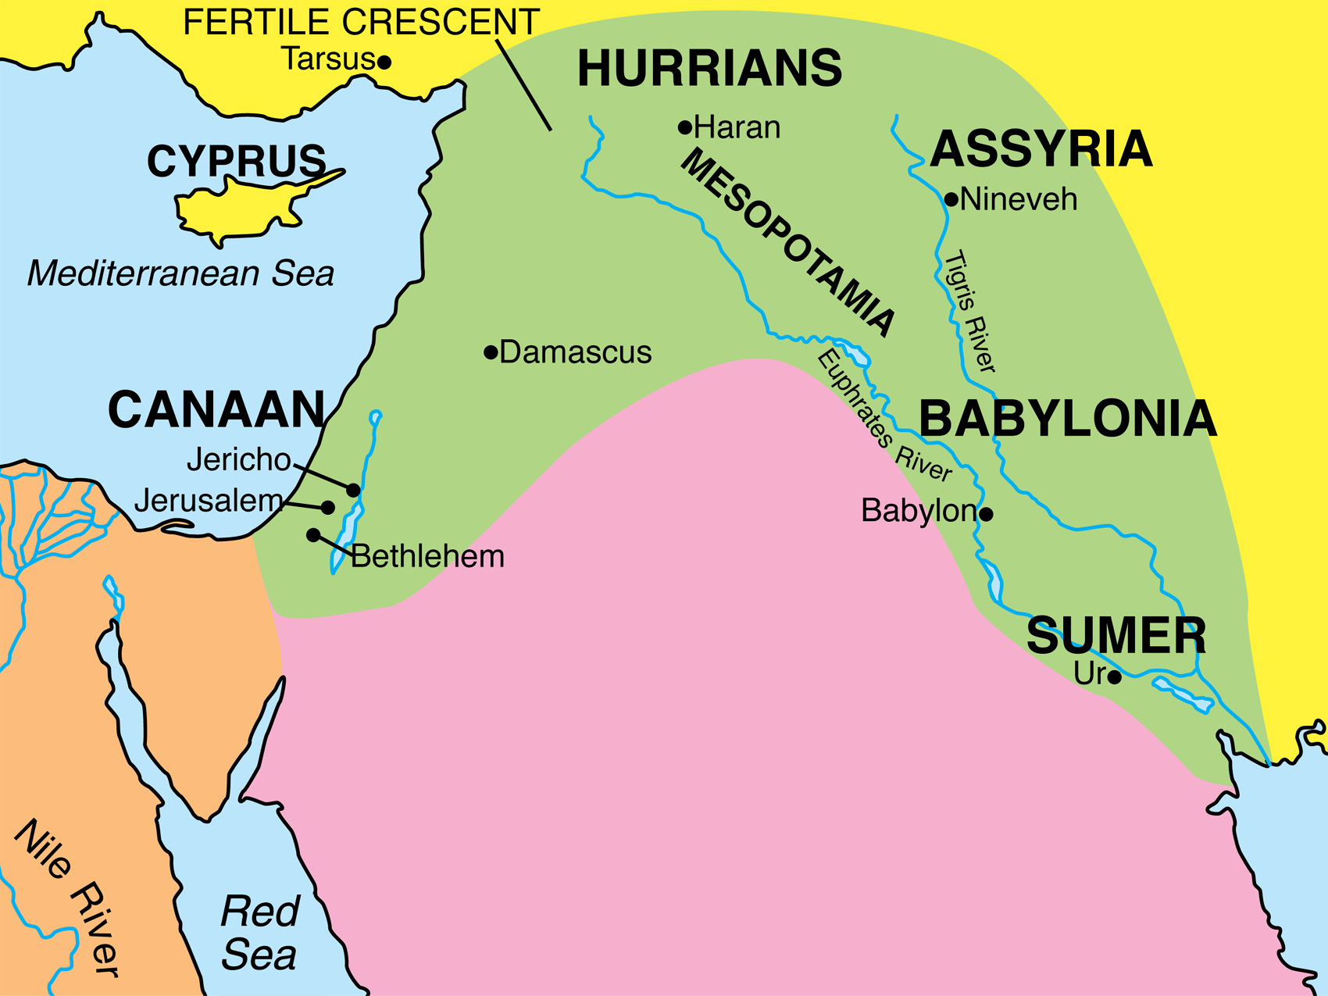
Susa
Notes:
Susa is where the Persian Palace was located which involves the accounts of Esther, Ezra and Nehemiah

Slide 6
Date: September 22-28 164 BC
Notes:
This cuniform item can be dated to somewhere between September 22nd to the 28th of 164 B.C.

Slide 8
Notes:
A mene. A weight of approximately 500g (

Slide 10
Daniel 5:25-28
25 “Now this is the inscription that was written out: ‘MENĒ, MENĒ, TEKĒL, UPHARSIN.’
26 “This is the interpretation of the message: ‘MENĒ’—God has numbered your kingdom and put an end to it.
27 “ ‘TEKĒL’—you have been weighed on the scales and found deficient.
28 “ ‘PERĒS’—your kingdom has been divided and given over to the Medes and Persians.”

Slide 11
THE CYRUS CYLINDER
Describes how king Cyrus of Persia allowed captives to return to their homes and rebuild their temples.
Notes:
The Cyrus cylinder

Slide 12
“So this Daniel enjoyed success in the reign of Darius and in the reign of Cyrus the Persian.”
Daniel 6:28

Slide 13
Around 200 years before it happened,
Isaiah prophesied…
“It is I who says of Cyrus, ‘He is
My shepherd!
And he will perform all My desire.’
And he declares of Jerusalem, ‘She will be built,’
And of the temple, ‘Your foundation will be laid.’ ”
Isaiah 44:28

Slide 14
II Chronicles 36:22-23
22 Now in the first year of Cyrus king of Persia—in order to fulfill the word of the LORD by the mouth of Jeremiah—the LORD stirred up the spirit of Cyrus king of Persia, so that he sent a proclamation throughout his kingdom, and also put it in writing, saying,
23 “Thus says Cyrus king of Persia, ‘The LORD, the God of heaven, has given me all the kingdoms of the earth, and He has appointed me to build Him a house in Jerusalem, which is in Judah. Whoever there is among you of all His people, may the LORD his God be with him, and let him go up!’ ”
See also Ezra 1:1-4
Notes:
While the previous citation quoted Isaiah, Chronicles and Ezra reference Jeremiah. Most likely, they are referring, not to Cyrus’ being called by name but to Jeremiah’s prophecy that the captivity would last 70 years (Jer. 25:12; 29:10). Cyrus fulfilled this by bring the captivity to an end. This is seen most clearly in Chronicles where the previous context speaks of the 70 years (II Chron. 36:21)

Slide 15
THE CYRUS CYLINDER
THE BIBLE:
Real People
Real Events
Notes:
The Cyrus cylinder

Slide 17
The king’s scepter
Esther 5:1-2
“Now it came about on the third day that Esther put on her royal robes and stood in the inner court of the king’s palace in front of the king’s rooms, and the king was sitting on his royal throne in the throne room, opposite the entrance to the palace. When the king saw Esther the queen standing in the court, she obtained favor in his sight; and the king extended to Esther the golden scepter which was in his hand. So Esther came near and touched the top of the scepter.”
Notes:
Thought to be Xerxes (Ahaseurus in the Bible, king for Esther)

Slide 18
Esther 1:7
Drinks were served in golden vessels of various kinds, and the royal wine was plentiful according to the king’s bounty.
Notes:
A silver and gold drinking cup which can hold two bottles of wine. This was a drinking cup (not a serving jug). History records that the Persians were very fond of wine.

Slide 19
Esther 1:1-2
“Now it took place in the days of Ahasuerus, the Ahasuerus who reigned from India to Ethiopia over 127 provinces, in those days as King Ahasuerus sat on his royal throne which was at the citadel in Susa,”
Esther 2:21
“In those days, while Mordecai was sitting at the king’s gate, Bigthan and Teresh, two of the king’s officials from those who guarded the door, became angry and sought to lay hands on King Ahasuerus.”
Notes:
One of a series of wall panels taken from the east gate of the palace at Susa. This depicted the immortals. 1,000 special warriors of the king. Mordecai would have been sitting by these.

Slide 23
Inscription:
“Artaxerxes…son of Darius the kin, in whose house this silver drinking cup was made.”
Nehemiah 2:1
And it came about in the month Nisan, in the twentieth year of King Artaxerxes, that wine was before him, and I took up the wine and gave it to the king. Now I had not been sad in his presence.

Slide 24
THE ACCURATE BIBLE
REAL PEOPLE
Cyrus
Artaxerxes
REAL EVENTS
Cyrus sends God’s people back to Jerusalem to rebuild the temple

