Slide 1
ARTIFACTS THAT MATTER
Part 3 - Egypt

Slide 2
Purpose of this series
Support the Bible
Real places
Real people
Real events
Accurate descriptions
Better understand the Bible
To understand that more knowledge of history enriches our understanding of the Bible.

Slide 4
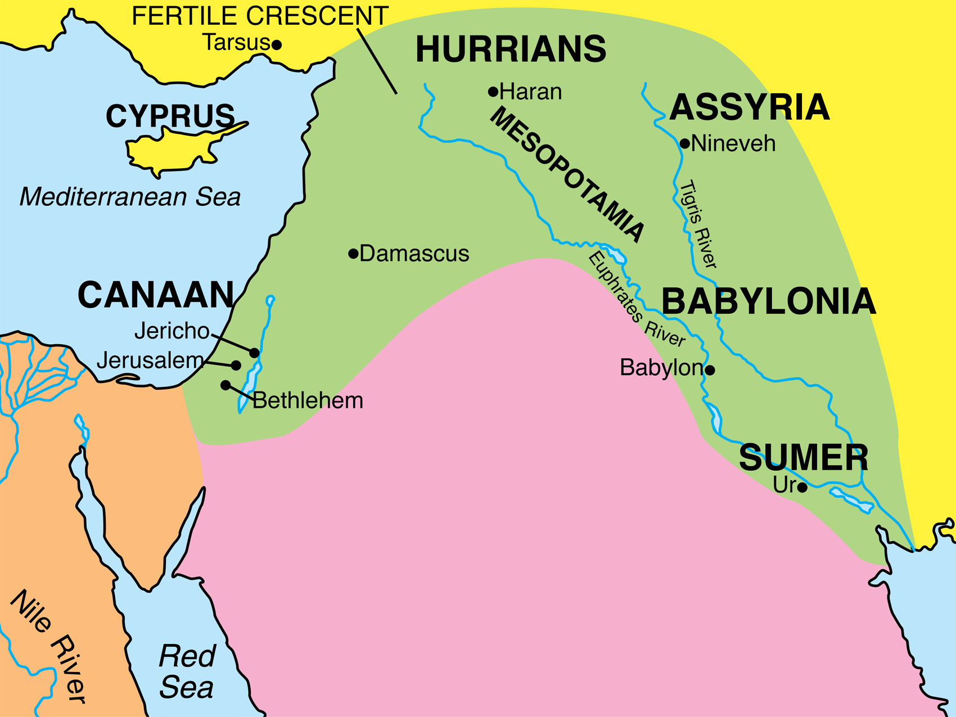

Slide 7
List of kings
Removing unpleasant history

Slide 8
Notes:
Sesostres III. Likely pharoah while Joseph served as second in command

Slide 9
Notes:
Tuthmosis III. Likely the pharaoh of the plagues

Slide 10
Notes:
Typical Egyptian attire and head dress during the times of Joseph and Moses.

Slide 12
Notes:
The ram represents the god of Amun. The statue below his head, is Tirhakah, (II Kings 19:9). He was the “crushed reed” the Assyrians accused Hezekiah of relying on (Is. 36:1-6). This failed attempt by Tirhakah is also recorded in Sennacherib’s records.

Slide 14
Pharaoh Tirhakah or Taharqa
“When he heard them say concerning Tirhakah king of Cush, ‘Behold, he has come out to fight against you,’ he sent messengers against to Hezekiah saying,”
II Kings 19:9
See also Isaiah 36:1-6

Slide 15
Moreover, he made the laver of bronze with its base of bronze, from the mirrors of the serving women who served at the doorway of the tent of meeting.
Exodus 38:8
Notes:
A bronze mirror from Egypt during the time of Moses. The Israelites plundered Egypt (Ex. 12:35-36). Then the bronze basin of the tabernacle was made “from the mirrors of the serving women” (Ex. 38:8).

Slide 16
Notes:
This is an Egyption “pillow”. They served to get your head off the ground, away from bugs and to allow air circulation. There were also ivory “pillows”. Jacob used a stone (Gen. 28:11)

Slide 17
“He came to a certain place and spent the night there, because the sun had set; and he took one of the stones of the place and put it under his head, and lay down in that place.”
Genesis 28:11

Slide 18
“The Egyptians compelled the sons of Israel to labor rigorously; and they made their lives bitter with hard labor in mortar and bricks and at all kinds of labor in the field, all their labors which they rigorously imposed on them.”
Exodus 1:13-14
Notes:
Ex. 1:13-14 – “The Egyptians compelled the sons of Israel to labor rigorously; and they made their lives bitter with hard labor in mortar and bricks and at all kinds of labor in the field, all their labors which they rigorously imposed on them.” - This is an iron sickle with a wooden handle

Slide 19
Notes:
Wooden hoe

Slide 20
Notes:
Wooden hoe

Slide 21
Notes:
A winnowing fan

Slide 23
Notes:
Small idols like these were to be had in every corner of the room where a man or woman might be. These were to serve as protection. The gods of Egypt could not protect them from the God of gods. (Ex. 8:3,21-22)

Slide 24
The Nile will swarm with frogs, which will come up and go into your house and into your bedroom and on your bed, and into the houses of your servants and on your people, and into your ovens and into your kneading bowls.
Exodus 8:3

Slide 25
“For if you do not let My people go, behold, I will send swarms of flies on you and on your servants and on your people and into your houses; and the houses of the Egyptians will be full of swarms of flies, and also the ground on which they dwell. But on that day I will set apart the land of Goshen, where My people are living, so that no swarms of flies will be there, in order that you may know that I, the LORD, am in the midst of the land.”
Exodus 8:21-22

Slide 26
Notes:
Mummified sacred bull. Though this is from Roman times, the practice did not change in Egypt. There were special sacred bulls, that once dead, would be mummified and buried and a young unblemished bull would take it’s place. Consider then the added significance of the plague on the cattle (Ex. 9:3-4). It also informs us of the idea of the golden calfs (Ex. 32; I Kings 12:28) and why Ezekiel says they didn’t leave the idols of Egypt (Ez. 20:8)

Slide 27
“Behold, the hand of the Lord will come with a very severe pestilence on your livestock… but the Lord will make a distinction between the livestock of Israel and the livestock of Egypt…”
Exodus 9:3a,4a

Slide 28
Golden Calf (Ex. 32; I Kings 12:28)
“They did not cast away the detestable things of their eyes, nor did they forsake the idols of Egypt”
Ezekiel 20:8

Slide 29
Notes:
An Egyptian reed basket. Actually older than Moses. The one Moses was placed in would have had tar and pitch so that it could be waterproof and float.

Slide 30
“But when she could hide him no longer, she got him a wicker basket and covered it over with tar and pitch. Then she put the child into it and set it among the reeds by the bank of the Nile.”
Exodus 2:3

Slide 38
“Then Joseph made the sons of Israel swear, saying, ‘God will surely take care of you, and you shall carry my bones up from here.’ So Joseph died at the age of one hundred and ten years; and he was embalmed and placed in a coffin in Egypt.”
Genesis 50:25-26
Joseph buried in Israel in Joshua’s days (Josh. 24:32)

Slide 39
Notes:
Roman shoes from around the time of Jesus (1st century BC – first century AD)

Slide 41
“Your clothing did not wear out on you, nor did your foot swell these forty years. Thus you are to know in your heart that the Lord your God was disciplining you just as a man disciplines his son.”
Deuteronomy 8:4-5

