Slide 1
ARTIFACTS THAT MATTER
SENNACHERIB
AND
LACHISH

Slide 2
Purpose of this series
Support the Bible
Real places
Real people
Real events
Accurate descriptions
Better understand the Bible
To understand that more knowledge of history enriches our understanding of the Bible.

Slide 4
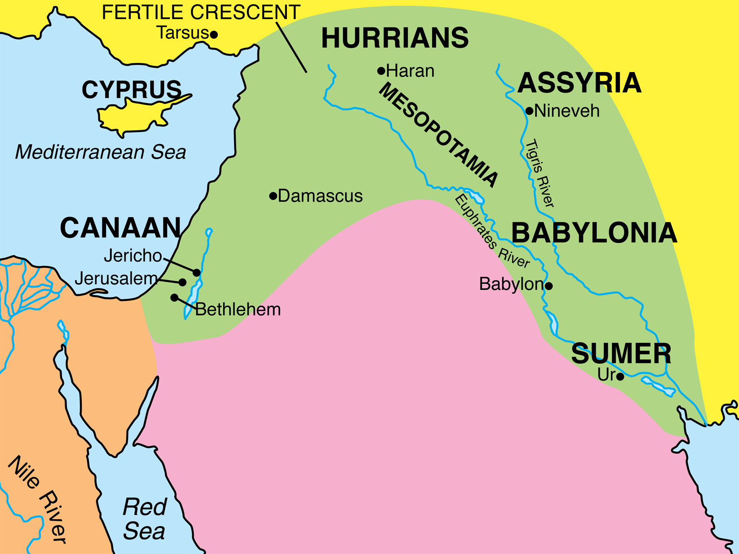

Slide 5
Lachish

Slide 6
Micah 1:13,16
Harness the chariot to the team of horses,
O inhabitant of Lachish—
She was the beginning of sin
To the daughter of Zion—
Because in you were found
The rebellious acts of Israel.
…
Make yourself bald and cut off your hair,
Because of the children of your delight;
Extend your baldness like the eagle,
For they will go from you into exile.

Slide 7
Isaiah 36:1-2 1 Now in the fourteenth year of King Hezekiah, Sennacherib king of Assyria came up against all the fortified cities of Judah and seized them. 2 And the king of Assyria sent Rabshakeh from Lachish to Jerusalem to King Hezekiah with a large army. And he stood by the conduit of the upper pool on the highway of the fuller’s field.

Slide 8
Notes:
Terracotta foundation document

Slide 9
Notes:
This section details the Sennacherib’s attack against Judah (conquest of Lachish and siege of Jerusalem)

Slide 13
TAYLOR PRISM
Mentions Merodach-Baladan, king of Babylon (Is. 39:1) who is conquered by Sennacherib
Mentions the tribute that Hezekiah sent to Sennacherib (II Kings 18:14-16)
Says he shut up Hezekiah in Jerusalem “like a caged bird”

Slide 27
Notes:
Siege engine. Archer in back along with man who’s job is to douse the front of the engine with water to keep it from catching fire as the enemy launches fire “bombs” at it.

Slide 31
Notes:
On the right, Jewish men (likely leaders of the city) are being flayed alive.

Slide 34
“Sennacherib King of the world,
King of Assyria, on a throne he sat and
the booty of Lachish passed before him.”

Slide 35
“Then Hezekiah king of Judah sent to
the king of Assyria at Lachish”
II Kings 18:14a

Slide 36
Notes:
Siege camp. In the top left corner, priests are offering up sacrifices to their gods. Notice the fortified walls surrounding the camp.

Slide 37
Notes:
These are not Judean prisoners, but they are prisoners from another nation being required to play the lyre.

Slide 39
PSALM 137:1-3 1 By the rivers of Babylon, There we sat down and wept, When we remembered Zion. 2 Upon the willows in the midst of it We hung our harps. 3 For there our captors demanded of us songs, And our tormentors mirth, saying, “Sing us one of the songs of Zion.”

Slide 40
Notes:
Captured Jews who are at a quarry. Just out of this picture is a huge human headed bull being pulled from the quarry (such as in the next picture) or perhaps it’s one of the ones that Sennacherib ends up dying between.

Slide 42
Tiglath-Pileser III
Or
Pul (II Kings 15:19)

Slide 44
A Similar Biblical Act As A Sign Of Conquest
Joshua 10:24-25
24 When they brought these kings out to Joshua, Joshua called for all the men of Israel, and said to the chiefs of the men of war who had gone with him, “Come near, put your feet on the necks of these kings.” So they came near and put their feet on their necks.
25 Joshua then said to them, “Do not fear or be dismayed! Be strong and courageous, for thus the LORD will do to all your enemies with whom you fight.”

Slide 48
Then David ran and stood over the Philistine and took his sword and drew it out of its sheath and killed him, and cut off his head with it. When the Philistines saw that their champion was dead, they fled. … So when David returned from killing the Philistine, Abner took him and brought him before Saul with the Philistine’s head in his hand. I Sam. 17:51,57

Slide 50
As powerful as Sennacherib was, he celebrated the destruction of Lachish, not the destruction of Jerusalem.
What could possibly explain his conquest of every foe except for Jerusalem?
II Kings 18:13-19:36

Slide 51
CONCLUSION
The Bible is once again confirmed
Real people
Real places
Real events
Our understanding of the Scriptures should be deepened.
Perhaps we can better understand Hezekiah’s willingness to plunder the temple.
We become even more impressed with God’s victory over Sennacherib

